Slide 1
EUROfusion TSVV-5 VTT/Aalto University – Report 2021 / Plan 2022
Andreas Holm, Mathias Groth
– Aalto University

Slide 2
List of deliverables in 2021 and their status
Assessment of collisional-radiative models for hydrogen molecules
Comparison CRM CRUMPET using Forschungszentrum Jülich AMJUEL and H2VIBR databased versus CRM YACORA using IPP-Garching AM databases (Andreas Holm et al., PET 2021)
Vibrationally resolving H₂ in 1D Eirene simulations reduces the effective dissociation rate by up to a factor of 2
Initial testing of EIRENE with vibrational resolved states for JET benchmark case
Plotting of individual vib. states and tracking of states of particles transitioning from one vib. state to another
Measurements of T2 and D-T Fulcher bands (JET experiments M18-27 and M21-15), and discussion of spectroscopic analyses for H₂, D₂ and T₂ Fulcher band measurements (JET experiments M18-27 and B18-09) for comparison to EIRENE predictions

Slide 3
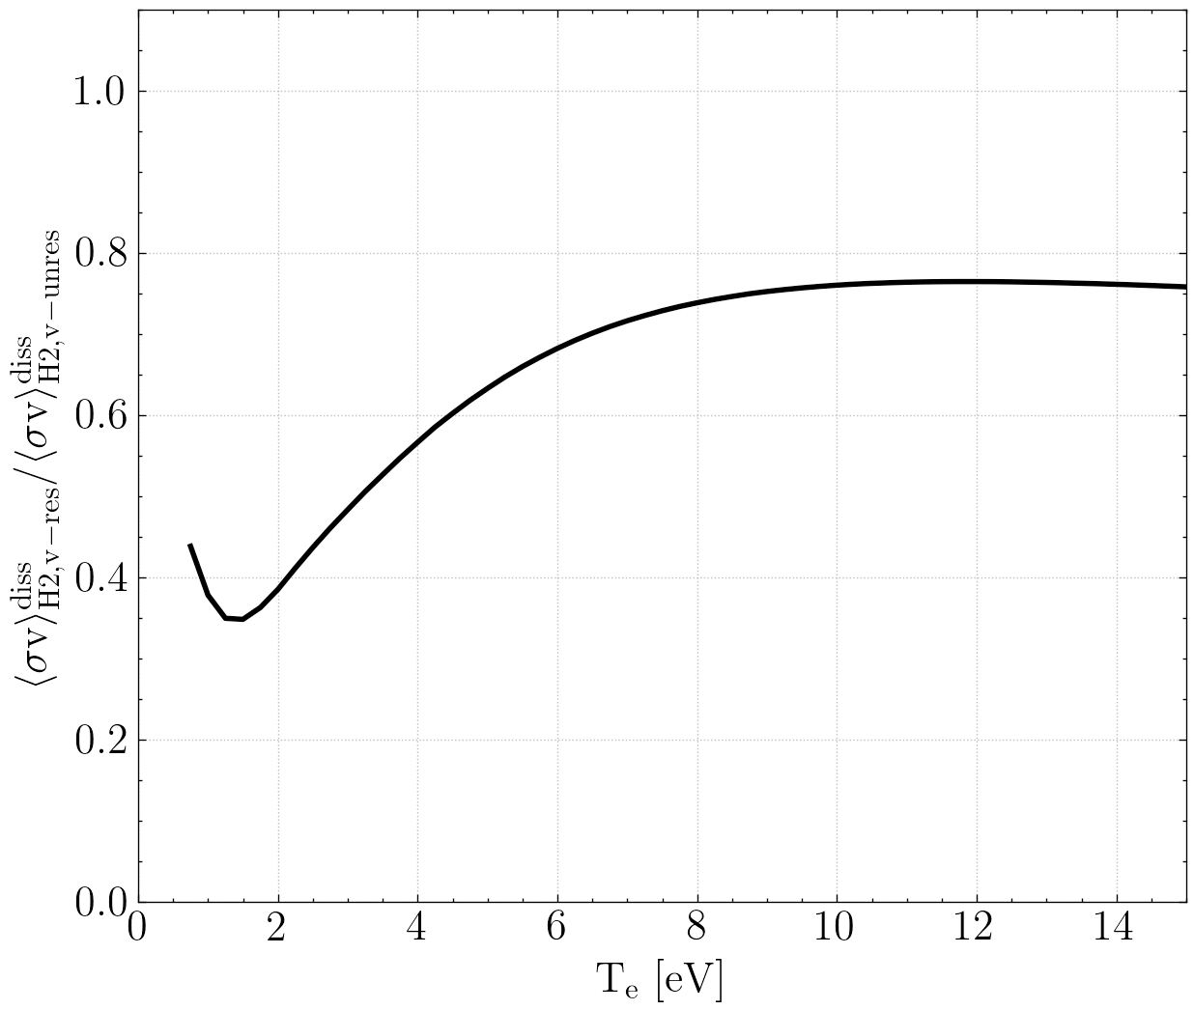
Re-assessment of H2VIBR: Up to 60% decrease in effective H₂ diss. rate observed for vib-resolved H2VIBR vs AMJUEL rates
Effective dissociation rates evaluated in transport-free Eirene simulations
Eirene simulations in agreement with collisional-radiative (CR) Yacora simulations
H2VIBR rates do not include all the CR processes considered in AMJUEL
AMJUEL and H2VIBR consider different CR processes → different effective rates for the same processes between the databases
n_{e}=10²⁰ m⁻³
Andreas Holm, PET 2021, CPP 2021

Slide 4
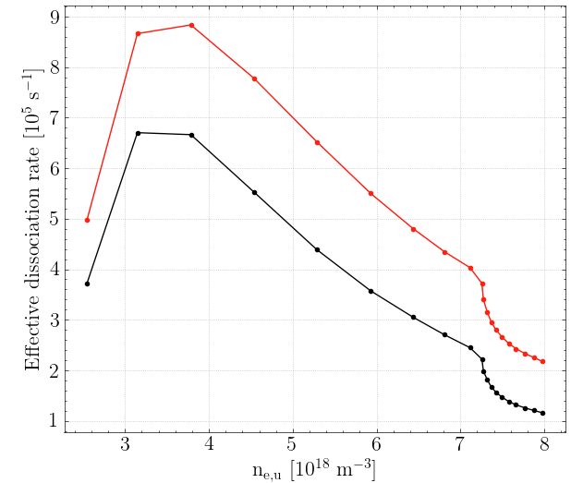
Vibrationally resolving H₂ in 1D Eirene simulations reduces the effective dissociation rate by up to a factor of 2
60% of reduction attributed to difference in rates → remaining difference due to transport of vibrationally excited states
Up to 40% reduction in effective dissociation rate due to transport of vibrational states
Effect cannot be directly assessed due to differences in the H2VIBR and AMJUEL rates
By evaluating a H₂ CR model in Eirene during simulations, all CR effects could be considered
$$H_{2}^{AMJUEL}$$
$\left\langle σv\right\rangle$_{eff. diss}
$$H_{2}^{H2VIBR}(v)$$
Andreas Holm, PET 2021, CPP 2021

Slide 5
Previous capability of obtaining vibrationally resolved molecular densities with EIRENE recovered
Background plasma obtained from EDGE2D-EIRENE pure-D run bloman/jet/81472/oct1017/seq#1 for JET-ILW benchmark case
Settings of EIRENE adapted from SOLPS4.0/EIRENE run for AUG from 1998 (Fantz et al., PSI 2000, JNM 2001)
Standalone EIRENE runs without and with vibrationally resolved D₂ molecules for JET benchmark case
Initial plotting of molecular densities of individual vib. states + tracking of states of particles transitioning from one vib. state to another

Slide 6
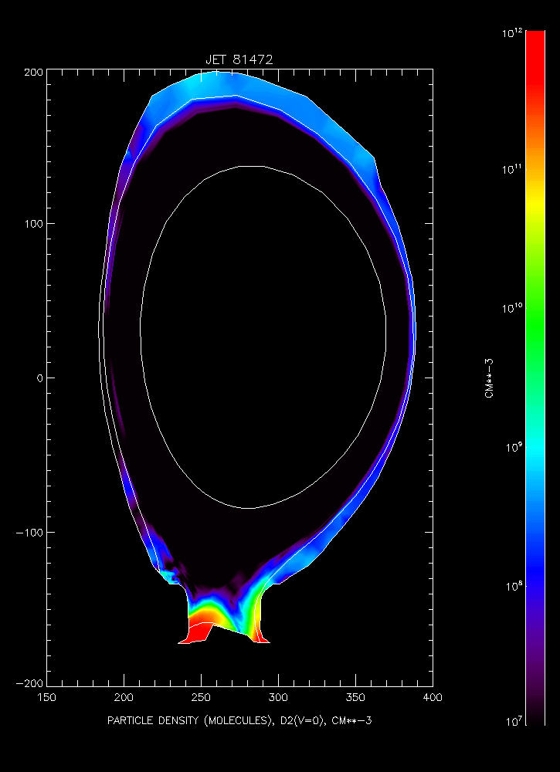
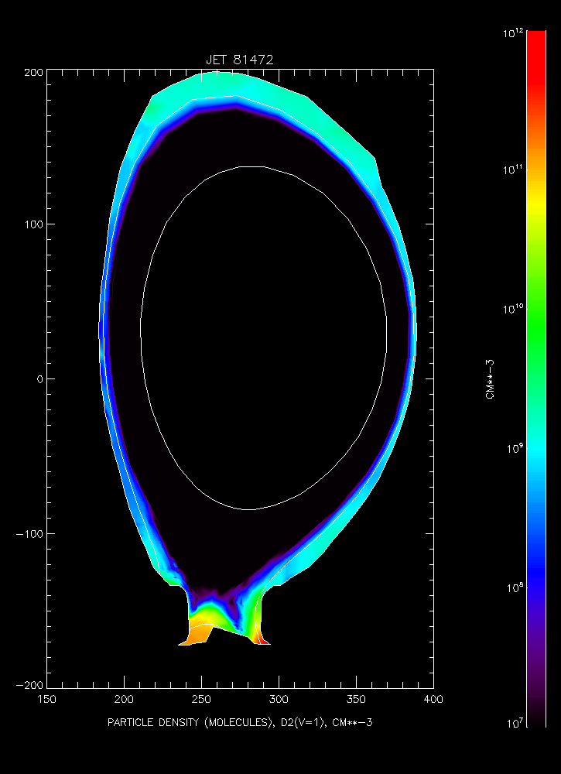
Previous capability of obtaining vibrationally resolved molecular densities with EIRENE recovered
n_{D2} (v=0)
10¹² cm⁻³
n_{D2} (v=1)
10¹² cm⁻³
10⁷ cm⁻³
10⁷ cm⁻³

Slide 7
Previous capability of obtaining vibrationally resolved molecular densities with EIRENE recovered
Tracks of D₂ molecules transitioning from ground state to v=5 vibrationally excited state

Slide 8
Plans for 2022
Comparison of H₂ fundamental data in AMJUEL and H2VIBR to IPP Garching H₂ database (Dirk Wünderlich, Ursel Fantz, Richard Bergmair)
Comparison of vibrational populations predicted by EIRENE H2_COLRAD, CRUMPET and YACORA with AMJUEL/H2VIBR and IPP Garching H₂ database
Development of optionally running internal H₂ CRM in EIRENE versus pre-calculated tables ⇒ assessment of its impact
Testing of coupled SOLPS-ITER runs with vibrationally resolved H₂
SOLPS-ITER runs for H, D and T plasmas, EDGE2D-EIRENE for D-T
Discussion of spectroscopic analyses for H₂, D₂, T₂ and D-T Fulcher band measurements and preparation of comparison to EIRENE predictions

