Slide 1

Status Report for WPPWIE
3rd WPPWIE Project Board | 15.03.2022
S. Brezinsek (PL), M. Reinhart (PSO)
J.W. Coenen, A. Hakola, K. Schmid, A. Kirschner, H.v. Meiden, J. Likonen, G. Calabro

Slide 2
Project Board presentation topics - Spring
# | Project Board
1 | [max. 5 min] WP Organization
2 | [max. 20 min] WP Main Objectives & Summary of Achievements (previous year) Status of Grant Milestones & Grant Deliverables (previous year)
3 | [max. 5 min] Risks & Mitigations Register: Current Status
4 | [max. 10 min] Project Change Requests & Other Items for Decision/Approval by PB
5 | AOB

Slide 3
1 – WPPWIE Organization
Plan at set-up
of EUROfusion
In FP9
Work Package Plasma-Wall Interactions and Exhaust including Theory Simulation, Validation and Verification
PEX-FZJ transferred from
FP8 (MST2) into FP9.
No official interaction
or discussion with PEX team
as start of parts in 2022+
Originally in EF Grant plan
embedded into WP.
Now part of WPAC
with only advice from
WPPWIE. Finance and
report control via WPAC.
Former JET-2 activities
only until 2023 secured
With financial support.
No sample analysis
With T operation foreseen
In original plan!
Only finance for 1 year in FP9 given
reorganise in 2021 and cover 2 years
Insufficient to give final advise
as „hybrid shape development
and modelling takes time“

Slide 4
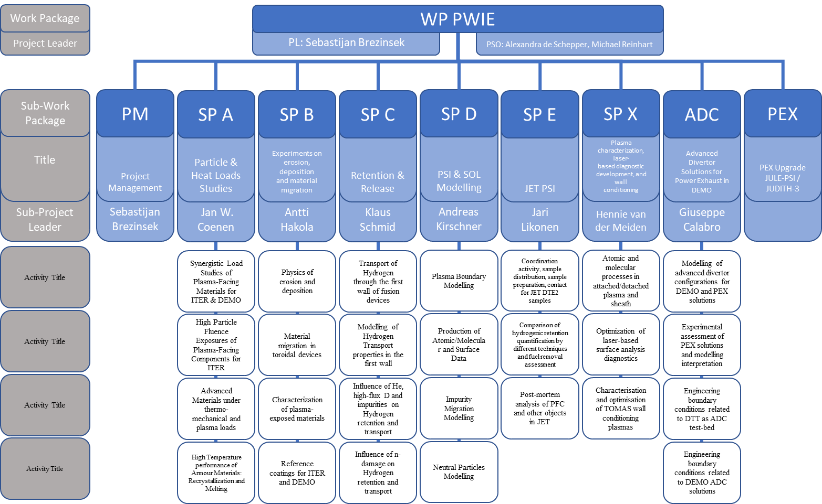
1 – WP Organization: Work-Breakdown Structure
DPL for ADC: Giuseppe Calabro
Note PSO exchange mid 2021: A.Zinken for IMS entries
from
2022 on
Task descriptions
in PMP ANNEX 2
(and IMS)
~6 months 9.2021/3.2022
only in 2022+2023
Modelling
of ADC for DTT
only in 2021+2022

Slide 5
1 – WPPWIE Organization: Facilities Operation
Facility | RU | Funding rate | Days in 2021 | Days in 2022 | Comment
MAGNUM-PSI | DIFFER | 70 % | 13 | 54 | 14 days transferred from 2021 to 2022
Upgrade PILOT-PSI | DIFFER | 70 % | 4 | 21 | 8 days transferred from 2021 to 2022
PSI-2 | FZJ | 70 % | 70 | 70
JULE-PSI | FZJ | 70 % | 0 | 0 | Not yet operational
GLADIS | MPG | 70 % | 8 | 8
JUDITH-2 | FZJ | 40 % | 20 | 20
QSPA | KIPT | 40 % | 20 | 20
OLMAT | CIEMAT | 40 % | 4 | 4
GYM | ENEA | 40 % | 15 | 20
TOMAS | FZJ | 40 % | 15 | 20
Accelerator | MPG | 40 % | 52 | 57
Accelerator | DIFFER | 40 % | 0 | 30 | 15 days transferred from 2021 to 2022
Accelerator | FZJ | 40 % | 10 | 12
Accelerator | VR | 40 % | 15 | 18
Accelerator | JSI | 40 % | 20 | 20
Accelerator | RBI | 40 % | 10 | 12
Accelerator | VTT | 40 % | 5 | 5
Accelerator | IST | 40 % | 10 | 12
Accelerator | NCSRD | 40 % | 5 | 8
No major changes to indicative resources and plans in 2021 and 2022. 2022 Increase in accelerator mainly for SP E activities!

Slide 6
1 – WPPWIE Organisation: Human Resources
PMs
2021
PM 2021 | P.M. | SP A | SP B | SP C | SP D | SP E | SP X | ADC | Sum
CEA |  | 6 | 6 | 19 | 6 |  | 2 | 2 | 41
CIEMAT |  | 3 | 3 |  |  |  | 2 |  | 8
CU |  |  |  |  |  |  |  |  | 0
DCU |  |  |  |  |  |  | 0 |  | 0
DIFFER | 2 | 10 | 0 | 0 | 2 |  | 6 |  | 20
DTU |  | 5 |  |  |  |  |  |  | 5
ENEA | 4 |  | 7 | 3 | 7 |  | 4 | 48 | 73
EPFL |  |  |  |  |  |  |  | 5 | 5
FZJ | 19.6 | 19 | 11 | 14 | 21 |  | 15 |  | 99.6
IAP |  |  | 0 |  |  |  |  |  | 0
IPP.CR |  |  |  |  | 5 |  |  |  | 5
IPPLM |  |  | 0 | 0 |  |  | 2 | 2 | 4
ISSP-UL |  |  |  |  |  |  | 0 |  | 0
IST |  |  | 4 |  |  |  |  |  | 4
JSI |  | 3 | 7 | 14 |  |  |  |  | 24
KIPT |  | 60 |  |  |  |  | 4 |  | 64
KIT |  |  |  |  | 9 |  |  |  | 9
LPP-ERM-KMS |  | 0 |  |  |  |  | 7 | 8 | 15
MPG | 2 | 7 | 11 | 17 | 5 |  |  | 10 | 52
NCSRD |  |  | 2 |  |  |  |  |  | 2
OEAW |  |  | 5 | 3 | 5 |  |  |  | 13
RBI |  |  | 5 |  |  |  |  |  | 5
UKAEA |  |  |  | 6 |  |  |  |  | 6
UT |  |  |  |  |  |  | 9 |  | 9
VR |  | 6 | 5 | 3 | 11 |  | 3 |  | 28
VTT | 2 |  | 6 |  | 15 |  |  | 4 | 27
PMs
2022
PM 2022 | P.M. | SP A | SP B | SP C | SP D | SP E | SP X | ADC | Sum
CEA |  | 6 | 6 | 29 | 6 |  | 2 | 2 | 51
CIEMAT |  | 5 | 3 |  |  |  |  |  | 8
CU |  |  |  |  |  | 4 | 13 |  | 17
DCU |  |  |  |  |  |  | 5.96 |  | 5.96
DIFFER | 2 | 17.94 | 7.94 | 7.94 | 2 |  | 9.97 |  | 47.79
DTU |  | 5 |  |  |  |  |  |  | 5
ENEA | 4 |  | 7 | 3 | 7 |  | 4 | 30 | 55
EPFL |  |  |  |  |  |  |  | 5 | 5
FZJ | 19.6 | 19 | 11 | 14 | 21 | 15 | 15 |  | 114.6
IAP |  |  | 21.83 |  |  | 14 |  |  | 35.83
IPP.CR |  |  |  |  | 5 |  |  |  | 5
IPPLM |  |  | 9.92 | 7.94 |  | 6 | 2 | 3 | 28.86
ISSP-UL |  |  |  |  |  | 12 | 5.96 |  | 17.96
IST |  |  | 4 |  |  | 11 |  |  | 15
JSI |  |  | 7 | 14 |  |  |  |  | 21
KIPT |  | 60 |  |  |  |  | 4 |  | 64
KIT |  |  |  |  | 9 |  |  |  | 9
LPP-ERM-KMS |  | 4 |  |  |  |  | 9 | 5 | 18
MPG | 2 | 7 | 11 | 19 | 4 | 3 |  | 10 | 56
NCSRD |  |  | 3 |  |  | 3 |  |  | 6
OEAW |  |  | 5 | 3 | 5 |  |  |  | 13
RBI |  |  | 5 |  |  |  |  |  | 5
UKAEA |  |  |  | 6 |  | 11 |  |  | 17
UT |  |  |  |  |  |  | 9 |  | 9
VR |  | 7 | 5 | 3 | 14 | 10 | 3 |  | 42
VTT | 4 |  | 6 |  | 15 | 11 |  | 5 | 41
Some transfer of human resources, but no major difference to integral of indicative resources foe 2021 and 2022.
=
Transfer of resources

Slide 7
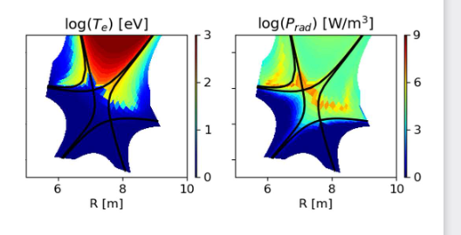
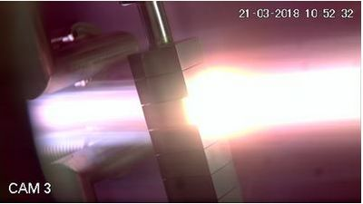
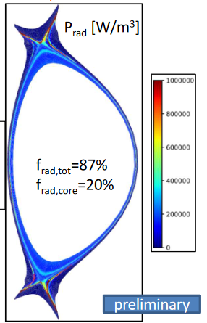
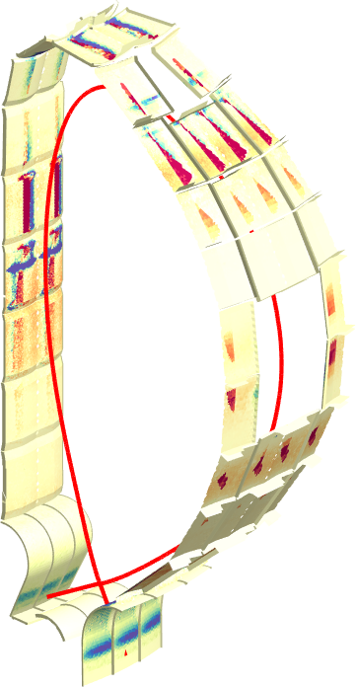
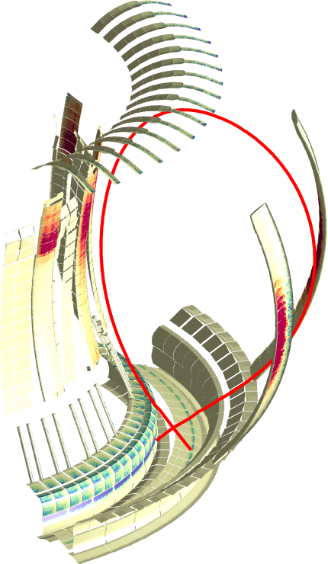
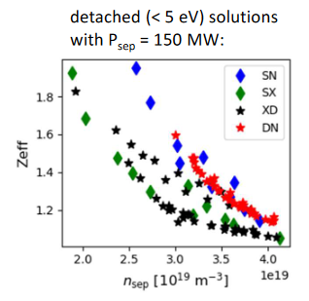
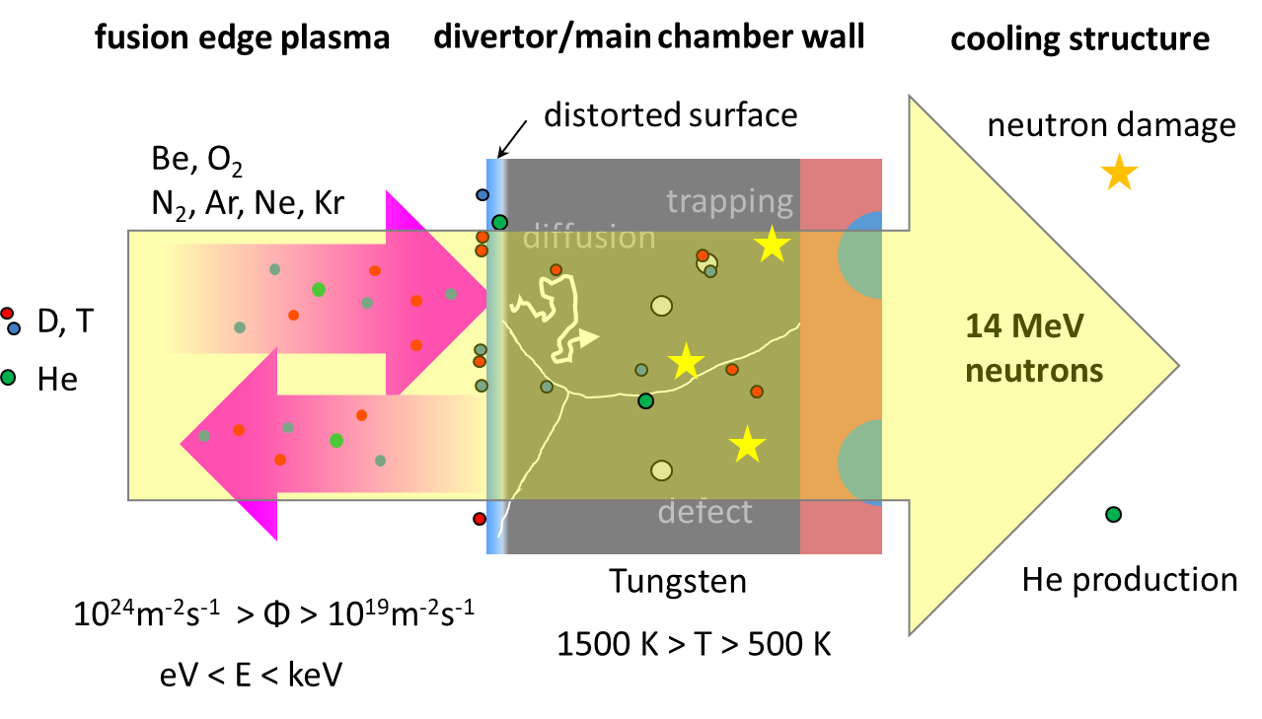
2 – WPPWIE Main Objectives
Focus on ITER and DEMO materials, H and isotopes, He, seeding gases, and impurities
Advanced Divertor Solutions
Tungsten
Particle and heat flux
Tungsten + Deuterium
Radiative divertor
Tungsten + D +
seed gas (Ar+ Kr)
[O. Pan]
Goal: steady-state operation
MAGNUM
DEMO
[T. Morgan]
JET
ITER
[L. Aho Mantila]
[J. Romazanov]
[T. Schwarz-Selinger]
3D erosion & deposition modelling
Beryllium
Fuel (Tritium) retention
Tungsten + Deuterium/Helium
Support in WPTE regarding material migration in metallic devices!
PWI in WPW7X with Graphite

Slide 8
2 – WPPWIE Summary of Achievements: SP A
Particle and heat load studies in preparation of ITER and DEMO exploitation
SP A.1 Synergistic Load Studies of Plasma-Facing Materials for ITER & DEMO
WM01 | Development analysis methods to determine of underlying mechanisms for recrystallization which impacts the lifetime of tungsten-based PFCs from e.g. WPMAT (ITER+DEMO)
WM02 | Assessment of W-heavy alloy PFCs for use in current and future fusion devices with a focus on high heat flux treatment and high fluence plasma exposure (DEMO+ITER)
WM03 | Exposure of DEMO baseline divertor PFC mono-blocks (from WPDIV) in MAGNUM-PSI in D and D+Ne conditions to high fluence (DEMO)
Done
SP A.2 High Particle Fluence Exposures of Plasma-Facing Components for ITER
Done
SP A.3 / Advanced Materials under thermo-mechanical and plasma loads
SP A.4 / High Temperature performance of Armor Materials: Recrystallization and Melting
Shifted
Participants: CEA, CIEMAT,
DIFFER, DTU, FZJ, JSI, KIPT,
LPP-ERM-KMS, MPG, VR
Full reporting under INDICO https://indico.euro-fusion.org/event/1568/
and SP A reporting within WPPWIE review meeting (1/2022)

Slide 9
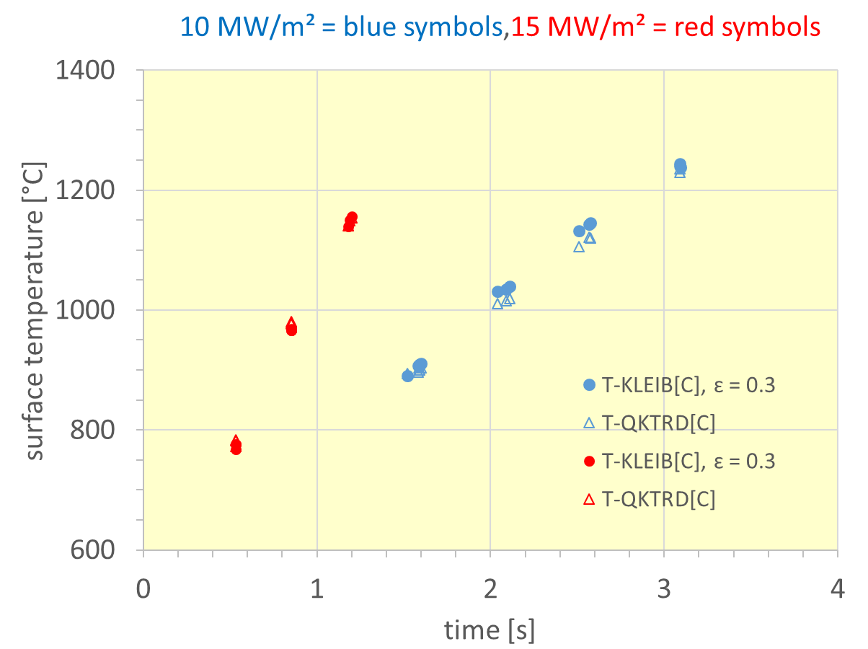
2 – WPPWIE Summary of Achievements: SP A
Particle and heat load studies in preparation of ITER and DEMO exploitation
Motivation: Transition of W7-X from graphite to W PFM for divertor target and baffle plates. Moderate heat fluxes up to 10 MW/m² allow to consider W heavy alloys materials, reduced manufacturing costs due to machining with high speed standard tools.
SP A.1 Synergistic Load Studies of Plasma-Facing Materials for ITER & DEMO
MPG
SP A.2 High Particle Fluence Exposures of Plasma-Facing Components for ITER
GLADIS screening results
WSM-W95 Ni3.5 Cu1.5
SP A.3 / Advanced Materials under thermo-mechanical and plasma loads
SP A.4 / High Temperature performance of Armor Materials: Recrystallization and Melting
Participants: CEA, CIEMAT,
DIFFER, DTU, FZJ, JSI, KIPT,
LPP-ERM-KMS, MPG, VR
Study of thermal operation limits close to the melting of Cu/Ni FCC (T_{liq}~1380°C)
Study integrity and performance of samples before and after “Melting event”
Behaviour under transient cyclic heat load of 15 MW/m², 1.2 s and 40 MW/m², 0.2 s
Conclusion: Screening tests successful so far. Results to be compared with other heavy alloys. Test on linear plasma device envisaged. Feed-back to WPDIV and WPW7X activities.

Slide 10
2 – WPPWIE Summary of Achievements: SP B
Experiments on erosion, deposition and material migration
SP B.1 Physics of erosion and deposition
WM04 | Experimental determination of effective tungsten sputtering yields on different types of rough surfaces in pure and mixed plasmas and comparison with laboratory experiments (ITER+DEMO)
WM05 | Provision of the gross and net erosion balance of W PFCs in L- and H-mode plasmas in tokamaks with the aid of marker probes (ITER)
WM06 | Completion of W marker tiles surface analysis exposed in the deuterium campaign C3. First assessment of the erosion/deposition on W PFUs in WEST after the He campaign C4 (ITER+DEMO)
Largely done
SP B.2 Material migration in toroidal devices
Done
SP B.3 Characterization of plasma-exposed materials
SP B.4 Reference coatings for ITER and DEMO
Done
Participants: CEA, CIEMAT, DIFFER, ENEA, FZJ, IAP, IPPLM, IST, JSI, MPG, OEAW, RBI, VR, VTT
Full reporting under INDICO https://indico.euro-fusion.org/event/1568/
and SP B reporting within WPPWIE review meeting (1/2022)

Slide 11
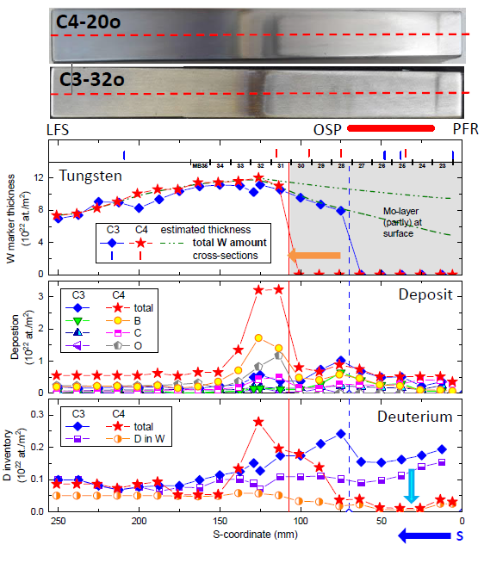
2 – WPPWIE Summary of Achievements: SP B
Experiments on erosion, deposition and material migration
Motivation: Understanding of material erosion and deposition in WEST (PFC facility / phase 1) with mixed W plasma-facing units in the divertor. Qualification of W monoblocks. Usage of W-coated graphite PFCs with marker layers to assess global migration
SP B.1 Physics of erosion and deposition
Main results – lower divertor tile analysis
C3 (deuterium) and C4 (helium) campaign showed largely comparable erosion/deposition
Strong erosion at the inner and outer strike line areas: >0.1 nm/s averaged over C3/C4
Thick deposited layers (>10 µm, growth rate >1 nm/s) on the HFS of the inner strike like
Deposits mainly composed of B, C, O, and W.
Strong arcing also observed in the region of the deposits
He operations at the end of C4: no clear signs of nanotendrils nor He bubbles (>10 nm)
SP B.2 Material migration in toroidal devices
SP B.3 Characterization of plasma-exposed materials
SP B.4 Reference coatings for ITER and DEMO
Participants: CEA, CIEMAT, DIFFER, ENEA, FZJ, IAP, IPPLM, IST, JSI, MPG, OEAW, RBI, VR, VTT
Conclusion: WEST operation influenced so far by
impurities (O+C) causing large sputtering, large migration,
and complex W co-deposits without ELM-induced sputtering
CEA, MPG, VTT

Slide 12
2 – WPPWIE Summary of Achievements: SP D
Plasma-edge and plasma-wall interaction modelling
WM10 | Provision of plasma backgrounds for a set of JET-ILW H-mode D plasmas (EDGE2D-EIRENE), WEST He plasmas (SOLEDGE-EIRENE), and W7-X H plasmas (EMC3-EIRENE) used for interpretative impurity migration modelling (ITER)
WM11 | Provision of atomic, molecular and surface data necessary to model impurity migration. Main focus is on ionisation, excitation, reflection and sputtering data for W materials including morphology effects and crystal orientation (DEMO+ITER)
WM12 | Benchmark the quantify the predictive modelling capabilities of erosion sources, impurity migration and resulting deposition in JET, WEST, W7-X, and ITER (ERO, WallDYN) (ITER)
SP D.1 Plasma Boundary Modelling
Done
SP D.2 Production of Atomic/Molecular and Surface Data
Done
SP D.3 Impurity Migration Modelling
SP D.4 Neutral Particles Modelling
Done
Participants: CEA, DIFFER, ENEA, FZJ, IPP.CR, KIT, MPG, OEAW, VR, VTT
Full reporting under INDICO https://indico.euro-fusion.org/event/1568/
and SP D reporting within WPPWIE review meeting (1/2022)

Slide 13
2 – WPPWIE Summary of Achievements: SP D
Plasma-edge and plasma-wall interaction modelling
Motivation: Interpretative modelling of WEST experiments with SOLEDGE-EIRENE (2D) and ERO2.0 (3D) to describe W migration and W content in WEST plasmas and compare
synthetic diagnostics with optical spectroscopy (to determine O content)
SP D.1 Plasma Boundary Modelling
SP D.2 Production of Atomic/Molecular and Surface Data
#55797
low density
SP D.3 Impurity Migration Modelling
CEA, FZJ + WEST team
W influx passing separatrix and polluting core (from ERO)
SP D.4 Neutral Particles Modelling
Conclusion: ERO2.0 predicts with 2D SOLEDGE-EIRENE the WI emission / W source in the WEST lower divertor under the assumption of 2-3% of O in the plasma for attached conditions. W-O-C-B co-deposit physics not yet in. Note large upper divertor W emission!
Participants: CEA, DIFFER, ENEA, FZJ, IPP.CR, KIT, MPG, OEAW, VR, VTT

Slide 14
2 – WPPWIE Summary of Achievements: SP D
Plasma-edge and plasma-wall interaction modelling
Motivation: Provide input in atomic and molecular data for DEMO conditions and laboratory experiments with W and seeding species Ar, Kr, Xe which partially is not existing and needed for predictions (incl. TSVVs). Use of molecular dynamics codes.
SP D.1 Plasma Boundary Modelling
SP D.2 Production of Atomic/Molecular and Surface Data
SP D.3 Impurity Migration Modelling
ÖAW
SP D.4 Neutral Particles Modelling
Sputtering yields from the irradiation of W(110) surface by non-cumulative Ar impact (NNP) and former works.
Probabilties of Ar reflection, adsorption and
retention (=below the first W layer) with NNP
Participants: CEA, DIFFER, ENEA, FZJ, IPP.CR, KIT, MPG, OEAW, VR, VTT
Conclusion: NN-Potentials are required in some cases, but for Ar-W good data set obtained (including Ar in W retention) as function of impact energy.

Slide 15
2 – WPPWIE Summary of Achievements: SP C
Fuel retention and release
SP C.1 Transport of Hydrogen through the first wall of fusion devices
WM07 | Documentation of the impact of oxygen layers on the uptake and release of hydrogen from W (ITER+DEMO)
WM08 | Assessment of the role of W layers on the hydrogen isotope permeation through steels (DEMO)
WM09 | Determination of the H permeation through ITER W PFC to the underlying Cu heatsink (ITER)
Largely done
SP C.2 Modelling of Hydrogen Transport properties in the first wall
Done
SP C.3 Influence of He, high-flux D and impurities on Hydrogen retention and transport
Done
SP C.4 Influence of n-damage on Hydrogen retention and transport
Participants: CEA, DIFFER, ENEA, FZJ, IPPLM, JSI, MPG, OEAW, VR
Full reporting under INDICO https://indico.euro-fusion.org/event/1568/
and SP C reporting within WPPWIE review meeting (1/2022)

Slide 16
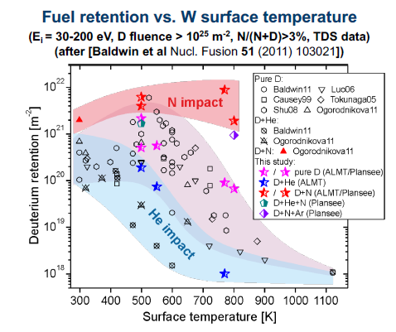
2 – WPPWIE Summary of Achievements: SP C
Fuel retention and release
Motivation: Understanding the role of He impact on D fuel retention in W in view of the ITER divertor and DEMO first wall. Impact of additional seeding species (Ne, Ar, N) and “neutron” damage on the He + D + W system regarding fuel retention
SP C.1 Transport of Hydrogen through the first wall of fusion devices
SP C.2 Modelling of Hydrogen Transport properties in the first wall
SP C.3 Influence of He, high-flux D and impurities on Hydrogen retention and transport
SP C.4 Influence of n-damage on Hydrogen retention and transport
PSI-2 in D + He admixture
on different W materials
PSI-2
Participants: CEA, DIFFER, ENEA, FZJ, IPPLM, JSI, MPG, OEAW, VR
FZJ, VR
Conclusion: Reduction of D retention over wide range of temperature conditions with He.

Slide 17
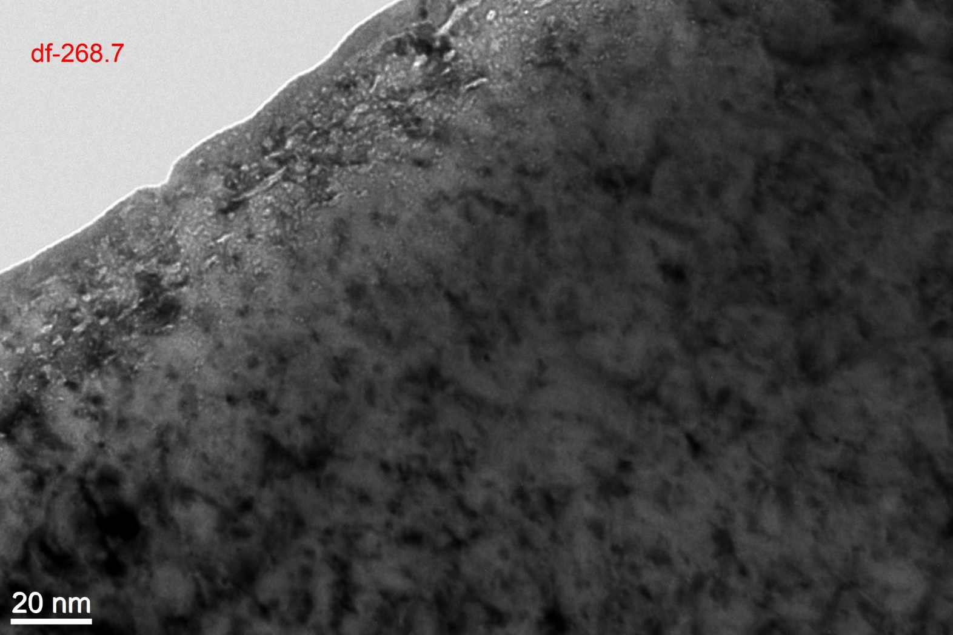
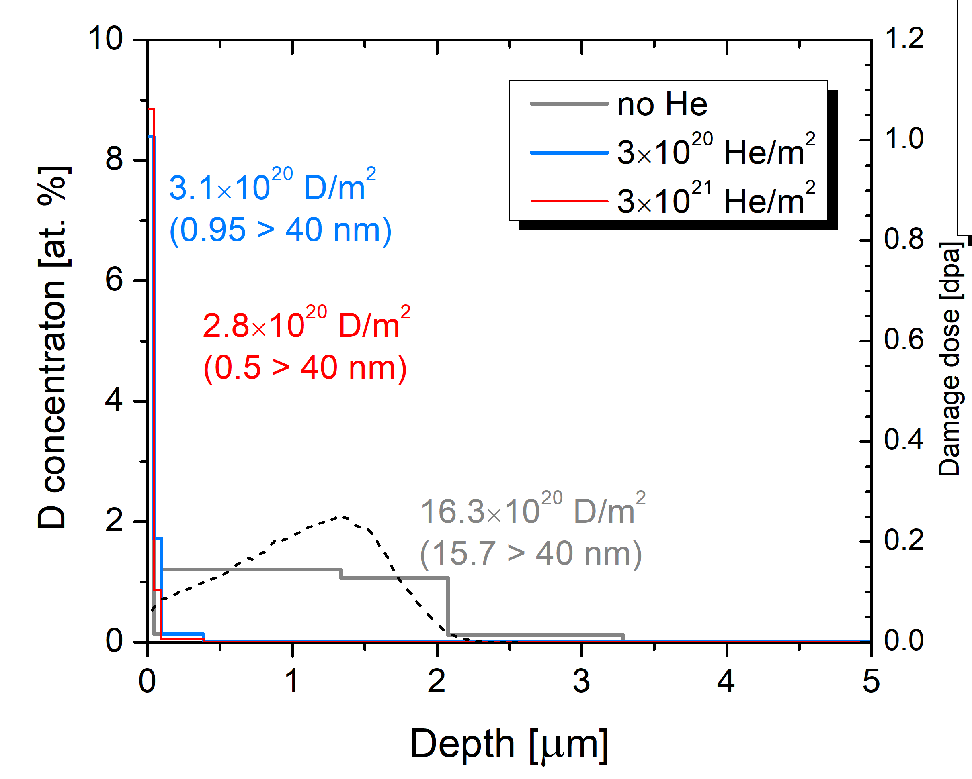
2 – WPPWIE Summary of Achievements: SP C
Fuel retention and release
Motivation: Understanding the role of He impact on D fuel retention in W in view of the ITER divertor and DEMO first wall. Impact of additional seeding species (Ne, Ar, N) and “neutron” damage on the He + D + W system regarding fuel retention
SP C.1 Transport of Hydrogen through the first wall of fusion devices
Underlying physics investigation in labor experiment
Irradiate W by 3 keV He ions @ RT (create He cluster/bubbles), create self-damage by 20 MeV W to 2 microns (area of high retention w/o He).
Exposure to low energy D ions at 300 eV/D at 450 K to study D uptake
Formation of He nanobubbles up to 40 nm observable with high He concentration (16%)
Location with high He nanobubbles in line with
location of highest D retention of up to 10%!
He with nanobubbles act as barrier and prevent
at this temperature diffusion deeper into W
High D concentration in the near surface can impact local recycling (potentially on ELMs)
SP C.2 Modelling of Hydrogen Transport properties in the first wall
Underfocus
SP C.3 Influence of He, high-flux D and impurities on Hydrogen retention and transport
W reference
SP C.4 Influence of n-damage on Hydrogen retention and transport
Participants: CEA, DIFFER, ENEA, FZJ, IPPLM, JSI, MPG, OEAW, VR
Conclusion: Complex matrix of D + He + n-damage + X
as function of surface temperature. Need to transfer
infomation carefully to ITER and DEMO conditions.
MPG, JSI

Slide 18
2 – WPPWIE Summary of Achievements: SP X
Plasma characterization, laser-based diagnostic development, and wall conditioning
SP X.1 Atomic and molecular processes in attached/detached plasma and sheath
WM13 | Realization of diagnostics for determination of ro-vibrational distribution of the ground state of H₂ and D₂ and atomic densities in PSI-2 and MAGNUM-PSI to provide access to neutral particle properties under ITER and DEMO conditions (ITER+DEMO)
WM14 | Determination of the role of material composition and surface roughness on the laser-induced ablation rate and its conversion into depth-resolved information about material composition and fuel content in ITER-like materials and surface layers or co-deposits (ITER)
WM15 | Quantification of the energetic neutral contribution in Ion and Electron Cyclotron Wall Conditioning in TOMAS and qualification of its impact on fuel removal from W7-X PFCs (DEMO+ITER)
Largely
done
SP X.2 Optimization of laser-based surface analysis diagnostics
Done
SP X.3 Characterisation and optimisation of TOMAS wall conditioning plasmas
Done
Participants: CEA, CIEMAT, CU, DCU, DIFFER, ENEA, FZJ, IPPLM, ISSP-UL, KIPT, LPP-ERM-KMS, UT, VR
Full reporting under INDICO https://indico.euro-fusion.org/event/1568/
and SP X reporting within WPPWIE review meeting (1/2022)

Slide 19
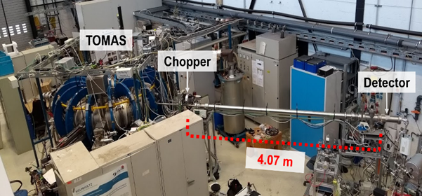
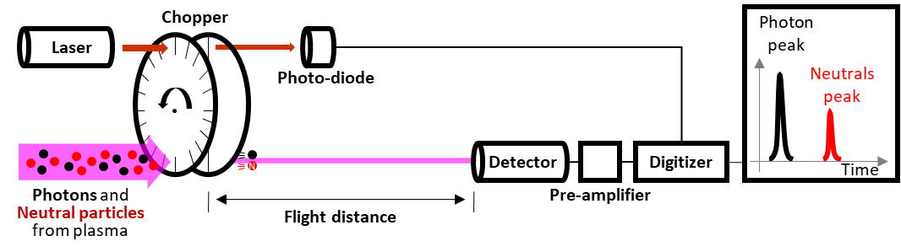
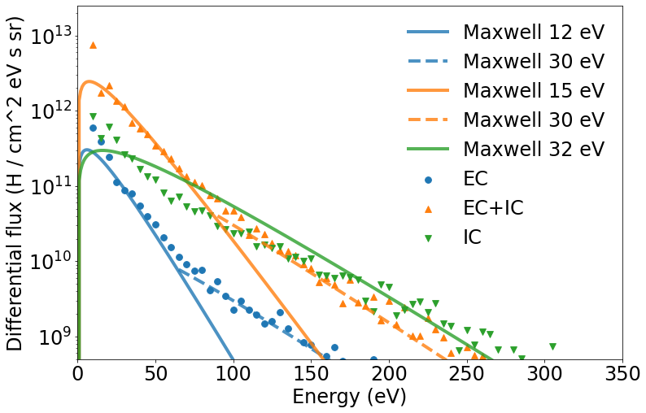


2 – WPPWIE Summary of Achievements: SP X
Plasma characterization, laser-based diagnostic development, and wall conditioning
Motivation: Wall conditioning (fuel and impurity) control is crucial for steady-state operation in long-pulse operation in view of DEMO. ECWC and ICWC are potential tools to
operate with active magnetic field. Characterisation and optimization of techniques.
SP X.1 Atomic and molecular processes in attached/detached plasma and sheath
Underlying physics investigation in TOMAS
Wall conditioning at recessed areas is done by ions and neutrals (chemistry)
Flux and energy of energetic neutrals is key ingredient to enhance eficiency
Comparison of ICWC and ECWC plasma and neutral flux density and energy
Time-of-flight measurement revealed two
Maxwellian distributions with hot tail
Further optimization and characterization
by Langmuir Probes and Spectroscopy
Next step cleaning and fuel removal efficiency on prepared material samples: D in W or C / B on C.
SP X.2 Optimization of laser-based surface analysis diagnostics
SP X.3 Characterisation and optimisation of TOMAS wall conditioning plasmas
Time-of-flight system
LPP-ERM/KMS, VR, KIPT, FZJ
Participants: CEA, CIEMAT, CU, DCU, DIFFER, ENEA, FZJ, IPPLM, ISSP-UL, KIPT, LPP-ERM-KMS, UT, VR
Conclusion: Excellent system to study and enhance
Wall conditioning for toroidal devices at hand-
Needs more manpower and mission time. Loss of
key personal to ITER.
Differential flux ($H^{0}$/ $cm^{2} eV s sr$)
Energy ($eV$)

Slide 20
2 – WPPWIE Summary of Achievements: SP ADC F-J
Advanced Divertor Configurations for DEMO and DTT
Note: The milestones are for 2021-2022
SP-ADC.F / Modelling of advanced divertor configurations for DEMO and PEX solutions
WM16 | Improvement of detached regimes in ADCs, including the effects of kinetic neutrals and sensitivity studies for the most uncertain input parameters regarding e.g. plasma transport (DEMO+ITER)
WM17 | Development of a reduced model from ADC experiments/simulations to scaling laws applicable for DEMO size and comparison with scaling laws extracted from existing DEMO scale simulations (DEMO)
WM18 | Engineering compatibility assessment of potential best promising DEMO ADC solutions with the DTT facility (DEMO)
WM19 | Engineering DEMO evaluation of most favourable ADC solutions in terms of VDE and disruption events compatibility (DEMO)
SP-ADC.G / Experimental assessment of PEX solutions and modelling interpretation
In progress
SP-ADC.H / Engineering boundary conditions related to DTT as ADC test-bed
In progress
SP-ADC.I / Engineering boundary conditions related to DEMO ADC solutions
In progress
In progress
SP-ADC.J / Modelling of standard and advanced divertor configurations for DTT
Full reporting under INDICO https://indico.euro-fusion.org/event/1568/
and SP F-J reporting within WPPWIE review meeting (1/2022)
Participants: CEA, ENEA, IPPLM, LPP-ERM-KMS, MPG, VTT, ENEA

Slide 21
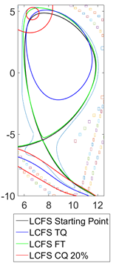
2 – WPPWIE Summary of Achievements: SP ADC F-J
Advanced Divertor Configurations for DEMO and DTT
Motivation: Input to the selection of the DEMO first divertor option from a set of pre-selected
ADC configurations. Optimization of the solutions by introduction of advanced fluid neutral models for fast screening and performance runs with kinetic neutrals. Joint work with WPTE and WPDES to minimise effort.
SP-ADC.F / Modelling of advanced divertor configurations for DEMO and PEX solutions
SP-ADC.G / Experimental assessment of PEX solutions and modelling interpretation
Progress from DTT-ADC
Increased number of cases
SF- convergence for DEMO obtained
Full set of simulations for comparison
will be available soon
Hybrid (SN+XD etc.) magnetic configurations are in preparation
Hybrid (SN+SX) assessed (stabilize plate) and impact of disruptions VDEs studied
Faster simulations with optimized neutral
treatment. SN tested. SX set-up
Other ADC in 2022.
SP-ADC.H / Engineering boundary conditions related to DTT as ADC test-bed
SP-ADC.I / Engineering boundary conditions related to DEMO ADC solutions
SP-ADC.J / Modelling of standard and advanced divertor configurations for DTT
Participants: CEA, ENEA, IPPLM, LPP-ERM-KMS, MPG, VTT, ENEA

Slide 22
2 – Status of Grant Milestones & Grant Deliverables (previous year)
GA Deliverable No. | Title | Due Date | Status | Details on Status (in case of delays or issues)
D05.01 | Post-mortem analysis of plasma-facing components exposed in W7-X (graphite) and WEST (ITER-like tungsten PFUs) in FP8. Reports on campaign integrated material migration pattern and modelling in both devices. | 31/12/2021 | Completed
D05.02 | Diffusion and trapping modelling in W PFCs under combined D+He impact and ion-induced self-damage for ITER / DEMO-like conditions. Report on underlying physics and fuel recovery strategies. | 31/12/2021 | Completed
GA Milestone No. | Title | Due Date | Status | Details on Status (in case of delays or issues)
M05.01 | Initial tile analysis of WEST PFUs and W7-X TDU PFCs Completed | 31/12/2021 | Completed
M05.02 | Comparative modelling of first set of revised advanced divertor solutions executed. | 31/12/2021 | Completed
M05.03 | Modelling of fuel retention in W under combined D+He exposure and self-damaged W by diffusion and trapping executed. | 31/12/2021 | Completed

Slide 23
3 – Risk & Mitigation Register: Current Status – page 1
Description of Risk | Severity | Likely hood | Proposed Mitigation Action | Risk materialized? | Mitigating Measures applied? | Comments
Selected high heat flux facilities are not available due to technical issues (SP A) | M | L | Delay activities or transfer to other facilities not selected in the first place | N |  | Note – OLAMT added to list of HHF
Selected linear plasma devices are not available due to technical issues (SP A, B, C, X) | M | L | Delay activities or transfer to other linear plasma devices in the WP PWIE portfolio | Y [2021] | Y | MAGNUM-PSI exp. days transferred into 2022. No further delays.
Selected accelerator facilities are not available due to technical issues (SP A, B, C, X, E) | M | L | Delay activities or transfer to other Accelerator facilities in the WP PWIE portfolio | N |  | Not yet relevant
Selected TE or W7-X campaigns and attached PFC components for analysis / modelling delayed | M | M | Delay activities or redistribute resources to other toroidal facilities, linear plasma devices and laboratory experiments | N [2021] Y [2022] | N | Note – no WEST campaign with samples in 2022
Start of JULE-PSI operation delayed (SP C) | M | M | Compensate with PSI-2 operation as much as feasible and delay activities with Be and neutron damage to a later period | N |  | Not yet relevant
Funding for LIBS on a remote handling arm in JET not available or test not compatible with JET program (SP X, SP E) | M | H | Focus on LIBS on a remote handling arm in WEST (AIA) under WP TE as technical demonstration in a full W device (no Be and no T possible). Compensate with experience in JULE-PSI | Y | N | Call for Proposals LIBS on JET remote handling arm under WPTE. If LIBS at JET will be installed, it will be ready after end of plasma operation at JET in2023. No funding for operation and no SPE anymore as in 2024 closed! Unclear situation who is in charge and how to finance operation. Unclear if consortium will be build because of BREXIT and lack of resources in laboratories.

Slide 24
3 – Risk & Mitigation Register: Current Status – page 2
Description of Risk | Severity | Likely hood | Proposed Mitigation Action | Risk materialized? | Mitigating Measures applied? | Comments
Funding for LID-QMS in JET not available or test not compatible with JET program (SP X, SP E) | M | L | Transfer studies to FREDIS and JULE-PSI with residual JET-ILW samples. Reduce scope of this task. | Y [2021] N[2022] | Y [2021] N [2021] | No EUROfusion funding in 2021. UKAEA and FZJ financed work to build system at JET. EUROfusion funding in 2022 under WPTE (not PWIE). Needs clear idea how to operate and under which flag.
No decision about the ADC solution for DEMO and DTT possible in given two years framework (SP ADC) | H | H | Coordination between involved EUROfusion partners in FTD and FSD on possible paths towards a timely ADC solution for DEMO. Assessment of consequences for a test in DTT. Increase of ADC resources will be required if more time is needed to conclude physics solutions. | Y [2021] | Y [2021] | DTT ADC modelling introduced in collaboration of WPDIV and WPPWIE. Compromise ADC solution based on SN configuration. No enough funding to complete mission until 2024 when AUG will operate ADC.
Access to the CEA Tritium lab not granted or not covered by the available resources (SP C) | M | H | Reduce scope and focus on activities every other year with resources combined over 2 years. Check for alternatives at UKAEA or ISPPUL | Y | Y | Combine resources of 2021 and 2022. Still insufficient low. Note ISPPUL has not contributed in 2021 (no EF contract) and UKAEA is uncertain. More funding required.
Access to the LPP-ERM/KMS hot cell for material characterisation not granted or covered by the available resources (SP A) | M | M | Reduce scope and focus on activities every other year with resources combined over 2 years. Check for alternatives at FZJ hot material laboratory. | Y | Y | Combine resources of 2021 and 2022. Still insufficient low. FZJ hot material lab not yet available.

Slide 25
3 – Risk & Mitigation Register: Current Status – page 2
Description of Risk | Severity | Likely hood | Proposed Mitigation Action | Risk materialized? | Mitigating Measures applied? | Comments
Access to JET material samples from FP8 not accessible due to BREXIT restrictions (SP E) | M | H | Adaption of scope of SP E to the samples from JET-ILE 1-3 available in European laboratories | N | N | Solution for 2022 found, but agreed money for distribution not yet transferred into WPPWIE. Transport in 2022 more challenging and expensive than in 2021!
Additional JET samples after DTE2 not available and ready for analysis (SP E) | H | H | Prolongation of SP E with additional funding for the remaining time of FP9 in order to be able to wait for the reduction of neutron activation. Redistribution of samples to laboratories with T, Be and activation permission. Analysis done at start of PWIE. |  |  | There is no decision to take out samples from JET after DTE2 or end of lifetime. There is also no EUROfusion funding to look into the tiles and study if damages, higher retention took place or melting occurred. PL assumes, UKAEA will analyse this in their MTF without exploitation of EUROfusion which would be a failure if EUROfusion don’t have hands on these samples and utilise the labs we asked to be ready for the samples.
QSPA (HHF – plasma gun) is not operational | Y | Y | Shift activities in subsequent years and transfer subset of urgent activities to OLMAT.

Slide 26
4 – Project Change Requests & Other Items for Decision/Approval by PB
Decisions on PCRs
# PCR | PCR Title | PCR Status | Comments
1. | Shift of MAGNUM-PSI (DIFFER) time and analysis from 2021 to 2022 (cryo issue) (SP A) | Implemented* | Done and number of days still workable in DIFFER. Note that machine cost are lower in 2022 and some additional hardware money allocated
2. | Shift of activities in 2021 into 2022 due to absence of EUROfusion grant (SP B, SP X) (IAP, ISPP-UL, DTU, IPPLM [WUT]) | Waiting approval* | Transfer of 2021 activities into 2022. Money transfer with reduction of PM due to increase of costs in 2022.
3. | CU was not part of EF grant in FP9. Now included into 2022 and PWIE PMP (SP X, SP E) | Implemented* | CU performed in 2021 activities assuming they will join EF. This work can’t be invoiced. Implementation into 2022+ plans with additional resource in 2022 and 2023 to compensate for 2021 absence.
4. | Transfer of CEA T laboratory resources foreseen in 2021 into 2022 to accumulate enough resources for meaningful use (SP C) | Waiting approval* | Resources and program for 2021 implemented and discussed with Deliverable owner. More resources needed for meaningful of expensive T laboratory. Loss of competence if no further support.
5. | Transfer of LPP-ERM/KMS resources in area of SCK-CEN and used of analysis and studies in hot cell (SP A) | Waiting approval* | Transfer into 2023/24 due to Corona and access to the laboratory discussed with SCK-CEN.
6. | Participation of CIEMAT in SP X stopped and resources transferred to SP A and OLMAT use | Waiting approval* | OLMAT qualified in 2021 as high heat flux facility and resources in 2022 used for application. Additional resource in 2022 from unallocated hardware.
* Changes implemented in IMS system since last PB. Changes in IMS regarding financial envelope information from GA in December 2021.
Note: Minor re-arrangements (<2PM within SPs) due to organisational/Corona issues done. Delays until April not listed here.

Slide 27
5 – AOB (including lessons learnt)
Reporting at the end of FP8 and start of FP09 is challenging and too high (view of PL and all SPLs)
  The idea to stop FP8 by day X and start FP9 by day Y is not working in practice
  A large number of FP8 reporting is required from the existing WPPWIE team for the old WPPFC
Need for more time and more coordinative approach to really show the outcome of FP8.
The burden to change within the project even minor PM or k€ is too high and not practicable.
  A request must be made to the financial department even for 1PM change within the WP!
  A shift from one year to another is done by „cancellation“ of one task in year Y and a new task in year Y+1.
Request: changes within the WPs below a certain number of PM and money shall be free adjustable by the PL
Mission cost rules in FP9
  The mission cost rules are GOOD for the PMU and good for the Laboratories regarding the invoices and accounting
  The mission cost system is UNPRACTICAL for the PL and PSO
  Multiple requests to the HoD and PMU by different PL and TFL to discuss and elaborate the issue failed so far
Note the mission budget as such is insufficient for PWIE in 2022 if people really do experiments at MAGNUM, TOMAS, PSI-2.
Request to remove “TSVV” from the WPPWIE name and rethink deliverables related to TSVVs within WPPWIE
  The long name in the grant was settled before the TSVVs was moved into WPAC
  Control is done via Scientific Board and Thrusts, but reporting is done solely to WPAC and the CO of WPAC
As there is no active control of the WPPWIE leader on the TSVVs 5-7, better remove it from the title.
Note, the CO of AC is discussing changes directly with PI of TSVVs

Slide 28
Back-up

Slide 29
5 – AOB (including lessons learnt)
FTD and FSD link
  Good established link to Mission 1 (Scenario) and some Mission 2 (Exhaust) aspects
  Request to have better coordination under Mission 2 (Exhaust) and Mission 3 (Materials) between both departments
Proposal introduce biweekly short meetings about critical issues for DEMO to avoid parallel working
EEG for TOKES collapsed
  Selected person can’t be employed by JSI as there is no 100% funding (no official information to PL by anyone)
  Loss of key code to the fusion community likely

Slide 30
1 – WPPWIE Organization within EUROfusion
Works hand in hand with FTD (DCT) in the area of DEMO exhaust solutions, PWI, and safety
Supports WPDIV in DTT divertor selection (modelling) and PFC qualification on plasma (DEMO, W7-X, etc.)
TSVV
Fusion Technology Department
Neutral Gas Dynamics
in the Edge
TSVV
WP MAT
WP DIV
WP DES
WP SAE
Plasma Exhaust:
Fluid/Gyrofluid Edge Codes
Impurity Sources,
Transport, and Screening
WP PWIE
Plasma Exhaust:
Gyrokinetic/Kinetic Edge Codes
Plasma-Wall Interaction
in DEMO
WP PrIO
WP TE
WP W7X
WP SA
Fusion Science Department
(Thrust 1)
(Thrust 2)
Works hand in hand with WPTE and WPW7X in the areas of PWI and PFC-compatible exhaust solutions
Executes post-mortem analysis of PFCs (WEST, AUG, W7-X, JET etc.) and associated interpretation
S. Brezinsek | 3rd WPPWIE PB | 15.03.2022

Slide 31
1 – WP Organization with team
Surname | First Name | Role (in WP) | Beneficiary | Email
Brezinsek | Sebastijan | Project Leader | FZJ | s.brezinsek@fz-juelich.de
Coenen | Jan Willem | Sub-Project Leader SP A | FZJ | j.w.coenen@fz-juelich.de
Hakola | Antti | Sub-Project Leader SP B | VTT | antti.hakola@vtt.fi
Schmid | Klaus | Sub-Project Leader SP C | MPG | Klaus.Schmid@ipp.mpg.de
Kirschner | Andreas | Sub-Project Leader SP D | FZJ | a.kirschner@fz-juelich.de
Likonen | Jari | Sub-Project Leader SP E | VTT | jari.likonen@vtt.fi
Van der Meiden | Hennie | Sub-Project Leader SP X | DIFFER | h.j.vandermeiden@differ.nl
Calabro | Giuseppe | Deputy Project Leader SP ADC | ENEA | giuseppe.calabro@unitus.it
Zinken | Angela | Project Support Office | FZJ | a.zinken@fz-juelich.de
Reinhart | Michael | Project Support Office | FZJ | m.reinhart@fz-juelich.de
Douai | David | EUROfusion Coordination officer | CEA | David.DOUAI@eurofusion.org

Slide 32
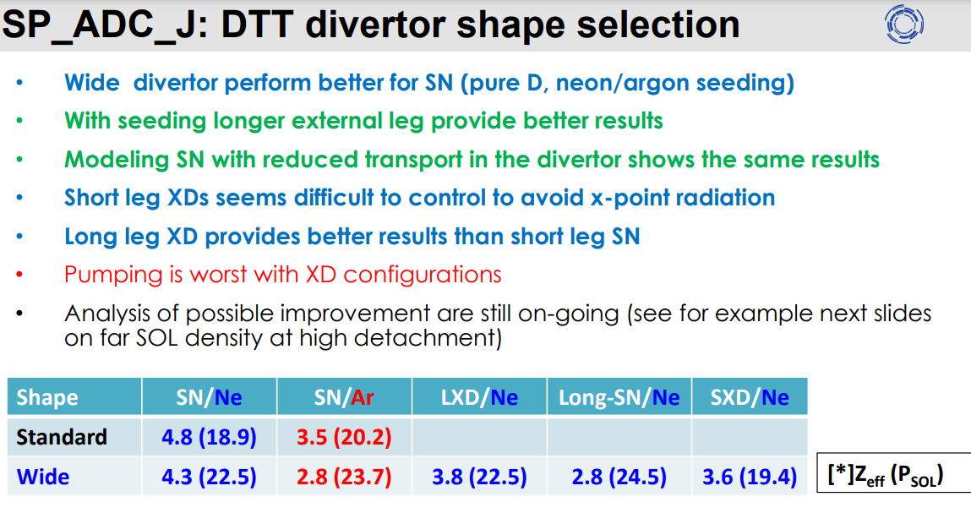
SP ADC-J: Modelling of standard and ADC for DTT
P. Innoncente and team

Slide 33
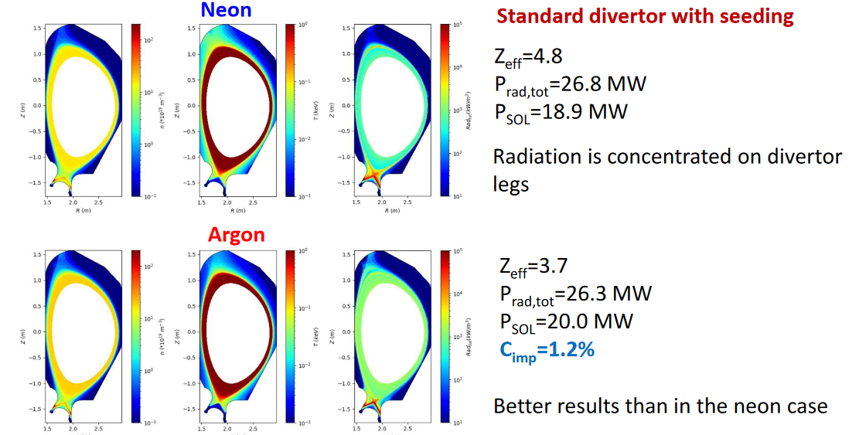

Slide 34
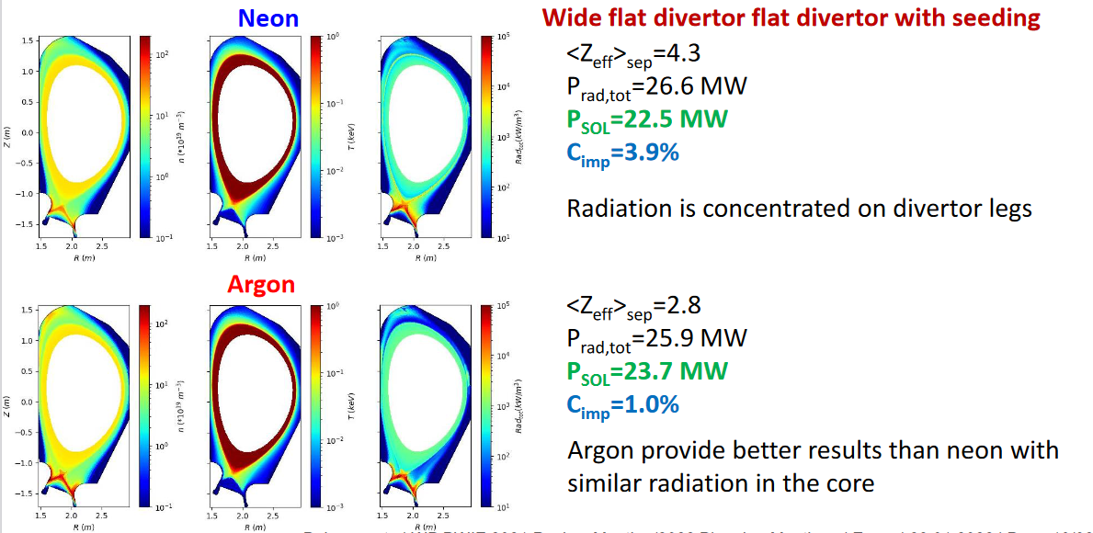

Slide 35
