Slide 1
Thrust 4 meeting
TSVV#13 Stellarator Turbulence Simulation
J. M. García Regaña
on behalf of the TSVV#13 team and collaborators

Slide 2
TSVV#13 Project
Objectives and key deliverables
Advancing the understanding of turbulence in stellarators and narrowing the gap w.r.t. its tokamak counterpart.
Addressing aspects of particular relevance for stellarators, like electromagnetic turbulence, interplay between neoclassical (NC) physics and gyrokinetic (GK), which remain practically unexplored.
1) Stellarator GK codes verified against each other and 2) validated against stellarator and 3D tokamak experiments, 3) able to address the interaction between NC and GK turbulence and 4) to assess relative weight of NC and turb. transport. 5) Develop reduced models.
Project overview in 2021
4 out of 9 milestones and 2 out of 15 SMART deliverables addressed in 2021 and 3 new milestones added.
Team (CIEMAT, CCFE, MPG, DIFFER)
J.M. García-Regaña (PI), E. Sánchez, J. L. Velasco (CIEMAT), M. Barnes, D. A. St.-Onge (CCFE/U. Oxford), A. Bañón, J. Riemann, A. Zocco (MPG), J. Proll (DIFFER) + External Experts: M. J. Pueschel (DIFFER), R. Kleiber (MPG) … + PhD students.
Changes w.r.t. initial team: D. A. St.-Onge (U. Oxford) and A. Zocco (MPG) replacing F. I. Parra (PPPL) and J. A. Alcusón (UC3M).
Codes: stella, GENE, EUTERPE, GENE-3D, KNOSOS
Tasks for ACHs: stella optimized performance (CIEMAT), improved solvers for EUTERPE and GENE-3D (MPG), support for visualization (EPFL) and handling of EUTERPE data (VTT).

Slide 3
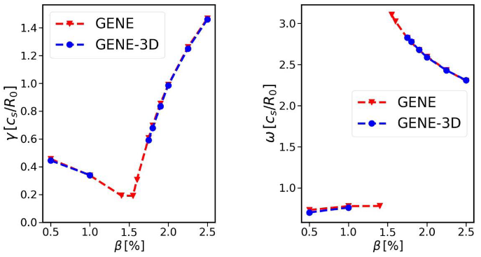
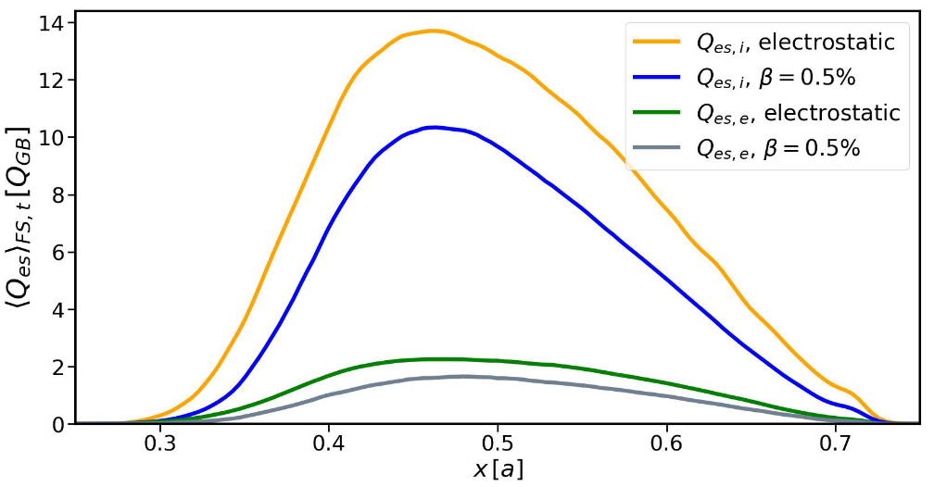
2021 Milestones
Milestone ID | Short name | Brief description | Participants | Progress
M1.1 | M-STELLA-COLL | Implementation of the full linearized collision operator in stella. | MB*, A. v. Boetticher | 50 %
M1.2 | M-BENCHMARK-ES-GLOB | Benchmark between GENE-3D and EUTERPE for electrostatic turbulence with adiabatic electrons. | ES*, ABN, JR, JGR | 100 %
M1.3 | M-STELLA-FFS | Development of a full-flux-surface (FFS) version of stella. | MB* | 100 %
M1.4 | M-GENE-3D-EM | Development of an electromagnetic version of GENE-3D and implementation of methods that allow to use larger time steps in GENE-3D simulations. | ABN*, F. Wilms | 100 %
[Wilms JPP’21]

Slide 4
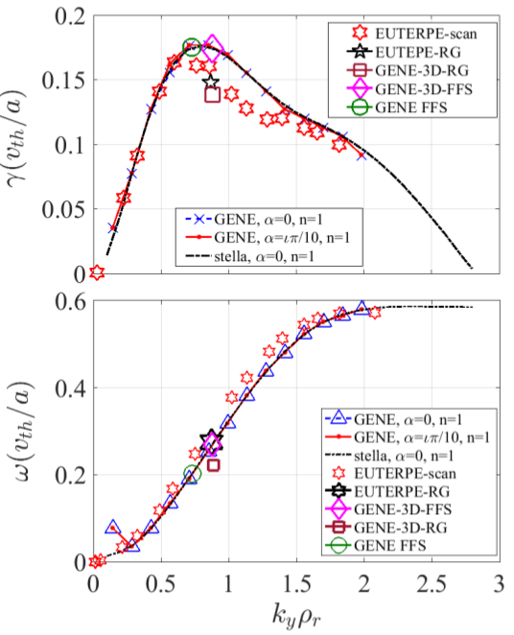
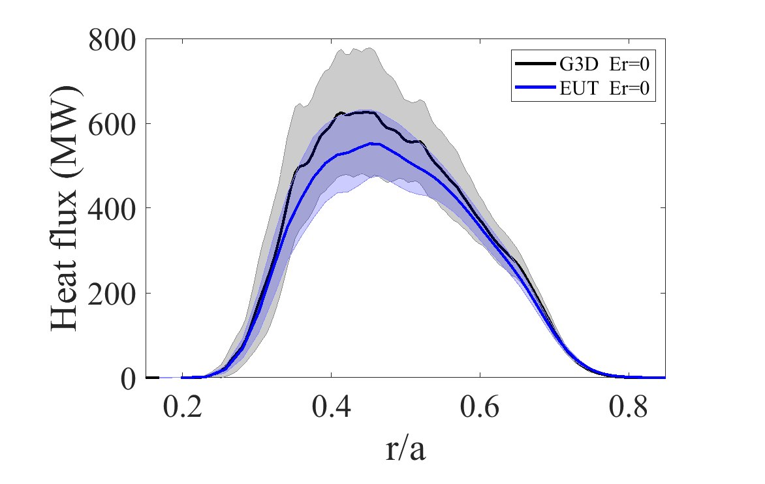
2021 Milestones
Milestone ID | Short name | Brief description | Participants | Progress
M1.1 | M-STELLA-COLL | Implementation of the full linearized collision operator in stella. | MB*, A. v. Boetticher | 50 %
M1.2 | M-BENCHMARK-ES-GLOB | Benchmark between GENE-3D and EUTERPE for electrostatic turbulence with adiabatic electrons. | ES*, ABN, JR, JGR | 100 %
M1.3 | M-STELLA-FFS | Development of a full-flux-surface (FFS) version of stella. | MB* | 100 %
M1.4 | M-GENE-3D-EM | Development of an electromagnetic version of GENE-3D and implementation of methods that allow to use larger time steps in GENE-3D simulations. | ABN*, F. Wilms | 100 %
Linear comparisons at [Sánchez NF’21]. Nonlinear comparisons at [Sánchez EFTC’21, paper in prep.].

Slide 5
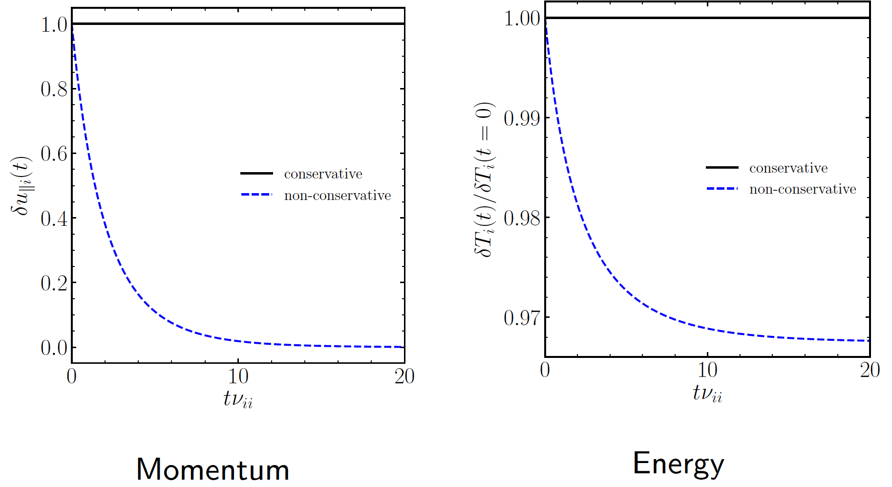
2021 Milestones
Milestone ID | Short name | Brief description | Participants | Progress
M1.1 | M-STELLA-COLL | Implementation of the full linearized collision operator in stella. | MB*, AvB | 100 %
M1.2 | M-BENCHMARK-ES-GLOB | Benchmark between GENE-3D and EUTERPE for electrostatic turbulence with adiabatic electrons. | ES*, ABN, JR, JGR | 100 %
M1.3 | M-STELLA-FFS | Development of a full-flux-surface (FFS) version of stella. | MB* | 100 %
M1.4 | M-GENE-3D-EM | Development of an electromagnetic version of GENE-3D and implementation of methods that allow to use larger time steps in GENE-3D simulations. | ABN*, F. Wilms | 100 %
Gyro-averaged C_{tp}+ C_{fp} Hirshman&Sigmar model.
Conservation of density, energy and momentum including fp. terms.
Spitzer coeffs. compared against exact FP operator.
Self-adjointness.

Slide 6
2021 Milestones
Milestone ID | Short name | Brief description | Participants | Progress
M1.1 | M-STELLA-COLL | Implementation of the full linearized collision operator in stella. | MB*, A. v. Boetticher | 100 %
M1.2 | M-BENCHMARK-ES-GLOB | Benchmark between GENE-3D and EUTERPE for electrostatic turbulence with adiabatic electrons. | ES*, ABN, JR, JGR | 100 %
M1.3 | M-STELLA-FFS | Development of a full-flux-surface (FFS) version of stella. | MB* | 100 %
M1.4 | M-GENE-3D-EM | Development of an electromagnetic version of GENE-3D and implementation of methods that allow to use larger time steps in GENE-3D simulations. | ABN*, F. Wilms | 100 %
FFS stella branch, employing explicit methode, merged with trunk version. Preliminary linear comparisons carried out.
See: https://github.com/stellaGK/stella

Slide 7
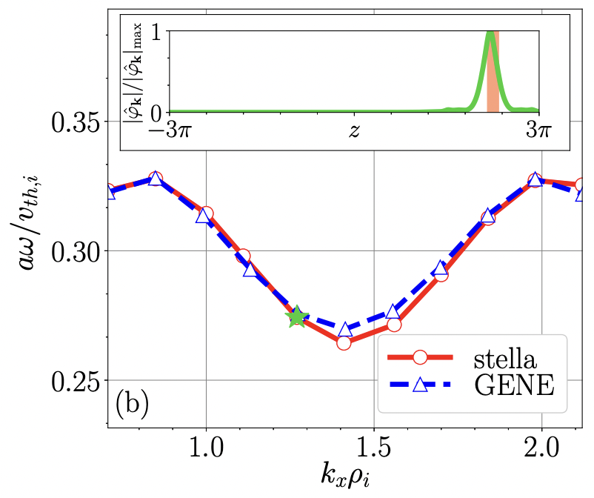
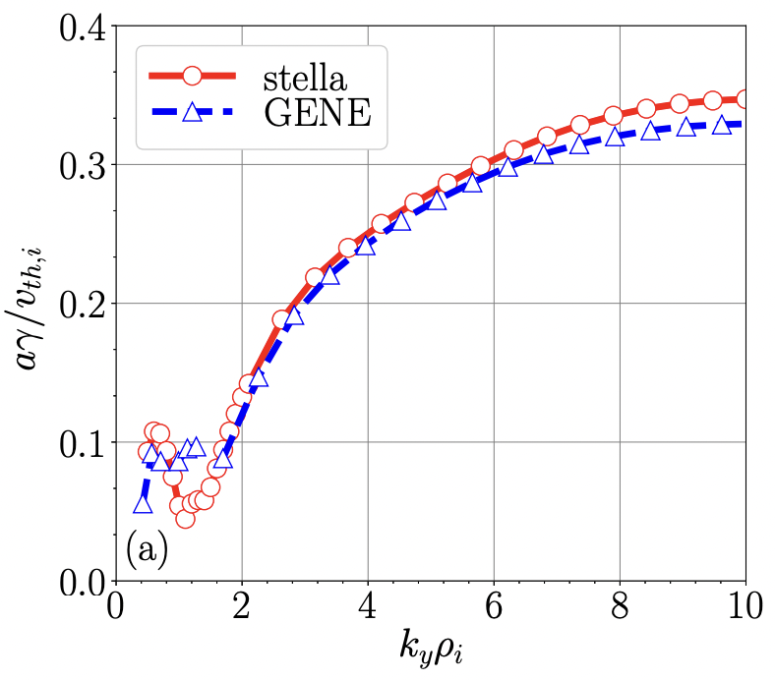
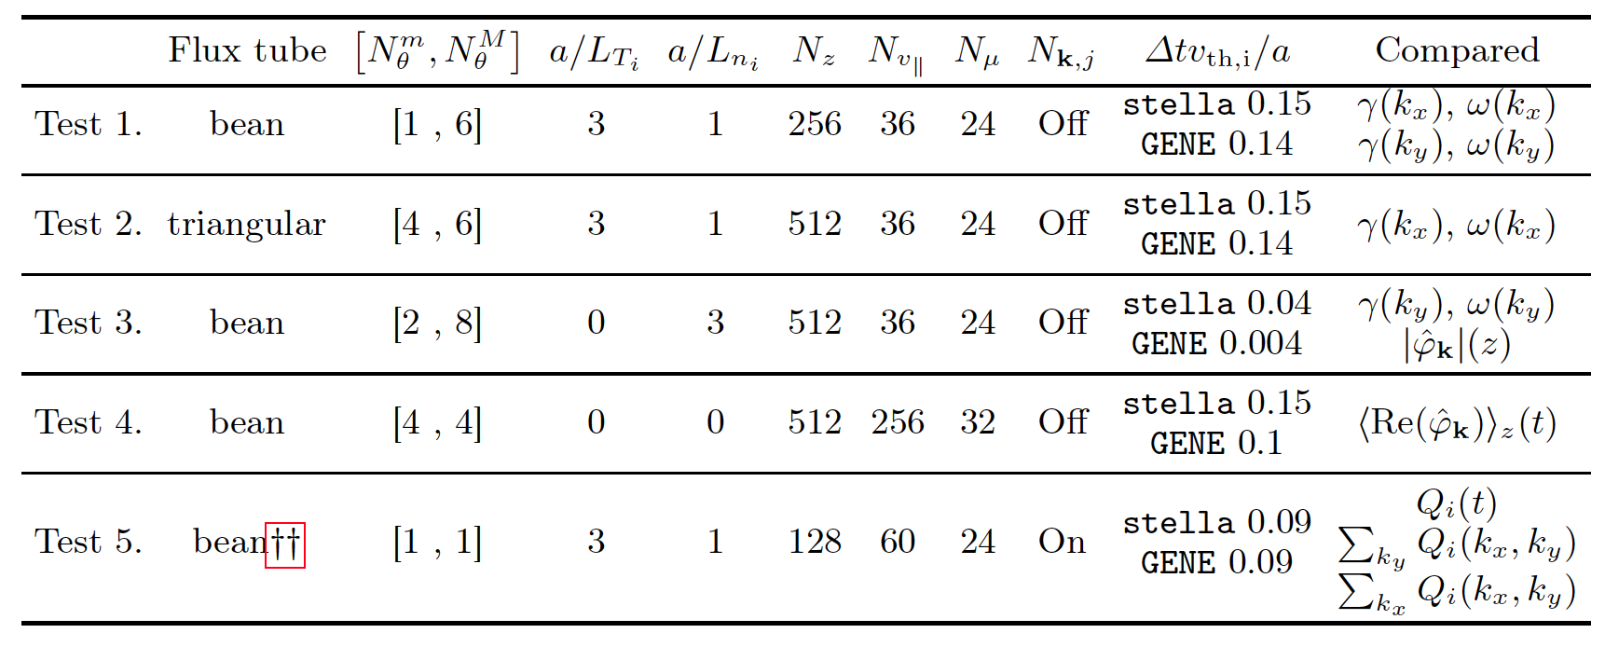
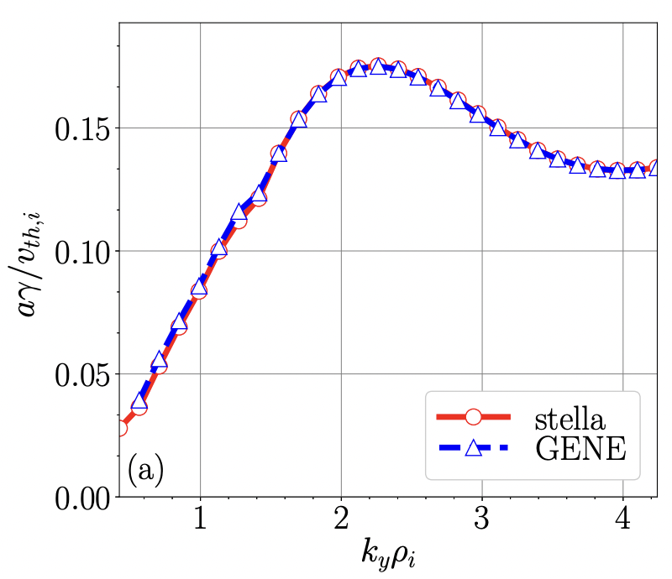
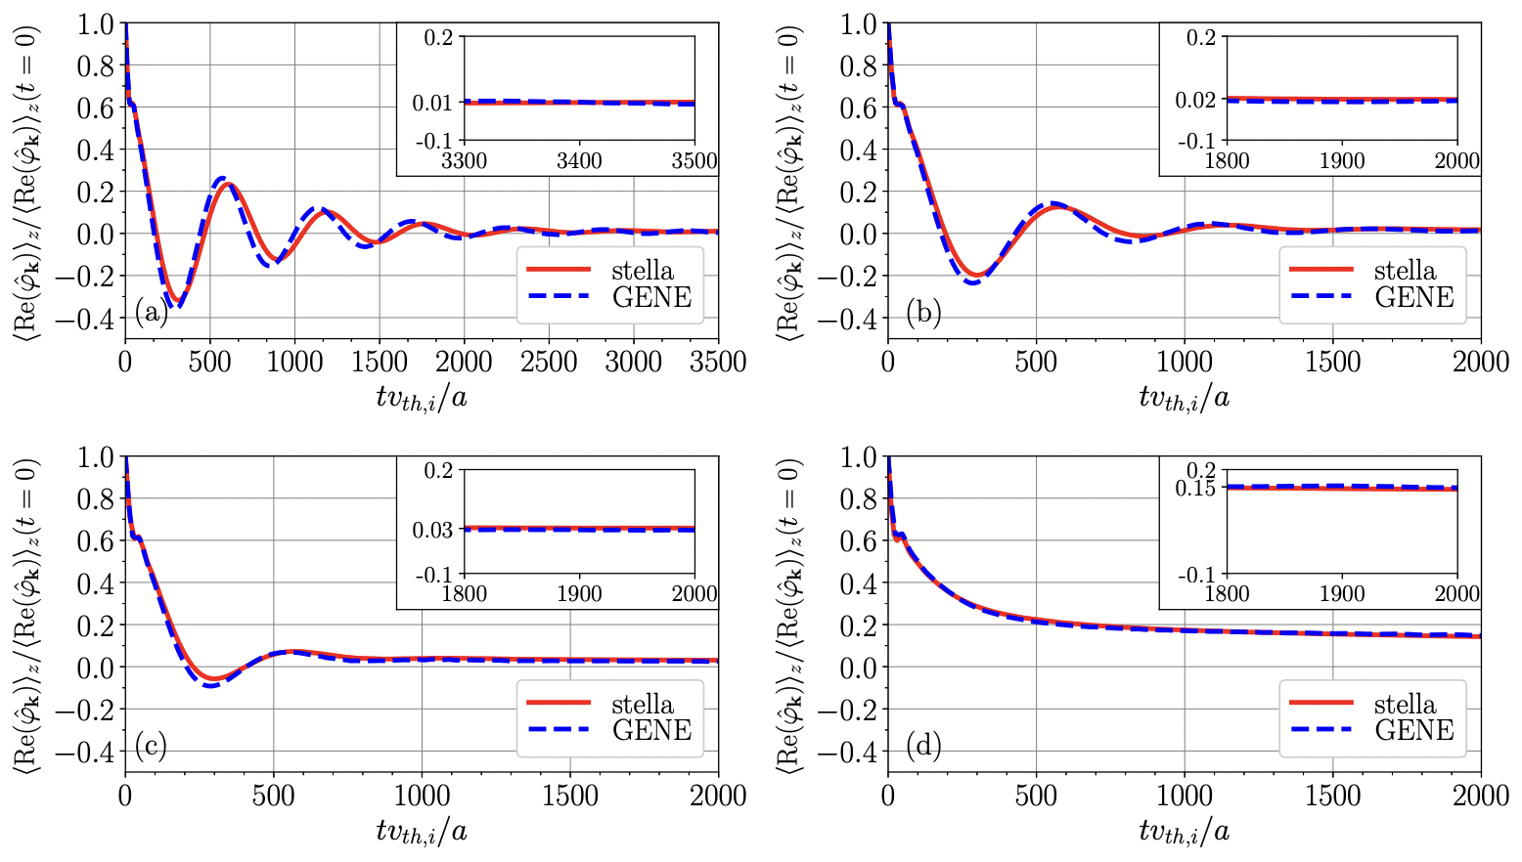
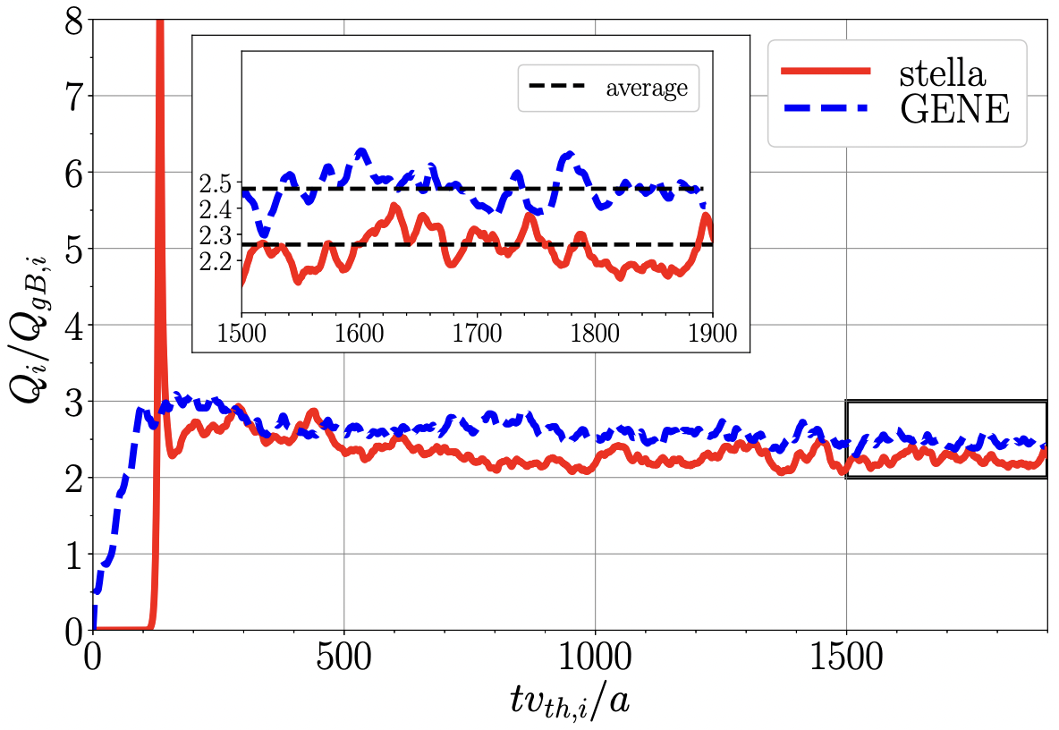
Deliverables in 2021
Deliverable ID / Short name | Key deliverable(s) | Due date
D1.1 / D-REF-CASES | 1, 3, 4 | March 2021
Agreed W7-X reference case and set of representative OP2 operation scenarios for comparisons, benchmark activities.
D1.2 / D-TURB-ZTRANSP | 3, 4 | Dec. 2021 → 2022
Study of the effect of collisions on the background turbulence and impurity transport in multispecies electrostatic flux tube simulations.
[González-Jerez JPP submitted’21]

Slide 8
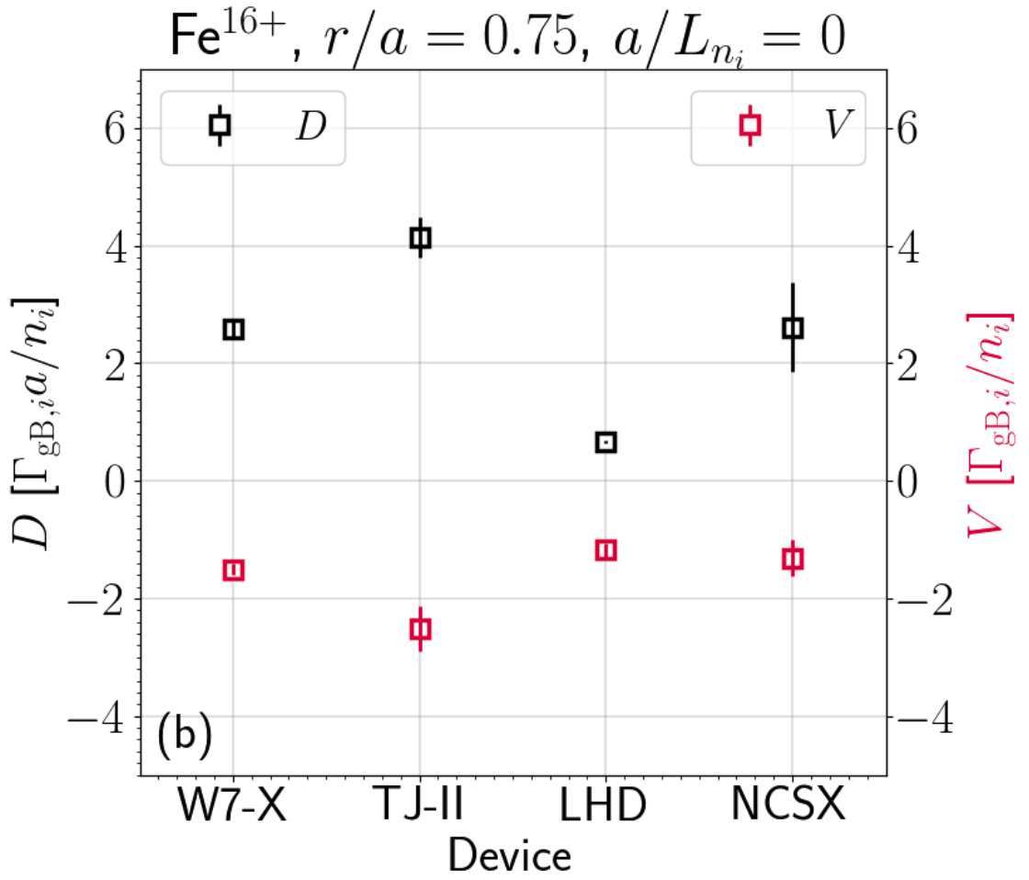
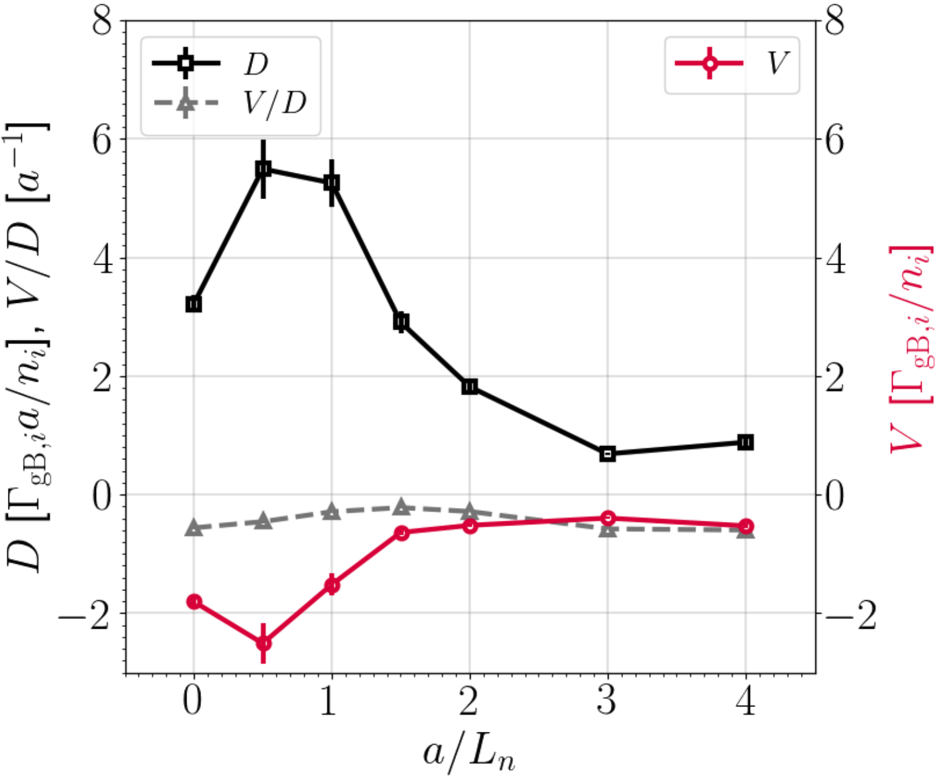
Deliverables in 2021
Deliverable ID / Short name | Key deliverable(s) | Due date
D1.1 / D-REF-CASES | 1, 3, 4 | March 2021
Agreed W7-X reference case and set of representative OP2 operation scenarios for comparisons, benchmark activities.
D1.2 / D-TURB-ZTRANSP | 3, 4 | Dec. 2021 → 2022
Study of the effect of collisions on the background turbulence and impurity transport in multispecies electrostatic flux tube simulations.
Transport coefficient of Fe¹⁶⁺ for different stellarators (left) and for W7-X with increasing electron density gradient (right) [García-Regaña JPP’21 and NF’21]

Slide 9
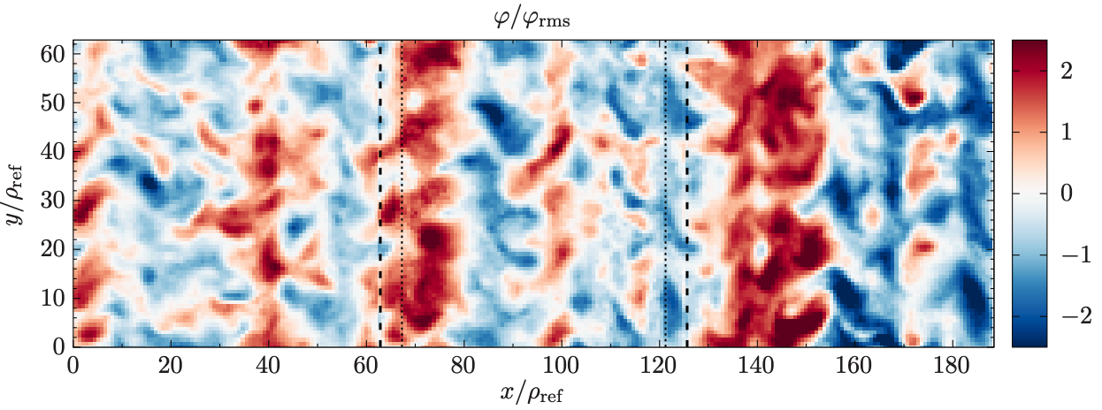
Other developments
Milestone ID | Short name | Brief description | Participants | Progress
M1.5 | M-TANGO-KNOSOS | Coupling of the code KNOSOS to the transport code TANGO, to input neoclassical fluxes apart from turbulent fluxes from GENE-3D | ABN*, JLV | 100 %
M1.6 | M-STELLA-TOK-GLOBAL | Global gyrokinetic version of stella for tokamak simulations | DSO*, MB | 100 %
M1.7 | M-STELLA-BC | Implementation of generalized T&S boundary conditions for FTs [Martin&Landreman’18] in stella.. | AGJ*, JGR | 100 %
[González-Jerez
in progress’22]
[D. St-Onge, EFTC’21 & submitted ’22]

Slide 10
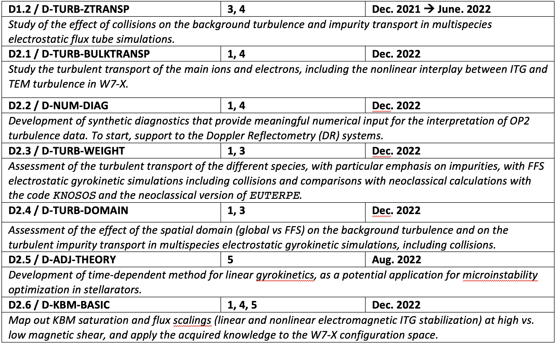
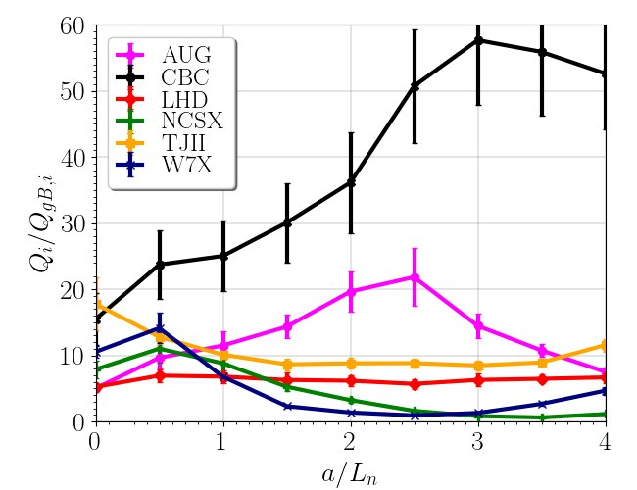
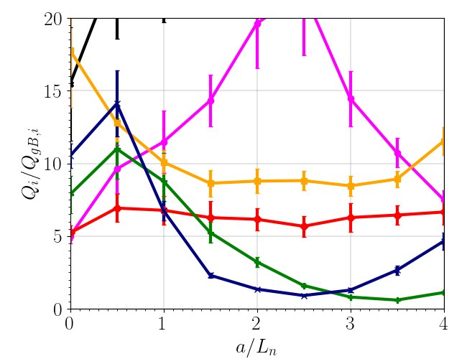
Progress along 2022 deliverables
[Thienpondt EFTC’21]

Slide 11
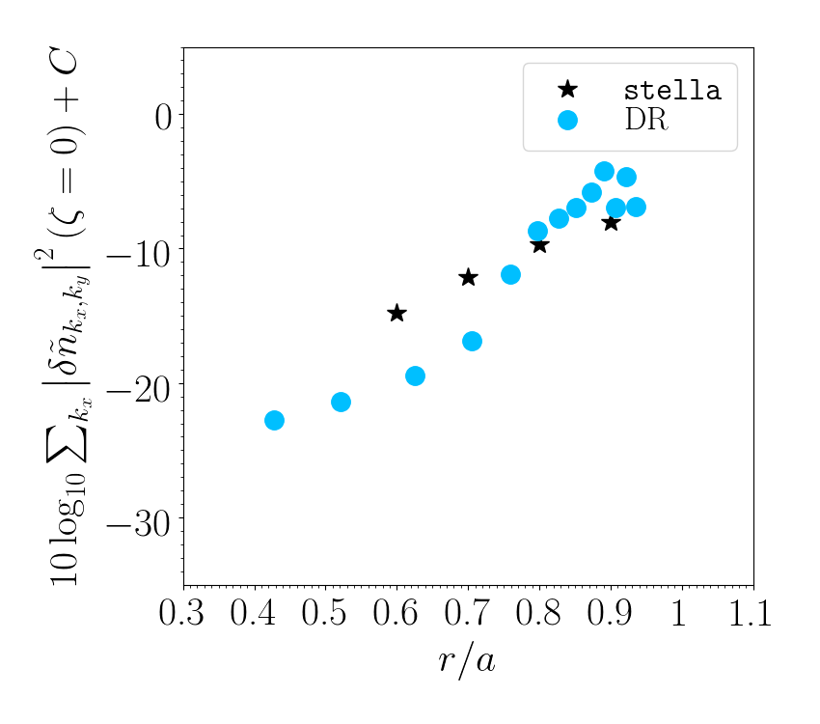
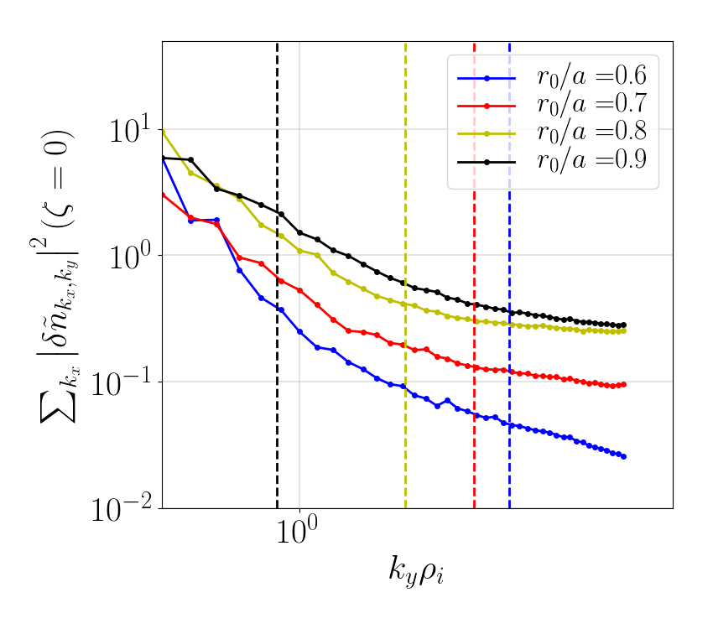
Progress along 2022 deliverables
[González-Jerez
in progress ’22]

Slide 12
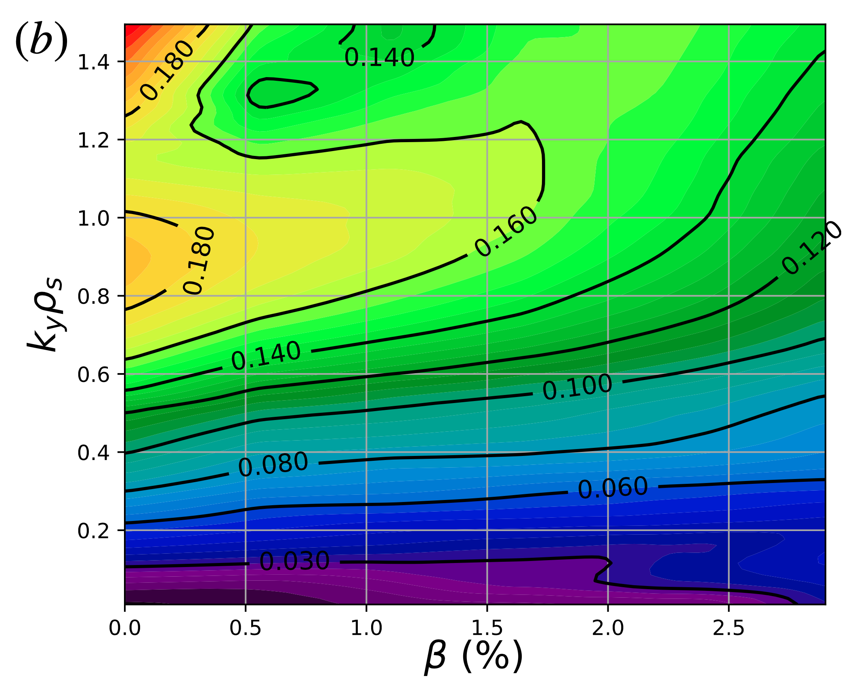
Progress along 2022 deliverables
[Mulholland in progress ’22]

Slide 13
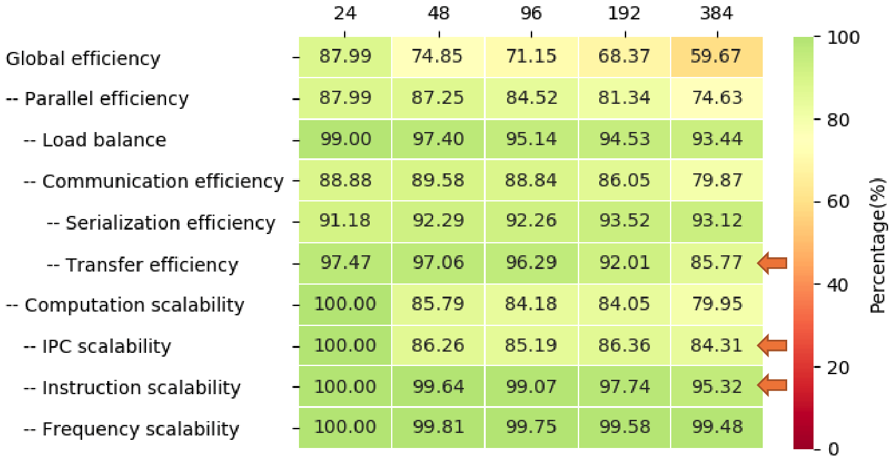
HPC and ACH support
ACH-CIEMAT support (4 PM/2021, 12 PM/2022) for stella performance assessment and optimization.
KoM meeting in July 19 and follow-up meeting in November 11.
ACH-MPG support (12 PM/2022) for improvement of the GENE-3D and EUTERPE solvers.
Activity virtually canceled due to lack of resources (responsible person, R. Lago, no longer at ACH-MPG).
ACH-VTT support (1 PM/2022) for advice on massive data transfer provided and activity close.

Slide 14
HPC and ACH support
ACH-CIEMAT support (4 PM/2021, 12 PM/2022) for stella performance assessment and optimization.
KoM meeting in July 19 and follow-up meeting in November 11.
ACH-MPG support (12 PM/2022) for improvement of the GENE-3D and EUTERPE solvers.
Activity virtually canceled due to lack of resources (responsible person, R. Lago, no longer at ACH-MPG).
ACH-VTT support (1 PM/2022) for advice on massive data transfer provided and activity close.
98.1 % of 60 M CPUhrs. spent in Marconi (+ 15 M in BSC/MN4 for EUTERPE)
New budget of 80 M CPUhrs. granted for the 6th cycle.

Slide 15
Summary
All 2021 milestones and deliverables have been completed with the exception of one deliverable.
Three extra code development pieces have been carried out in 2021 and progress along 2022 deliverables has been made.
A radially global version of stella for tokamak simulations. Tokamak simulations are regularly included in our scans and comparisons (D-TURB-BULKTRANSP).
ACH-CIEMAT support activities ongoing. ACH-MPG in search for someone who replaces R. Lago as responsable of the activities for GENE-3D and EUTERPE.
Fluent communication within the team (team meetings on a regular basis), with the WPW7X (regular presentations in the W7-X topical groups), with TSVV10 (EM EUTERPE sims.) and TSVV12 (stella-STELLOPT coupling).

