Slide 1
TSVV thrust meeting
TSVV 12: stellarator optimisation
Per Helander on behalf of the TSVV 12 team
IPP Greifswald, Germany

Slide 2
Major projects
Stellarator optimisation (ROSE, Stellopt, Simsopt)
Neoclassical code (KNOSOS)
MHD equilibrium and stability codes (GVEC, SPEC, CAS3D)
Orbit integrators (GORILLA, SIMPLE, ANTS, ASCOT, BEAM3D)
Quick assessment of ITG threshold and turbulence
  Next meeting
Edge (EMC3, Bsting)
Not just codes, but analytical support too.

Slide 3
Highlights of 2021 activities
Novel mathematical methods for characterising and optimising stellarator MHD equilibria were devised.
The optimisation capabilities of the ONSET and ROSE codes were enhanced by the addition and the extension of the MANGO meta-library of optimisation algorithms.
The development of the free-boundary extension of the GVEC MHD equilibrium code has been initiated.
Another equilibrium code, SPEC, was used to evaluate MHD stability.
Three trajectory-following codes for assessing fast-particle confinement, SIMPLE, GORILLA and ASCOT5, were developed.
The KNOSOS code for computing neoclassical transport from the bounce-averaged drift kinetic equation was extended and developed.
A novel and very rapid way has been devised for assessing the linear stability threshold of ion-temperature-gradient instabilities with the aim developing a tool that can be used within the optimisation loop for future stellarators.

Slide 4
2021 deliverables
SD1.2: The derivation of a first principles instability model will allow for running optimization codes without ad-hoc turbulence models or computationally expensive gyrokinetic codes.
  A first model was published in 2021, have now completed an extension.
SD2.2. Define and implement common interfaces for particle codes and perform cross-code validation of existing and new code parts.
  Done + in progress
SD3.1: Exploit the direct capability in SPEC to evaluate the ideal and resistive, internal and external, stability of stellarator equilibria.
  Done and published
SD4.3: Investigate if spectral condensation or a specific choice of the poloidal angle of the plasma boundary can improve stellarator optimization regarding the achieved penalty values and regarding iterations needed during the optimization.
  Done and published.
SD4.4: Investigate analytically the advantages and disadvantages of different ways of representing the magnetic field with respect to reducing the stellarator optimization space and the ease of combining coil and stellarator optimization.
  Done and published
SD5.1: Implement an interface for the type of optimizer in the optimization code ROSE such that it can use optimizers of the MANGO library. These optimizers will be then tested against each other.
  Done

Slide 5
SPEC
The Stepped-Pressure Equilibrium Code is based on a mathematical framework that blurs the traditional distinction between equilbrium and stability, and between ideal and resistive MHD.
SD3.1: Exploit the direct capability in SPEC to evaluate the ideal and resistive, internal and external, stability of stellarator equilibria (end 2021). Fully achieved
  Calculated both the linear instability threshold for tearing modes in a cylinder and the nonlinear saturation amplitude.
SD3.1: Exploit the direct capability in SPEC to evaluate the ideal and resistive, internal and external, stability of stellarator equilibria. (end 2021). Fully achieved
  Can now optimise for integrability of the magnetic field (avoid islands and chaotic regions)

Slide 6
Approach extended to a cylindrical tokamak
Saturated tearing modes obtained with SPEC
Consider cylindrical equilibria parametrized by
r
q
z
Both a shooting code and SPEC predict an
m=2, n=1 instability for q₀ > 1.
q₀
r
Exact nonlinear theory predicts w_{sat} .
[Arcis PoP 2006]
w/a
q₀

Slide 7
Approach extended to a cylindrical tokamak
Saturated tearing modes obtained with SPEC
Consider cylindrical equilibria parametrized by
r
q
z
Both a shooting code and SPEC predict an
m=2, n=1 instability for q₀ > 1.
q₀
r
Exact nonlinear theory predicts w_{sat} .
[Arcis PoP 2006]
M=6, N=3
Solved resistive MHD with the SPECYL code with S = 10⁸ (1 star ~ 1 week) .
[Capello PPCF 2004, Bonfiglio PoP 2010]
w/a
M=4, N=2
M=2, N=1
Run SPEC at fixed j_{z} to obtain w_{sat} (1 circle ~ 1min) .
Note: requires a model for the island asymmetry.
q₀

Slide 8
KNOSOS
KNOSOS is a relatively new code for neoclassical transport.
  Solves the bounce-averaged drift kinetic equation and is therefore much faster than most previous codes.
Connection with TSVV13: KNOSOS included in Tango suite, together with GENE3D GK code.
Connection with WPW7X: employed for analysss of Wendelstein 7-X experiments [Estrada (2021a) NF, (2021b) NF, Carralero (2021) NF, (2022) PPCF]:
  Ongoing: further analyses of OP1 campaign and experimental proposal for OP2.
  Goal: validation of W7-X neoclassical optimization in order to inform new neoclassical optimization strategies.

Slide 9
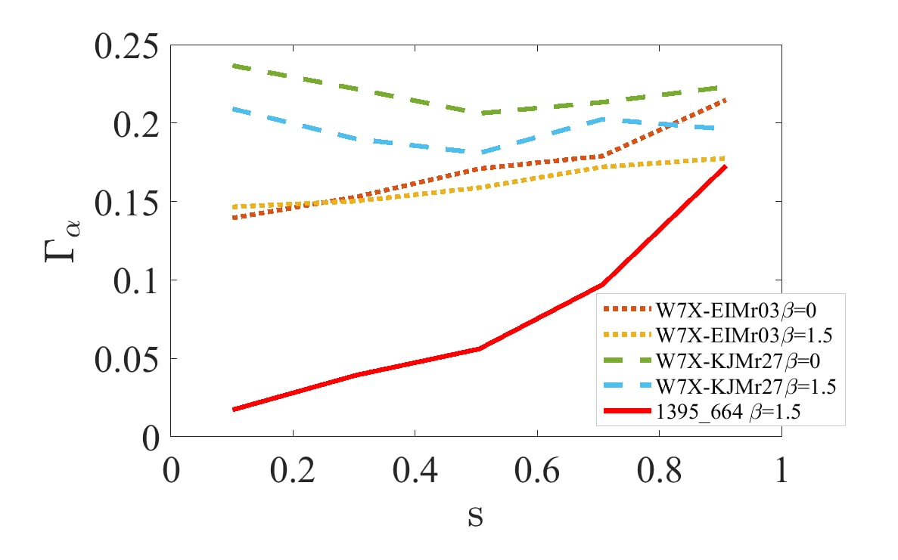
SD1.3 Integration of KNOSOS into stellarator optimization suites
Energetic ion confinement in stellarators (spin-off result):
Based on KNOSOS (bounce-averaged calculations) we have derived Γ_{α} , a figure of merit for the collisionless confinement of energetic ions [Velasco (2021b) NF].
Ongoing: development of KNOSOS-MC, bounce-averaged radially global code for the calculation of neoclassical transport of energetic ions in 3D configurations.
Applied to the experimental validation of W7-X optimization [Velasco, next ISHW].
Optimization activities at CIEMAT:
Optimization using STELLOPT, with proxy Γ_{α} among others.
Working on a helias configuration optimized for fast ion confinement [Sánchez, next ISHW].

Slide 10
SD2.1 Fast tools for bootstrap current
Goal: expand KNOSOS (able to calculate radial transport at low collisionality).
Implemented collisionless limit of bootstrap current at low collisionality.
Implemented transport in plateau and PS collisional regimes.
Ongoing: bootstrap current at low collisionality
[Escoto, next ISHW]
SD1.1 Integration of stella into stellarator optimization suites
stella [Barnes (2019) JCP]: stellarator gyrokinetic code with implicit treatment of the parallel streaming and acceleration terms ⇒ fast calculation of electrons.
Included in optimization suite STELLOPT (to be tested).

Slide 11
GVEC
For several decades, VMEC has been the standard MHD equilibrium code for stellarators.
  We are developing a new code: GVEC
Standard interface to VMEC (done)
Working towards major deliverable in 2023: Development of a free-boundary version of GVEC, via thorough theoretical analysis and numerical prototyping of both existing and new approaches for the vacuum region, addressing specifically robustness and computational cost of the coupling to the energy minimization approach for the plasma region. Have achieved the following:
  Theoretical assessment of the free-boundary problem.
  Improved convergence with accelerated gradient descent (fixed-boundary test)

Slide 12
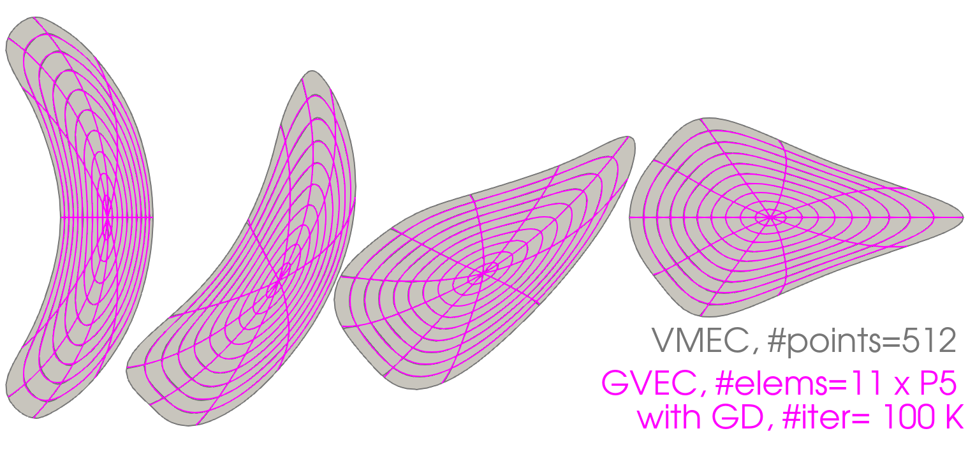
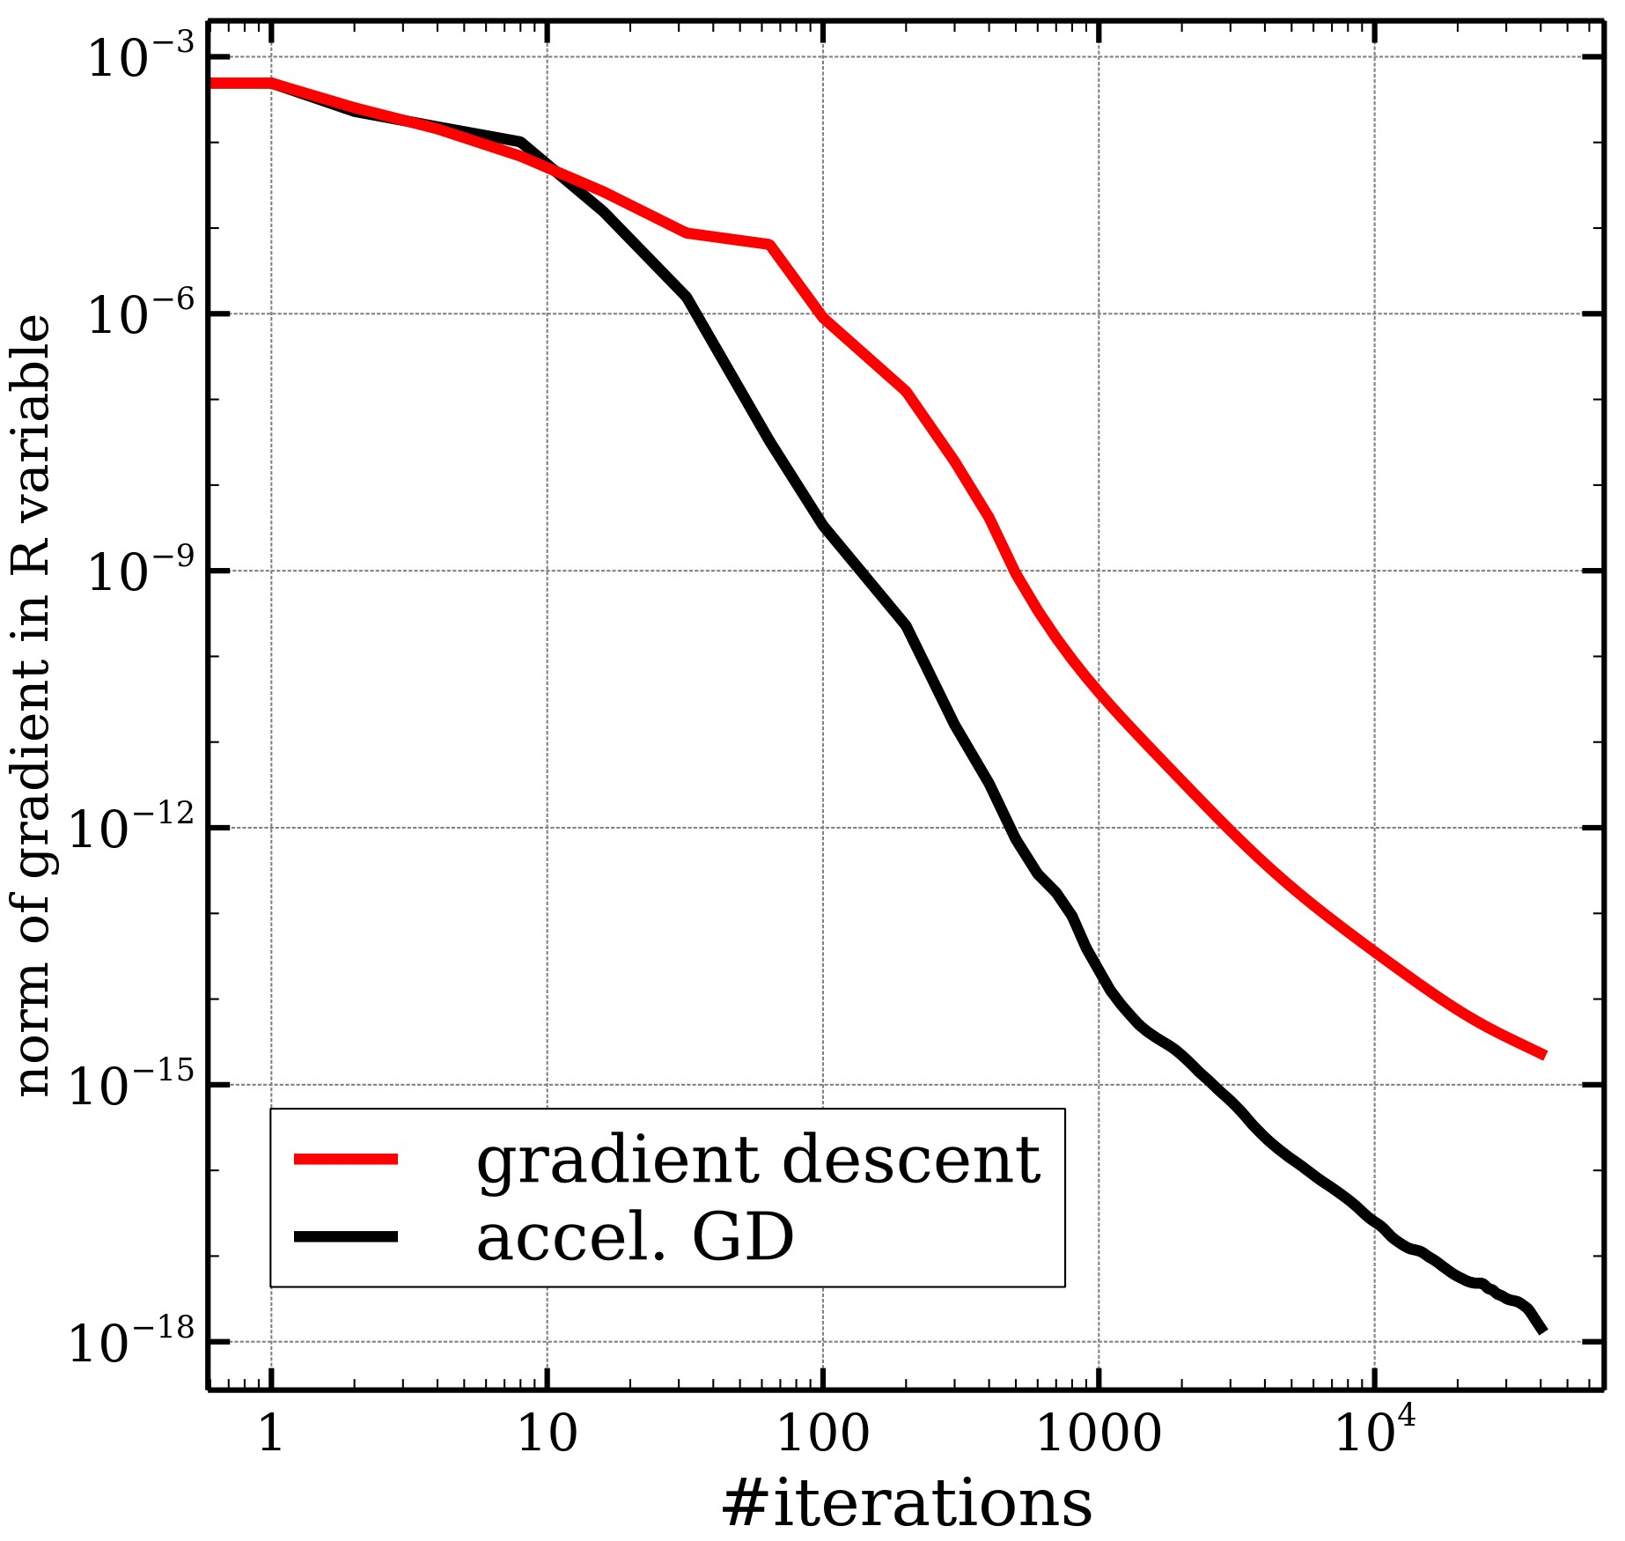
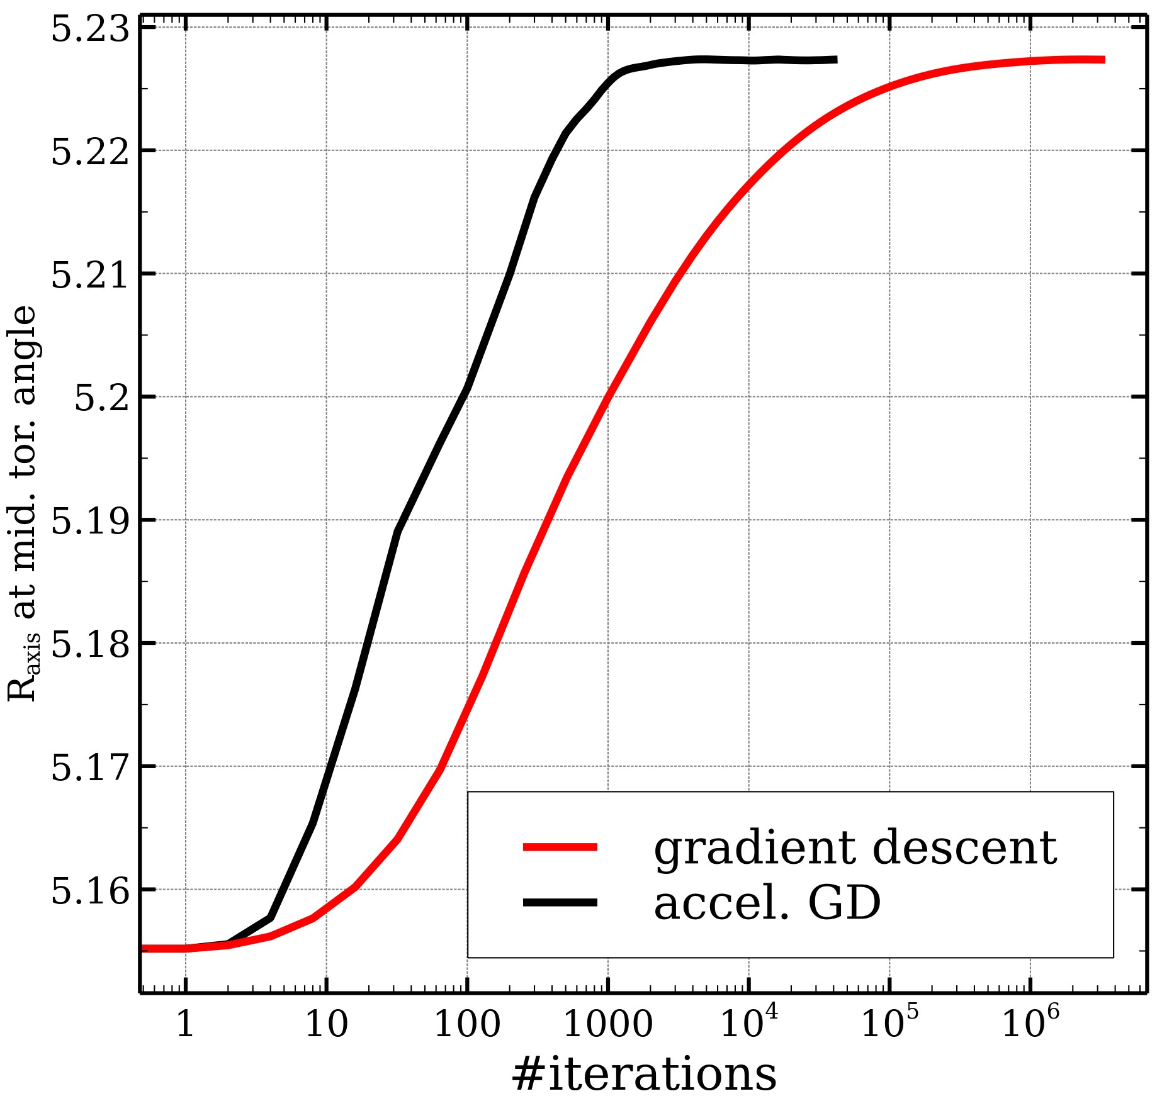
GVEC - accelerated gradient descent
Tested on W7-X fixed boundary case (compared to VMEC)
When iterating to very small force residuals, undesired solution features appear (not clear why, possibly related to missing angular constraint)
Accelerated gradient descent needs factor 10-100 less iterations to converge (forces, axis position) compared to gradient descent

Slide 13
GVEC - Theoretical assessment free-boundary
The fixed-boundary equilibrium problem amounts to the minimization of a positive-semi-definite energy the gradient descent method is used in GVEC
This formulation can be generalized to the free-boundary problem in various ways, depending on
  how the field in the vacuum region is computed (boundary integral equations, virtual casing)
  which constraints are imposed (prescribed toroidal current, rotational transform,...)
However, such generalizations do not possess a natural variational formulation and cannot be dealt with via a gradient descent method
We have re-cast these problems in the form of “generalized Nash equilibrium problems”, different algorithms exist, and could be considered in GVEC
Decision: VMEC’s free-boundary algorithm belongs to this class, start with this!
  boundary integral solver for the vacuum region (Merkel’s approach)
  Iterate between plasma energy minimization and boundary integral solution

Slide 14
Fast-particle-following codes
SD2.2. Define and implement common interfaces for particle codes and perform cross-code validation of existing and new code parts.(Interfaces defined and implemented in 2021; cross-code validation in 2022)
Investigations on guiding-center tracer GORILLA
  GORILLA: mesh-based, symplectic, coordinate-independent
  Suitable for high-performance thermal particle tracing
  Not suitable for energetic alphas in its current form. Reason: artificial diffusion (large Larmor radius)
Extensions of guiding-center tracer SIMPLE
  SIMPLE: symplectic, uses canonical flux coordinates, now also Boozer coordinates
  Faster classification methods based on parallel adiabatic invariant and recurrence
  Compatibility with ANTS and non-stellarator-symmetric VMEC equilibria
Insight into relation of phase-space structure to alpha losses
  Regions of regular orbits act as loss barriers
  May lead to development of additional fast metric for optimizers

Slide 15
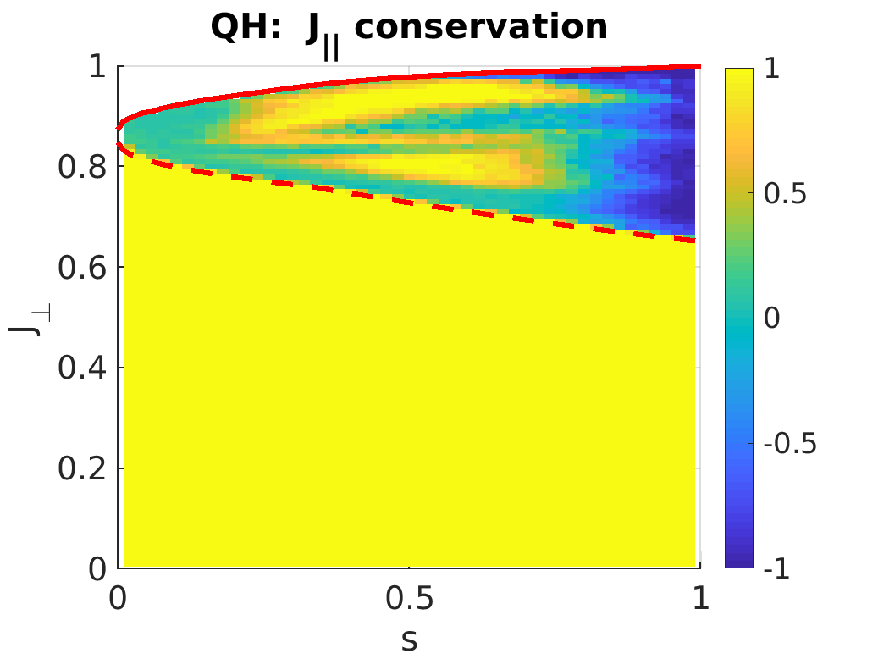
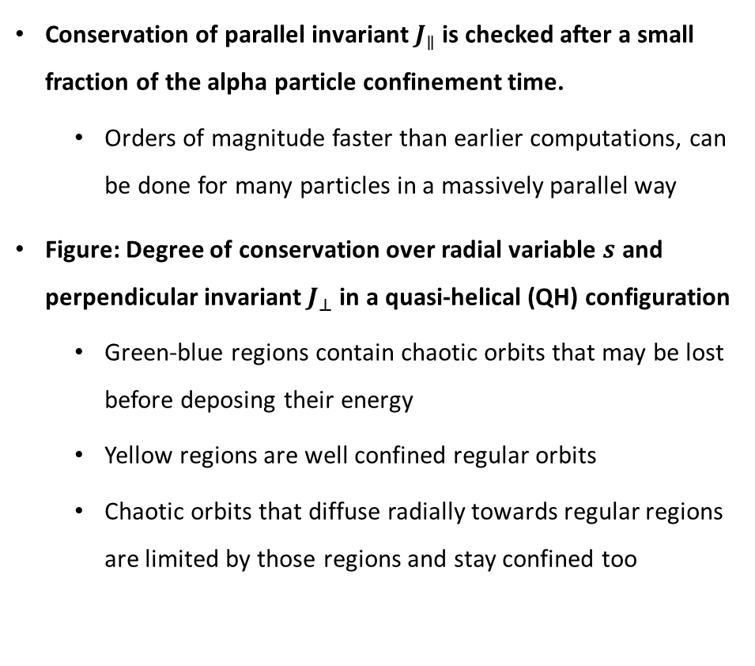
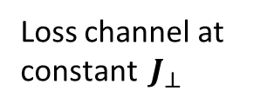
Novel fast classification for alpha confinement optimization
Conservation of parallel invariant $J_{∥}$ is checked after a small fraction of the alpha particle confinement time.
  Orders of magnitude faster than earlier computations, can be done for many particles in a massively parallel way
Figure: Degree of conservation over radial variable $s$ and perpendicular invariant $J_{⊥}$ in a quasi-helical (QH) configuration
  Green-blue regions contain chaotic orbits that may be lost before deposing their energy
  Yellow regions are well confined regular orbits
  Chaotic orbits that diffuse radially towards regular regions are limited by those regions and stay confined too
Barrier for chaotic
radial diffusion
of alpha particles
Loss channel at
constant $J_{⊥}$

Slide 16
Extra material

Slide 17
At high C, no ideal 𝛽-limit, but chaos can emerge
We can optimize the boundary for integrability
Initial
Objective: minimize Greene‘s residue for selected orbits
β ~ 2 %
Degrees of freedom: shape of conducting wall (R_{mn},Z_{mn})
~ 300 equilibria
~ 1 day wall-clock time
Optimized
SPEC was coupled to SIMSOPT, a stellarator optimization framework
[Landreman et al, JOSS, 2021]

Slide 18
At high C, no ideal 𝛽-limit, but chaos can emerge
We can optimize the coils for integrability
Initial
Objective: minimize Greene‘s residue for selected orbits
β ~ 2 %
Degrees of freedom: external fields (B_{coils}.n)_{mn}
~ 150 equilibria
~ 2 days wall-clock time
Optimized (𝛿B/B ~ 1%)
[Baillod et al, submitted to PoP]
https://arxiv.org/abs/2111.15564

Slide 19
At high C, no ideal 𝛽-limit, but chaos can emerge
We can optimize ECCD for integrability
β ~ 2 %
Initial (only bootstrap)
Objective: minimize Greene‘s residue for selected orbits
Degrees of freedom: current deposition profile {I_{𝜙}^{v}}
~ 200 equilibria
~ 1 day wall-clock time
Optimized (bootstrap + ECCD)
[Baillod et al, submitted to PoP]
https://arxiv.org/abs/2111.15564

Slide 20
Summary
SPEC retrieves ideal stability in a stellarator
[Kumar et al, PPCF 2021]
VMEC equilibrium
SPEC equilibrium
20

Slide 21
Summary
SPEC retrieves ideal stability in a stellarator
[Kumar et al, PPCF 2021]
CAS3D eigenmodes
SPEC eigenmodes
stability 𝛽-limit
21

Slide 22
GVEC - Status
SD 4.1 (Deliverable for 2023): Development of a free-boundary version of GVEC
M4.1(06/21) Standard interface to GVEC
converter to a VMEC-like netcdf output
M4.4 (06/22) MPI parallelization of fixed-boundary GVEC
Assessed MPI parallel concepts show scaling issues (small workload for >1 node)
M4.5 (06/22) Decision which methods to implement in the free-boundary prototype [...]
Decision made after theoretical assessment (next slide)
M4.6 (12/22) Integration of fixed-boundary GVEC into optimization framework
Planned, not started yet
Other:
Improved convergence with accelerated gradient descent (slide)
Add constraint of the current profile (instead of the iota profile)

Slide 23
GVEC - Status (alternative version w/o milestones)
SD 4.1 (Deliverable for 2023): Development of a free-boundary version of GVEC
Steps accomplished:
Theoretical assessment of the free-boundary problem.
Improved convergence with accelerated gradient descent (fixed-boundary test)
Standard interface: converter to VMEC-like netcdf output
Ongoing / next steps:
Assessed MPI parallel concepts show scaling issues (small workload >1 node)
Add constraint of the current profile (instead of the iota profile)
Implement first free-boundary version using Merkel’s approach
Integration of GVEC into optimization framework not started (scheduled 12/22)

