Slide 1
HydKin: brief introduction and perspectives
D. Borodin et al.

Slide 2
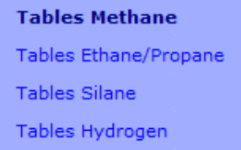
EIRENE A&M reaction data base
Atomic processes:
mostly ADAS (including bundled states, MS etc.)
Molecular processes:
Books (latex): AMJuel, HydHel, H2Vibr, Methane
➔ EIRAM web interface (eirene.de) (V.Kotov)
Table data:
CxHy (HydKin?..), N₂, NxHy, …
Accessible through HydKin
HYDKIN (eirene.de)
http://www.eirene.de/hydkin/
Closed by password for now…
One can test “pure A&M side“ decoupled from transport with high flexibility:
1D beam or constant plasma logic
Relaxation times
Sources/sinks and reservoirs are available

Slide 3
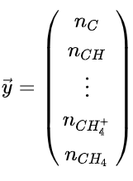
Hydkin as solver
http://www.eirene.de/U1_U4_JUEL-4229.pdf
Sources
Vector of species
Sinks
Master operator
$$\left[\frac{Part}{Vol}\right]$$
Arbitrary time, multiple timesteps
Any specie can be tracked or declared as “reservoir” with enforced density
Various output (, matrix of transitions, branching, to ERO, to EIRENE?..)
Some visualisation
Web-based interface (pearl)

Slide 4
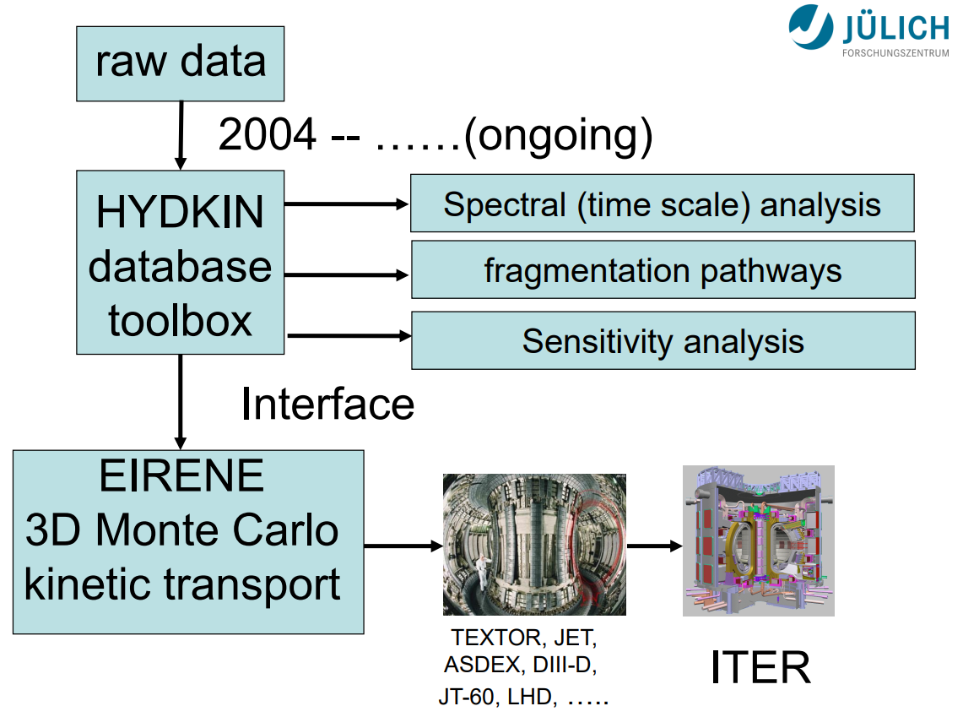
D.Reiter view on using HydKin
IAEA presentation (2013),
lectures etc.

Slide 5
B.Küppers – work plan
Incorporate H₂ Daten in HydKin
➔ (at first Mal AMJuel, H2Vibr other „old“ FZJ data)
Determine default cases (with checkboxes like by the HxCy family)
a) H₂ (most trivial case),
b1, b2) H₂ resolved by vibration levels (7 und 14 Levels, c)
include MAR/MAD
Provide scalings for H₂/D₂/T₂
Physical basis should be provided by DB, FC etc
Put HydKin online (find solution for libraries issue)
Assist with EIRENE Webpages
➔ Details need to be defined…
Provide automatic reaction input for EIRENE from HydKin (classic + JSON)
Documentation and versioning of HydKin

Slide 6
Yacora for H in different plasma regimes
Courtesy D.Wünderlich,
IPP-Garching
Yacora is alternative CRM for the hydrogen atom (under active development):
➔ In principle a complete set of input parameters, but some are based on simple assumptions.
CMSS-2021, D.Borodin
Excitation of atomic hydrogen…
…in ionizing…
…and recombining plasmas
dissociative
recombination
dissociative
recombination
dissociative
recombination
H₂⁺
H₂⁺
H₂⁺
recombination
dissociative
recombination
recombination
dissociative
recombination
recombination
dissociative
recombination
H⁺
H₃⁺
H⁺
H₃⁺
H⁺
H₃⁺
n_{p}
n_{p}
n_{p}
H
H₂
H
H₂
H
H₂
direct
excitation
H⁻
dissociative
excitation
direct
excitation
dissociative
excitation
direct
excitation
dissociative
excitation
H⁻
H⁻
mutual
neutralization
mutual
neutralization
mutual
neutralization
[D.Wünderlich and U.Fantz,
Atoms 2016, 4(4), 26]
Attached divertor plasma
Driver region of NBI sources
Detached divertor plasma
Expansion region of NBI sources
Huge number of free parameters ⇒ Evaluation needs a lot of time and experience

Slide 7
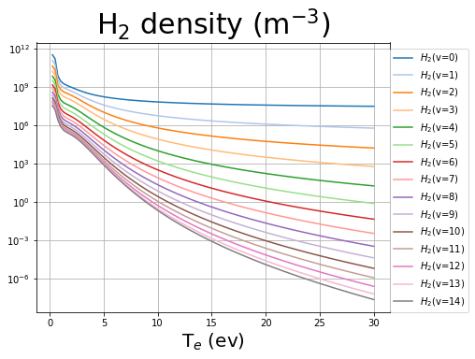
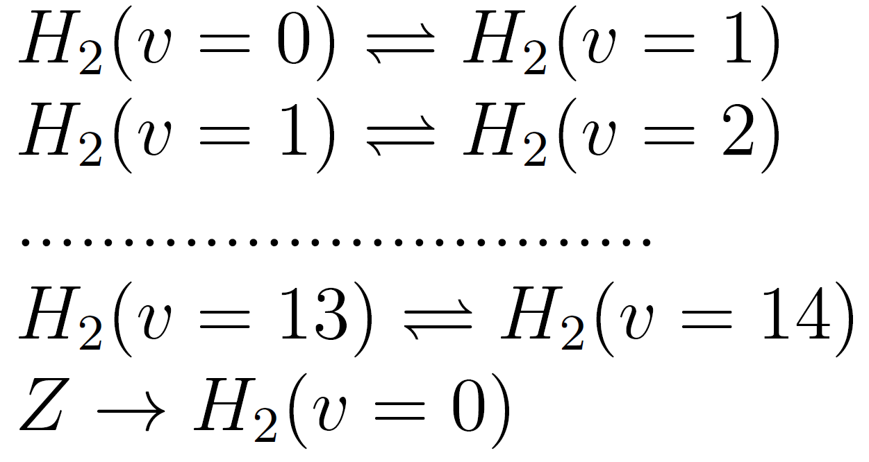
Yacora: inclusion of molecular source term
Stationary Yacora run vibrationally resolved:
At low T_{e}<10eV proton impact and vibrational transitions dominate
Particle species
Reactions
electron impact
proton impact
electron impact
vibrational transitions
H₂ source term

Slide 8
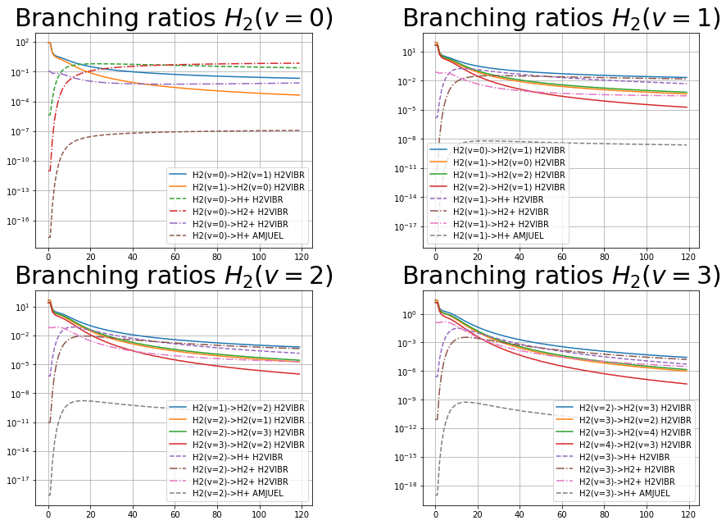
Yacora: inclusion molecular source term
Stationary Yacora run vibrationally resolved:
results
source= 10²¹ m⁻³s⁻¹
small temperature (T<5eV):
density peak
main reactions: vibrational excitation and proton impact

Slide 9
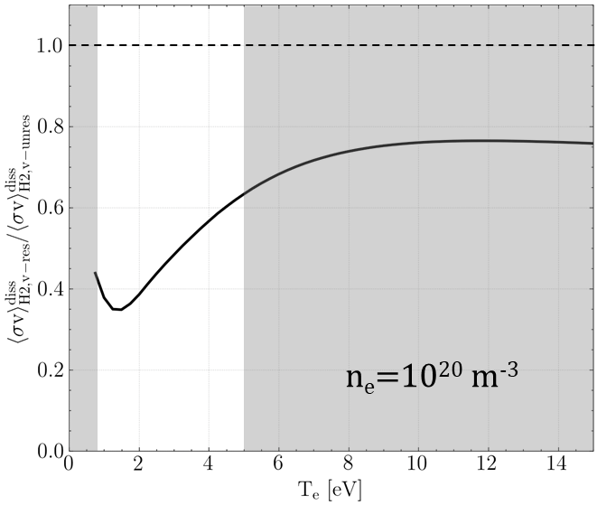
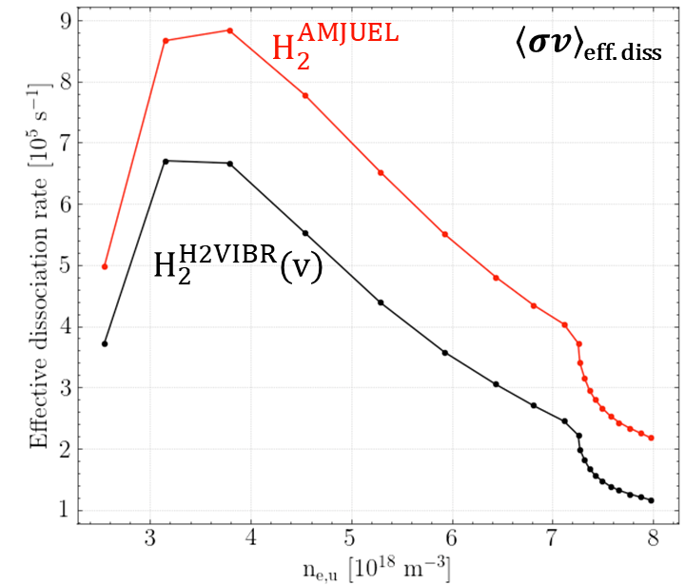
Assessment of the available A&M data bases
➔Effects cannot be directly assessed due to differences in the H2VIBR and AMJUEL rates
➔ Full scale H₂ CR model inside EIRENE?..
H2VIBR rates do not include all the CR processes considered in AMJUEL; also particular rates are different
transport-free Eirene simulations agree with YACORA
60% of reduction attributed to difference in rates → remaining difference due to transport of vibrationally excited states
Up to 40% reduction in effective dissociation rate due to transport of vibrational states
Andreas Holm,
M.Groth, et al.,
PET 2021,
CPP 2021

Slide 10
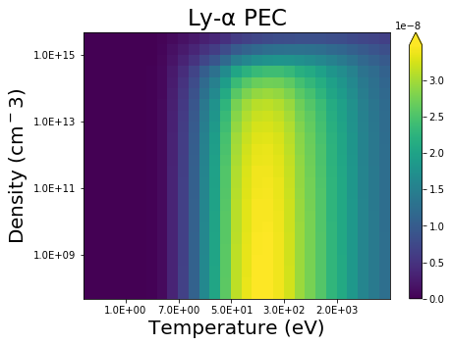
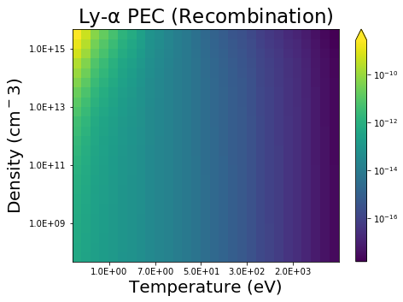
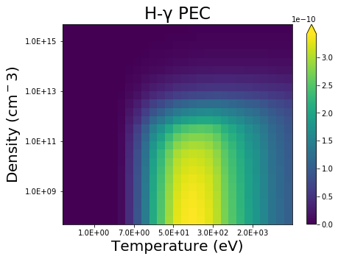
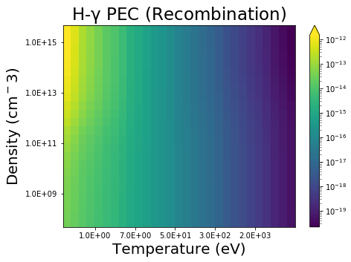
ADAS’96 data for H/D/T spectroscopy
$$I\left[\frac{ph}{{cm}^{3}∙sr∙s}\right]=\frac{1}{4π}ε$$
$$ε_{i→j}=$$
$$=n_{e}∙\sum_{σ}{{PEC }_{σ, i→j}^{excit}}∙N_{σ}^{Z}+$$
$$+ n_{e}∙\sum_{ρ}{{PEC }_{ρ, i→j}^{recomb}}∙N_{ρ}^{Z+1} \\ +{ N}_{H}∙\sum_{ρ}{{PEC }_{ρ, i→j}^{CX}}∙N_{ρ}^{Z+1}$$
$$σ,ρ −MS in ions Z and Z+1$$

Slide 11
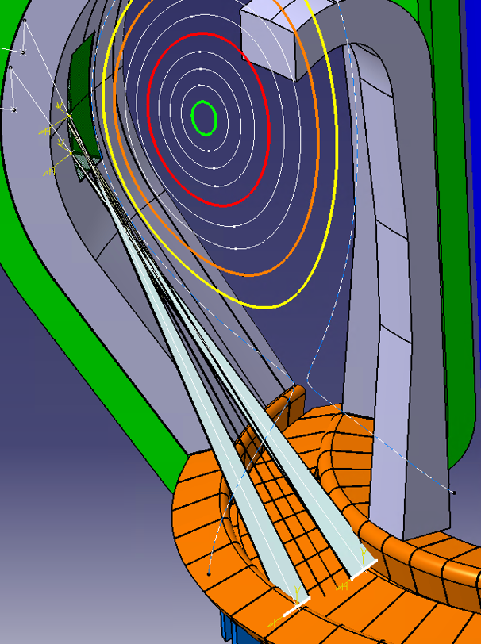
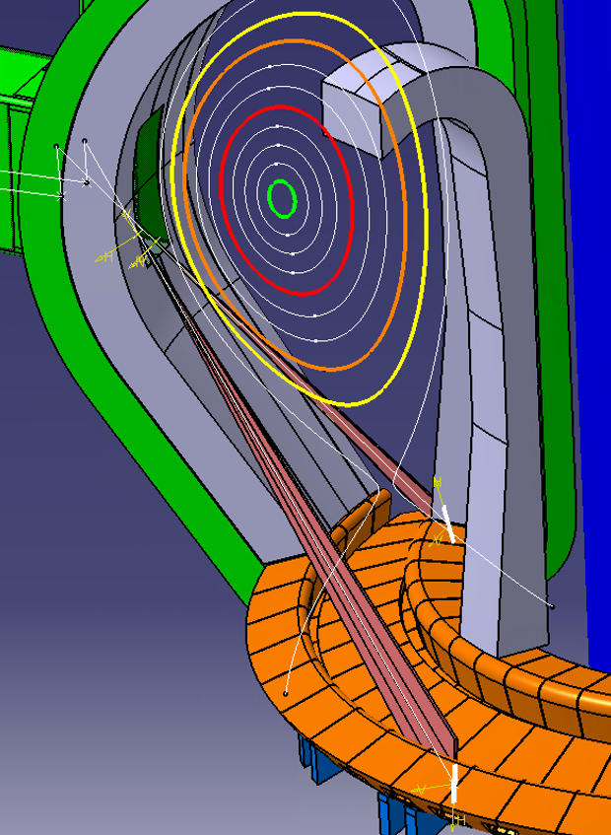
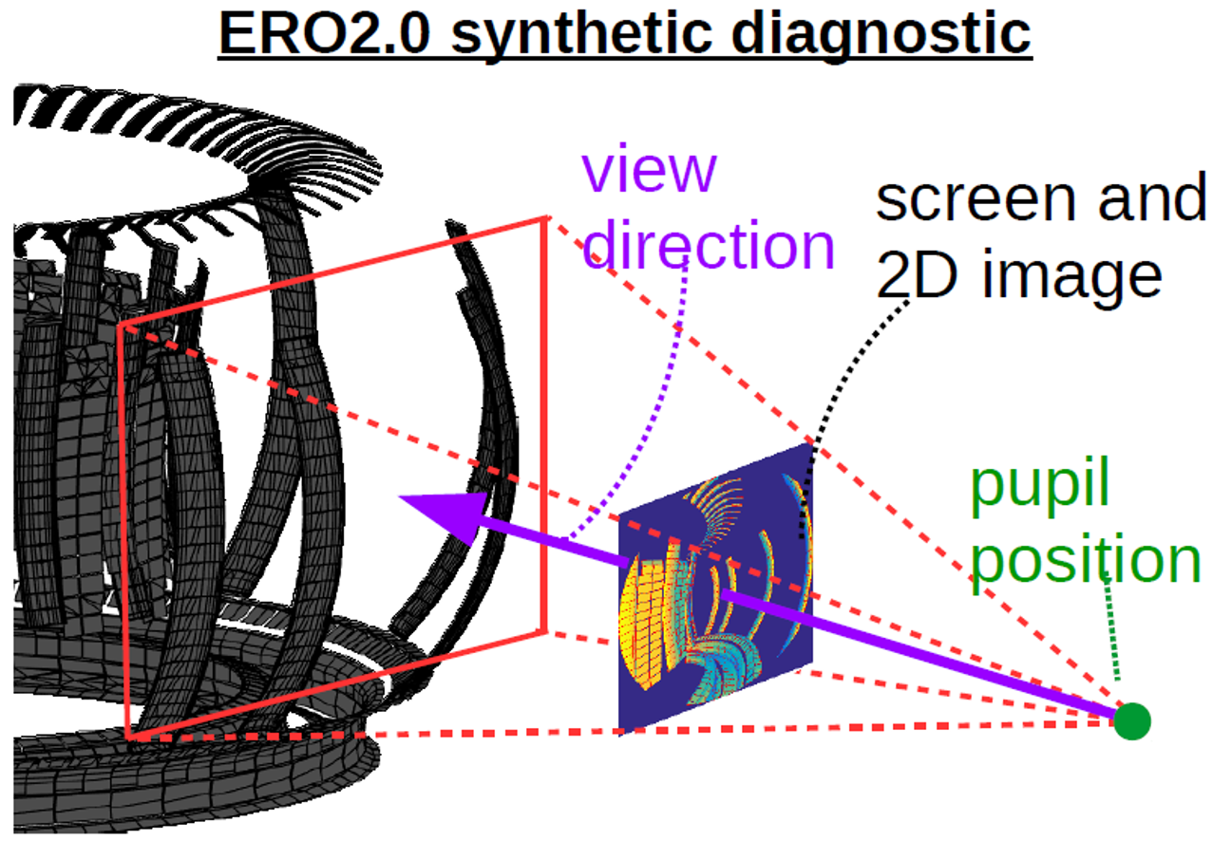
3D-integration of line intensities for 2D cameras in ERO2.0:
Improved synthetic diagnostics are necessary e.g. for DEMO
Plasma near VT
VT surface
Toroidal rotation of 2D SOLPS-ITER simulations in 3D tokamak context needed!
$$I\left[\frac{ph}{{cm}^{3}∙sr∙s}\right]$$
Brightness is conserved in geometrical optics! So, one can integrate the cells.

Slide 12
Ideas for improvement of EIRENE CRMs
Rethinking data formats
Use new ADAS “mdf” formats?..
Use YACORA formats?..
Use original CCC, RMPS etc. data
Sustain reproducibility for fitting formulae data
Go to linearly (log, spline, poly, …) tab data? ASCII or BINARY (e.g. HDF5)?
We need flexible (XML, JSON?...) master files for any data collection
Rethinking data input
We need well-readable reaction lines.
Input by vibrational and rotational states should be semi-automatic.
Transition matrix generation should be automatic.
We need back-compatibility with old EIRENE input files
Input for EIRENE and postprocessor should be the same!
Which postprocessor?..
YACORA, EIRENE (“eirene –pp”), HYDKIN (perl + web)?
We need to treat sinks and sources, particle velocity distributions (1D beam), define “reservoirs” as HydKin solver provides
We need synthetic diagnostics to validate the code/data with spectroscopy and bolometry
Probably we need to combine all options in a single CRM

Slide 13
How we can organize EIRENE-YACORA interaction?
This is just a list of possible ways to go. Obviously, the cooperation should go in mutual interest, fully voluntarily, adequate to available resources and well-fitting to plans and obligations of all sides!
YACORA can provide the data for the EIRENE main loop directly
Some development will be needed on YACORA side. FZJ should be contributing to this programming.
Partially it can be done as post processing tools (easy part to agree).
Some data critical for EIRENE may be missing in YACORA. EIRENE may need additional flexibility. If YACORA is the only/primary way of using A&M data, FZJ should be able to do such development by the own team.
YACORA provides just the data, EIRENE keeps (rather develops…) its own data structure
How do we properly acknowledge YACORA effort on compilation and validation of the data?
We still need to agree on formals, wrappers etc.
We just consult with each other on the data sources, do some code-code validation etc.
I would wish a stronger cooperation!..
We can take a good example and start over with it including understanding missing functionality on both sides
We use external platforms and experinece
ADAS EU „mdf“ files, IAEA GNAMPP, D.Tskhakaya (IPP CR), BIT1/BIT2 codes.

Slide 14
Thanks for the attention!
➔ 2 more slides on CXN...

Slide 15
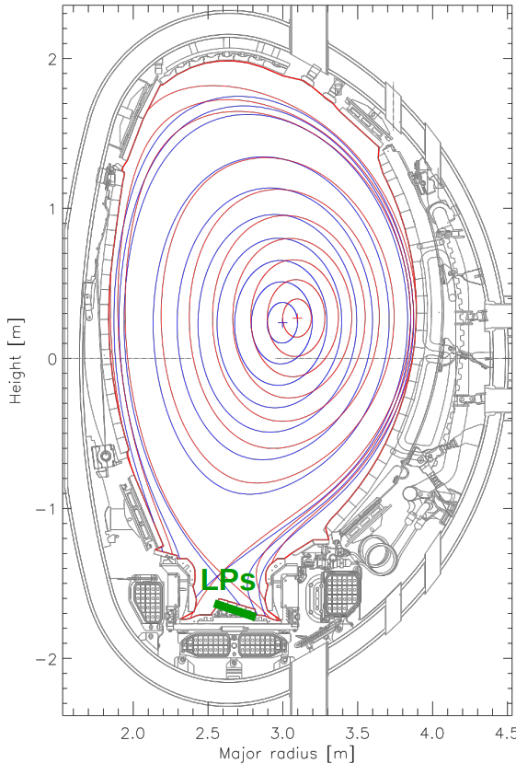
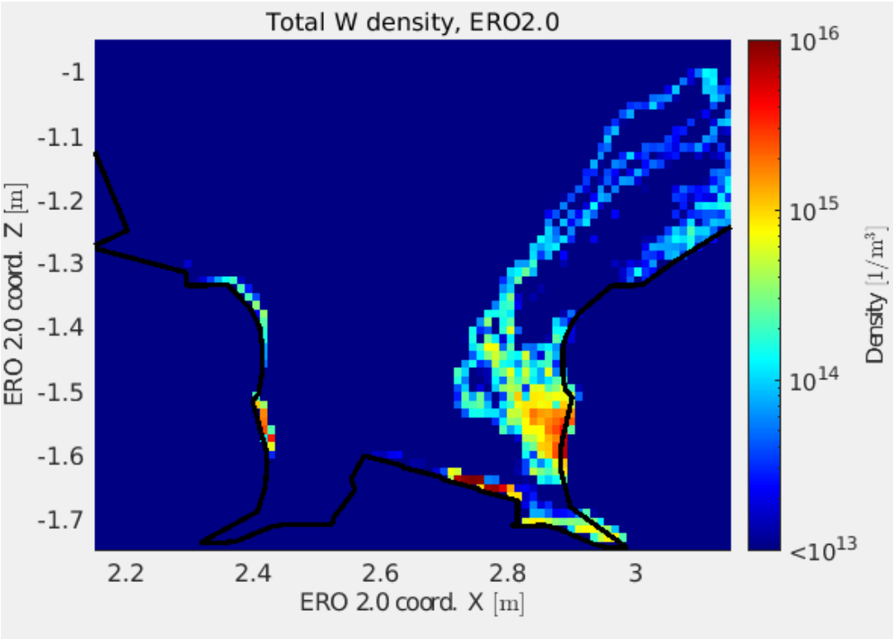
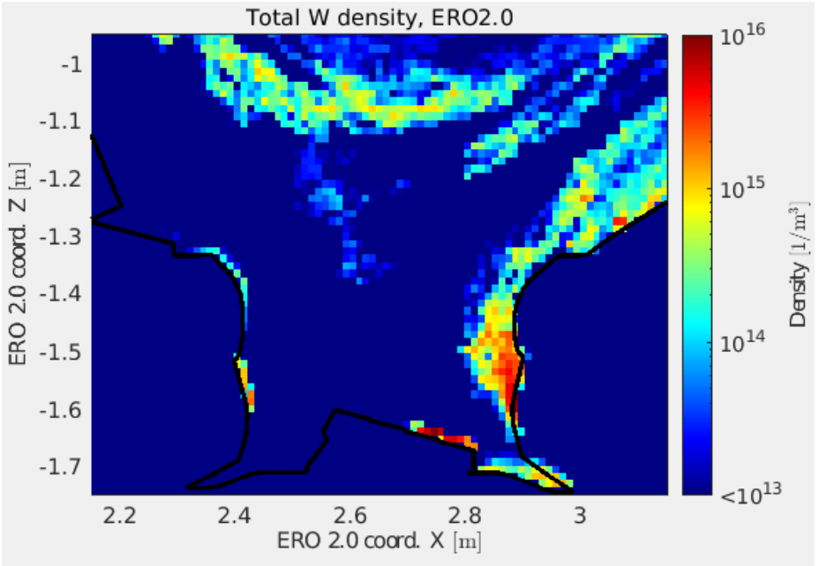
CXN in EIRENE: W erosion in JET divertor
“M18-18”
Diagnostic optimised scenario “M18-18”
Fusion performance scenario “M18-02”
“M18-02”
CXN
CXN
CXN
CXN
CXN
CXN
H.Kumpulainen, M.Groth, et al., PFMC-2021, NME paper in press
CXN flux routinely extractable from EIRENE simulations (just post processing of the output).
Use and importance of the CXN fluxes by ERO2.0 demonstrated for both Be and W erosion in JET-ILW and ITER.
CX reactions take considerable fraction of EIRENE performance, however FKH and parallelization allows large speed-up for simulations at ITER and DEMO scale.

Slide 16
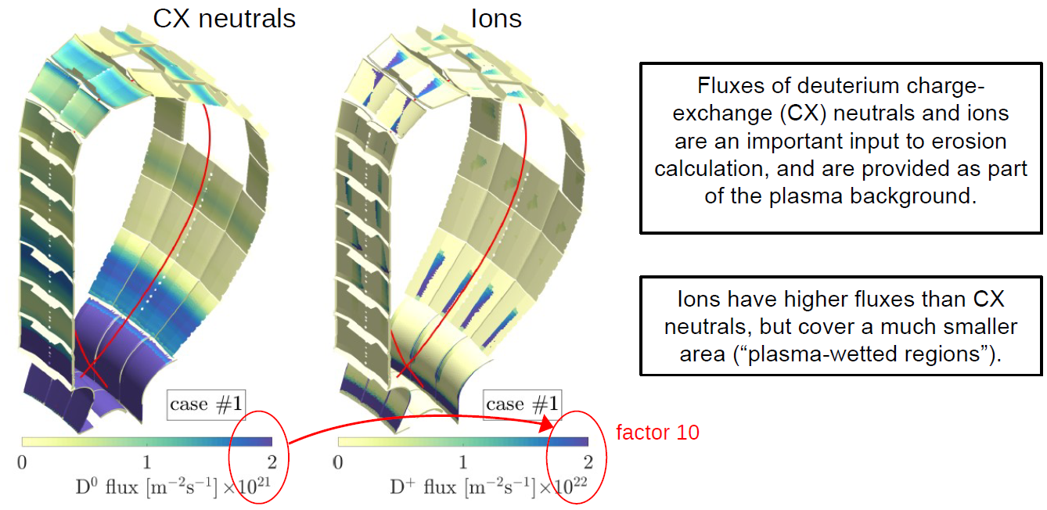
CXN and direct plasma impact fluxes in ITER
SOLPS+OEDGE ➔ ERO2.0
Be self-sputtering is also of importance!
Courtesy J.Romazanov,
DPG-2021, NF-2022 paper

Slide 17
Thanks for the attention!

