Slide 1
Available neutral gas systems
T. Kremeyer¹, D. Boeyaert², CP. Dhard¹, M. Jakubowski¹, D. Naujoks¹, F. Reimold¹, T. Romba¹, O. Schmitz², S. Sereda², V. Winters¹
¹Max Planck Inst. for Plasma Physics, 17491 Greifswald, Germany
²University of Wisconsin - Madison, Madison, WI 53706, USA

Slide 2
Fueling
Gas injection Pellets NBI
Divertor gas system HFS vs LFS with blower gun Link to TG Fast ion
Main gas system (HFS) OP2.1 steady state only LFS
MPM gas system (LFS)
Gas puff imaging (LFS)
ICRH gas system (LFS)

Slide 3
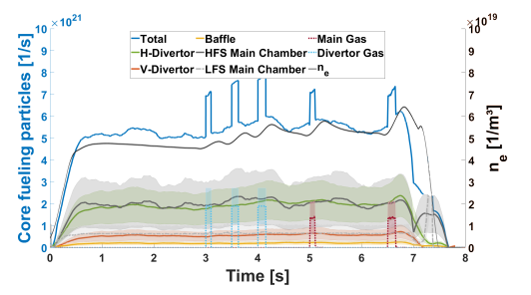
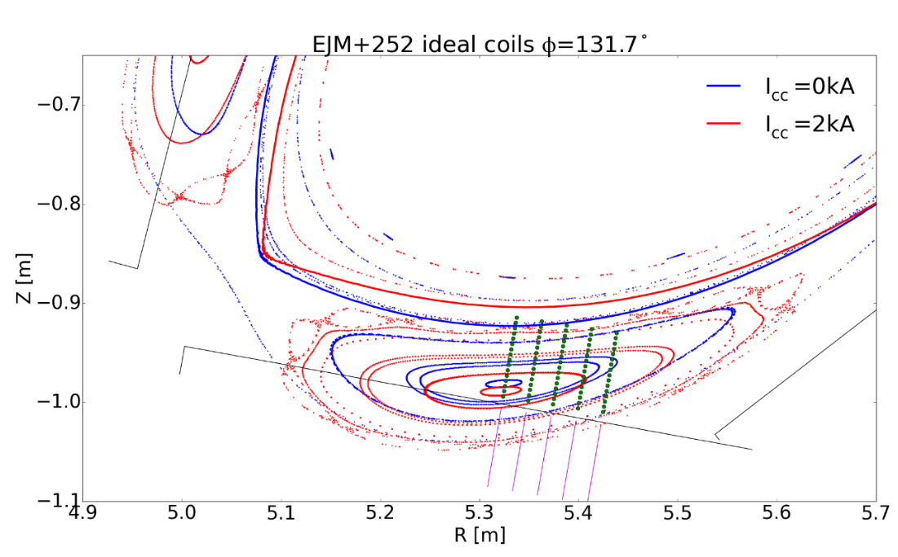
Gas Fueling – OP1.2
Main Gas System - 5 AEZ ports (each module) + AEO30
H, He, N, Ar, Ne, Diboran
H flow: max. 2.4E+22 a/s
Prefill, Nozzle far away from plasma – feedback control overreaction
Divertor Gas System - 5 Nozzles in AEH30 + AEH51
5 Nozzles in AEH30 + AEH51
Succesfull feedback control
Fueling efficiency sensitive to nozzle location
Evidence for island/edge transparency at high f_{rad}
 | Valve 5 | Valve 4 | Valve 3 | Valve 2 | Valve 1 | Main
Mean | 0.12 | 0.22 | 0.31 | 0.44 | Broken | 0.28
SD | 0.01 | 0.07 | 0.04 |  |  | 0.09
Injections | 6 | 15 | 8 | 1 |  | 7
f_{rad} | 0.17-0.22 | 0.16-0.31 | 0.16-.024 | 0.2
Nozzle
5 4 3 2 1

Slide 4
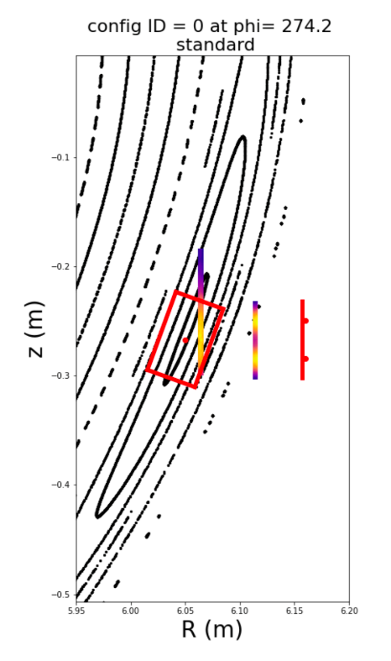
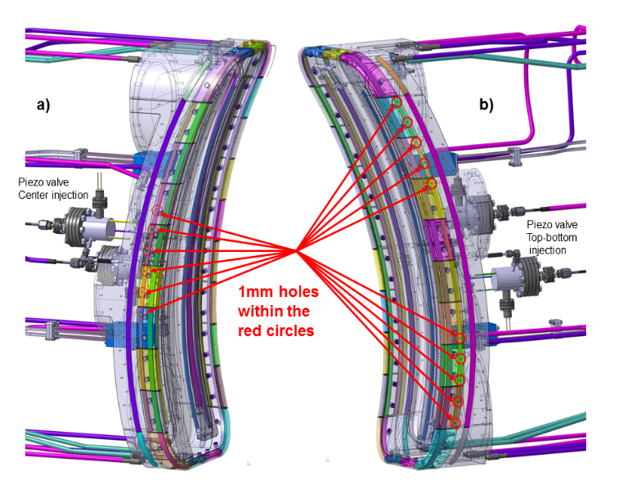
Gas Fueling – OP2.1 New hardware
Gas puff imaging
Divertor Gas System extension
H flow: 8E+19 a/s – (OP2.1 3.6E+22 a/s) – OP2.2 2.3E+23 a/s
5 Nozzles in AEH30, AEH50, AEH51. 1 Nozzle (Nozzle 3) in all other divertor modules
Feedback on: Interferometer, NGM, Divertorbolometer, W_{Dia,} Targettemperature
MPM with piezo head
H flow: ~3 E+20 a/s
Fast piezo valve with FZJ-GAS2 head from AEK40
Variable distance to LCFS, 1 Gas type a day
Gas puff imaging
H flow: 2E+20 a/s – 6.E+20 a/s, supersonic (~Mach 1.1)
H and He from AEK50
Collimated, but no sharp puffs (~2E+20 atoms leak after valve closing)
ICRH gas system
H flow: 2.9E+18 – 2.4E+20 a/s
H, D, He from AEE31
10 Hz with minimum pulse of 10 ms on and 90 ms off

Slide 5
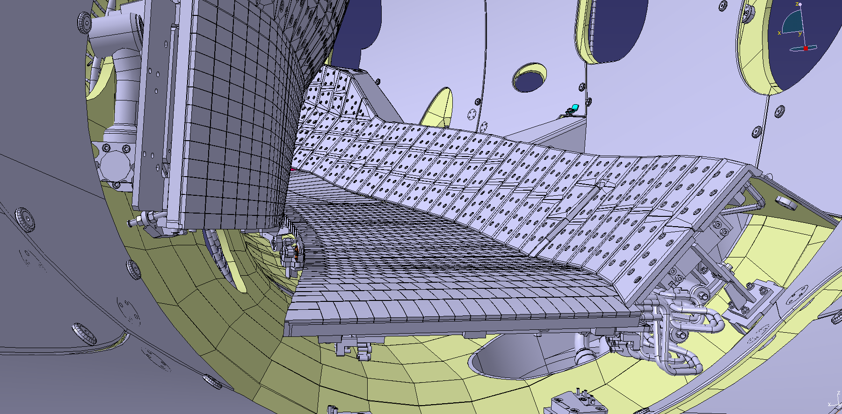
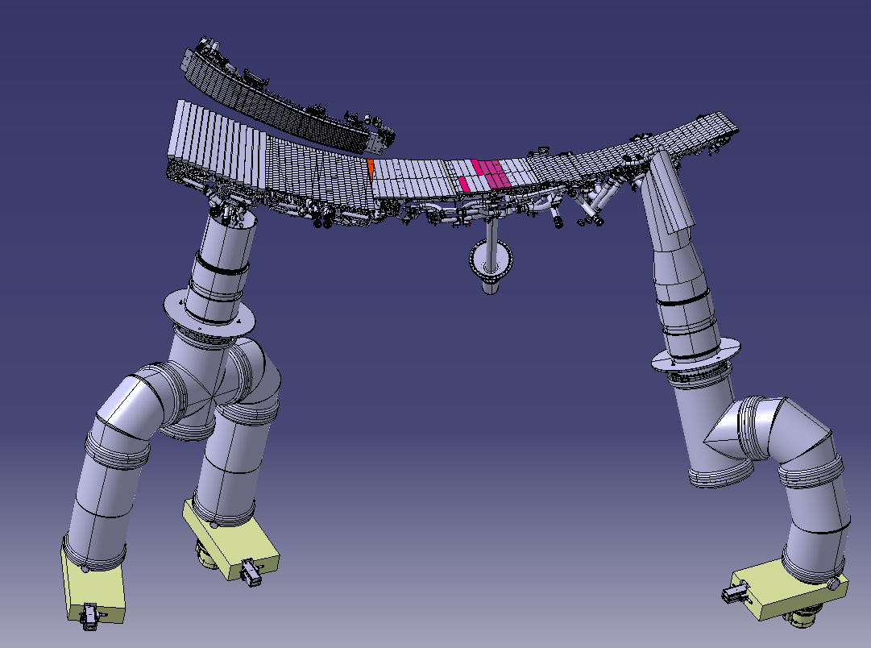
Particle exhaust by turbo molecular pumps
sub-divertor space
was separated
$Γ_{Pumped}=S_{eff}×p_{n}$
$p_{n}×S_{TMP}=Γ_{Pumped}$
$Γ_{Ion target}$ (99%)
$Γ_{Wall}$ (±0.8%)
$Γ_{Recycling}$
$$Γ_{Pumpgap}$$
$Γ_{Pumped}$
$$Γ_{Leakage}$$
$$Γ_{Recycling}$$
$=5.20×{10}^{22} 1/s$
$$Γ_{Ion Target}$$
High iota
$$Γ_{Pumpgap}$$
Low iota
$$Γ_{Leakage}$$
$$Γ_{Pumped}$$
Location | Pressure [mbar] | 100% S_{TMP} [l/s] | 89% S_{TMP} [l/s] | $Γ$ 100% [a/s] | $Γ$ 89% [a/s]
Low iota | 1.82 E-4 ± 5.4 E-5 | 2120.6 | 1887.3 | 1.88 E+19 | 1.67 E+19
High iota | 9.26 E-5 ± 3.9 E-6 | 1224.1 | 1089.4 | 5.51 E+18 | 4.90 E+18
Total 10 modules |  |  |  | 2.43 E+20 0.5 % $Γ_{Recy}$ | 2.16 E+20 0.4 % $Γ_{Recy}$
Pumping
distribution
77 % Low iota
23 % High iota
(0.4%)
Notes:
Now that the wall behavior is covered, lets take a closer look at the divertor
In this CAD model the front baffle was removed to allow a look inside.
Ion are intercepted by horizontal and vertical target
Most particles recycle, some neutrals move through the pump gap into sub-divertor region
From there they can leak back through the pump gap, or through small gaps into MC
Or pumped by our TMPs. Sub divertor was seperated, pumped with 2 pumps in low iota, and one in high.
Pumped particles are determined by the pumping speed and the neutral pressure.
Pressure gauges here and here and S_eff through conductance calculations
Pumps typically at 89%, leads to a total pumped flow of 0.4%, where 77% in low, 23% in high iota

Slide 6
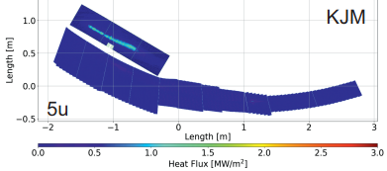
Particle Exhaust and compression in other configurations
high mirror
Exhaust is determined by divertor pressure, not by compression
Low main chamber pressure desirable to minimize main chamber erosion due to CX
[M. Jakubowski, NF 2021]
Configuration | Pump gap [mbar] | Midplane [mbar]
Low-iota | 4.2 E-5 ± 5.5 E-6 | 3.5 E-6 ± 6.5 E-7
Standard (attached) | 3.4 E-4 ± 6.0 E-5 | 3.0 E-6 ± 6.7 E-7
Standard (detached) | 7.0 E-4 ± 5.2 E-5 | 1.2 E-5 ± 1.6 E-6
High-iota | 7.7 E-4 ± 3.5 E-4 | 1.3 E-5 ± 6.9 E-6
High-mirror | 4.0 E-4 ± 5.0 E-6 | 4.7 E-6 ± 1.0 E-6
Notes:
Now that we completed the fuel cycle from neutralization to re-ionization, lets look at the other magnetic field configurations W7-X can operate under
Low iota, strike line further away
Standard, closer and vertical
High iota, strike line moves further back
High mirror with the load predominantly on the vertical target.
Exhaust only dependant on sub-divertor pressure, many neutrals in the main chamber not an issue from a naive exhaust perspective
However low main chamber pressure desirable to minimize main chamber erosion due to CX
Low iota, not many neutrals make it through the pump gap
Standard in detachment double exhaust, but cut compression in half due to 4x higher midplane
Similar to high iota, despite different strike line position
High mirror in between.
Thick SOL might shield us from strong CX and therefore we might be able to life with a lower compression as long as we have higher exhaust

Slide 7
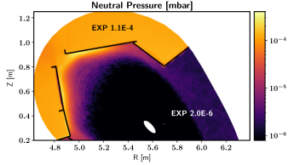
Particle Exhaust – OP2
New Hardware:
Cryo pumps
NGM on HFS midplane (AEL10)
DRGA – extended set of sensors
Different sub-divertor closure – upper and lower now connected
Ion target flow through Langmuir probes and divertor thermography
$$Γ_{Pumped}$$
$$Γ_{Ion Target}$$
$$Γ_{Pumpgap}$$
$$Γ_{Wall}$$

Slide 8
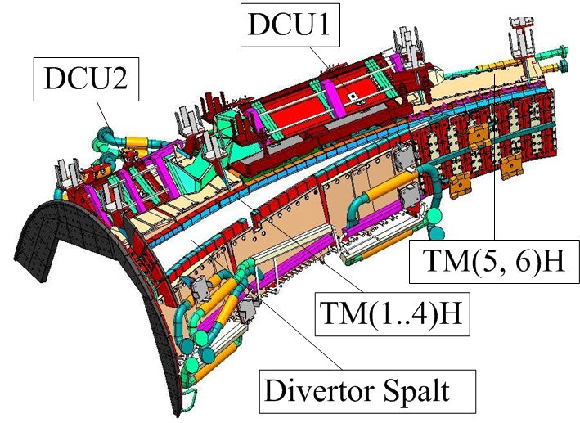
3 times more pumping with cryo pumps in OP2
New Hardware:
Cryo pumps add significant pumping speed in the sub-divertor
Optimized sub-divertor closure
Fully water-cooled first wall will reach equilibrium wall conditions easier
Pumping system | Combined sub-divertor pumping speed
Turbo molecular pumps | 33 447 l/s
Cryo vacuum pumps | 106 100 l/s
Estimated pumped particles ≈ $1×{10}^{21} 1/s$
Strong enough to balance large wall source - Wall source will be less dynamic
4 NBI sources at a total of $1.1×{10}^{21} 1/s$
[C.P. Dhard]
Notes:
In the future the exhaust will be upgraded with cryo pumps
Additionally sub-divertor gaps now 10% of pump gap
Fully cooled wall will decrease in dynamic
Cryo adds 3 times more pumping
Estimated pumped particles strong enough to compensate even a large wall source, which will be less of an issue
Almost by itself pump all 4 NBI sources, plus NBI brings its own pumps

Slide 9
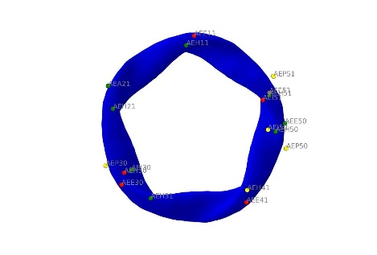
Neutral Pressure Gauges
Pressure range: 1E-7 – 1E-2 mbar
Uncertainty: ~ factor 2, pressure dependend
Location: AEI (Low iota Pumpgap), AEH (Low iota Pumpduct), AEP (High iota Pumpgap), AEE (Midplane LFS)
Additional Main vacuum system
Penning-Pirani
Capacitance manometers
At 1 Hz

Slide 10
WISP
Non-invasive
Total pressure from 1e-5 – 1e-2 mbar
2% He in H at lowest pressure
He: 667.8 nm; 706.5 nm; 728.4 nm (587.4 nm optional)
H: Hα 656.2 nm
Time resolution of 100 ms at lowest and < 1 ms at highest pressure
High light sensitivity for spectroscopy with ORNL Filterscopes
AEI40 and AEI41

Slide 11
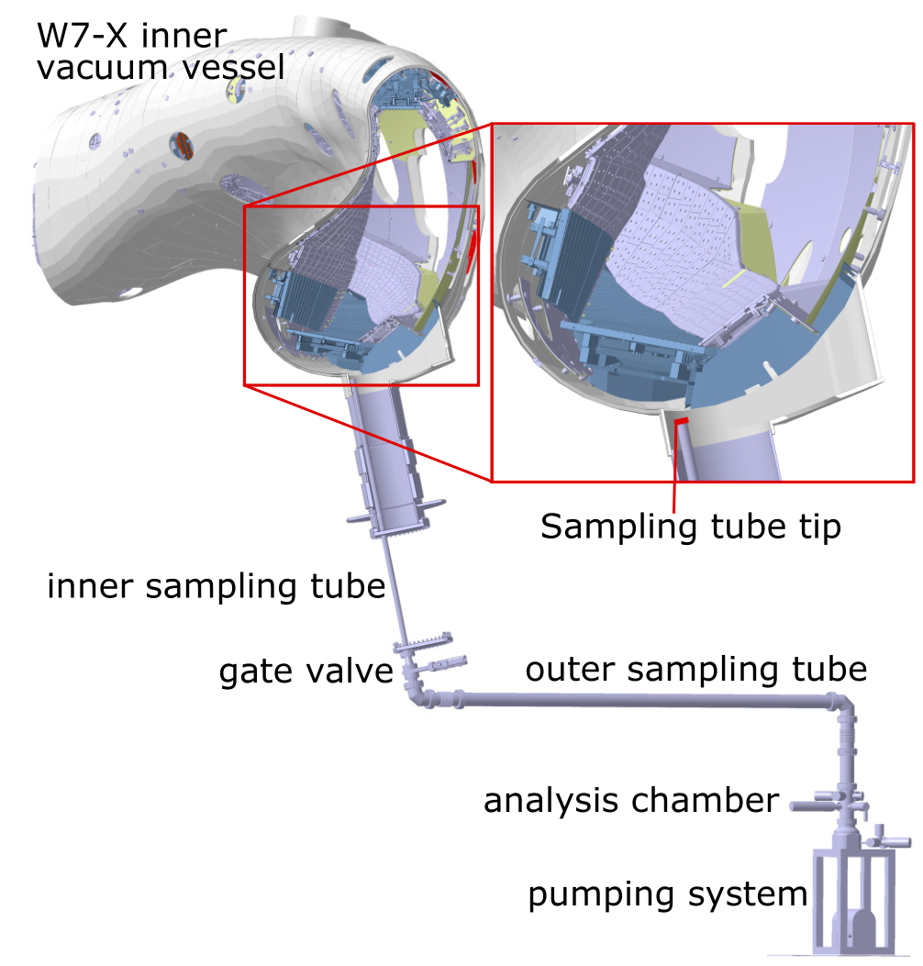
DRGA overview
Position: lower divertor module 4, low iota tail (AEH40)
Capabilities: partial pressure measurement of exhaust gas for a pre-defined set of gases
Two mass spectrometers, one fast, one sensitive
Accuracy: hard to tell currently, will be determined during absolute calibration foreseen in summer.
~1s gas transfer time to the analysis chamber
Additionally:
ADB mass spectrometer

Slide 12
Appendix
Appendix

