Slide 1
He NBI for τ_{p} measurements

Slide 2
Core gas fueling
Objectives:
Measure the core confinement time of He
  Via NBI blibs
Approach:
Inject 1E+20 particles per NBI injection (or preparatory program to find the right setting for a density increase of 5E+18)
10 injections in 10s discharge
Specific requirements:
  Diagnostics: All density measurement (TS, IEDDI, NGMs)
  He-beam
  CXRS, WISP, HEXOS, Spectroscopy
Particles [e/s]
NBI
NBI
NBI
NBI
NBI
NBI
NBI
NBI
NBI
NBI
Time [s]
Task Force(s) | II
Mag. Configurations | EJM, FTM, KJM
No. of programs | 10
Requested Parameters
Heating [MW] (ECRH) | 5 MW (ECRH)
Density (feed-back) [10¹⁹ m⁻³] | 5; 8; 11 (fb)

Slide 3
Gas injection as recycling proxy

Slide 4
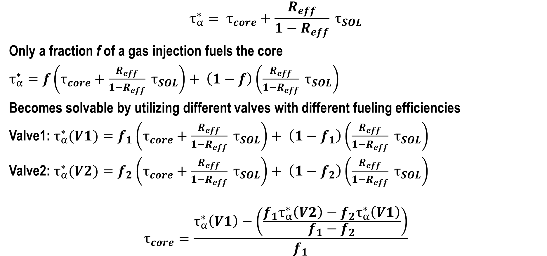
Can we get τ_{core} from gas injections?
$$τ_{α}^{∗}= τ_{core}+\frac{R_{eff}}{1−R_{eff}} τ_{SOL}$$
Only a fraction f of a gas injection fuels the core
$τ_{α}^{∗}=f\left(τ_{core}+\frac{R_{eff}}{1−R_{eff}} τ_{SOL}\right)+ \left(1−f\right)\left(\frac{R_{eff}}{1−R_{eff}} τ_{SOL}\right)$
Becomes solvable by utilizing different valves with different fueling efficiencies
Valve1: $τ_{α}^{∗}(V1)=f_{1}\left(τ_{core}+\frac{R_{eff}}{1−R_{eff}} τ_{SOL}\right)+ \left(1−f_{1}\right)\left(\frac{R_{eff}}{1−R_{eff}} τ_{SOL}\right)$
Valve2: $τ_{α}^{∗}(V2)=f_{2}\left(τ_{core}+\frac{R_{eff}}{1−R_{eff}} τ_{SOL}\right)+ \left(1−f_{2}\right)\left(\frac{R_{eff}}{1−R_{eff}} τ_{SOL}\right)$
$$τ_{core}=\frac{τ_{α}^{∗}\left(V1\right)−\left(\frac{f_{1}τ_{α}^{∗}\left(V2\right)−f_{2}τ_{α}^{∗}\left(V1\right)}{f_{1}−f_{2}}\right)}{f_{1}}$$

Slide 5
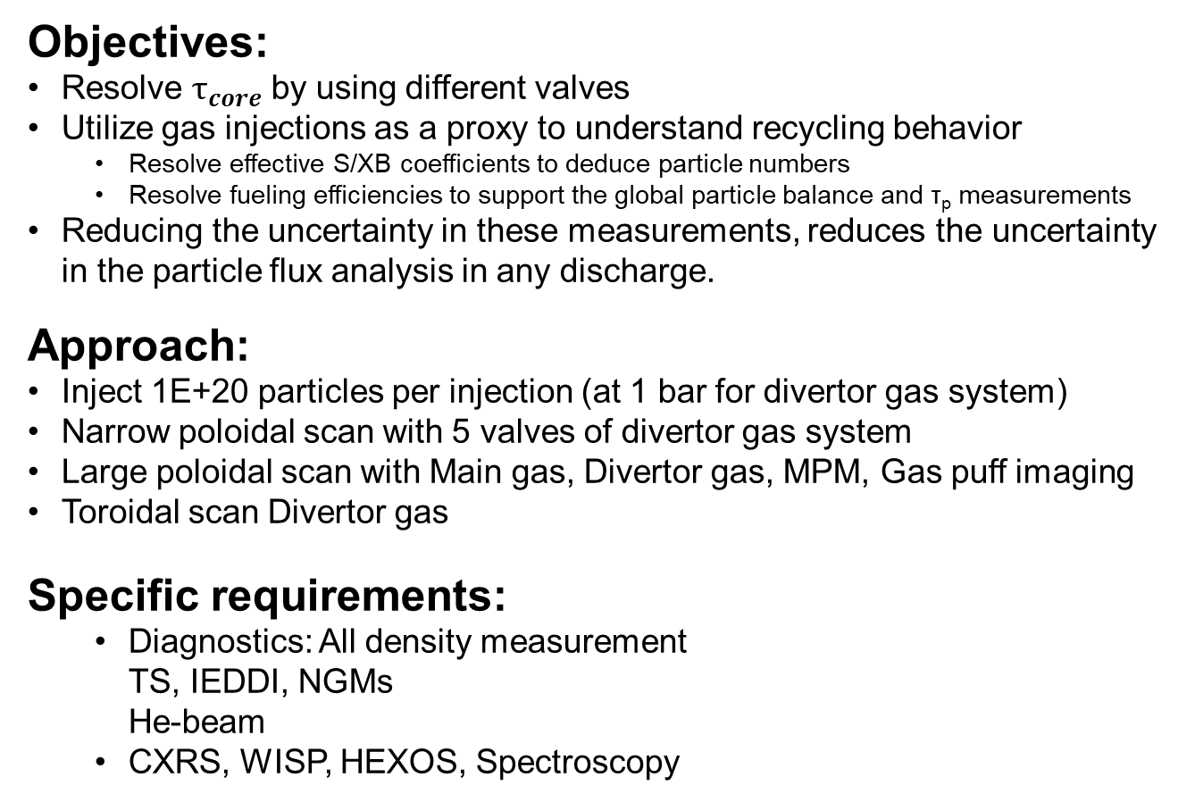
He Recycling proxy
Objectives:
Resolve $τ_{core}$ by using different valves
Utilize gas injections as a proxy to understand recycling behavior
  Resolve effective S/XB coefficients to deduce particle numbers
  Resolve fueling efficiencies to support the global particle balance and τ_{p} measurements
Reducing the uncertainty in these measurements, reduces the uncertainty in the particle flux analysis in any discharge.
Approach:
Inject 1E+20 particles per injection (at 1 bar for divertor gas system)
Narrow poloidal scan with 5 valves of divertor gas system
Large poloidal scan with Main gas, Divertor gas, MPM, Gas puff imaging
Toroidal scan Divertor gas
Specific requirements:
  Diagnostics: All density measurement
  TS, IEDDI, NGMs
  He-beam
  CXRS, WISP, HEXOS, Spectroscopy
Task Force(s) | II
Mag. Configurations | EJM, FTM, KJM
No. of programs | 9, 9, 9
Requested Parameters
Heating [MW] (ECRH) | 5 MW (ECRH)
Density (feed-back) [10¹⁹ m⁻³] | 5; 8; 11 (fb)

Slide 6
Recycling proxy
Narrow poloidal scan:
Large poloidal scan:
Toroidal scan:
  Valve 3 in all HM
Particles [e/s]
Valve 2
Valve 1
Valve 3
Valve 4
Valve 2
Valve 5
Valve 1
Valve 3
Valve 4
Valve 5
Time [s]
Particles [e/s]
Divertor
Divertor
Main gas
Main gas
MPM
MPM
Gas puff imag
Gas puff imag
Time [s]
Particles [e/s]
HM 40
HM 31
HM 41
HM 50
HM 11
HM 51
HM 10
HM 20
HM 21
HM 30
Time [s]

