Slide 1
Gas fueling hardware overview
Thierry Kremeyer¹, C.P. Dhard¹, P. Drews³, E. Flom², G. Fuchert¹, M. Jakubowski¹, M. Krychowiak¹, E. Wang¹, V. Winters¹
Email: thierry.kremeyer@ipp.mpg.de
¹Max Planck Inst. for Plasma Physics, 17491 Greifswald, Germany
²University of Wisconsin - Madison, Madison, WI 53706, USA
³Forschungszentrum Jülich GmbH, IEK–Plasmaphysik, 52425 Jülich, Germany

Slide 2
Fueling
Gas injection Pellets NBI
Divertor gas system HFS vs LFS with blower gun Link to TG Fast ion
Main gas system (HFS) OP2.1 steady state only LFS
MPM gas system (LFS)
Gas puff imaging (LFS)
ICRH gas system (LFS)

Slide 3
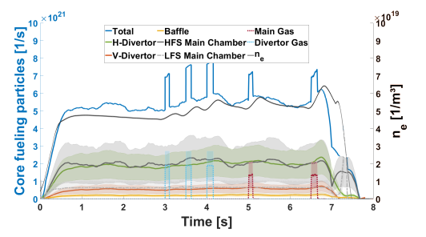
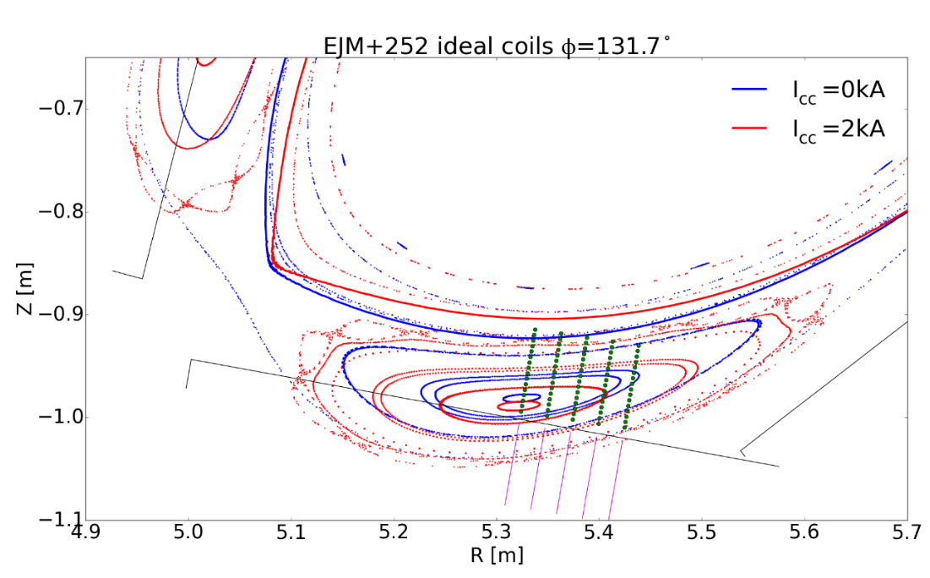
Gas Fueling – OP1.2
Main Gas System - 5 AEZ ports (each module) + AEO30
H, He, N, Ar, Ne, Diboran
H flow: max. 2.4E+22 a/s
Prefill, Nozzle far away from plasma – feedback control overreaction
Divertor Gas System - 5 Nozzles in AEH30 + AEH51
5 Nozzles in AEH30 + AEH51
Succesfull feedback control
Fueling efficiency sensitive to nozzle location
Evidence for island/edge transparency at high f_{rad}
 | Valve 5 | Valve 4 | Valve 3 | Valve 2 | Valve 1 | Main
Mean | 0.12 | 0.22 | 0.31 | 0.44 | Broken | 0.28
SD | 0.01 | 0.07 | 0.04 |  |  | 0.09
Injections | 6 | 15 | 8 | 1 |  | 7
f_{rad} | 0.17-0.22 | 0.16-0.31 | 0.16-.024 | 0.2
Nozzle
5 4 3 2 1

Slide 4
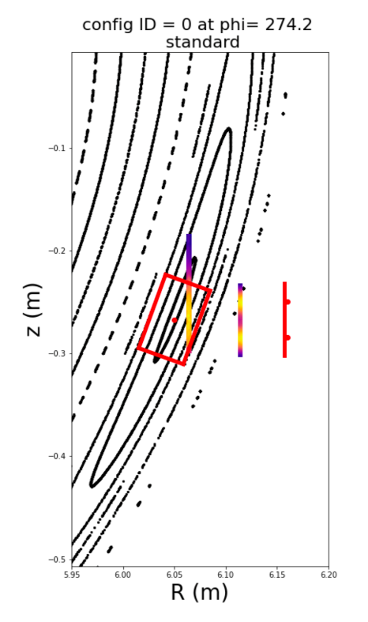
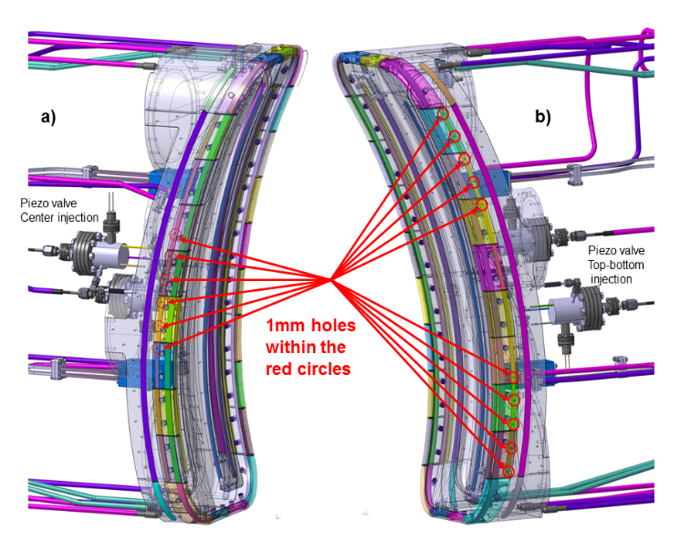
Gas Fueling – OP2.1 New hardware
Gas puff imaging
Divertor Gas System extension
H flow: 8E+19 a/s – (OP1.2 3.6E+22 a/s) – OP2.1 2.3E+23 a/s
5 Nozzles in AEH30, AEH50, AEH51. 1 Nozzle (Nozzle 3) in all other divertor modules
Feedback on: Interferometer, NGM, Divertorbolometer, W_{Dia,} Targettemperature
MPM with piezo head
H flow: ~3 E+20 a/s
Fast piezo valve with FZJ-GAS2 head from AEK40
Variable distance to LCFS, 1 Gas type a day
Gas puff imaging
H flow: 2E+20 a/s – 6.E+20 a/s, supersonic (~Mach 1.1)
H and He from AEK50
Collimated, but no sharp puffs (~2E+20 atoms leak after valve closing)
ICRH gas system (1-CCD-T0005.2)
H flow: 2.9E+18 – 2.4E+20 a/s
H, D, He from AEE31
10 Hz with minimum pulse of 10 ms on and 90 ms off

Slide 5
Gas Fueling – OP2.1 Physics
Neutral penetration
What physics dominate - Density along flight path? Accelerated by CX? Ionization in island with strong diffusion?
Fueling location (Divertor vs. HFS vs. LFS)
Island topology (I_{cc} or valve location or planar coils) Toroidal and Up/Down assymetries
Different gas flows (low and very high) - Tunneling with high fluxes?
Control Core vs SOL fueling
Ne, N, Ar – impurities
He as recycling proxy, neutral He penetration
Recycling
Gas injection as proxy for recycling neutrals
Divertor vs HFS wall vs LFS wall
Ionization source in SOL
Where do particles ionize in the SOL
Link to SOL transport

