Slide 1
Jülich, Feb. 15th, 2022
Inter fluxtube transport
Forschungszentrum Jülich GmbH, Institut für Energie- und Klimaforschung - Plasmaphysik, 52425 Jülich, Germany

Slide 2
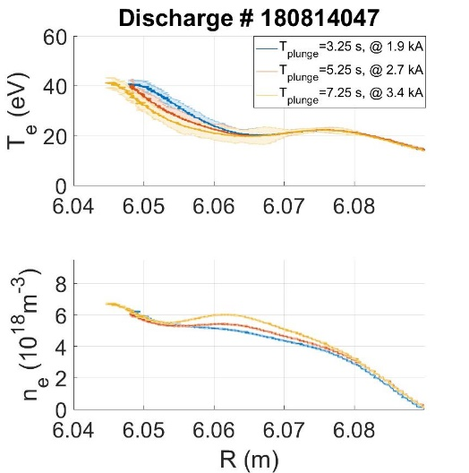
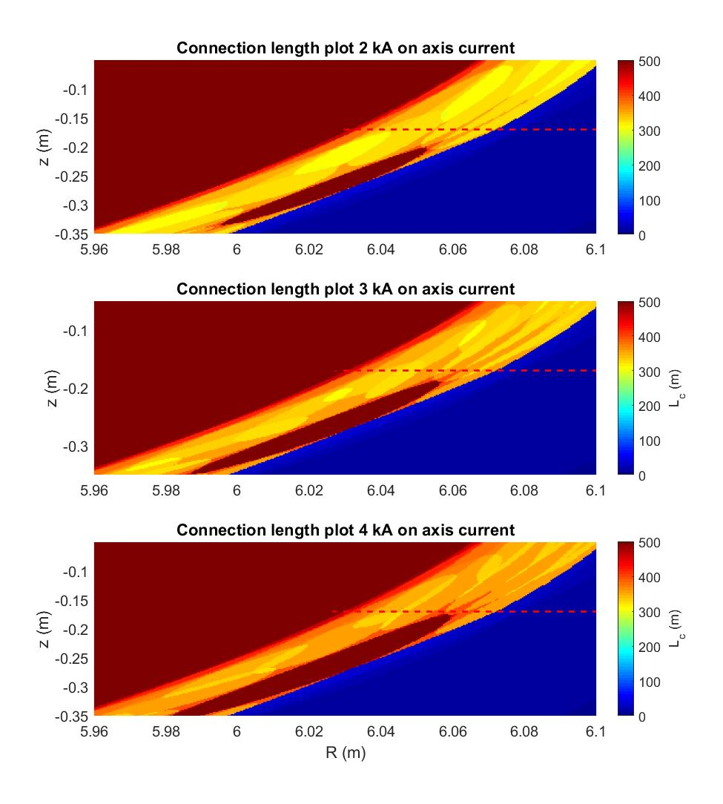
Previously in OP. 1.2b
The evolving toroidal current is modifying the edge topology by moving the island inwards
Less of the island is intersected by the divertor, which increases the overall connection length in the island region and the size of the island
In long high performance discharge we expect also discharges with a high beta
A high beta will cause stochastization of the edge
The larger more well confined edge island can possibly accumulate more impurities (given a source)
The MPM edge electron temperature and density profiles, and turbulence measurements (and possibly ion temperature profiles) with high resolution can resolve local changes

Slide 3
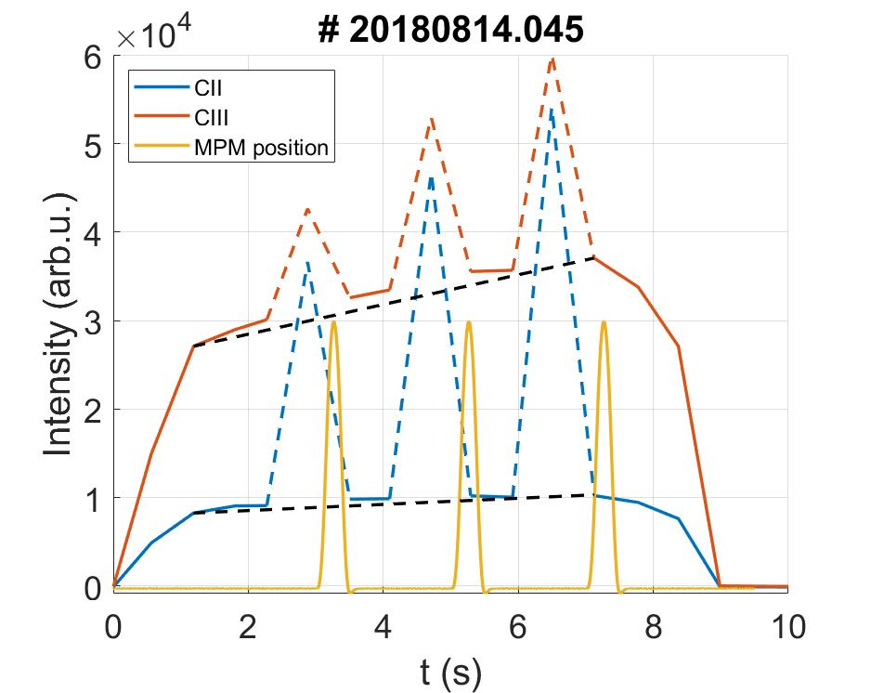
He beam effect on carbon intensity measurement with the overview spectrometer

Slide 4
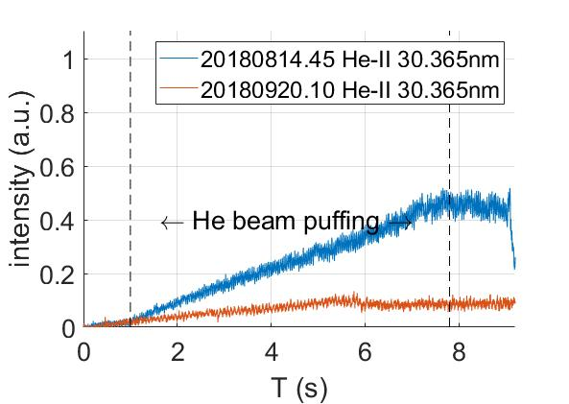
Comparison He puff/ wo He puff HEXOS

Slide 5
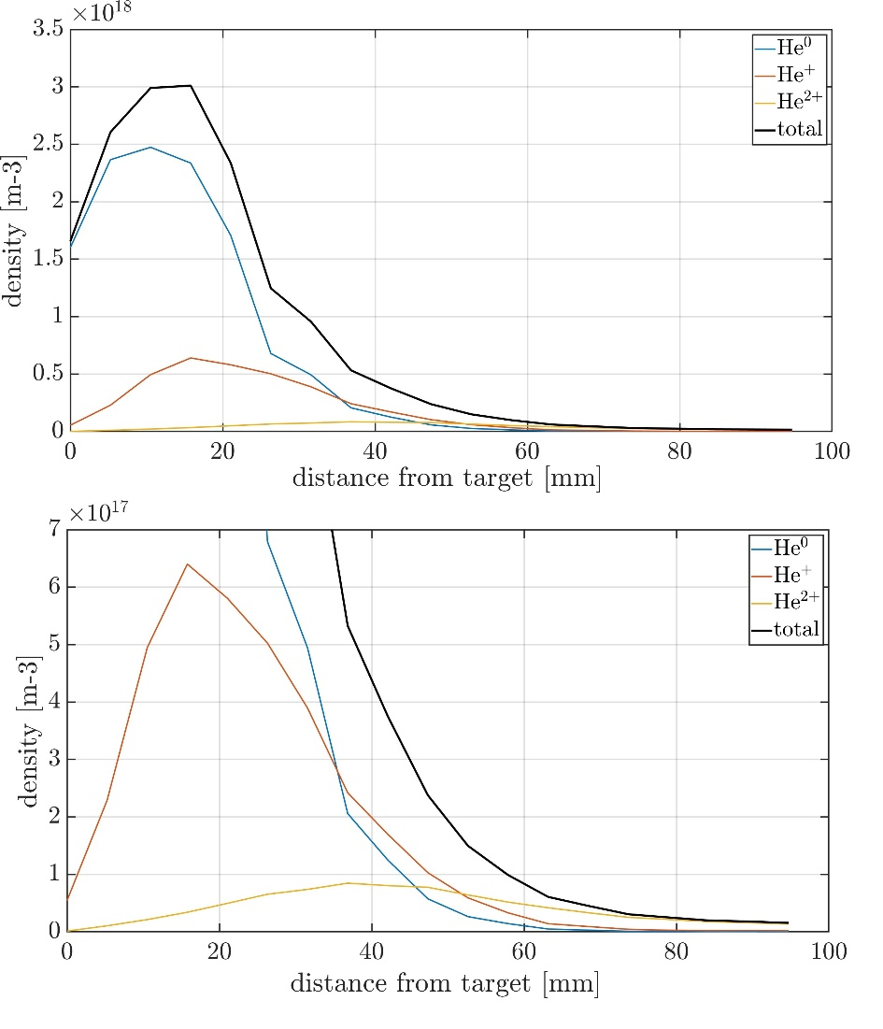
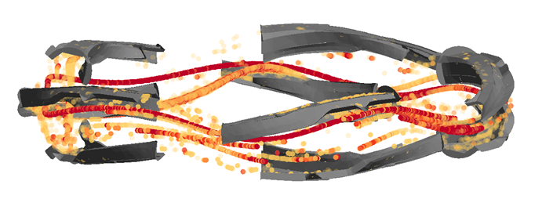
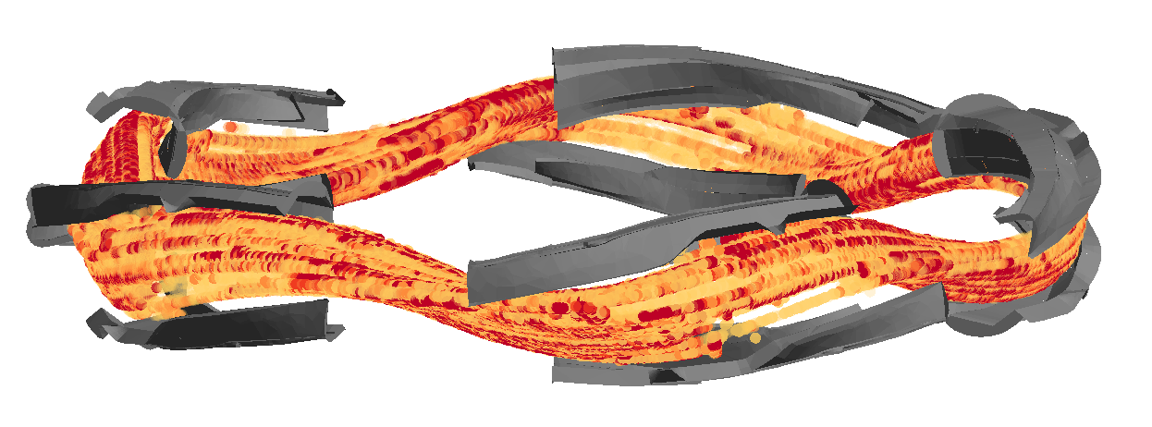
ERO 2 results
He+
He 2+

Slide 6
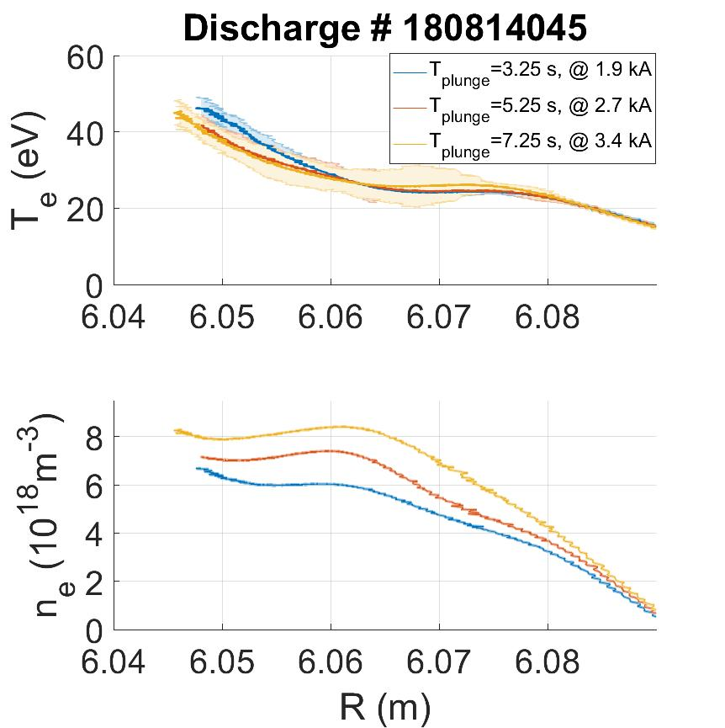
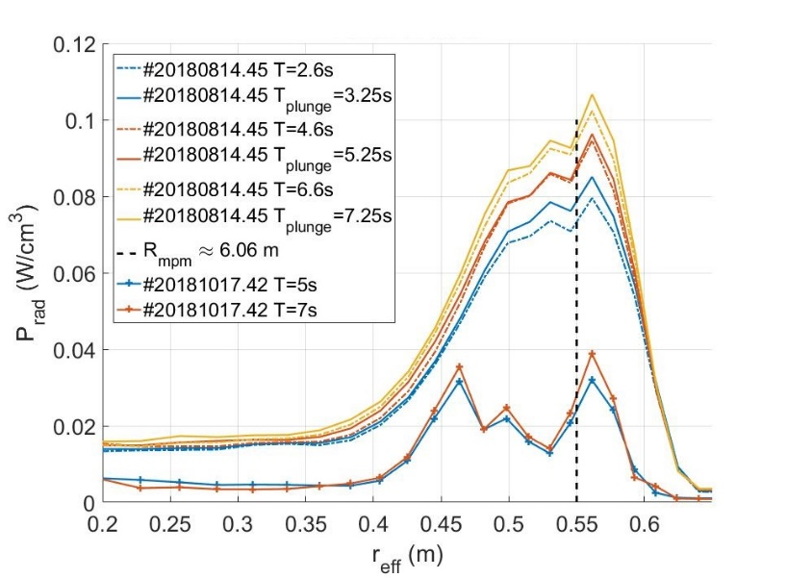
Planned proposal
Important questions:
How much can additional puffing be used to increase the confined impurities in the island?
How much does the position of the puffing affect the impurity retention and distribution
How strong is the cross-island transport? ICRH puffing port (or other divertor module ports) and MPM are not in the same flux tube
Is the cross transport different for Carbon and Helium (or other)?
Modelling support form ERO can calculated a particle balance to quantitatively understand the transport in the edge plasma

Slide 7
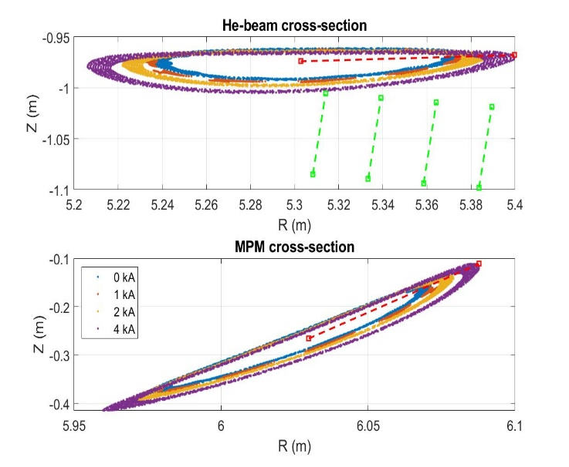
Planned proposal
ICRH port with different poloidal positions will be available
MPM puffing with different radial position is an option
Puffing from different divertor modules
ERO 2 modelling is available
Test if island peaking can be increased with more puffing (find a limit)
Test how puffing in different flux tubes affects other islands (dependence on impurity species

Slide 8
Beta effect on island transport of edge impurities
Forschungszentrum Jülich GmbH, Institut für Energie- und Klimaforschung - Plasmaphysik, 52425 Jülich, Germany

Slide 9
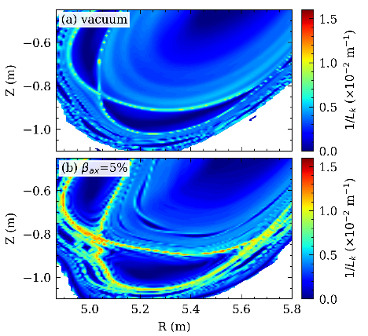
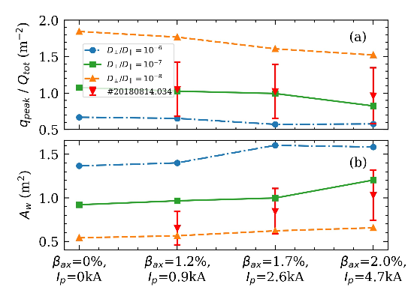
Planned proposal
Hint modelling predicts an increase of stochastization and decrease of peak heat flux
How will the increased stochastization affect the impurity transport?
If less impurities are confined, how will this influence the edge profiles and radiation?
Will the decrease of heat flux from the topology change be counteracted by decreased radiation?
Kind regards to S. Zhou for the figure from his draft for NF

Slide 10
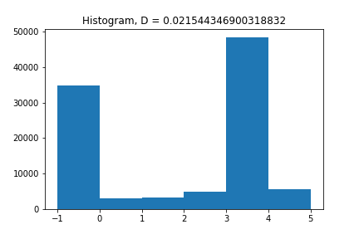
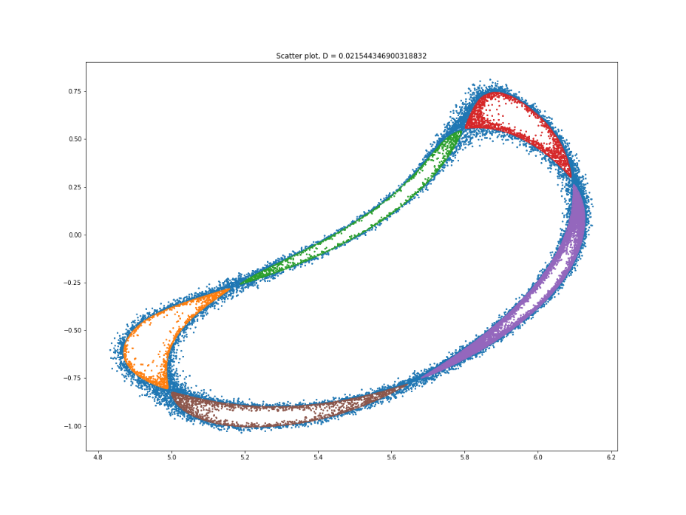
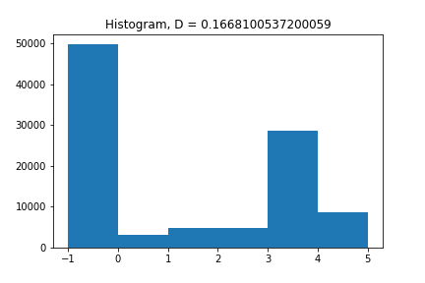
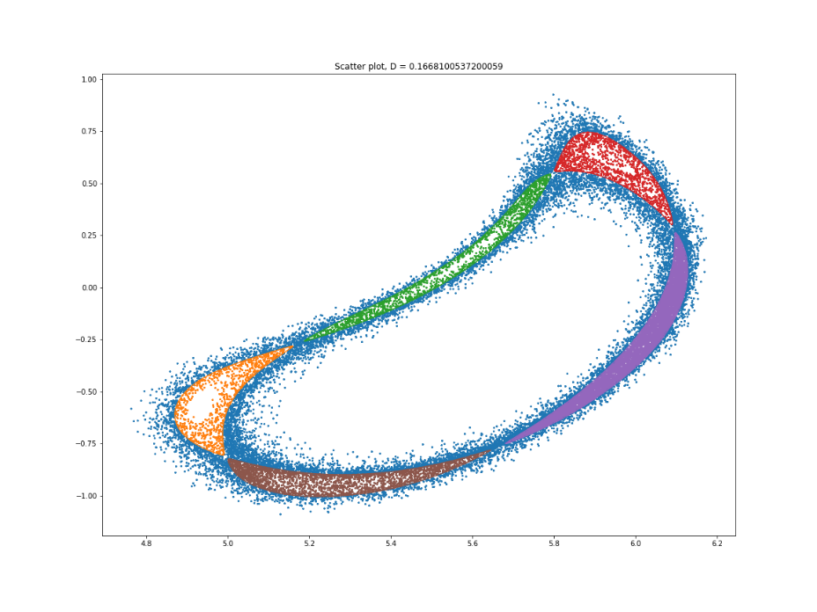
Planned proposal
Measure with the MPM in high beta discharges
Puff from the divertor gas boxes
Conduct puffing with the MPM in different positions (far scrape off layer, in the island and close to the LCFS)
Different gases like H2, He or CH4 show a very different behavior
The question is if stochastization would allow for a global distribution in the edge or reduce the retention of impurities

Slide 11
Ion to electron temperature ratio during He puffing
Forschungszentrum Jülich GmbH, Institut für Energie- und Klimaforschung - Plasmaphysik, 52425 Jülich, Germany

Slide 12
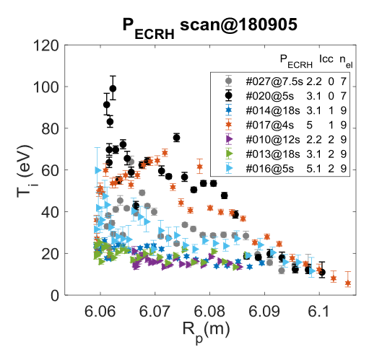
Planned proposal
Very little data basis for ion temperatures
How much are the ion temperatures modified if electron temperatures remain constant but heat flux is reduced in the case of helium puffing?
This can be done piggy back with other experiments, if thermocouple probes are used or ideally with the RFA probe

