Slide 1
S/XB quantification by puffing in OP2.X
E. Wang, T. Kremeyer, M. Krychowiak, Y. Luo, J. Liu, …

Slide 2
Proposals
1) S(D)/XB for hydrogen particles (H and H₂)
H atoms: Balmer lines
H₂ molecules: Fulcher band (600-640nm)
2) S(D)/XB for carbon erosion
C atoms: C I (909nm)
C_{X}H_{Y} molecules: CH, C₂, …
3) S/XB for Helium
H₂ puffing
CH₄ puffing
He puffing

Slide 3
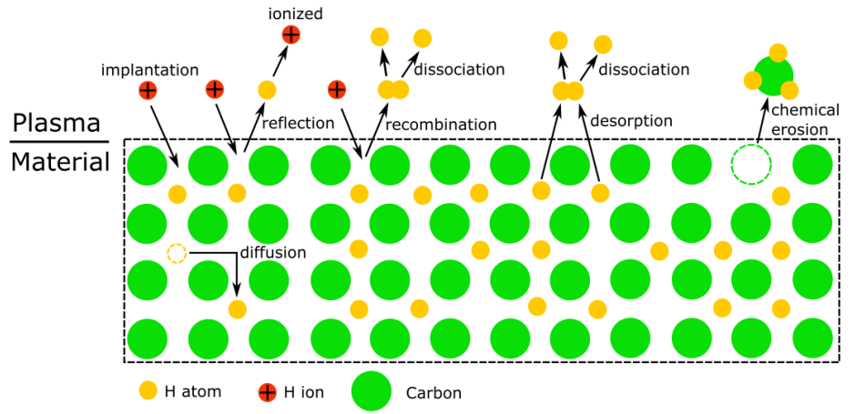
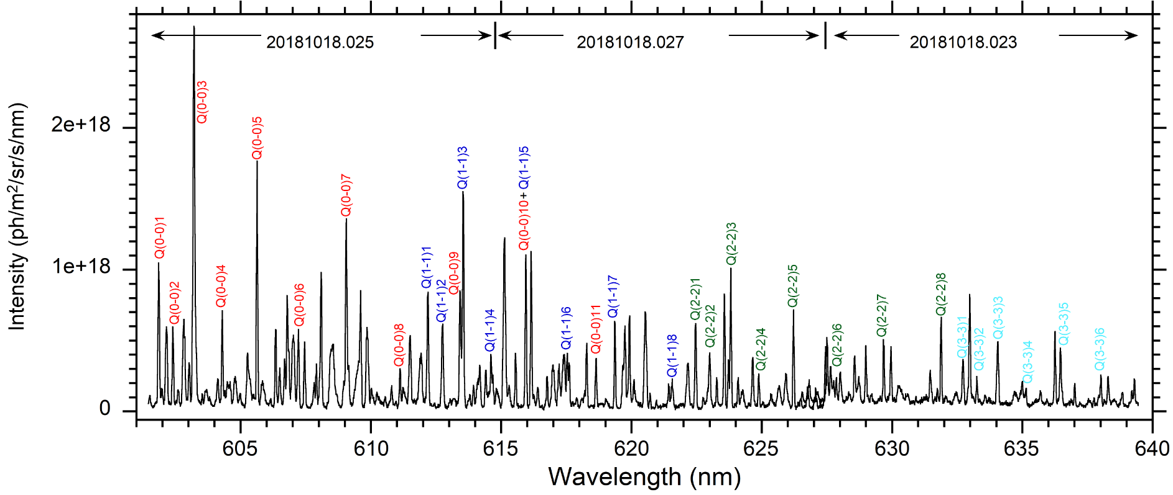
S(D)/XB for hydrogen particles (H and H₂)
Hydrogen ions come from different PWI processes.
H/H₂ ratio should be known.
Hydrogen particle flux:
$$Γ^{tot}=Γ_{H}+2∙Γ_{H_{2}}$$
e.g. H_{γ} (434nm)
Fulcher band: 600-650 nm
Part of PWI processes
H₂ Fulcher band

Slide 4
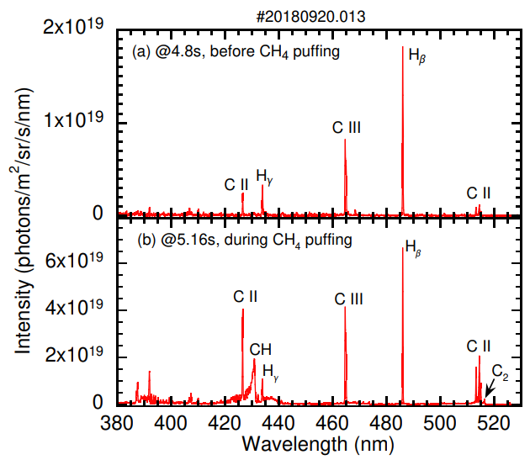
S(D)/XB for carbon erosion
Carbon source = physical sputtering + chemical sputtering
Physical sputtering: C I (909nm)
Carbon chemical sputtering
$$Γ_{C}^{chem}=Γ_{C}^{CHx}+Γ_{C}^{C2Hy}+Γ_{C}^{C3Hz}+… (x≤4,y≤6,z≤8)$$
CH Gerö band: 427-432 nm
C₂ Swan band: 510-517 nm
Dissociation chain (CH₄)

Slide 5
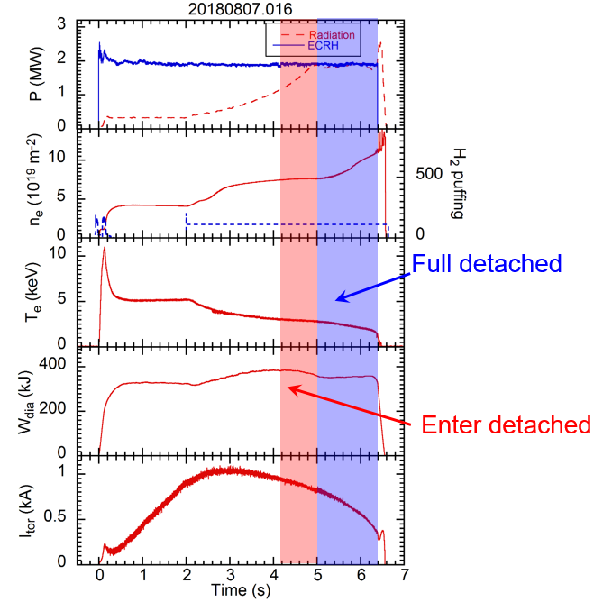
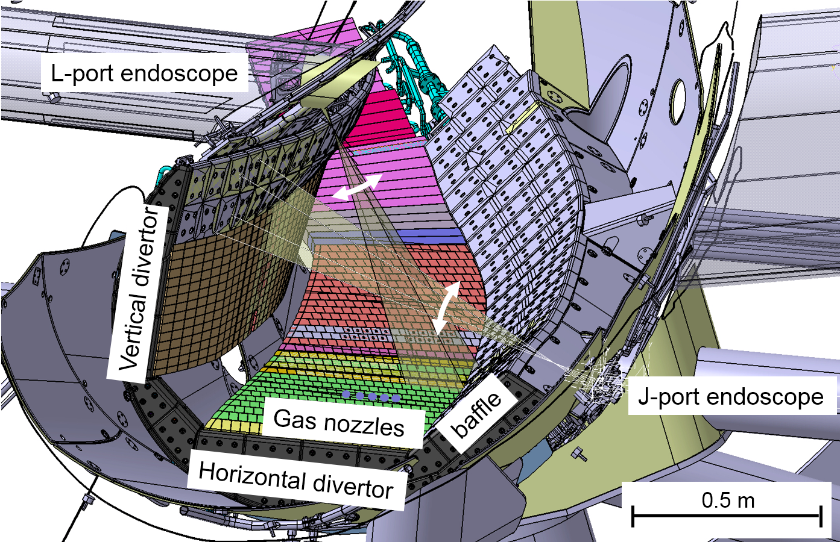
Discharg design
1) Diagnositcs:
Endoscope filter cameras and spectrometers, divertor spectrometers, divertor Langmuir probes, He-beam,
mid-plane manipulator, IR camera, …
2) H₂ , CH₄ and He puffing from He-beam in divertor plates
3) H₂ , CH₄ and He puffing should be small amount to avoid strongly disturb local plasma.
Puffing during density climbing
FZJ endoscopes (only L-port in OP2.1)

