Slide 1
Bootstrap current effect and He-puffing
Forschungszentrum Jülich GmbH, Institut für Energie- und Klimaforschung - Plasmaphysik, 52425 Jülich, Germany

Slide 2
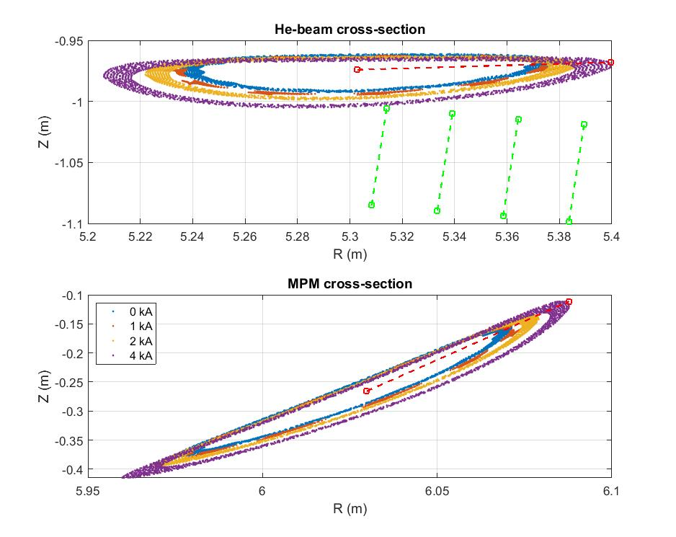
Comparing MPM and He beam plane
The MPM and He beam measure in the same island
The island is strongly affected by the evolving toroidal current
The size of the confined island area can affect the Helium retention

Slide 3
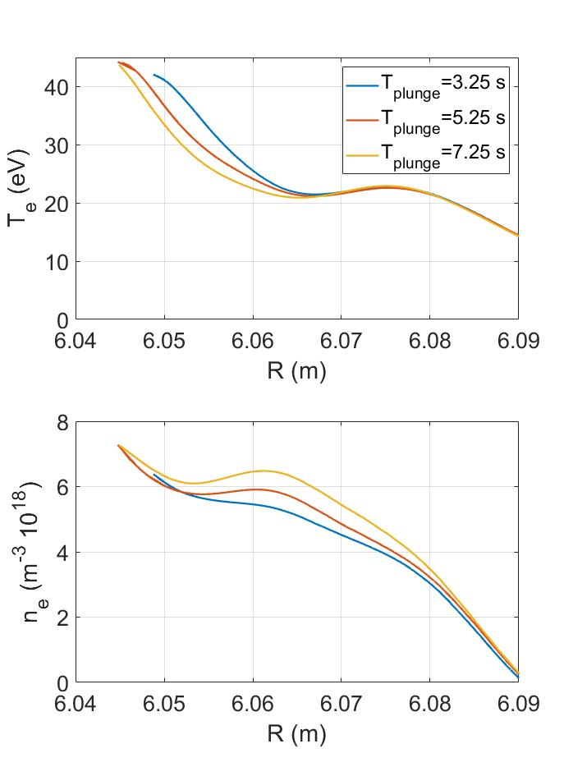
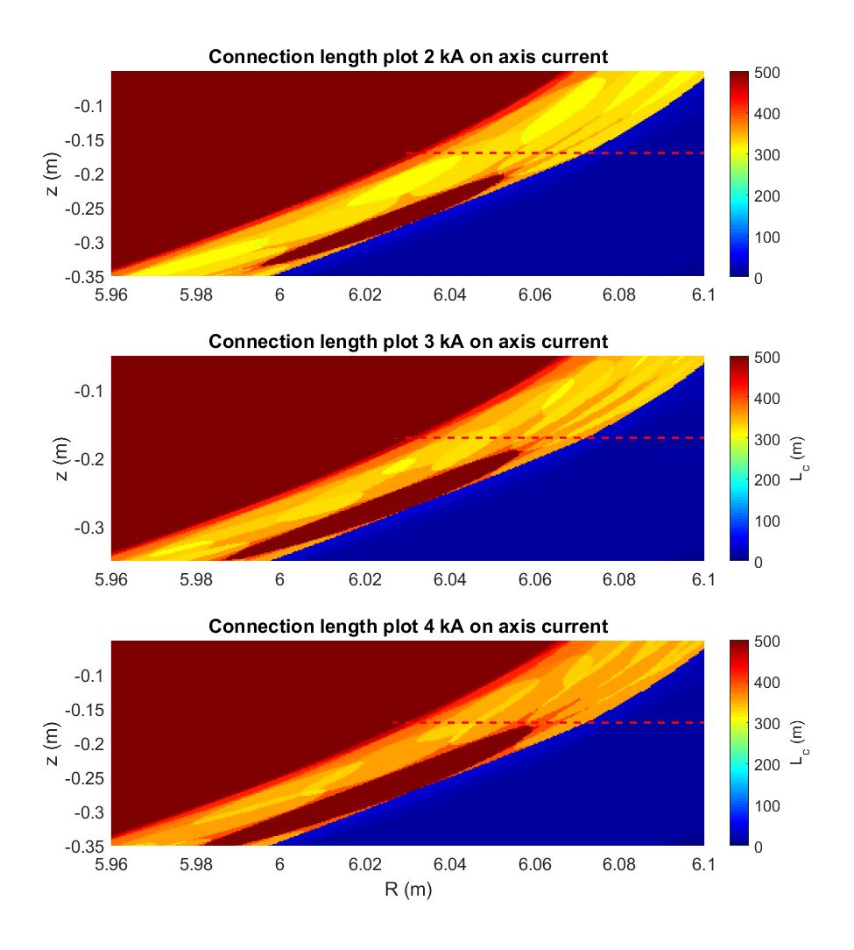
Current effect on the plasma edge
The MPM and He beam measure in the same island
The island is strongly affected by the evolving toroidal current

Slide 4
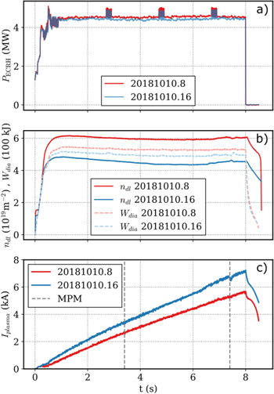
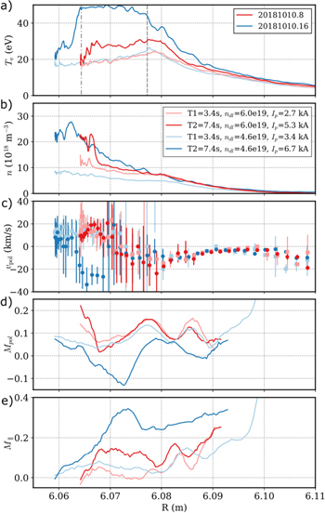
Current Threshold
C. Killer 2019 Plasma Phys. Control. Fusion 61 125014

Slide 5
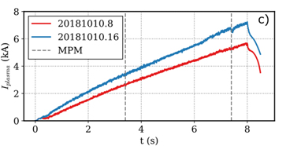
Proposal
Test if the island size affects the retained amount of helium
Scan the amount of helium that is puffed
Time the MPM plunges preferably that at least three measurements are done for each phases
Observe the current effect in the “linear” phase and after crossing the threshold
This can be combined with a current effect proposal in the TG: ”island divertor dynamics”
How can we control the current?

