Slide 1
On the hunt for a reactor-relevant scenario for W7-X
G. Fuchert for the W7-X team
DPG Frühjahrstagung, Mainz, 2022

Slide 2
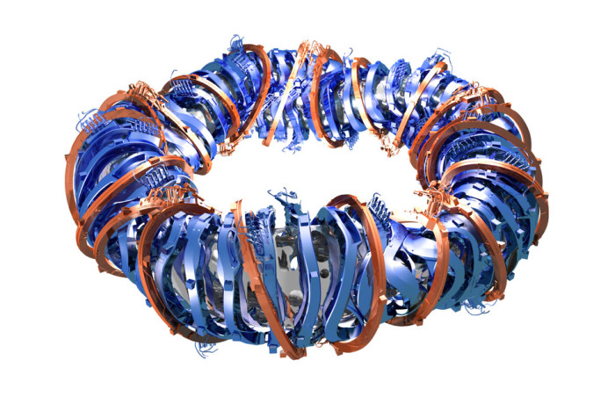
Mission of Wendelstein 7-X (W7-X)
In stellarators, neoclassical transport increases drastically with temperature
  Confinement of a classical stellarator not sufficient for reasonable reactor designs
Solution: Stellarator optimization
  Design a magnetic field with reduced neoclassical transport
W7-X designed to demonstrate fusion-relevant conditions in steady-state
  n_{e}>10²⁰ m⁻³, T_{e}≈T_{i} > 4 keV, P_{heat} < 20...30 MW
  long-pulse operation: 30 minutes
R | 5.5 m
a | 0.53 m
V_{plasma} | ≈ 30 m³
B | 2.5 T (< 3 T)
t_{Plasma} | 30 min

Slide 3
Design criteria for W7-X
General criteria
Low shear
High iota around 1 (reduced Pfirsch-Schlüter currents)
Optimization criteria
1. Closed magnetic surfaces / sufficiently small error fields
2. Reduced neoclassical transport at low collisionality
3. Sufficient confinement of fast ions
4. MHD stability at finite β (5%)
5. Good equilibrium properties at finite β (5%):
Low Shafranov shift
6. Compatibility of magnetic field and exhaust
concept (magnetic island divertor, reduced bootstrap current)
Feasible modular coils

Slide 4
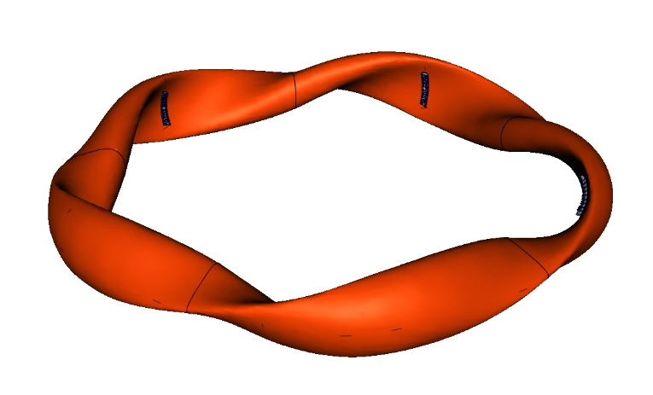
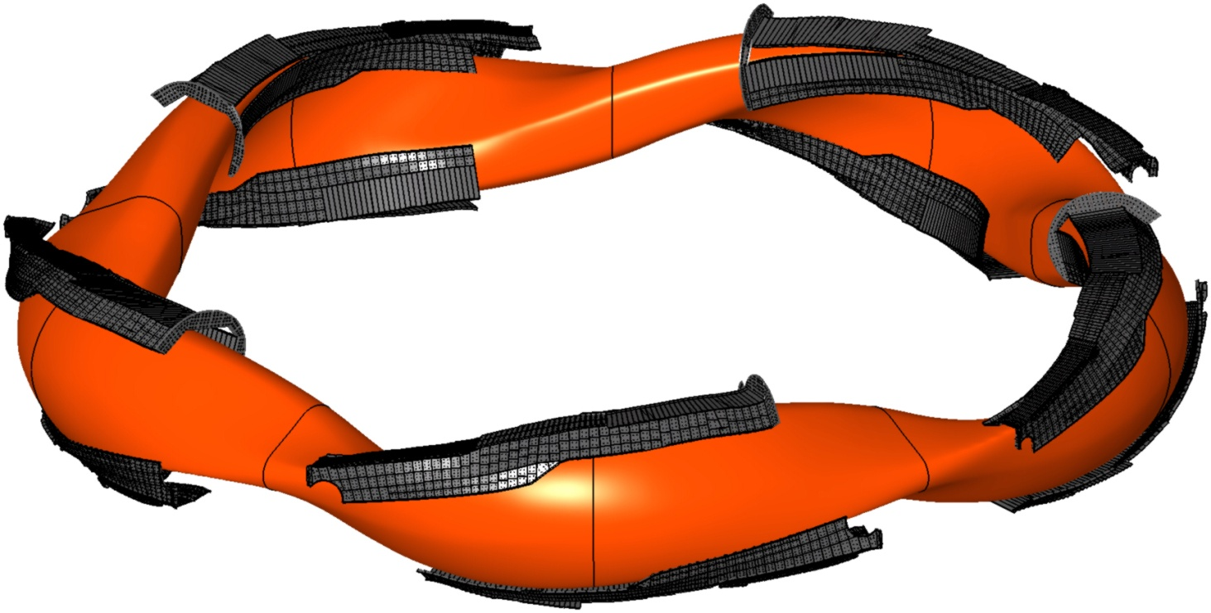
Prove optimization of W7-X in staged approach
OP 2: 2022 …
Steady-state operation
Actively cooled divertor configuration
P_{cw} ~ 10 MW, P_{pulse} ~ 20 MW (10 s)
P/A ≤ 10 MW/m²
30 minutes @ 10 MW
OP 1.2: 2017 / 2018
Uncooled divertor configuration
P ≤ 10 MW, ∫ P dt ≤ 80 MJ
τ_{pulse} ~ 10 s
(>60 s @ reduced power)
OP 1.1: 2015 / 2016
Limiter configuration
P < 5 MW, ∫ P dt ≤ 2 (4) MJ
τ_{pulse} ~ 1 (6) s

Slide 5
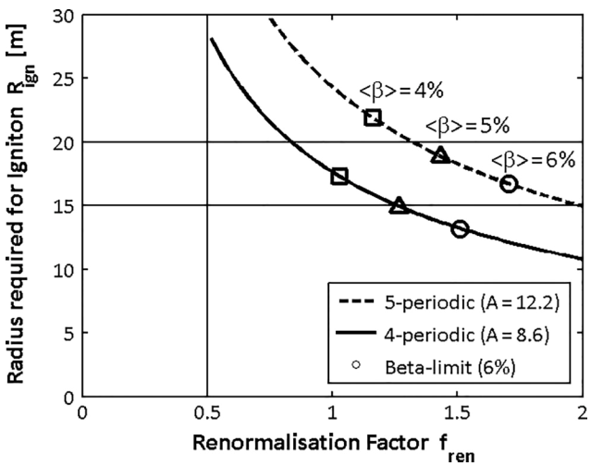
First steps in the demonstration
No operational limits preventing us from reaching relevant plasmas
  High density operation preferable (confinement, impurities, etc.) and stellarators do not feature the Greenwald density limit observed in tokamaks.
  Several physics effects require a minimum temperature
  For a certain heating power that leads to density limits
Plasmas have sufficient performance
  Reactor of reasonable size: f_{ren}=τ_{E}/τ_{ISS04} > 1 required
  f_{ren} > 1.5 is preferable
Feasible power and particle exhaust scheme
  Detachment required
[H. Yamada et al., NF 45 (2005)]
[F. Warmer et al., FST 68 (2015)]

Slide 6
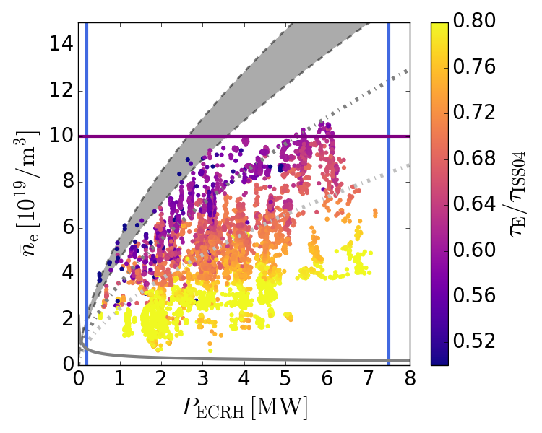
Operational limits observed in ECRH plasmas

Slide 7
Operational limits observed in ECRH plasmas
Lines and curves: Operational limits that cannot be (easily) crossed
No dots: No plasma operation possible (or not attempted)
One dot: 200 ms of stable plasma operation

Slide 8
Operational limits observed in ECRH plasmas
Central density reaches X2-cutoff at 1.2·10²⁰ m⁻³
Technical limit: minimum/maximum gyrotron power (to be upgraded)
Acceptable O2
absorption for
central T_{e} > 2 keV
Optimum O2
absorption for
central T_{e} > 3 keV
Radiative density
limit
Optimum X2
absorption above
pressure threshold

Slide 9
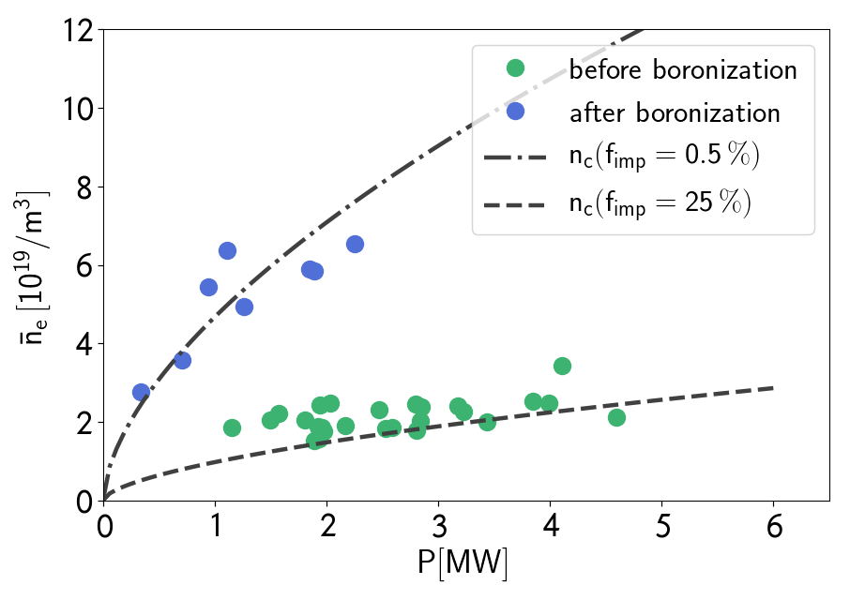
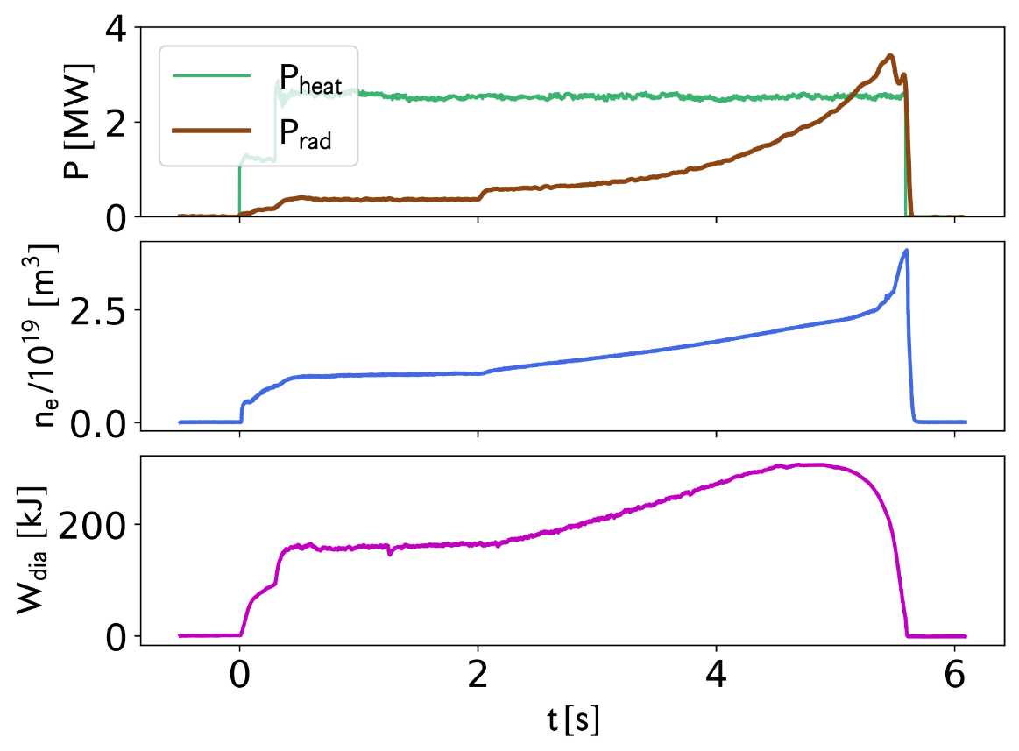
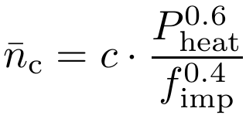
Radiative density limit
Impurity radiation in the plasma edge leads to the Sudo-limit of stellarators
  [S. Sudo et al., NF 30 (1990)], adaptation for W7-X: [G. Fuchert et al., NF 60 (2020)]
  Sudo-limit is an edge density limit
  In steady-state plasmas often linked to line-averaged density
f_{imp}=0.5%
f_{imp}=25%

Slide 10
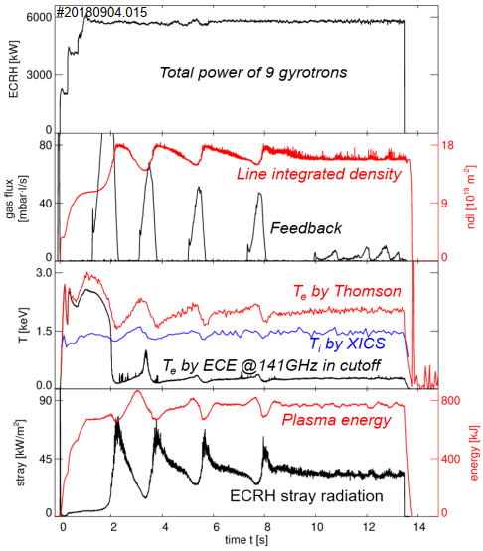
O2-heating at W7-X
Above the X2-cutoff, 1.2⋅10²⁰ m⁻³, ECRH is operated in O2
  O2 heating has been demonstrated in steady-state
  [H.P. Laqua et al., NF 61 (2021)]
For an efficient absorption, a central T_{e} above 2 keV
(better 3 keV) is required
  Imposes a power-dependent density limit
In purely gas-fueled ECRH plasmas, this „heating limit“
is lower than the radiative density limit
  Reaching detachment in high-density plasmas more challenging

Slide 11
Extrapolation
Given the current knowledge, fusion-relevant plasma operation seems possible
  Improved performance would increase central T_{e} at given n_{e} and P_{ECRH} (i.e. higher density limit)
Towards a reactor

Slide 12
Energy confinement in steady-state plasmas
In steady-state ECRH plasmas, τ_{E}/τ_{ISS04} < 1
  Not compatible with reactor-size considerations
  Roughly comparable with an L-mode plasma in a tokamak
Towards a reactor

Slide 13
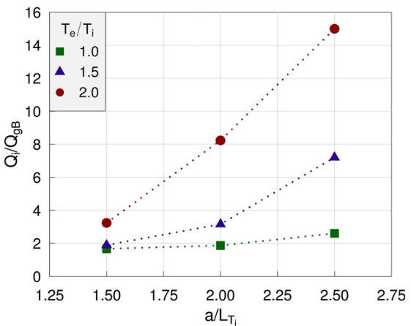
Performance in gas-fueled ECRH plasmas
Unfavorable conditions in ECRH heated plasmas
  Predominant electron heating leads to high T_{e}/T_{i}.
  High T_{e} reduces collisional coupling of electrons and ions.
  Weaker coupling reinforces high T_{e}/T_{i}.
  High T_{e}/T_{i} leads to stronger ITG turbulence
  → higher ion heat transport.
  This transport also reinforces the high T_{e}/T_{i}.
With these conditions, the ion temperature does
not increase with ECRH power
  Ion heat transport appears to be very stiff
  The high degree of stiffness is an „illusion“ caused by the
  increasing T_{e}/T_{i}.
This cycle needs to be broken!
  One way to achieve this is a strong density gradient, which
  stabilizes ITG turbulence.
Ion heat flux in gyro-Bohm units as a function of the temperature gradient length for different Te/Ti (Gyro-kinetic simulations, non-linear, fluxtube)
[M. Beurskens et al., NF 61 (2021)]

Slide 14
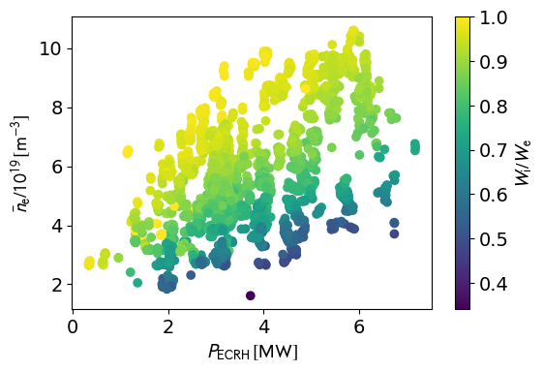
Operational space of equilibrated plasmas
Plasmas with T_{e}/T_{i} close to one exist close to the radiative density limit
  Confinement may extrapolate more favorably to even higher densities
  But improved confinement could be needed to go there (radiative density and O2-heating limit)

Slide 15
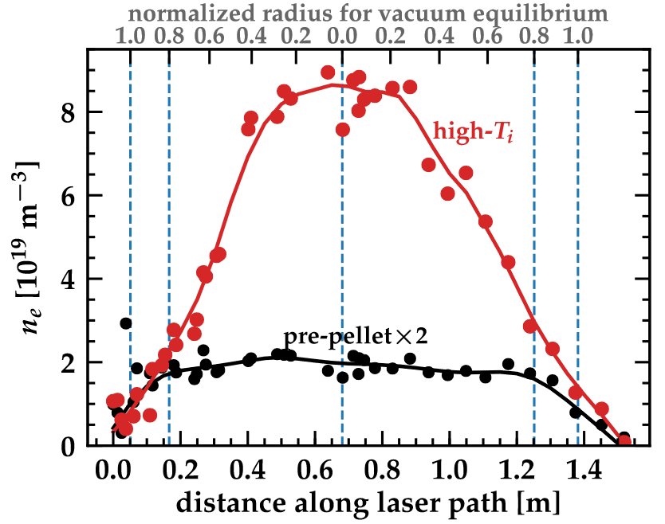
Peaked density profiles
During and after pellet injection:
  Peaked density profiles
    [S. Bozhenkov, NF 60 (2020)]
  Equal temperatures for electrons and ions
  Both features reduce ITG turbulence in W7-X
    [J A Alcusón, PPCF 62 (2020) 035005]
    [M Beurskens, NF 61 (2021) 116072]
Other scenarios with peaked profiles and
(somewhat) improved confinement
  Massive impurity injection events
    [Lunsford, PoP 28 (2021) 082506]
  NBI-heated plasmas
  ECRH plasmas with very low power or high density
[S. Bozhenkov, NF 60 (2020)]

Slide 16
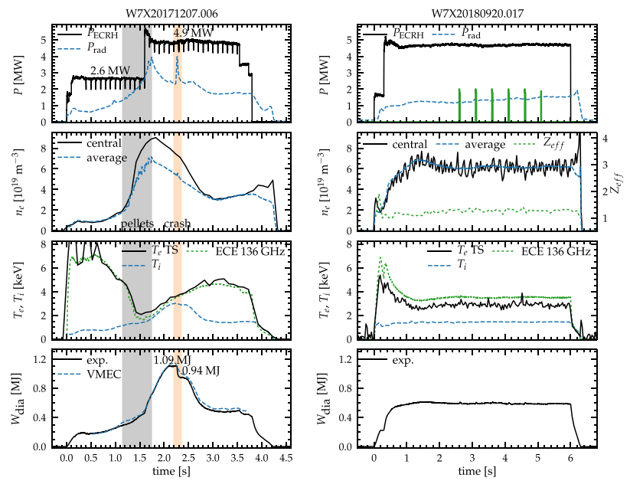
Performance after pellet injection
In several plasmas, a significant improvement of performance has been observed after pellet injection.
  [S. Bozhenkov, NF 60 (2020)]
P_{ECRH} ≈ 5 MW, n_{e} ≈ 5⋅10¹⁹ m⁻³,
T_{e} ≈ T_{i} > 3 keV, f_{ren} ≈ 1.5
Highest triple product observed in a stellarator.
This performance would not have been possible without the NC optimization
  [C.D. Beidler, Nature 596, (2021)]
[S. Bozhenkov, NF 60 (2020)]

Slide 17
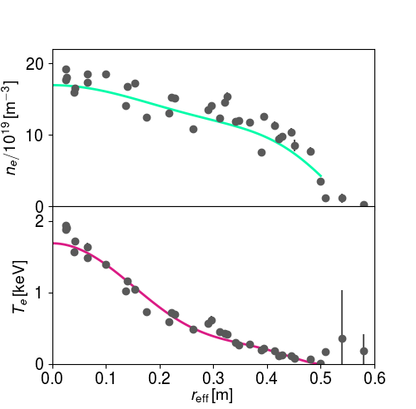
Strong density gradients in steady-state?
It seems that W7-X can reach fusion-relevant performance (only?) with peaked density profiles
To achieve steady-state operation,
a new pellet injector for continuous injection has been developed
Possibly the plasma can even sustain peaked profiles on its own (e.g. high-density O2 plasmas)
  Particle pinch under certain conditions?
  Impact on performance unclear due to low heating efficiency in the experiments so far.
Steady-state profiles in a high-density O2-heated plasma
(20180904.011, 5 s)

Slide 18
Strong density gradients in steady-state?
It seems that W7-X can reach fusion-relevant performance (only?) with peaked density profiles
To achieve steady-state operation,
a new pellet injector for continuous injection has been developed
Possibly the plasma can even sustain peaked profiles on its own (e.g. high-density O2 plasmas)
  Particle pinch under certain conditions?
  Impact on performance unclear due to low heating efficiency in the experiments so far.
Steady-state profiles in a high-density O2-heated plasma
(20180904.011, 5 s)
Peaked density profiles could lead to steady-state scenario with sufficient performance. But what about the exhaust?

Slide 19
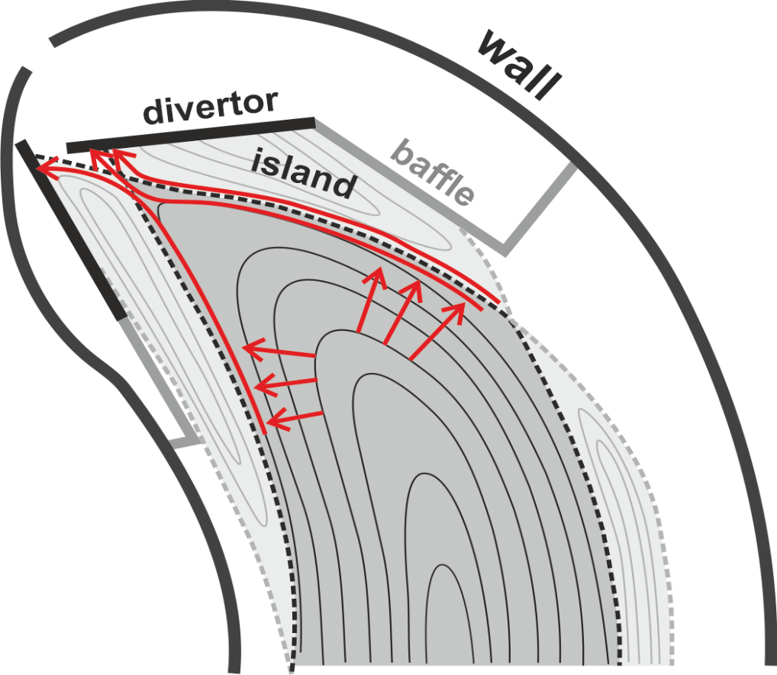
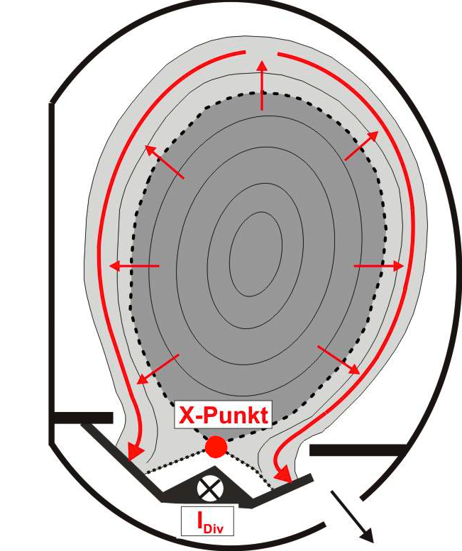
Why do we need a divertor?
radial transport into SOL: D⊥, χ⊥
radial transport into SOL: D⊥, χ⊥
Plasma core performance is to be maximized
Stable density control
Low impurity concentration (Z_{eff})
Helium-ash
X point
[M. Jakubowski et al., PSI 2020 (Jeju, Korea)]

Slide 20
Why do we need a divertor?
radial transport into SOL: D⊥, χ⊥
radial transport into SOL: D⊥, χ⊥
Divertor plasma defines
plasma wall interface
Power exhaust, heat flux < 10MW/m²
Efficient particle exhaust for density control, particle flux within technical limit
Impurity screening
→ Detachment required!
X point
[M. Jakubowski et al., PSI 2020 (Jeju, Korea)]

Slide 21
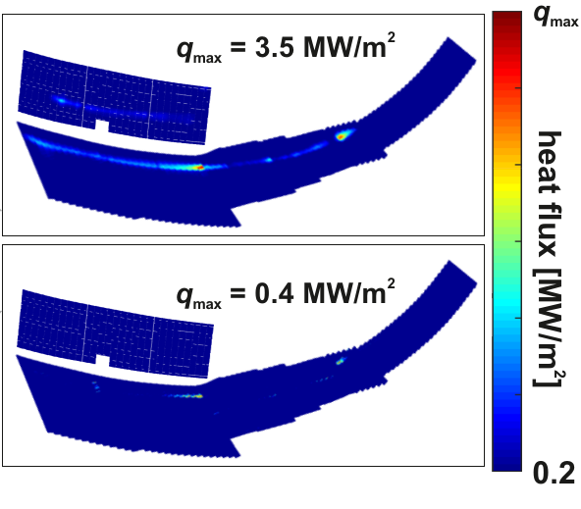
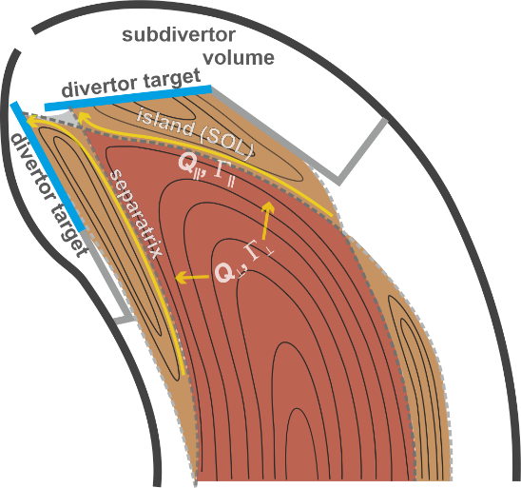
Stable detachment regime
Radiated power fraction of 80-90%
Drop in diamagnetic energy ≲10 %
attached
detached
Constant Z_{eff} ≈ 1.5
Sufficient sub-divertor pressure
Virtually no convective loads to the target.
detachment
[O. Schmitz, et al., NF 61 (2021)]
[M. Jakubowski et al., NF 61 (2021)]
Notes:
After reducing the scaling by nearly an order of magnitude, one can just about see the remains of the strike lines. The discharge was run at 5.5 MW ECRH heating in O2-mode with feedback controlled line integrated density of about 1 1020 m-2. Zeff remained constant at 1.5. The radiated power fraction stayed at about 80-90 % and the diamagnetic energy dropped only by about 10%. The sub-divertor neutral pressure measured at the entrance to the pumping gap rose slightly to comfortable 0.07 Pa with the compression factor between 20 and 30. This level of neutral compression enabled stable density control as shown in the next slide.

Slide 22

Conditions for proper particle exhaust
Neutral pressure in the subdivertor (pumping region) increases in detachment
  Neutral penetration depth increases → neutral particles can more efficiently reach the pumping gap.
  Necessary for good pumping efficiency and particle exhaust.
Neutral pressure in subdivertor degrades if ionization front crosses the separatrix (deep detachment)
  Particle exhaust capability diminished
Optimization task: Find a detached scenario with proper particle exhaust that is compatible with the high-performance scenario candidates
#20180814.025
detached
j_{sat} [A/mm²]
Notes:
Optimum divertor performance requires not only mitigating divertor heat loads, but also maximising sub-divertor neutral pressures and thereby particle exhaust. You see here experimental data for neutral pressure at the pumping gap (blue points) and ion saturation current measured by Langmuir probes (red points). As one can see, the highest neutral pressure behind the pumping gap is not reached at the maximum of the particle flux at frad=0.5-0.6, but at frad of 80% to 85 %. In order to understand that we need to look into simulation analysis.

Slide 23
Summary
The operational space of W7-X allows for reactor-relevant plasmas
  n_{e}>10²⁰ m⁻³, T_{e,i} > 3 keV, P_{ECRH} ~ 10..20 MW
Plasma performance has to be optimized further
  Attempt to stabilize the high performance after pellet injection
  Exploration of other routes to high performance (NBI, ICRH, ECRH with peaked density profiles)
  H-mode-like scenarios?
Plasma detachment is stable and reproducible
  So far mainly in a narrow parameter range
  A combined scenario of high performance and detachment has yet to be developed
  Different paths seem realistic
After the first experimental campaigns, a lot of work still needs to be done,
but there is a clear path forward.

