Slide 1
How to determine the sub-divertor leakage
Thierry Kremeyer¹, C.P. Dhard¹, Y. Feng¹, V. Haak¹, J. Igitkhanov², M. Krychowiak¹, D. Naujoks¹, G. Schlisio¹, C. Tantos², S. Varoutis², U. Wenzel¹ and the W7-X Team
Email: thierry.kremeyer@ipp.mpg.de
¹Max Planck Inst. for Plasma Physics, 17491 Greifswald, Germany
²Karlsruher Institut für Technologie, 76131 Karlsruhe, Germany

Slide 2
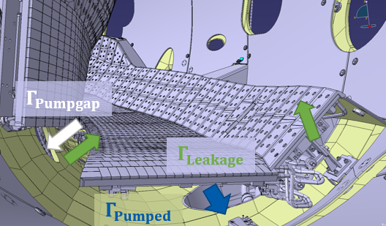
Outline
Decay of a gas injection
S_{eff} estimate
EMC3-EIRENE modeling of Γ_{Pumpgap}
EMC3-EIRENE modeling with and without pump
Simple sub-divertor surface estimate
DIVGAS modeling
Total recycling flux taken at 5E+22 particles/s

Slide 3
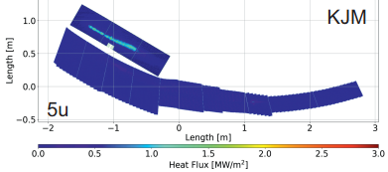
Particle Exhaust and compression in other configurations
high mirror
Exhaust is determined by divertor pressure, not by compression
Low main chamber pressure desirable to minimize main chamber erosion due to CX
[M. Jakubowski, NF 2021]
Configuration | Pump gap [mbar] | Midplane [mbar]
Low-iota | 4.2 E-5 ± 5.5 E-6 | 3.5 E-6 ± 6.5 E-7
Standard (attached) | 3.4 E-4 ± 6.0 E-5 | 3.0 E-6 ± 6.7 E-7
Standard (detached) | 7.0 E-4 ± 5.2 E-5 | 1.2 E-5 ± 1.6 E-6
High-iota | 7.7 E-4 ± 3.5 E-4 | 1.3 E-5 ± 6.9 E-6
High-mirror | 4.0 E-4 ± 5.0 E-6 | 4.7 E-6 ± 1.0 E-6
We exhaust ≈ 0.5% of the recycling flux
Notes:
Now that we completed the fuel cycle from neutralization to re-ionization, lets look at the other magnetic field configurations W7-X can operate under
Low iota, strike line further away
Standard, closer and vertical
High iota, strike line moves further back
High mirror with the load predominantly on the vertical target.
Exhaust only dependant on sub-divertor pressure, many neutrals in the main chamber not an issue from a naive exhaust perspective
However low main chamber pressure desirable to minimize main chamber erosion due to CX
Low iota, not many neutrals make it through the pump gap
Standard in detachment double exhaust, but cut compression in half due to 4x higher midplane
Similar to high iota, despite different strike line position
High mirror in between.
Thick SOL might shield us from strong CX and therefore we might be able to life with a lower compression as long as we have higher exhaust

Slide 4
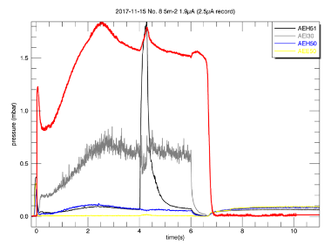
Decay of a gas injection
S_{r} = V_{AEH} /t = 512l/0.14s = 3657l/s
S_{r} = S_{pumped} + S_{leakage}
S_{pumped} = 2350 l/s
0.69 % of the recycling flux is transported
through the pumpgap
64 % of particles in the sub-divertor
are pumped

Slide 5
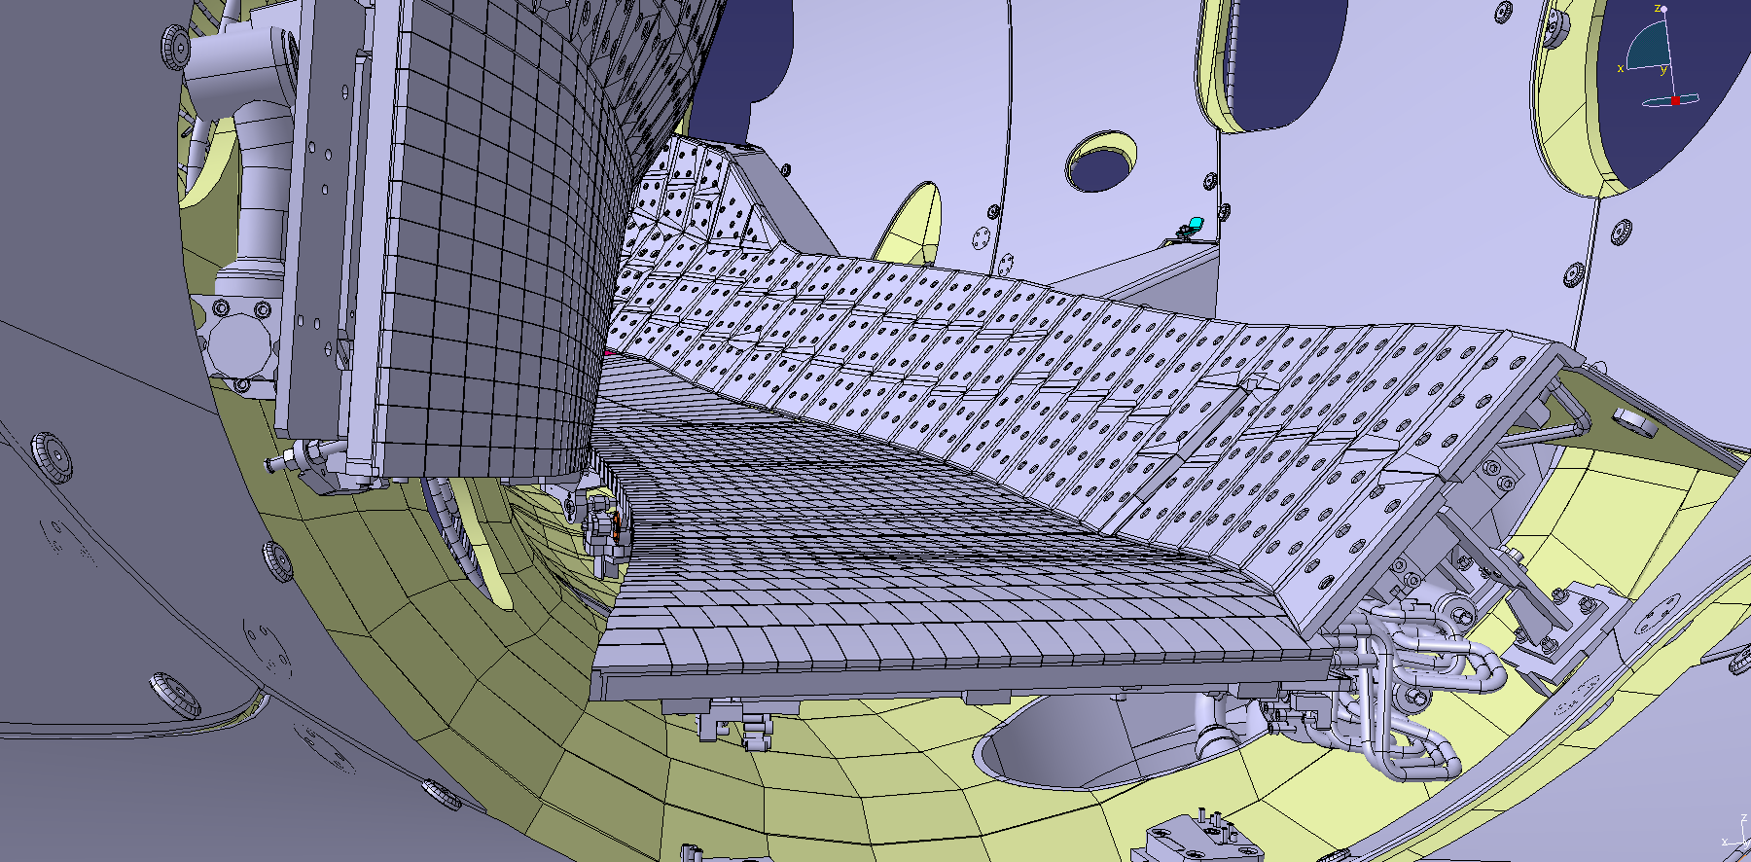
Leakage estimation for low-iota section
Low-iota leakage estimate based on gas puff removal time without plasma
S_{eff} = V/τ = 512 l / 0.14s = 3657.1 l/s S_{eff} = S_{Pumped} + S_{Leakage}
Scaled up to full sub-divertor volume for 10 modules
$$Γ_{Leakage}≈2.14×{10}^{20}1/s=\text{0.4 }\text{\% }Γ_{Recycling}$$
Sub-divertor space:
V_{low-iota}= 512 l V_{high-iota}= 47 l
A_{Pumpgap} = 0.15m²
A_{∑Gaps} ≈ 115% A_{pumpgap}
$Γ_{Ion target}$ (99%)
$Γ_{Wall}$ (±0.8%)
$Γ_{Recycling}$
$$Γ_{Pumpgap}$$
$Γ_{Pumped}$
(0.4%)
$$Γ_{Leakage}$$
$$Γ_{Recycling}$$
$=5.20×{10}^{22} 1/s$
$$Γ_{Pumpgap}$$
$$Γ_{Leakage}$$
$$Γ_{Pumped}$$
(0.4%)
Location | Pressure [mbar] | S_{Leakage} [l/s] | $Γ$_{Leakage} [a/s]
Low iota | 2.63 E-4 ± 5.7 E-5 | 1536.5 | 1.96 E+19
Notes:
Incoming particles might not be pumped, but leak from the sub-divertor.
Sub-divertor is not vacuum tight. Pump-gap is needed for particles to enter, but also leave
Additional gaps make up another 15% of that surface
To determine leak rate, removal time of a gas injection in the sub-divertor.
With known volume we resolve the pumping speed in the sub-divertor, which is pumped and leakage.
Leak rate for low iota section, scaled up to full divertor reveils that we leak as many particles from the sub-divertor, as we pump

Slide 6
Conductance estimate
Ansatz 1 – Sub-divertor particle balance
$$Γ_{Pumpgap,1}=Γ_{Pumped}+Γ_{Leakage}$$
$$Γ_{Pumpgap,1}=3.84×{10}^{20}1/s$$
Ansatz 2 – Conductance estimate for S_{eff}
S_{eff,pumpgap} ≈ 1795.5 l/s
$$Γ_{Pumpgap,2} =2.66 ×{10}^{20}−2.99×{10}^{20}1/s$$
Average low-iota:
$$Γ_{Pumpgap,low−iota}=3.25±0.50 ×{10}^{20}$$
$$Γ_{Pumpgap,total} =4.30±0.53 ×{10}^{20}=\text{0.}\text{8} \text{\% }Γ_{Recycling}$$
$Γ_{Ion target}$ (99%)
$Γ_{Wall}$ (±0.8%)
$Γ_{Recycling}$
$$Γ_{Pumpgap}$$
$Γ_{Pumped}$
(0.4%)
$Γ_{Leakage}$ (0.4%)
$$Γ_{Recycling}$$
$=5.20×{10}^{22} 1/s$
$$Γ_{Pumpgap}$$
$$Γ_{Leakage}$$
(0.8%)
$$Γ_{Pumped}$$
Location | Pressure [mbar] | 100% S_{eff} [l/s] | 89% S_{eff} [l/s] | $Γ$ 100% [a/s] | $Γ$ 89% [a/s]
Low iota Pumpgap | 3.43 E-4 ± 6.0 E-5 | 1795.5 | 1598.0 | 2.99 E+19 | 2.66 E+19
Notes:
With the leak rate and pump rate determined we can look at how many particles move into the sub-divertor
2 methods: 1st Ansatz particle balance, we know how many particles leave sub-divertor, these must come in, mainly through pump gap
2. Ansatz: conductance estimate for pumping speed, neutral pressure gauge in pump gap.
Average these low-iota values and add high iota we resolve that 0.8% of recycling flux enters the sub-divertor through pump gap, of which half is pumped out, and half leaks back into the main chamber

Slide 7
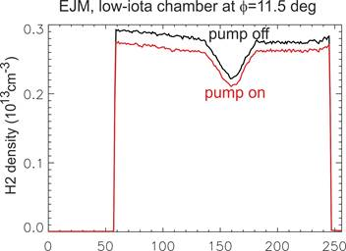
EMC3-EIRENE modeling
4 % of the recycling flux is transported through the pump gap
Since we pump 0.5 % of the recycling flux, 12.5 % of particles in the sub-divertor are pumped
Turning on the pump in the model causes the pressure to drop by about 5%

Slide 8
Simple surface estimate
The pump in the low-iota chamber with a pumping speed of~2.12m**3/s (2120 l/s) can be regarded as a purely absorbing surface with an area of about 47 cm**2 assuming thermalized hydrogen moelcules in the divertor chamber of room temperature.
On the other hand, neutrals can escape through the divertor gap which has a total area of 1400 cm²
The probability of a particle being pumped is therefore 47/(1400+47)~3%, with the rest 97% escaping through the pump gap.
Of course, the pump gap is not a perfect sink for the trapped particles, as particles escaping from the divertor chamber have a certain probability of returning to the chamber.
Even asuming that this "recycling coefficient" is 50%, the probability of a particle being removed by the pump is 47/(0.5*1400+47)~6%, still less than 10%.

Slide 9
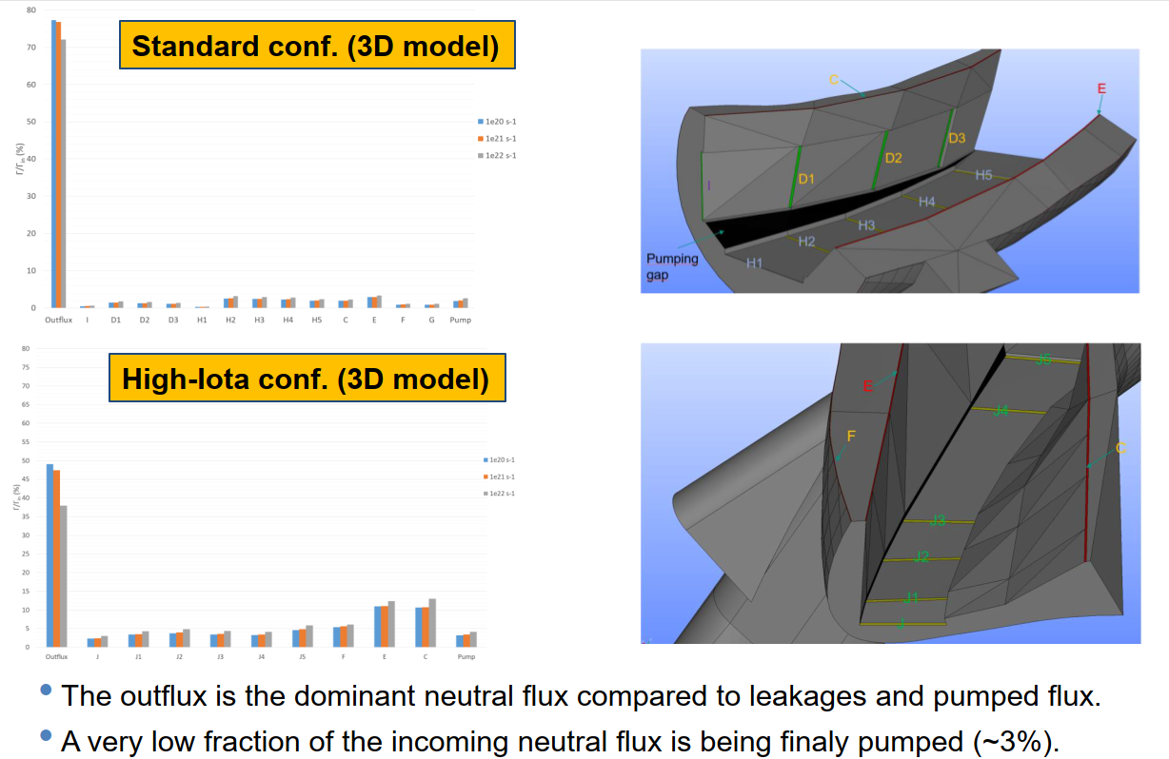
DIVGAS 3D

Slide 10
DIVGAS 2D

Slide 11
Summary
Recycling flux: 5.0 E+22 a/s Pumped flux: 2.5 E+20 a/s Exhaust fraction: 0.5 %
Method | Recycling fraction through Pumpgap | Fraction of sub-divertor particles pumped
Gas puff decay (Conductance) | 0.69 % | 64 % (50%)
EMC3-EIRENE | 4 % | 12.5 % (5% pressure drop w pump)
Simple surface estimate | 16 % (8.3%) | 3 % (6 %)
DIVGAS 3D | 25 % | 2 %
DIVGAS 2D | 4.1 % | 12 %

Slide 12
Appendix
Appendix

Slide 13
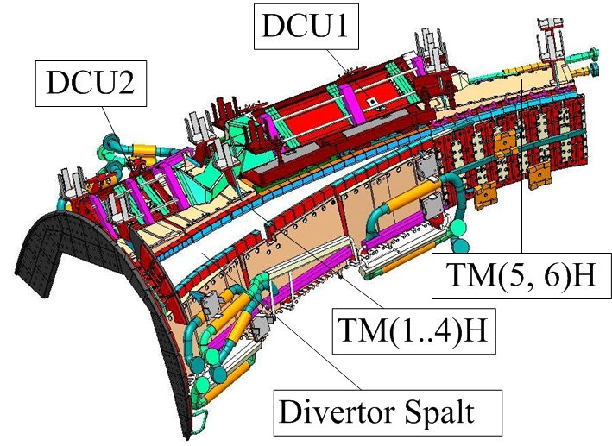
3 times more pumping with cryo pumps in OP2
New Hardware:
Cryo pumps add significant pumping speed in the sub-divertor
Optimized sub-divertor closure
Fully water-cooled first wall will reach equilibrium wall conditions easier
Pumping system | Combined sub-divertor pumping speed
Turbo molecular pumps | 33 447 l/s
Cryo vacuum pumps | 106 100 l/s
Estimated pumped particles ≈ $1×{10}^{21} 1/s$
Strong enough to balance large wall source - Wall source will be less dynamic
4 NBI sources at a total of $1.1×{10}^{21} 1/s$
[C.P. Dhard]
Notes:
In the future the exhaust will be upgraded with cryo pumps
Additionally sub-divertor gaps now 10% of pump gap
Fully cooled wall will decrease in dynamic
Cryo adds 3 times more pumping
Estimated pumped particles strong enough to compensate even a large wall source, which will be less of an issue
Almost by itself pump all 4 NBI sources, plus NBI brings its own pumps

Slide 14
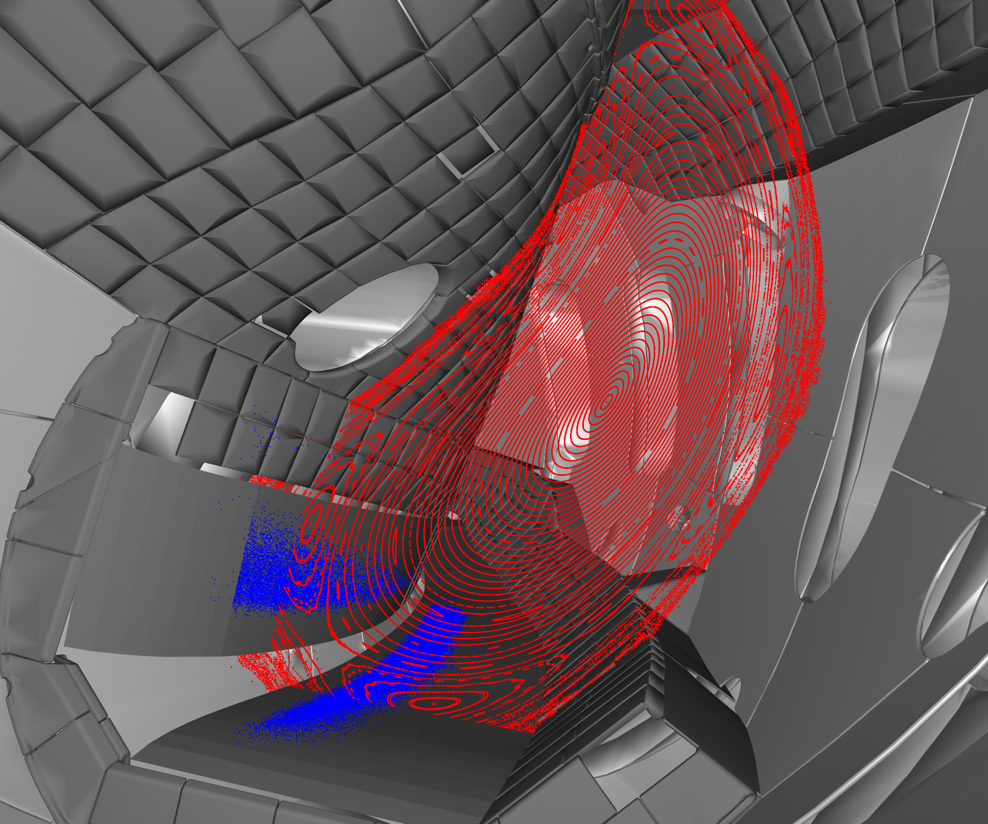
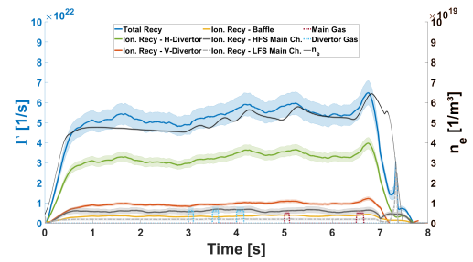
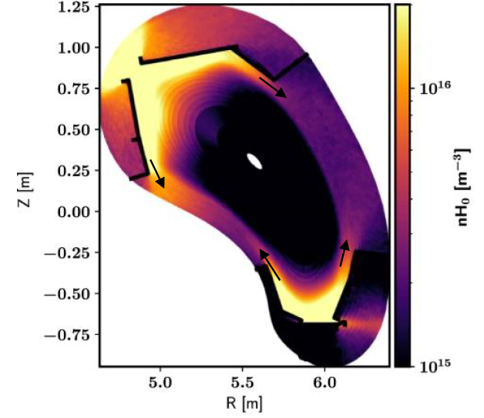
Conclusion – The H fuel cycle in attached standard configuration
Fractions of the total recycling flux
$$Γ_{Recycling}$$
$Γ_{Ion target}$ (99%)
$Γ_{Wall}$ (±0.8%)
$Γ_{Recycling}$
$Γ_{Pumpgap}$ (0.8%)
$Γ_{Pumped}$
(0.4%)
$Γ_{Leakage}$ (0.4%)
$$Γ_{Recycling}$$
τ_{p} = 0.26 s
$$Γ_{Recycling}$$
= 5.2 E+22 1/s
$Γ_{Leakage}$
= 1.9 E+20 1/s
99 %
$Γ_{Ion target}$
= 5.15 E+22 1/s
0.4 %
0.8 %
$Γ_{Wall}$
= ± 3.9 E+20 1/s
[V. Winters, PPCF2021 & AAPPS MF2-I1]
0.8 %
 | Normal island
τ_{p} | 0.26 s ± 0.12
τ_{p}* | 8.17 s ± 0.13
$$\overline{R}$$ | 0.97 ± 0.49
$Γ_{Pump gap}$
= 3.8 E+20 1/s
0.4 %
$Γ_{Pumped}$
= 1.9 E+20 1/s
Notes:
After a finite particle confinement time, 5.2E+22 particles leave the plasma
99% arrive in the divertor
Wall pumping in this example at 0.8%
Of all particles arriving in the divertor, 1% gets through the pump gap
Half exhausted, half leaks back in
Other 99% recycle, majority close to recycling surface, but fraction leaks along the targets into main chamber
Re-ionize and fuel the plasma
Particles repeat this cycle for 8 seconds before eventually being exhausted
R at 0.97 despite the large absolute uncertainty due to error propagation, matches quite well with slightly higher 99.6% by neutral exhaust
While this doesn‘t sound like much, enough to compensate large wall source and NBI sources in the future and already allowed stable density operation in attached and detached scenarios.
For H only sources have to be pumped -> wall source larger, high recycling desireable because of Tritium
He we will get an issue, pumping 11% higher for He, but only pump what in subdivertor
More potential to optimize particle collection, rather than sub-divertor exhaust
Before we go to W divertor, modeling study on optimized target shape driven by physics! Maybe need to limit configurations for good optimization

Slide 15
What do we need to show for successfull divertor operation
Fueling to raise density
Where are particles fueled to i.e. where do they ionize?
Can we control the ionization location by the right choice of fueling system, parameters and location?
Goal: Fuel H mainly into core while fueling impurities mainly into SOL.
Exhaust H to de-couple fueling and density control
Divertor plugging: How well does the island divertor collect particles? (Divertor Physics) ${Γ_{Pumpgap}}/{Γ_{Ion Target}}$
Divertor leakage: How well does the island divertor remove particles? (Vacuum Engineering) ${Γ_{Pumped}}/{Γ_{Pumpgap}}$
Compression as simple metric: High divertor pressure to pump, low main chamber pressure to minimize CX erosion
Exhaust impurities
He recycling probably exceed DT fusion source, but at shorter confinement time
How well are Z>1 particles exhausted
Core -> SOL -> Divertor -> Pump out

Slide 16
He exhaust – OP2.1
He NBI ready in OP2.2 – no core He source in OP2.1
BUT: He recycling probably exceed DT fusion source, at shorter confinement time
Study He recycling and removal
He recycling – penetration depth
He confinement in H – τ_{p}* and τ_{p}
He compression in the divertor
He pump out with TMP
Ar frosting of cryo pumps – not trivial, first test!

