Slide 1
subdivertor neutral gas balance
D. Naujoks, and W7-X team
Max-Planck-Institut für Plasmaphysik, Wendelsteinstraße 1, 17491 Greifswald, Germany

Slide 2
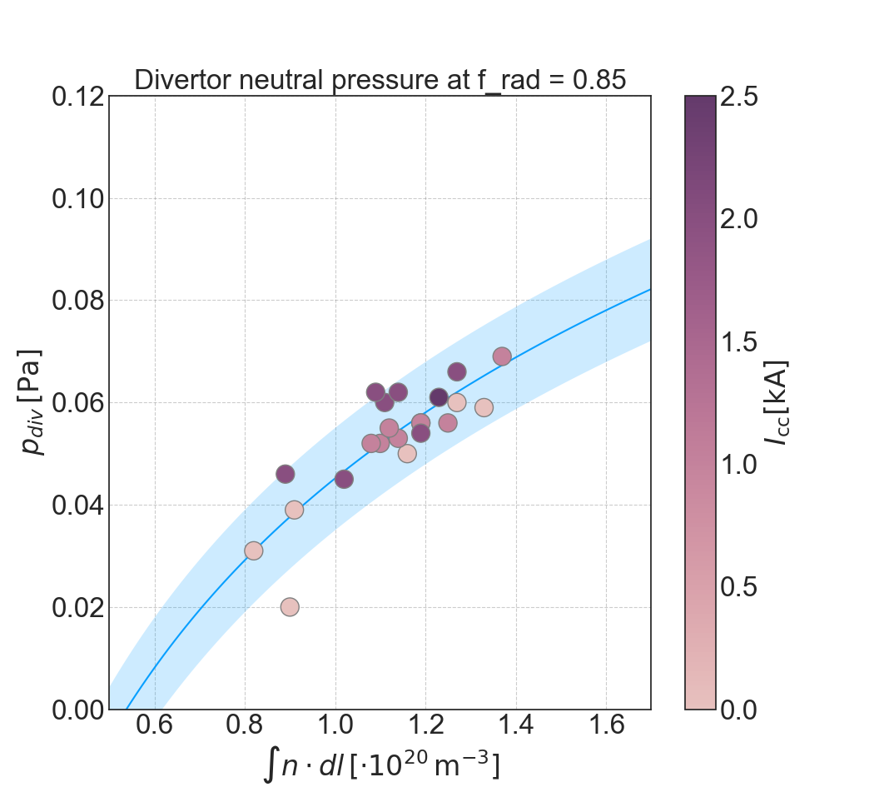
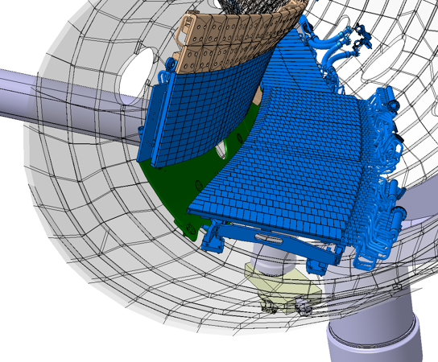
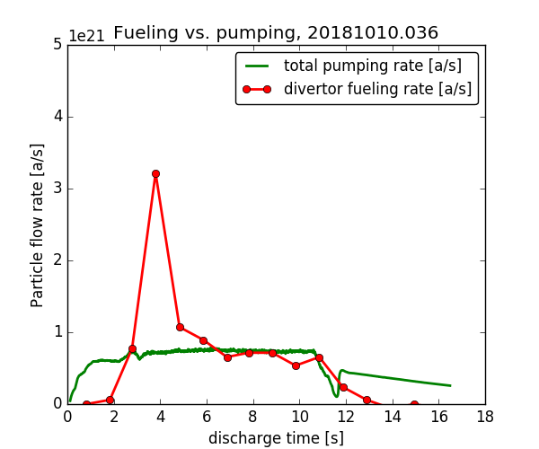
TF-II: exhaust - OP1.2 pumping efficiency
steady state -> no wall pumping, efficient exhaust required for density control by compensating outgassing, gas inlet, pellets, NBI
plasma domain
the island divertor can build up high sub-divertor pressures providing good density control with saturated first wall
pumping gap
20181016.016
20181010.036
sub-divertor
domain
Source: M. Krychowiak
High-iota configuration seem to be very promising for long-pulse operation: surprisingly higher pressures were found
where particle exhaust is through the AEP sub-divertor

Slide 3
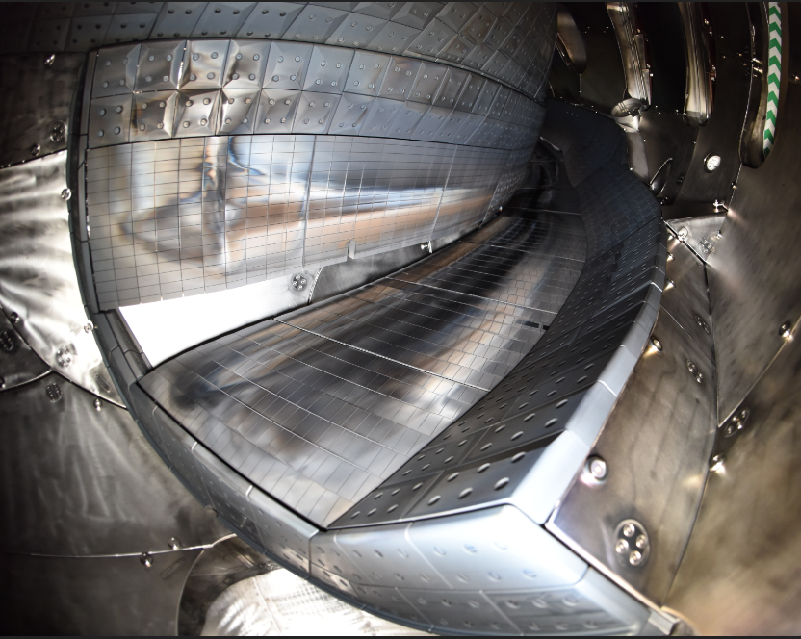
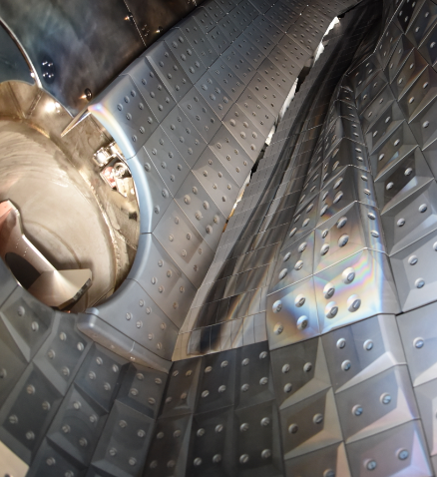
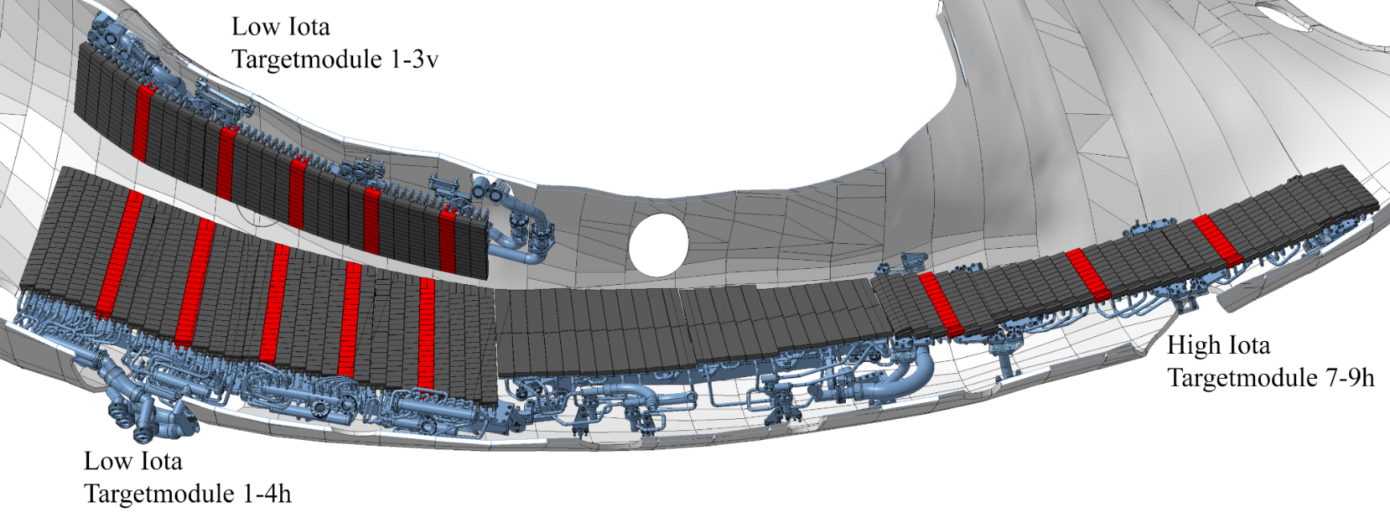
TF-II: exhaust - pumping gaps
large pumping gap
small pumping gap
AEH port
AEP port

Slide 4
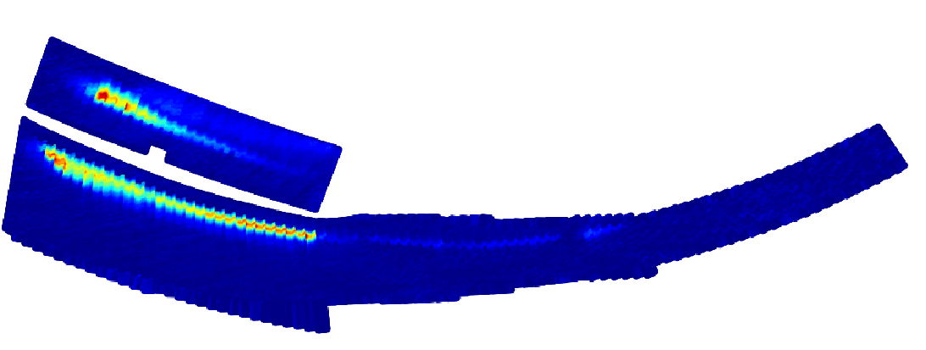
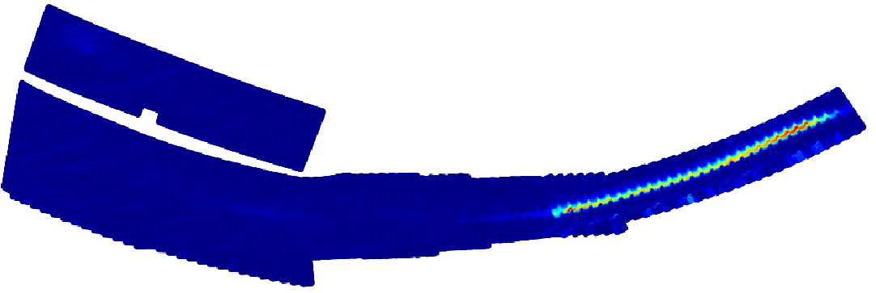
TF-II: exhaust - OP1.2 pumping efficiency AEH/AEP
neutral gas exhaust is effective if control of plasma density can be maintained regardless of what the various gas inlet systems, NBI, pellets, and wall deliver to the plasma.
control the temperature-induced outgassing of the wall components by active pumping (TMPs, cryopumps), cooled PFCs
the pumping is more efficient the higher the neutral gas pressure is
more particle/heat load
-> more recycling
-> higher neutral gas pressure?
Standard configuration (EJM) up to P_{div} = 4*10⁻⁴ mbar (AEH port)
High-iota configuration (FTM) up to P_{div}= 1*10⁻³ mbar (AEP port)
Standard configuration
High-iota configuration
AEP port
AEH port

Slide 5
TF-II: exhaust - OP1.2 pumping efficiency AEH/AEP
neutral gas exhaust is effective if control of plasma density can be maintained regardless of what the various gas inlet systems, NBI, pellets, and wall deliver to the plasma.
control the temperature-induced outgassing of the wall components by active pumping (TMPs, cryopumps)
the pumping is more efficient the higher the neutral gas pressure is
more particle/heat load
-> more recycling
-> higher neutral gas pressure?
Standard configuration (EJM) up to P_{div} = 4*10⁻⁴ mbar (AEH port)
High-iota configuration (FTM) up to P_{div}= 1*10⁻³ mbar (AEP port)
Source: V. Haak [high_low_iota_liste_18_01_2022.xlsx]

Slide 6
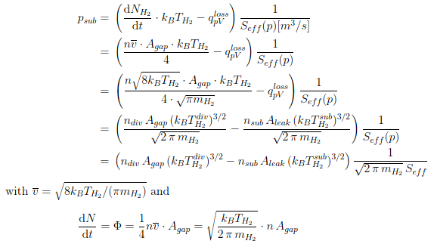
Particle balance model – one subdivertor unit
plasma domain
pumping gap
steady state
sub-divertor
domain

Slide 7
Particle balance model – one subdivertor unit
plasma domain
pumping gap
steady state
if S_{eff} -> 0
note that A_{gap} is part of A_{leak}
sub-divertor
domain

Slide 8
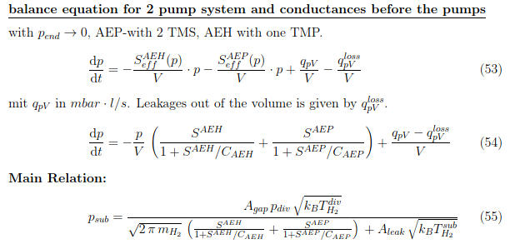
Particle balance model

Slide 9
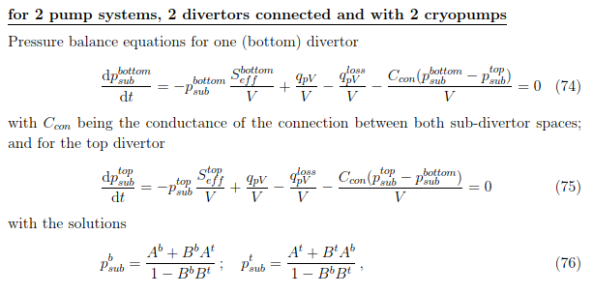
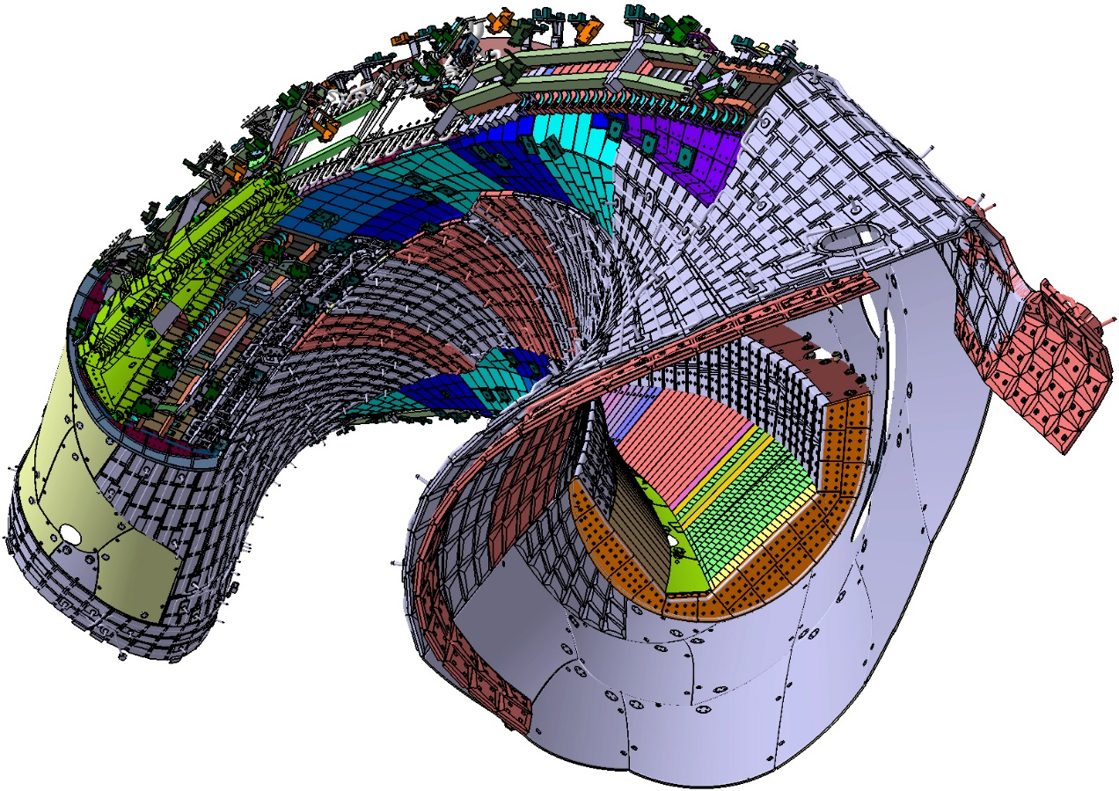
Particle balance model
Source: 1-ACE-Y0100.0

