Slide 1
Neutral gas pressures for different magnetic configurations during OP1.2b

Slide 2
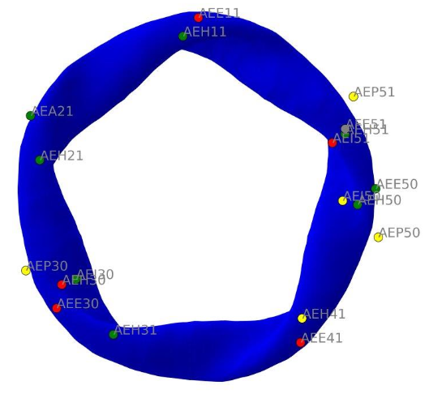
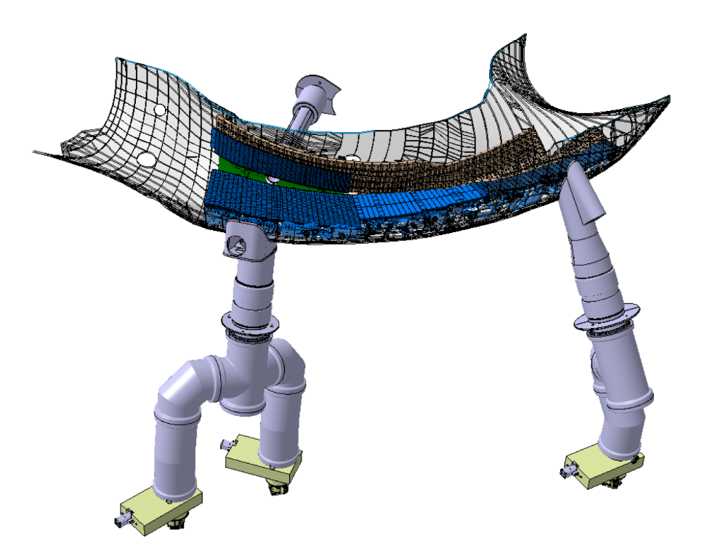
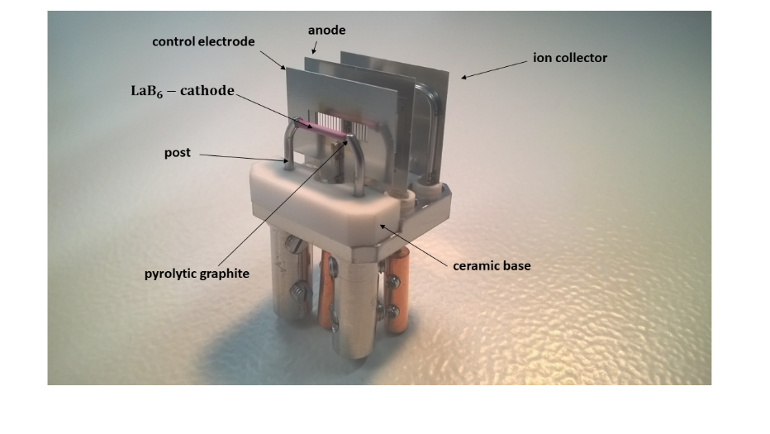
Neutral gas pressure gauges during OP1.2b
19 neutral gas pressure gauges installed (8 tungsten/ 11 LaB6-cathodes):
Midplane: AEE11 / AEE30/ AEE41/ AEE50
low iota pumping gap: AEI30/ AEI50/ AEI51
Low iota pump duct: AEH11/ AEH21/ AEH30/ AEH31/ AEH41/ AEH50/ AEH51
High iota pumping gap/ pump duct: AEP30/ AEP50/ AEP51
AEA21/ AFE 51
14 NPGs worked throughout the whole campaign.
AEH
AEI
AEJ
Source: https://w7x-logbook.ipp-hgw.mpg.de/components?id=QRG#XP_20181018.41
Source: D. Naujoks – 1-QRH-Y0008.1
AEP
AEH
Source: Wenzel et al 2022

Slide 3
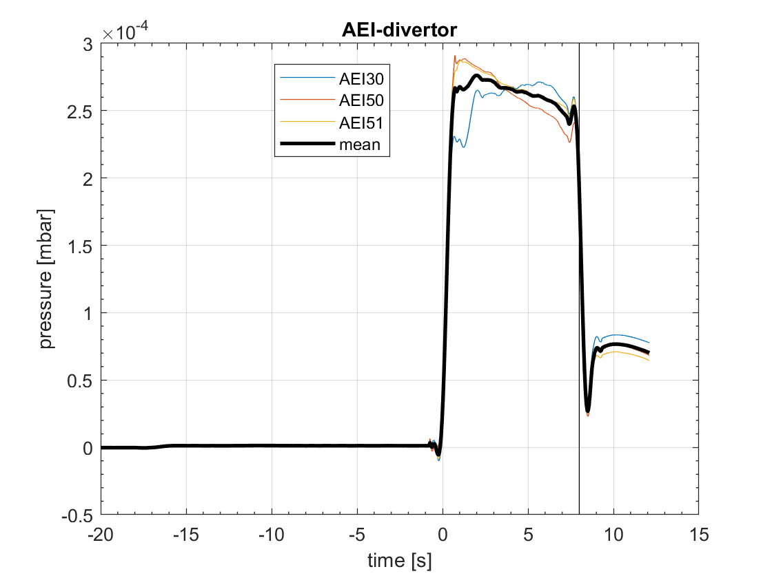
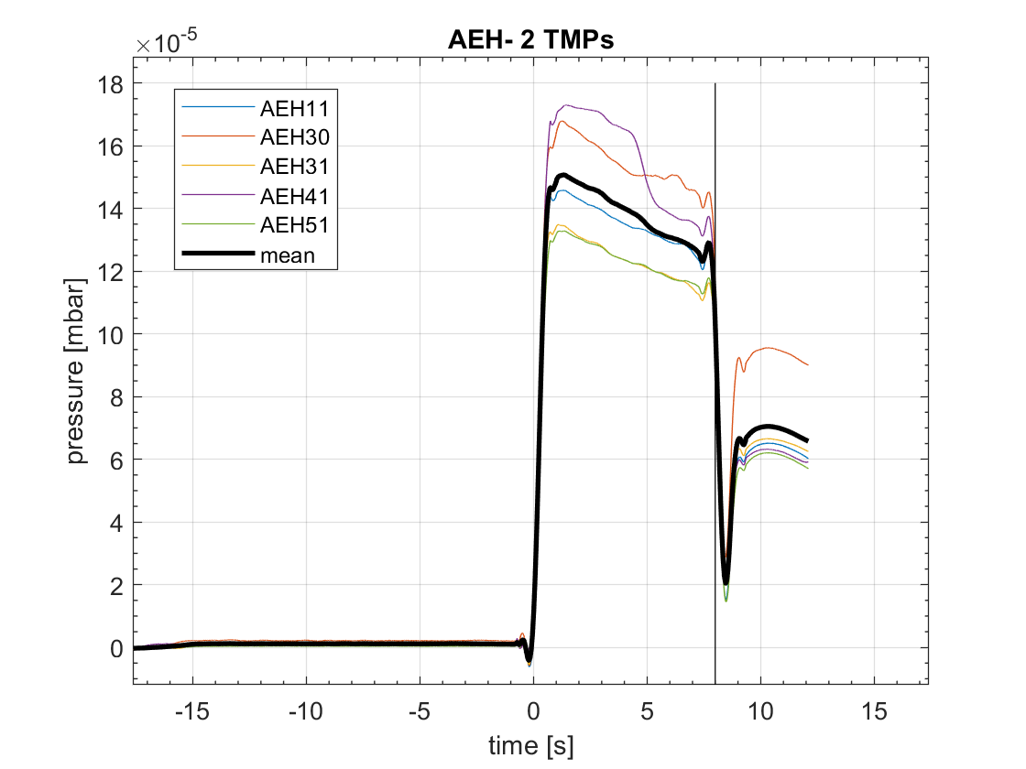
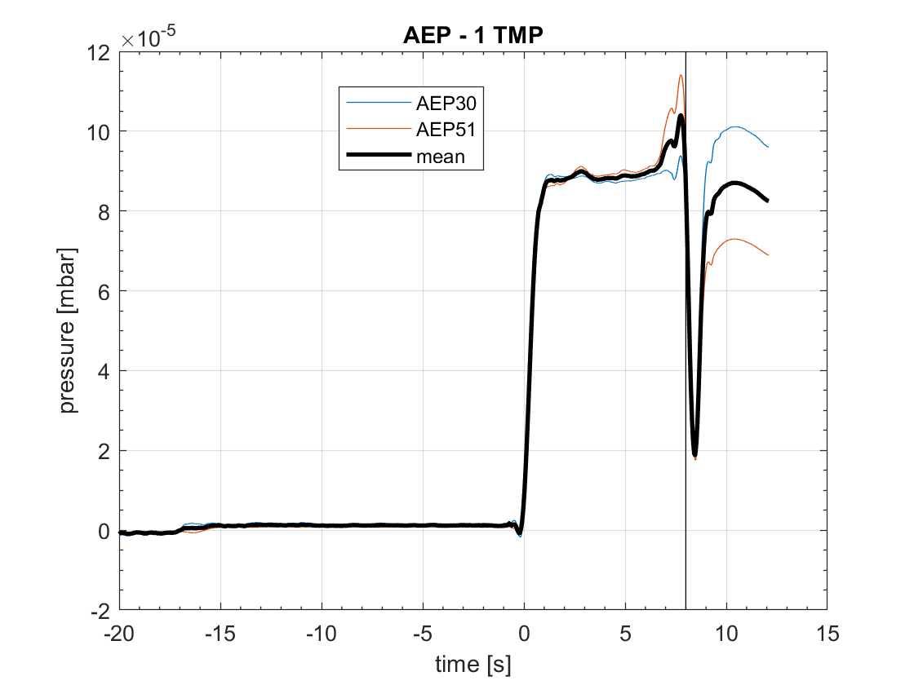
NPG signals and analysis
Raw data from the NPGs is calibrated with an individual nonlinear calibration
Signal from the working NPGs during a plasma discharge can be displayed (here 20181010.008, standard configuration, attached)
Black vertical line indicates end of the ECRH heating
Black line shows the average neutral gas pressure at the different locations, i.e. AEH, AEP and AEI
For further analysis, the time average during the plasma discharge according to ECRH heating (here from ~1 to 8s) is taken
AEI
AEH
AEP

Slide 4
Standard configuration attached/ detached
In attached configuration: neutral gas pressure is highest at the AEI position (near pumping gap)
Neutral gas pressure between 5e-05 and 2.5e-04 mbar at the pump ducts (AEH and AEP, depending on the density)
Linear increase of p with the density
Unexpectedly high neutral gas pressure in the high iota part of the divertor (p_AEH/p_AEP ~ 2)
Detached configuration (average f_rad > 0.6): p between 1e-04 and 4e-04 mbar at the pump ducts, 6e-04 at the pumping gap (but few discharges for comparison)

Slide 5
Standard configuration attached/ detached
Compression in attached configuration between 40 and 80 at the pumping gap (AEI), 20 - 40 at AEH port and 10 - 30 at AEP port (with respect to the midplane; AEE)
Detached configuration: slightly lower compression at all three locations (although the neutral gas pressure does not decrease)

Slide 6
High iota configuration
At the pumping gap: 1e-05 to 9e-05 mbar, only slight increase with increasing density
Similar pressures at the AEH port
At AEP port/ small pumping gap: 2e-04 to 1e-03 mbar
Neutral gas pressure at AEH port is a factor of ~ 0.06 lower than at the AEP port
Higher compression at the AEP port in high iota configuration compared to AEH port in standard configuration

Slide 7
Other configurations
High mirror configuration: similar to standard configuration, highest neutral gas pressure at the pumping gap (1-4e-04 mbar), lower neutral gas pressure at the AEH port (8e-05 – 2.5e-04 mbar) and AEP port (~ 1e-04 mbar)
p_AEH/p_AEP ~1.5-2
Linear increase with respect to the density
low iota configuration: similar neutral gas pressure at the pumping gap and the AEH port (4-1.3e-04 mbar)
Lower pressure at the AEP port by a factor of 2-4

Slide 8
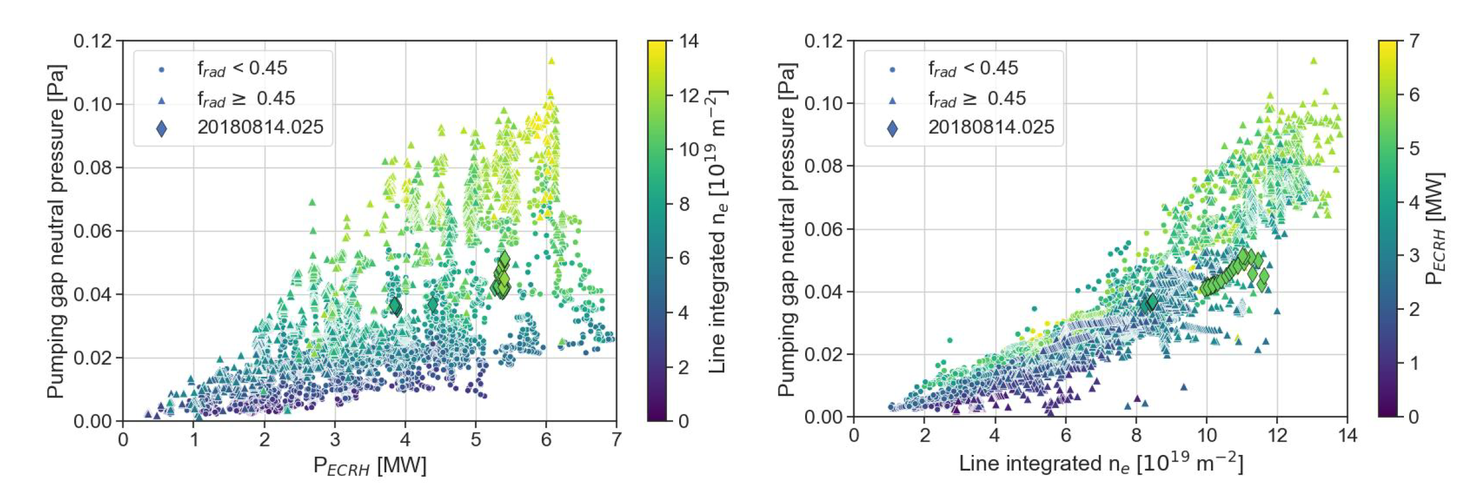
Neutral gas pressure in all configurations
Source: presentation; V. Perseo – OP1.2b detachment in the juice
Dependence of the neutral gas pressure on many parameters regardless of the magnetic configuration can be analyzed with the juice database
Also, a linear dependence of the neutral gas pressure at the pumping gap (AEI) on the density is observed
Neutral gas pressure weakly depends on the heating power

Slide 9
Summary – neutral gas pressures
Neutral gas pressures in the subdivertor for a reference density of 5e19m^-3:
configuration | Pressure AEE (midplane) | Pressure AEI (pumping gap) | Pressure AEH (pump duct) | Pressure AEP (high iota pump duct)
EJM attached (standard) | 4.5e-06 mbar | 1.5e-04 mbar | 9e-05 mbar | 7e-05 mbar
EJM detached (standard) | 1e-05 mbar | 6.5e-04 mbar | 4e-04 mbar | 2.5e-04 mbar
FTM (high iota) | 4.5e-06 mbar | 3e-05 mbar | 2e-05 mbar | 4e-04 mbar
KKM (high mirror) | 3e-06 mbar | 1.5e-04 mbar | 8.5e-05 mbar | 7.5e-05 mbar
DBM/DAM (low iota) | 4e-06 mbar | 3e-05 mbar | 3e-05mbar | 1e-05 mbar
Highest neutral gas pressures in the detached state
In the attached state, highest pressure at the pumping gap in standard and high mirror configuration
High pressure in the high iota part (AEP) especially in the standard and high mirror configuration

Slide 10
Summary – pumped particles
With a pumping speed of 2350 l/s at the AEH pump duct and 1180l/s at AEP (Wenzel et al 2022), these neutral gas pressures account for the following pumped particle flux (T = 302K) :
configuration | Pressure AEH (pump duct) | Pressure AEP (high iota pump duct) | Pumped particles AEH (2350 l/s) | Pumped particles AEP (1180 l/s)
EJM attached (standard) | 9e-05 mbar | 7e-05 mbar | 1.01e19 a/s | 3.96e18 a/s
EJM detached (standard) | 4e-04 mbar | 2.5e-04 mbar | 4.51e19 a/s | 1.42e18 a/s
FTM (high iota) | 2e-05 mbar | 4e-04 mbar | 2.25e18 a/s | 2.26e18 a/s
KKM (high mirror) | 8.5e-05 mbar | 7.5e-05 mbar | 9.58e18 a/s | 4.25e18 a/s
DBM/DAM (low iota) | 3e-05 mbar | 1e-05 mbar | 3.38e18 a/s | 5.66e17 a/s

Slide 11
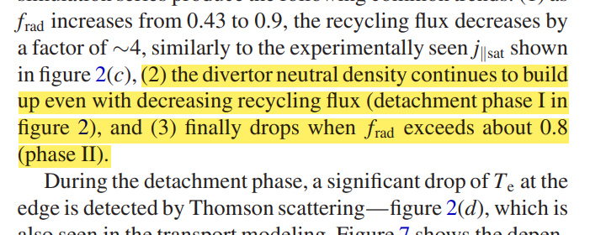
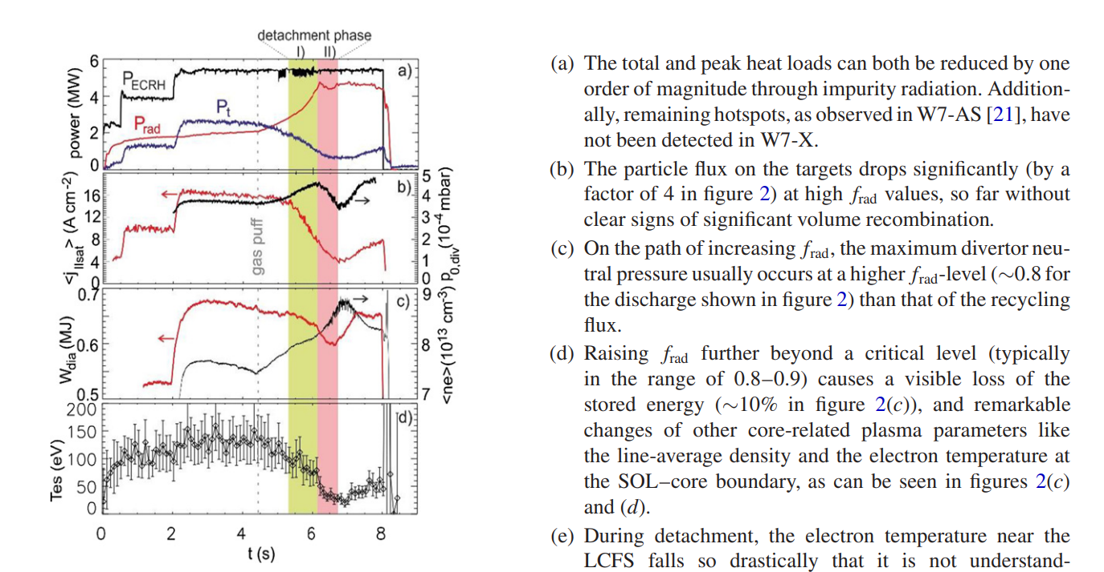
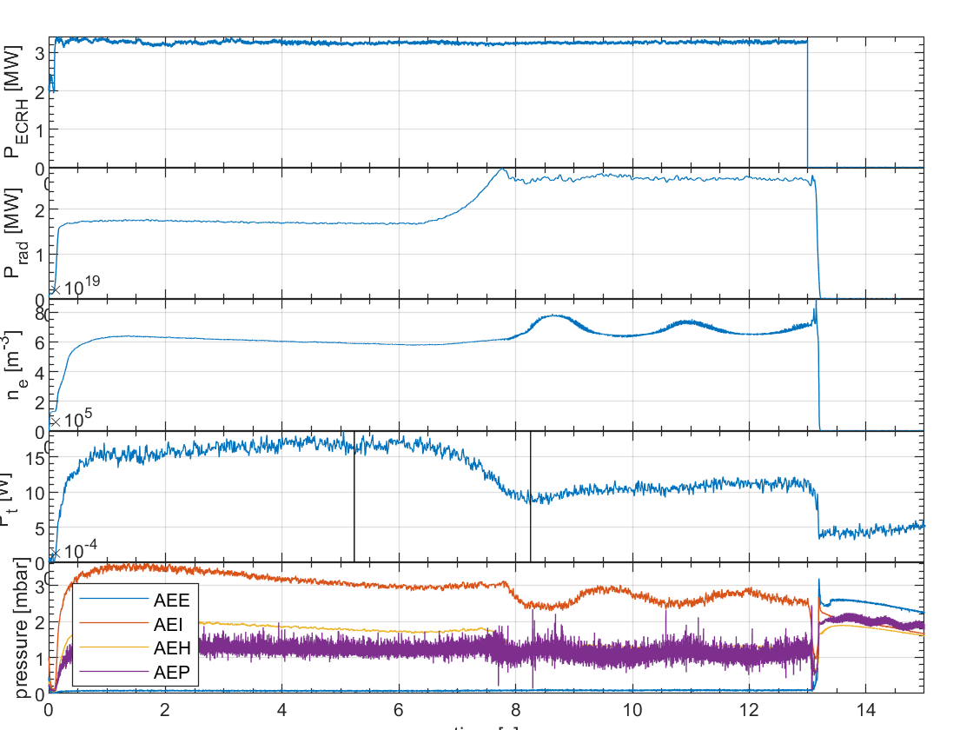
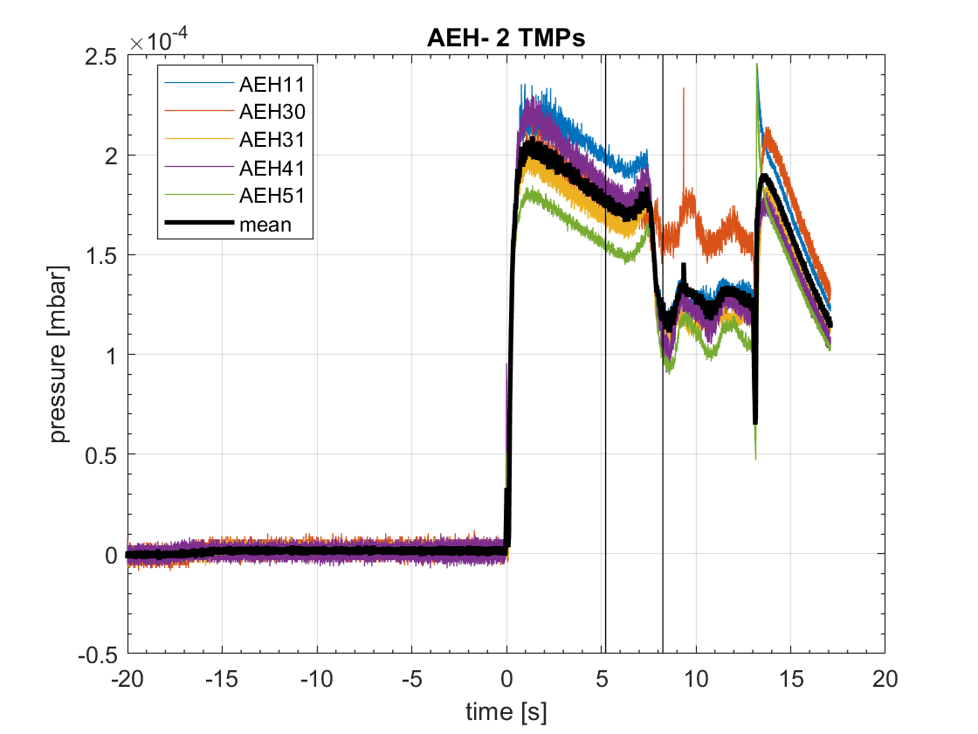
Neutral gas pressure during transition to detachment
20180814.025
Highest neutral gas pressure in divertor seems to occur at the highest f_rad (at least for NPGS at AEH)
After that, the neutral gas pressure decreases
Increase of the neutral gas pressure before detachment cannot be observed in every discharge
20180814.016
Detachment phase
Source: Feng et al 2021
Clear definition for the start of detachment needed
General trend for the evolution of the neutral gas pressure during detachment ís difficult to detect…

Slide 12
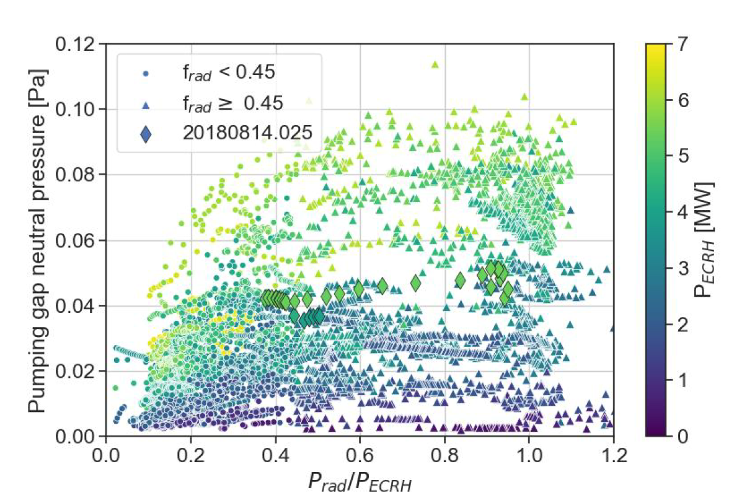
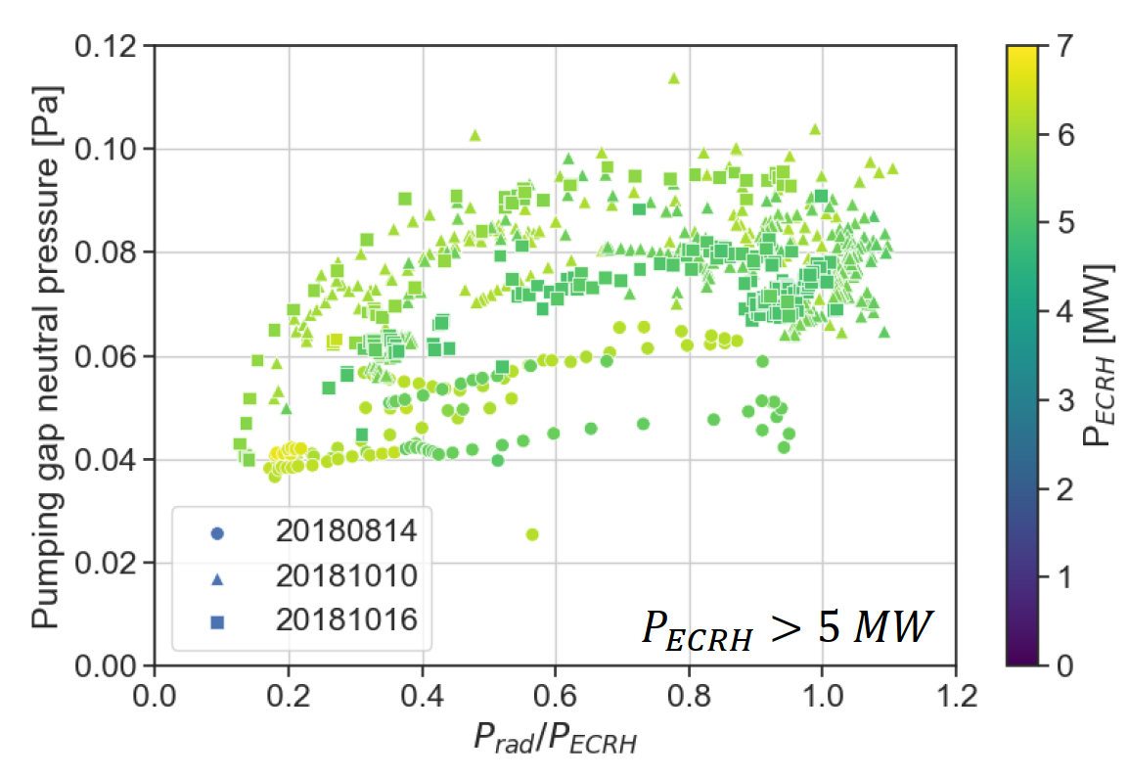
Neutral gas pressure during detachment
Source: presentation; V. Perseo – OP1.2b detachment in the juice
Dependence of the neutral gas pressure on f_rad not very obvious

