Slide 1
OP2 Proposals: Divertor Plugging
Amit Kharwandikar

Slide 2
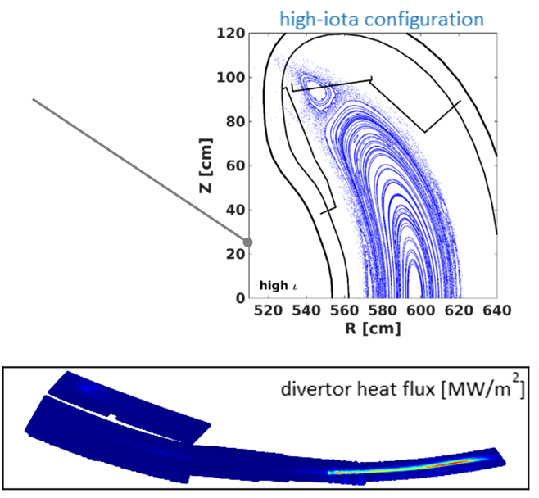
Proposals

Slide 3
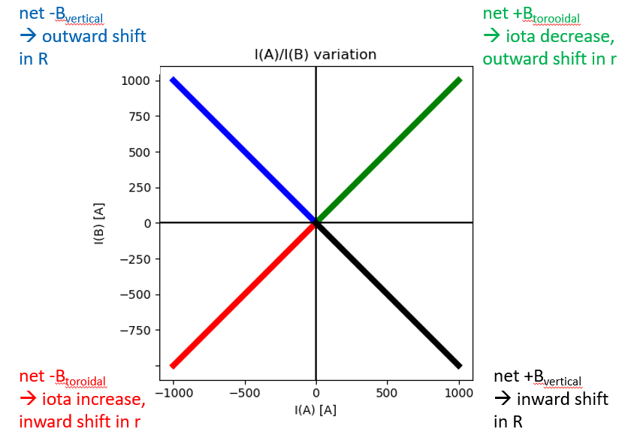
Tool: Effect of Planar coil currents
FTM -> Increase size of plasma
KJM -> Outward shift of plasma + Increase size of plasma
Change currents to observe effects on separatrix ->

Slide 4
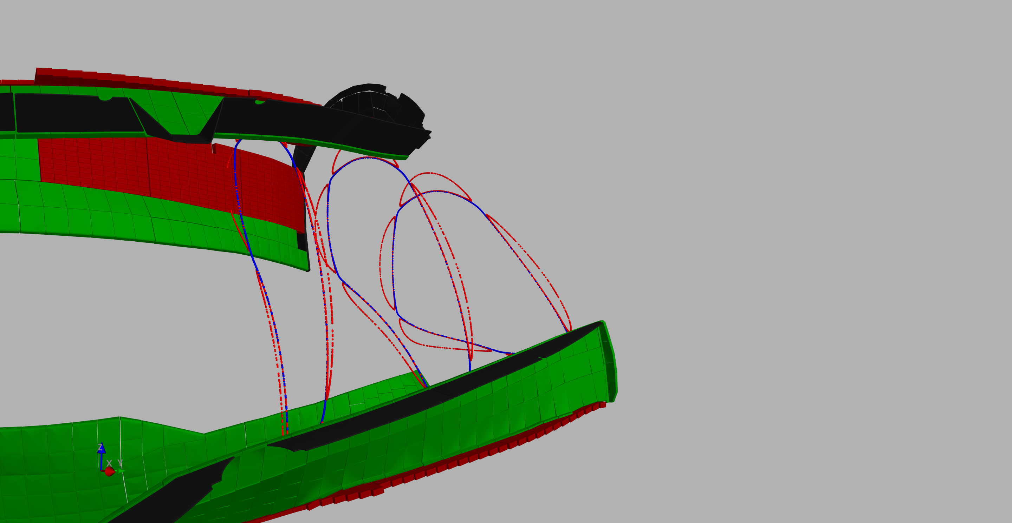
Tool: Poincare maps

Slide 5
Main goal
Load outboard and inboard PFCs, primarily baffles till 250 KW/m^2
With hot, dense plasma, close the exit route of neutrals flying
along the baffles
along the TM1h and TM9h ~ end of strike lines
Poloidalally: iota scan
Toroidally: mirror ratio

Slide 6
Discussion

