Slide 1
E-TASC / TSVV Task #13 Stellarator Turbulence Simulation 6th meeting
J. M. García Regaña

Slide 2
Workplan 2021
2021 report approved.
https://idm.euro-fusion.org/?uid=2P4KFS&version=v1.0
5th E-TASC SB (2-3 March) focused on reporting of 2021 activities and main achievements of the TSVV.
The weight between code development and code exploitation has been different from what was initially expected … Nonetheless, code developments, initially unforeseen, have been carried out, and several physical problems have been addressed earlier than planned.

Slide 3
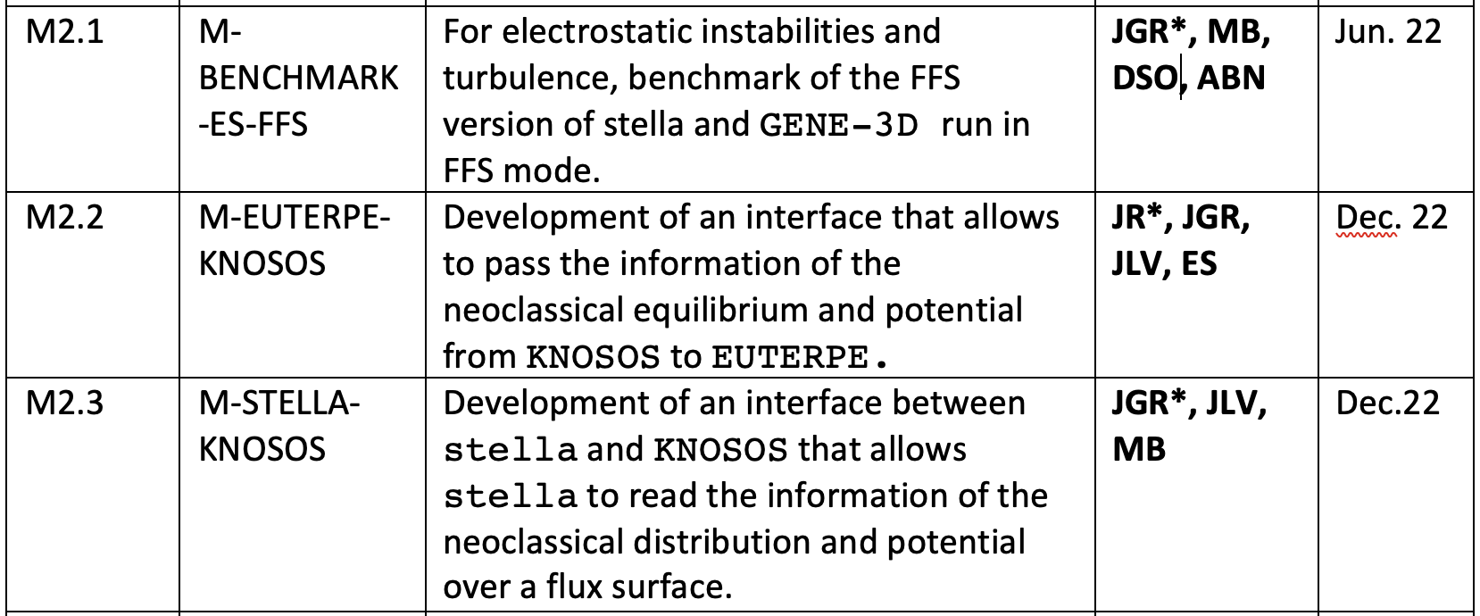
Workplan 2022: milestones
(new) M-TANGO-KNOSOS: coupling of the code KNOSOS to the transport code TANGO, to input neoclassical fluxes apart from turbulent fluxes from GENE-3D. (JLV, ABN)
(new) M-STELLA-TOK-GLOBAL: global gyrokinetic version of stella for tokamak simulations (DSO, MB).
(new) M-STELLA-BC: Implementation of generalized T&S boundary conditions for FTs [Martin&Landreman’18] in stella (AGJ, JGR).

Slide 4
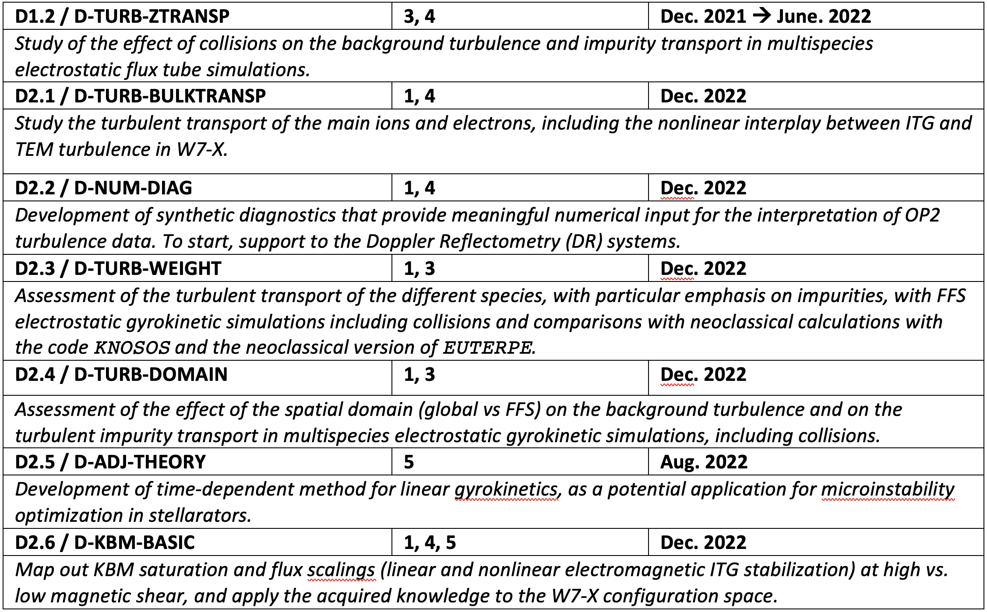
Workplan 2022: Deliverables

Slide 5
Workplan 2022: Deliverables
Please, consider these as a living lists and communicate developments aligned with the deliverable content as well as any additional progress unforeseen initially, e.g. W7-X campaign support, 3D tokamak activities, TANGO-KNOSOS coupling, stellarator BC in stella, …

Slide 6
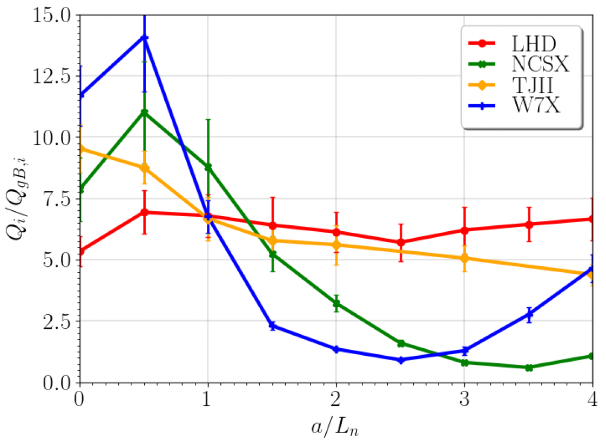
Workplan 2022: Deliverables
[Thienpondt EFTC’21]
Please, consider these as a living lists and communicate developments aligned with the deliverable content as well as any additional progress unforeseen initially, e.g. W7-X campaign support, 3D tokamak activities, TANGO-KNOSOS coupling, stellarator BC in stella, …

Slide 7
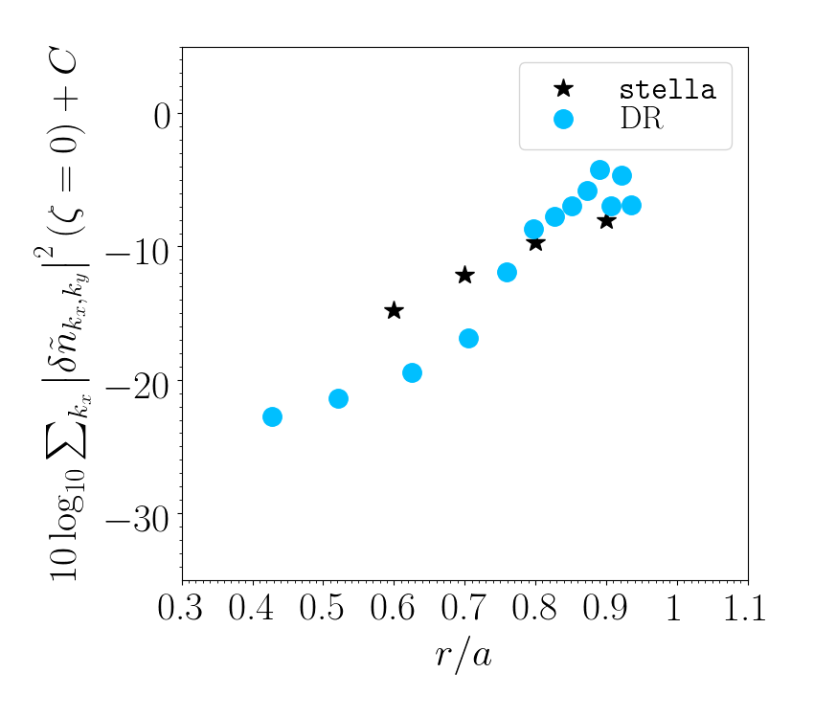
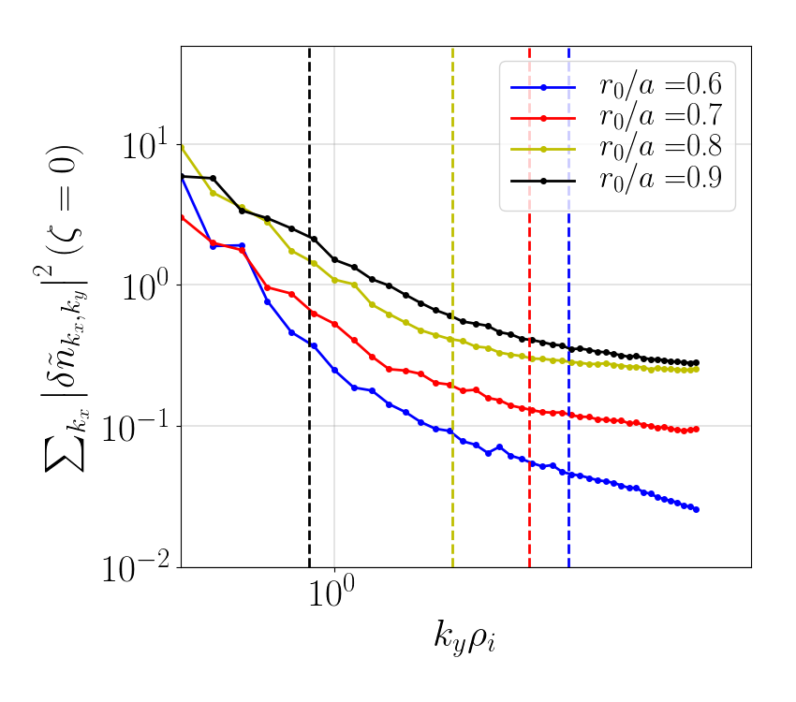
Workplan 2022: Deliverables
[González-Jerez ongoing’22]
Please, consider these as a living lists and communicate developments aligned with the deliverable content as well as any additional progress unforeseen initially, e.g. W7-X campaign support, 3D tokamak activities, TANGO-KNOSOS coupling, stellarator BC in stella, …

Slide 8
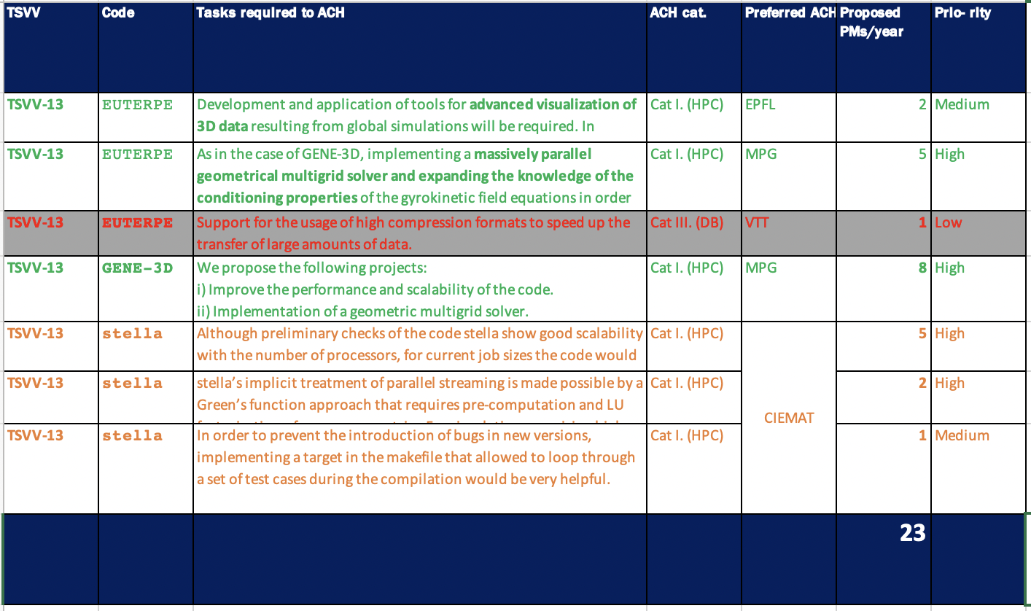
TSVV13 requests on ACHs for 2023 (DL 28/2/2022)
Requests for 2021-2022 to be continued/launched in 2023

Slide 9
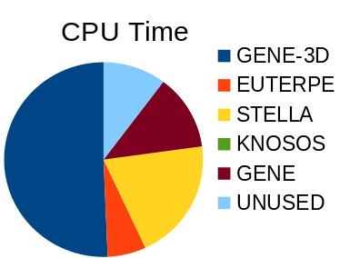
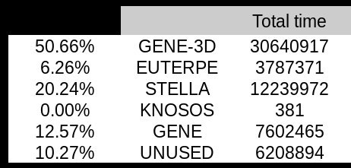
HPC resources
The usage of the TSVV/Marconi: about 90 % spent budget of 60 M CPUhrs.
Granted 82 M CPUhrs for the 6th Marconi cycle, to begin on March 1.
Figures by H. Thienpondt

Slide 10
Next Meetings
Regular meetings
February 14
March 14
April 11 ?
May 9
June 13
July 11
August
September 12
October 10
November 14
December 12
Next E-TASC SB
March 2 and 3 (PIs to present 2021 achievement and progress so far)
Next Thrust* 4 Meeting
March 4
T. Görler (TSVV#1) and D. Told (TSVV#4) as guests.
Topics of interest for the tokamak community to be discussed → feedback?
*Thrust: group of members from related TSVVs, Work Packages (WPs) and other E-TASC programme stakeholders, set as communication platform between WPs and TSVVs on behalf of the entire E-TASC SB. (L. Villard, F. Jenko, I. Calvo, X. Litaudon, P. Helander, S. Henneberg, J. M. G. Regaña in Thrust 4)

