Slide 1

WPPWIE Introduction
M. Reinhart
FZJ Project Support Office

Slide 2
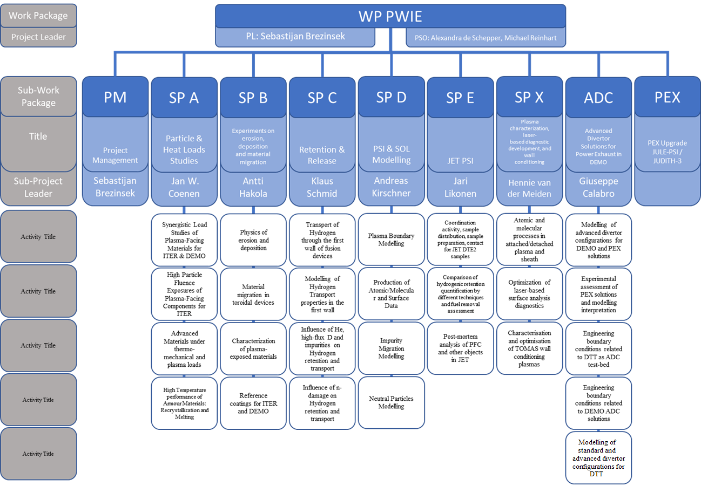
Structure of WP PWIE

Slide 3
WPPWIE Resources 2022
Current Status:
Tasks and deliverables (including resources) have been set up end of 2021 and finalized after the annual meeting of WPPWIE in January 2022.
Tasks and deliverables (including resources) for 2022 have been entered in IMS in February 2022.
This version of the resource allocation (from IMS) will be approved by the WPPWIE Project Board in March 2022 and by the General Assembly in April 2022.
2023-2025 Resources are allocated as „Indicative Resources“ and are also approved by the General Assembly.

Slide 4
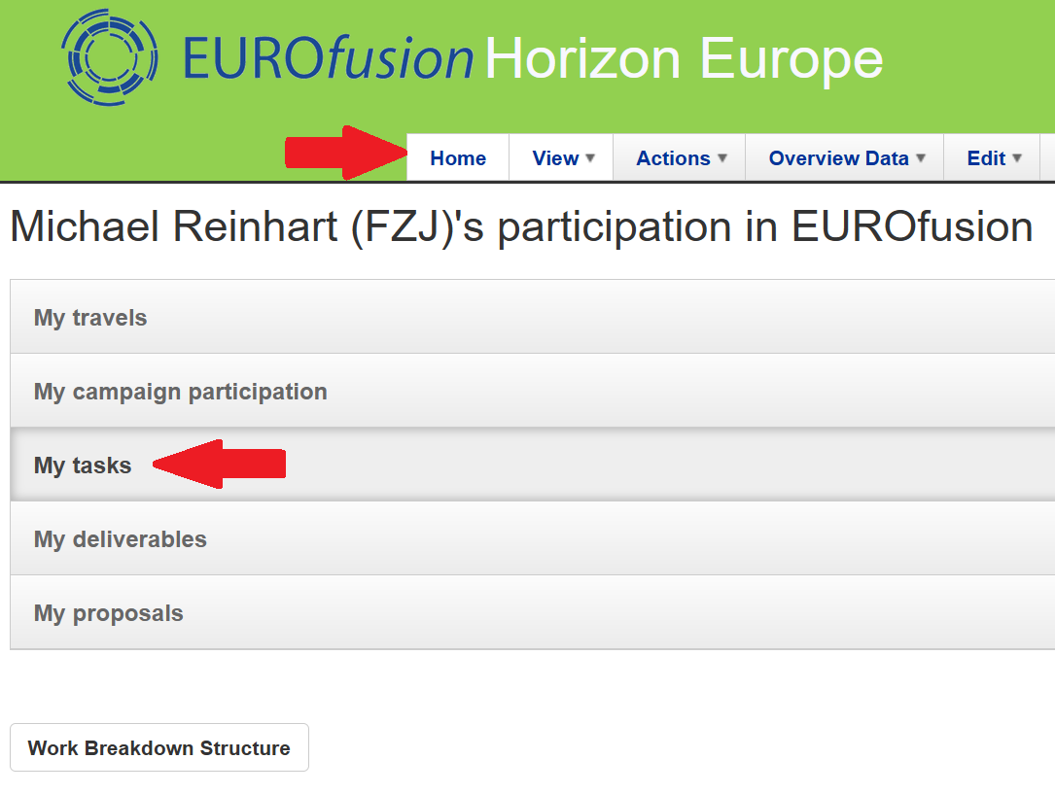
IMS Review of task specifications
Task definitions on IMS (E.1, E.2, E.3) now need to be reviewed and approved.
Reviewers include the deliverable owners. Please check any automated emails which are coming from IMS, and periodically check your tasks on IMS (table under „Home“-“My tasks“).

Slide 5
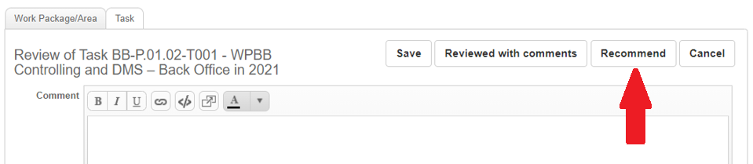
IMS Review of task specifications
Deliverable owners need to check if the title of their deliverable (description of their work) is correct and if they are the correct person to be deliverable owner (=person responsible for the completion of this work, not neccessarily the only person actually doing the work)
If all is OK, press „Recommend“.
If there is any issue, do nothing on IMS, instead contact the (Sub-)Project Leader (Jari Likonen, Sebastijan Brezinsek) and the PSO (Michael Reinhart)

Slide 6
Reporting of 2022 work
The reporting of the 2022 deliverables is due on 31/12/2022.
Reporting will be done via the Subproject Leader with the documents for the Annual Review meeting in November 2022.
Any activities/results after November can be added to the reports afterwards.
Deliverables that are delayed beyond 2022 (=not ready to be reported), will be reported in seperate documents when the work is done.
Deliverables that have not started at all in 2022 will be completely transferred to 2023.

Slide 7
Important links
IMS: https://ims.euro-fusion.org/fp9/ (also for IMS+IDM account application!)
WPPWIE Project Documents: https://idm.euro-fusion.org/default.aspx?uid=2PBXPU
WPPWIE Reporting: https://idm.euro-fusion.org/default.aspx?uid=2PLQPF
SPE Email list: https://lists.euro-fusion.org/listinfo/wppwie-spe
Thank you for your attention!

