Slide 1
WP PWIE SPE kick-off meeting
Jari Likonen

Slide 2
Goals and agenda of the meeting
The goals of the meeting are to
Introduce and discuss the tasks attached to each Research Unit under SPE
Identify possible gaps and opportunities for collaboration, and
Decide on concrete next steps, to be reviewed in the summer
9:30
9:45
Introduction to PWIE and SP E
Presentations of SP E task holders – please focus on the question ”What will be done in 2022 and what is needed from others/EUROfusion”
Please be brief: each presentation is 8 min + 2 min for quick feedback Discussion
End of the meeting
11:45
12:15
Everybody is invited to contribute to the discussions, also those who are not task holders of any of the SP E activities!

Slide 3
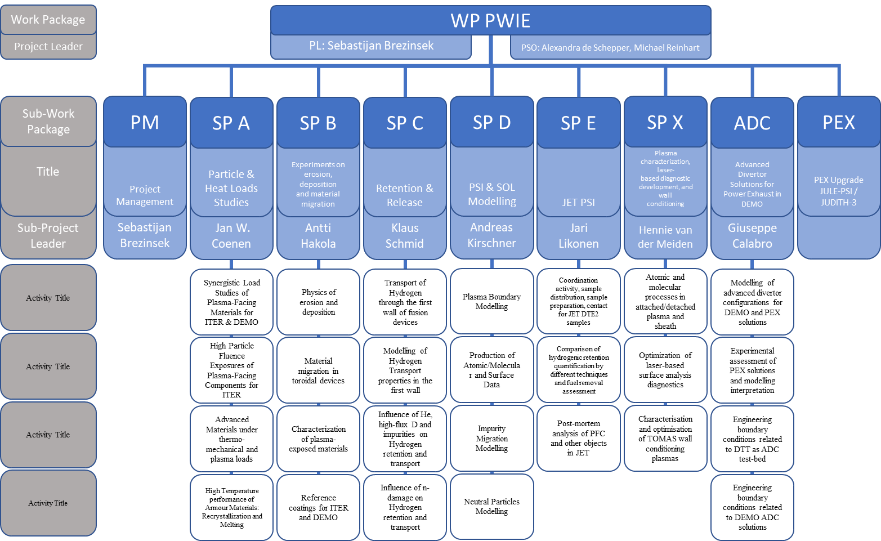
Structure of PWIE and SP E

Slide 4
SP E focus points in 2022
I: Coordination activity, sample preparation and distribution for remaining JET ILW3 samples → SP E.1
II: Comparison of hydrogenic retention quantification by different techniques and fuel removal assessment (ITER housekeeping approach) → SP E.2
III: Investigation of material migration from the limiters and the main wall towards the divertor (ITER). Post-mortem analysis of PFCs and other diagnostic components, modelling under SP D → SP E.3

Slide 5
General issues – sample logistics
Sample distribution from CFFE and VTT will start based on the analysis plan
Before shipping any samples to another RU the sending RU must inform both CCFE (I. Jepu) and VTT (J. Likonen)
Before shipping any samples to another RU the sending RU must ask permission from the receiving RU to accept the shipment
      List each item (sample) to be shipped
      Provide the estimated total T activity (usually this is obtained from CCFE or VTT)

Slide 6
Contact info and next steps
Your SP E contact
Jari Likonen (jari.likonen@vtt.fi)
Project leader
Sebastijan Brezinsek (s.brezinsek@fz-juelich.de)
Project Support Officer
Michael Reinhart (m.reinhart@fz-juelich.de)
PMU Coordination Officer David Douai (david.douai@cea.fr)
1st project meeting in January
2nd project meeting in ~July
                progress report 2022
3rd project meeting in ~November
          report 2022
1st project meeting in January 2023
  planning 2023

Slide 7
Analysis plan 2022
CU (Comenius University)
        Participation in LIBS and LID-QMS experiments at FZJ and VTT
    Data analysis of LIBS and LID-QMS results
FZJ
      Fuel retention studies using LID-QMS, TDS jointly with CU
  Several castellation Be samples from limiter and upper dump plate tiles, poloidal section from HFGC tile and tile 1 (ILW3) for LID-QMS
  Metallography and microstructure of W lamellae
  Samples from W lamellae (B02, B12, B13, B17, B23 and B24)
  Comparison with stack C samples (OSP on stack C)
  Cutting of Langmuir probes?
IAP
    Sample preparation (Be tile, W lamellae, Langmuir probes?, louvre clip?)
    Fuel retention studies using GDOES and TDS (divertor samples)
    Louvre clips: chemical structure of co-deposits with XPS

Slide 8
Analysis plan 2022
IPPLM (WUT,NCBJ)
        Microstructure of Langmuir probes (W-wedge 1, 3, 5) and W lamellae (stack B, C)
        SEM, TEM, FIB, nanoindentation, XRD?
ISPP_UL
      Fuel retention studies using FC, TDS (divertor samples from tiles 0 and 1, simulation of C39 baking cycle)
      Samples from W lamellae (stack B, C, D, poloidal set)
  Louvre clips: chemical structure of co-deposits with FT-IR
IST
    Fuel retention studies using IBA (divertor samples from tiles 0 and 1)
    IBA analyses before and after TDS
    IBA analysis of mirror cassettes (tubes) for metal migration
    AMS (for tritium)?
  MPG
  Fuel retention studies using IBA (divertor samples from tiles 0 and 1)
  Analysis of W lamellae (stack B, before cutting)

Slide 9
Analysis plan 2022
NCSRD
        Fuel retention studies of divertor samples (tiles 0 and 1) with D beam
        µ-beam analysis of W lamellae (stack B) to compare with stack A samples
VR
      Fuel retention studies using IBA (divertor samples from tiles 0 and 1)
      µ-beam analysis of Langmuir probes
      SEM analysis of IWC inserts (Be coating)
VTT
    Preparation of divertor samples, cross sections for microscopy
    Fuel retention studies using SIMS (divertor samples from tiles 0 and 1)
    Participation in TDS experiments jointly with UKAEA
    UKAEA
    Participation in IBA experiments jointly with IST
    Fuel retention studies using TDS (divertor samples from tiles 0 and 1, simulation of C39 baking cycle, W lamellae)
    Microstructure of Langmuir probes (SEM, nanoindentation)
    Raman analysis of louvre clips

Slide 10
BACKUP SLIDES

Slide 11
SP E.1 planning for 2022
Description of activity | Involved RUs | Due date | Comments
Shipment of 1XR18 C3 to IAP | CCFE, IAP | 2/2022 | RE damage
Cutting of 1XR18 C3 | IAP | 2/2022
Shipment of divertor tiles to VTT | CCFE, VTT | 2/2022
Shipment of W lamellae and mirror cassettes to IAP | CCFE, FZJ, IAP | 3/2022 | B02, B13, B14, B23, B24 available Decision on how many to cut
Shipment of Langmuir probes | CCFE, IPPLM | 3/2022 | Decision on how many
Coring of tile 14IWG1A, 14BNG4D, 2BNG6C, 2ONG7A, 2ONG8B | VTT | 4/2022
Cutting of mirror cassettes in 2023?
Notes:
Replace by your deliverables

Slide 12
SP E.1 planning for 2022
Description of activity | Involved RUs | Due date | Comments
Cutting of W lamellae | FZJ, IAP | 5/2022 | Cutting of W lamellae
Shipment of samples from tiles 0 and 1 | VTT, IST, MPG, NCSRD, VR | 5/2022 | First IBA and then TDS,LIBS,LID-QMS
Shipment of samples from tiles 0 and 1 | VTT, FZJ, IAP, ISSPUL | 6/2022 | Tile 0: c-series partly used for TDS, a- and b-series for IBA, TDS…
Sectioning and preparation of samples from metallic JET components | IAP | 7/2022
Notes:
Replace by your deliverables

Slide 13
SP E.2 planning for 2022
Description of activity | Involved RUs | Due date | Comments
SIMS analysis, tile 0 and 1 samples | VTT | 5/2022 | 2 sets from tile 0 available
IBA analysis, tile 0 and 1 samples (1st set) | IST, CCFE | 6/2022
IBA analysis, tile 0 and 1 samples (1st set) | MPG | 7/2022
IBA analysis, tile 0 and 1 samples (2nd set) | NCSRD | 6/2022
IBA analysis, tile 0 and 1 samples (2nd set) | VR | 7/2022
TDS analysis and post IBA analysis, tile 0 and 1 samples | CCFE, IST, VTT | 9/2022
Cutting of mirror cassettes in 2023?
Notes:
Replace by your deliverables

Slide 14
SP E.2 planning for 2022
Description of activity | Involved RUs | Due date | Comments
Characterization of tiles 0 and 1 with LIBS, LID-QMS, TDS and metallography | FZJ, CU | 11/2022
Analysis of samples from tiles 0 and 1 with TDS and GDOES | IAP | 11/2022
Analysis of samples from tiles 0 and 1 with TDS, FC and dissolution method | CCFE, ISSPUL, VTT | 11/2022
Simulation of JET39 baking cycle, post-characterization with IBA | ISSPUL, IST | 11/2022
Cutting of mirror cassettes in 2023?
Notes:
Replace by your deliverables

Slide 15
SP E.3 planning for 2022
Description of activity | Involved RUs | Due date | Comments
Electron microscopy, nanoindentation of Langmuir probes, W lamellae | IPPLM, CCFE | 6/2022
Characterization of JET PFCs with LIBS , LID-QMS, TDS and metallography | FZJ, CU | 6/2022
Characterization of PFCs and diagnostics components using IBA | VR | 8/2022
Notes:
Replace by your deliverables

Slide 16
SP E.3 planning for 2022
Description of activity | Involved RUs | Due date | Comments
Characterization of JET PFCs and diagnostics components using IBA | IST, MPG | 9/2022
Analysis of JET PFCs with TDS, XPS and GDOES | IAP | 9/2022
Analysis of JET PFCs with μbeam NRA | NCSRD | 9/2022
Raman analysis of louvre clips | CCFE | 9/2022
Characterization of JET PFCs using TDS, FC of JET PFCs | ISSPUL | 11/2022
Characterization of JET PFCs using SIMS | VTT | 11/2022
Notes:
Replace by your deliverables

