Slide 1

IAP activities in 2022: Sample preparation and TDS and GDOES analysis of JET samples- plans and capabilities
C.P. Lungu, C. Porosnicu, B. Butoi, O. G. Pompilian, C. Staicu, V. Zaroschi
E. Grigore, C. Ruset, F. Baiasu
IAP (Institute of Atomic Physics, Bucharest, Romania)

Slide 2
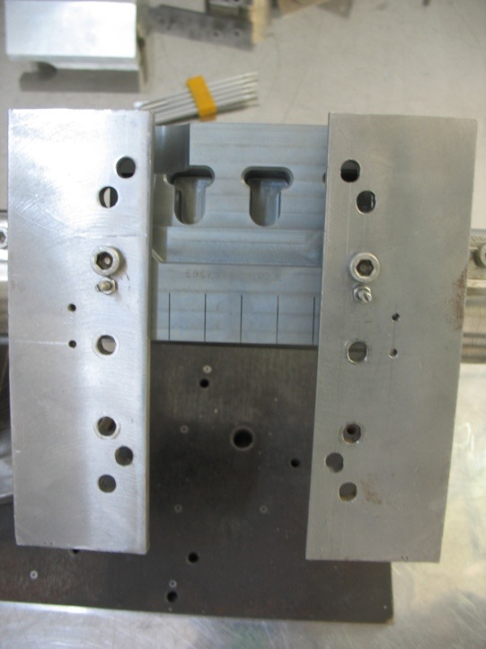
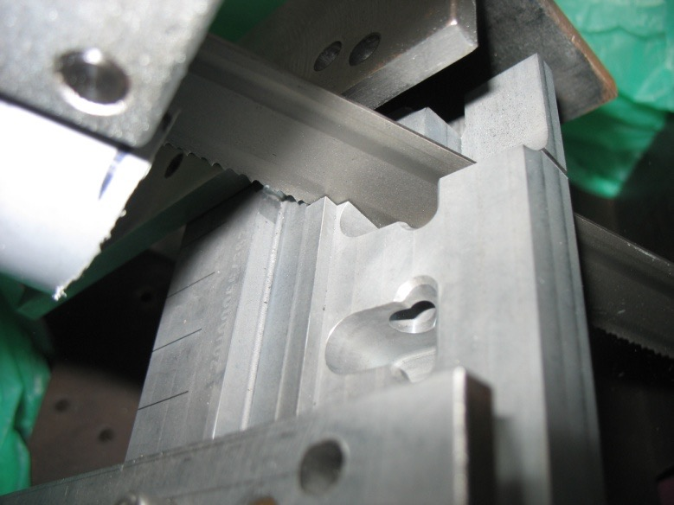
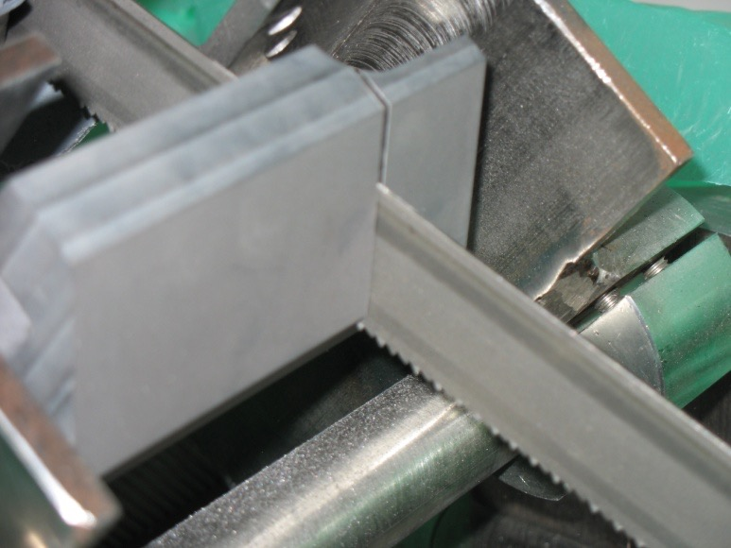
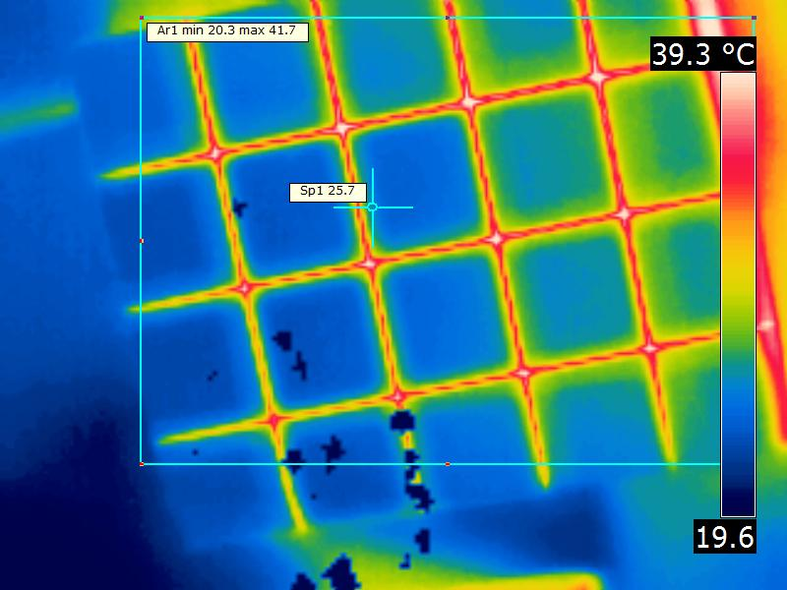
2022 Sample preparation and cutting – Be tiles
Using beryllium processing facility, we extract components of the Be tiles
Typical sample sizes: 10 mm x 10 mm x 10-12 mm or 10 mm x 10 mm x 2.5 mm
Any other size is possible with some constrains
For temperature monitoring in real time a FLIR® E-Series Advanced Thermal Imaging Camera, (+/- 1 ºC ; 20-900 ºC) was used
During cutting the tile temperature did not exceed 58ºC

Slide 3
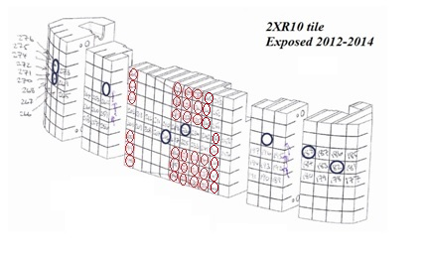
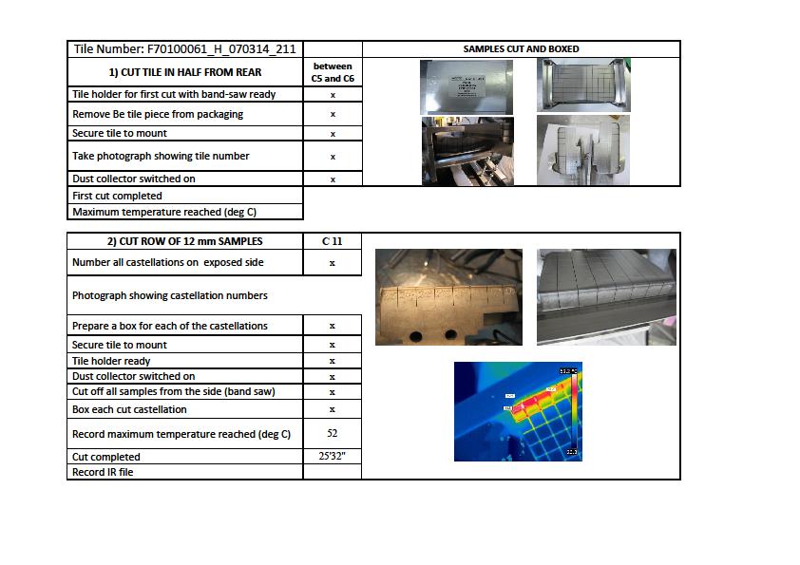
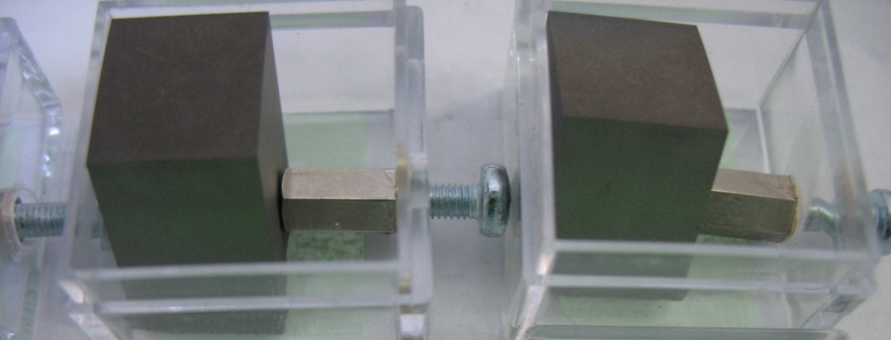
2022 Sample preparation and cutting – Be tiles
Cutting process recording document
Cut samples were packed in special 1” x 1” x 1” plastic boxes and sent to CCFE.
Active surfaces were not touched or exposed to any foreign object

Slide 4
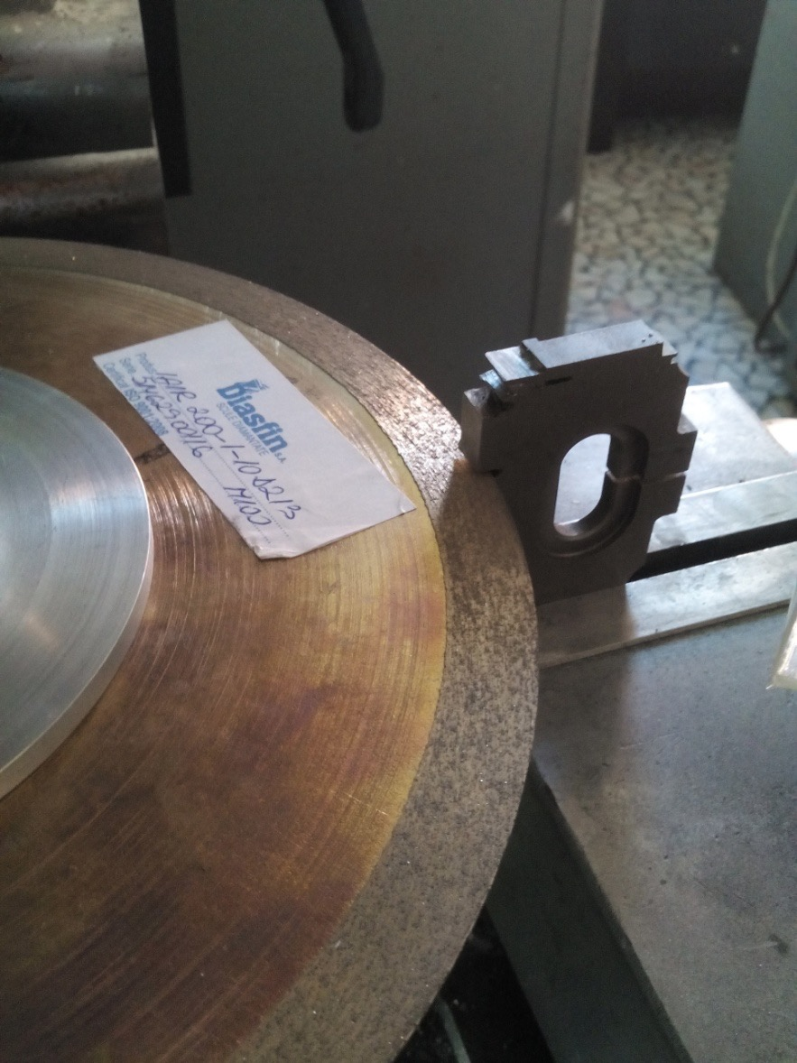
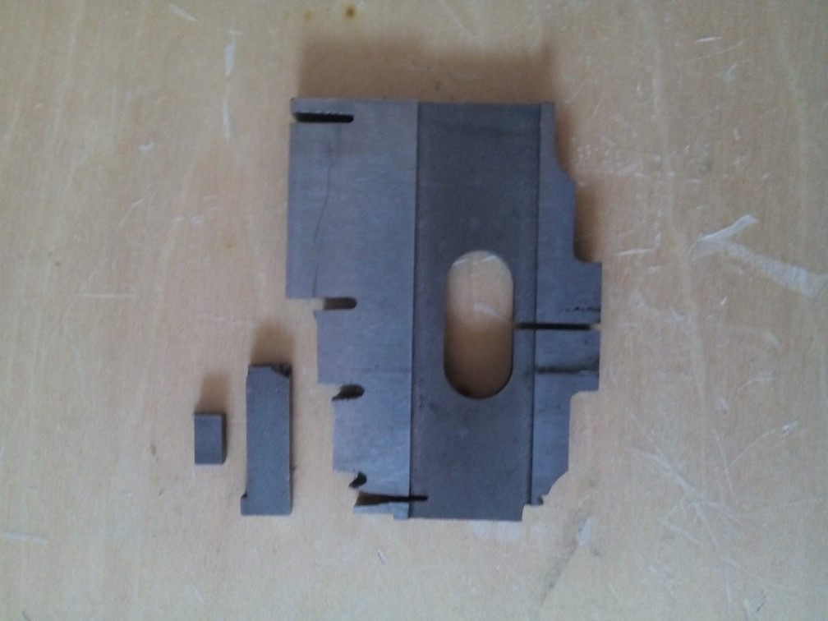
2022 Sample preparation and cutting - W lamelae
- Special designed diamond milling discs/machine

Slide 5
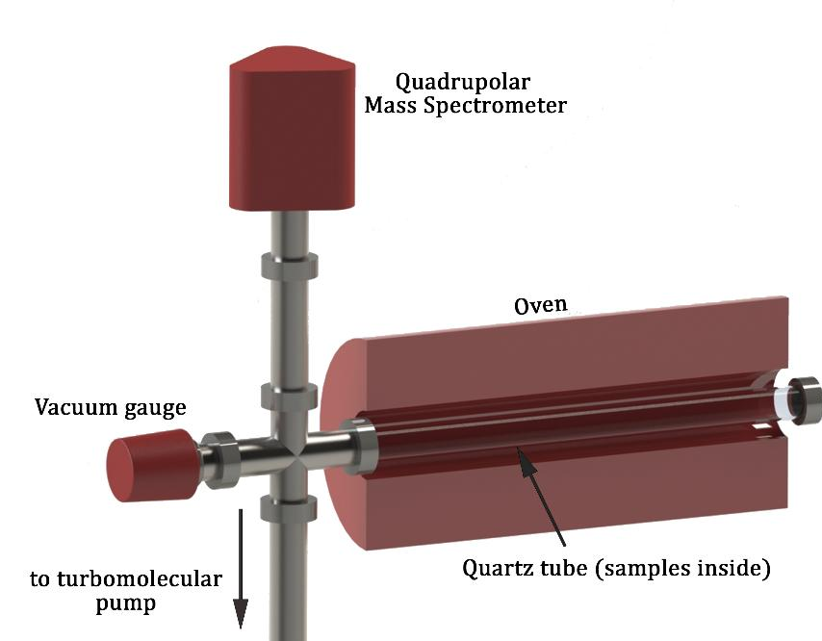
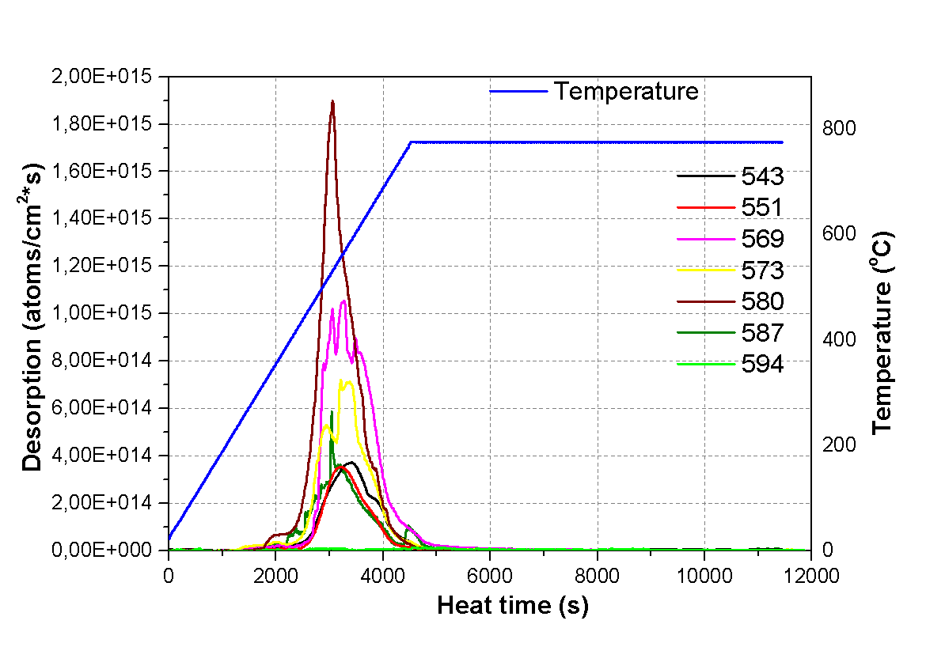
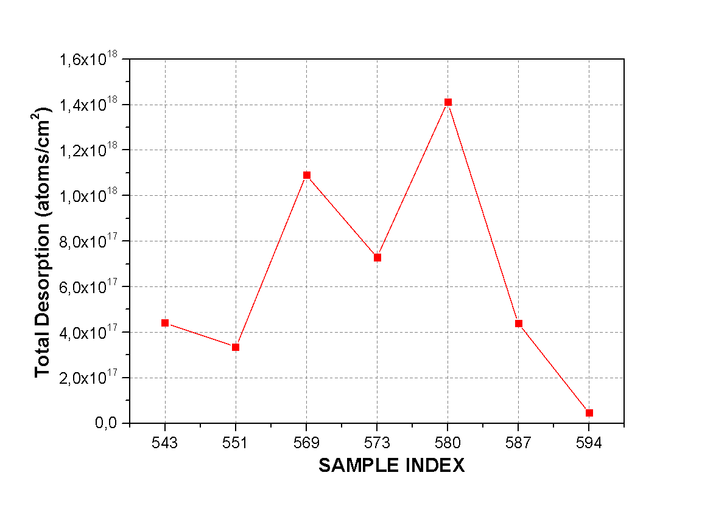
2022 TDS capabilities
Quadrupole mass spectrometer and an oven with a linear heating rate up to a maximum temperature of 1300 K.
Information provided by the TDS system identifies the trapping states of gaseous components in materials and to accurately measure their inventory.
Post mortem analysis of first-wall tiles and divertor components from JET fusion reactor.
Sample number | D inventory (atoms)
543 | 4.40E17
551 | 3.35E17
569 | 1.09E18
573 | 7.28E17
580 | 1.41E18
587 | 4.38E17
594 | 4.50E16

Slide 6
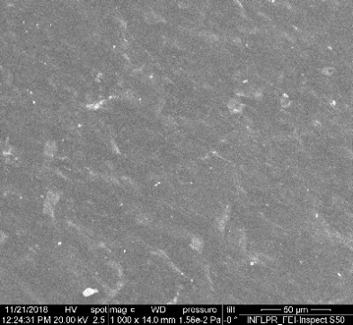
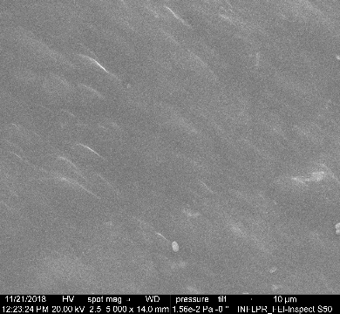
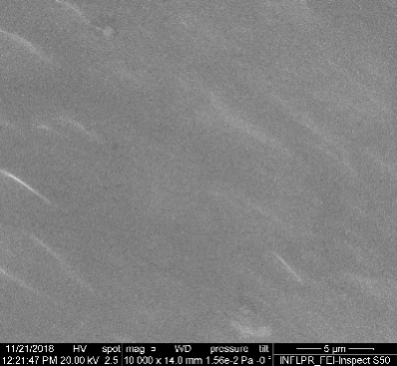
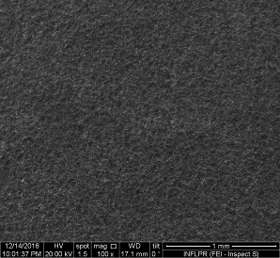
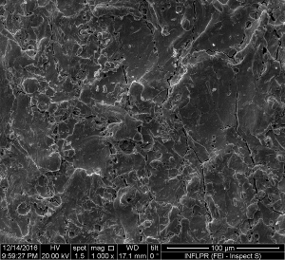
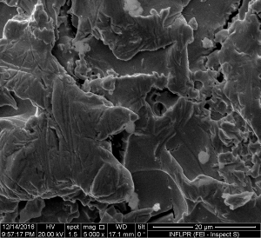
2022 SEM imaging capabilities
Sample number | 1000x | 5000x | 10000x
437
Sample / Lamella | 100x | 1000x | 5000x
5/A23

Slide 7
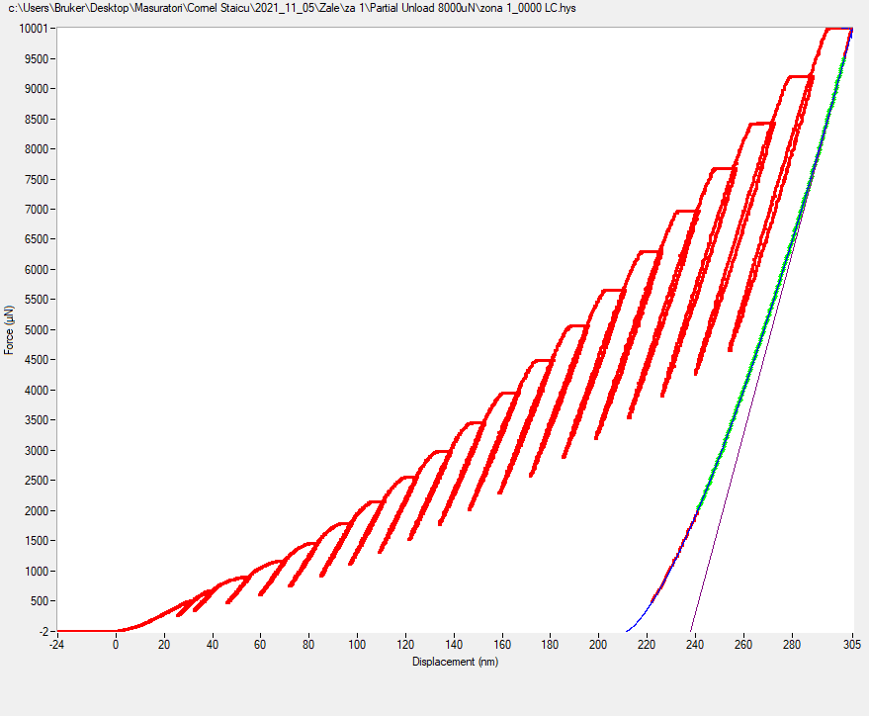
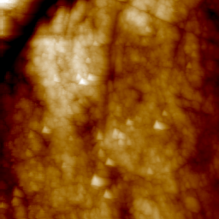
2022 Nanoindenting capabilities

Slide 8
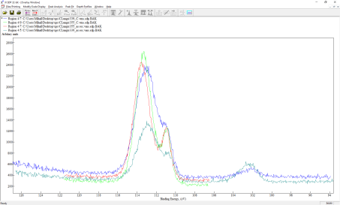
2022 Other capabilities – XPS evaluation
Samples (4D14):
339
339 c (Ar etched for 10 min)
355
355c (Ar etched for 10 min)
Sample | C 1s (%) | O 1s (%) | Be 1s (%) | Ni 2p3 (%) | N 1s (%) | Fe 2p3 (%)
182 | 13.1 | 26.2 | 59.6 | - | 1.1 | -
182_C | 2.8 | 23.2 | 72.4 | 0.1 | 1.5 | 0.1
226 | 37.6 | 12.6 | 47.7 | - | 1.6 | -
226_C | 96.6 | 1.3 | 2.1 | - | - | -
289 | 20.3 | 26 | 51.4 | - | 2.4 | -
289_C | 13.1 | 26.3 | 58.1 | 0.1 | 2.2 | 0.2
290 | 21.2 | 28.1 | 48.6 | - | 2.0 | -
290_C | 13.9 | 25.4 | 58.9 | - | 1.8 | -
339 | 62.7 | 8.5 | 25.5 | - | 1.6 | -
339_C | 58.4 | 7.7 | 31.3 | - | 2.1 | -
355 | 34.8 | 33.6 | 30.5 | - | 1.1 | -
355_C | 17.1 | 37.7 | 43.9 | - | 1.3 | -
367 | 9.9 | 24.2 | 63.9 | 0.2 | 1.5 | 0.2
367_C1 | 2.0 | 24.7 | 71.8 | 0.1 | 1.2 | 0.2
367_C2 | 1.3 | 37.6 | 57.3 | 0.5 | 2.9 | 0.4
368 | 15.7 | 39.7 | 41.3 | 0.7 | 2.1 | 0.5
368_C1 | 9.8 | 41.3 | 45.0 | 0.9 | 2.4 | 0.6
368_C2 | 1.7 | 40.7 | 52.6 | 1.7 | 2.6 | 0.7
369 | 13.1 | 39.4 | 42.6 | 0.9 | 3.5 | 0.7
369_C1 | 3.0 | 44.2 | 48.0 | 1.3 | 2.9 | 0.7
369_C2 | 1.5 | 38.2 | 53.4 | 2.3 | 3.6 | 1.0
Be, BeO

Slide 9
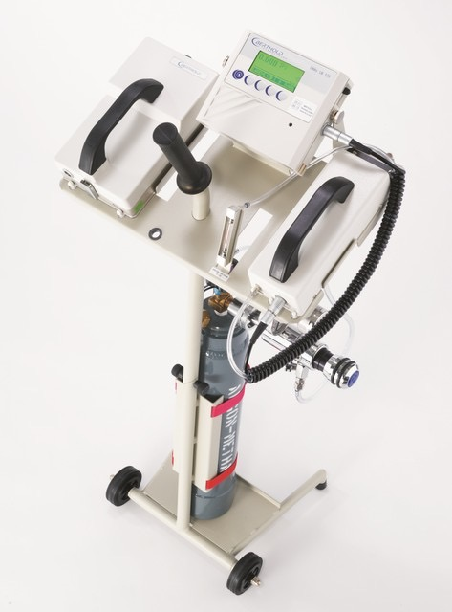
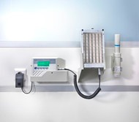
2022 Other capabilities – Surface tritium monitoring
Tritium surface monitor LB 1230UMo with LB 1230 open window gas flow proportional counter detector, Berthold type/ detection area 155 x 15 mm; effective area 22 cm²; detection limits 2.2 Bq, 0.1 Bq/cm² with window completely open.

Slide 10
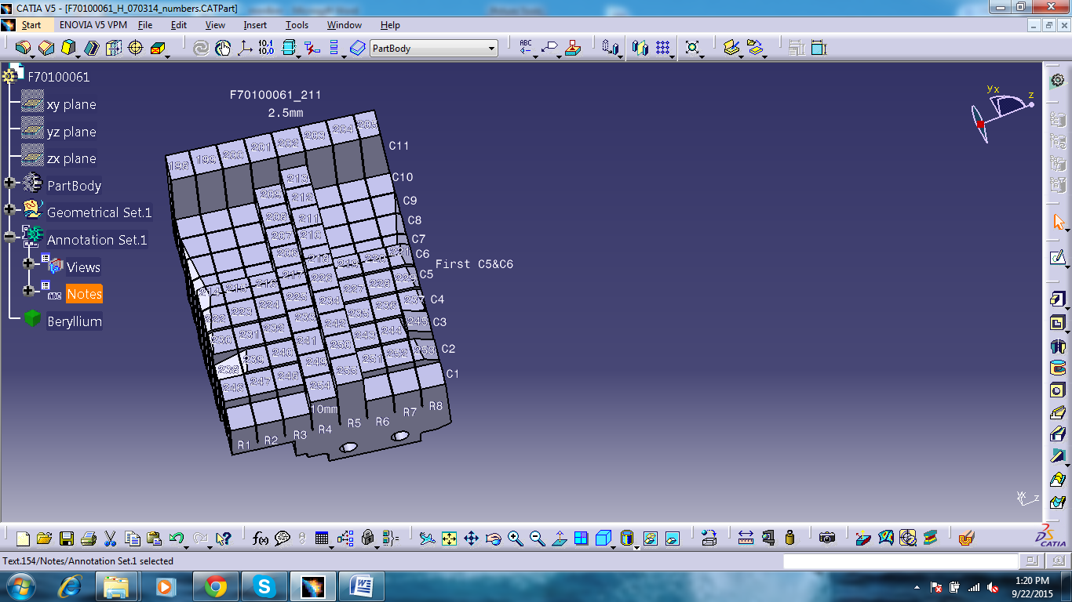
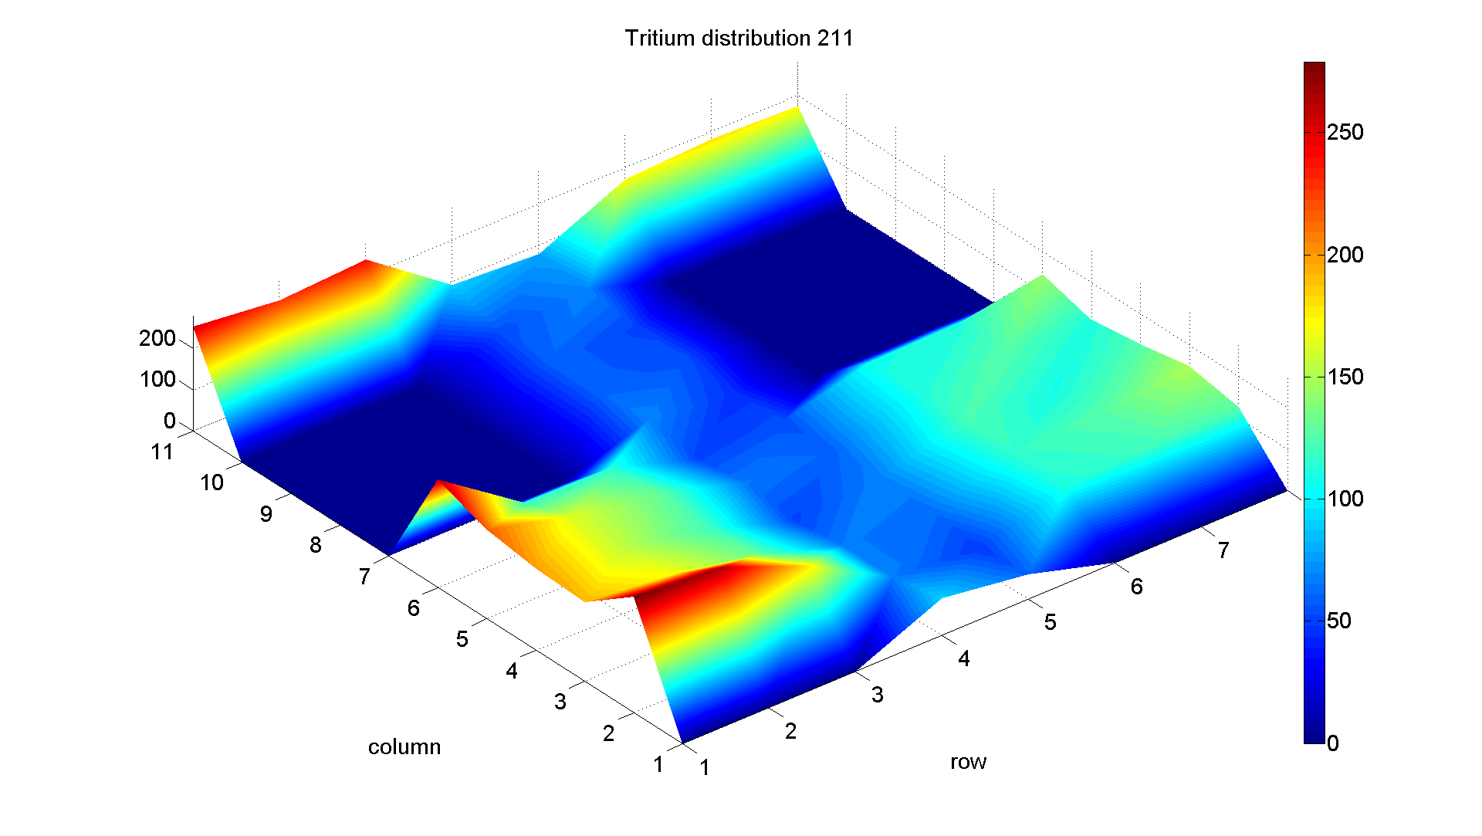
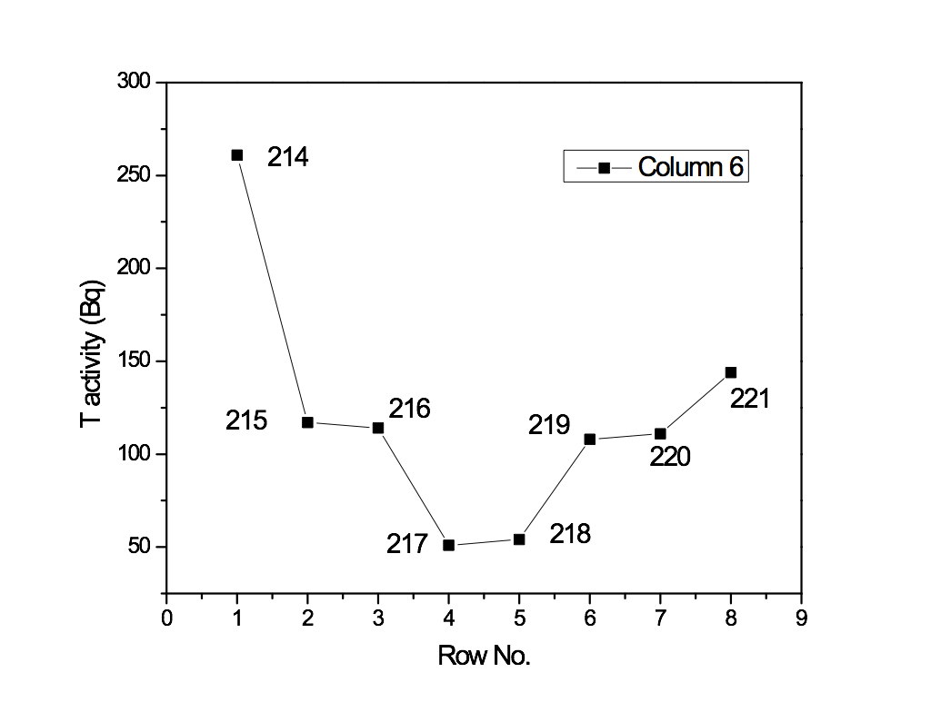
2022 Other capabilities – Surface tritium monitoring
Central tile (211) from 2XR10 IGWL Assembly
36 samples from WPJET3 task were measured

Slide 11
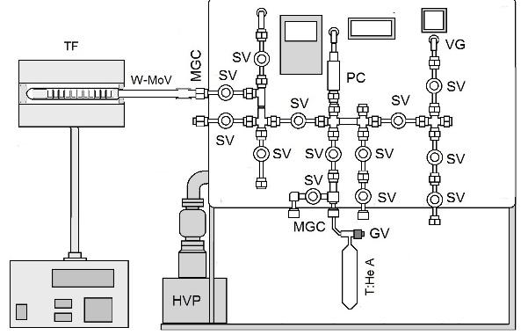
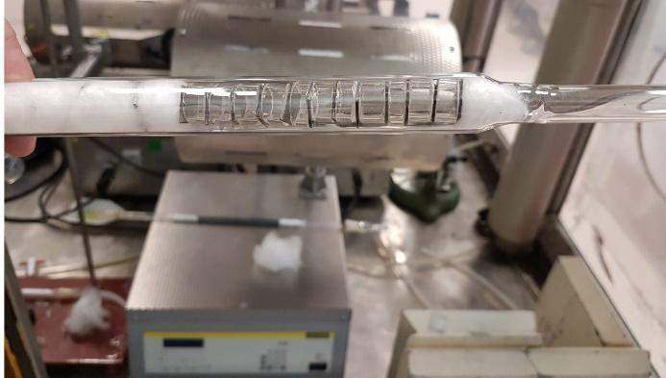
2022 Other capabilities – Sample tritiation
The glass ampule with W-Mo samples was preliminary vacuumed at room’s temperature (1 h at pressure less than 1 Pa) and degassing at 100⁰ C (1 h at pressure less than 1.3 10⁻² Pa).
The W-Mo samples were put in contact with T₂:³He mixture extracted from an old tritium gas source. The samples were kept in the T₂:³He atmosphere for 196 hours at 200⁰ C, followed by slow decrease of the temperature to the room value and maintaining at this temperature for minimum 8 hours.

Slide 12
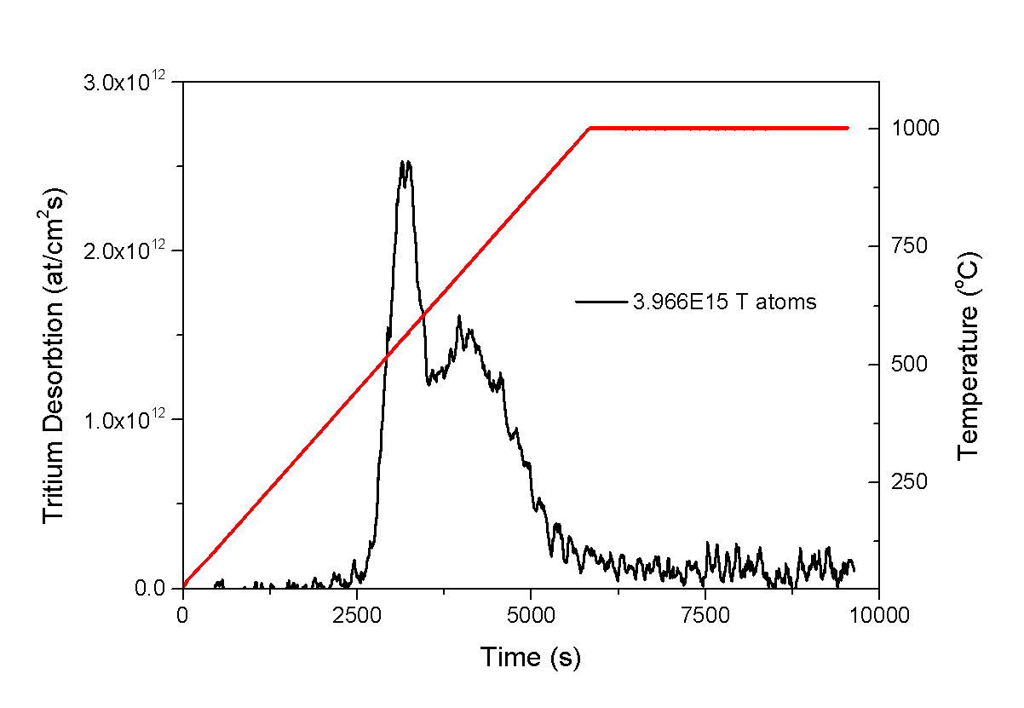
2022 Other capabilities – Sample tritiation
The glass ampule with W-Mo samples was preliminary vacuumed at room’s temperature (1 h at pressure less than 1 Pa) and degassing at 100⁰ C (1 h at pressure less than 1.3 10⁻² Pa).
The W-Mo samples were put in contact with T₂:³He mixture extracted from an old tritium gas source. The samples were kept in the T₂:³He atmosphere for 196 hours at 200⁰ C, followed by slow decrease of the temperature to the room value and maintaining at this temperature for minimum 8 hours.

Slide 13
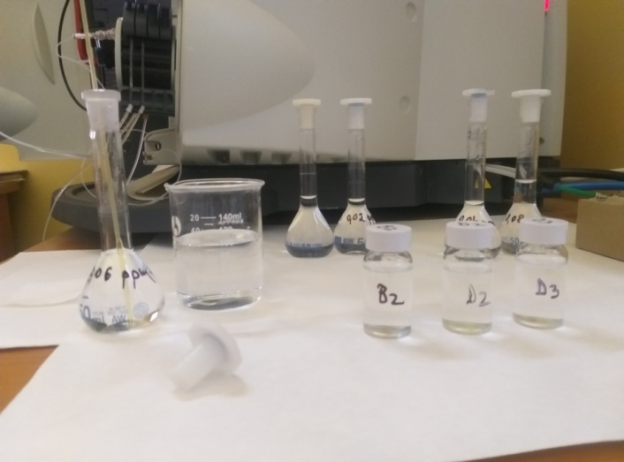
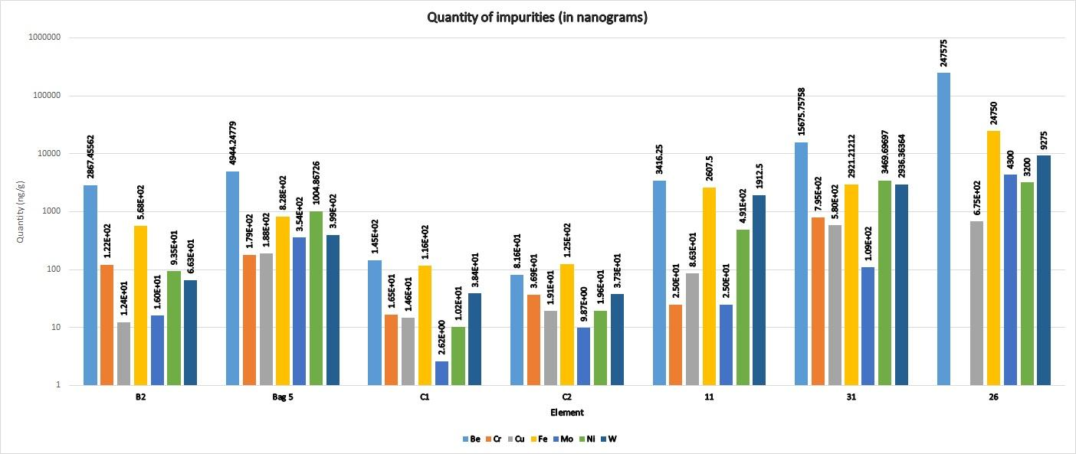
2022 Other capabilities – ICPOES
Sample | B2 | D1 | 31 | C1 | C2 | 11 | 26
Be Wt ratio | 0.766 | 0.626 | 0.592 | 0.422 | 0.248 | 0.399 | 0.854
Cr Wt ratio | 0.032 | 0.023 | 0.030 | 0.048 | 0.112 | 0.003 | 0.000
Cu Wt ratio | 0.003 | 0.024 | 0.022 | 0.043 | 0.058 | 0.010 | 0.002
Fe Wt ratio | 0.152 | 0.105 | 0.110 | 0.338 | 0.379 | 0.304 | 0.085
Mo Wt ratio | 0.004 | 0.045 | 0.004 | 0.008 | 0.030 | 0.003 | 0.015
Ni Wt ratio | 0.025 | 0.127 | 0.131 | 0.030 | 0.059 | 0.057 | 0.011
W Wt ratio | 0.018 | 0.051 | 0.111 | 0.112 | 0.113 | 0.223 | 0.032
B2 - swab pot 27
D1 - divertor dust 2014-11
31 - HFGC Divertor tile (2014)
C1 - 15BNG6D – Dust 2010-2014
C2 – 14BWG6B – Dust 2010-2014
11 - SEM stubs
26 - SEM stubs

Slide 14
Conclusions
Sectioning of Be tiles
Sectioning of selected lamella ILW-2 and ILW-3
SEM imaging of samples
Nano-indentation of Be tiles and W lamellae
TDS and full high temperature outgassing of samples from
sectioned tiles.
Other capabilities
Surface tritium monitoring
Ar sputtered XPS measurements are available
Manufacture tritiated samples for calibration of T measurements and
determine T content
Perform TDS with implanted calibration samples, with D, T, He, etc.
Analysis of dust composition by ICP-OES

Slide 15
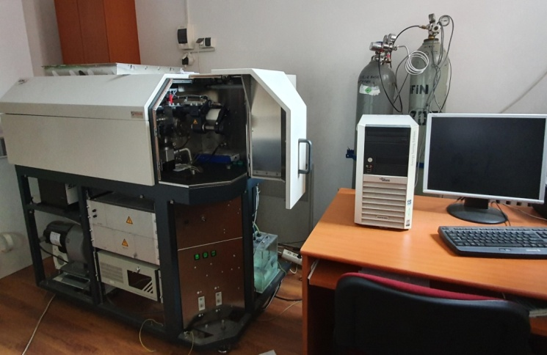
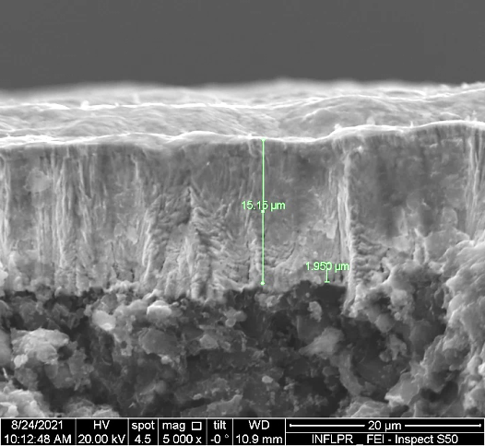
Analysis capabilities:
Glow Discharge Optical Emission Spectrometer (GDOES) able to perform depth profile analysis (29 elements +1). It is provided with a monochromator that can be set on a specific emission line (D, He, etc)
Illustration of GDOES profiles
GDOES equipment
GDOES depth profile for a sample cored from marker tile exposed to WEST plasma (C3- 34il )
SEM image of a cross section for Mo/W marker on FGG

Slide 16
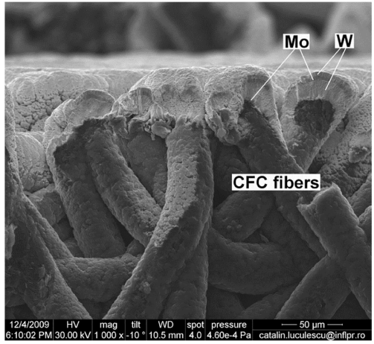
GDOES measurements:
SEM image of a cross section for Mo/W marker on CFC
GDOES depth profles for (witness sample) Tile 3 before plasma exposure in ILW1 campaign
GDOES depth profles for the samples cored from Tile 3 at s = 470 (a) and at s = 554 (b) after plasma exposure in ILW-3 campaign

Slide 17
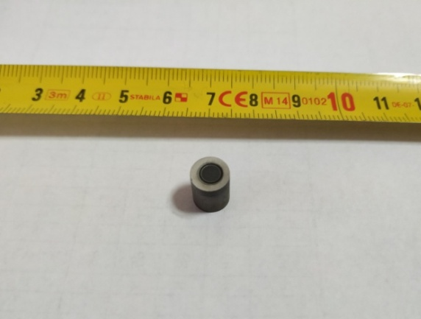
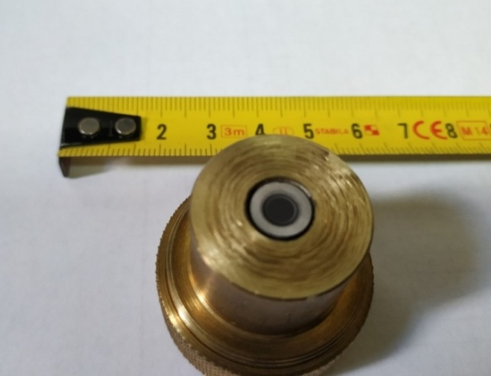
GDOES measurements:
GDOES sample cut
GDOES sample measurement device (a) and cored FGG sample used for GDOES measurement (b)
Requirements: samples Φ= 7mm and h=10mm

Slide 18
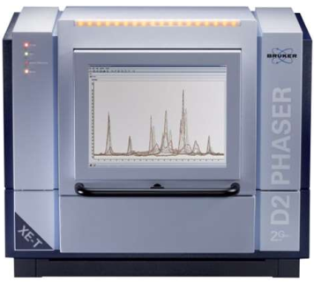
XRD measurements
X-ray diffraction (XRD) equipment. Used for :
- Phase analysis measurements
- Crystallite size measurements
- Quantitative phase analysis
XRD of a Be cut sample

