Slide 1
University of Latvia activities in 2022: Tritium and composition analysis of JET samples – plans and capabilities
E. Pajuste et al
WP PWIE SP E: Kick-off meeting
2nd March, 2022

Slide 2
OUTLINE
Tritium analysis methods
Dissolution/etching
TDS
Full combustion
Materials that can be analyzed
Additional analysis

Slide 3
Different concepts of tritium measurements in plasma facing materials (available at UL)
Releasing tritium from the material
Getting tritium to the detector
Detecting tritium
Information obtained
Thermal
Non-thermal
Purge gas
Proportional counter
(beta radiation)
Total tritium content
Depth profile
TPD
Liquid
Desorption spectra
Dissolution
Liquid scintillation
(beta radiation)
Combustion

Slide 4
Dissolution/etching method
Materials to be applied for: bulk metals, metallic coatings
Based on controlled dissolution/etching of metallic matrix and measurement of tritium being released
Tritium measurment in gasous phase (proportional gas flow detector)
Purge gas
Plasma facing surface
Me
HT, DT, T²
Me⁺
T⁺,
DTO, HTO
T⁰ interstitial
T⁺ chemically bonded to impurities
HT, DT or T₂ in pores
Tritum measurement by the means of liquid scintillation
Dissolution/etching
Me
Tritium measurements based on its radioactivity
$$A_{T_{total}}=A_{T_{gas}}+A_{T_{liquid}}$$
If dissolution/ etching rate is controlled - depth profile can be assessed of tritium released in the gas phase

Slide 5
Thermal desorption
Materials to be applied for: all
Based on controlled thermal treatment and measurement of tritium being released as a result of diffusion
Tritium measurement in gaseous phase (proportional gas flow detector)
Purge gas
HTO,DTO,
HT, DT, T₂
Plasma facing surface
Me, CFC,
mixed
Me, CFC,
mixed
Heating
Rate ~5 K·min⁻¹
T_{max} ~1300K
Before monitor the zinc bed at ~400ºC converts HTO/DTO to HT, DT, and traces of T₂
T⁰ interstitial
T⁺ chemically bonded to impurities
HT, DT or T₂ in pores

Slide 6
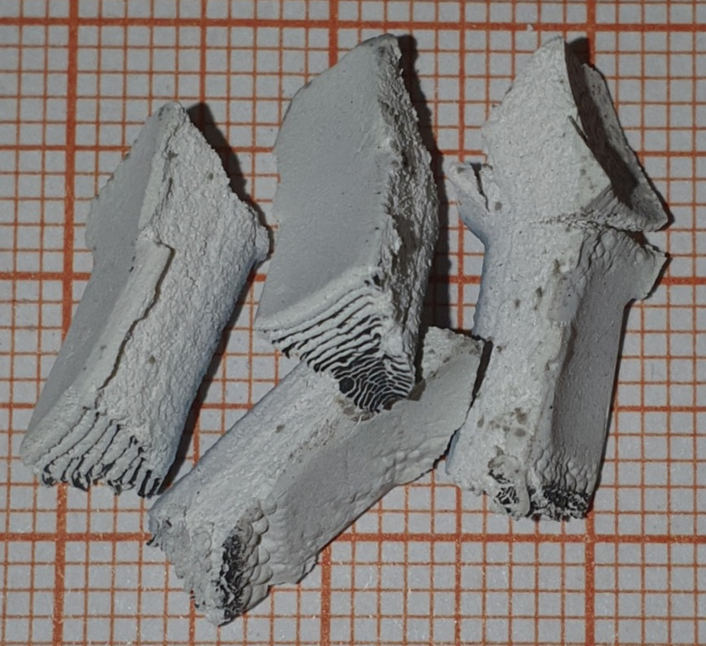
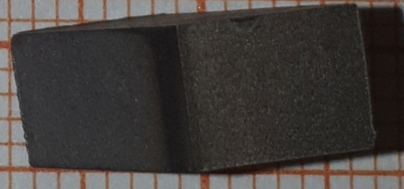
Full combustion
Materials to be applied for: all combustible
Based on full oxidation of material (destruction of the matrix) itself and and measurement of tritium being released
All tritium species are oxidized to water form
HTO,DTO,
HT, DT, T₂
Plasma facing surface
Me, CFC,
mixed
Measured by the means of liquid scintillation
MeO , CO₂,
T0 interstitial
T+ chemically bonded to impurities
HT, DT or T2 in pores
Heating in moistened air
~1100K
Example of Be specimen

Slide 7
Combination of methods
Chemical dissolution
Electrochemical dissolution
Electrochemical dissolution
Full combustion
Chemical dissolution
Electrochemical dissolution
Be
Inconel
W
CFC
First beryllium coating is dissolved and tritium measured (both in gas phase in a liquid). Process is followed by electrochemical etching - measurement of tritium in Inconel substrate.
First tungsten coating is electrochemically etched and tritium measured (both in gas phase in a liquid). Process is followed by full combustion- measurement of tritium in CFC substrate.

Slide 8
Comparison of methods
Characteristics | Chemical or electrochemcal etching | TDS | Full combustion
Information obtained | tritium total amount depth profile chemical state (Tº, TH, TD, T₂ in gas phase, T⁺ - in liquid phase | Tritium total amount Desorption spectra | Tritium total amount
Tritium release method | Dissolution in 1M H₂SO₄ solution or electrochemical etching with simultaneous hydrogen measurement (by different aproaches) | Heating in a furnace, ~5ºC/min up to 1030ºC and held 1h at this temperature | Heating in a furnace in a moistened air, up to 1223K and held for 4-6 h at this temperature, HT and T2 oxidized in CuO furnace
Carrier gas | Argon, can be varied | Helium + 0,1% H₂(must be dicussed) | Moistened air
Tritium measurement | Proportional counter – gas phase Liquid scintillation – liquid phase | Proportional counter | Liquid scintillation

Slide 9
Materials to be analysed
Chemical/electrochemical etching - Be, W, Inconel + can be devloped for other metals
Combustion - all the materials that are combustible (carbon based, metals)
TDS - all solid materials
Combination of the methods - coatings, mixed materials

Slide 10
Additional analysis to be performed
SEM, FT – IT, TG/TDA
Data analysis for evaluation of the factors influencing tritium retention in plasma facing materials using mathematical methods
Tritium behavior in non-exposed materials - sorption-desorption, permeation (both HT and HTO available)

Slide 11
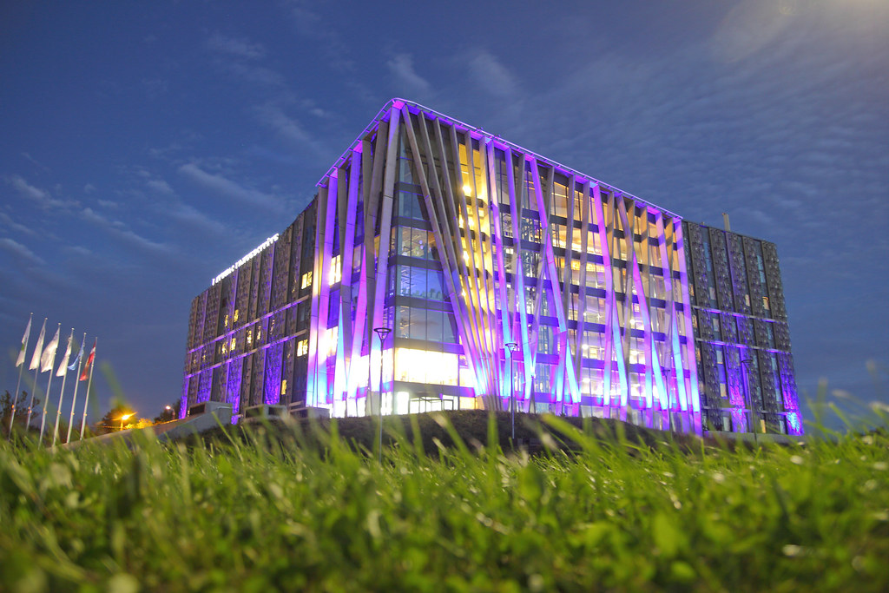
Thank you for your attention!
Asoc. prof. Dr. Elina Pajuste
Institute of Chemical Physics
University of Latvia
Jelgavas 1, Riga, Latvia
elina.pajuste@lu.lv

Slide 12
Supplementary slides

Slide 13
COMPARISON OF METHODS
Dissolution/etching
TDS
Full combustion
Information on
total tritium amount
depth profile
chemical state (can be adapted)
In layered materials information on tritium in each layer can be assessed
Fast
No elevated temperatures used (safe)
Information on
total tritium amount
Desorption spectra
Tritium trapping energies can be assessed
Applicable to all kinds of material
High sensitivity
Information on
total tritium amount
Can be assumed that all tritium is measured since the «hosting matrix» is fully destroid.
ADTVANTAGES
Not all tritium might be measured if not sufficient layer thickness is etched (remains in bulk)
Some data might be lost if tritiated water vapor condensates before reaching the Zn bed
Time consuming
Limited information on tritium initial state in the material
DISADTVANTAGES

Slide 14
Dissolution method - beryllium
Successive layers of Be are removed using 1 mol/L sulphuric acid and amount of evolved hydrogen (depicted as ‘H’) and released tritium (depicted as ‘T’) measured. Argon is used as a purge gas (~8 L/h).
Be⁰ + 2H⁺ → Be ²⁺ + 2H⁰
H⁰ + H⁰ → H_{2 (gas ph.)}
H⁰+T⁰ _{(solid phase)} → HT _{(gas ph.)}
T₂ _{(solid ph.)} → T_{2 (gas ph.)}
T⁺_{(solid ph.)} → T⁺ _{(liquid ph.)}
Tritium in purge gas is measured by tritium monitor TEM 2100 with a proportional gas flow detector DDH 32 (counting gas - mixture of Ar and 10% methane)
Solution containing tritium is distilled and 5 or 1 mL (+4 mL deionized water) aliquot mixed with 15 mL of Ultima Gold scintillation cocktail and analysed for total tritium with a TRi-Carb 2910TR counter (PerkinElmer, Inc).
T⁰_{(solid phase)}- tritium atoms as interstitials in the bulk beryllium;
T_{2(solid phase)}- molecular tritium trapped in the bulk beryllium;
T⁺_{(solid phase)}- tritium chemically bonded with the impurities in the bulk beryllium;
T_{2(gas phase)}- molecular tritium released in the flow of the purge gas;
T⁺_{(liquid phase)}-tritium remaining in the acid solution as a part of the HTO⁺ ion;
$$A_{T_{total}}=A_{T_{gas}}+A_{T_{liquid}}$$

Slide 15
Dissolution method - beryllium
Simultaneous etching of the metal surface and measurements of the released tritium in purge gas (proportional counter) and solution (liquid scintillation)

Slide 16
Electrochemical dissolution method - tungsten, inconel
Successive layers of W are removed using electrochemically in 35% KOH solution where both electrods are tungsten, amount of evolved hydrogen (depicted as ‘H’) and released tritium (depicted as ‘T’) measured. Applied voltage ~3V. Argon is used as a purge gas (~8 L/h).
Tritium in purge gas is measured by tritium monitor TEM 2100 with a proportional gas flow detector DDH 32 (counting gas - mixture of Ar and 10% methane)
Solution containing tritium is distilled and 5 or 1 mL (+4 mL deionized water) aliquot mixed with 15 mL of Ultima Gold scintillation cocktail and analysed for total tritium with a TRi-Carb 2910TR counter (PerkinElmer, Inc).
$$W+2{OH}^{−}+2H_{2}O →{WO}_{4}^{2−}+6H^{0}$$
H⁰ + H⁰ → H_{2 (gas ph.)}
H⁰+T⁰ _{(solid phase)} → HT _{(gas ph.)}
T₂ _{(solid ph.)} → T_{2 (gas ph.)}
T⁺_{(solid ph.)} +OH⁻→ HTO _{(liquid ph.)}
T⁰_{(solid phase)}- tritium atoms as interstitials in the bulk tungsten;
T_{2(solid phase)}- molecular tritium trapped in the bulk tungsten;
T⁺_{(solid phase)}- tritium chemically bonded with the impurities in the bulk tungsten;
T_{2(gas phase)}- molecular tritium released in the flow of the purge gas;
T⁺_{(liquid phase)}-tritium remaining in the KOH solution as a part of the OT⁻ or HTO molecule ion;
$$A_{T_{total}}=A_{T_{gas}}+A_{T_{liquid}}$$

Slide 17
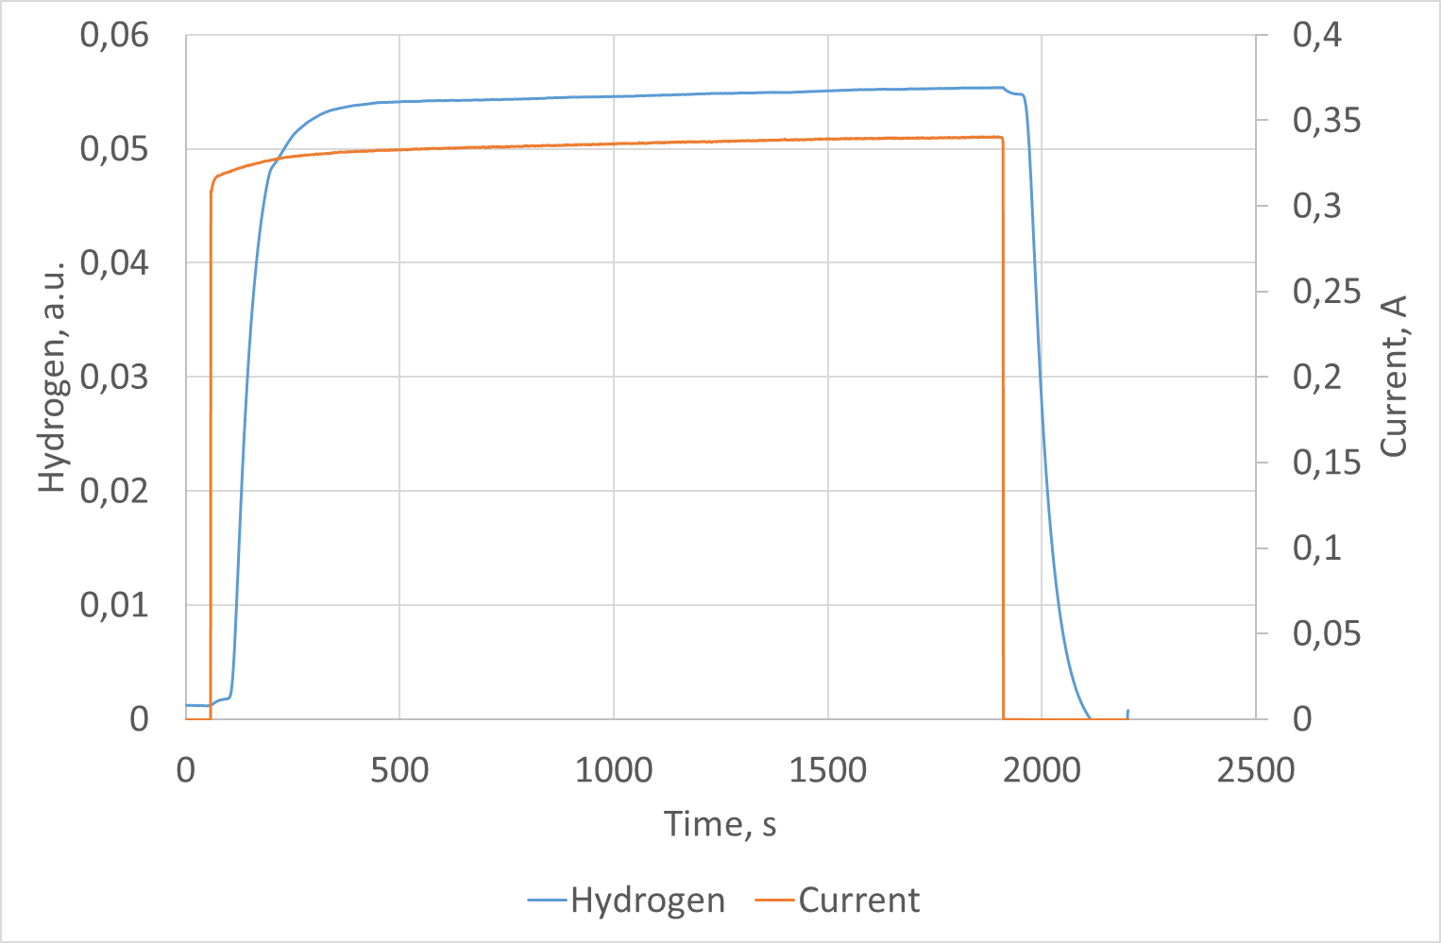
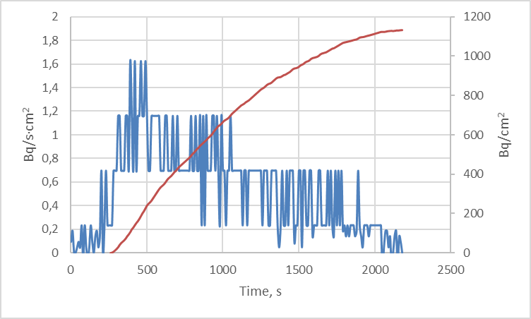
Dissolution method - tungsten
Simultaneous etching of the metal surface and measurements of the released tritium in purge gas (proportional counter) and solution (liquid scintillation)

Slide 18
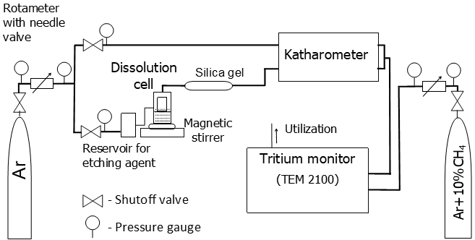
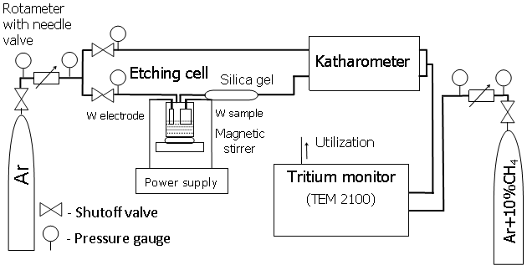
Experimental Setup
Beryllium – chemical etching
Tungsten, inconel – electrochemical etching

Slide 19
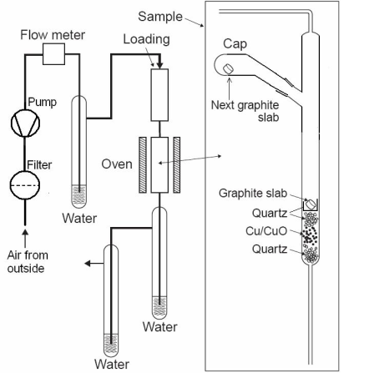
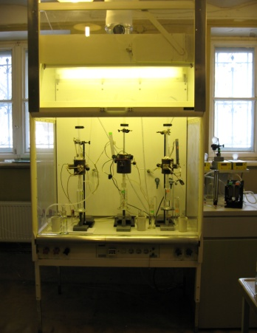
Full combustion
Method is based on a full combustion of the sample in the moistened air.
Combustion conditions:
Temperature: 850-870 °C,
Flow rate of moistened air: 15-20 mL/min,
Time of a complete combustion, 4-6 h.

Slide 20
Thermal desorption
Purge gas He + 0.1% H₂ at 14-15 L/h.
The quartz tube in the setup had two compartments – one for the sample in a quartz boat and one for a bed of granulated zinc.
The quartz cap had a thermocouple channel – an inner quartz tube sealed towards the sample.
The zinc bed at ~400ºC converts tritiated water to molecular gaseous tritium (HT, DT, and traces of T₂).
Heating rate 4.8 ºC/min to 1030ºC and then kept at that temperature for 1 h.
Temperatures of the sample, the zinc bed and the cold trap were continuously measured. The tritium activity in the purge gas was continuously monitored using a proportional counter with an operating volume of 300 cm³ and a tritium monitor TEM 2102A.
The total released tritium activity was calculated by integrating the release rate over the time where a release was measurable.

Slide 21
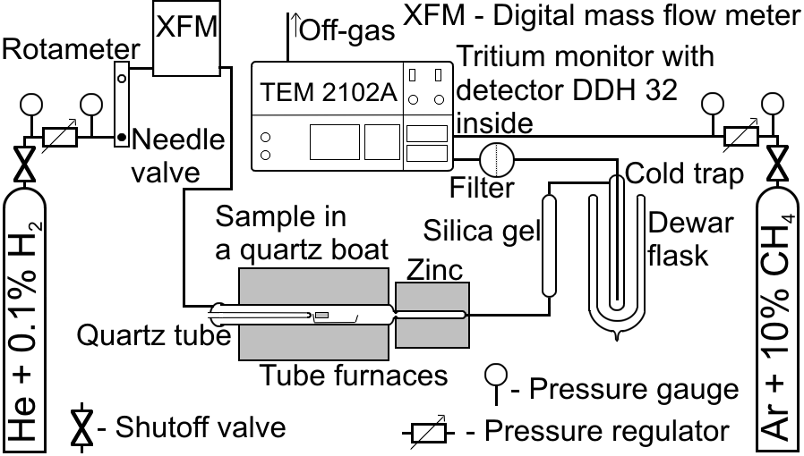
Thermal desorption - experimental setup

