Slide 1
PWIE, SP E NCSRD: Work plan for 2022
PWIE
A. Lagoyannis, P. Tsavalas, M. Axiotis and K. Mergia
NCSR “Demokritos” (NCSRD)

Slide 2
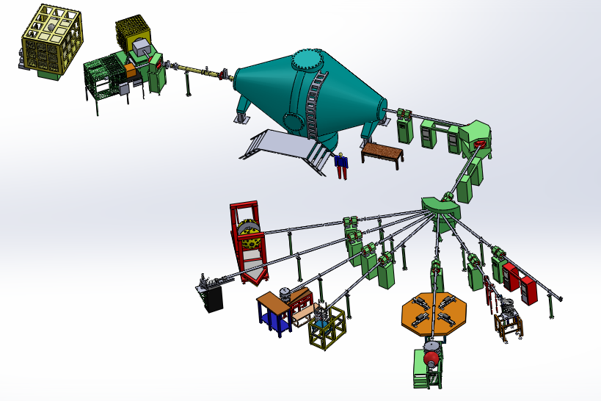
Tandem Accelerator Lab

Slide 3
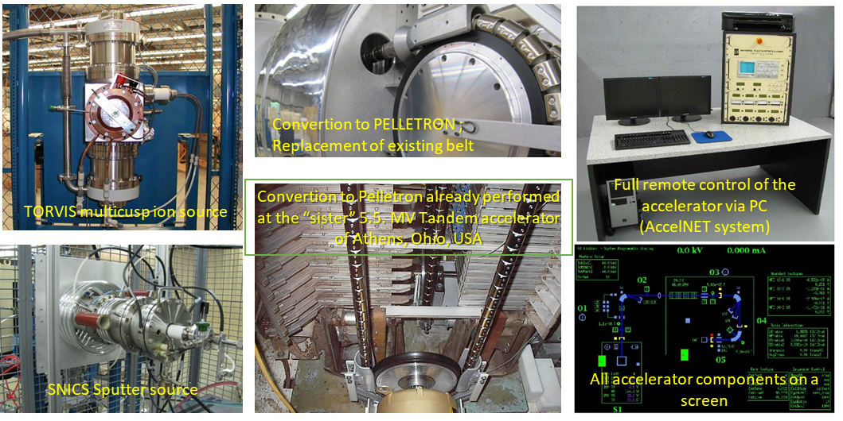
Upgrade Plan
5.5 MV Tandem Accelerator
Tandem hall

Slide 4
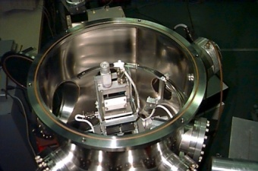
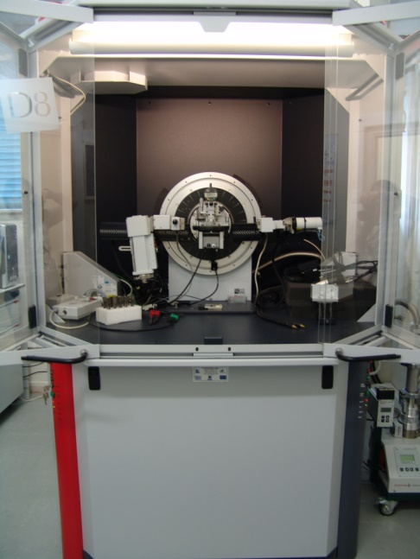
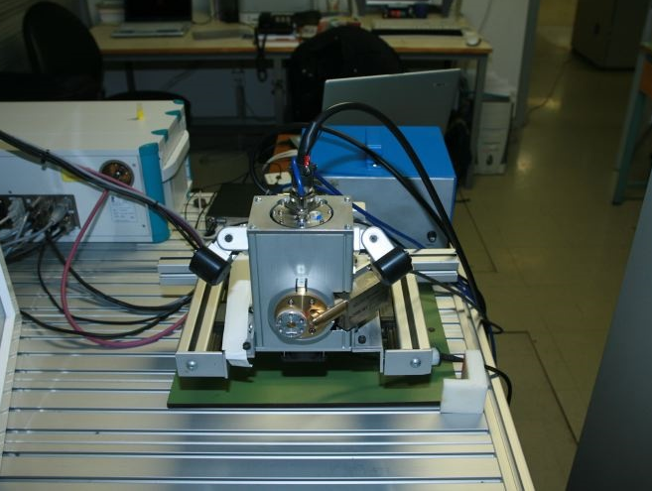
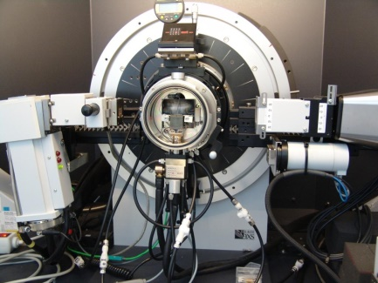
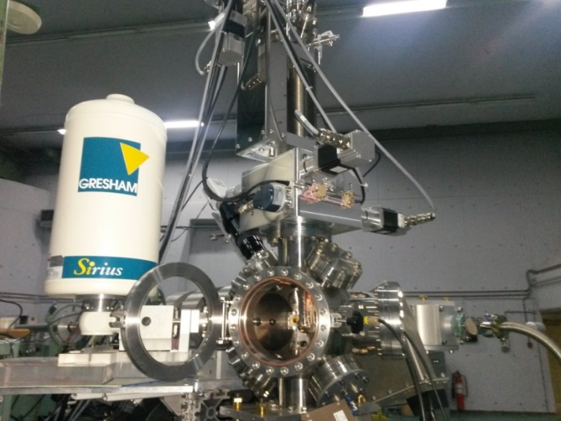
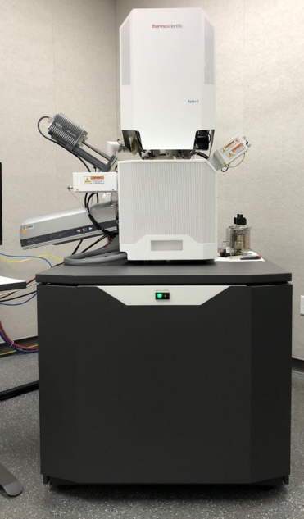
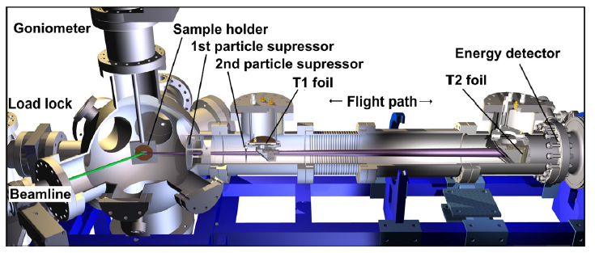
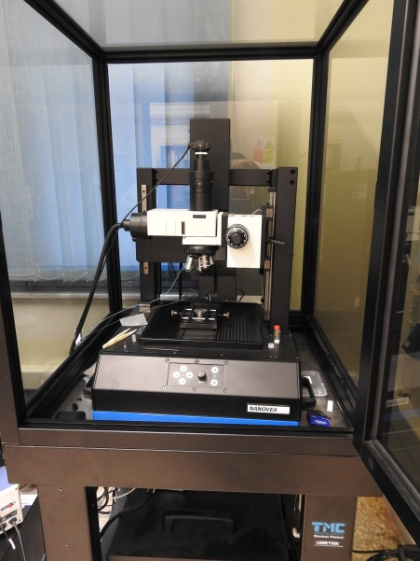
Experimental Setups & Capabilities
IBA chamber (RBS – NRA – PIGE)
X – Ray Fluorescence
Milli and micro XRF
X – Ray Diffraction/Reflectivity
(190 K– 1800 K)
Indenter
SEM
EDS
TOF – ERDA

Slide 5
Main Research Areas within WP-JET2 in FP8
Post-mortem analysis of
W/CFC samples from JET divertor (fuel retention, material migration/deposition, metallographic analysis)
W lamellae from JET divertor (material migration/deposition, metallographic analysis, hardness measurements)
Be samples from JET main wall (fuel retention, material migration/deposition, metallographic analysis)
Employing
Ion beam analysis (RBS/NRA, PIXE)
SEM with EDS analysis
X-ray fluoresence spectroscopy
X-diffraction
Depth sensing indentation

Slide 6
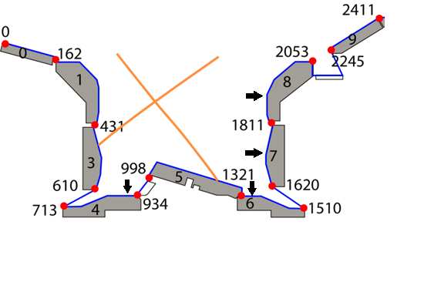
2022 Work Plan (I)
SP E.2: Comparison of hydrogenic retention quantification by different techniques and fuel removal assessment
Work plan: Milli- and micro-beam NRA measurements using a deuteron beam on ILW JET divertor.
A. Lagoyannis et al. Nuclear Fusion 2017

Slide 7
2022 Work Plan (II)
SP E.3 Post-mortem analysis of PFC and other objects in JET
Work plan: Ion beam TOF ERDA and NRA measurements on ILW JET divertor Tiles using a deuteron beam to quantify material migration (Be, C, O) from the main chamber as well as Nitrogen retention.
Mapping of the deposited carbon on the castellation sides of Be samples
ILW1 IWGL outer (27)
ILW1 IWGL wing (76)
Previous Results
P. Tsavalas et al. (to be published)

