Slide 1
Design considerations and challenges for first wall heat load control in ITER
Timo Ravensbergen¹, Federico Pesamosca², Richard Pitts¹, Martin Kocan¹
¹ITER Organization, St Paul Lez Durance, France
²Max-Planck institüt für Plasmaphysik, Garching bei München, Germany

Slide 2
Outline
ITER First-wall heat loads in early operation
Key issues
  Limiter start-up
  H-L back transition
ITER plasma control and protection systems
FW heat load control on ITER
IR diagnostic coverage
Community involvement

Slide 3
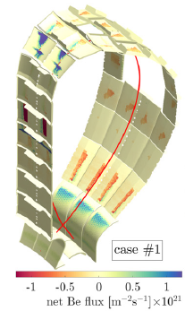
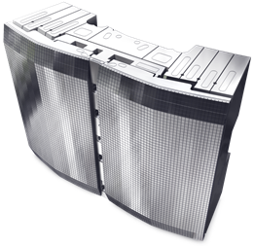
ITER first-wall heat loads are critical early on
First-wall heat load problems precede those in the divertor
  Divertor only challenged in PFPO-2 and beyond
Actively cooled → water leaks
  Faceted panel design
  Toroidal+poloidal protection of leading edges ←→ increased global heat loads
  Castellated design (not individually shaped)
ITER: large machine with small tolerances
  Only 10-20 % of the FW is wetted by plasma
  → Highly localized heat loads

Slide 4
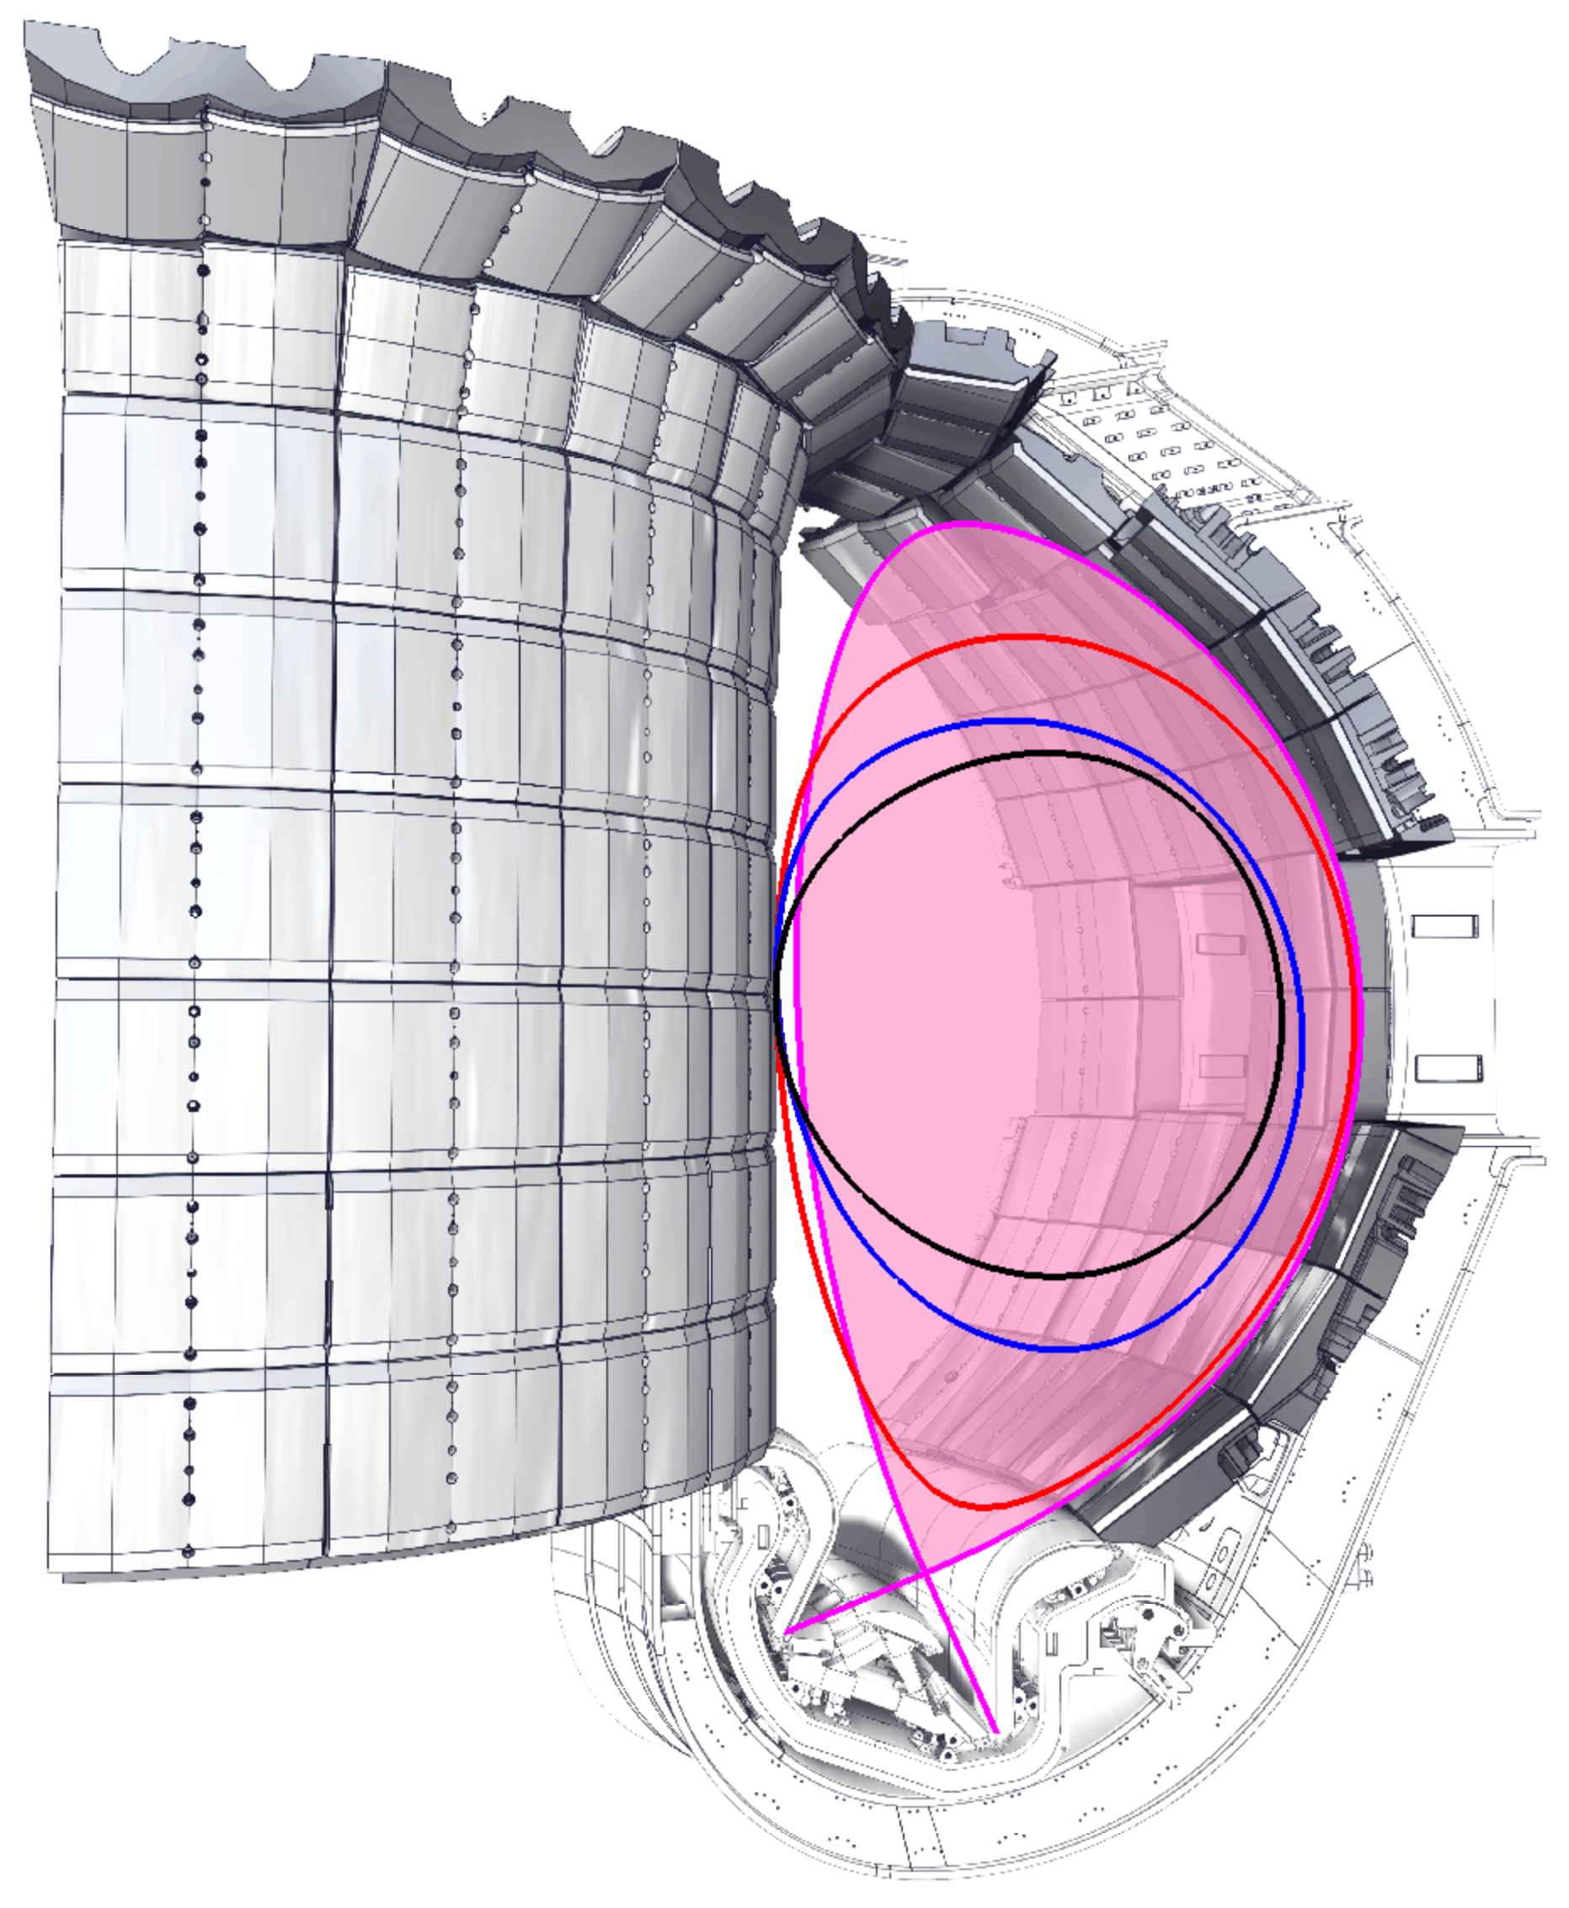
Key issue: inboard start-up (I)
Preferred on ITER
  Lower 3D stray fields, TF ripple, flux consumption
  Resonance region for ECRH assist
B_{T} = 5.3T
Scenario design: I_{p} ≳ 3.3 MA for X-point transition (t ~ 11 s)
  I_{p} ~ 5 MA, P_{SOL} = 5 MW
  FW panel heat flux strongly dependent on misalignment → critical on inboard panels
2.4 s, 1 MA
5.3 s, 2 MA
9.9 s, 3 MA
[Pitts STAC 2019]
full bore, 15 MA

Slide 5
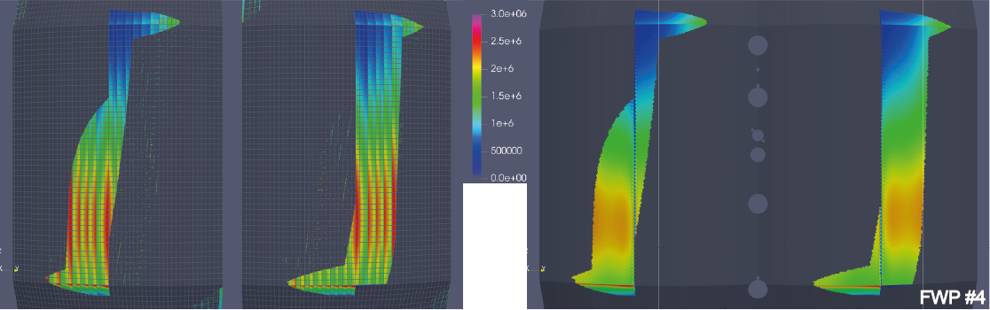
Key issue: localized heat loads
[Pitts STAC 2019]
Panel facets + castellations → hot spot localization
Challenging to model/predict and observe with IR
Will change during ITER operation

Slide 6
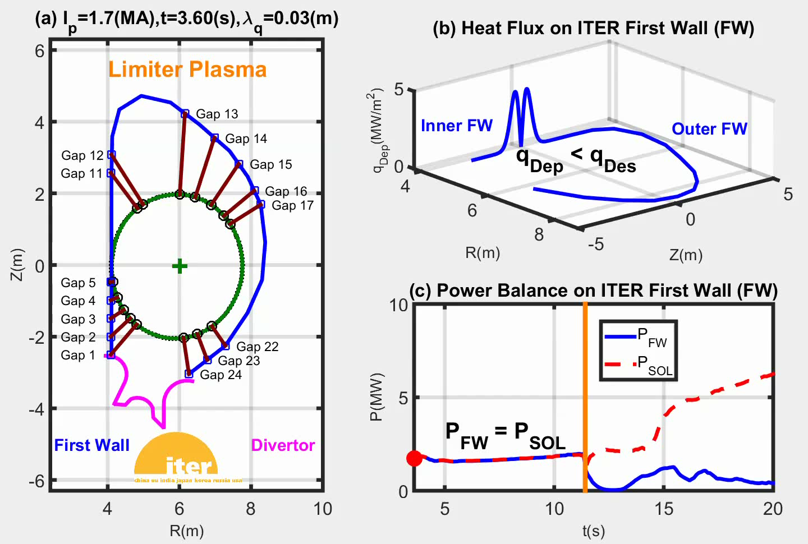
Key issue: inboard start-up (II)
[H. Anand NF 60 2020]

Slide 7
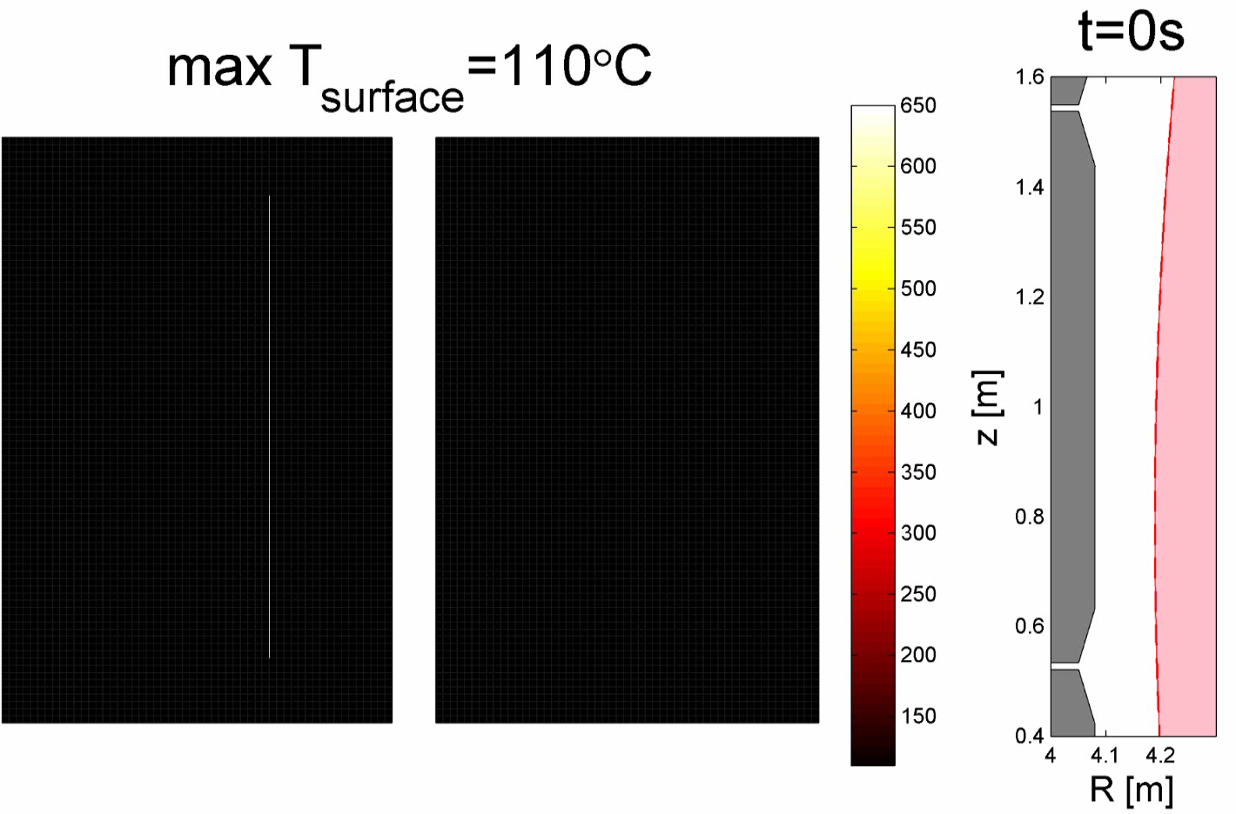
Key issue: H→L back-transition
~600°C in 1 s
IR (>200°C) will only see issue at the very end
[M. Kocan private]

Slide 8
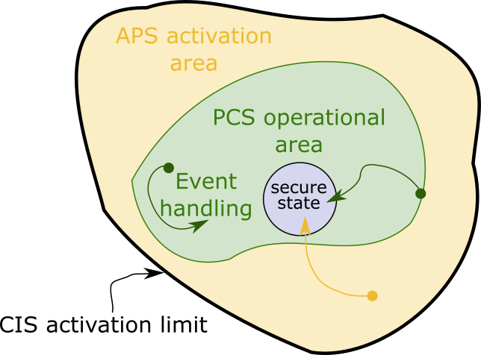
ITER will have a two-tier protection system
PCS:
  Nominal plasma control
  Off-normal event handling
  Prediction, prevention
APS:
  Machine protection, not control
  Mitigate or steer back
CIS:
  Trigger DMS or pulse termination
→ Formally separated diagnostics, algorithms, and infrastructure (configuration)

Slide 9
FWHL control development for ITER
ITER control design requires time:
  Controllers need to be designed and implemented
  Diagnostic-PCS interfaces frozen early
  Limited experimental time
  Commissioning in preceding, low power regimes
  Diagnostics (IR cameras) with limited sensitivity
  Machine protection ←→ Downtime
    Not all hot spots are critical
    Not all hot spots can be detected
  Moderate changes already require formal re-commissioning (APS+PCS!)
→ Difficult on ITER to develop new control methods:
  Demonstrated reliability ←→State-of-the-art
  Develop now, refine on ITER and advance the ITER Research Plan
~15MW/m²

Slide 10
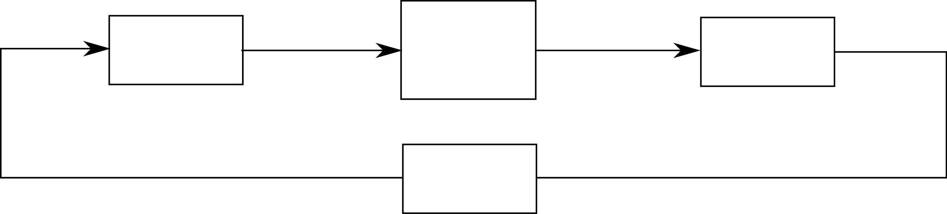
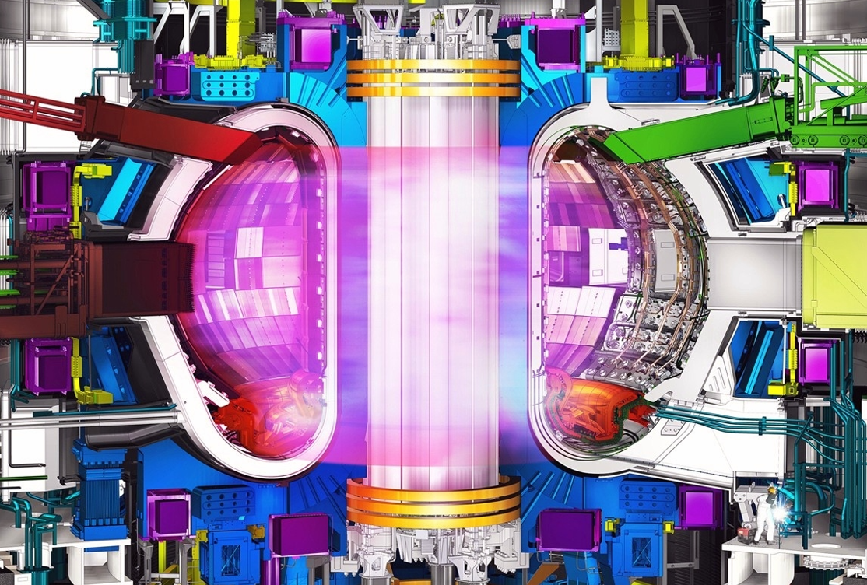
FWHL control loop
Modify magnetic eq.
Adjust input power
Impurity seeding
Plasma termination
IR/visible cameras
LP
Eq. reconstruction
Dα emission
Temperature
Heat flux
RT
Processing
actuator
Event-driven
control
Monitor and raise event

Slide 11
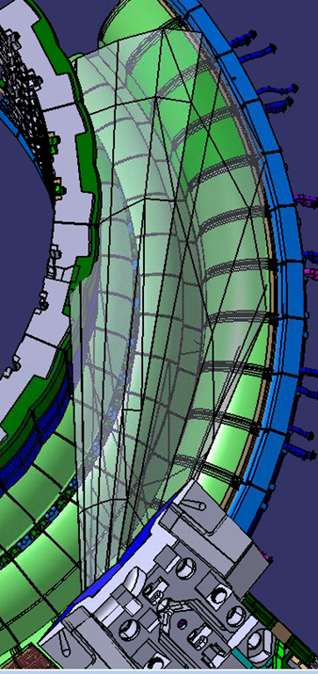
55.G1/GA/G6: The ITER IR/Vis diagnostic systems
Max surface temperature (BC), luminance (MP) and their profiles (AC)
Power load and its profile for AC (inverse problem)
  55.G1: 4 eq. ports. 15 views. ~6-12 mm VIS, ~8-24 mm IR (>castellations!)
  55.GA: 5 upper ports, 5 views. 3 mm VIS, 5 mm IR
  55.G6: 1 eq. port and view, high res. 3 mm IR
Time resolution 2 ms. Fast windowing mode at 0.02 ms
  → Sensitive from 200°C onwards!
55.GA
55.GA
55.G6
55.G1

Slide 12
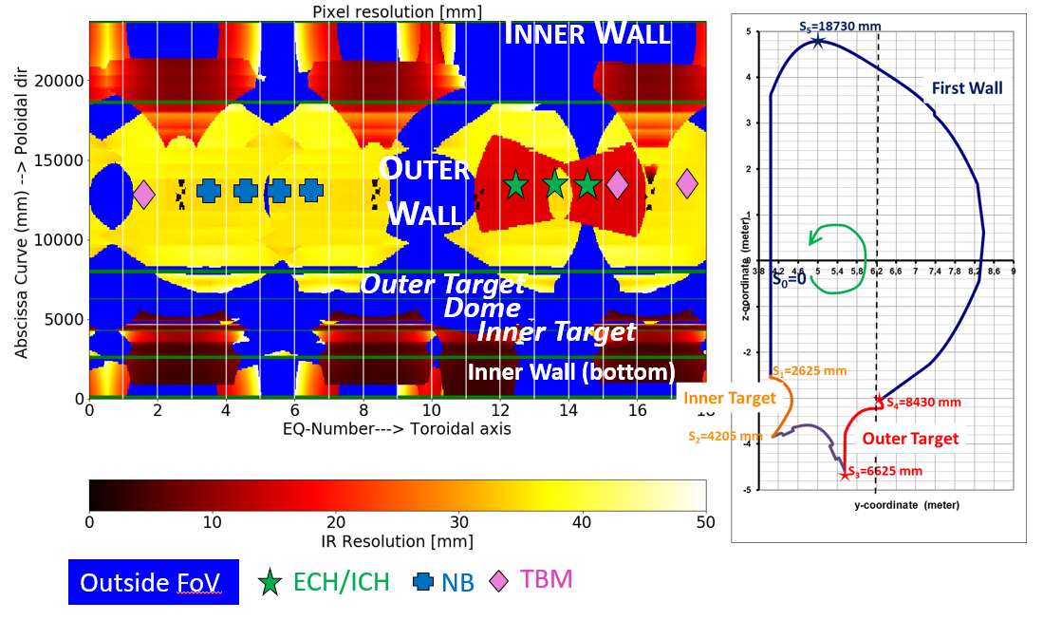
55.G1 IR coverage
73,5% on inner div.
33% on outer divertor
77% on first wall
24% overlapping

Slide 13
Summary and community involvement
ITER has uniquely shaped FW panels leading to multiple challenges
ITER has to follow a rigorous and systematic design procedure
Event-based FWHL control critical for safe operation
55.G* systems with large coverage are key
Formal assessment of control before deployment requires:
  Time-dependent, high fidelity models (reflections, active cooling)
  Synthetic diagnostics (IR instrument function)
  Experimental validation of methodologies
  Advanced reliable hot spot detection and image processing
  Scenarios design for deliberate heat load provocation
→ We will need help from the fusion community to address all these points!

Slide 14
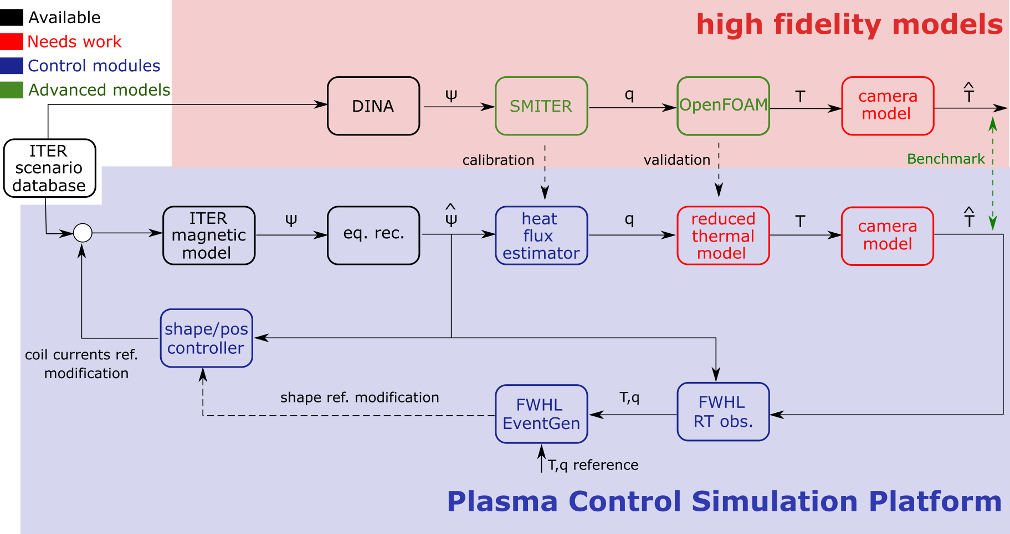
Current FWHLC PFPO-1 design work

Slide 15
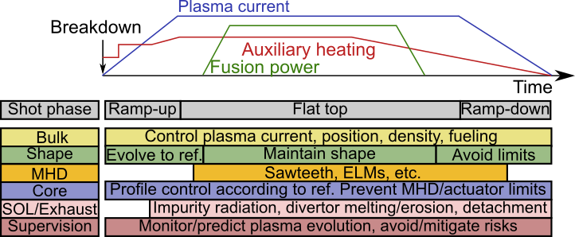
ITER control as integrated challenge
FWHLC:
Monitoring function, i.e. ‘event-driven’ control, not ‘continuous control’
Will have functions in APS and PCS
Divertor integral part of the challenge
Challenge comes in stages: Full performance only in PFPO-2

