Slide 1
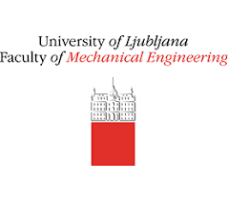
WP-W7x & WP-PriO
Infrared Synthetic Diagnostic for improving IR interpretation in metallic environment
M-H. Aumeunier ª, M. Le Bohecª , R. Brunetª , A. Juvenª , R. Mitteauª, E.Grelierª, M.Brank^{b} , L.Kos^{b}, S. Pamela^{c}
ª CEA Cadarache, IRFM, 13108 Saint Paul-Lez-Durance, France
^{b} Institut Jozef Stefan (JSI), University of Ljubljana, Faculty of mechanical engineering, LECAD laboratory, Slovenia
^{c} CCFE-UKAEA Culham Science Centre, Abingdon, UK
FSD Science Meeting on IR for machine protection , 2022 March 29th

Slide 2
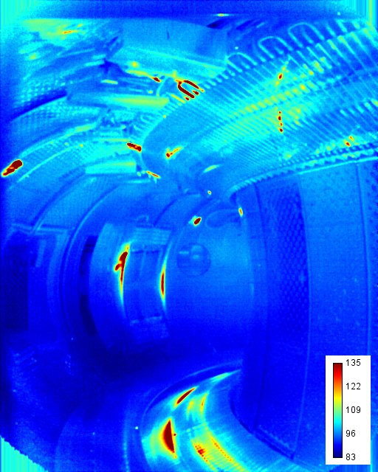
The challenge of IR thermography in fusion devices
WEST Wide Angle TG View (#55210)
IR thermography is a key diagnostic in fusion devices ….
1/ Machine Protection / Wall Monitoring System (avoid PFC damaging, crack, water leak)
2/ Wall-Plasma Interaction studies (study PCF ageing, understand edge plasma, optimize plasma scenario)
Hot Spot ? Reflections patterns ?
…but IR measurement is not straightforward
Several sources of error :
Environment : parasitic light coming from the observed scene itself - radiative environment, variable emission, multiple reflections
Instrument : optical transfer function, stray-light, calibration
Known deposited heat flux
This will have consequences both:
Qualitative analysis: presence of false hot spot in the image
Quantitative analysis: high surface temperature error
Development of numerical approaches aiming to get more reliable surface temperature measurement based on IR synthetic diagnostic

Slide 3
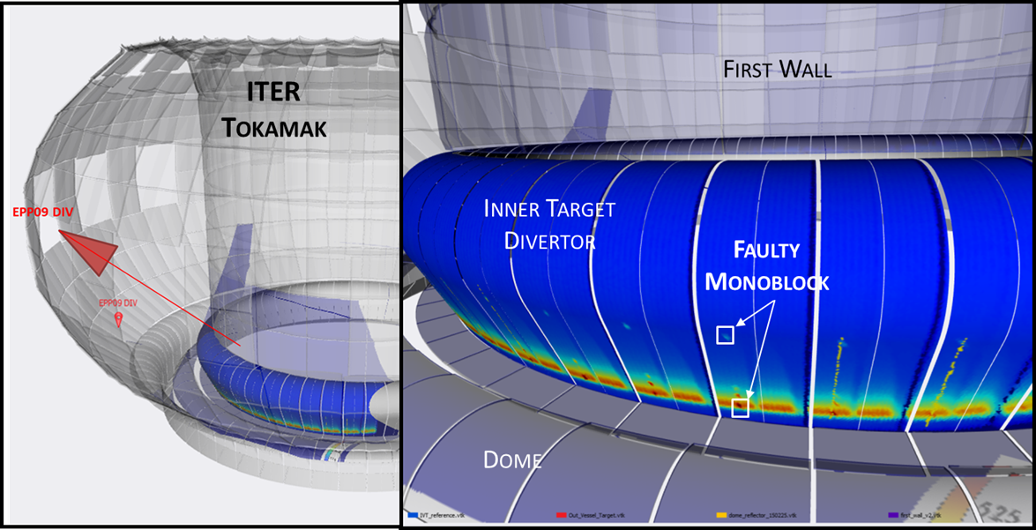
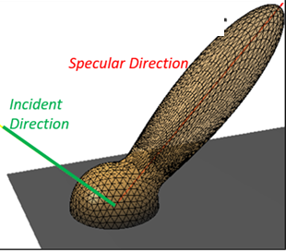
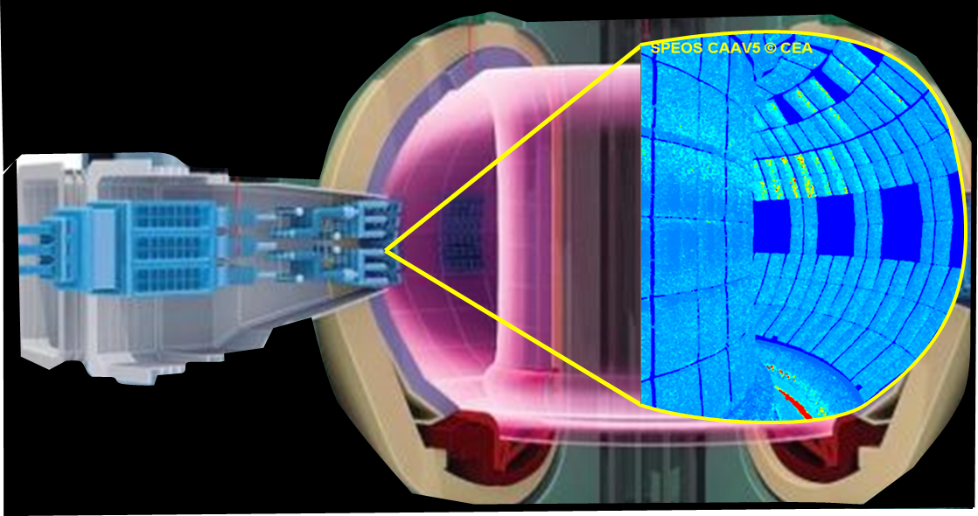
A “digital twin” approach
3D Temperature Field
Wall Optical Properties
Camera
IR synthetic diagnostic: an end-to-end simulation aiming to model all physical phenomenon involved in the IR measurement chain: from source to optical response of instrument
1 pixel
PSF
1
IR Source Modeling
Modeling of plasma heat loads deposited on PFCs (main IR source)
Modeling of resulting 3D temperature field
Synthetic IR images
2
Materials optical/radiative Modeling
Emissivity model
Reflectivity Model
ITER Wide Angle Viewing Sytem
3
Optics Modeling
Camera model
Optical Transfer Function
Light propagation in 3D model based on Monte Carlo Ray Tracing (MCRT) code
(ANSYS-SPEOS CAAV5) getting all radiations of thermal scene

Slide 4
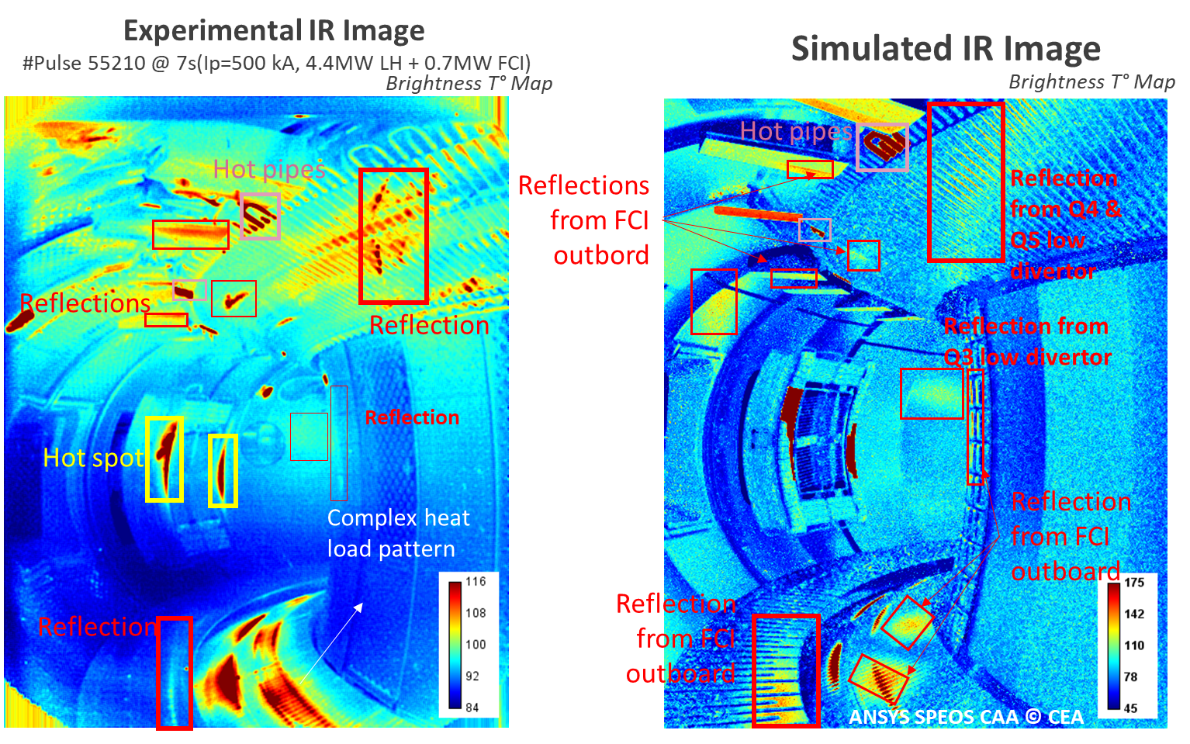
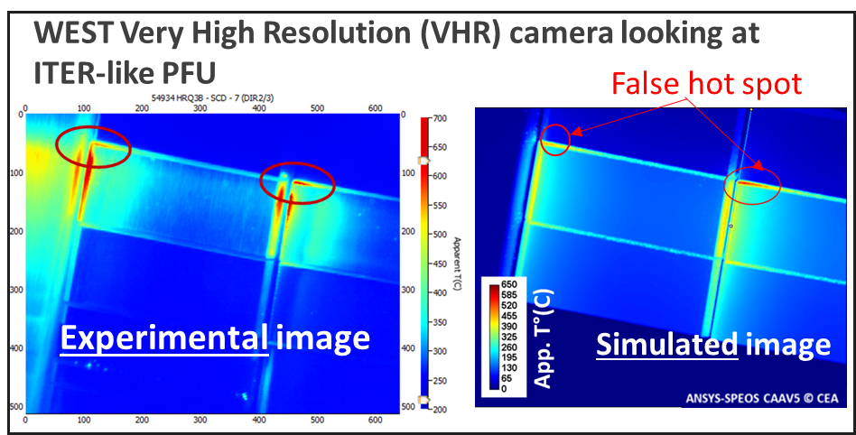
Application to existing machines: Improving the operational field to achieve plasma performances
WEST wide angle TG view
2020: Tokamak WEST (France)
First qualitative comparison on WEST, AUG, W-7x devices
Discriminating reflections patterns to real thermal events
Proving presence of high specular reflections (even in carbon machine)
Proving local change of optical properties causing false hot spots on WEST PFUs edges
2021: Stellarator W7-X (Allemagne)

Slide 5
Challenges for preparing ITER operations from IR synthetic diagnostic
Improving “digital twin”
Improving thermal scene used as input of photonic model
Materials optical properties (BRDF)
Transient events modeling
Developing integrated solution software
IR “pre-quantitative” thermography for real-time protection of FW/divertor : hot spot detection
IR quantitative thermography for physics analysis: estimating T° and/or emissivity from IR image
CEA/IRFM, Basel University, IUSTI (AMU)
CCFE (UK), CEA/IRFM
JSI (Slovenia), CEA/IRFM
CEA/IRFM
CEA/IRFM+LIST, IUSTI+Fresnel (AMU)

Slide 6
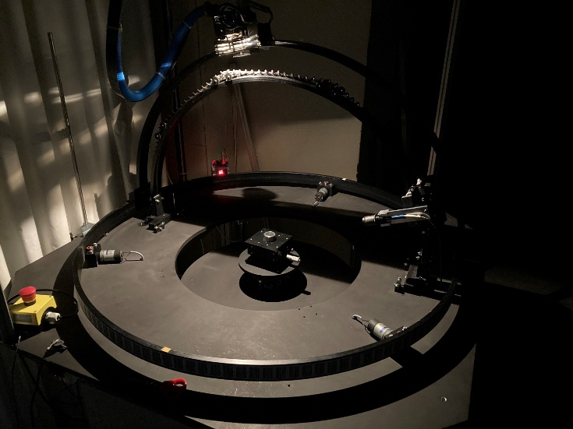
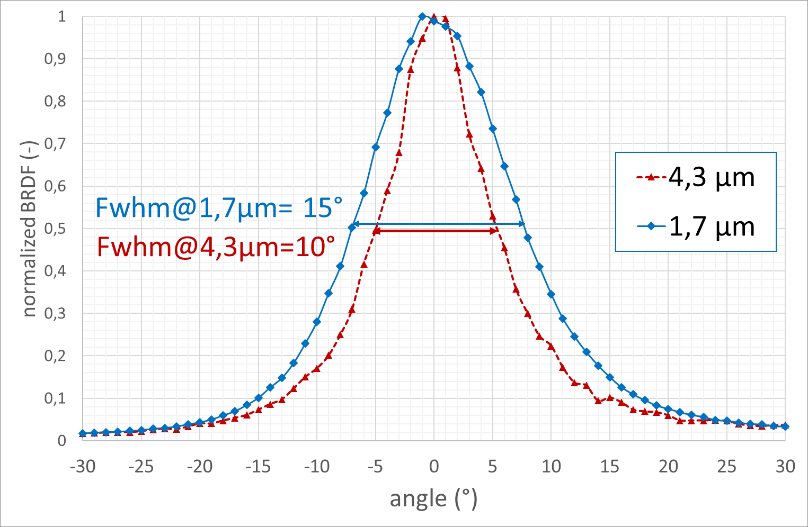
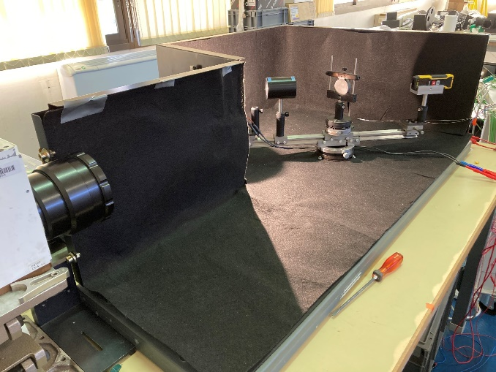
Challenge 1 : Improving digital twin
Improving “digital twin”
Improving thermal scene used as input of photonic model
Materials optical properties (BRDF)
Transient events modeling
Developing integrated solution software
IR qualitative thermography for real-time protection of FW/divertor : hot spot detection
IR quantitative thermography for physics analysis: estimating T° and/or emissivity from IR image
Goals:
get a complete description of materials reflectance and emissivity (with angular, spectral and T° dependence), and this as a function of surface state of materials (wrt roughness, before and after exposure)
Find theoretical models (fitting to experimental data) for implementation in synthetic diagnostic
Facilities:
Dedicated instruments (VIS-NIR): goniometer, ellipsometer, Integrating Sphere Cary
IR optical bench (with camera)
Narrowing of BRDF in MWIR range (more specular)
Basel University facility
CEA task
in partenariat with Basel University
CEA/IRFM facility
M.Le Bohec et al., RSI 2022 (to be submitted)

Slide 7
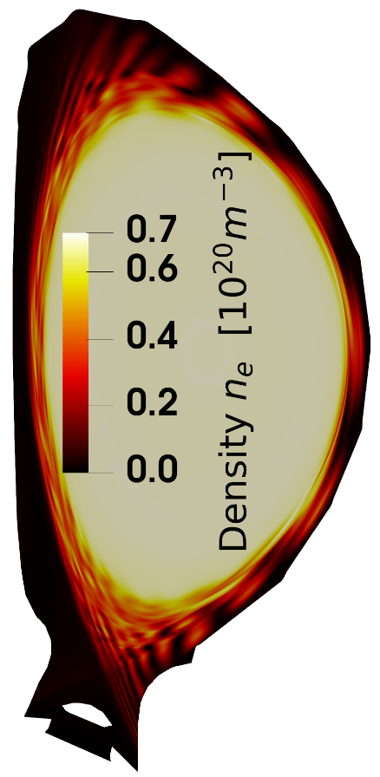
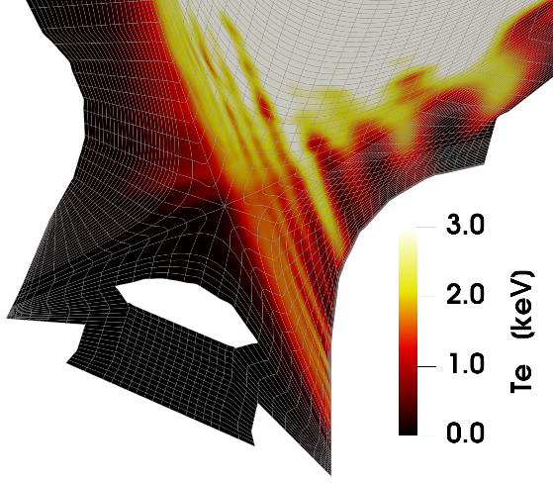
Challenge 1 : Improving digital twin
Improving “digital twin”
Improving thermal scene used as input of photonic model
Materials optical properties (BRDF)
Transient events modeling
Developing integrated solution software
IR qualitative thermography for real-time protection of FW/divertor : hot spot detection
IR quantitative thermography for physics analysis: estimating T° and/or emissivity from IR image
Goals: include realistic modelling of MHD transients (ELMs and disruptions) in IR synthetic diagnostic
Means:
JOREK tools for modeling transient events (or simple analytic expressions)
ANSYS-SPEOS tools for IR modeling
Work in 2022
Demonstrate the data-coupling between a JOREK simulation with the ANSYS-SPEOS platform for a given ITER plasma scenario. Focused on ELMs simulations.
ITER poloidal cross section picturing the particle density and electronic temperature during an ELMs (for std plasma scenario 15 MA)
S.J.P. Pamela, G.T.A. Huijsmans, M. Hoelzl, A Generalised Formulation of G-continuous Bezier Elements Applied to Non-linear MHD Simulations, Journal of Computational Physics, 111101, ISSN 0021-9991, 2022

Slide 8
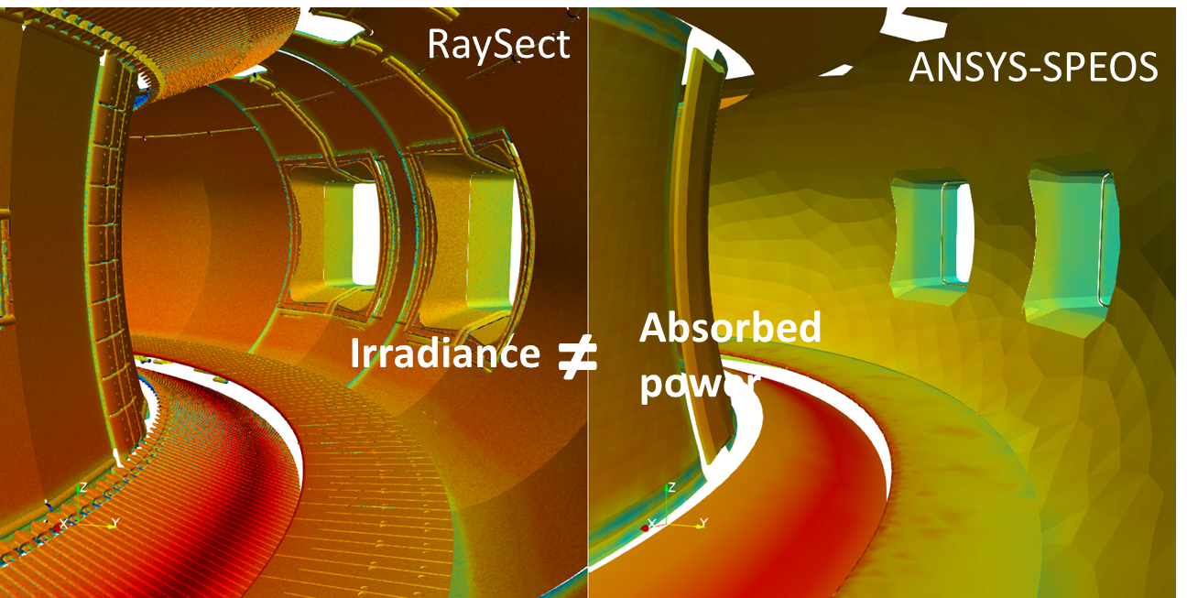
Challenge 1 : Improving digital twin
Improving “digital twin”
Improving thermal scene used as input of photonic model
Materials optical properties (BRDF)
Transient events modeling
Developing integrated solution software
IR qualitative thermography for real-time protection of FW/divertor : hot spot detection
IR quantitative thermography for physics analysis: estimating T° and/or emissivity from IR image
Goals:
develop a robust and friendly integrated platform software for IR synthetic diagnostic
Means
Based on SMITER platform developed for ITER (including 3D viewing, Heat flux estimation SMARDA vs PFCFLUX, Raysect code)
Use commercial RT code (ANSYS-SPEOS) as reference tools
Work :
Benchmark RaySect (with ANSYS-SPEOS) on the ability to simulated IR images from a tokamak scene (from plasma to camera). First results on radiative power estimation leading us to work on the modeling of optical properties
Developing new RT code for accelerating computing time (today: 12H image for 4-core CPU)
Radiative power on WEST divertor computer from RaySect & ANSYS-SPEOS

Slide 9
Challenge 2: First wall/divertor hot-spots monitoring system for real time protection
Improving “digital twin”
Improving thermal scene used as input of photonic model
Materials optical properties (BRDF)
Transient events modeling
Developing integrated solution software
IR qualitative thermography for real-time protection of FW/divertor : hot spot detection
IR quantitative thermography for physics analysis: estimating T° and/or emissivity from IR image
Goals:
develop robust algorithms based on machine learning techniques to detect and classify hot spot in IR images in real time
First results proving the capability to detect hot spots in simulated images from ITER ➔ detection algorithms trained on infrared WEST experimental data
Next challenge: train algorithms with simulated data to anticipate change of IR reflections models
Deep Learning and Image Processing for the Automated Analysis of Thermal Events on the First Wall and Divertor of Fusion Reactors, E.Grelier et al., submitted to PPCF
Toward automatic wall protection of magnetic fusion reactors based on IR monitoring, R. Mitteau et Al. , submitted to PPCF.
Automatic Hot-spot detection in simulated IR images from ITER

Slide 10
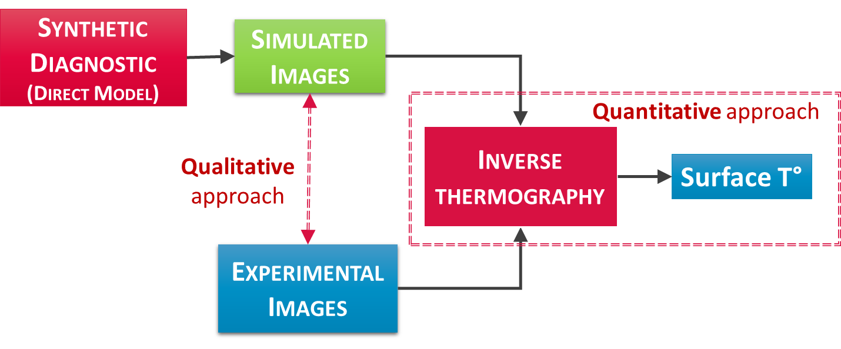
Challenge 3: IR quantitative thermography
Improving “digital twin”
Improving thermal scene used as input of photonic model
Materials optical properties (BRDF)
Transient events modeling
Developing integrated solution software
IR qualitative thermography for real-time protection of FW/divertor : hot spot detection
IR quantitative thermography for physics analysis: estimating T° and/or emissivity from IR image
Goal:
Estimate surface temperature and/or emissivity from IR images filtering reflections features and correcting unknown emissivity
2 ways investigated for solving inverse problems
With optimization-based approach
With deep-learning based approach

Slide 11
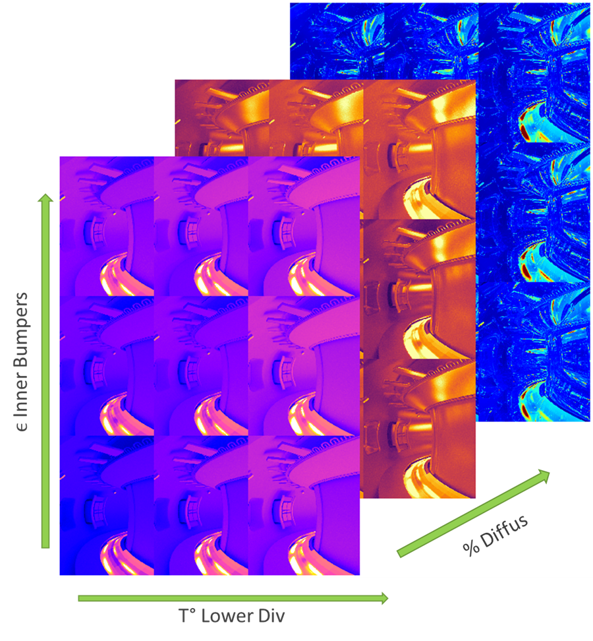
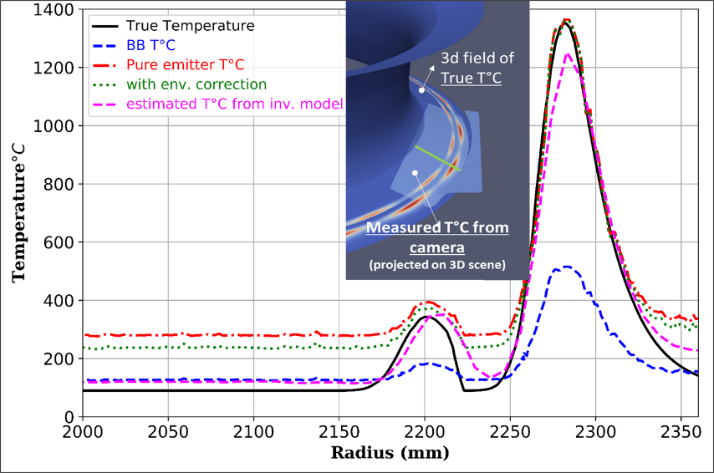
Challenge 3: Solving IR inverse problems
With optimization-based methods
First results obtained from reduced analytical model assuming diffuse surface
Next step: Monte Carlo inversion based on precomputed radiance methods to include specular behavior (WP-PrIO tasks)
From Machine-Learning approach
First results obtained from deep-learning algorithms trained from simulated database assuming pure specular surface (faster to generate)
Challenge: construction of representative and large training data set
C. Talatizi et al., Fusion Engineering and Design,171, 2021
First WEST synthetic data base
Temperature profile on WEST divertor
R. Brunet at al., IR measurement synthetic database for inverse thermography model based on deep learning, SOFT 32th, 2022(to be submitted)
A. Juven et al., Machine learning-base methods for temperature estimation in fusion devices, IVMSP 2022 (to be submitted)

Slide 12
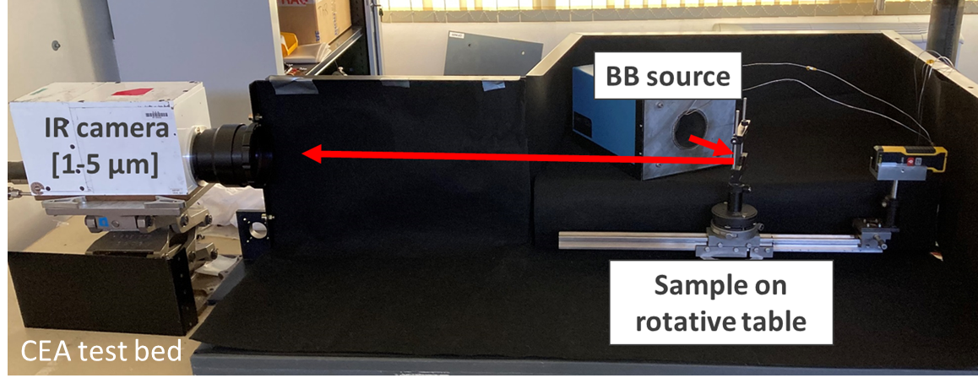
Towards a better interpretation and control of IR measurement in ITER
Our objective: developing numerical approach for getting reliable surface temperature from IR thermography system with metal wall
Numerical approaches based on 2 parts:
Developing robust forward model (synthetic diagnostic) which means efforts on:
Thermal scene modeling ➔ steady state heat flux modeled from magnetic field line tracing, integration of ELMs, disruptions dealt with WP-PrIO tasks + fast ions losses, ICRH hot spots to be implemented
Experimental and theoretical characterization of optical properties of in-vessel components: under going with WEST samples (pre and post mortem)
Instrument modeling (spatial resolution, stray-light)
Developing inverse methods : 2 approaches under study
Optimization methods calling physics-based model (reduced analytical model and/or MCRT)
Machine learning methods trained on synthetic data base (precomputed)
Encouraging results obtained on numerical prototype (tokamak-like) for the 2 inverses approaches. Efforts continue to remove limitations
Next steps:
Short-term: Validating on laboratory experiments
Testing on tokamaks in operation (WEST, W7-X, AUG) with different geometries, materials
Integrating IR synthetic diag and associated tools in ITER tools (IMAS)

