Slide 1

“Theory, Simulation, Verification and Validation”
TSVV Task 7: Plasma-Wall Interaction in DEMO
2022: STATUS AND PLANS
D. Matveev 11.02.2022

Slide 2







TSVV-07
    Plasma background, wall geometry, material choice, steady-state
    and transient heat loads – interaction with WP PWIE, WP DES, DCT, …
PWI in DEMO
Interaction scheme
Post-processing: extraction of parameters to the wall (e.g. CX fluxes and distributions)
PWI
erosion, morphology
PIC
sheath collisionality, ion fluxes & distributions, heat loads, thermionic current
ERO2.0
local and global
impurity transport
(castellation, roughness)
PWI
(erosion, morphology,
layer formation)
Fuel retention
co-deposition, n-damage
Dust
mobilization, transport
deposition mapping
Transients
melting
splashing
ACH support: IMAS compatibility, code optimization for HPC

Slide 3
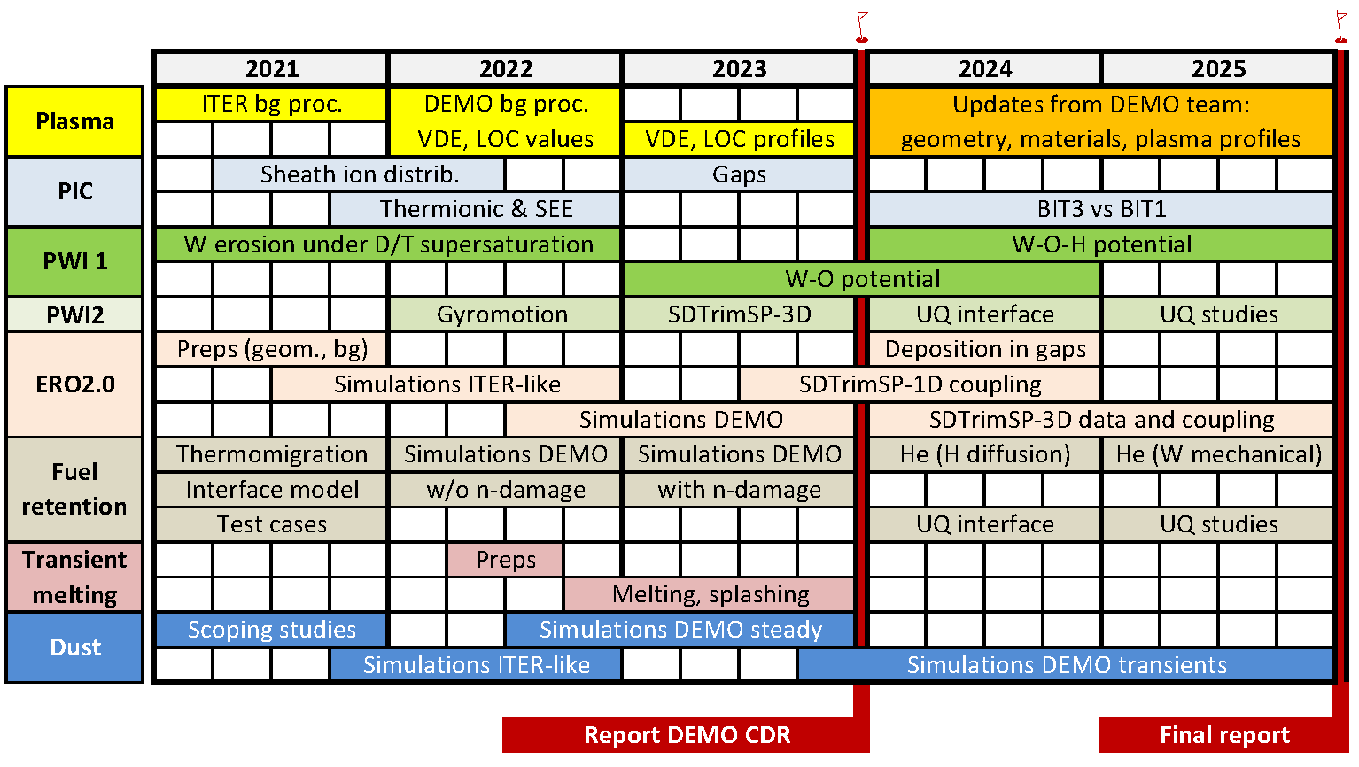
PROJECT TIMELINE

Slide 4
Team and resources
Team member | Research unit | 2022
ACH | ACH | 18.6
Dmitry Matveev | FZJ | 9
Juri Romazanov |  | 3
Chrisopher Baumann |  | 9
NN (PhD or Post-Doc) |  | 6
Aleš Podolník | IPP.CR | 6
Michael Komm |  | 0
David Tskhakaya |  | 0
Jernej Kovačič | JSI | 6
NN (PhD or Post-Doc) | VTT | 9
Svetlana Ratynskaia | VR | 6
Panagiotis Tolias |  | 6
Ladislas Vignitchouk |  | 6
ACH support
ERO2.0 ACH-BSC 4PM
SPICE2 ACH-BSC 4PM
MIGRAINe ACH-VTT 6PM
~ 4 PM still available in 2022 !
(+ CEA/USPN and IPP Garching teams not present at this meeting)

Slide 5

TASKS 2022
    Dedicated PIC studies with BIT-1 for DEMO-relevant high-density (ne~1e22) divertor sheath: provide relevant input for erosion, dust transport and transient melting simulations
    Full 3D ERO2.0 simulations using existing PWI databases, sheath models and the plasma solution agreed upon in the preceding phase of the project: provide first erosion-deposition maps and wall lifetime for the main chamber and divertor of DEMO
    Dedicated dust transport simulations with MIGRAINe for net deposition locations from ERO2.0
    Post-process and implement in ERO2.0 and MIGRAINe improved DEMO plasma solution from DCT
    PIC simulations with SPICE: identify whether the escaping current scales with electron thermal velocity (which depends only on Te) or on ion sound speed (which includes the influence of Ti).
    Cumulative MD simulations with 10-100 million impacts utilizing available W-H interatomic potentials to simulated supersaturated W surfaces under ion irradiation; compare to static cases
    Implement representative surface heat fluxes and halo current densities during DEMO VDEs and loss of confinement (external input DCT/WPDES) for transient melting simulations with MEMOS-U
    Detailed analysis of input/output of all involved codes to summarize how it can be reduced to IMAS compatible interfaces; identify the work program for IMAS compatibility implementation with ACH

Slide 6
DELIVERABLES 2022
    Improved results on DEMO-relevant high-density (ne~1e22) divertor sheath from PIC simulations: plasma profiles; energy, velocity and angular distributions at PFC as input ERO2.0 and MIGRAINe
    First erosion-deposition maps and wall lifetime in the main chamber and divertor of DEMO based
    on existing PWI databases, sheath models and the “2021” DEMO geometry and plasma background
    Dust survival rates and accumulation maps for net deposition locations from deliverable 2
    Improved DEMO plasma solution (DCT) post-processed and implemented in ERO2.0 and MIGRAINe
    Description of the influence of the ion temperature on the escaping current and conclusions on the validity of existing scalings for simulations of transient melting
    Final (cumulative) erosion yields for H supersaturated W from MD simulations
    Representative values of surface heat fluxes and halo current densities during DEMO VDEs and loss of confinement (external input) processed and implemented for transient melting simulations
    Detailed IMAS compatibility requirements and respective work plan

Slide 7
DISCUSSION
    HPC resources Marconi:
      anything left from 5th cycle?
      6th cycle:

Slide 8
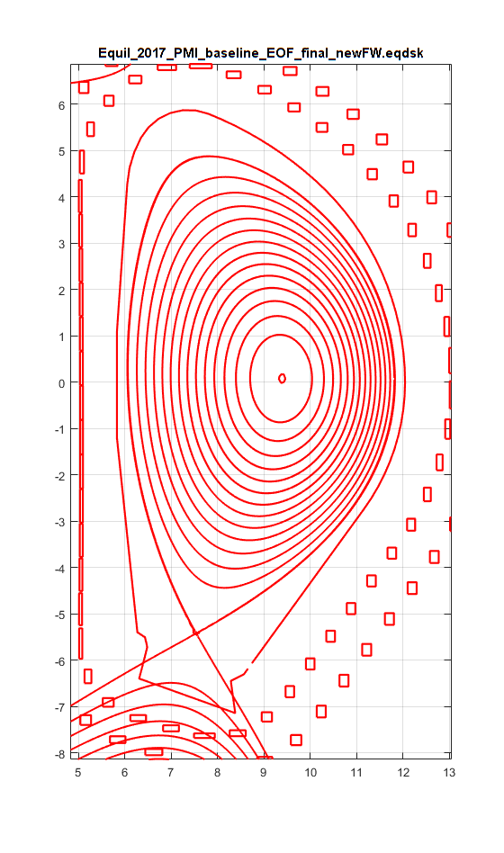
DISCUSSION
EOF = End of Flat Top
    DEMO
      Equilibrium: G EQDSK Format:
      SOLPS-ITER (F. Subba et al 2021)

Slide 9
DISCUSSION
    ACH support 2022-2023: parallelization, optimization, IMASization
      ERO2.0
      SPICE2
      MIGRAINe
      MEMOS-U (?)
      IMAS I/O: ACH tutorial: https://docs.psnc.pl/display/WFMS/Tutorial+-+adapting+codes+to+IMAS
      EUROfusion Standard Software: version control, continuous integration, user interface, validation&verificadtion, code dissemination, documentation and user support

