Slide 1
Proposal ideas on fast electrons in the edge
C. Killer for TG Scenario, 21.02.2022

Slide 2
Recap: indications for electron population far outside the SOL
hot spots on walls, probes, … (at positions that are not expected to receive heat loads)
negative floating potentials seen by probes (where it should be zero, since n=0)
occurring in pure ECRH plasmas with P_{ECRH}/n_{dl} > 1 (for P_{ECRH} in MW and n_{dl} in 10¹⁹m⁻²)
relevance to TF 1: Exploration of heating scenarios using upgraded plasma heating capabilities
Exhaustive operational map of the W7-X configuration space incl. operation limits
Demonstration of safe operation of heating systems
see also:
Physics meeting 20.11.2019
TG scenario 16.03.2020, 21.09.2020
20181002.46
[video: Aleix Puig Sitjes]

Slide 3
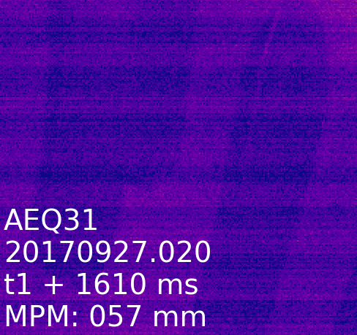
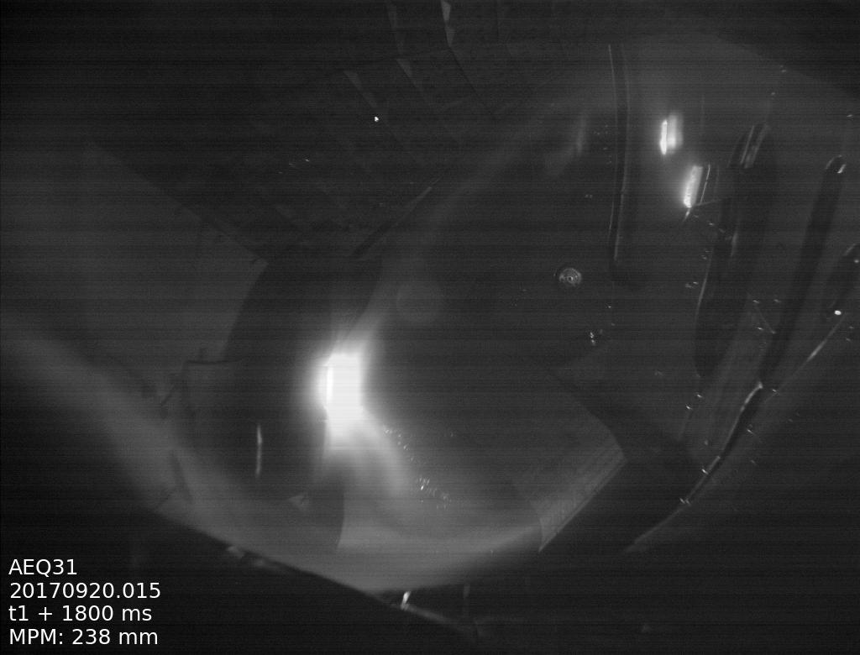
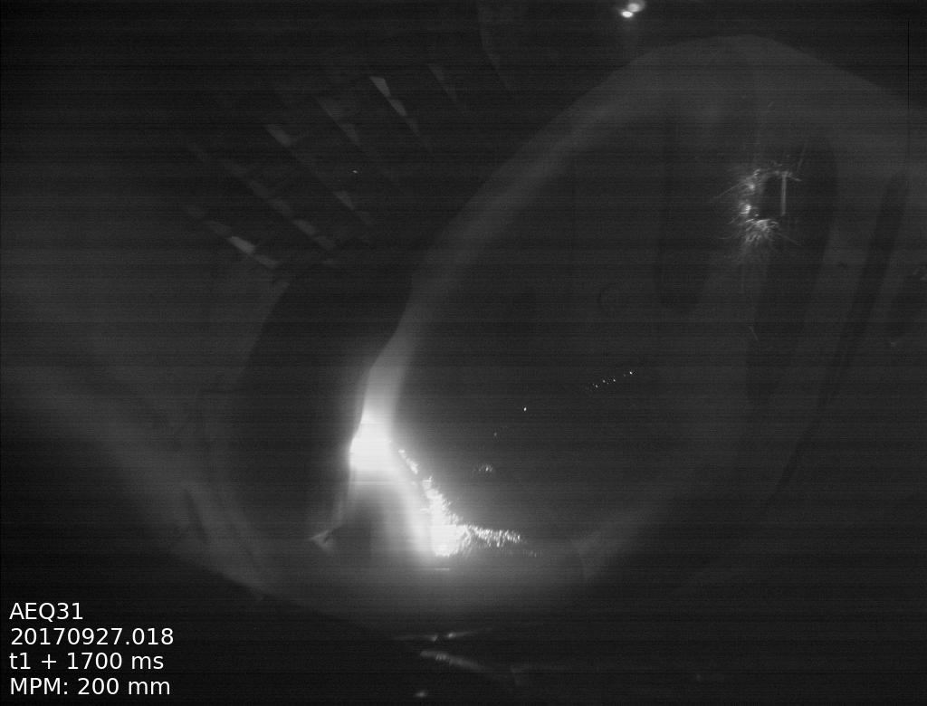
some more obversations
hot spots in low density plasmas depending on magnetic configuration
stationary “stripes” on MPM → presumably by electron population tied to rational surface
EJM
KJM

Slide 4
Relevance for OP2
TF I: Exploration of heating scenarios using upgraded plasma heating capabilities
Exhaustive operational map of the W7-X configuration space incl. operation limits
Demonstration of safe operation of heating systems
ECRH power has increased from OP1 and will increase further
does the P_{ECRH}/n_{dl} > 1 existence regime transfer to higher power? Hopefully not… → map out operational space (in heating power, density, potentially ECRH details (choice/settings of gyrotrons))
acceleration mechanism
candidate: Parametric Decay Instability. First observations in OP1.2b, experiments with upgraded diagnostic planned [Moseev+DTU]
parallel electric fields (similar to tokamak runaway mechanism) can transiently appear in edge due to current distribution, but no candidate for plasma in equilibrium [Aleynikov]
fundamental understanding of fast particle losses
experimentally observed fast electron losses as validation for ASCOT, BEAMS3D
(in some configurations (e.g. KJM), MPM data indicates ion losses in pure ECRH plasmas)

Slide 5
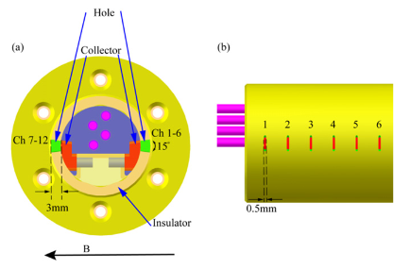
Proposals for OP2.1/2.2
piggyback survey using MPM whenever electric probes are operated
look for fast particle signatures outside the SOL whenever electric probes are operated (see caki_007 in OP1.2b)
in addition have an eye on pop-up divertor probes (although these only cover a much smaller spatial area)
use MPM and video cameras in P_{ECRH}, n operational space
if this is caused by PDI, SOL density profiles are important → study variations of SOL density profile while keeping n_{dl} constant.
PDI group is preparing dedicated proposals (TG Heating?) → perhaps attach MPM operation to those proposals
in OP1.2b, worst scenario was in reversed field. Coincidence? → Carefully check reversed field experiments
inject pellets / Tespel in fast electron scenario → increased ablation (seen in TJ-II)
new electron probe for measurement of non-thermal electron currents (FZJ/EAST)
shielding ions (small aperture, electrical bias) → only sensitive to electrons
resolves direction along/against field (indications for preferred directionality of electrons in OP1.2)
presentation later today (TG Edge/Divertor, 21.02.2022 15.30)

