Slide 1
Plasma Wall Interaction and Exhaust
WP PWIE SP B: Meeting on results from WEST C3 marker PFUs
Broad-beam PIXE/NRA/RBS results - correspondence to MPG results (IST)
Rodrigo Mateus
Norberto Catarino
Rui Silva
Eduardo Alves 4 March 2022

Slide 2
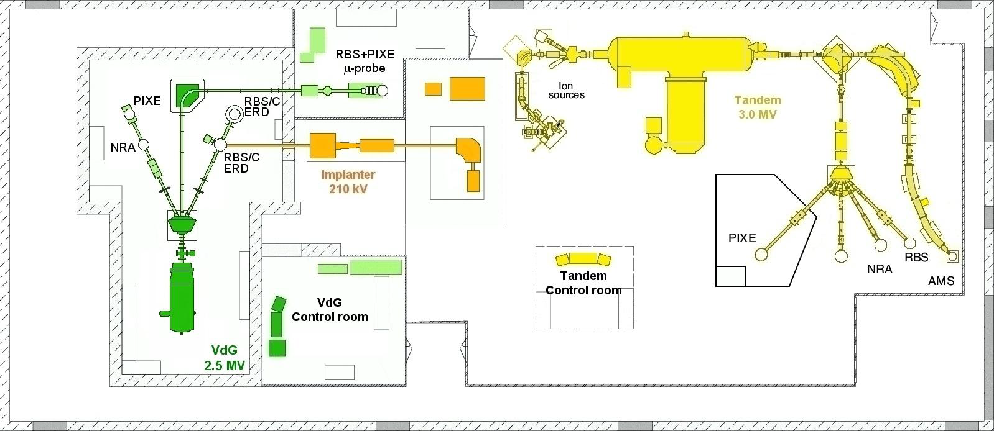
Laboratory layout
JET
JET chamber - EBS, RBS, NRA, PIXE, from small samples to full tiles
RBS/C, ERD chamber - EBS, RBS, NRA, Be-based, W-based,
small samples, good adhesion

Slide 3
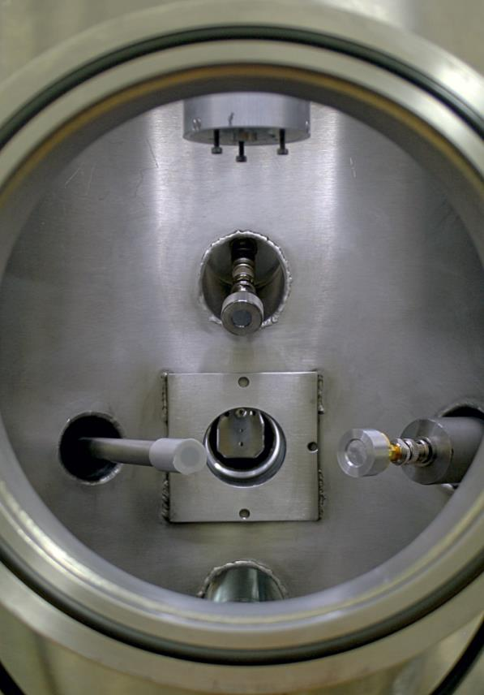
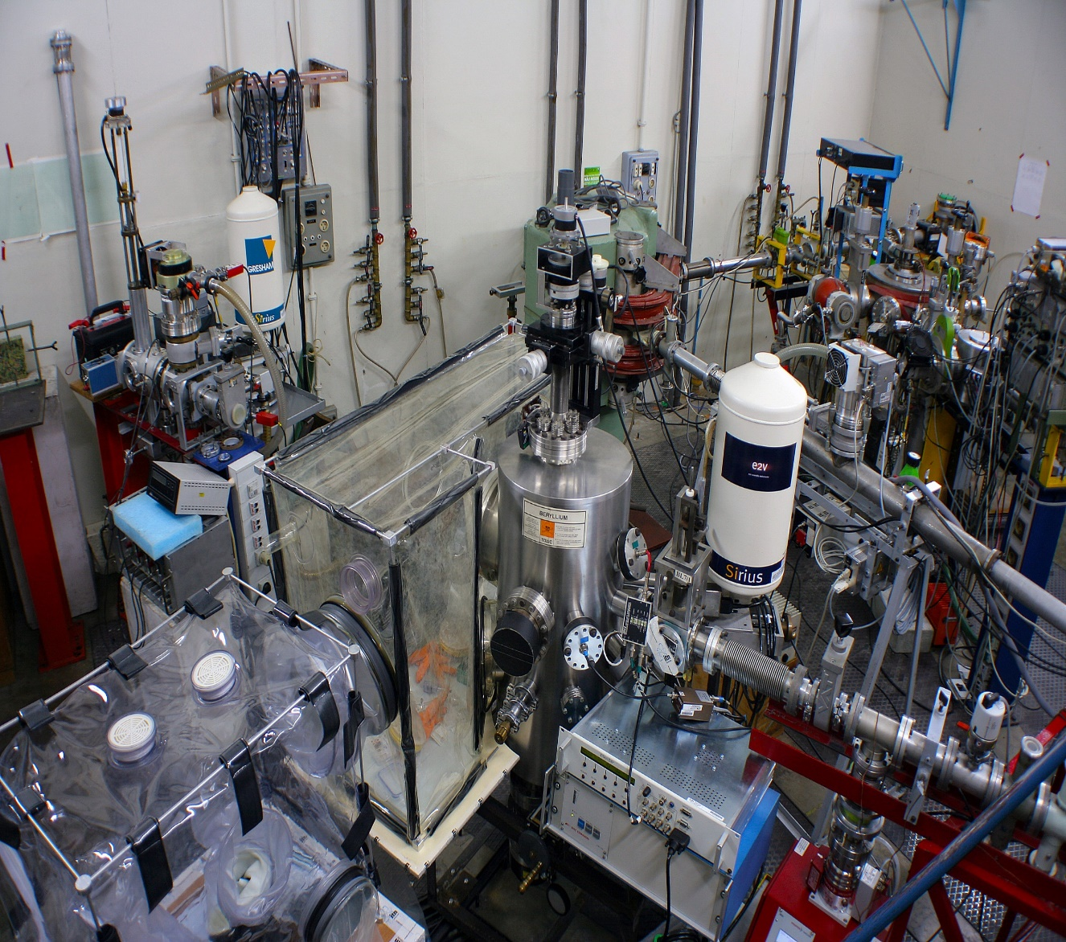
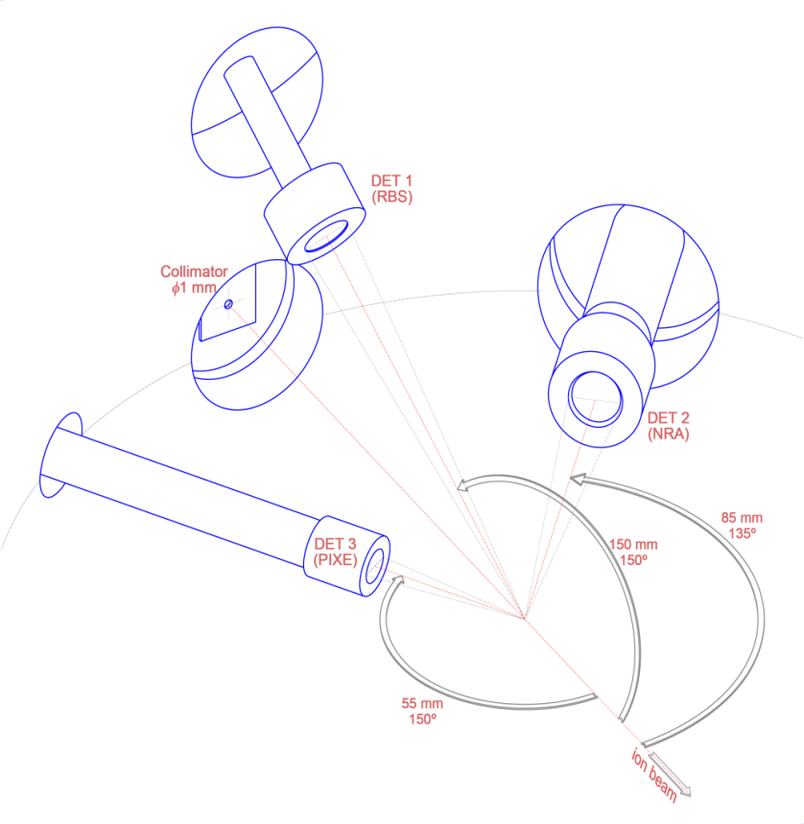
Experimental Setup
Experimental chamber
JET line
Detector geometry

Slide 4
Experimental IBA conditions
Measurement positions in the samples
4 points per core every ∼3.0-4.0 mm
(deviated ∼2 mm from SIMS analysis at VTT).
Spot size area ~ 1 mm²
IBA experimental conditions
PIXE: 2300 keV proton beam detector at 150°
EBS: 2300 keV proton beam detector at 150°
NRA: 1000 keV and 2300 keV ³He beams detector at 135°
Available information
D contents along depth ranges down to ∼3-4 μm in W-based coatings by NRA
Contents of B and C co-deposits by NRA (2300 keV), if they are significant
W contents above the Mo interlayer by EBS
Amounts of minor contaminants by PIXE
Evaluate the presence of other elements like O from elemental depth profiles by EBS

Slide 5
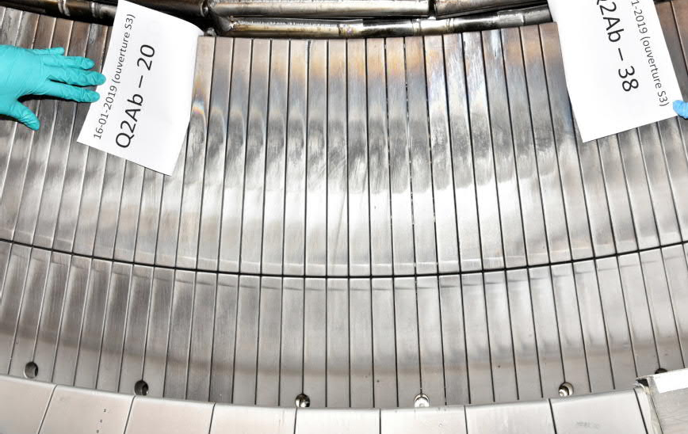
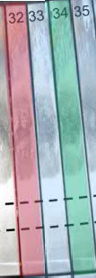
Tiles for SEM and IBA analyses
Tiles configuration at WEST
Standard initially cooled W-coated graphite tiles
16 erosion marker tiles installed in WEST phase 1
2 retrieved after campaign C3
(D exposure only)
2 erosion marker tiles
and 1 standard tile after C4
(He phase at end of campaign)
HFS
0
s
Inner tiles
^{q}//
ISP
OSP
0
^{q}//
Outer tiles
s
~2-4 µm W
15 µm W
3 µm Mo
C
~100 nm Mo
LFS
15 µm W
3 µm Mo
baffles
Photo after C3
C
standard tile erosion marker tile
EM: Erosion marker tiles
C1+C2+C3
C1+C2+C3+C4
04.03.2021
M. Balden, WEST task force meeting
6

Slide 6
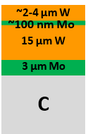
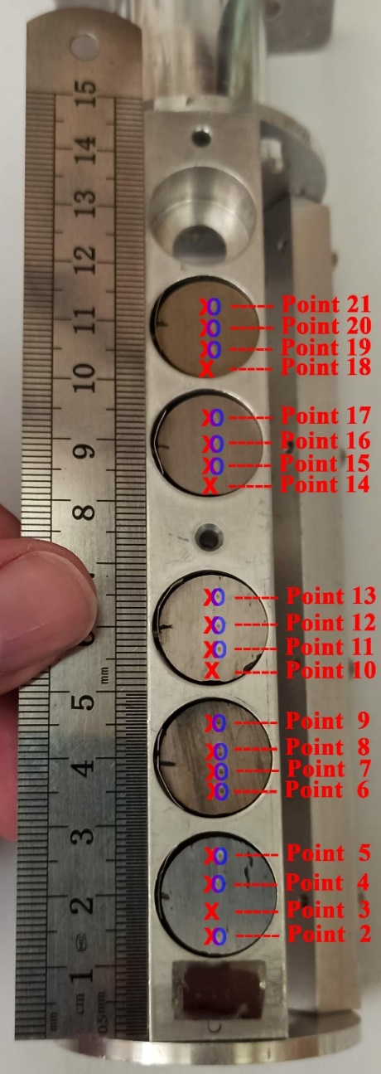
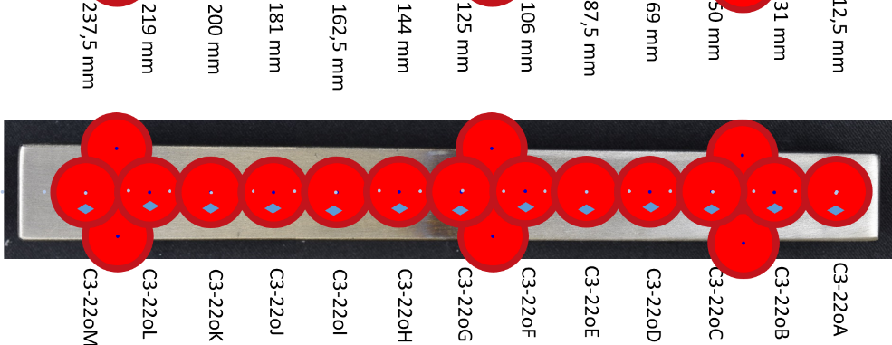
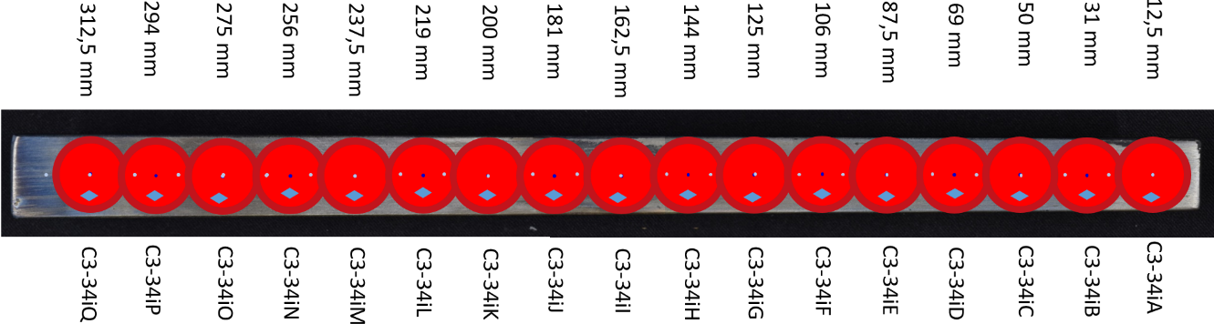
Analysis of C3 marker tiles of WEST
C3-22o marker tile of WEST
As-prepared
Marker Tiles
Analysed points:
x - IBA / IST ; 0 - SIMS / VTT
thin deposition some deposition erosion
C3-22oJ
x
x
C3-22oE
C3-34i marker tile of WEST
thin deposition erosion strong erosion some deposition
C3-34iM
C3-34iK
C3-34iB
x
x
x

Slide 7
Analysis of WEST samples by IBA
C3-34iK
C3-22oE
R. Mateus, E. Alves | WP PFC SP5 Kick-off meeting | 1 February 2019 | Page 7

Slide 8
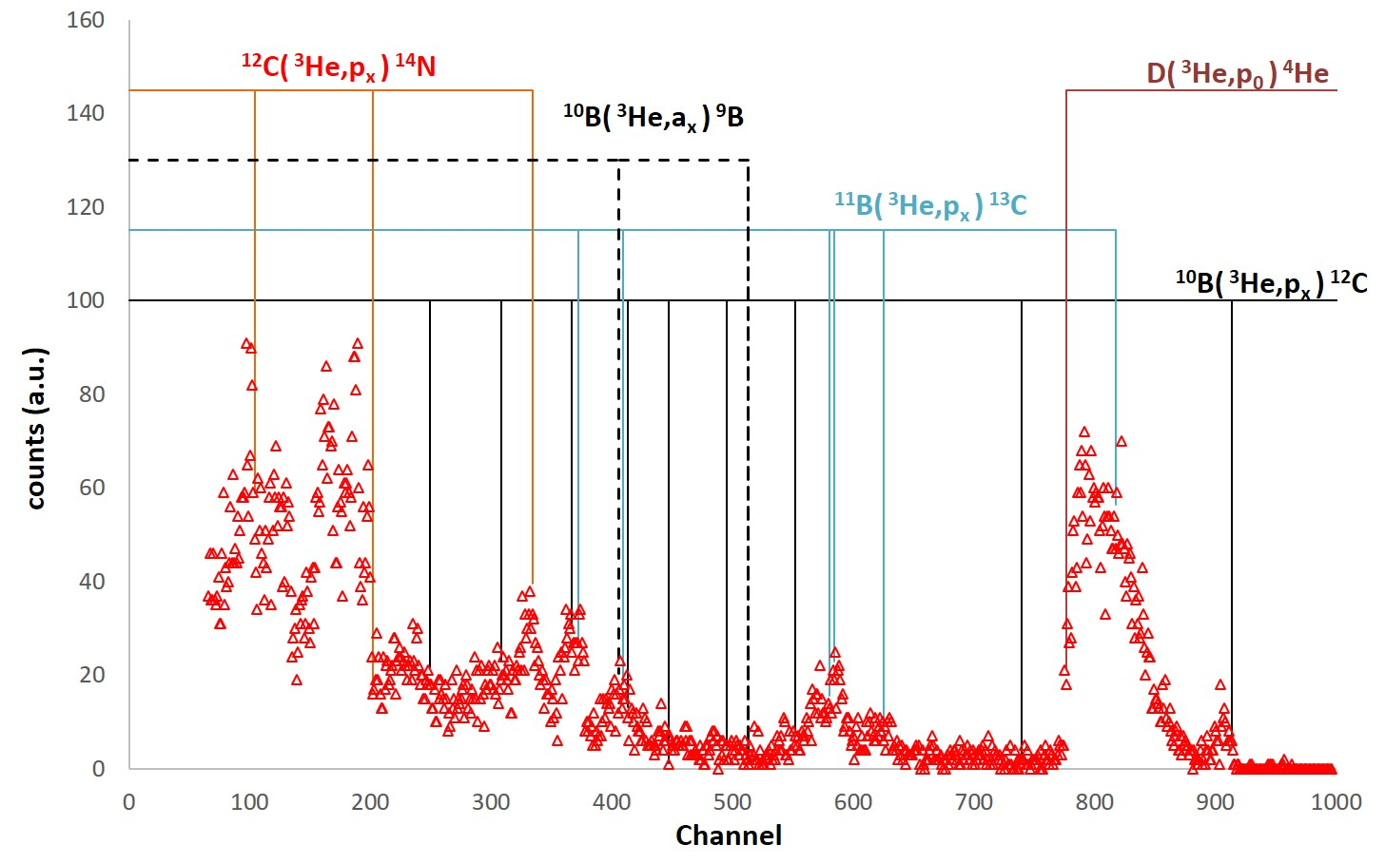
Analysis of WEST samples by IBA
Identification of particle yields in NRA spectra:
example of NRA spectra of point 8 (sample C3-32iK)
Used yields for elemental quantification (cross sections from IBANDL data base)
²H(³He,p₀)⁴He [ W.Moller, F.Besenbacher, NIM 168 (1980) 11 ]
¹⁰B(³He,p₁)¹²C [ J.R. Patterson et al., Proc. of the Physical Society 88 (1966) 641 ]
¹²C(³He,p₀)¹⁴N [ G. Provatas et al., NIMB 500-501 (2021) 57 ]

Slide 9
Analysis of WEST samples by IBA
slightly lower
W contents (IPP)
co-deposition of O ?
Mo layer partly on
the surface (IPP)
agreement (IPP)
agreement (IPP)
¹¹B(p,α₁)⁸Be → c.s. ∼ 60 mb/sr at 150º (IBANDL)
⁸Be → ⁴He + ⁴He (complex analysis: use of standards or standard analysis ?)

Slide 10
Analysis of WEST samples by IBA

Slide 11
Summary
Samples of the exposed C3-22o and C3-34i Marker Tiles of WEST
were analysed by IBA at IST (C3-22oJ, C3-22oE ,C3-34iB, C3-34iK, C3-34iM).
Low D contents behind the depth range achieved by NRA analysis (∼3 μm)
B quantification difficult by the low cross-sections of the ¹⁰B(3He,p)¹²C reaction
C co-deposited in superficial layers in C3-22oJ, C3-22oE, C3-34iB, C3-34iM
Thick co-deposition of B and C in C3-34iK
Mo quantification is hindered by the first W layer (roughness effect ?)
Cr and Fe were identified by PIXE as minor contaminants in all the samples
The experimental setup at IST enables the analysis of WEST samples by IBA

