Slide 1
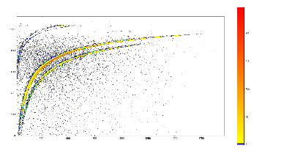
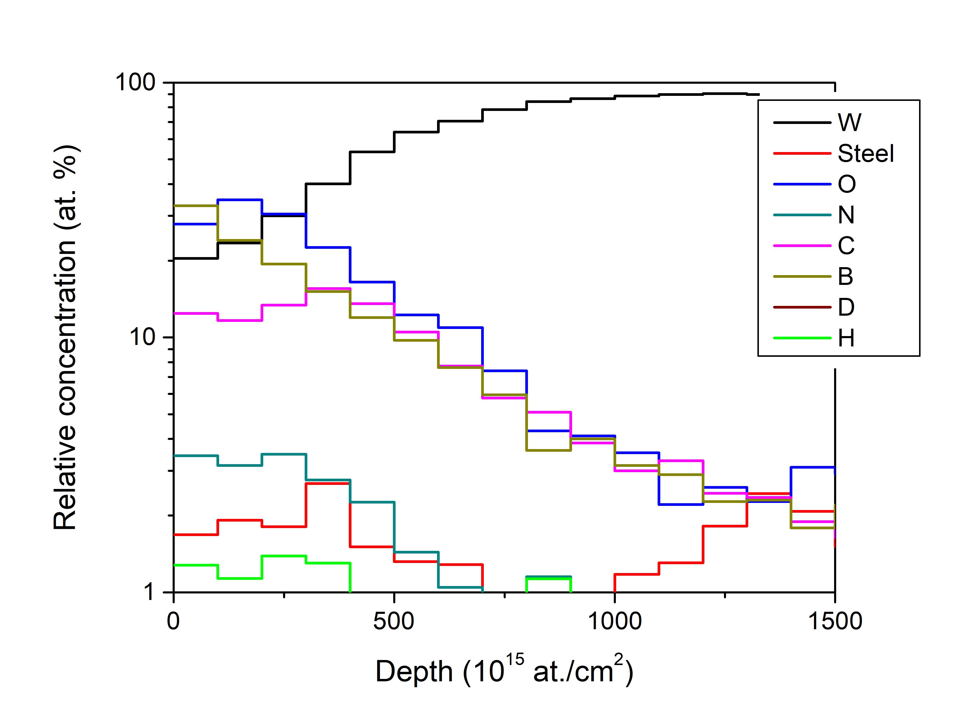
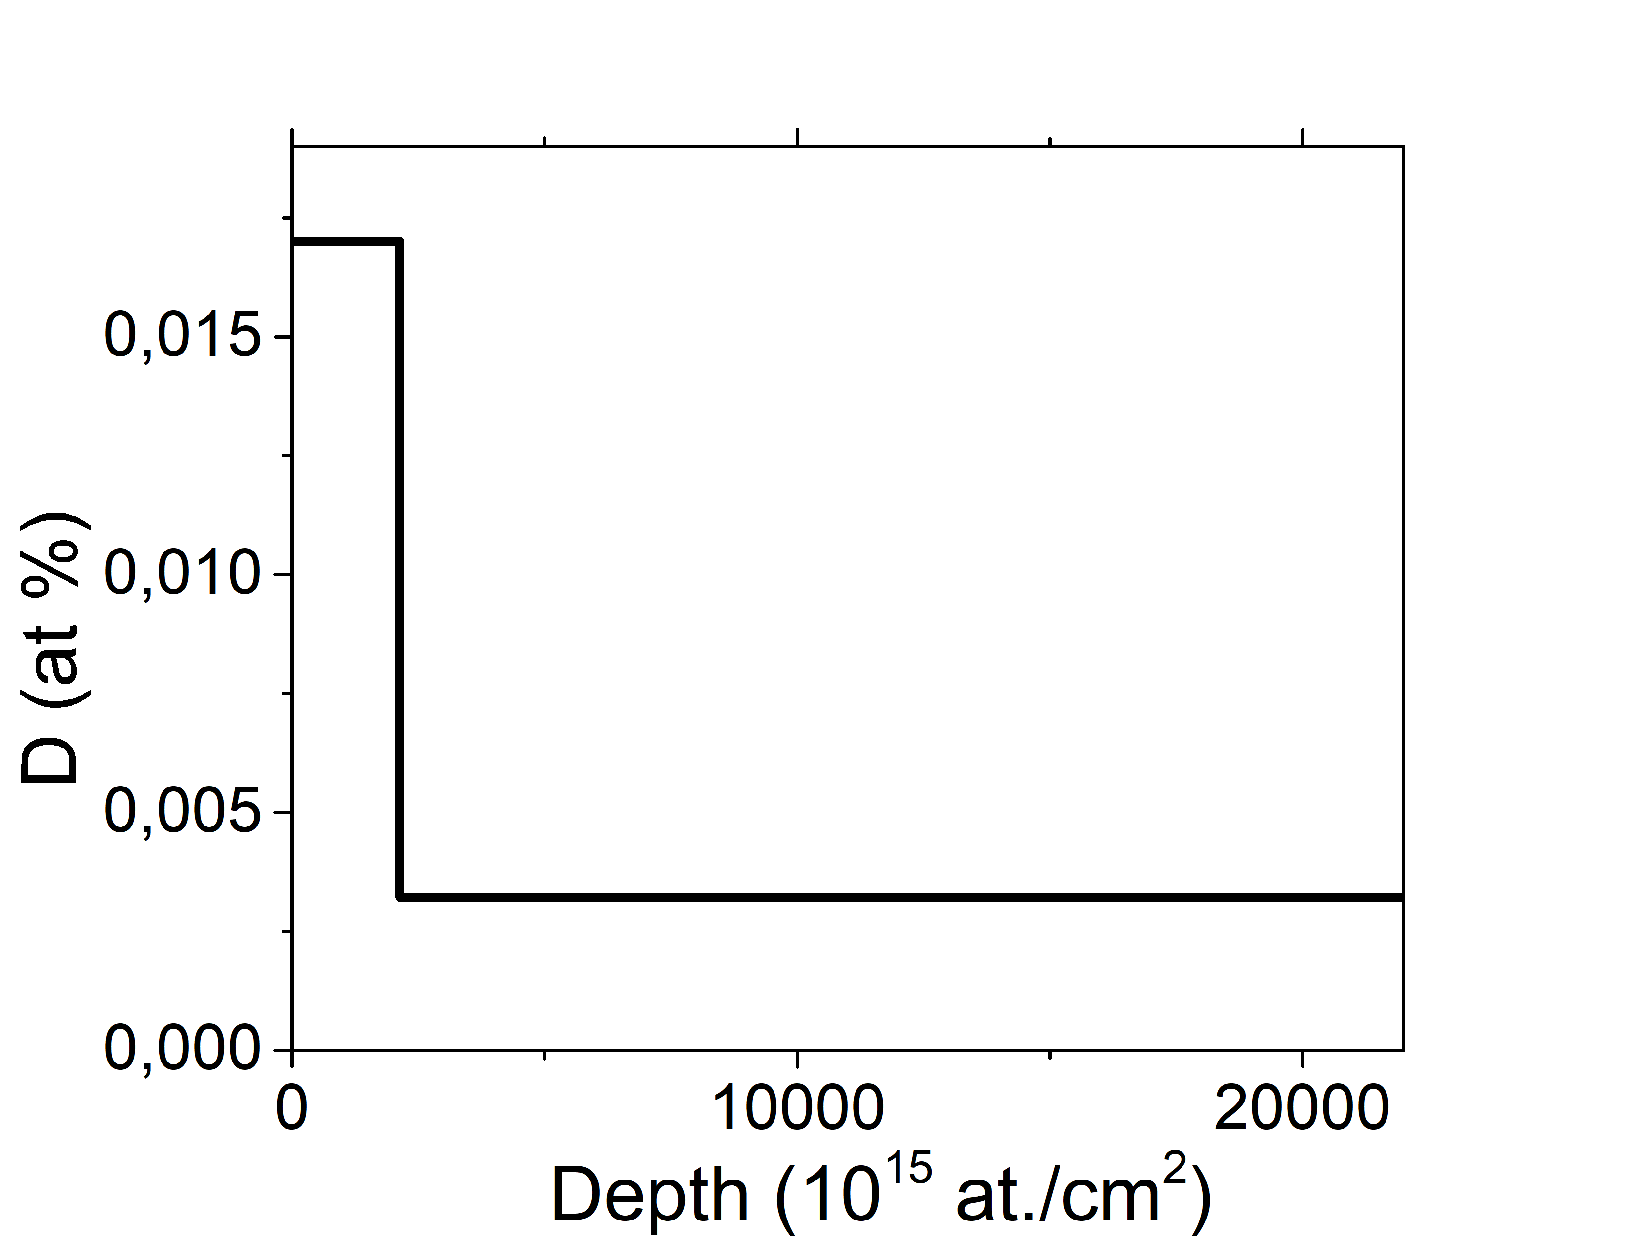
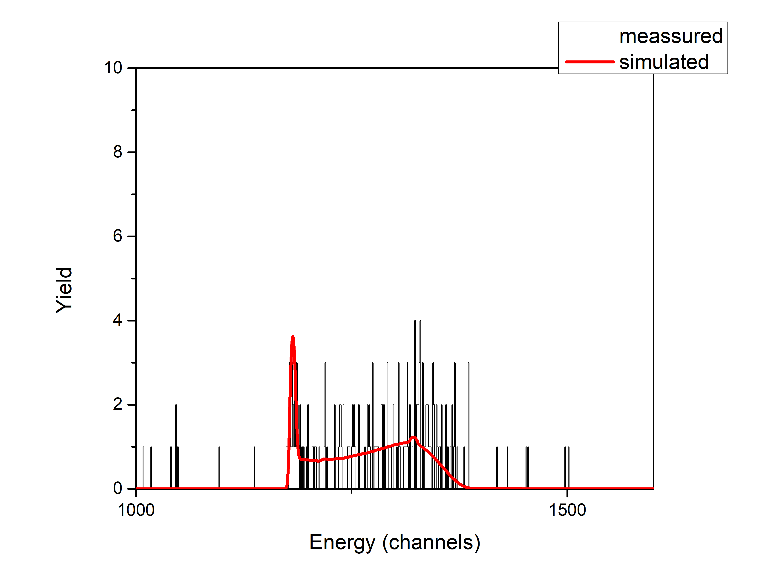
Ion beam analyses of PFC from WEST
Analysis
Results:
Measurements done, some analysis remaing
D: Surface concentration and small amount in the bulk (~10¹⁷ at./cm²)
ERDA: Mixed deposits no Helium found clear surface amounts of B and O
Surface composition and quantitative depth profiling
NRA for D, B, C (..)
ToF-ERDA for all elements (He, Li)
NRA
ERDA
Slightly problematic with roughness
Will show Helium (sensitivity ~10¹⁴ at./cm²)
Deeper depths?
<VR: Per Petersson, Marek Rubel>

