Slide 1

WEST C3 analysis RBI – TOF ERDA and RBS
Z. Siketić, M. Brajković, S. Gouesmia, I. Bogdanović Radović, RBI

Slide 2
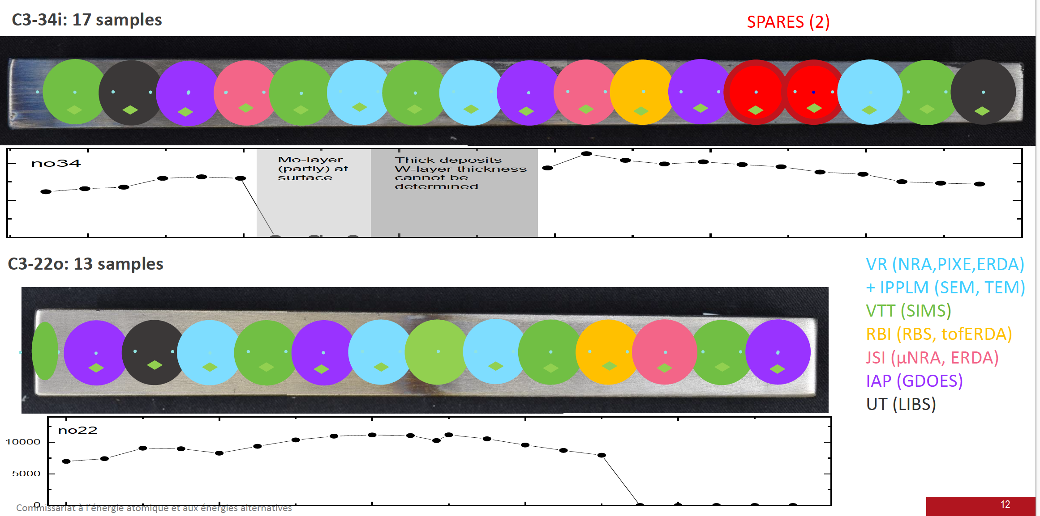
C3 erosion marker tiles from WEST
Two samples analysed by RBS and TOF ERDA

Slide 3
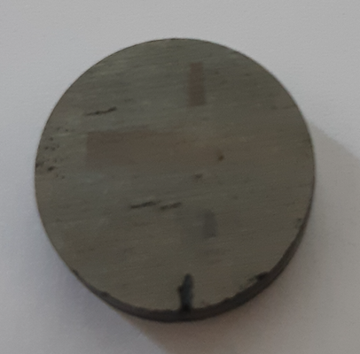
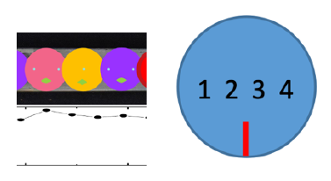
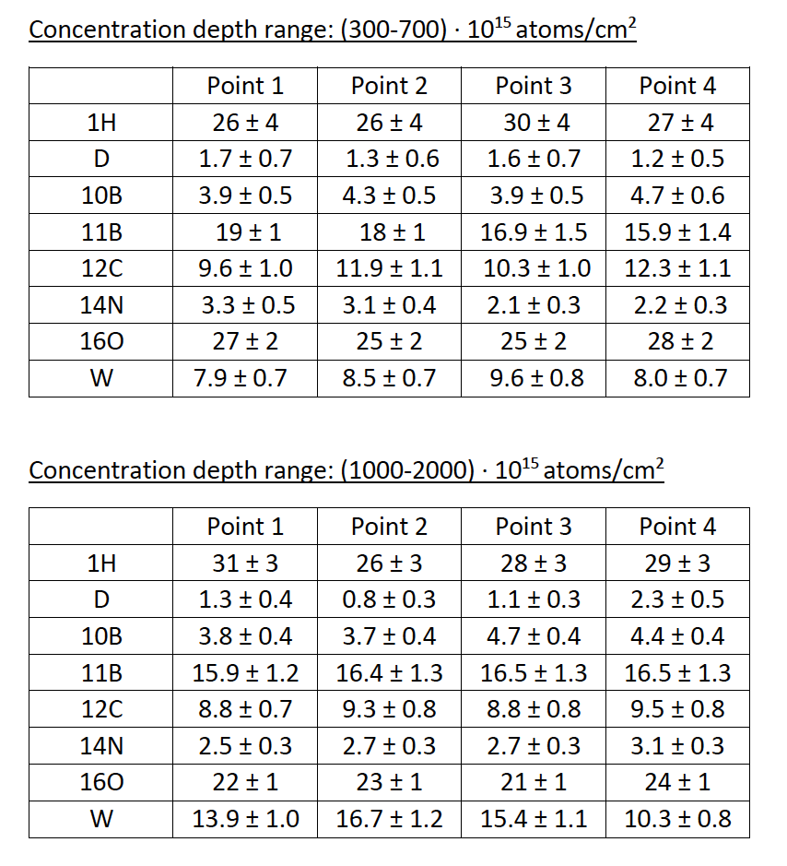
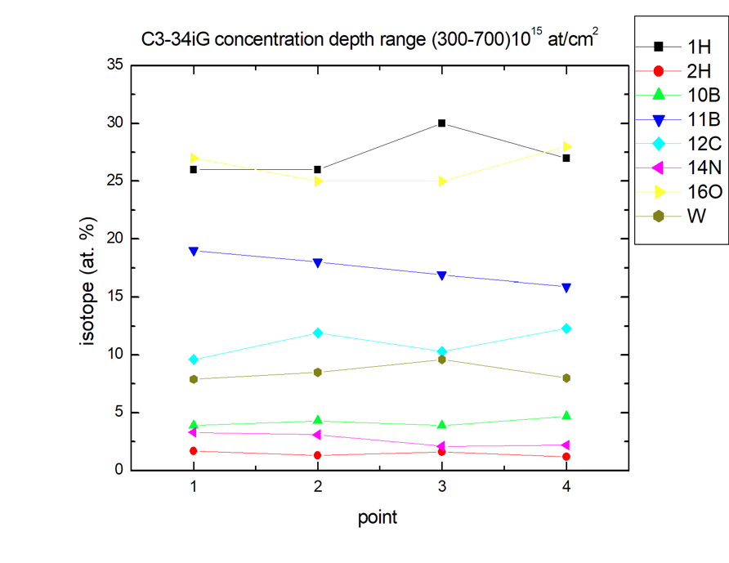
TOF ERDA on C3 erosion marker tiles from WEST
Sample C3-34iG
Four horizontal positions were measured by TOF ERDA 23 MeV ¹²⁷I⁶⁺ beam. Angle between sample surface and beam was 20∘. Spectrometer was placed at 37.5∘. Distance between each point was 3 mm.
1 2 3 4

Slide 4
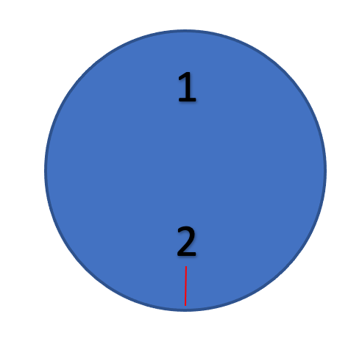
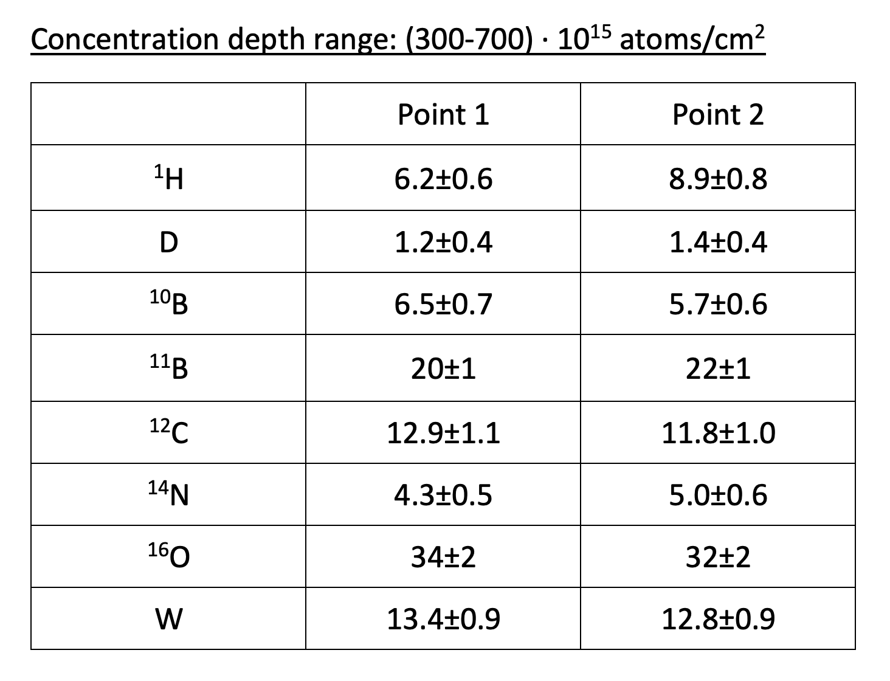
TOF ERDA on C3 erosion marker tiles from WEST
Sample C3-34iG
Two vertical positions were measured by TOF ERDA. Measurements were performed 1 year after horizontal measurements! Big difference in H!
1
2

Slide 5
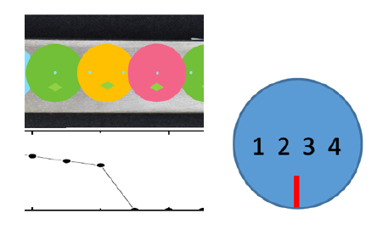
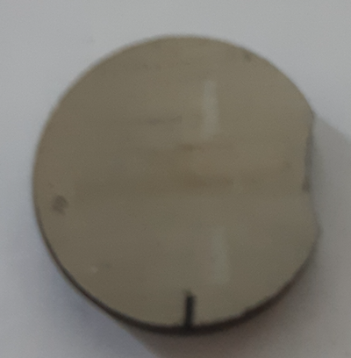
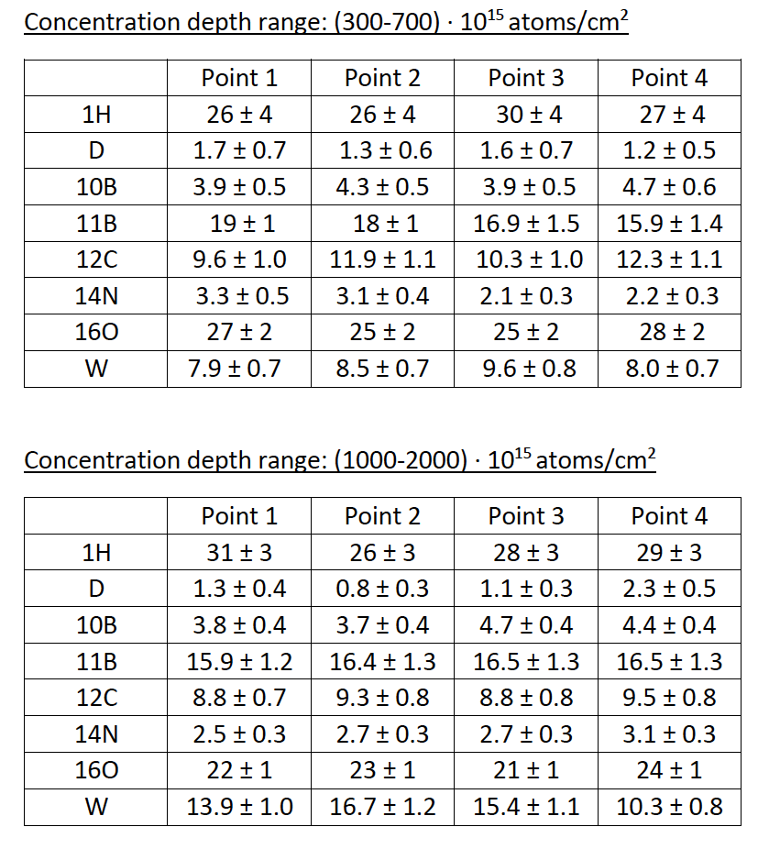
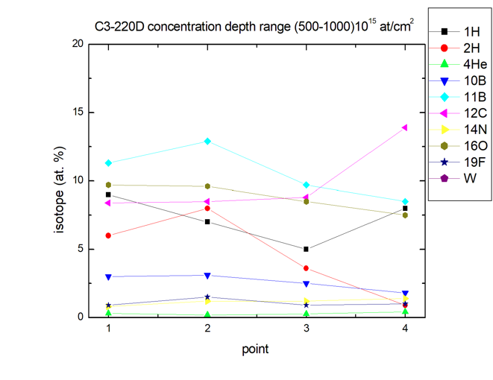
TOF ERDA on C3 erosion marker tiles from WEST
Sample C3-22oD
Four horizontal positions were measured by TOF ERDA.
Distance between each point was 3 mm.
1 2 3 4

Slide 6
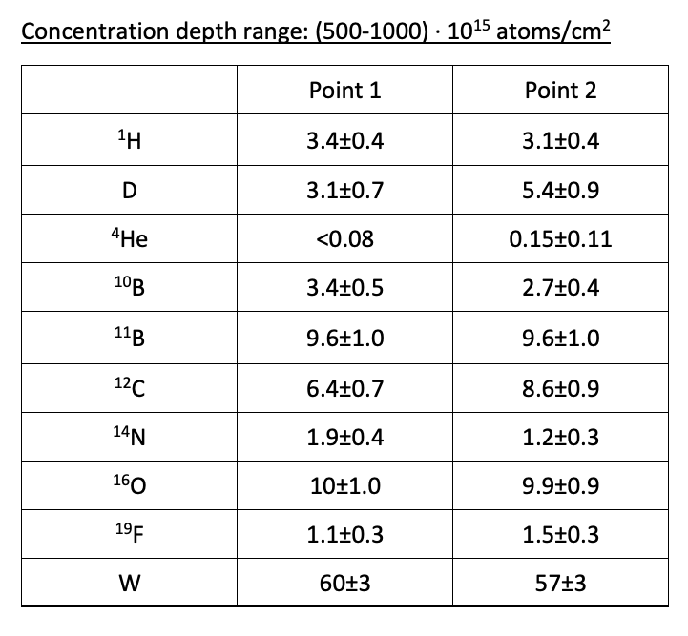
TOF ERDA on C3 erosion marker tiles from WEST
Sample C3-22oD
Two vertical positions were measured by TOF ERDA.
Measurements were performed 1 year after horizontal measurements! Big difference in H!
1
2

Slide 7
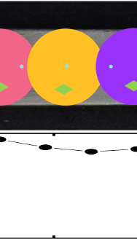
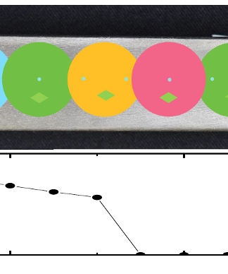
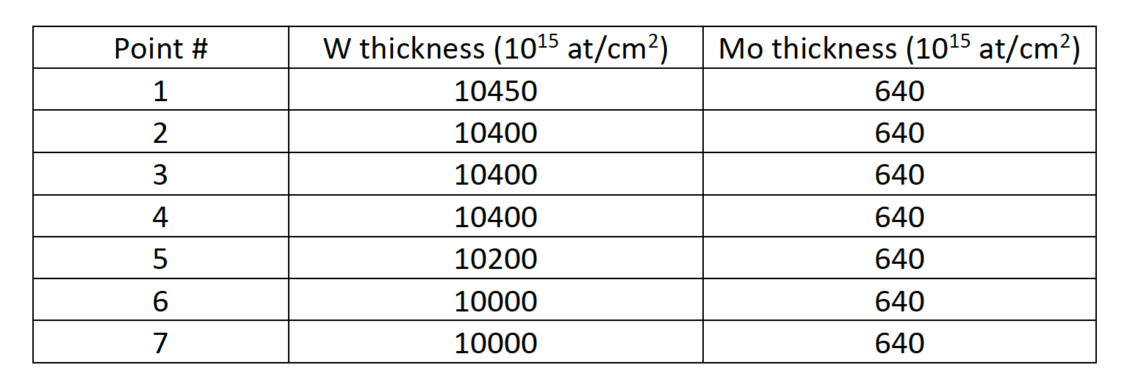
RBS on C3 erosion marker tiles from WEST
- 2 MeV protons with a solid state detector placed at 165º
C3-34iG –layer
C3-34iG was measured with a beam spot of 1 mm diameter and 7 different points along the sample were measured.
Layer thicknesses ~5%.
C3-22oD –layer was not seen

