Slide 1
Impact of NBI on SOL transport
V. Perseo, D. Gradic, …?

Slide 2
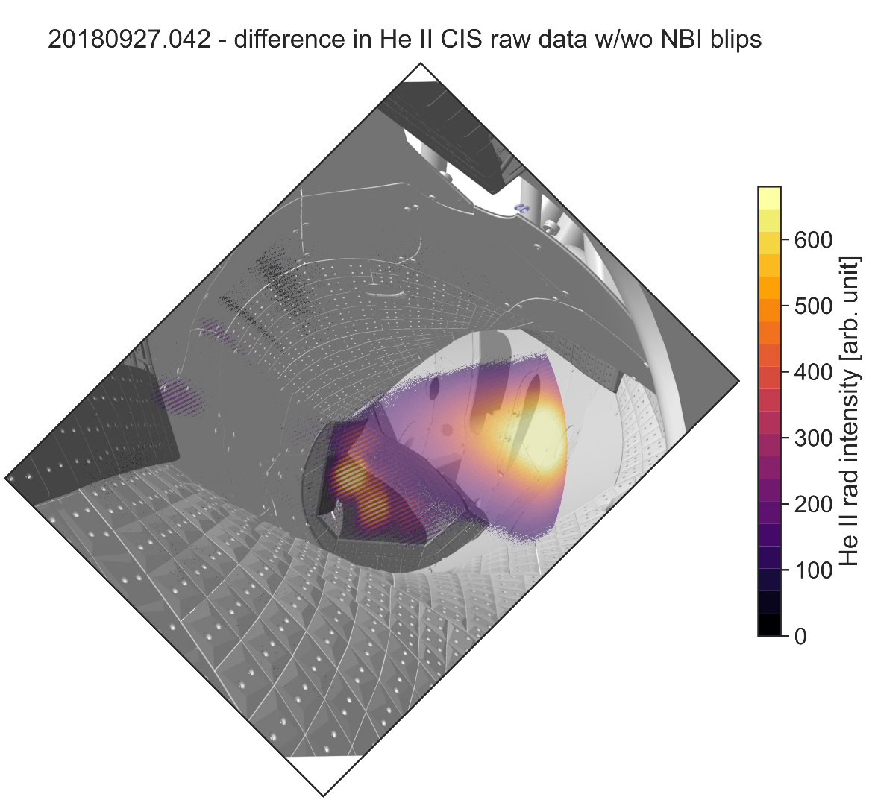
Impact of NBI on SOL transport
Motivation:
NBI beams cross the SOL and could deposit part or their particles and energy in the SOL, which could cause asymmetries in the island chain. Moreover, NBI operation might change $T_{i}$and $T_{e}$ at the upstream location and influence the SOL gradients.
Objectives:
Monitoring of SOL parameters during NBI and NBI+ECRH operation.
Special requirements:
Diagnostics:
CIS
IR cameras
Langmuir probes
Upstream $T_{i}$measurements?
Profile diagnostics?
… any other available diagnostic
Can be combined with:
NBI operation
Proposal meant to be fully piggy-back
Task Force(s) | I-2, III-2
Mag. Configurations | EIM, or KJM?
No. of programs | Piggy back

