Slide 1
Effects of SOL drifts on sheathdrop and plasma potential
A Pandey, C Killer, Valeria Perseo, Matt Kriete, Yu Gao, M Endler

Slide 2
Effects of SOL drifts on sheathdrop and SOL currents
Objectives:
how the drifts can affect sheath potential drop and plasma potential above the divertor in standard configuration.
would also relate to the effect of drifts on the heat flux deposition on the divertors through the sheath transmission factor.
Approach:
Correction of error fields
Measure the floating potential and plasma parameters through divertor LP
Calculate : plasma potential, sheathdrop, heat flux through the sheath
Compare for forward and reversed field cases
The plasma potential calculated may serve as input to the MPM mach probes for comparison
Specific requirements:
  Forward and Reversed field
  Diagnostics : Divertor Langmuir Probes, MPM with Mach probes, CIS, Divertor IR Cameras
Can be combined with:
  Detachment discharges with Forward and reversed field
  Up/Down asymmetry proposals
  SOL drift proposal
Task Force(s) | I, II, III
Mag. Configurations | EJM
No. of programs | --
Requested Parameters
Heating [MW] (ECRH, NBI, ICRH) | Low and high edge densities

Slide 3
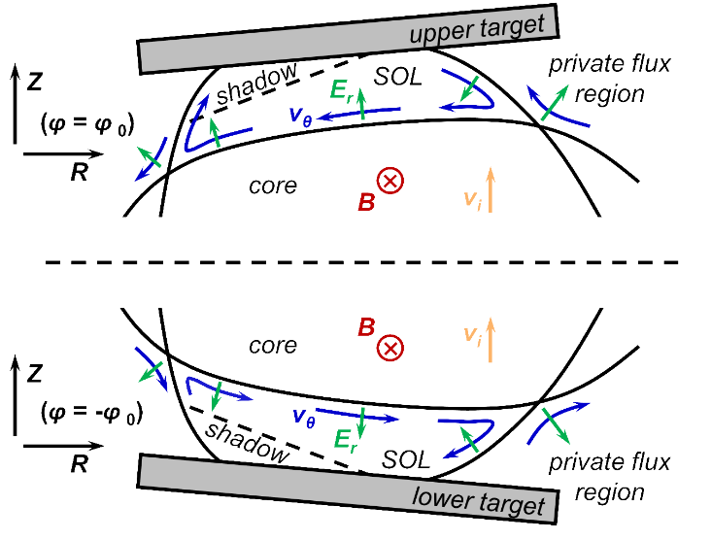
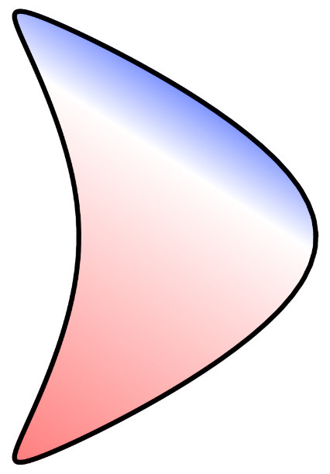
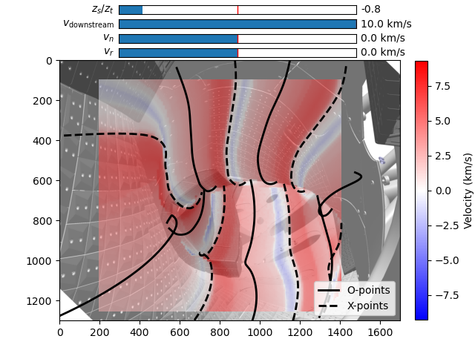
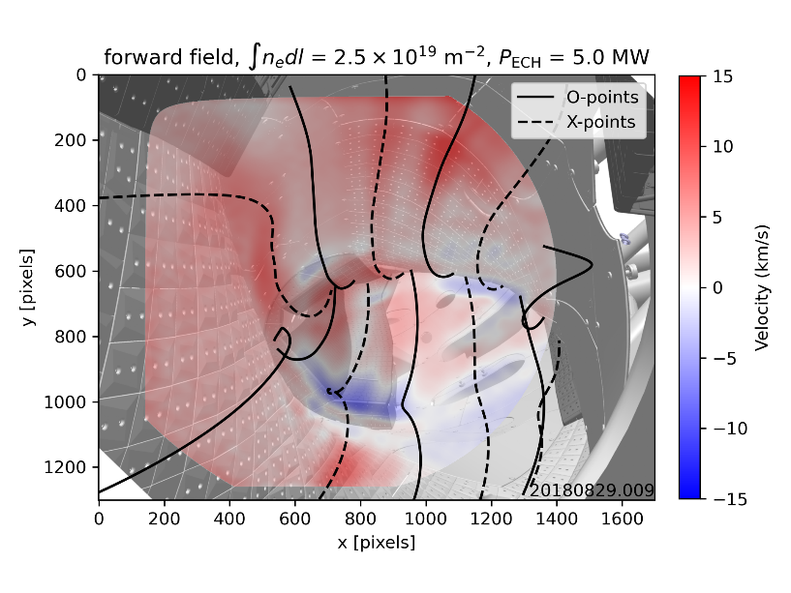
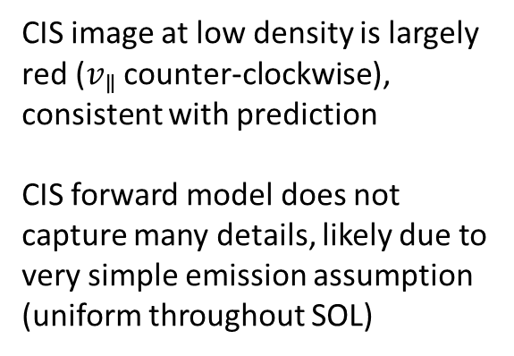



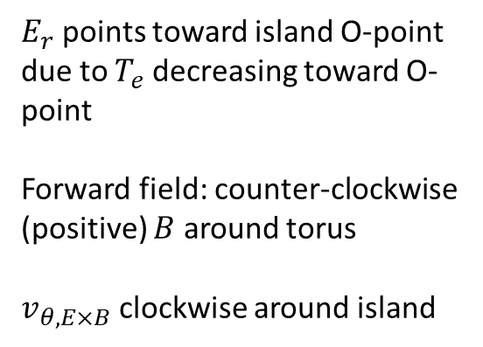

CIS measurements showing uni-directional flow over most of image at low density are consistent with direction of binormal $E×B$ drift
Forward field drift direction
CIS forward model
$$v_{θ,∥}$$
CIS measurements
stagnation point
$$v_{θ,E×B}$$
$$v_{θ,∥}$$
$E_{r}$ points toward island O-point due to $T_{e}$ decreasing toward O-point
Forward field: counter-clockwise (positive) $B$ around torus
$v_{θ,E×B}$ clockwise around island
Stagnation point shifts in direction of $v_{θ,E×B}$ → $v_{θ,∥}$ now counter-clockwise throughout most of island
island $ι$ has left-handed helicity: counter-clockwise $v_{θ,∥}$ around island → counter-clockwise $v_{∥}$ around torus (positive flow)
CIS image at low density is largely red ($v_{∥}$ counter-clockwise), consistent with prediction
CIS forward model does not capture many details, likely due to very simple emission assumption (uniform throughout SOL)

Slide 4
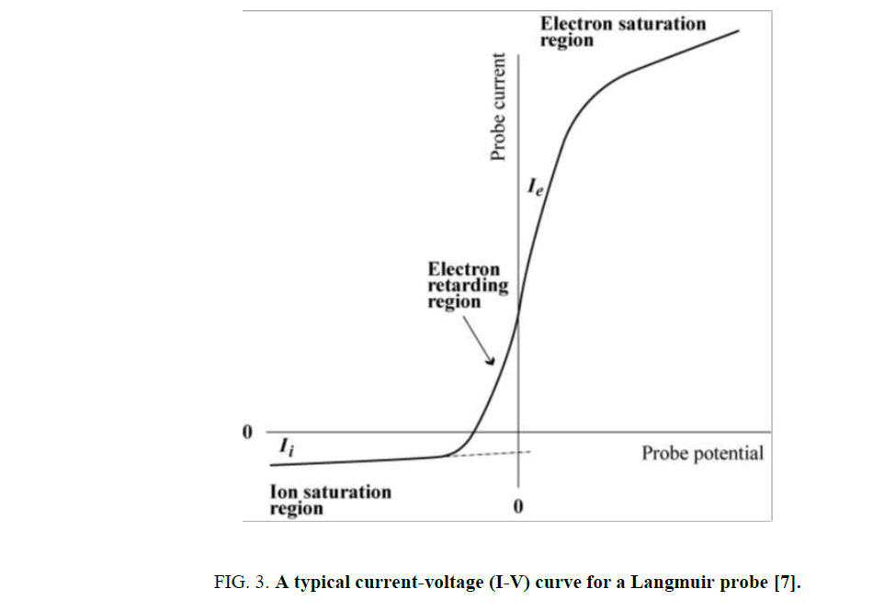
Quick refresher
Floating potential :
  unbiased (floating) surface exposed to the plasma gets charged to floating potential
  Electron current = ion current → No net current
  Negative with respect to the plasma potential
  Usually negative with respect to the ground
  Ground → 0 V
Floating Potential

Slide 5
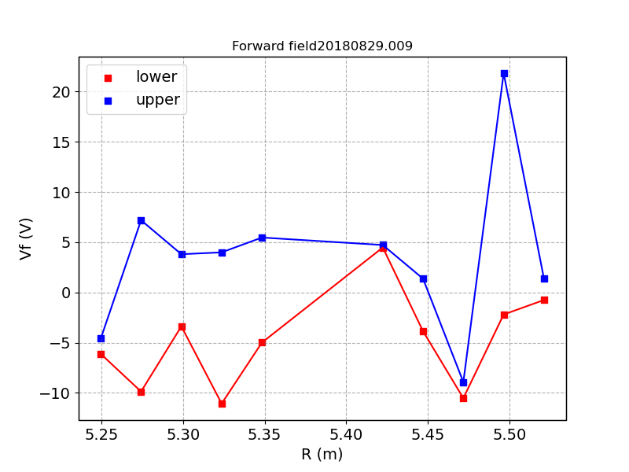
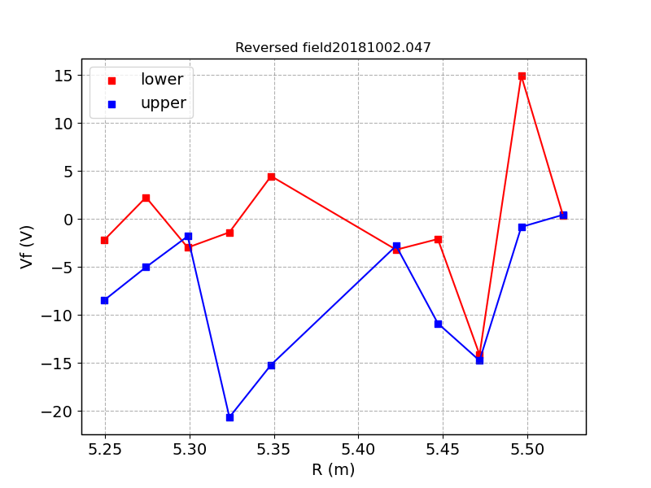
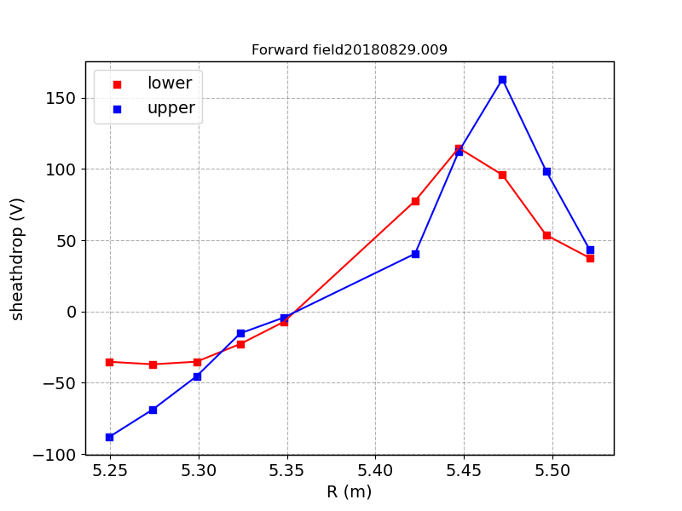
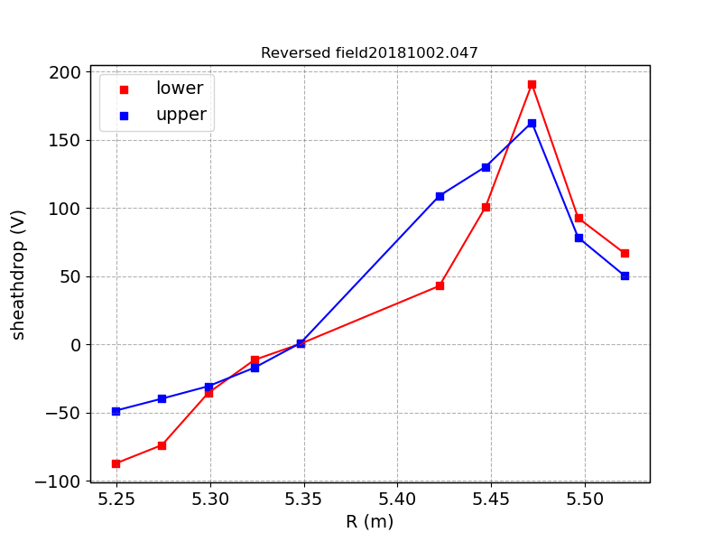
Measured Floating potential in low iota and standard (F/R)

Slide 6
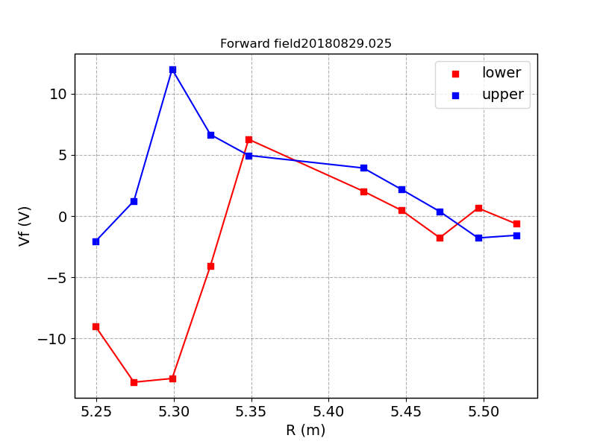
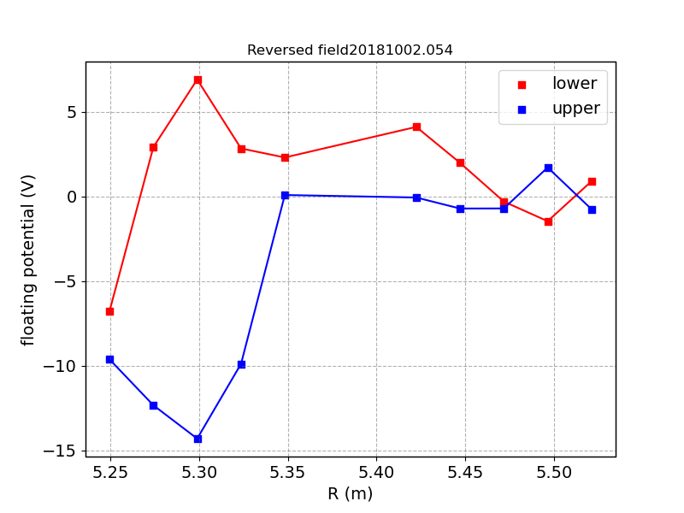
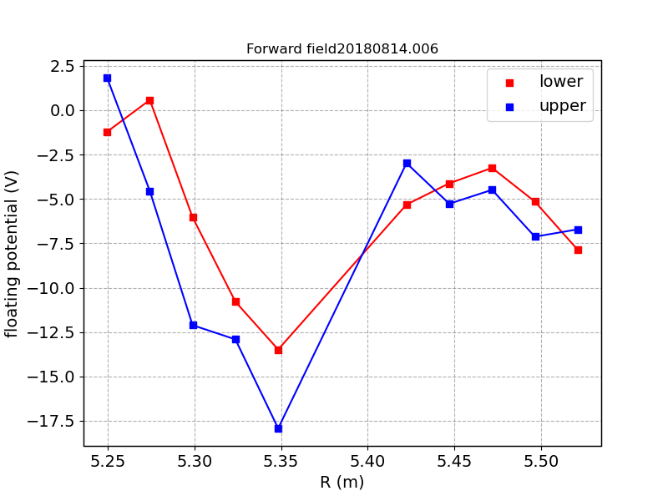
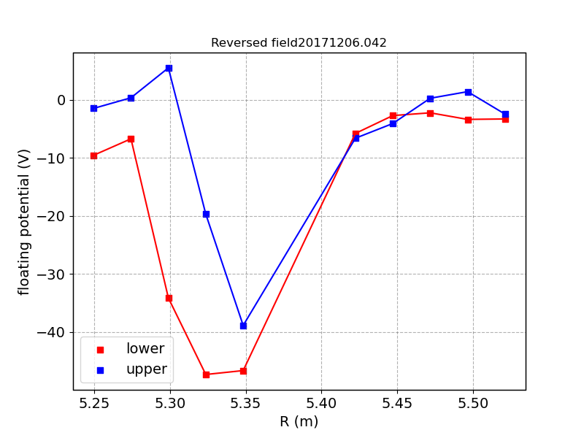
Measured Floating potential in low iota and standard (F/R)

Slide 7
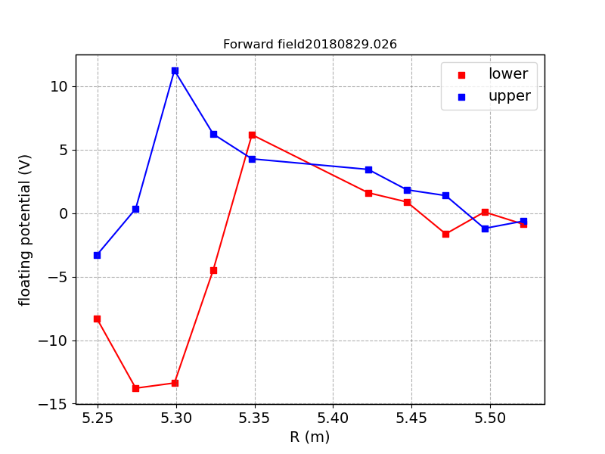
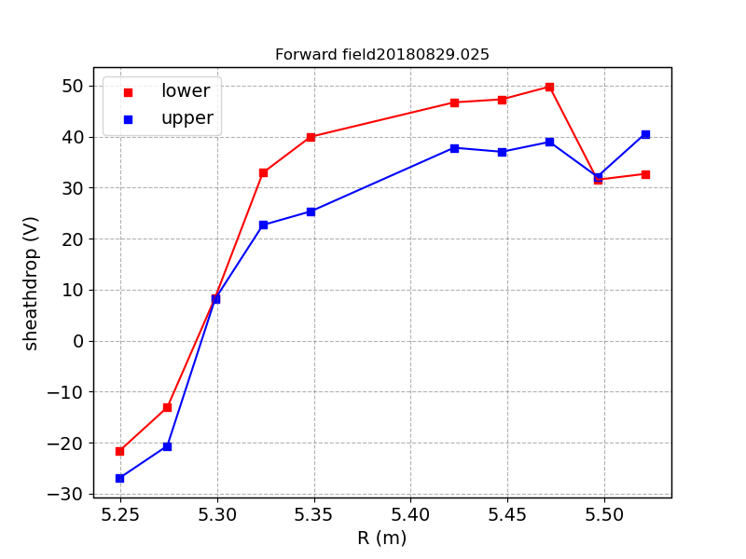
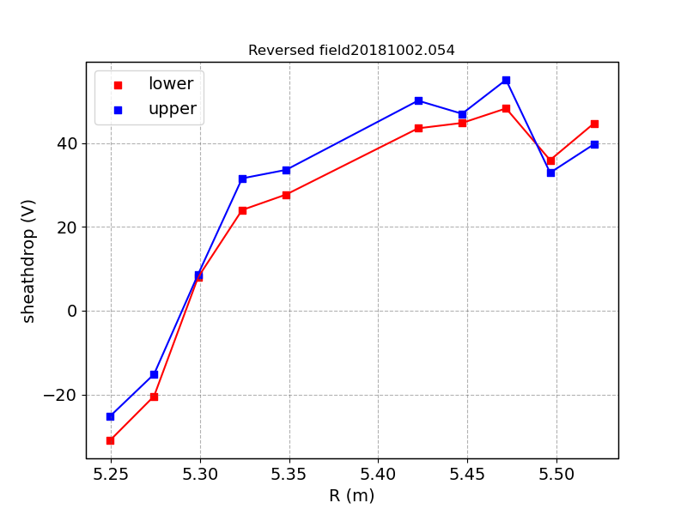
Measured Floating potential in low iota and standard (F/R)
The sheathdrop is computed on the divertor probes using the analytical model given in Phys. Plasmas 26, 013507 (2019)

Slide 8
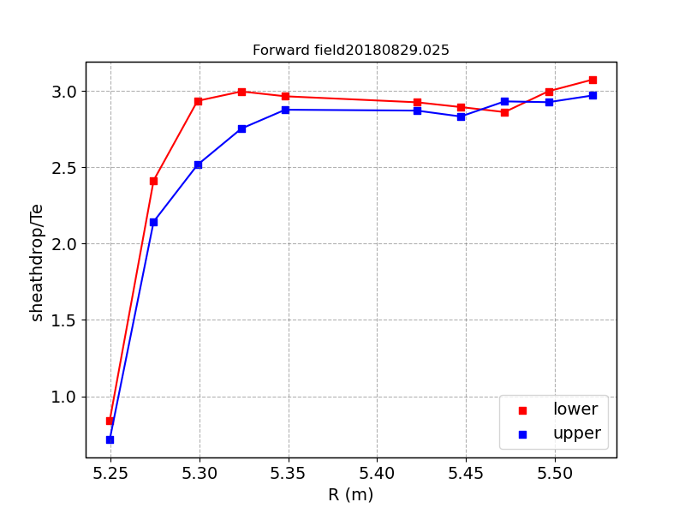
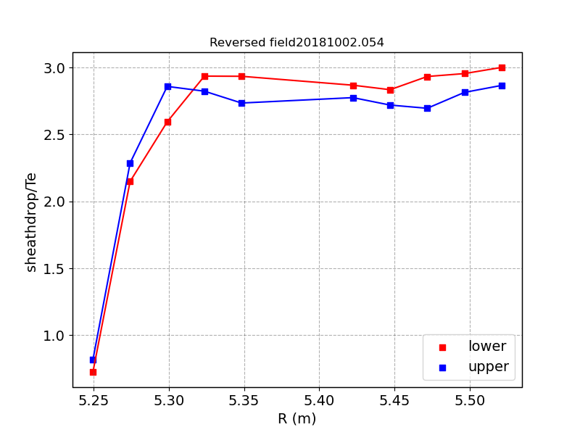
Measured Floating potential in low iota and standard (F/R)
The sheathdrop is computed on the divertor probes using the analytical model given in Phys. Plasmas 26, 013507 (2019

Slide 9
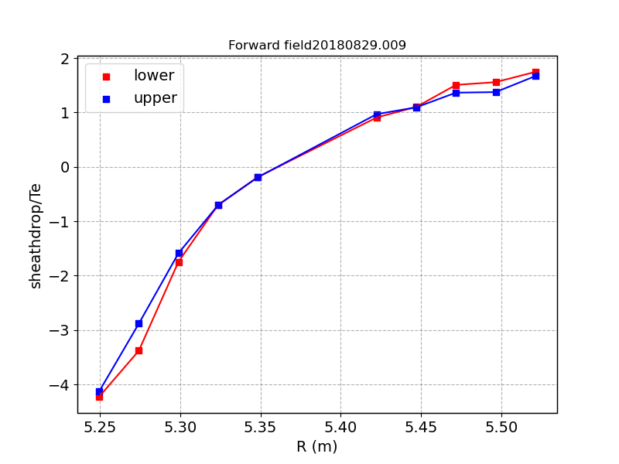
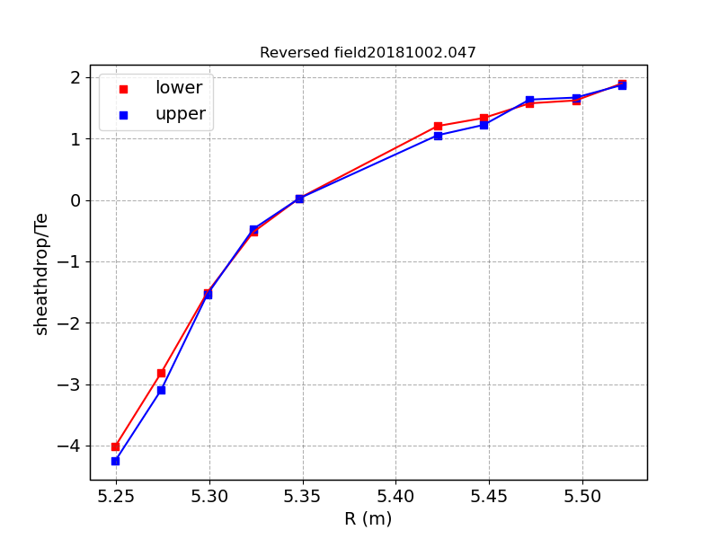
Measured Floating potential in low iota and standard (F/R)

Slide 10
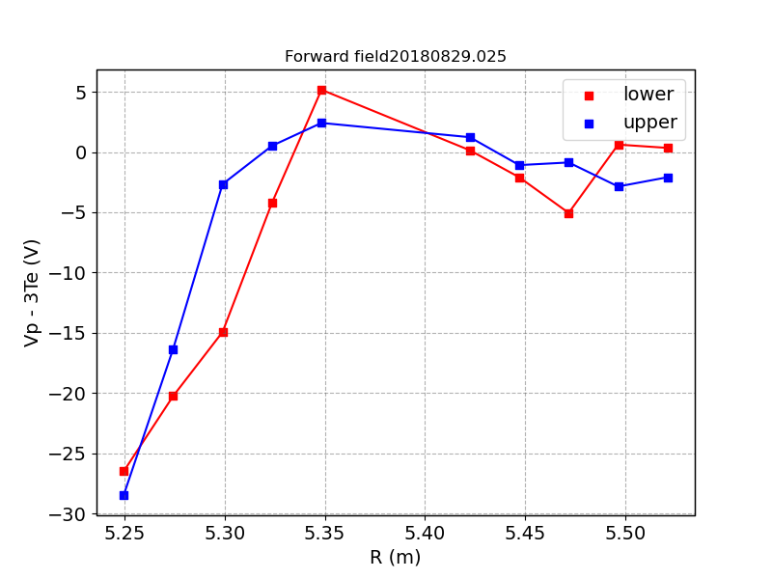
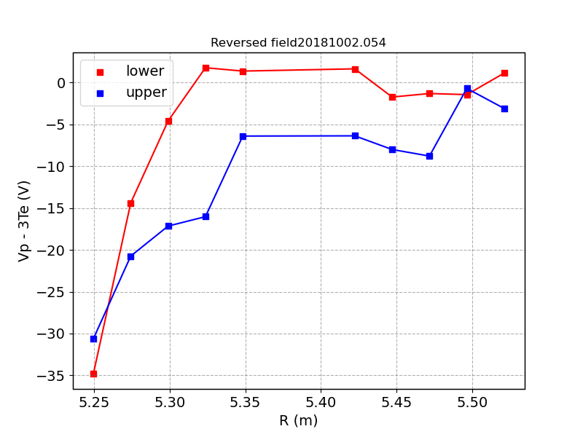
Measured Floating potential in low iota and standard (F/R)

Slide 11
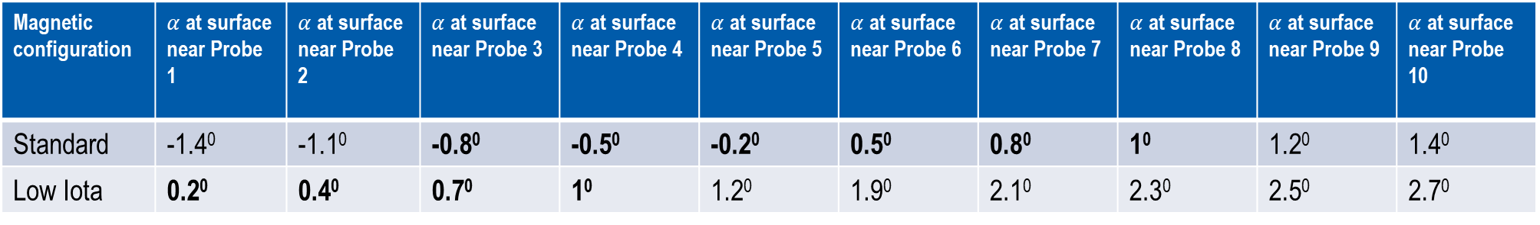
Magnetic field incidence angle on the divertor
Magnetic configuration | $α$ at surface near Probe 1 | $α$ at surface near Probe 2 | $α$ at surface near Probe 3 | $α$ at surface near Probe 4 | $α$ at surface near Probe 5 | $α$ at surface near Probe 6 | $α$ at surface near Probe 7 | $α$ at surface near Probe 8 | $α$ at surface near Probe 9 | $α$ at surface near Probe 10
Standard | -1.4⁰ | -1.1⁰ | -0.8⁰ | -0.5⁰ | -0.2⁰ | 0.5⁰ | 0.8⁰ | 1⁰ | 1.2⁰ | 1.4⁰
Low Iota | 0.2⁰ | 0.4⁰ | 0.7⁰ | 1⁰ | 1.2⁰ | 1.9⁰ | 2.1⁰ | 2.3⁰ | 2.5⁰ | 2.7⁰

