Slide 1

Proposals for SOL transport
03.03.2022 | Jie Yang, Philipp drews, Yunfeng Liang, Alexander Knieps, Song Zhou, Olaf Neubauer
Notes:
There are very little data for ion temperatures, hence I have two related proposals.

Slide 2
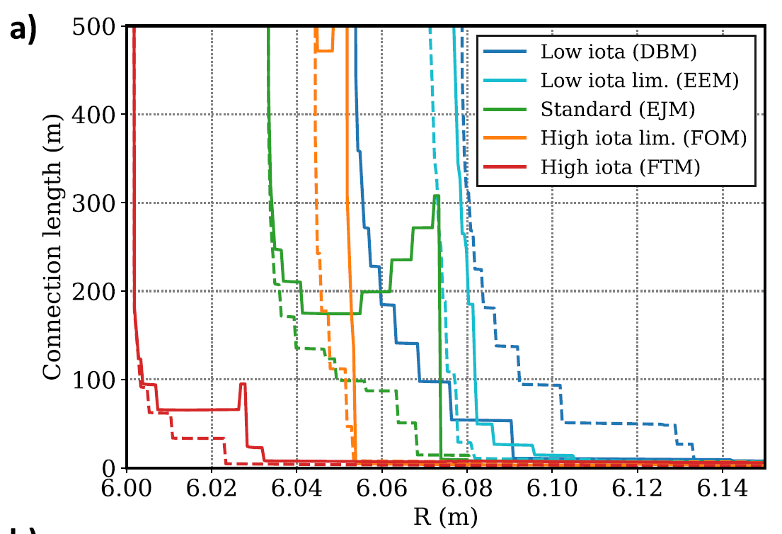
Configuration effect on T_{i} profile
Objectives:
There is very little data for T_{i}. Investigate magnetic configuration effect on SOL T_{i} profile
Strong change of connection length (the island remnant in most configurations is very small)
Approach:
Identify the role of the magnetic configuration on T_{i} profiles via MPM’s measurement
Specific requirements:
Configuration: standard, high mirror, high iota, low iota
Diagnostics: MPM/w RFA,CIS, poloidal correlation reflectometer (PCR), density profile reflectometer, divertor probes, divertor thermography, IR cameras…
Can be combined with:
Could be performed as a piggyback
*C. Killer, NF, 2019
Notes:
The first proposal is effect of magnetic configuration on ion temperature profiles
Previous experimental results have shown magnetic configuration significantly affects the SOL profiles of electron temperature, density and radial electric field. But there is very little data for ion temperature. Hence, we propose to investigate the ion temperature profiles in different magnetic configurations.
This figure plots the connection length along the manipulator for different magnetic configurations, they show large differences and have a large impact on SOL ion temperature profiles.
In this proposal, the main diagnostics is the manipulator with a RFA head, by its measurement, to identify the role of magnetic configuration on Ti profiles.
About the diagnostics, beside the RFA, CIS, PCR and maybe any other available diagnostics are required.
This proposal will be carried out in standard, high mirror, high iota and low iota configurations.
and it could be performed as a piggyback.

Slide 3
Study of T_{i}/T_{e} ratio in dependence of density, ECRH and ICRH heating
Objectives:
Investigate SOL Ti/Te ratio in dependence of density, ECRH and ICRH heating
Approach:
Monitoring of Ti/Te ratio during density rise, ECRH and ICRH operation via MPM’s measurement
Specific requirements:
Configuration: standard
Diagnostics: MPM/w RFA, CIS, poloidal correlation reflectometer (PCR), density profile reflectometer, divertor probes, IR cameras…
Keep density and heating during the discharge constant
Programs: 18
Notes:
Killer’s paper also shows the heating power and central plasma fueling have effects on SOL profiles (but their role is not consistent in all configurations). hence, the second proposal is to investigate the ion to electron temperature ratio in dependence of density, ECRH and ICRH heating.
this proposal will be carried out during density rise, ECRH and ICRH operation.

Slide 4
Measurement of ion temperature related turbulence
Three topics:
Beta effect on SOL profiles and turbulence transport
Magnetic topology effect on beta-induced Alfvén eigenmodes
Edge profiles and turbulence transport in the process from attached to detached plasmas
Notes:
Additionally, I also have several proposals about the ion temperature related turbulence transport, and they have been discussed in the SOL turbulence group. Hence, they won’t be shown here.

