Slide 1
Proposal Discussion for Upstream Characterization in W7-X
E. Flom, S. Zoletnik, F. Siddiki, M. Vécsei, G. Anda, C. Killer, P. Drews, J. Yang, Y. Li, E. Flom, D. Gradic, O. Schmitz

Slide 2
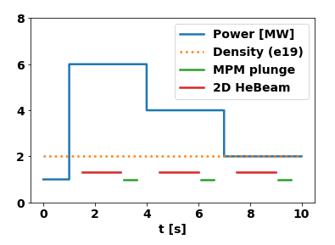
Base Scenario Idea
Basic scenario: EMJ+252, attached, constant density (feedback controlled). 1s allocated for startup, then power drops in 3s intervals
Repeat discharges will explore increasing densitites → 2, 4, 6, 8(?) e19
Important diagnostics: MPM, 2D helium beam, Divertor spectroscopy, CIS (Carbon), Divertor Langmuir, alkali beam
Plan for ~10 discharges including repeats
2x at each density to allow for e.g. spectroscopic coverage of multiple wavelengths
Requested feedback: MPM before or after HeBeam (both seems to run into each other?)
Possible alternate: power steps up instead of down?
1

Slide 3
Discussion
Discussion: radiated power fraction, should we try and feedback controll it?
Feedback on power drop instead of power ramp?
Synergistic proposal: Island size effects (control coil scans on same scenarios). These 0kA discharges serve as comparison case already
2D HeBeam budgeted for 2s, MPM budgeted for 0.5s. Any other diagnostics which perturb each other and must be accomodated?
2

