Slide 1
Beta and current effect on the Te/Ti ratio
Forschungszentrum Jülich GmbH, Institut für Energie- und Klimaforschung - Plasmaphysik, 52425 Jülich, Germany

Slide 2
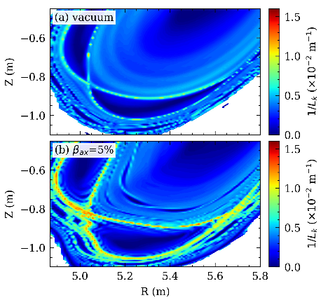
Planned proposal
This proposal can be done in combination with the density and power scan for the Te/Ti ratio
May low magnetic field experiments could also be done with this (higher beta possible then)
With constant heating power and density during the discharge the current effect can be studied too
Possibly more flexibility concerning the probe heads if thermocouple method works for ion temperatures (RFA probe is still preferred)
Kind regards to S. Zhou for the figure from his draft for NF

Slide 3
Jülich, März. 8th, 2022
Te/Ti ratio with Helium puffing
Forschungszentrum Jülich GmbH, Institut für Energie- und Klimaforschung - Plasmaphysik, 52425 Jülich, Germany

Slide 4
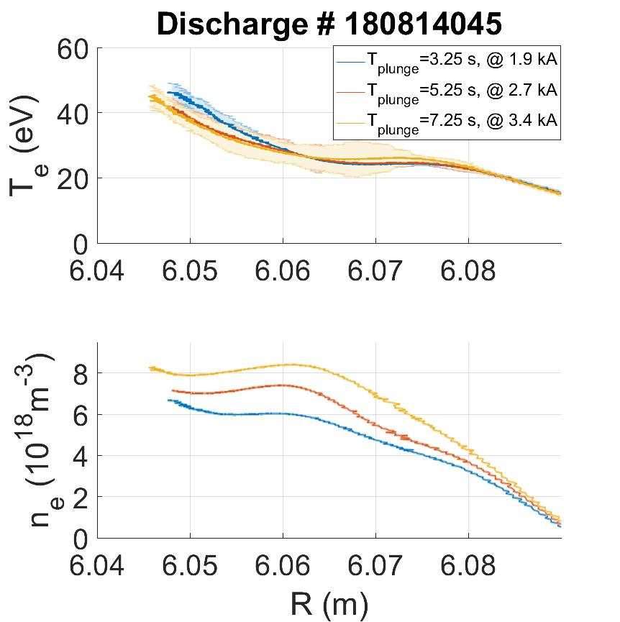
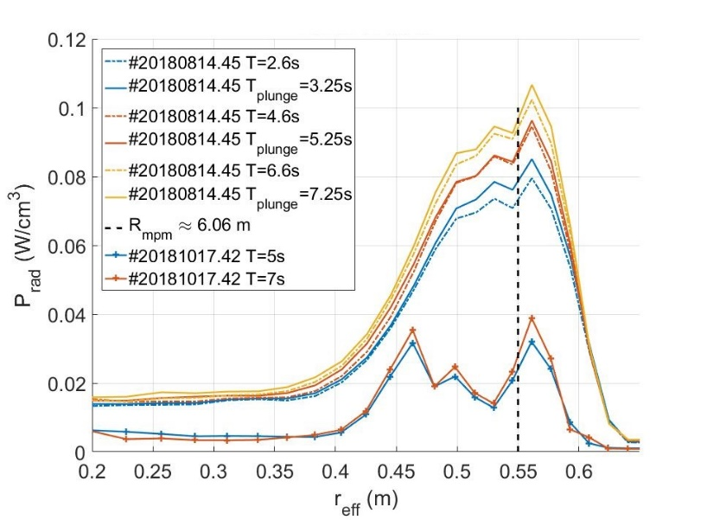
Planned proposal
This proposal can be combined with helium puffing proposals from fueling
How much can additional puffing be used to increase the confined impurities in the island?
How strong is the cross-island transport? ICRH puffing port and MPM are not in the same flux tube
Is the cross transport different for Carbon and Helium (or other)?
How is the Te/Ti ratio affected?
Modelling support form ERO can calculated a particle balance to quantitatively understand the transport in the edge plasma

Slide 5
Beta effect on island transport of edge impurities
Forschungszentrum Jülich GmbH, Institut für Energie- und Klimaforschung - Plasmaphysik, 52425 Jülich, Germany

Slide 6
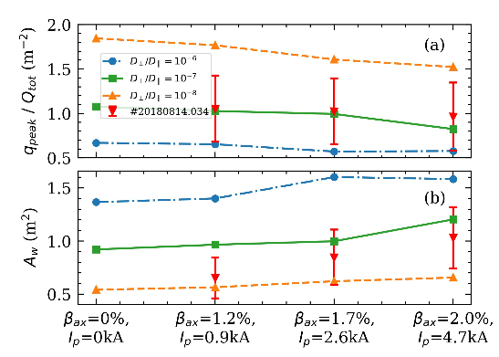
Planned proposal
Hint modelling predicts an increase of stochastization and decrease of peak heat flux
How will the increased stochastization affect the impurity transport?
If less impurities are confined, how will this influence the edge profiles and radiation?
How is the electron to ion temperature ratio affected?
This experiment could be done by mirroring the beta (density and heating power experiment) by varying the amount puffed from the helium beam
Kind regards to S. Zhou for the figure from his draft for NF

