Slide 1
Impurity flow measurements: identification of the thermal force regime
V. Perseo, V. Winters, …?

Slide 2
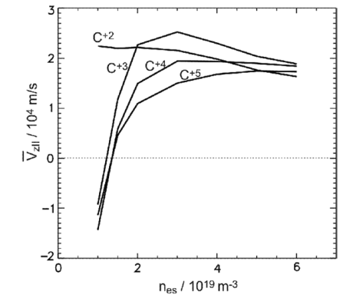
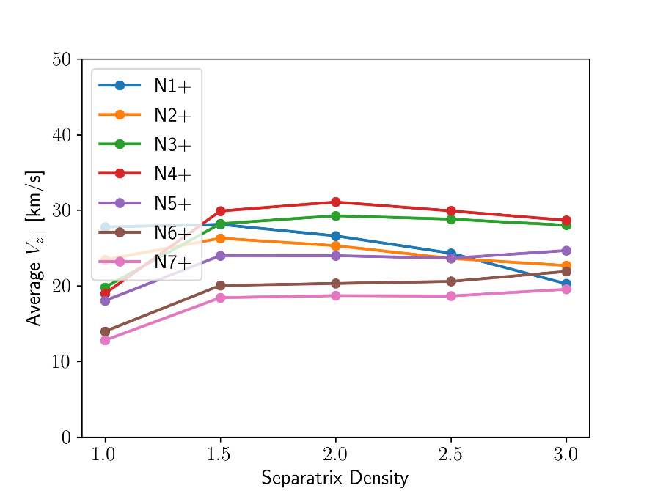
Background
EMC3-Eirene simulations (by Yuhe and Victoria) of average impurity flow velocity for each charge state
$${\overline{v}}_{Z∥}=\frac{∫n_{Z}v_{Z∥}⋅n_{i}v_{i∥}dv}{∫n_{Z}n_{i}|v_{i∥}|dv}$$
Simulations for standard magnetic configuration (no $I_{cc}$)
Inversion in the direction of the averaged impurity flow velocities at low densities due to thermal force regime
Gradual de-coupling of the impurity flow from the main ion flow + sharp transition below a critical density $n_{ec}$
Critical density changes for different impurity charge states, input power in the SOL, and connection lengths
Different regimes are expected also for different regions of the SOL (i.e. thermal force dominated scenarios should be observable close to the LCFS)
Y. Feng et al. NF 49 (2009)
P_{in}=10 MW
P_{in}=5 MW
V. Winters

Slide 3
Impurity flow measurements: identification of the thermal force regime
Objectives:
Identification of plasma parameters or SOL regions where the thermal force dominates the impurity parallel force balance by measuring the impurity flows
Approach:
Use different impurity line filters/puff (C II, C III, C IV, C VI, He II) to validate existence of thermal force dominated flows/transition to friction force regime using CIS. Need of series of experiments with different densities to be repeated for each filter
Special requirements:
Diagnostics:
CIS (with different filters)
Dispersive spectroscopy at the same wavelength selected by CIS filter
MPM with Mach probes to asses changes in the main ion flows
Profile diagnostics for temperature gradients?
CXRS for impurity content?
Program design:
If He II is measured, need of He puffs
Changing filter means changing the calibration set-up ($∼$20 min)
$f_{rad}$ should be kept $≤$0.3
Can be combined with:
Other proposals with density scans or He puffs
Example Time-trace (approx)
Task Force(s) | III-2
Mag. Configurations | EIM
No. of programs | 5 (as filters)
Requested Parameters
Heating [MW] (ECRH, NBI, ICRH) | Highest available input power
Density (feed-back/-fwd) [10¹⁹ m⁻³] | tdb

Slide 4
Open issues
EMC3-Eirene simulations performed with $P_{in}=$5 MW indicate that ${\overline{n}}_{ec}≈{2n}_{ec, sep}≈2−2.5⋅{10}^{19}$m⁻² → most likely too low to reach Increasing the critical density might be possible if:
studies are performed in configurations with decreased connection length with respect to standard (control coils, limiter, high iota) → need to be checked if available changes are enough to make an actual difference (simulations?)
the studies are performed at higher power → need to quantify how much higher for a reasonable density (simulations?)
At very low densities, drifts are expected to be important. Possible aids:
change in connection length/field line pitch should decrease the importance of at least binormal ExB drift (is the change with control coils enough?)
Measuring different charge states for carbon could give insights on what has the dominant role at low densities. For example, the critical density for the thermal/friction transition is particularly low for C II, so measuring C II at the same plasma conditions of C III, C IV and C VI can help in isolating the effects. Problem: change in measurement location due to passive nature of the measurement.
Resources might not be available to assess all the points before the proposal submission

