Slide 1
Proposal Discussions for Upstream / Island Size Characterization in W7-X
E. Flom, S. Zoletnik, F. Siddiki, M. Vécsei, G. Anda, C. Killer, P. Drews, J. Yang, Y. Li, E. Flom, D. Gradic, O. Schmitz

Slide 2
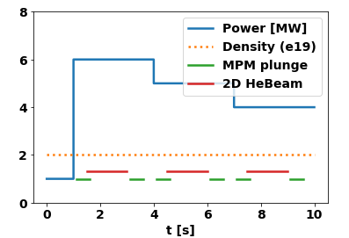
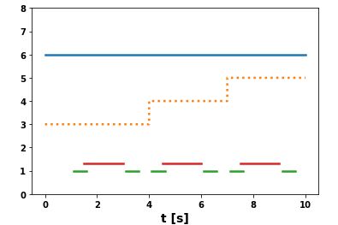
Upstream Characterization Proposal (modified)
Basic scenario A: EMJ+252 1s allocated for startup, then power drops in 3s intervals.
Repeat discharges will explore increasing densitites → 4, 6, 8, 10 e19
Then, scenario B: Power/dens scan over same parameters, but with density steps instead of power steps
Finally, repeat first discharge as last discharge to check for differences from e.g. different wall conditions.
→ Repeat first/last discharge on different day (if possible) to check for long-term wall conditon effects.
Important diagnostics: MPM, 2D helium beam, Divertor spectroscopy, CIS (Carbon), Divertor Langmuir, alkali beam, WISP gauges. Total # discharges: 10-12 including repeats due to e.g. gyrotron dropout
A
B
1
Notes:
Idea: 3 powers, 3 dens (power drops) THEN 3 powers, 3 dens (dens steps up in higher resolution), repeat each. Total of 12 discharges.

Slide 3
Island Size Effects Characterization
Second proposal: Island size effects → control coil scans on same scenarios
For island size, explore Icc of [-1, 1, 2] kA
→ -1 gives 10/10 island chain
→ The 0kA discharges come from previous proposal.
Density scan may need to be truncated to keep # of discharges managable
the choice of which densities we want to look at will be informed by upstream char. proposal (i.e. this proposal must be done second)
Goal: observe upstream/downstream relationships as fn. Of island size, validation of extended 2 pt model
A
B
2

