Slide 1
Radiation Scaling & Stability
G. Partesotti, F. Reimold, M. Krychowiak
28.03.2022
F. Reimold - EMC3 Drift Project
<number>

Slide 2
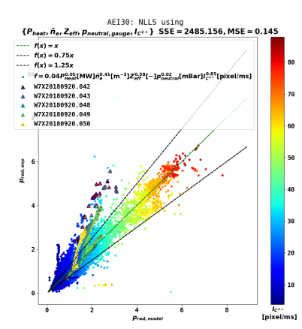
Radiation Scaling
Radiation scaling and front sensitivities for intrinsic and seeded impurities
Objective:
Extend radiation scaling database
Identify parameters that can be used as sensors
Study radiation front location sensitivity to operational parameters
Study radiation stability
Study impact of configurations
Study detachment threshold (c_{imp,lim} (n_{e},P_{H}))
Piggy-back addition:
Study of impurity concentration and Z_{eff} during detachment (M. Krychowiak)
Perturbative puffs to assess Prad sensitivity and response times in various plasma conditions (G. Partesotti)
Impurity seeding in different magnetic configurations (G. Partesotti)
28.03.2022
Lead Proponent – Proposal Summary
<number>

Slide 3
Radiation Scaling
Three configurations: standard (EIM), low-iota (DBM) and high-iota (FTM) with different islands structure
Approach:
For EIM, EIM^{r} & EIM* with N-seeding:
Scenario 1: Constant density & seeding + power steps (x3)
Scenario 2: Constant density & power + seeding steps (x2)
Repeat for EIM with Ne, Ar
For FTM, DBM with N-seeding:
Scenario 1 (x3)
For N: Constant seeding
For Ne and Ar: Constant seeding or blips (as required)
Task Force(s) | I, II, III
Mag. Configurations | EIM^{(*,r)}, FTM, DBM
No. of programs | 5+5+5 + 5+5 , 3, 3
Requested Parameters
Heating [MW] (ECRH, NBI, ICRH) | 1-6 (ECRH), 2 (NBI)
Density (feed-back/-fwd) [10¹⁹ m⁻³] | 4.0-7.0 (fb)
Impurities (seeding, LBO, TESPEL) | N, Ne, Ar (seeding)
28.03.2022
Lead Proponent – Proposal Summary
<number>

Slide 4
Radiation Scaling
Timetrace Scenario 1
Comments:
Ar Ne are recycling, while N is not.
Ar has similar ionization free path to N, while Ne‘s is shorter.
Seeding spike + seeding ramp down to take into account wall saturation
NBI blips to provide neutrals for charge exchange measurements
Fill in the f_{rad} gaps using different power + seeding combinations, and identify the operational range
Specific requirements:
Special diagnostic (settings)
Spectroscopy
SOL profiles
Timetrace Scenario 2
28.03.2022
Lead Proponent – Proposal Summary
<number>

Slide 5
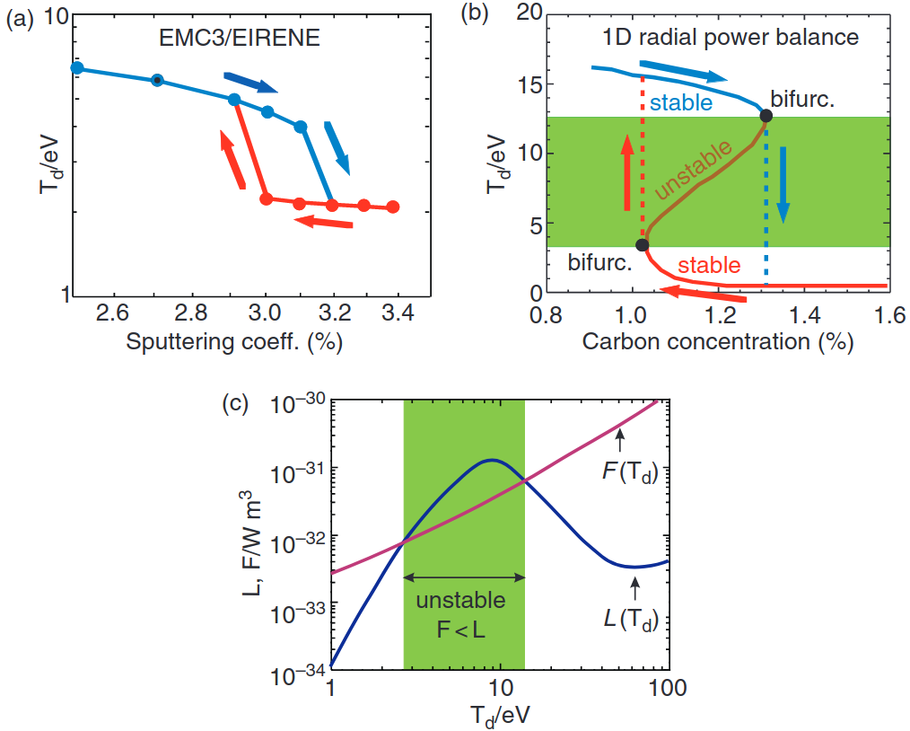
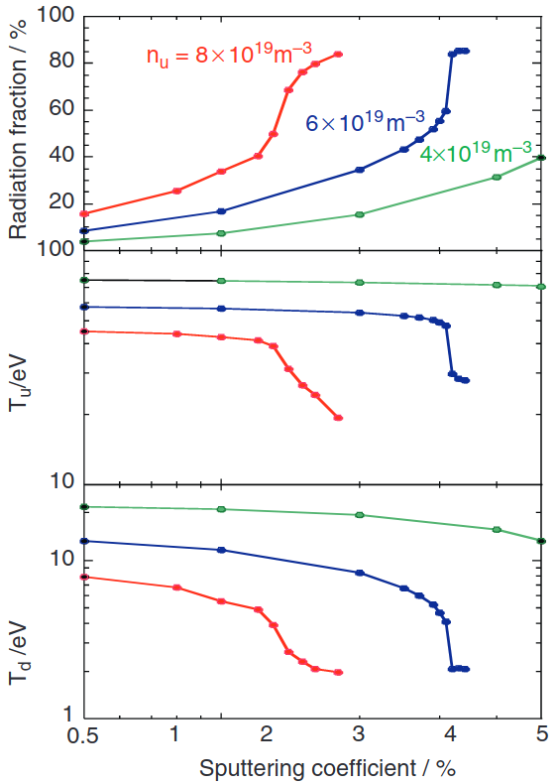
Radiation stability
Radiation stability for different island chains
Objectives:
Follow the radiation increase continously
Measure the location of the radiation front from target to separatrix
Investigate the stability by modifying the impurity concentration with N-seeding
Unstable branch for intermediate divertor temperature.
T_{d}: downstream temperature at the target
C: impurity concentration
L: cooling rate function
The curves should be roughly defined by Scenario 1 in the radiation scaling proposal
Piggy-back addition:
Correlation of radiation zone location with edge plasma parameters (D. Zhang)
28.03.2022
Lead Proponent – Proposal Summary
<number>

Slide 6
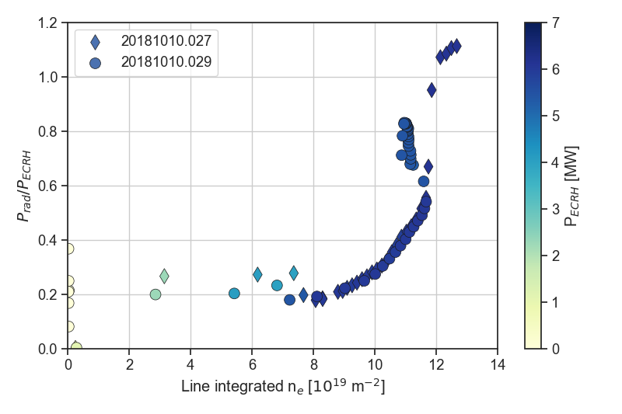
Radiation Stability
Approach:
„Fast“ f_{rad} scan: linearly increase density at fixed heating power. No seeding. Standard configuration (EIM)
Repeat to trace the Prad increase “S” curve
“Slow” f_{rad} scan: use density ramp proportional to 1/slope of fast f_{rad} scan
Repeat for different different magnetic configurations:
EIM^{r} + FTM + DBM
Possibly: add two density ramps at EIM with seeding and different heating powers
Specific requirements:
Special diagnostic (settings)
Spectroscopy
Target/SOL profiles
Task Force(s) | I, II, III
Mag. Configurations | EIM, EIM^{(r)}, FTM, DBM
No. of programs | 5+3+3+3
Requested Parameters
Heating [MW] (ECRH, NBI, ICRH) | 6 (ECRH), 2 (NBI)
Density (feed-back/-fwd) [10¹⁹ m⁻³] | 2.0-12.0 (fb)
Impurities (seeding, LBO, TESPEL) | Just intrinsic carbon + N
28.03.2022
Lead Proponent – Proposal Summary
<number>

