Slide 1
Numerical Result of DAEPS Code with General Axisymmetric Toroidal Geometry
Yueyan Li ^{1,2}, Matteo Valerio Falessi¹, Philipp Lauber³ Fulvio Zonca ^{1,4}
¹ CNPS and C.R. ENEA Frascati, C.P. 65, Frascati, Italy
² CREATE Consortium, Via Claudio 21, Napoli, Italy
³ MPI für Plasmaphysik, Boltzmannstr. 2, D-85748 Garching, Germany
⁴ IFTS, Department of Physics, Zhejiang University, Hangzhou, China
ATEP-9-Mar-2022

Slide 2
Outline
Introduction to the expression of general geometry
Model equation and action angle approach for general geometry
Numerical results
  Fluid continuous spectrum
  Kinetic continuous spectrum
  Eigenmode calculation
Summary and future work

Slide 3
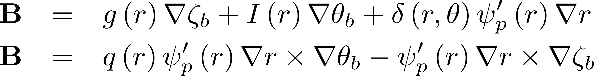
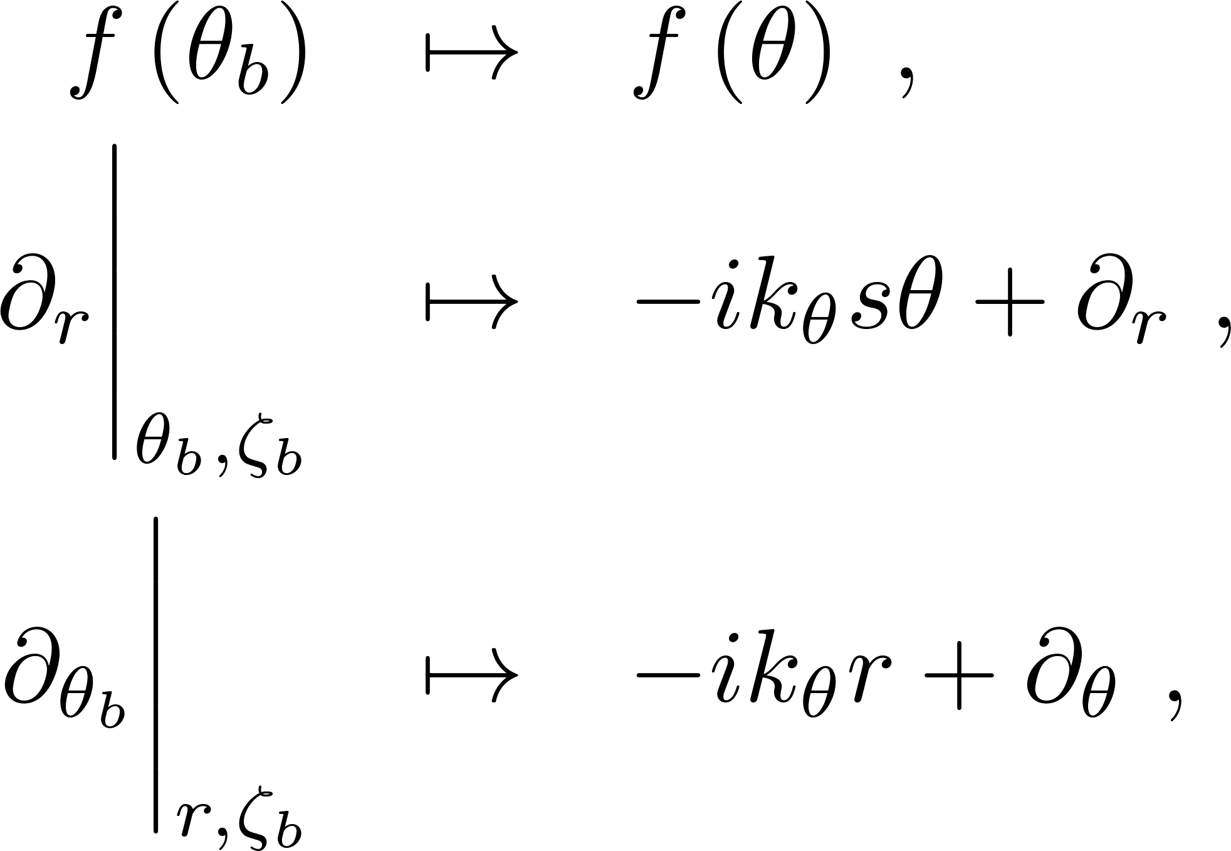
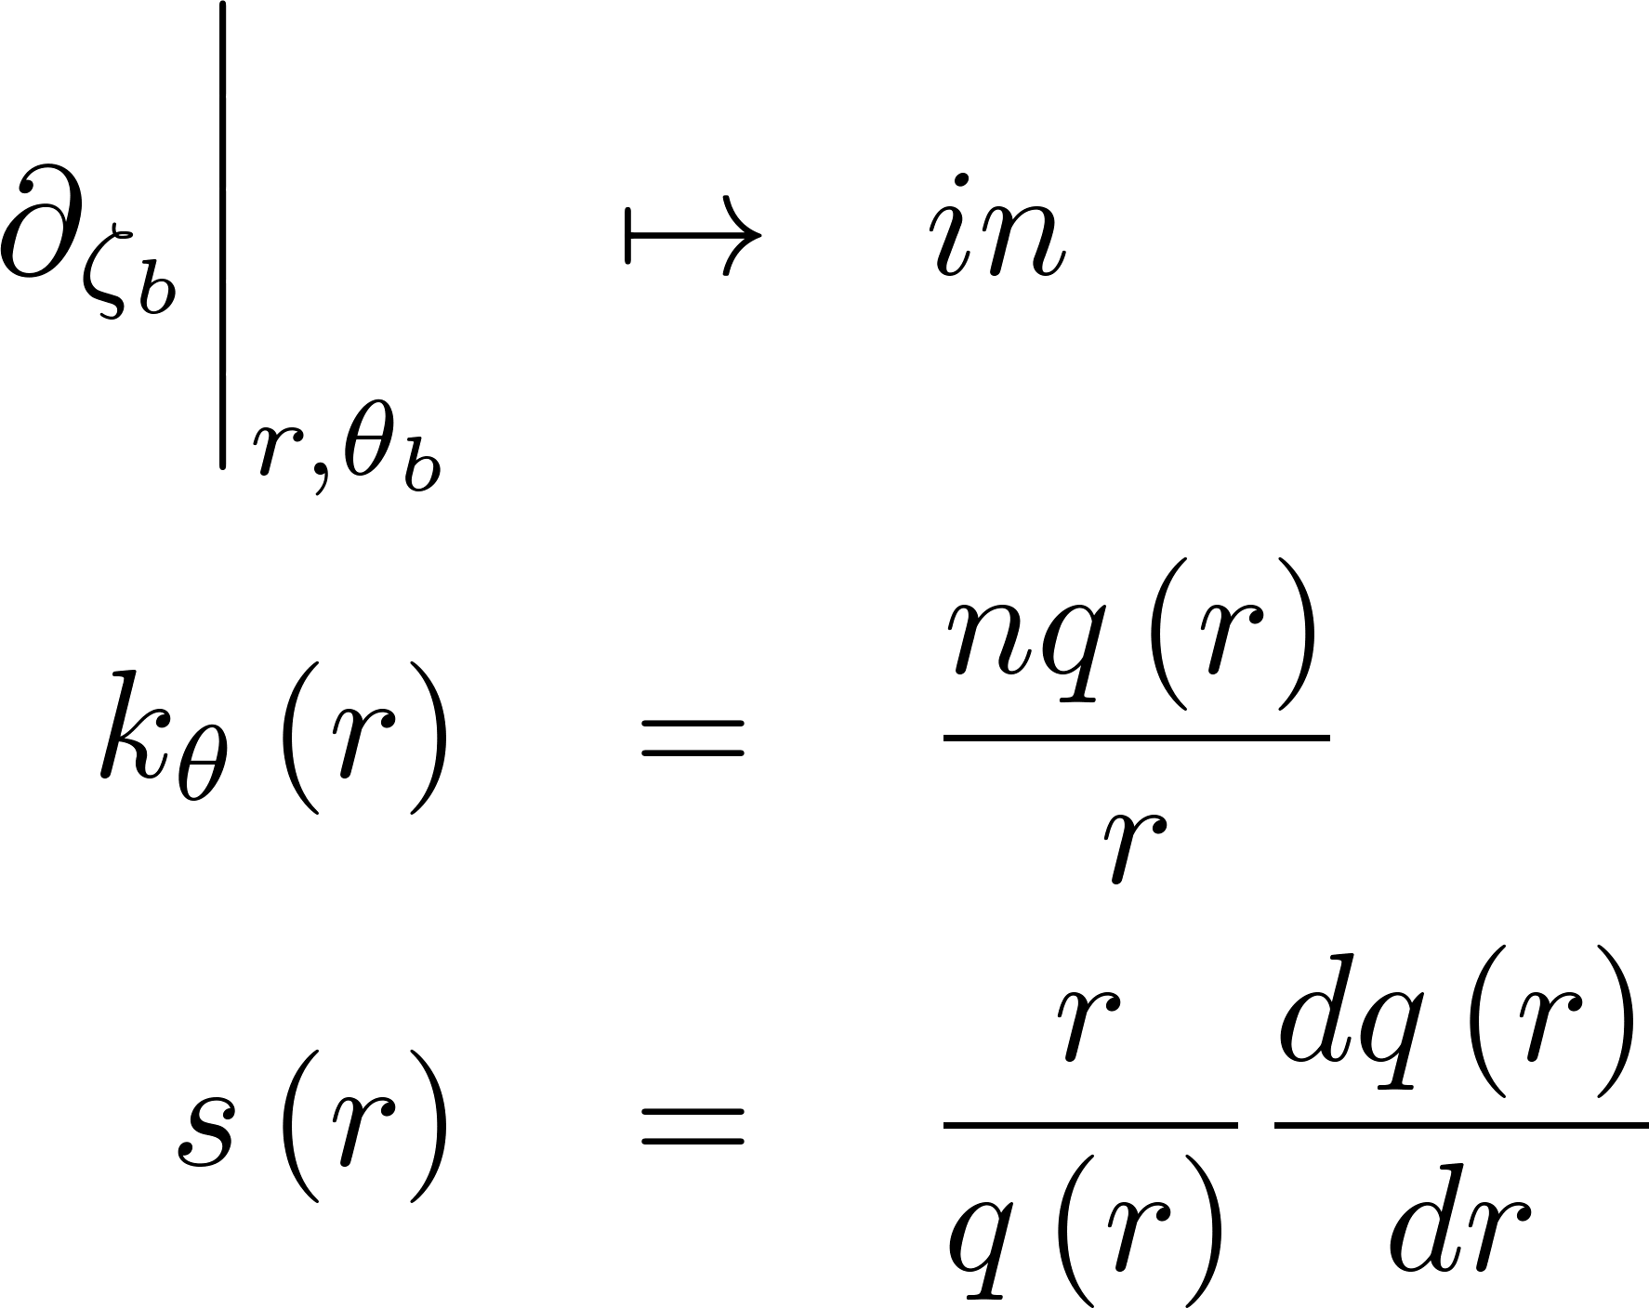

General Geometry: Boozer Coordinate
Boozer coordinate $(r,θ_{b},ζ_{b})$:
Jacobian:
Ballooning representation (compatible with expression of s-α model):

Slide 4
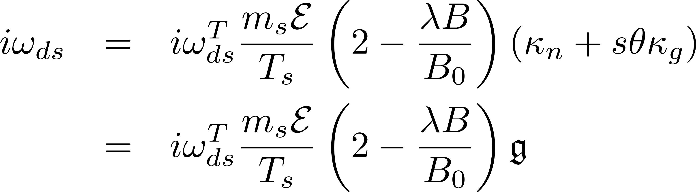
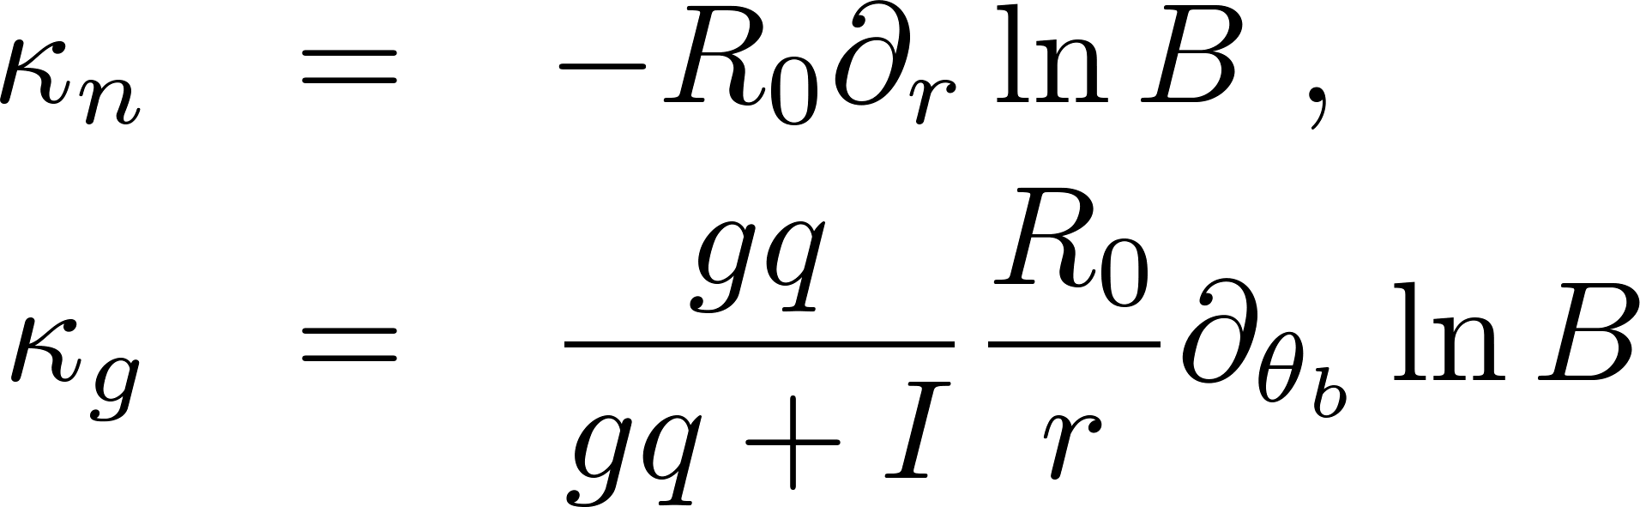
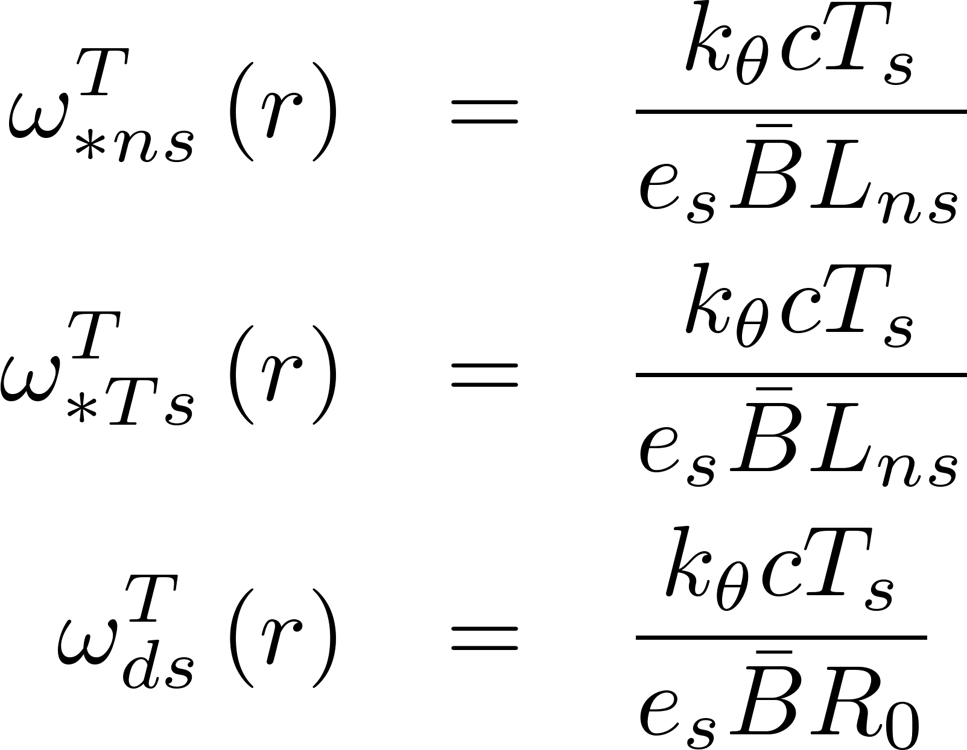
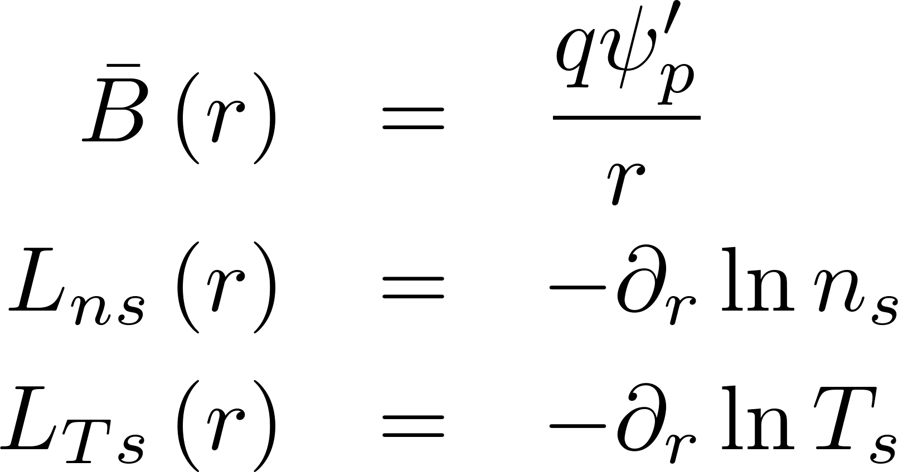

Ballooning Representation
Drift frequency ($δB_{∥}$ ignored, $κ=∇lnB$):
Free energy term:
Frequencies:

Slide 5
Outline
Introduction to the expression of general geometry
Model equation and action angle approach for general geometry
Numerical results
  Fluid continuous spectrum
  Kinetic continuous spectrum
  Eigenmode calculation
Summary and future work

Slide 6
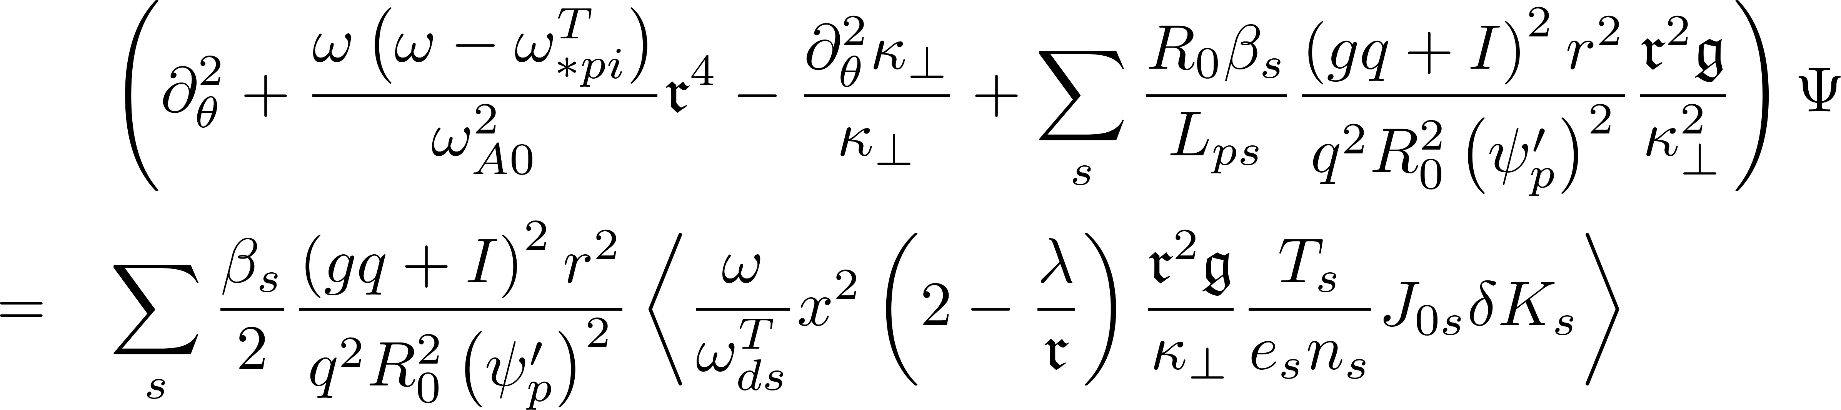
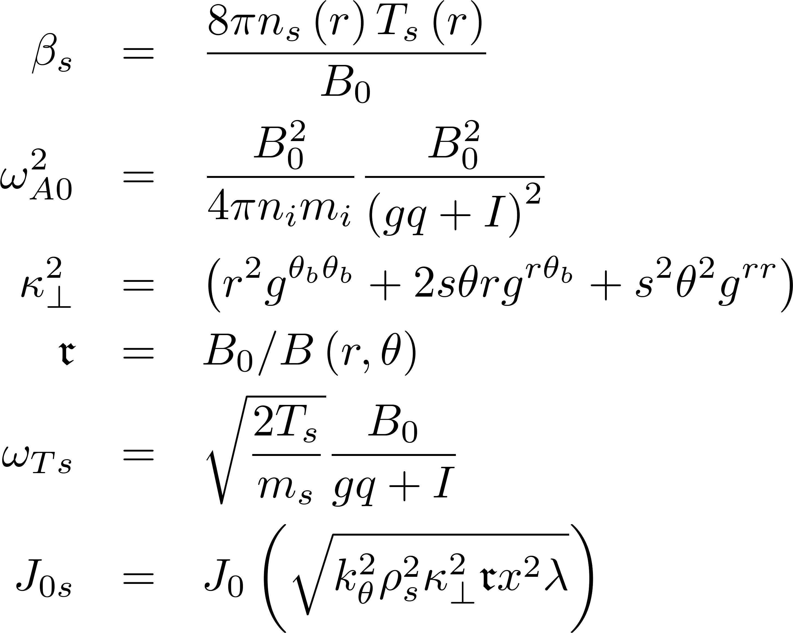
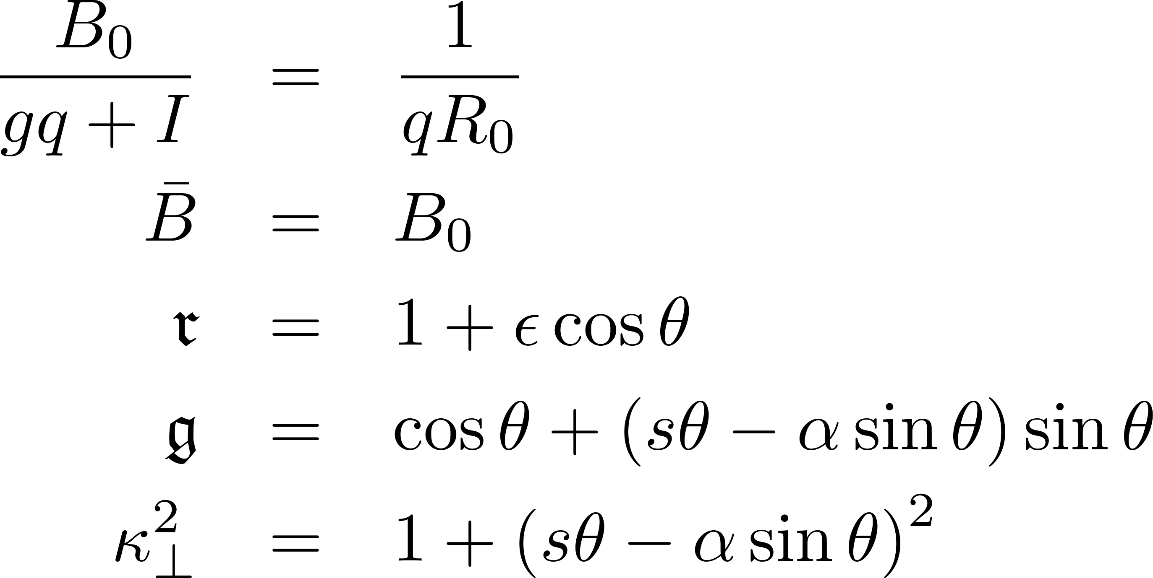
Model Equation
Vorticity equation:
Definitions:
The s-α model gives:

Slide 7
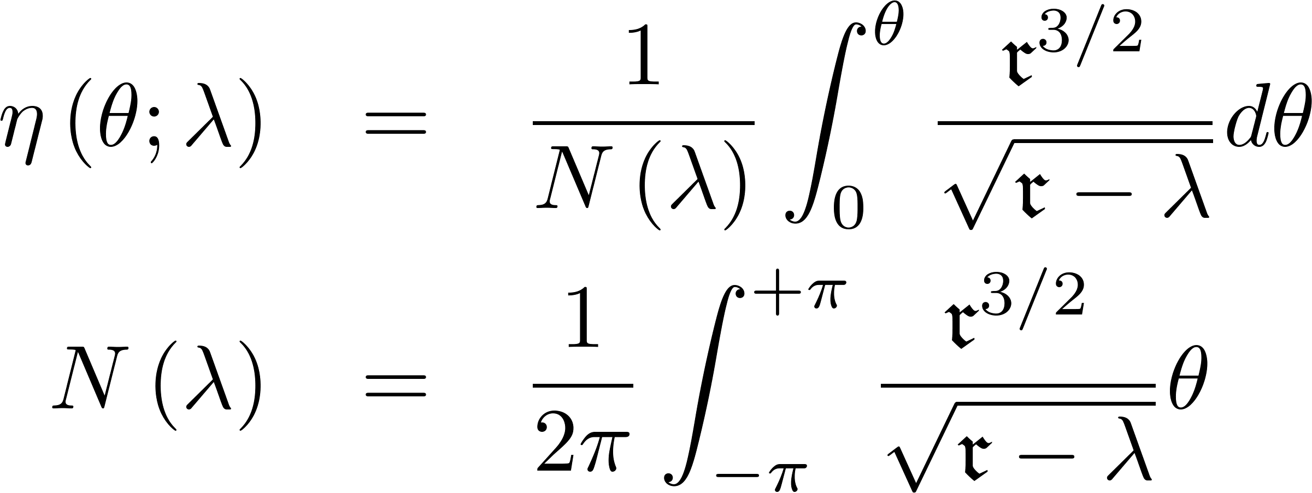
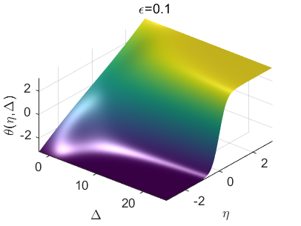
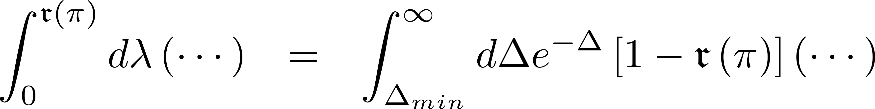
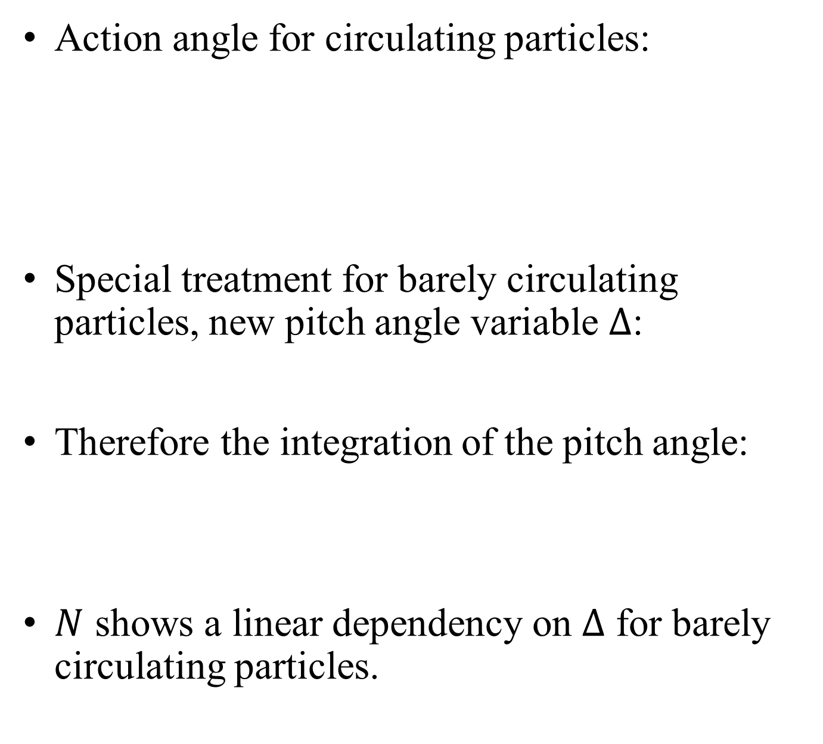
Action Angle Approach: Circulating Particles
Action angle for circulating particles:
Special treatment for barely circulating particles, new pitch angle variable $Δ$:
Therefore the integration of the pitch angle:
$N$ shows a linear dependency on $Δ$ for barely circulating particles.

Slide 8
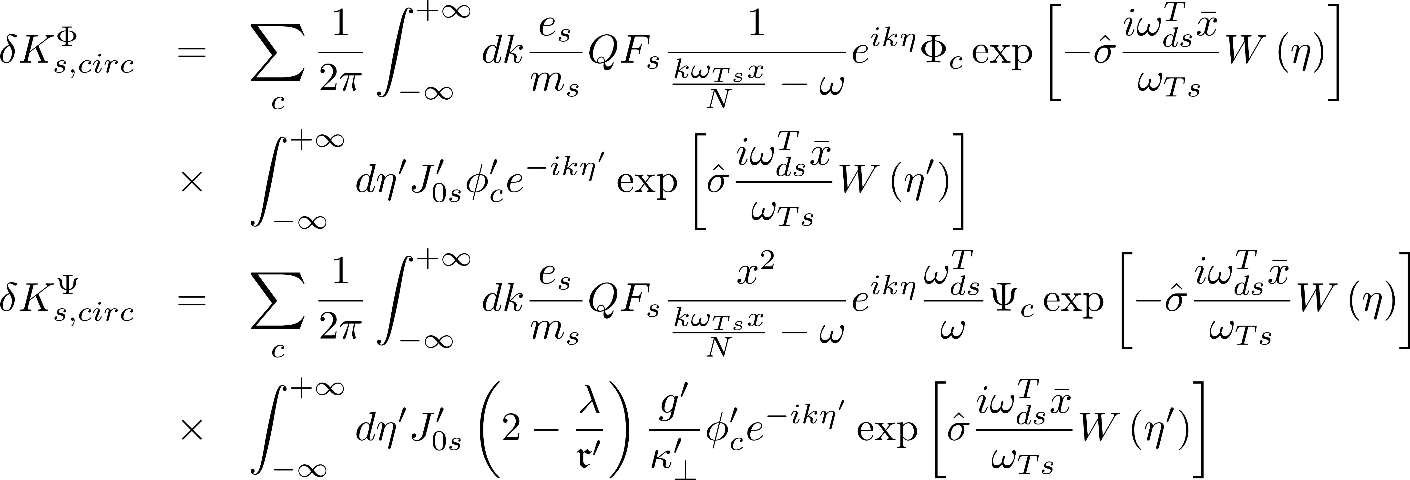
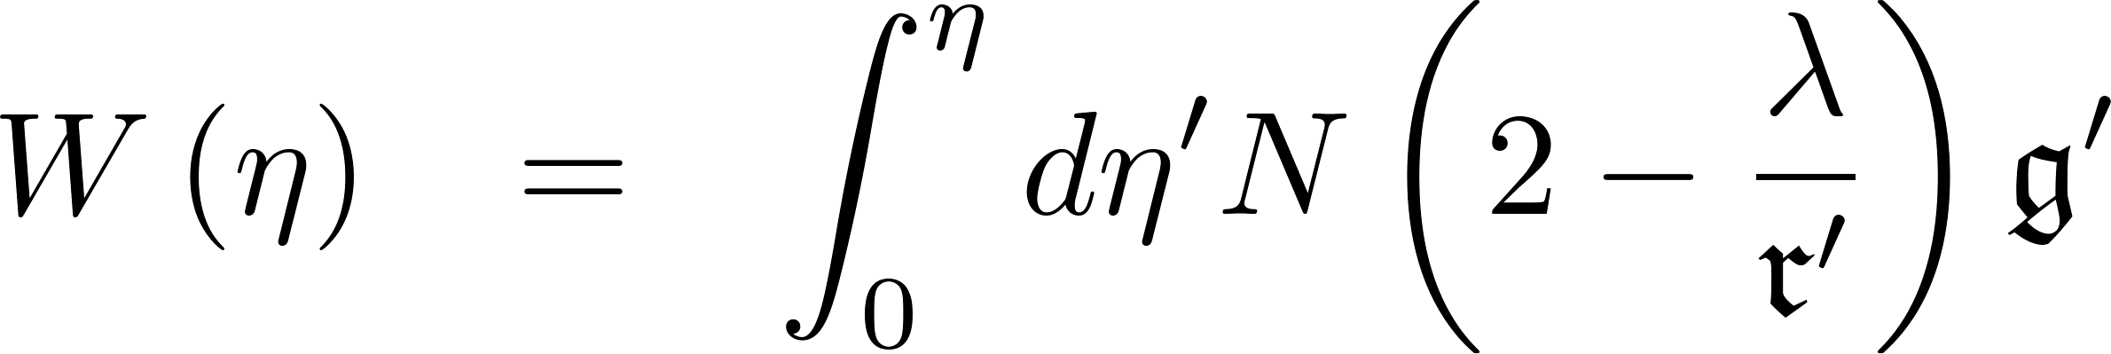
Action Angle Approach: Circulating Particles
Gyrokinetic equation:
Finite orbit width effect term of the propagator integration:

Slide 9
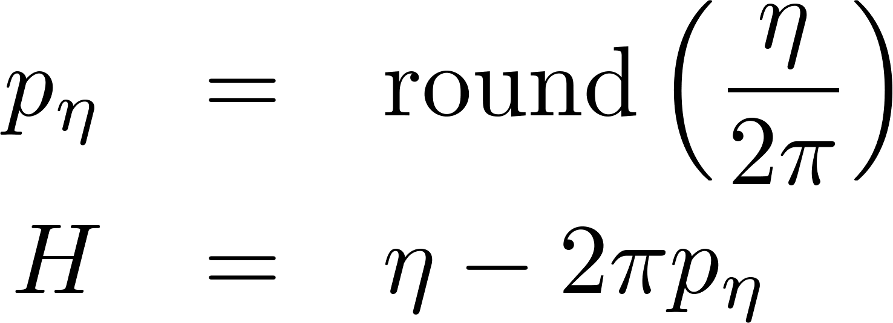
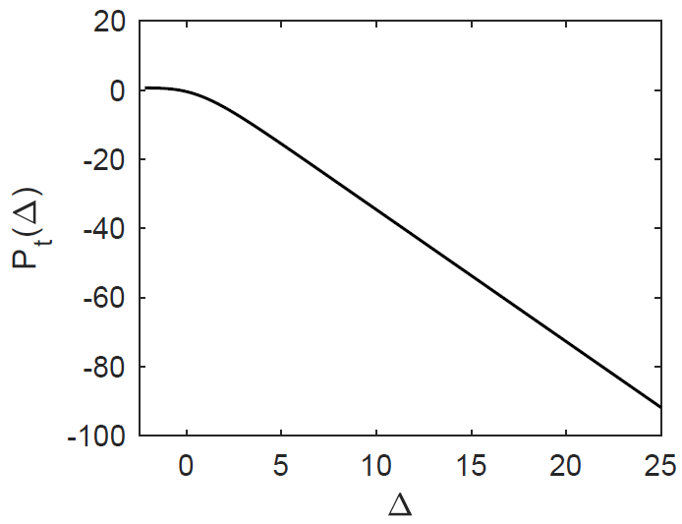
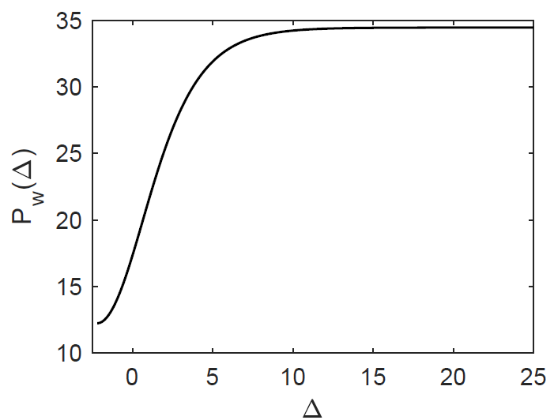

Action Angle Approach: FOW
The action angle is divided into sub-intervals with width $2π$:
The FOW term is further divided into the AC and DC part:

Slide 10
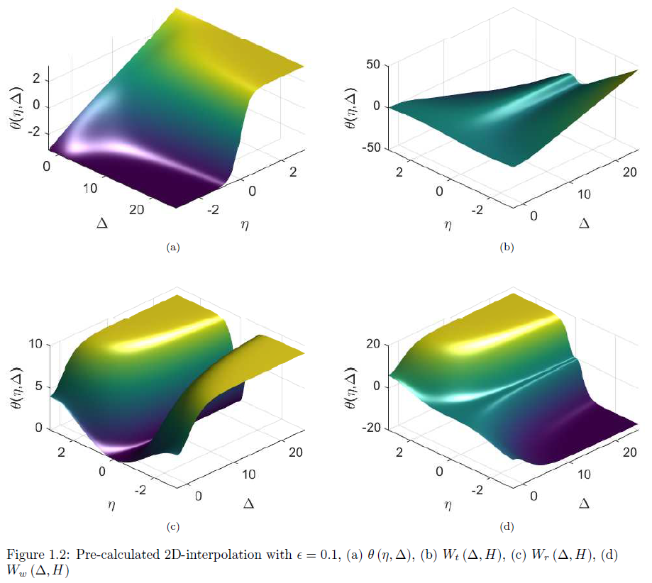
Action Angle Approach: FOW

Slide 11
Outline
Introduction to the expression of general geometry
Model equation and action angle approach for general geometry
Numerical results
  Fluid continuous spectrum
  Kinetic continuous spectrum
  Eigenmode calculation
Summary and future work

Slide 12
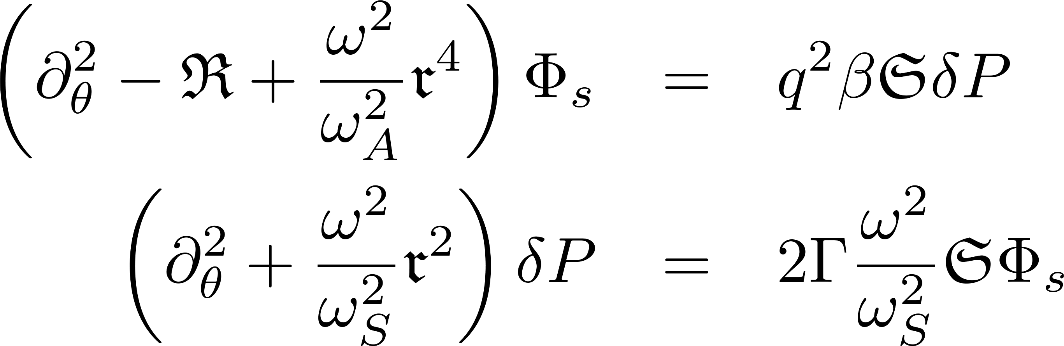
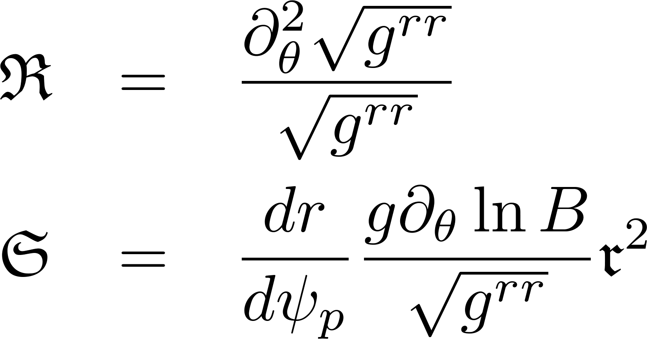
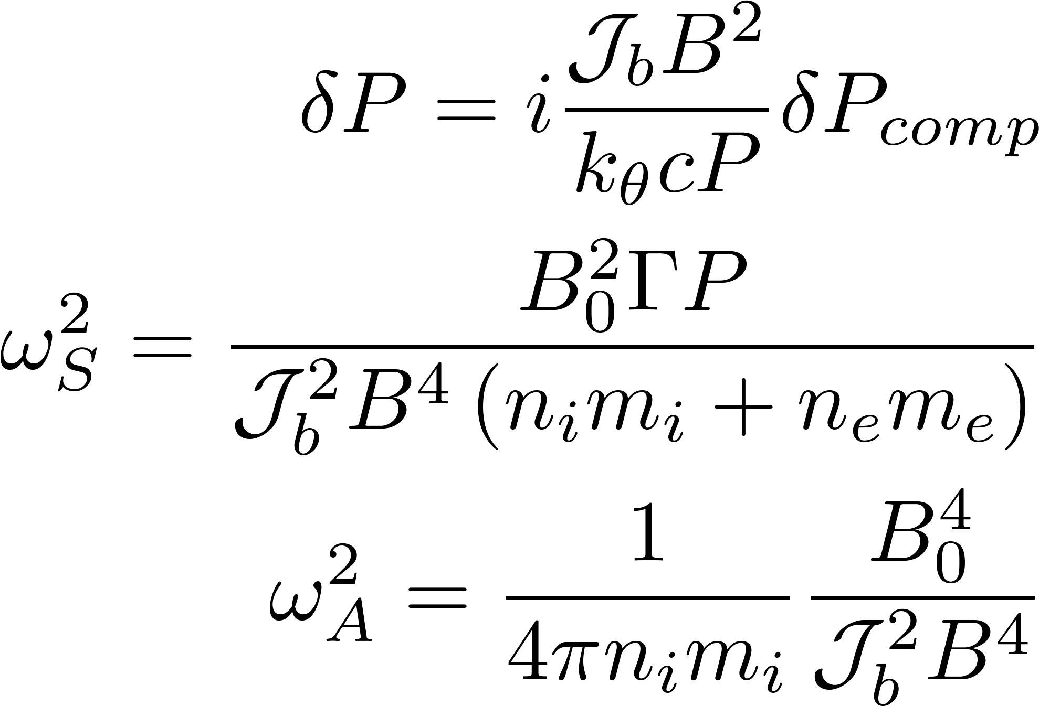
Fluid Continuous Spectrum
Model equation of fluid continuous spectrum [Chen17]:
Definitions:
Benchmark with FALCON

Slide 13
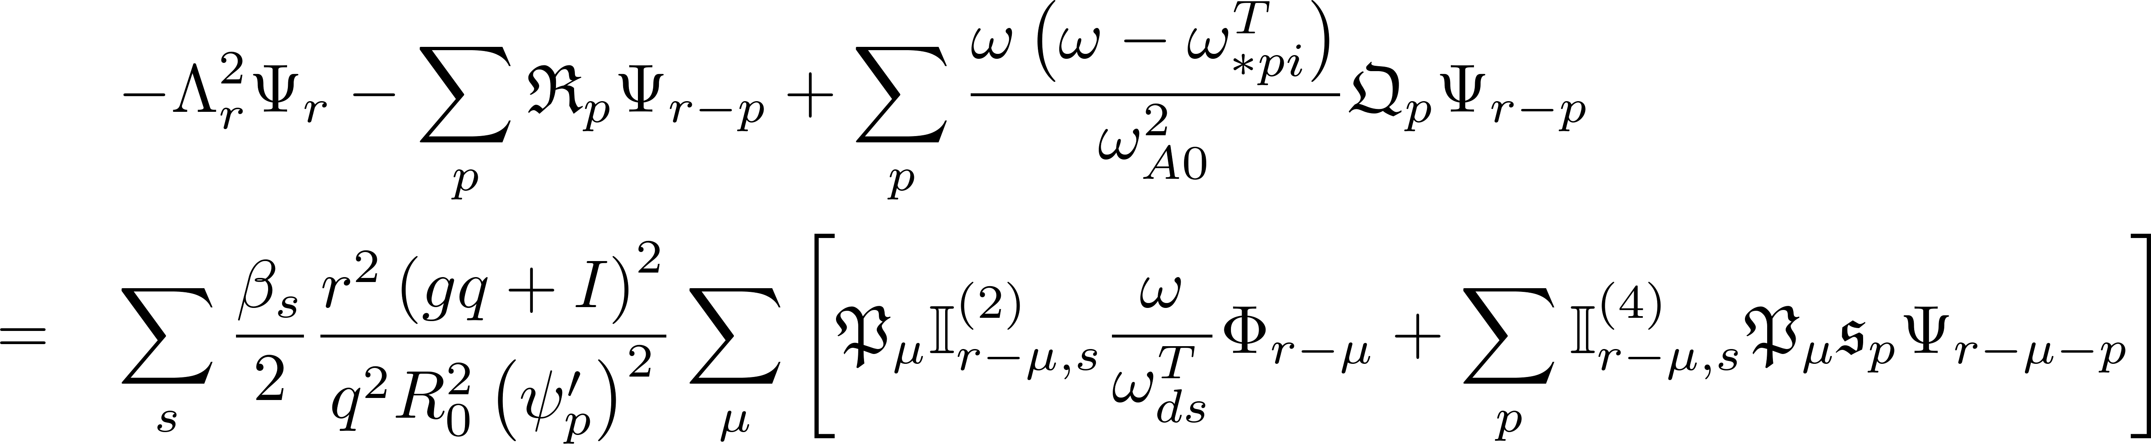
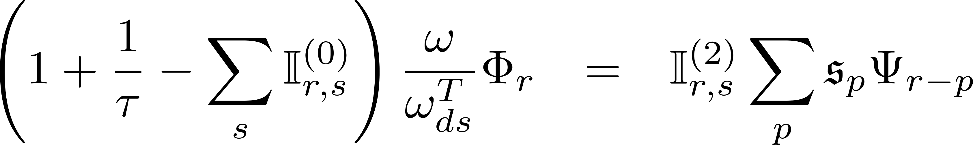
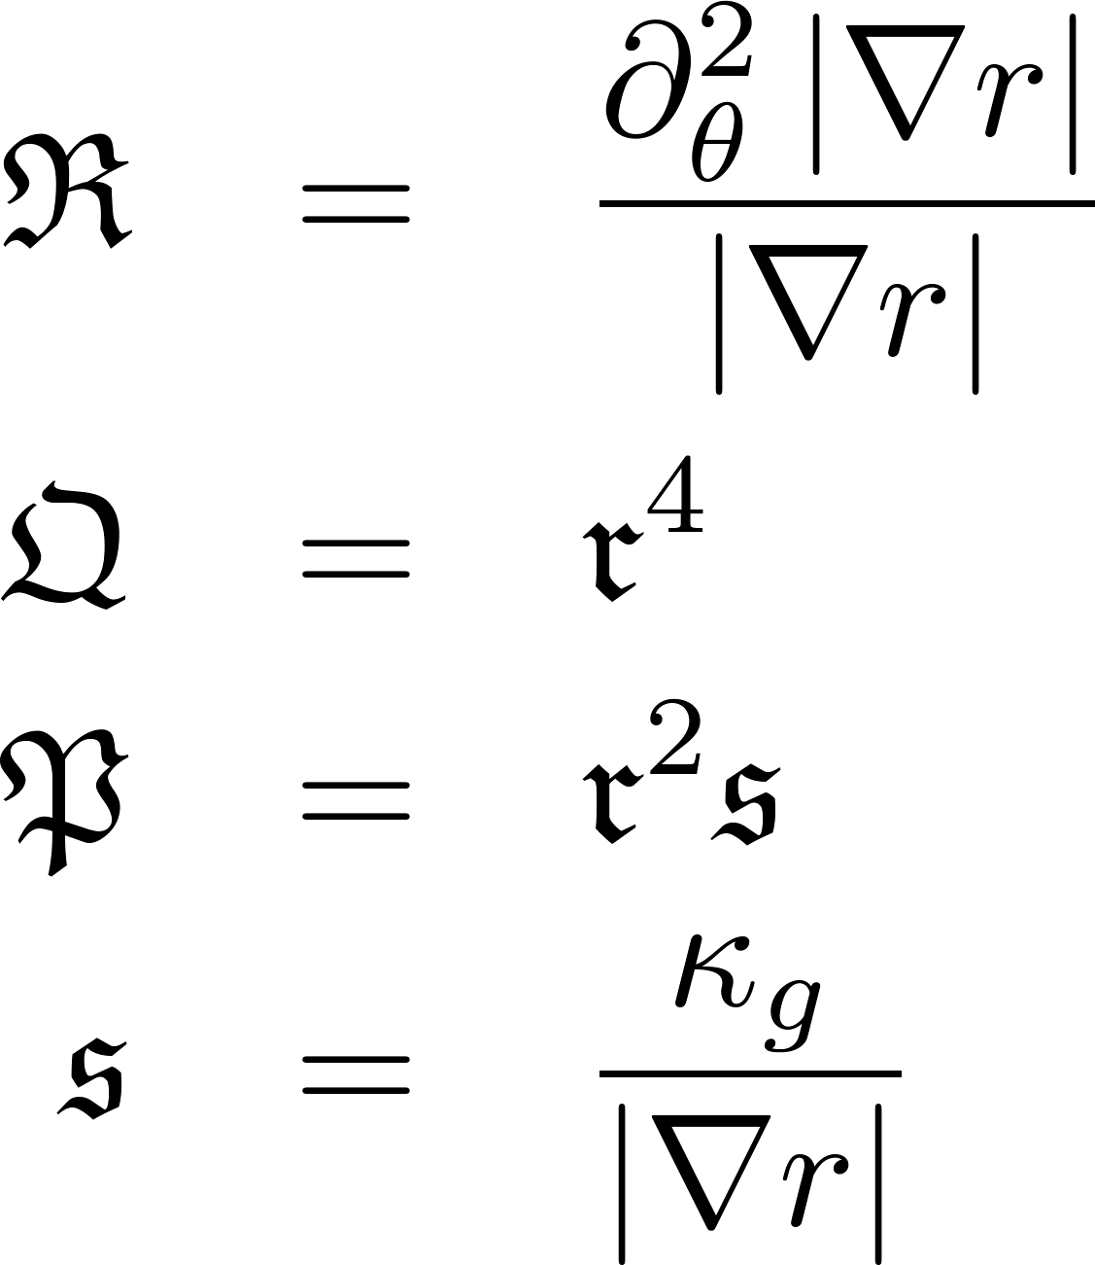
Kinetic Continuous Spectrum
Considering the well circulating particles, the numerical model for continuous spectrum:
Definitions:

Slide 14
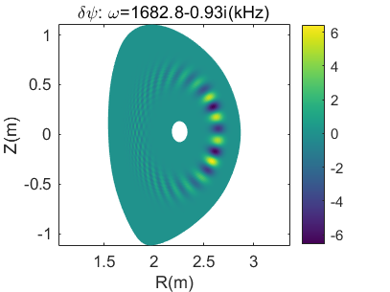
Eigenmode Calculation
N=20 TAE of DTT
Benchmark of kinetic continuum
  The frequency of the kinetic continuum is highly consistent with the fluid continuum
  The frequency of the damping TAE with thermal particle kinetic contribution lies inside the frequency gap of TAE

Slide 15
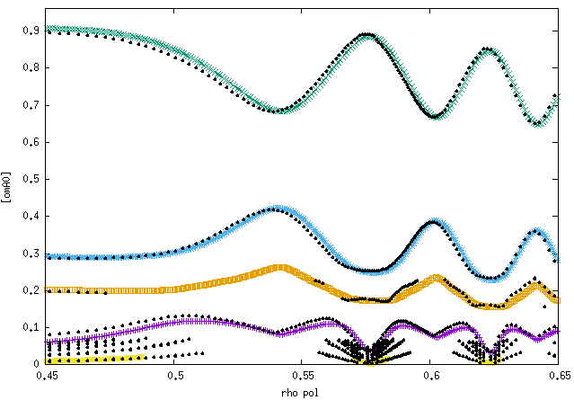
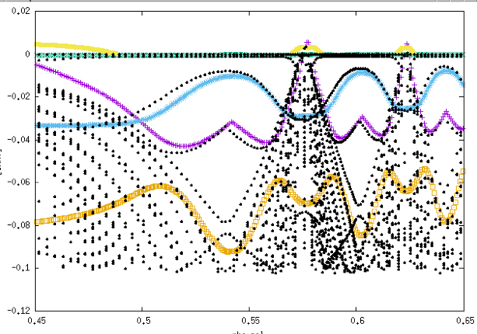

Benchmark with LIGKA on the Kinetic Continuum
N=20
Benchmark with LIGKA for ITER equilibrium
  The frequency of TAE, BAE and KBM branches are highly consistent
  The growth/damping rate of TAE, BAE and KBM branches are qualitatively consistent
  The frequency of BAAE branch is consistent for $nq−m≪1$

Slide 16
Outline
Introduction to the expression of general geometry
Model equation and action angle approach for general geometry
Numerical results
  Fluid continuous spectrum
  Kinetic continuous spectrum
  Eigenmode calculation
Summary and future work

Slide 17
Summary and Future Work
The model equation with general geometry for fluid and kinetic continuous spectrum as well as for the eigenmode calculation has been introduced.
Special treatment of pitch angle has been introduced to avoid the numerical ill behavior for barely circulating particles.
The DAEPS code is benchmarked with FALCON on the fluid continuous spectrum calculation, and with LIGKA on the kinetic continuous spectrum.
The frequency of kinetic continuous spectrum is highly consistent with the fluid continuous spectrum.
The DAEPS code is used to calculate stable and unstable modes with general geometric effect.
Future work:
  Further comparison and verification on the calculation of eigenmodes
  Action angle approach for trapped particles

Slide 18
Thanks

