Slide 1
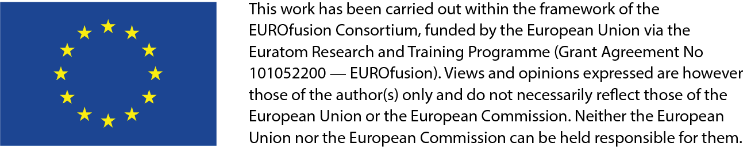
Additive manufacturing as tool to manufacture and maintain plasma facing components
D. Dorow-Gerspach, V. Ganesh, Th. Loewenhoff, J. Tweer, M. Wirtz

Slide 2
Outline
Introduction / Reminder of the project goal
O.1. AM-W: AM of W with density >99% and minimal crack density
O.2. Joints: Realizing advanced joints (FGM, W/W_{w}, W/steel, W/copper)
O.3. W-wire as armour: Realization and testing of W-wire as armour
O.4. Regeneration: Development of techniques for surface regeneration
O.5. Advanced heat sink geometries: Development, production and testing
O.6. Demonstrators of used technologies: Construction of prototype mock-ups

Slide 3
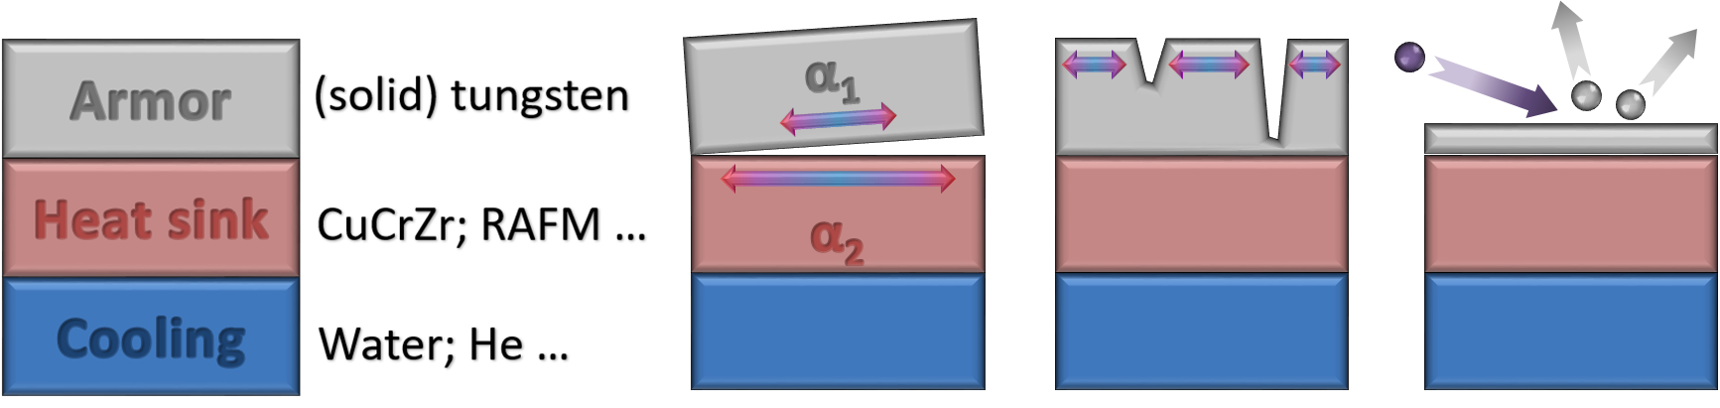
Introduction
Main issues of PFC: lifetime & safety
Lifetime: dominating topics are the joint and the surface
  Joint: difference in thermal expansion  cyclic stress (fatigue + neutron embrittlement)  failure
  Surface: erosion (cracking + crumbling, sputtering…)  thickness reduction  end of lifetime
Current solution: exchange the component

Slide 4
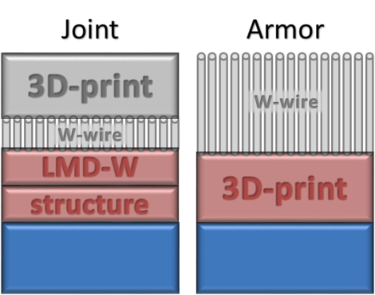
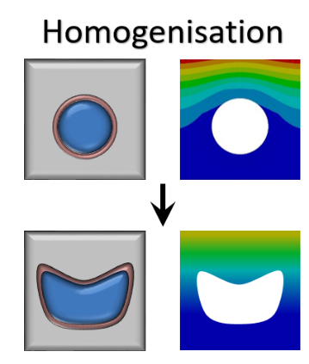
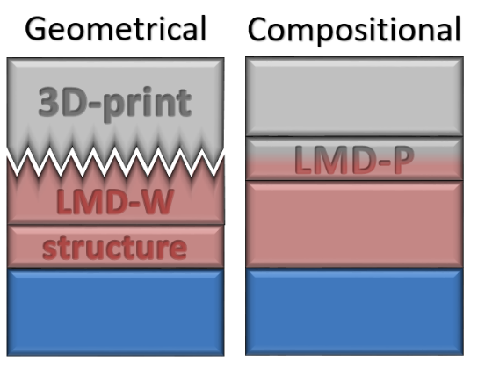
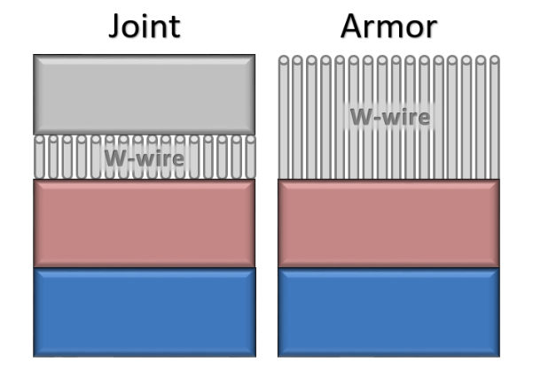
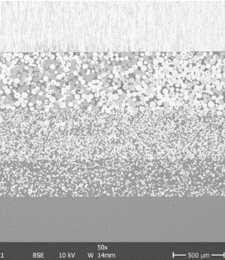
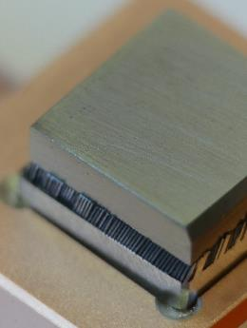
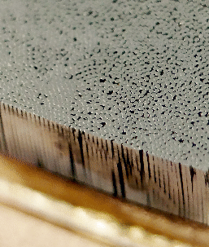
Project goal – Stress Reduction
Gradation (e.g. for FW)
  Reduce CTE mismatch
Compositional: FGM
  Powder metallurgic, AM
Geometrical: Macroscopic
Flexibility (FW, divertor)
  W-wires (Ø 100µm – 200µm)
  Occurring stresses remain within elastic regime
  More resistant to embrittlement
  As armor: ELM resistant
Standard MB (divertor)
  Wider MB  higher temp.
  Large Δ T  stress, fatigue
New MB/cooling design
  Size independent surface temp.
  Increasing the heat transfer
W
75% W
50% W
25% W
steel
Notes:
So next I want to show you our concrete ideas and concepts which we pursue within the framework of the Enabling research project to make real use of AM
Gute 4min im Moment
Max 12min bis hier sollte gehen
Noch ein Bild von der Wolfram auf Draht Probe einfügen!!

Slide 5
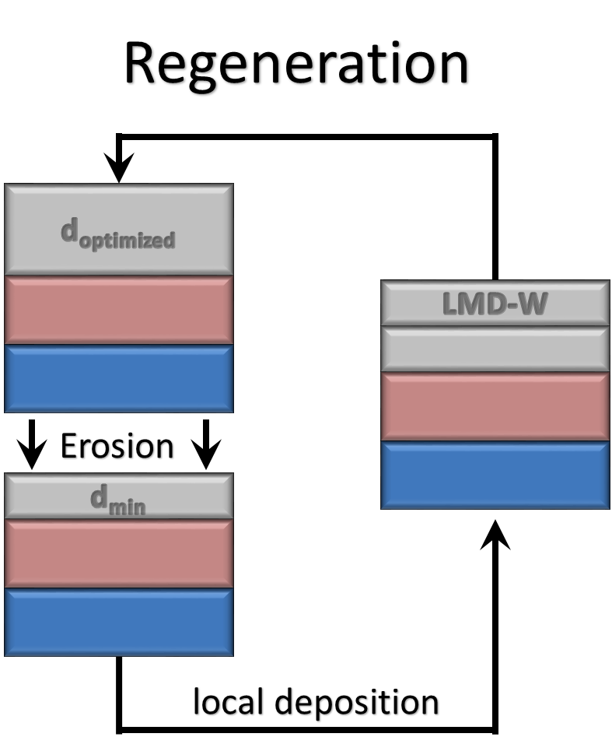
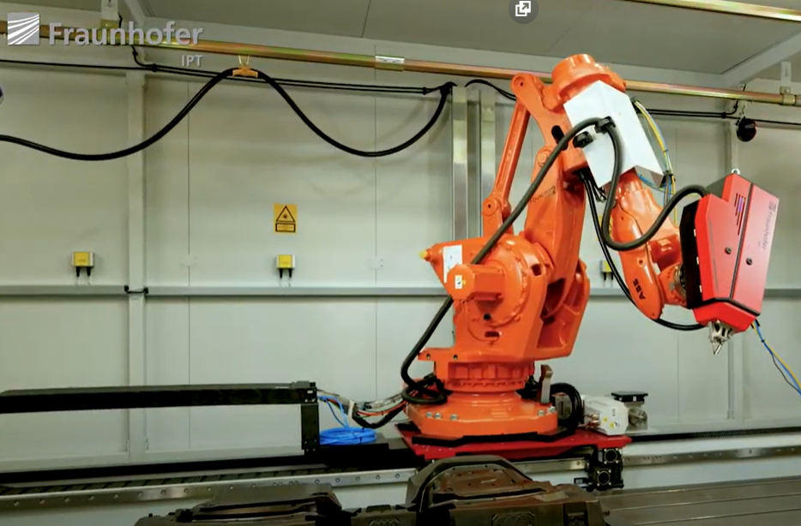
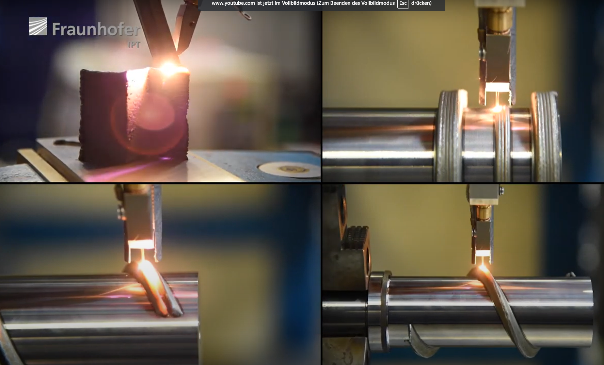
Project goal – Regeneration
In vessel replacement of eroded material
  Tile thickness can be chosen thinner
  Precise remote control and local deposition needed
LMD-W
https://www.youtube.com/watch?v=J58yn_fLFSk

Slide 6
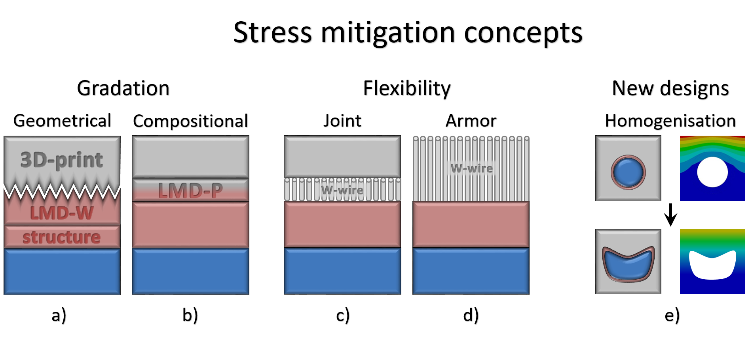
Project goal
Using combination of (AM-)techniques to:
  Increase robustness of joint and material surface
  Counteract inevitable erosion losses by local deposition of W

Slide 7
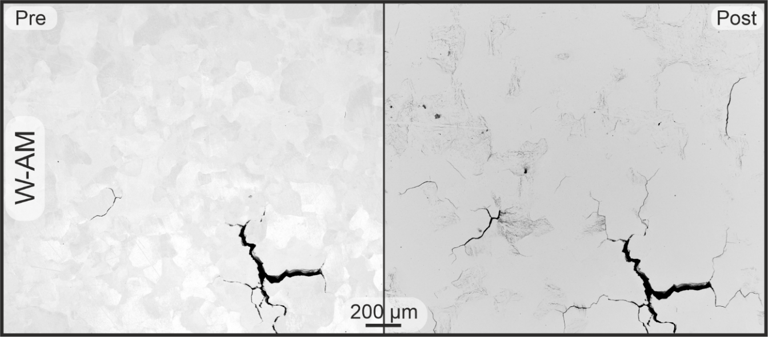
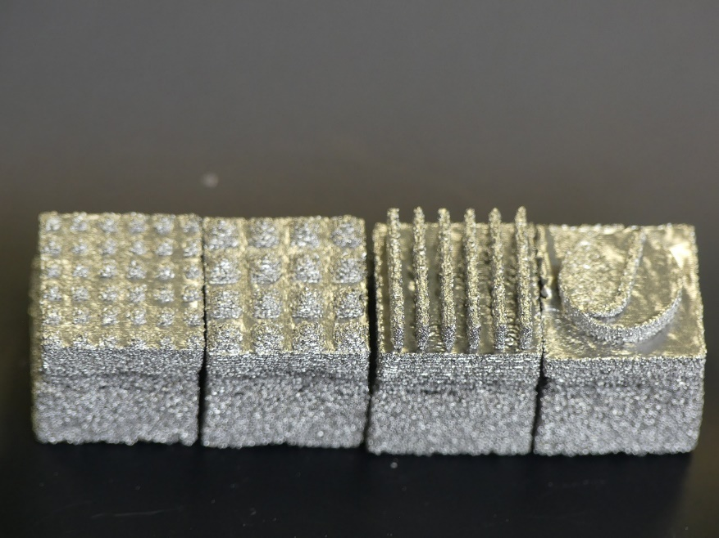
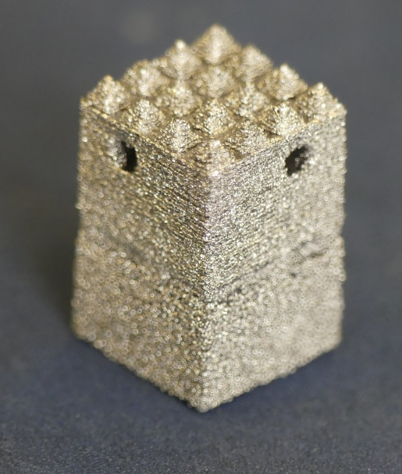
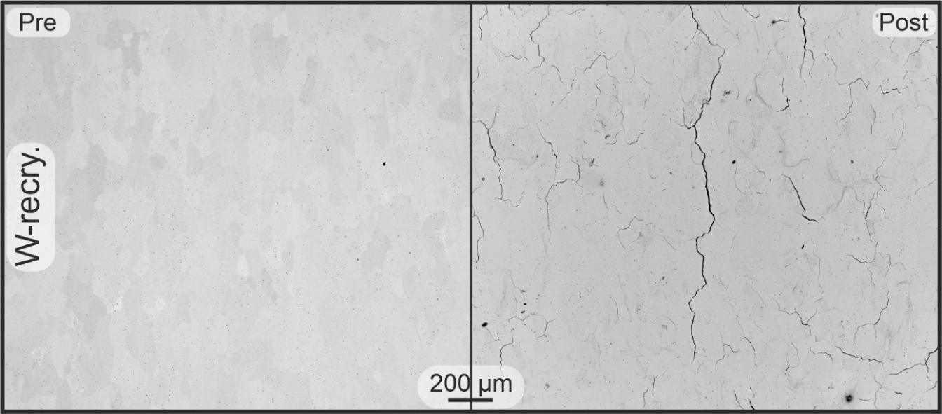
O.1. AM-W
AM-W with density >99% was realized at IFAM Dresden with low amount of cracks
  Hardness as recrystallized W (350 HV10)
  Fewer cracks than recry. W after 10⁵ HFF 3 at 700°C
  Advanced structures possible
  TDS: D retention even lower than recry. W
Notes:
D fluence: 3.4 x 10²⁵ /m², 200°C

Slide 8
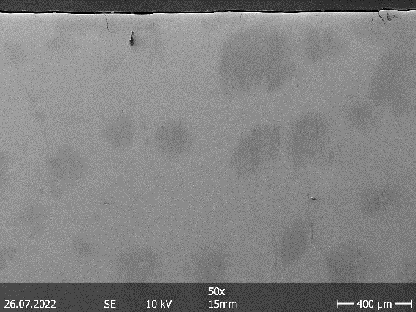
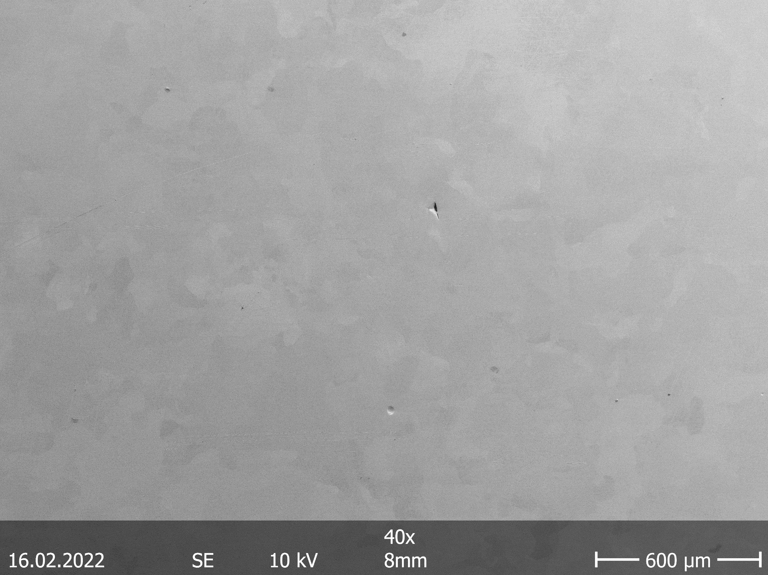
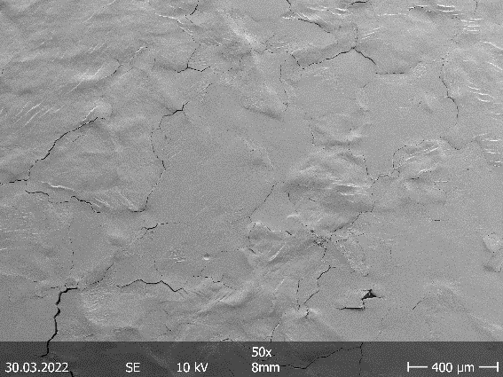
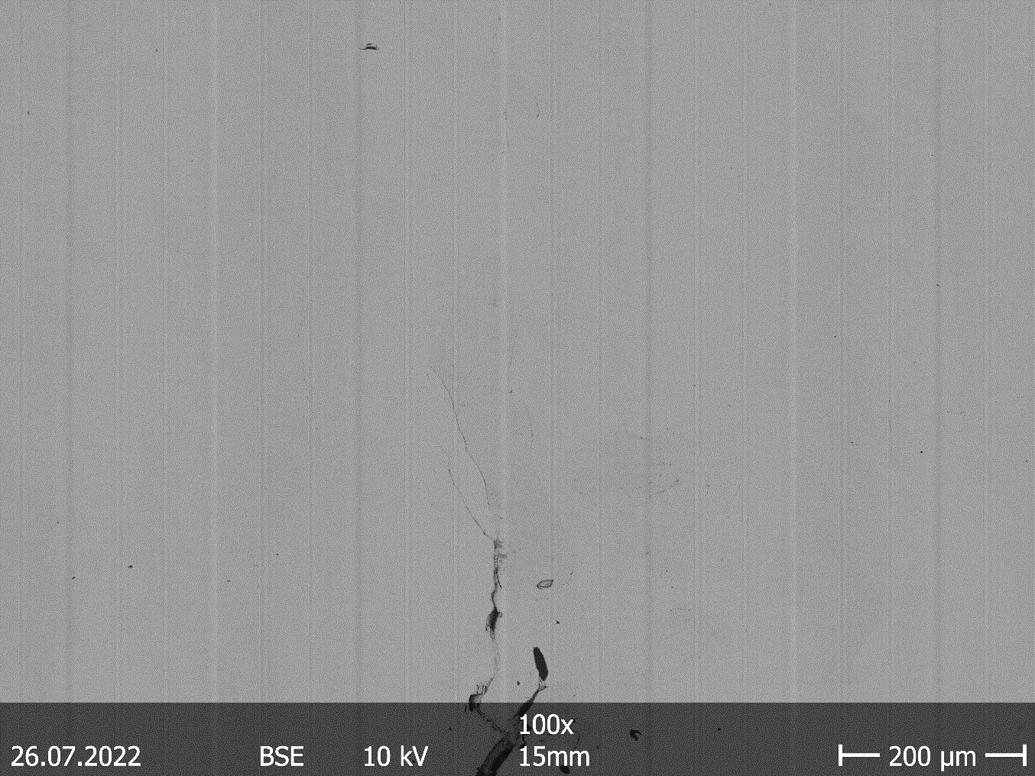
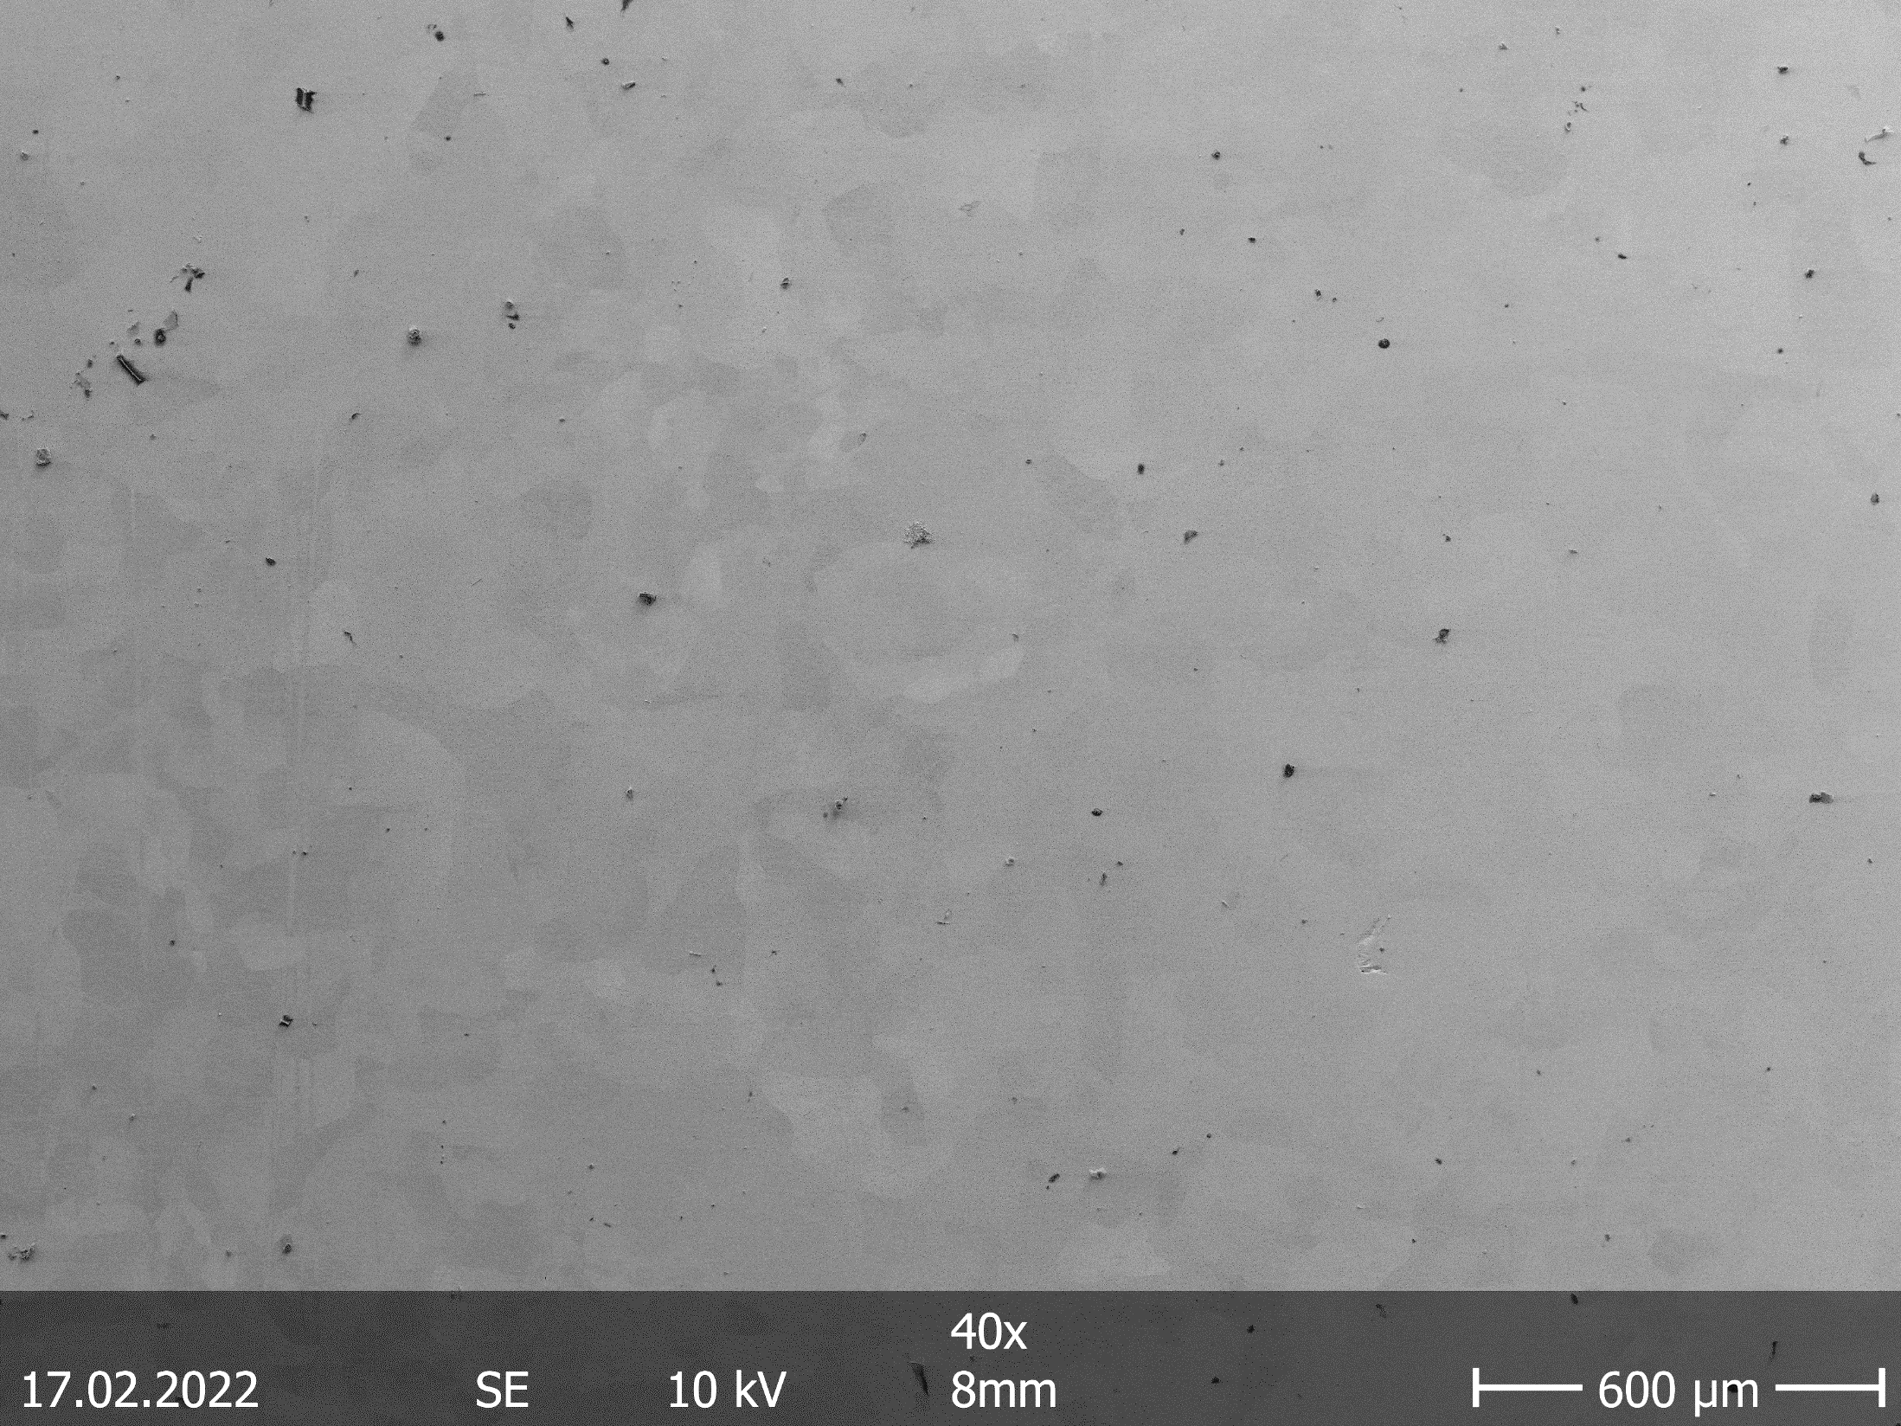
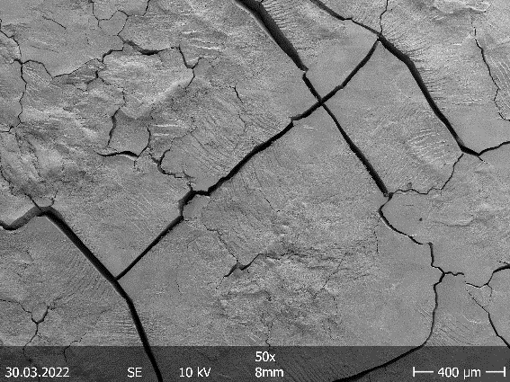
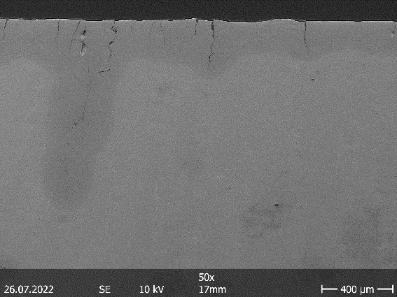
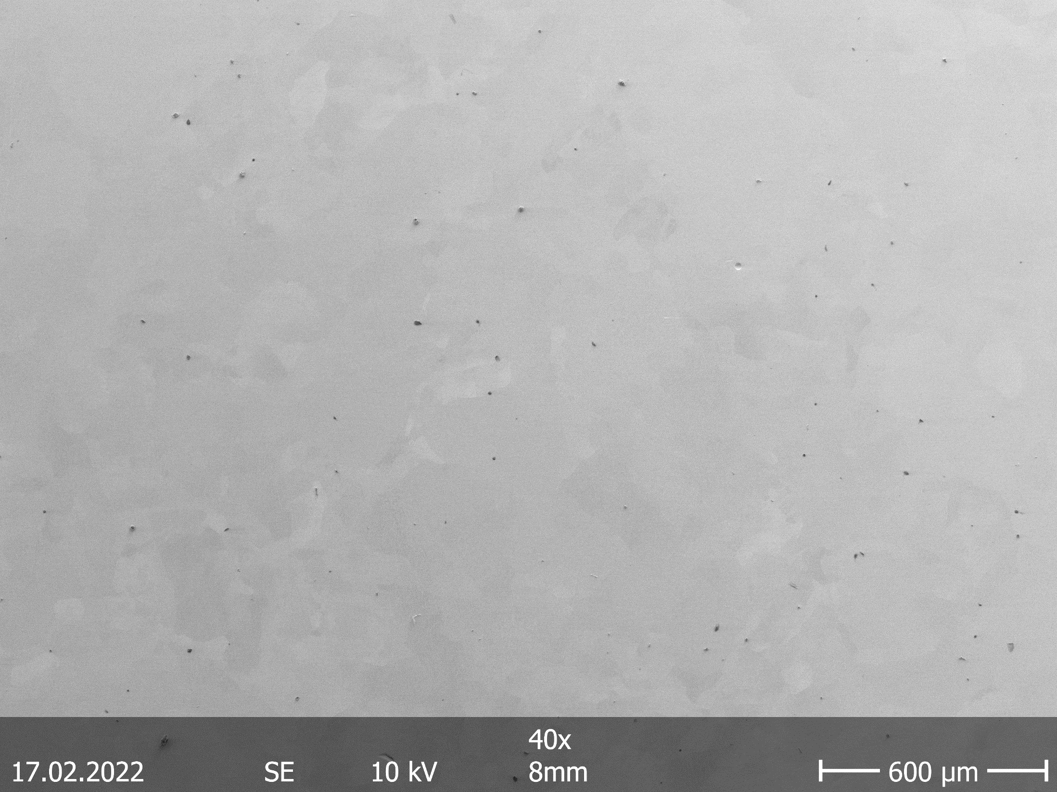
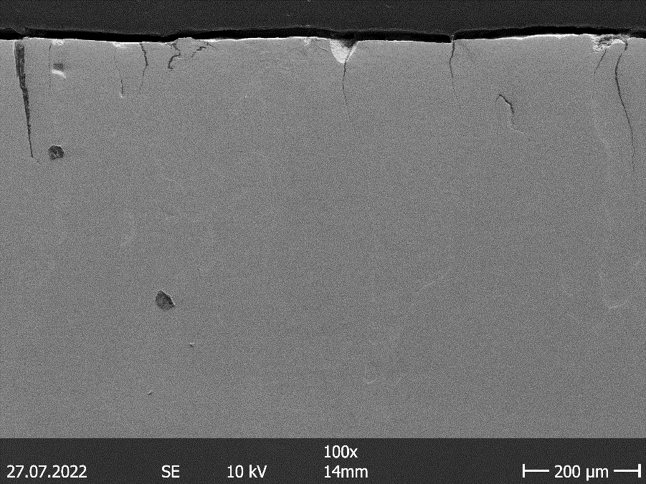
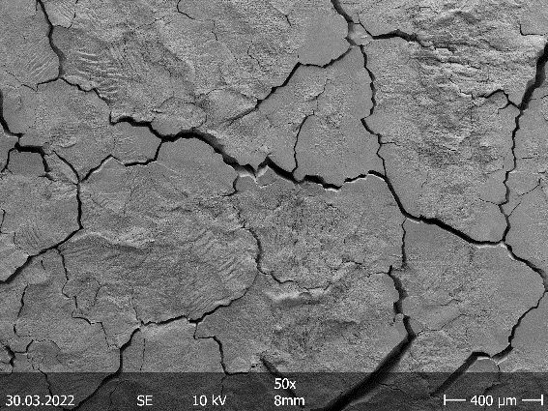
O.1. AM-W
New cooperation with KIT started
  Similar SEBM machine as at IFAM
  Nearly crack free, very few pores after polishing
  Cross sections very few in depth cracks
Tested @700°C with 10⁵ thermo shocks with F_{HF} = 3, 6 & 12 MW/m²s^{0.5}
  Crack density and depth increases with F_{HF}
  No macroscopic failure, power handling as standard

Slide 9
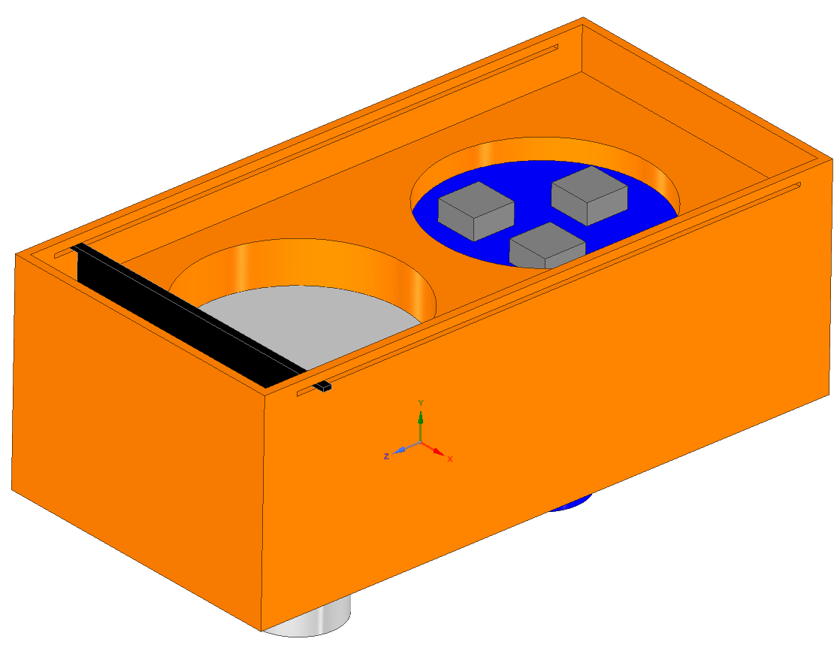
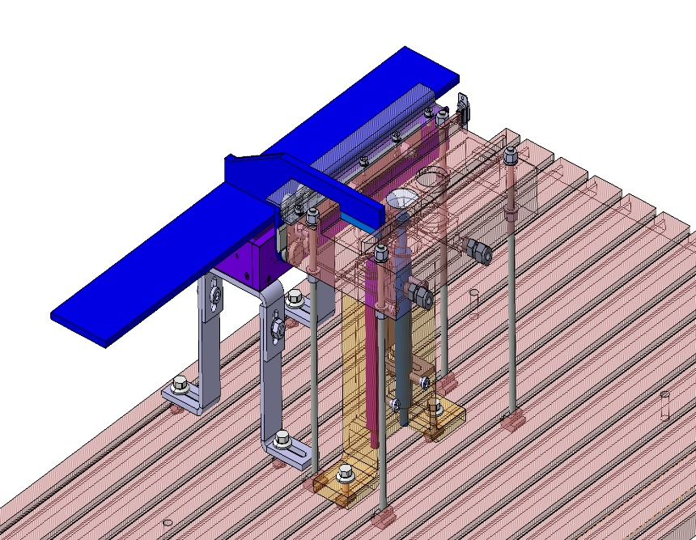
O.1. AM-W
New cooperation with KIT started
  Similar SEBM machine as at IFAM
  Nearly crack free, very few pores after polishing
  Cross sections very few in depth cracks
Tested @700°C with 10⁵ thermo shocks with F_{HF} = 3, 6 & 12 MW/m²s^{0.5}
  Crack density and depth increases with F_{HF}
  No macroscopic failure, power handling as standard
An upgrade for JUDITH 2 / 3 was foreseen to screen new material compositions and investigate influence of beam properties
  Developed iteratively with our central workshop
  Due to unsolved financing on hold at the moment

Slide 10
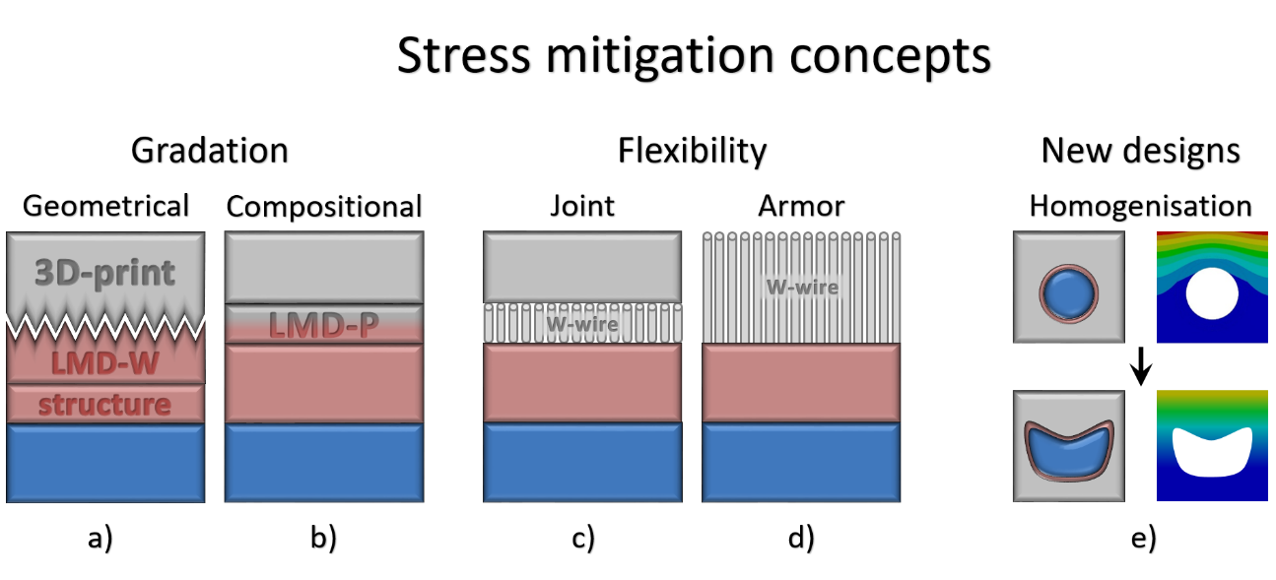
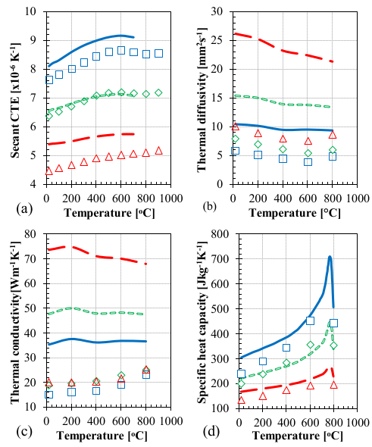
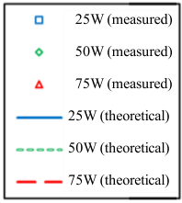
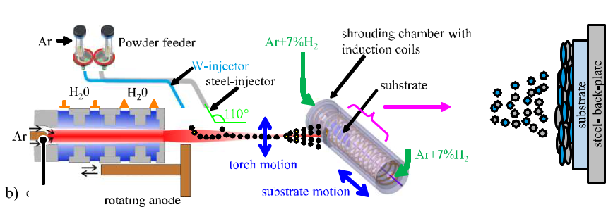
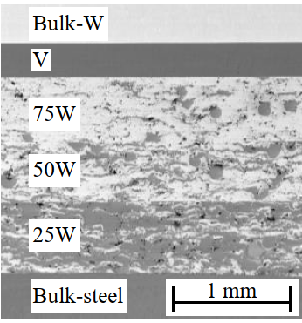
O.2. Joints – Compositional FGMs
Various different methods were used
  APS, EDS, SPS producing single & full stack
  Parameter studies to find suitable single- and complete stack manufacturing procedures
Atmospheric Plasma Sintering
https://doi.org/10.1016/j.fusengdes.2021.112896

Slide 11
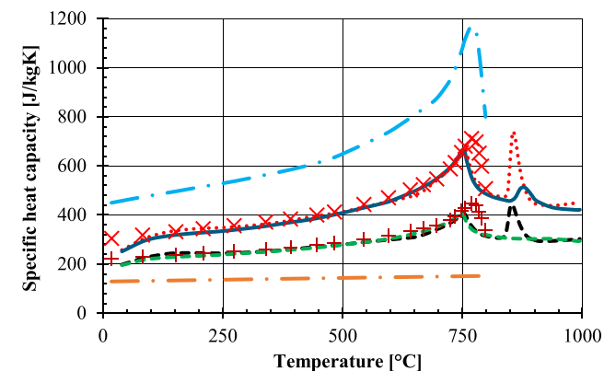
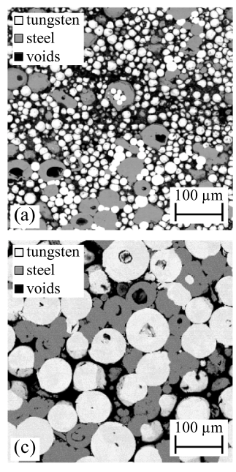
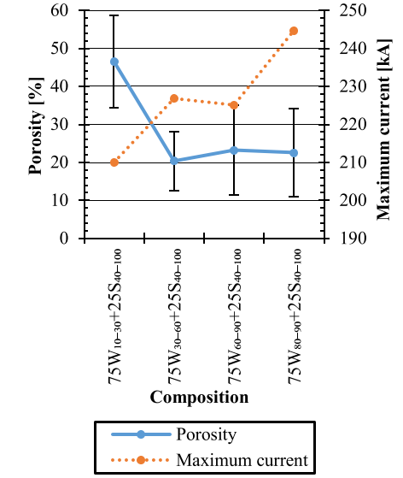
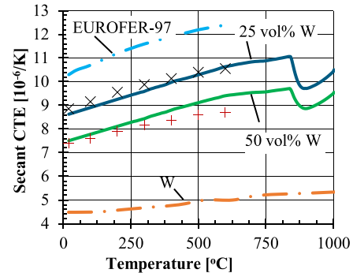
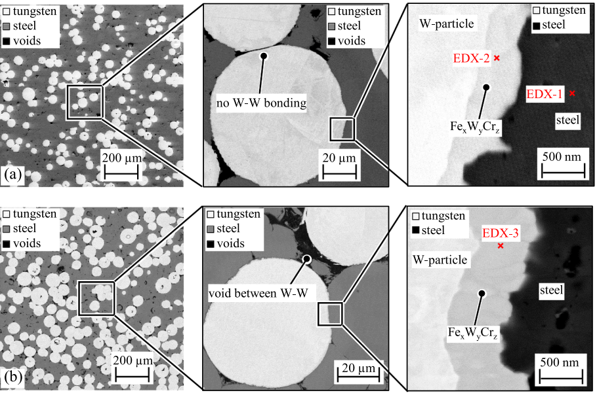
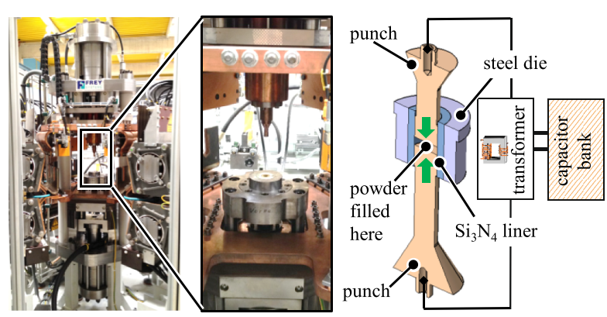
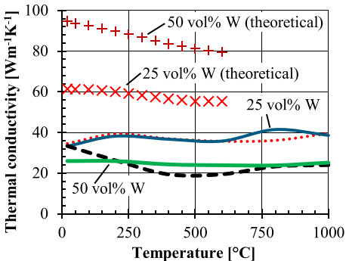
O.2. Joints – Compositional FGMs
Various different methods were used
  APS, EDS, SPS producing single & full stack
  Parameter studies to find suitable single- and complete stack manufacturing procedures
Electro Discharge Sintering
50 W 25 W
https://doi.org/10.1016/j.nme.2021.101089

Slide 12
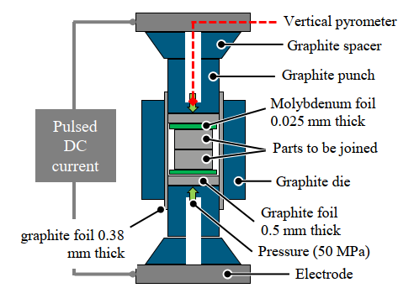
O.2. Joints – Compositional FGMs
Various different methods were used
  APS, EDS, SPS producing single & full stack
  Parameter studies to find suitable single- and complete stack manufacturing procedures
  Thermal conductivities are very low for all techniques and below theoretical expectations
Spark Plasma Sintering

Slide 13
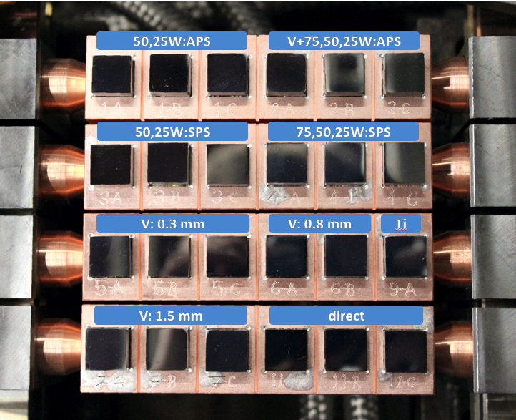
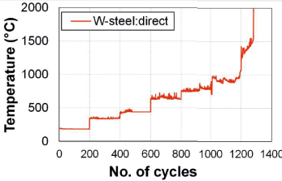
O.2. Joints – Small Scale Benchmarking
Clamping device for JUDITH 2
  Stacks soldered on Cu-holder
Sample requirement
  Same size (12x12mm²)
  Comparable thicknesses
  Same surface finish for the top-tiles
  Reasonable reference technology
  (Direct bonding, brazing…)
Up to 24 samples at once
  E.g.: 3 samples per type  8 sets
  Complex beam patterns allow to load each sample individually
  Failed samples can be excluded
3 mm W
0-1.5 mm X
3 mm steel

Slide 14
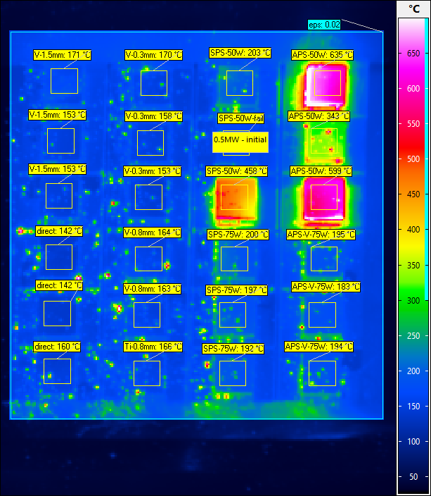
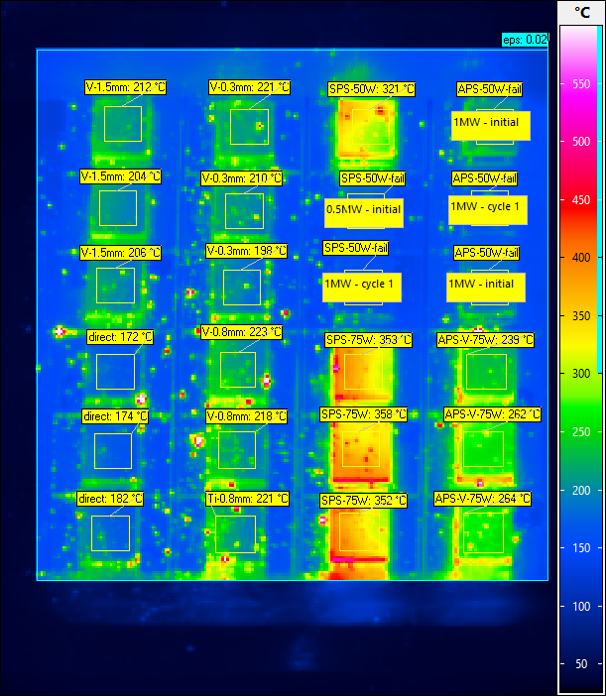
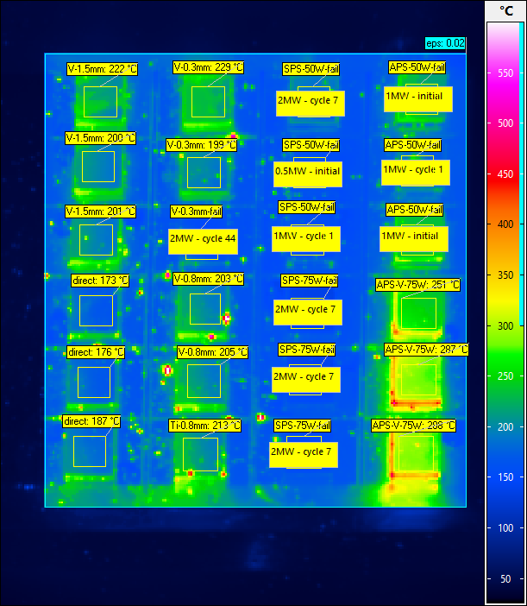
O.2. Joints – Small Scale Benchmarking
Screening at 1 MW/m² after 200 cycles at each power level to track the evolution
1 MW/m² - screening
1 MW/m² - cycle 200
1 MW/m² - after 2 MW cycling

Slide 15
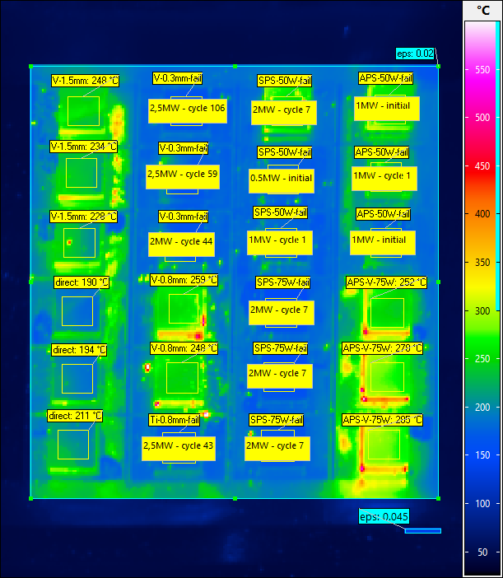
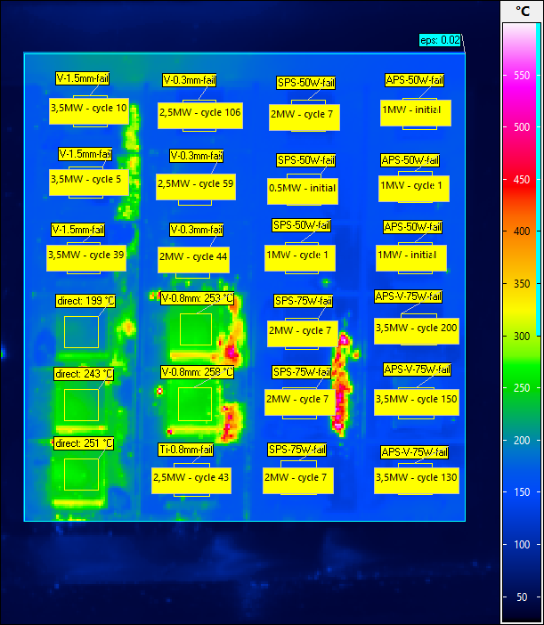
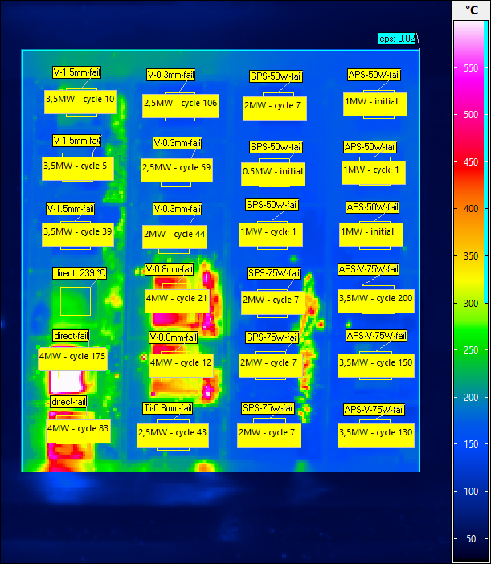
O.2. Joints – Small Scale Benchmarking
All new types failed after 3.5 MW/m² and during 4.0 MW/m² also the direct joint
1 MW/m² - after 3.0 MW/m²
1 MW/m² - after 3.5 MW/m²
1 MW/m² - after 4.0 MW

Slide 16





O.2. Joints – Geometrical Gradation
Two types were developed
  Pyramid
  Linear area ratio
Printing this year
Diffusion Bonding of bulk
Melting Cu within a mold
Spark Plasma Sintering
steel or Cu
SLM processed
Dimensions:
basic body
length: 12 mm
width: 12 mm
height: 3 mm
transition structure
length: 1.5 mm
width: 1.5 mm
height: 1.5 mm
W EBM or
SLM processed

Slide 17



O.2. Joints – Flexible joints with steel
Laser metal deposition
  Easily accessible technique
  At atmosphere using Ar flooding to prevent oxidation
  Good degree of infiltration
Cyclic high heat flux test
  3 samples with 4; 6; 9 mm W_{w}
  5 MW/m², 2000 cycles,
  30s on/off  600 – 900°C T_{surf}
  ➲ No loss of W_{w} or change of T_{surf}
➲ Solid joint of W and steel
one LMD-layer
Notes:
Veruch ABW

Slide 18





O.2. Joints – Flexible joints with W
Laser metal deposition
  Melting and mixing with W_{w}
  Very wavy surface
  “Bubbles” / high porosity
  ➲ Not suitable
Selective laser melting
  Powder based additive manufacturing technique
  Preheating up to 1000°C
  Selectively melting and build up structures layer by layer
  High density and versatile
  ➲ Very promising
Notes:
LPBF (Fraunhofer Augsburg - IGCV)

Slide 19



O.2. Joints – Flexible realization techniques
µ-brush-W: combining W_{W} with desired material depending on application
  Necessary: stable, reproducible
  and upscalable connection
Cu: spark plasma sintering
  Uniform but needs optimization
Steel: laser metal deposition
  Very solid & reproducible joint
W: selective laser melting
  Merging W_{w} with bulk W
  Enabling new designs

Slide 20




O.3. W-wire as armor
W-wire assembly
  Small scale design and Cu infiltration had been developed and tested before
  E.g. 10⁵ HFF 12: IGP-T vs. µ-brush
Larger spool design
  3 kg of 200 µm W-wire
  Enough to cover 460 cm², 3 mm thick
  Winding, clamping and slicing successful
  Cylindrical shape did not improve winding
Next steps
  Joining with steel, Cu, W employing new techniques and continue development
  Transient and steady state heat load test

Slide 21


O.4. Regeneration
LMD-W at IPT Aachen
  Ar flow, 4 kW IR laser, W on steel, W, W_{w}
  Porosity, Cracks have to be reduced

Slide 22





O.4. Regeneration
LMD-W at IPT Aachen
  Ar flow, 4 kW IR laser, W on steel, W, W_{w}
  Porosity, Cracks have to be reduced
Cooling holder to improve substrate temperature control during the deposition
  Parametric studies are performed -> work ongoing
  Width nicely tailorable by power and velocity

Slide 23



O.5. Advanced heat sink geometries - MB
Standard MB chain
  Wider MB  larger ΔT and maximum at edges
  Larger ΔT  higher risk for macro crack
  ➲ Solution: reduction in width
Goal: Wider MB-chain w/o macro crack
  No increase of ΔT with the width of the MB
  ➲ Non circular cooling channel
  Minimum T at edges to reduce stress at center
  More resistant against edge loadings
  ➲ More armor in the center
  Total amount of W reduced by > 20% using minimum of 5 mm armor
AM of Monoblocks and cooling channel
  Same width (28 mm) and cooling channel area
  Lower (170°C @ 10 MW/m²) and homogeneous (ΔT: 150°C  5°C) surface temperature

Slide 24


O.5. Advanced heat sink geometries - MB

Slide 25


O.5. Advanced heat sink geometries - MB
Notes:
HTC90k, 80lmin
Rechts: MB33x5x3

Slide 26



O.5. Advanced heat sink geometries
Improving the heat transfer of the cooling channel
Double Channel
  W: 11 mm
  H: 10.82 mm
  L: 150 mm
  T_{W}: 2 mm
  R_{C}: 0.5 mm
  L_{C}: 20 mm
Ribs:
  G_{R}: 1 mm
  α: 60°
  T_{R}: 1 mm
  D_{R}: 3 mm
  H_{R}: 3.75 mm
  l ≈ 3.6 mm
cross section
top view
W
H_{R}
T_{R}
H
D_{R}
G_{R}
α
(W-2G_{R})/2
l = T_{R} + (W-2G_{R})/[2tan(α)]
α
coolant flow direction
T_{R}

Slide 27





O.5. Advanced heat sink geometries
Printing of steel at FZJ (SLM)
  He tightness measured on test cylinders
  Open and closed channel successful
Further geometries and Cu (at IFAM)
are planned for this year
  Hydrodynamic and high heat flux tests to assess potential and impact of design

Slide 28
O.6. Prototype mock-up: W on steel
“Best” FGM as Interlayer
  Based on benchmark test: SPS (2, 3 layer)
  Tile size: 12×12 mm² or 20×20 mm²
  Combination with other fields possible, e.g.
    WfW, Oxidation resistant W-alloy, Barrier
Using W-wire as armor and as joint
  LMD of steel on one side
  Diffusion bonding thin steel layer on mock-up
  Using LMD or SLM to print W on W-wires
  Several can be combined for full coverage
ITER-W
Alloy-W
3D-W
3D-W
3D-W
3D-W
W-wire
SPS-FGM
SPS-FGM
LMD-steel
SPS-steel
W-wire

Slide 29
Publications / Contributions
Publications
  V. Ganesh – ID: 30420
  Manufacturing of W/steel composites using electro-discharge sintering process
  https://doi.org/10.1016/j.nme.2021.101089
  V. Ganesh – ID: 29595
  Manufacturing of W-steel joint using plasma sprayed graded W/steel-interlayer with current assisted diffusion bonding
  https://doi.org/10.1016/j.fusengdes.2021.112896
  D. Dorow-Gerspach – ID: 29029
  Additive manufacturing of high density pure tungsten by electron beam melting
  https://doi.org/10.1016/j.nme.2021.101046
Conference
  PFMC 18: Poster: V. Ganesh – ID: 28839
  First results on the manufacturing of W/steel composites using plasma spraying under inert atmosphere
  ICFRM 20: Poster talk: D. Dorow-Gerspach – ID: 29028
  Additively manufactured W, produced by laser and electron beam, under stationary and transient heat load
  CIMTEC 20: Invited: D. Dorow-Gerspach – ID: 30667
  Additive manufacturing of tailored plasma-facing fusion wall components
  CIMTEC 20: Poster: V. Ganesh – ID: 32745
  W/steel composites as a potential interlayer for the joining of W and steel for the first wall of a fusion reactor
  SOFT 32: Oral: D. Dorow-Gerspach – ID: 31785
  Progress in the realization of advanced armour designs for plasma-facing components
  SOFT 32: Poster: V. Ganesh – ID: 32746
  High heat flux testing results of various W-FGM-steel joints

Slide 30
Thank you for your attention
Outtakes

Slide 31
Project structure - detail
O.1. AM of tungsten
O.1.1. Exploring new and development of further AM techniques for tungsten
O.1.2. H-retention and plasma influence on AM-W
O.2. Advanced joints between PFM and heat sink
O.2.1. Geometrical gradation
O.2.2. Compositional gradation
O.2.3. Flexible joint by using W-wire
O.2.4. Small scale benchmark test
O.3. W-wire as advanced armor to resist thermal shocks
O.3.1. Sound joining of only the bottom of W-wire
O.3.2. Impact on thermal performance of W-wire armor
O.3.3. Influence of plasma on W-wire armor
O.4. Surface regeneration to compensate erosion loss
O.4.1. Regeneration of damaged surface
O.4.2. LMD-W process optimization to build up W meeting R_{a}-requirements
O.4.3. Investigation of post-deposition treatments like HFMI
O.5. Exploring advanced heat sink geometries
O.5.1. Assessment by FEM simulation of several different monoblock-type designs
O.5.2. Building several monoblocks based on O.5.1 by AM.
O.5.3. Production of a monoblock-chain and performance of HHF tests
O.6. Demonstrating feasibility and scalability of used technologies
O.6.1. Construction of cooling structures for test mock ups
O.6.2. Joining of tungsten to the cooling structures by using the most promising technologies (O.2.4.)
O.6.3. Build-up of W on part of the mock ups (regeneration)
O.6.4. Comparative thermal cycling test

Slide 32


Project structure / task agreement

