Slide 1
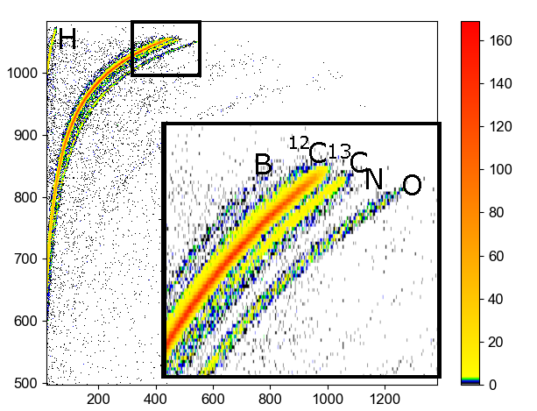
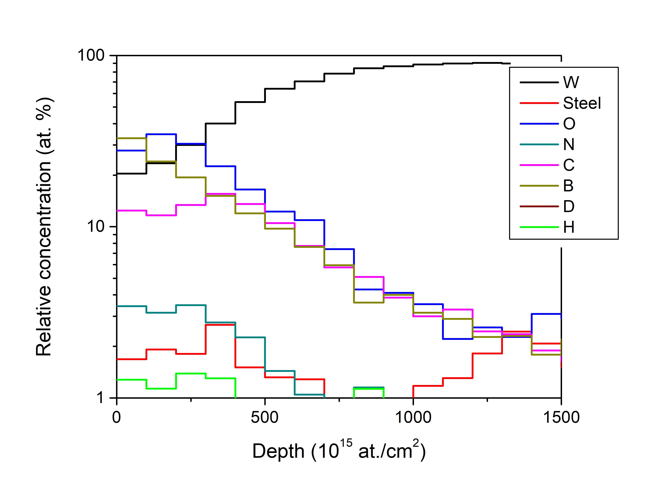
Ion beam analyses of PFC
Analysis: WEST and W7-X samples by ToF-ERDA and some NRA
W7-X locations with excess ¹³C
WEST (ERDA and NRA)
Slightly problematic with roughness
Will show Helium (sensitivity ~10¹⁴ at./cm²)
<VR: Per Petersson, Marek Rubel>

