Slide 1
OP 2.1/2.2 proposal list
G. Schlisio

Slide 2
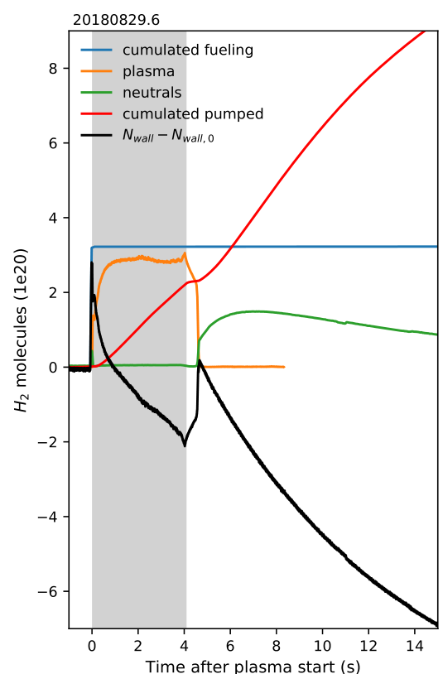
Geos_007: Extended measurement segment for operation of neutral gas manometers during post-plasma outgassing phase
Background:
While for most diagnostics the observed quantity ceases with the termination of plasma, this is not the case for neutral pressures in the plasma vessel.
The neutral gas manometers (QRG) offer fast observation of in-vessel pressure, which is relevant both during and after a plasma pulse.
Relevant to quantify outgassing of the new PFCs
Implementation:
Extension of measurement beyond the plasma heating phase
duration depends on the observed pressure reduction and will be in the order from a few ten seconds upto a few minutes, depending on the wall outgassing behaviour. The exact duration will have to be contiuously adapted during the campaign, as fair balance between pressure observation, time restrictions, and possible other interests.
Technically this is implemented by delaying Trigger T5 (post processing) from T4 (end of heating) by the given amount of time. (Trigger details according to 1-DBB31EA011-S0001.0)

Slide 3
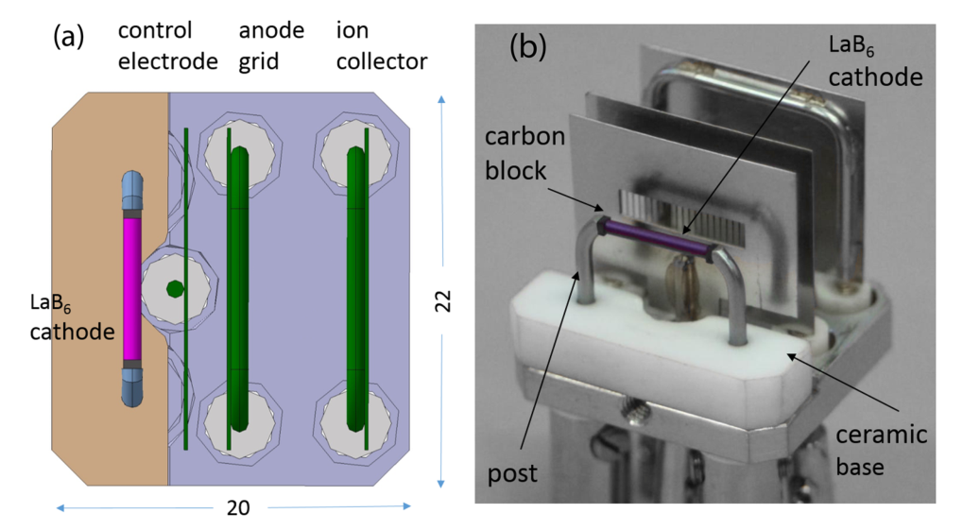
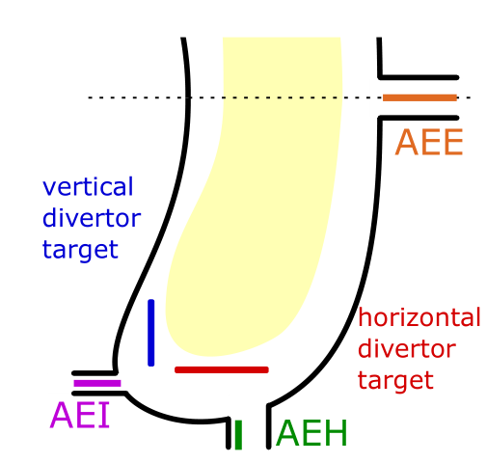
Geos_012: Operation of neutral gas manometers in between plasma pulses
Operate QRG manometers in between plasma pulses (IDLE segment) at low sampling rate
Manometer cathode remains heated throughout the entire time → excellent test of long term stability for the LaB6 cathodes
Needs careful commissioning first, start with one manometer in a less important and redundant position (e.g. AEH11), only extend if deemed safe for diagnostic and aquired info deemed necessary
Also serves as a long-term test of the manometers (O(hours)) relevant for long pulse operation expected at W7-X (½ h) and ITER (1 h)

Slide 4
Geos_008: Gas composition measurement of gas captured by the Cryo Vacuum Pumps
With the introduction of the Cryo Vacuum Pump (CVP) in OP2.1, a share of gas is trapped in the sub-divertor and not directly accessible to monitoring from the pumping ports anymore. To close this gap, we propose the monitoring of CVP trapped gas during regeneration.
This allows to study the whole exhaust gas and to e.g. (hopefully) close the carbon balance
The CVP regeneration is accomplished as CVP heatup into the unpumped plasma vessel (TMP gate valves closed) until a stable pressure is reached. Depending on the pressure, the gas is then pumped away with the available pumping system (TMPs and roots pumps).
We propose measuring the gas composition with the DRGA system (QRR). The exact procedure depends on the equilibrium pressure and required safety procedures and will be discussed with all involved groups (TLvD, TH/V, …).

Slide 5
Geos_010: Study of gas balance and wall conditions during detachement transition
Objectives:
Check how the transition to and from detachment affects the wall conditions on the strike line, e.g. gas consumption or release
Approach:
Sequence of detachement-attachment transitions, e.g:
10 s plasma setup
5 s detached plasma
5 s attached plasma
Based on density and pressure measurement we determine the amount of bound particles in the wall and can compare detached and non-detached states and their transitions (gas consumption/release).
Specific requirements:
Stable recipe for detachment transition
Diagnostics: QRG, Interferometer, fueling valves
Can be combined with:
Needs a number dedicated detachment experiment
repeat 4 to 5 times
Requested Parameters
Heating [MW] (ECRH, NBI, ICRH) | Whatever it takes for stable detachment
Density (feed-back/-fwd) [10¹⁹ m⁻³] | Whatever it takes for stable detachment
Plasma state | Controlled detachment

Slide 6
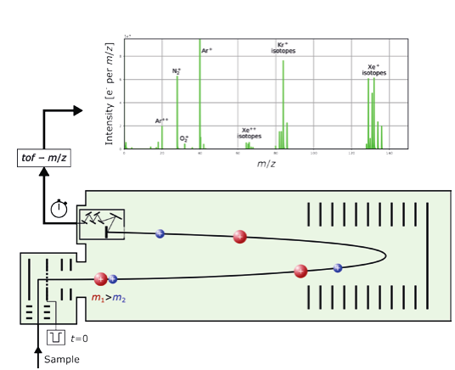
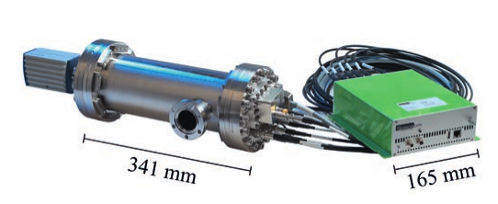
Geos_011: Test operation of a new TOF RGA
Recent development of a compact TOF mass spectrometer by a swiss company
Offer for a test operation in OP2.1 at the DRGA
Device promises fast scans and high resolution at low masses (H/D/T/He)
Recent Publication in Chimia DOI:10.2533/chimia.2022.52

Slide 7
Geos_009: Calibration of key neutral gas diagnostics and quantities: PV volume, Valves, pressure gauges, pumping speeds
Goal: full accountance of gas in- and output of W7-X, common standard for pressure measurement, simple calibrated data availability
Part of a larger undertaking, parts:
Measurement of PV volume
Calibration of pressure sensors
Calibration of gas valves
Measurement of pumping speed (TMPs, CVPs) at relevant positions and scenarios
Influence of the NBI on neutrals in the torus:
Pumping via getter pump
Neutralizer gas injection (with / without neutral beam?)

Slide 8
Geos_014: Accurate determination of PV volume
Methods:
Expansion method: expand known amount of gas into unpumped PV and measure resulting pressure
Injection method: inject known flux of gas for known amount of time, measure resulting pressure
Modelling: Derive volume from DMU → deemed not feasible by DE

Slide 9
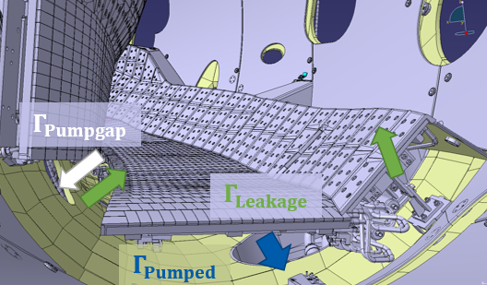
Geos_016: Pumping speed determination
Methods:
Pumpdown method: fill torus to a given pressure, open TMP gate valve(s) and measure pumpdown time → not feasible for CVPs
Equilibrium method: continuous injection of gas, measurement of pressure at intermediate positions
Approach:
Measure for all pumps at once vs for individual pumps – up/downsides?
Changes expected with / without plasma?
Relevant positions of pumping speed:
Low iota pumping gap (AEI)
Low iota pumping port (AEH)
High iota pumping port (AEP)
…?

Slide 10
Geos_017: Quantification of the NBI influence on neutral gas balance
Pumping:
Determine effective pumping speed at AEA20/21 port by opening gate valve and observe pressure in PV without neutralizer
How to model getter pump degeneration of pumping speed? (might also be interesting for CVPs)
Neutralizer gas injection:
Open gate valve with running neutralizer (but without beam)

