Slide 1
WPSA Code Management & Simulation 2022 plans
WPSA General Meeting, 4-6 May 2022
WPSA Code Management & Simulation Area Coordinator:
G. Falchetto CEA, IRFM (France)

Slide 2
OUTLINE
WPSA Code Management and Simulation strategy
WPSA CM ACTIVITIES 2021-22
WPSA CM Tasks & Deliverables 2022
Agenda

Slide 3
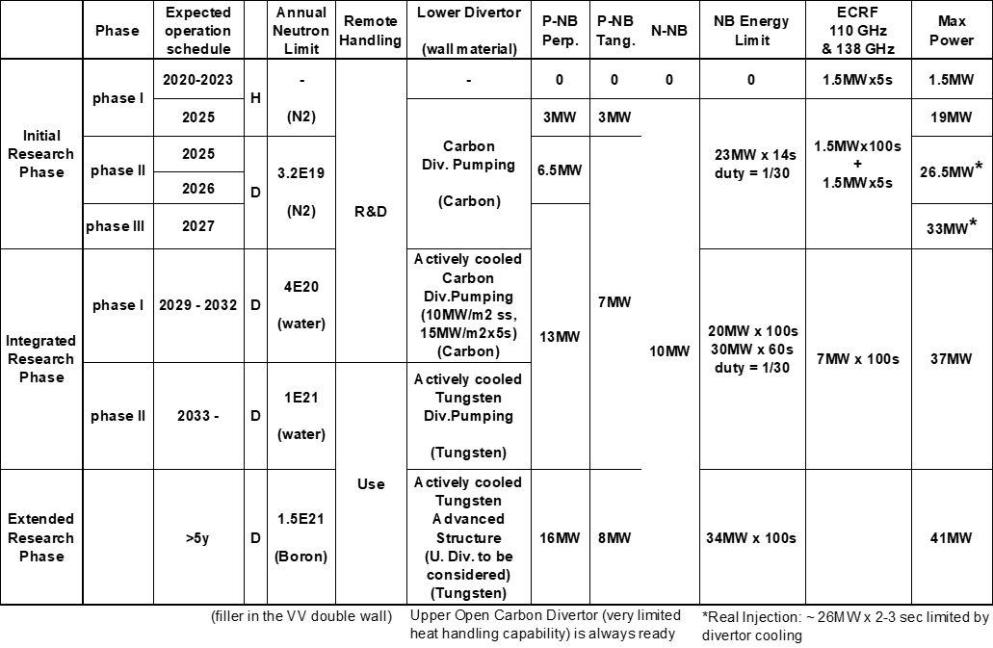
WPSA Code Management and Modelling area strategy
Establish reliable modelling codes, workflows and operation related tools for routine use in JT-60SA scientific exploitation
Modelling support to the enhancements and diagnostics procured by EU
Specific focus on modelling the Initial Research Phase
+ contribute to Integrated Research Phase wall diagnostics design (F4E/WPDIV)
Updated Project Phases BA SC 29

Slide 4
EUROfusion WPSA code management and modelling activities 2021-2022
Operation oriented tools and synthetic diagnostics :
Discharge simulator development
Breakdown simulator development & optimization of BD scenarios
Electron Cyclotron Wall Conditioning ECWC simulation tools validation
Visible imaging analysis tools provision (camera tomography, EDICAM)
Integrated Data Analysis tools requirement capture
Proposal for disruption mitigation/avoidance trigger
Assessment of PCI measurement
FILD synthetic diagnostics
Modelling for JT-60SA Initial Research Phase scenarios
Scenario modelling with operationally oriented integrated modelling transport codes
Edge and divertor modelling (C scenarios + wall diagnostics design support)
Energetic Particle stability analysis
MHD stability analysis
RWM control
Non-linear MHD modelling of pellet triggered ELMs
Runaway electron heat loads on PFC
Disruption modelling tools ready for validation
new
new
Coordinate with
Experiment Team
Topical Group Leaders
Notes:
The ongoing tasks under the “code management and modelling” area coordinated by Gloria Falchetto within EU project WPSA aiming at supporting JT-60SA scientific exploitation were presented.
On the one side, the development of operation related simulation tools such as the discharge simulator: first METIS CREATE-NL strong coupling has been achieved, although unstable in transient phases, hence an improved coupling method between FBE-transport codes (NICE/METIS) is being implemented.
On the other hand, ongoing modelling focused at addressing initial research phase scenarios: successful Scenario 2 ramp-up modelling with JINTRAC; SOLPS-ITER grid sensitivity study in pure D case assessing suitable reference resolution for benchmarking with SONIC; gyrokinetic Energetic Particle stability analysis (LIGKA) aiming at automated application of the EP workflow to the assessment of EP-stability in ramp-up and steady-state plasmas; non-linear MHD modelling of pellet triggered ELMS (JOREK) in Scenario 4 with reduced pedestal pressure (40kPa); computations preparing for validation of disruption modelling tools (CARMA0NL-CARIDDI) on JT-60SA mechanical data; and, finally, newly started task on simulations of energy deposited by runaway electrons (FLUKA) on PFC.

Slide 5
WPSA.CM Modelling Tasks 2022
TOPIC | Deliverable 2022 | Del Owner
Scenario development transport analysis | Integrated modelling of ramp-up of initial research phase scenarios with first principles transport models | L Garzotti D Taylor et al (UKAEA) P Strand D Yadikin E Fransson (VR) P Huynh (CEA)
MHD and control | MHD stability chain deployed to users | R Coelho (IST)
 | Application of CarMa-D model in state-space representation for developing RWM control time simulation and test controller concepts | L Pigatto et al (ENEA RXF)
 | Validation of disruption modelling tools (CarMa0NL-CARIDDI) on first JT-60SA mechanical data | F Villone et al (ENEA CREATE)
 | Estimate of heat load levels and distributions caused by REs via a workflow coupling particle tracing codes to FLUKA. | J Caloud A Casolari E Macusova (IPP.CR)
Pedestal and edge | Report/publication on (JOREK) modelling of multiple pellet injection in self-consistently evolving pedestal profile | S Futatani (CIEMAT UPC)
Energetic Particle modelling | Demonstration of automated application of the EP workflow to the assessment of EP-stability in ramp-up and steady state plasmas. | Ph Lauber (IPP-Garching)
 | Provide ASCOT distribution function for beam ions | A Snicker (VTT)
 | Analysis of linear AE stability of initial research phase (H,D) scenarios | R Coelho (IST)

Slide 6
WPSA.CM Modelling Tasks 2022
TOPIC | Deliverable 2022 | Del Owner
Edge and divertor modeling | Sensitivity study of low n /current drive scenarios with C divertor, with SOLEDGE3X edge transport code, including impurity seeding impact | G Falchetto K Galazka (CEA)
 | Assessment of JT-60SA Initial research phase II scenario 2 via edge/divertor modelling integrated with core conditions (SOLEDGE) | L Balbinot (ENEA)
 | Modelling of C wall Scenario 2 with SOLPS-ITER. | P Chmielewski (IPPLM)
 | Report on the benchmark of SOLPS_ITER to SONIC. | G Rubino D Coster (ENEA, IPP)

Slide 7
WPSA.CM Operation related Tasks 2022
TOPIC | Deliverable 2022 | Del Owner / Team
 | Plasma operation oriented tools
Plasma discharge simulator | Verified JT-60SA pulse simulator including implementation of current, gaps and vertical stabilization controllers | E. Joffrin JF Artaud G Giruzzi C Boulbe B Faugeras (CEA, Univ Nice) M Mattei D Frattolillo et al (ENEA CREATE)
 | Provision of discharge simulator select test cases | William Bin G Giruzzi (ENEA CNR Mi, CEA)
ECWC modelling | Report on the validation of ECWC code (TOMATOR-1D) on the first data from JT-60SA Integrated Commissioning | J Buermans (LPP-ERM-KMS)
Breakdown modelling | Documentation on runs on JT-60SA breakdown using a nonlinear optimization technique. | Daria Ricci L Figini M Mattei (CNR Mi, ENEA CREATE)
Integrated Data Analysis | Plan for the implementation of IDAV for JT-60SA scientific exploitation | R Fischer D Stieglitz (IPP Garching)
Disruption trigger | Proposal for building parsimonious disruption mitigation/avoidance triggers | Jesùs Vega (CIEMAT) M Gelfusa A Murari R Rossi T Cracinescu (ENEA, IAP) F Bairaktaris A Papadopulos (NCSRD)

Slide 8
WPSA.CM Synthetic diagnostics Tasks 2022
TOPIC | Deliverable 2022 | Del Owner / Team
 | Synthetic diagnostics development
Turbulent transport | Assessment of the JT-60SA PCI diagnostics measurement, on relevant high-beta gyrokinetic turbulence including fast ions | A Iantchenko (EPFL)
Visible imaging | Feasibility study of tomographic inversion for characterizing runaways in plasma conditions relevant for JT-60SA | J Cavalier J Svoboda (IPP.CR)
 | Improved EDICAM visualization tools | T Szepesi et al (EK)
FILD | Optimization of FILD detector head geometry using synthetic diagnostics | M Garcia-Munoz et al (CIEMAT Univ Sevilla)
new

Slide 9
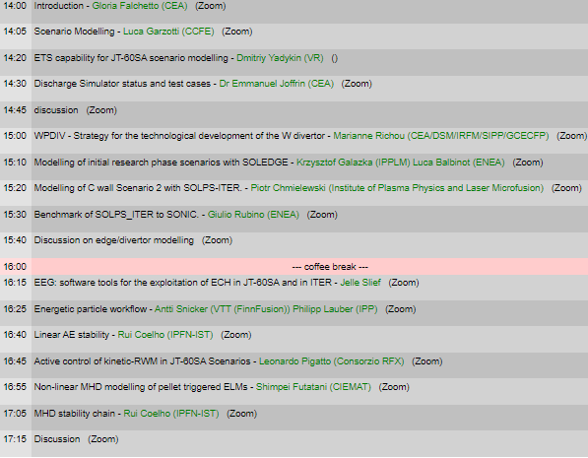
WPSA CM - Modelling session
Today 14h - 17h30 S1-3: Initial research phase modelling
Operation regime development
WPDIV
Edge/divertor
EEG
Fast particles
MHD control
pedestal
stability

Slide 10
WPSA CM - support to operation & diagnostics
Tomorrow Thu 5th
Operation related tool development : Integrated Data Analysis
15h30 – 16h30 Modelling in support to diagnostics
Divertor
WPDIV
Transport
Fast particles

Slide 11
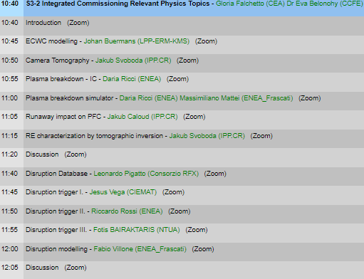
WPSA CM - support to IC and operation
Friday 6th 10h30 – 12h30 S3-2 Integrated Commissioning Relevant Operation related tool development and modelling
IC
MHD:
Runaway
Disruptions

Slide 12
THIS MEETING: SCIENTIFIC DISCUSSION
Progress towards the deployment of
validated modelling and analysis tools
for operation and scientific exploitation
Expected contents of the presentations/discussions:
scientific discussion on the status of the tasks
development plan
needs of input data
publication plan
coordination with QST and experiment team

