Slide 1
Integrated Commissioning Relevant Physics Topics WPSA CM – OP joint session
WPSA General Meeting, 4-6 May 2022
WPSA CM & OP Areas Coordinators
G. Falchetto (CEA), E. Belonohy (UKAEA)

Slide 2
WPSA CM operation related activities 2021-2022
Operation oriented tools and diagnostics software :
Electron Cyclotron Wall Conditioning ECWC simulation tools validation
Breakdown simulator development & optimization of BD scenarios
Camera tomography
https://wiki.euro-fusion.org/wiki/WPSA_Code_Management_and_Operations:_Camera_Tomography
EDICAM software
https://wiki.euro-fusion.org/wiki/WPSA_Code_Management_and_Operations:_EDICAM
Proposal for disruption mitigation/avoidance trigger
Modelling for JT-60SA Initial Research Phase
Runaway electron heat loads on PFC
Disruption modelling tools (CARMA/CARIDDI) validation
Notes:
The ongoing tasks under the “code management and modelling” area coordinated by Gloria Falchetto within EU project WPSA aiming at supporting JT-60SA scientific exploitation were presented.
On the one side, the development of operation related simulation tools such as the discharge simulator: first METIS CREATE-NL strong coupling has been achieved, although unstable in transient phases, hence an improved coupling method between FBE-transport codes (NICE/METIS) is being implemented.
On the other hand, ongoing modelling focused at addressing initial research phase scenarios: successful Scenario 2 ramp-up modelling with JINTRAC; SOLPS-ITER grid sensitivity study in pure D case assessing suitable reference resolution for benchmarking with SONIC; gyrokinetic Energetic Particle stability analysis (LIGKA) aiming at automated application of the EP workflow to the assessment of EP-stability in ramp-up and steady-state plasmas; non-linear MHD modelling of pellet triggered ELMS (JOREK) in Scenario 4 with reduced pedestal pressure (40kPa); computations preparing for validation of disruption modelling tools (CARMA0NL-CARIDDI) on JT-60SA mechanical data; and, finally, newly started task on simulations of energy deposited by runaway electrons (FLUKA) on PFC.

Slide 3
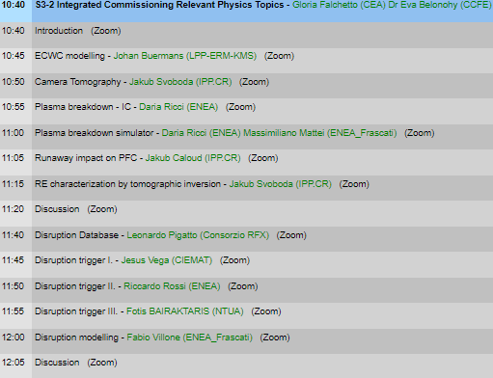
S2.3 IC Relevant Physics Topics
Friday 6th 10h30 – 12h30
IC
MHD:
Runaway
Disruptions

Slide 4
WPSA.CM IC/operation related Tasks Deliverables 2022
TOPIC | Deliverable 2022 | Del Owner / Team
ECWC modelling | Report on the validation of ECWC code (TOMATOR-1D) on the first data from JT-60SA Integrated Commissioning | J Buermans (LPP-ERM-KMS)
Breakdown modelling | Documentation on runs on JT-60SA breakdown using a nonlinear optimization technique. | Daria Ricci L Figini M Mattei (ENEA CNR Mi, CREATE)
Visible imaging | Feasibility study of tomographic inversion for characterizing runaways in plasma conditions relevant for JT-60SA | J Cavalier J Svoboda (IPP.CR)
MHD and control | Estimate of heat load levels and distributions caused by REs via a workflow coupling particle tracing codes to FLUKA. | J Caloud A Casolari E Macusova (IPP.CR)
 | Validation of disruption modelling tools (CarMa0NL-CARIDDI) on first JT-60SA mechanical data | F Villone et al (ENEA CREATE)
Disruption trigger | Proposal for building parsimonious disruption mitigation/avoidance triggers | Jesùs Vega (CIEMAT) M Gelfusa A Murari R Rossi T Cracinescu (ENEA, IAP) F Bairaktaris A Papadopulos (NCSRD)

