Slide 1
Disruption modelling
06/05/2022
F. Villone & CREATE Team

Slide 2
Outline
3D mesh
Disruption simulation tools
Activity plan
Discussion

Slide 3
3D meshing of JT-60SA
A detailed 3D mesh of the vacuum vessel has been produced
  Removing the passive plate, the main stabilizing effect is provided by vessel
Problem: the vessel is not periodically symmetric
  Ports do not replicate with an exactly periodic geometry
Approaches used
  One mesh covering 60° toroidally (“typical sector”) and fictitiously replicated with rotational symmetry
  One mesh covering 360°, reproducing the actual situation
    Recent code upgrades and optimization allow this last mesh to be proficiently used
A mesh of the stabilizing plate also is available
  Disregarded at the moment

Slide 4
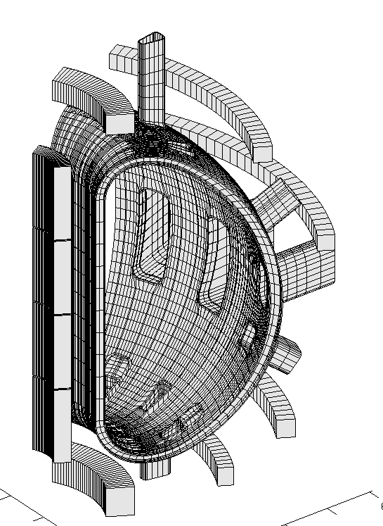
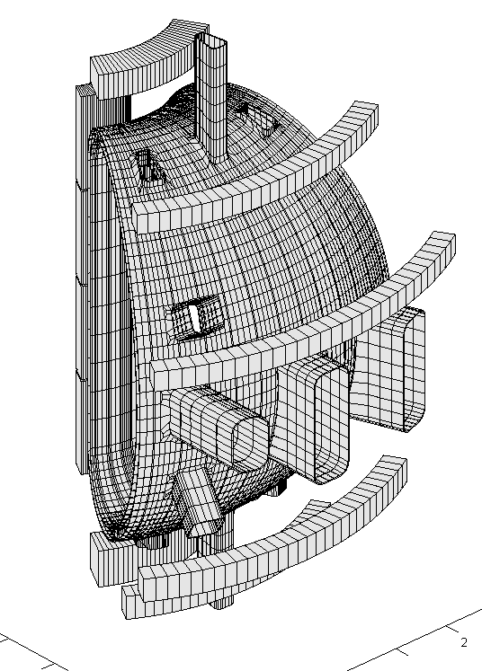
3D meshing

Slide 5
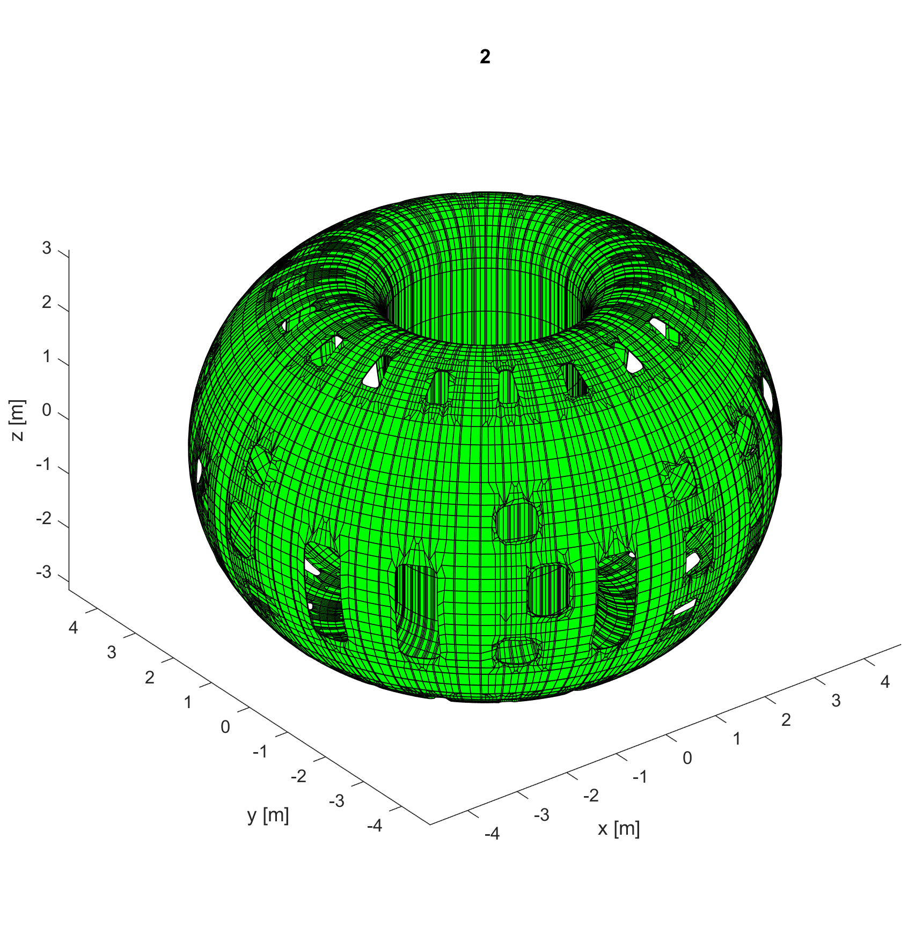
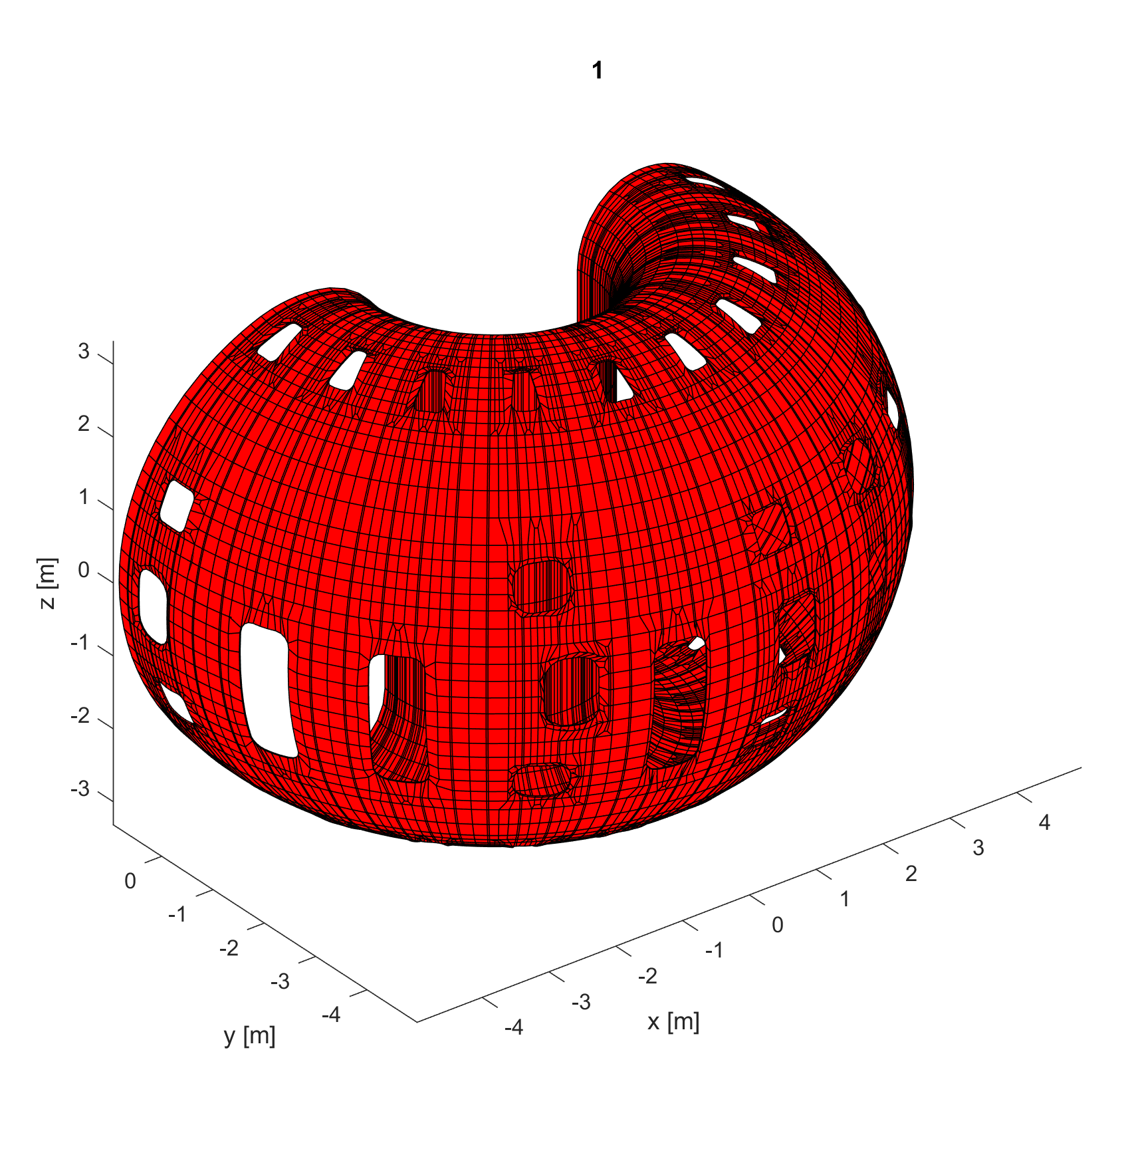
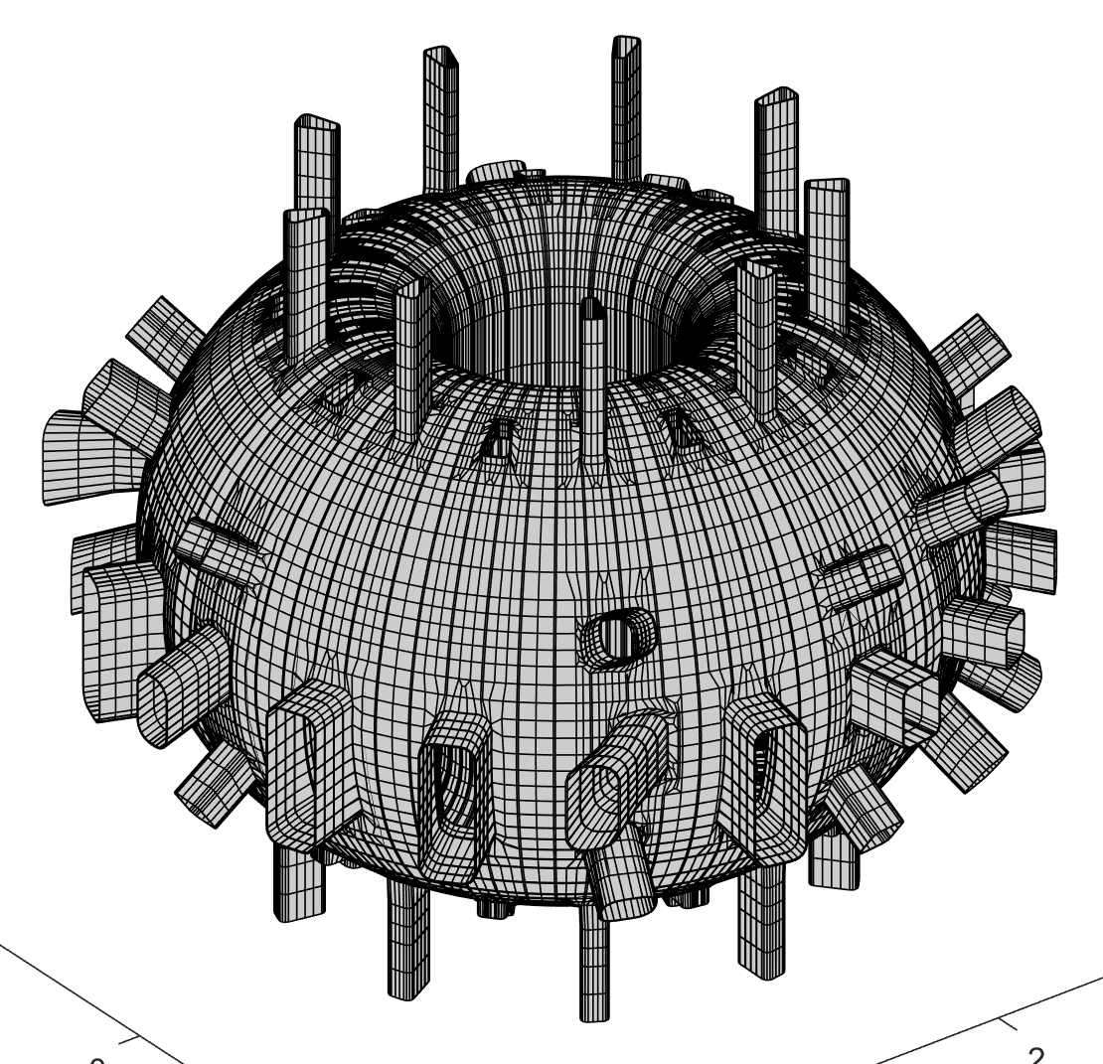
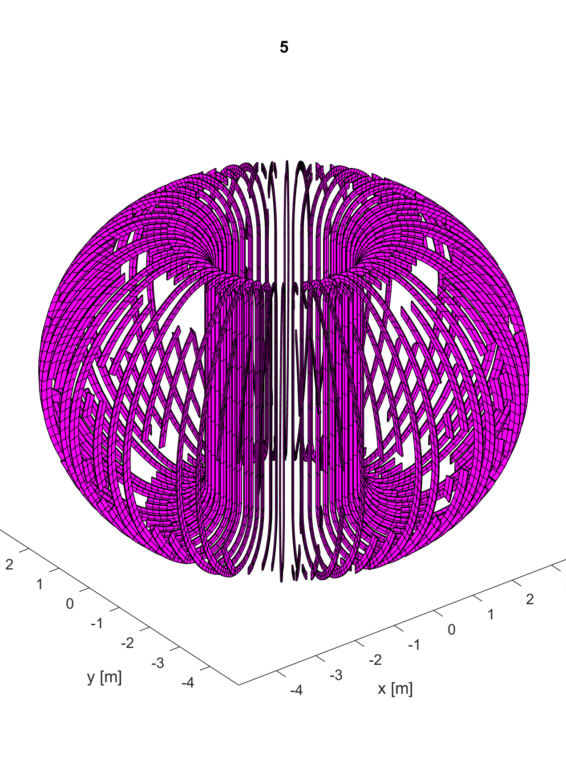
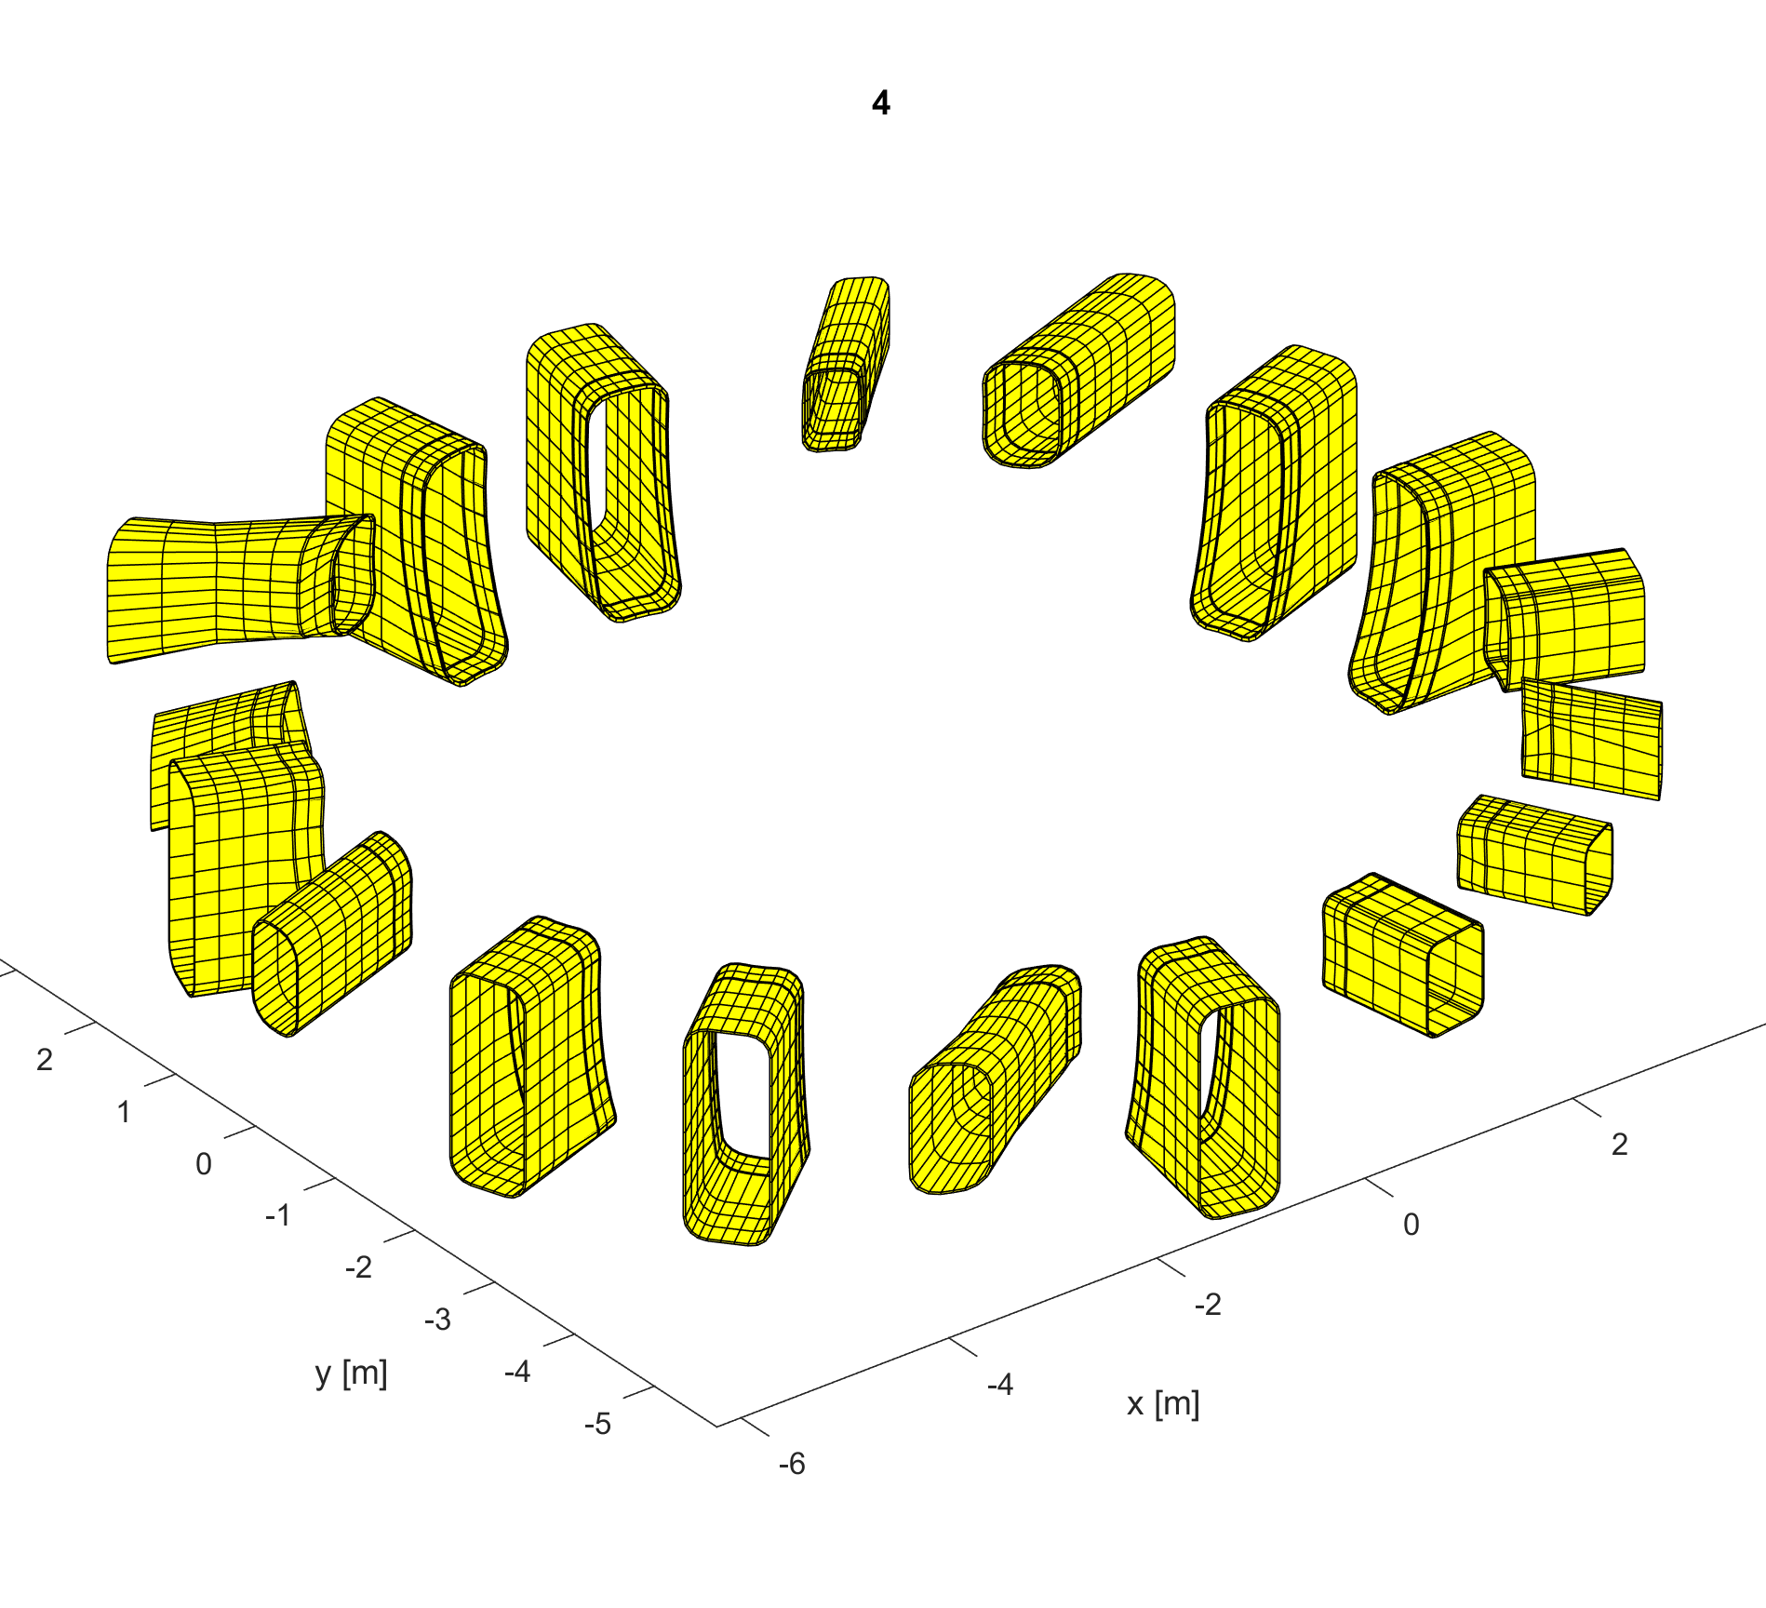
3D meshing

Slide 6
3D meshing
The 3D mesh features:
  Inner shell of the vessel (material #2)
  Outer shell of the vessel (materials #1 and #3)
  Ribs between the two shells of the vessel (material #5)
  Port extensions (materials #4, 6, 7, 8, 9)
The mesh features 65059 hexahedral 8-node elements and 121207 nodes, giving rise to 69981 numerical degrees of freedom, of which 341 are the additional degrees of freedom needed to account for the complex topology of the conducting structures, with several holes and handles. Such degrees of freedom have been computed automatically

Slide 7
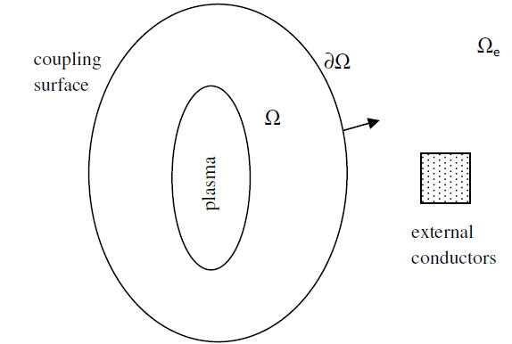
Disruption modelling
CarMa0NL: able to describe the evolutionary equilibrium of axisymmetric plasmas, in presence of three-dimensional volumetric conducting structures
Time scale of interest is supposed much longer than Alfvèn time
  Plasma mass can be neglected
  Plasma moves through equilibrium states
The formulation uses a coupling surface to describe the electromagnetic interaction between the plasma and the conductors
  The most convenient formulation can be used in each domain
F. Villone et al., Plasma Phys. Control. Fusion 55 (2013) 095008
Inside Ω: plasma evolutionary equilibrium
Outside Ω: eddy currents in 3D structures
On ∂Ω: suitable coupling conditions

Slide 8
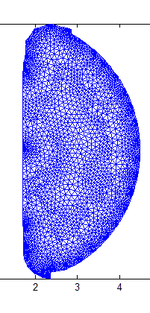
Disruption modelling
The mesh of the plasma region features 5745 second order triangles and 12884 nodes. On the boundary of the plasma region, 726 filaments are considered to represent the current density located on the coupling surface, which are magnetically equivalent to the plasma Their current is found resorting to equivalence electromagnetic theorems (virtual casing principle).

Slide 9
Disruption simulations
Starting equilibrium configuration:
Upper Single Null, low beta

Slide 10
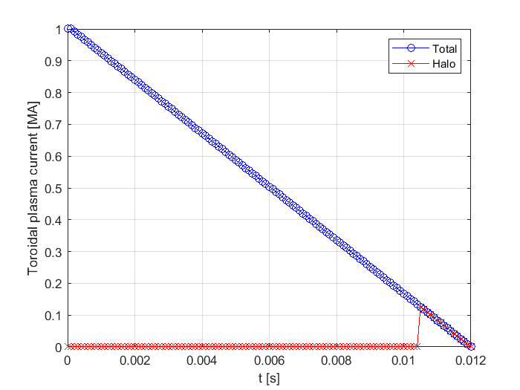
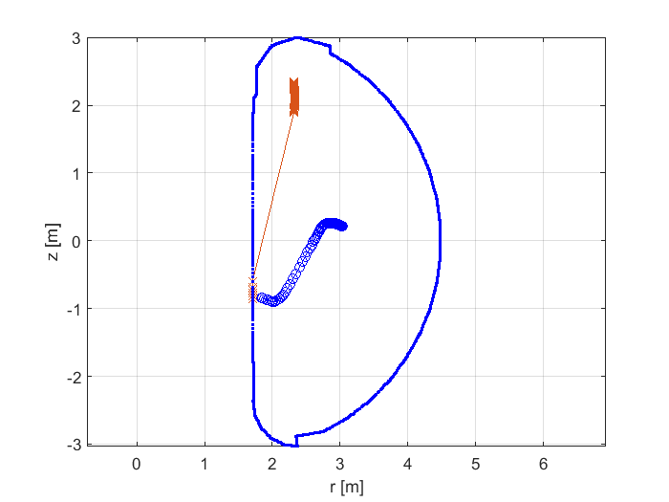
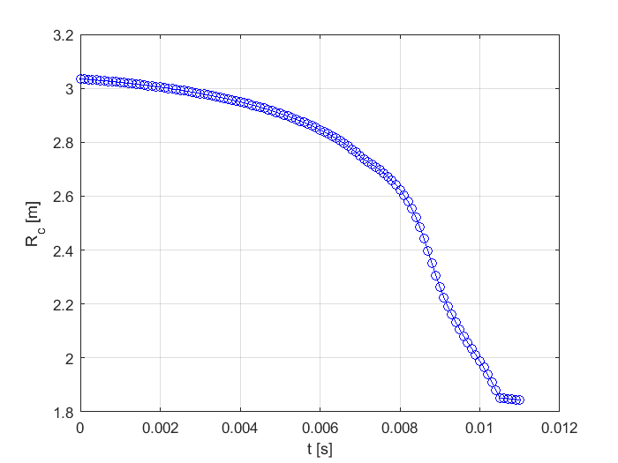
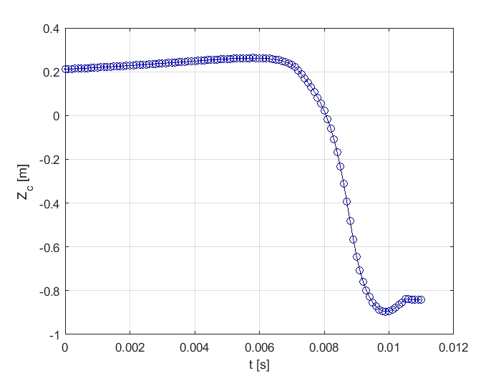
Disruption simulation
A Major Disruption (MD) has been considered.
Being the initial poloidal beta already low, no Thermal Quench (TQ) has been considered
A linear current quench lasting 12 ms is considered
Main plasma parameters

Slide 11
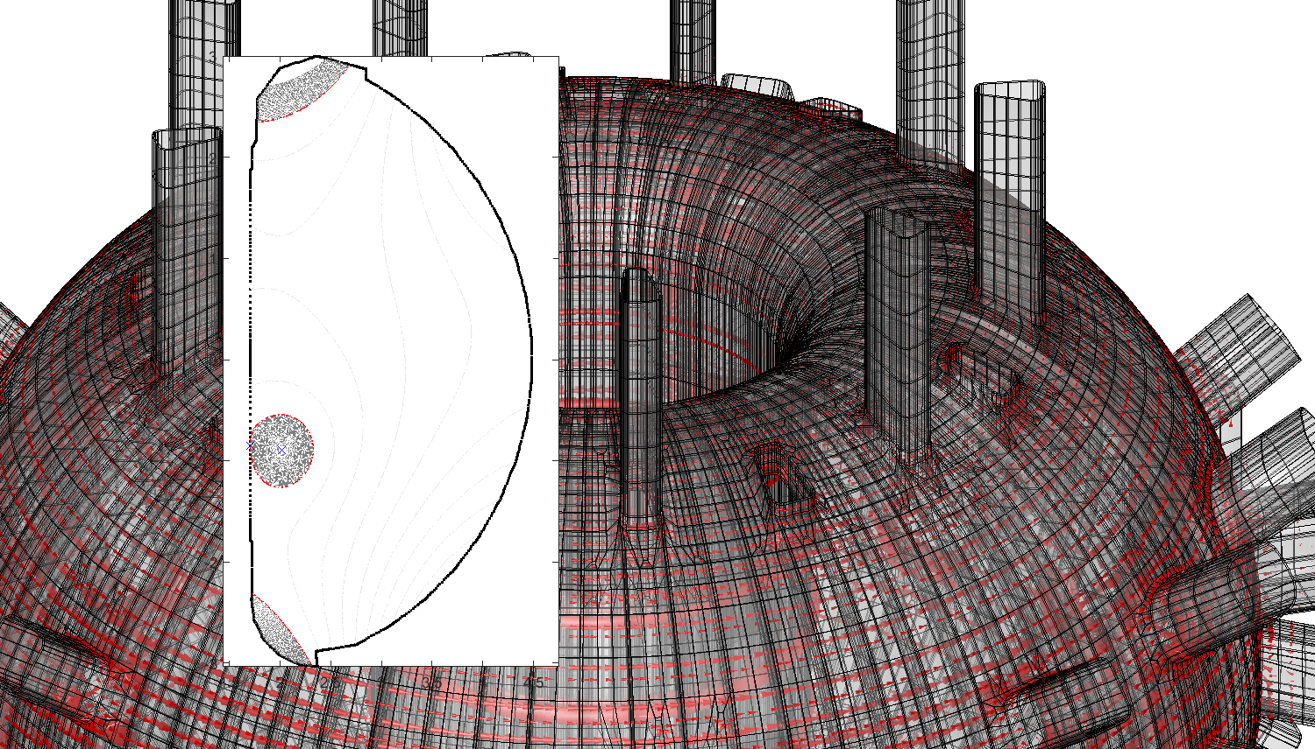
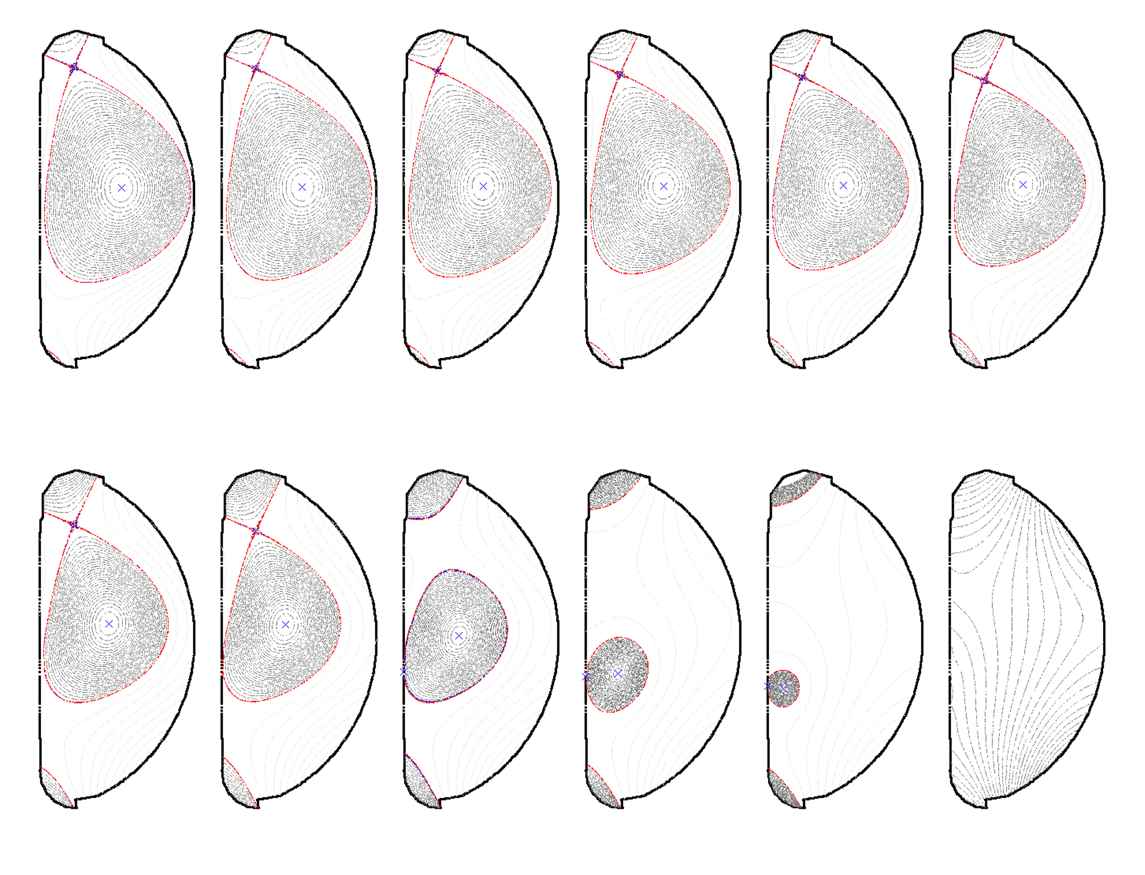
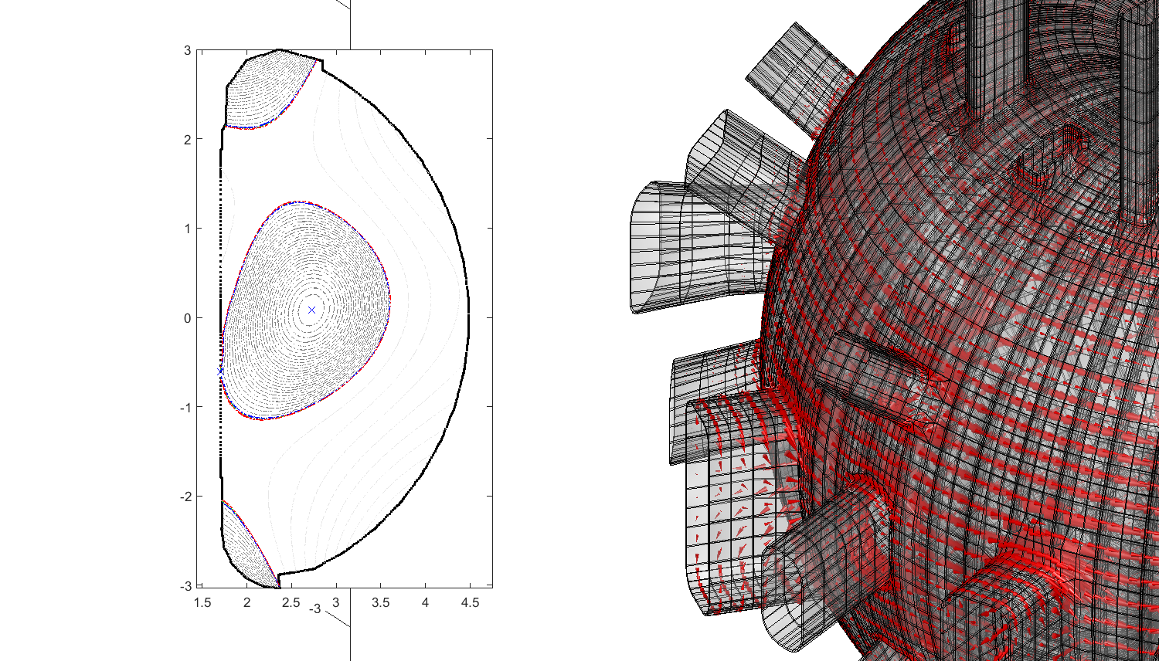
Disruption simulation

Slide 12
Conclusions
Implementation of a fully 3D mesh of JT-60SA covering the whole torus (360° toroidally) in the CarMa0NL computational tool
Evolutionary equilibrium simulation of a disruption for the upper single null configuration of JT-60SA with a realistic 3D wall
The model is ready for a validation of prediction against experimental data, being able to provide:
- magnetic field computation at sensors position
- vertical force due to disruption
- sideways force due to non-asymmetry of the vessel

