Slide 1
EDICAM commissioning experience Tamás Szepesi for the EU and JA EDICAM teams

Slide 2
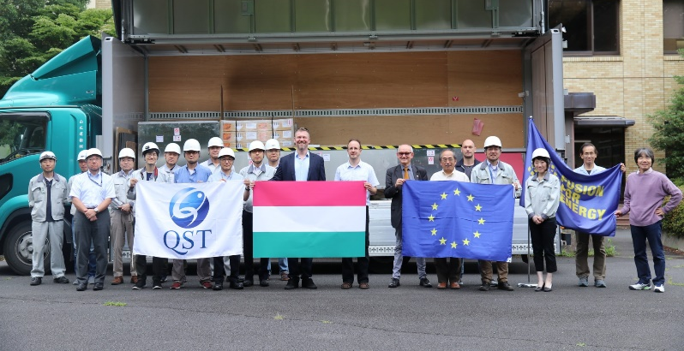
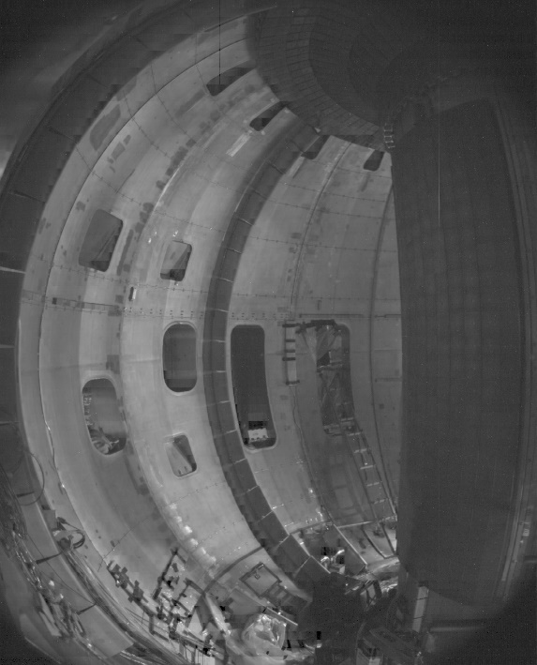
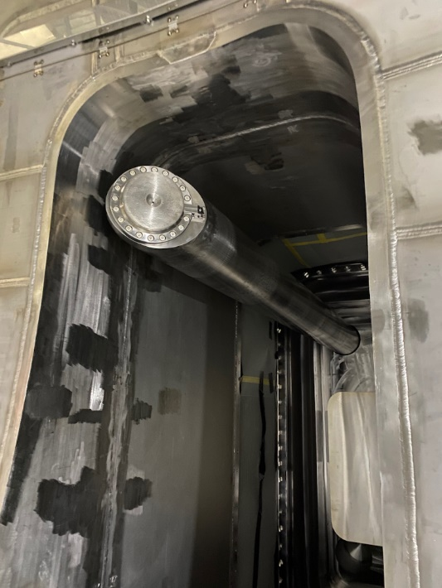
Project overview
HW/SW installation / testing / measurement
EDICAM delivered to Naka / 22 July 2019
individual linkage test / Nov 2019
integrated linkage test #1 / 13 March 2020
port plug installed / 10 April 2020
first in-vessel images / 16 April 2020
first high-quality images / 14 May 2020
integrated linkage test #2 / 5 Aug 2020
integrated linkage test #3 / 2 Oct 2020
integrated linkage test #4 / 18 Nov 2020
software update / March 2021
integrated linkage test #5 / 23 March 2022
T. Szepesi EDICAM commissioning | WPSA General Meeting 2022.05.05. 2

Slide 3
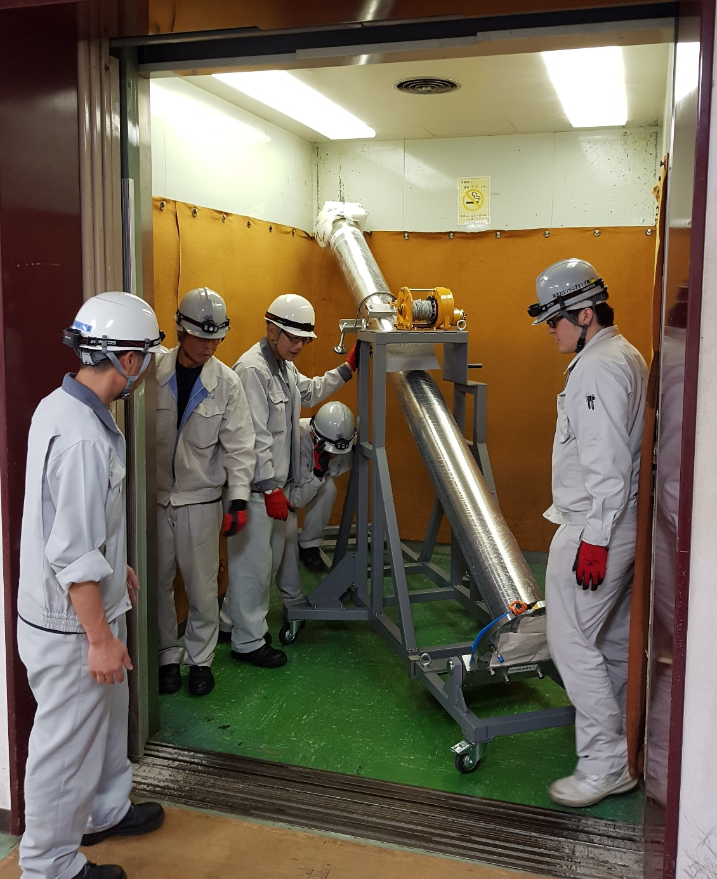
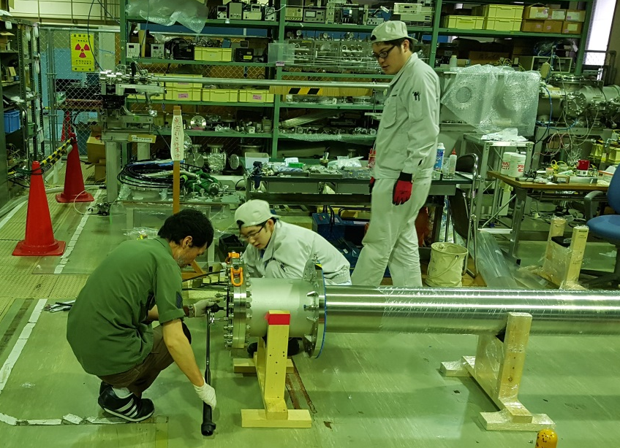
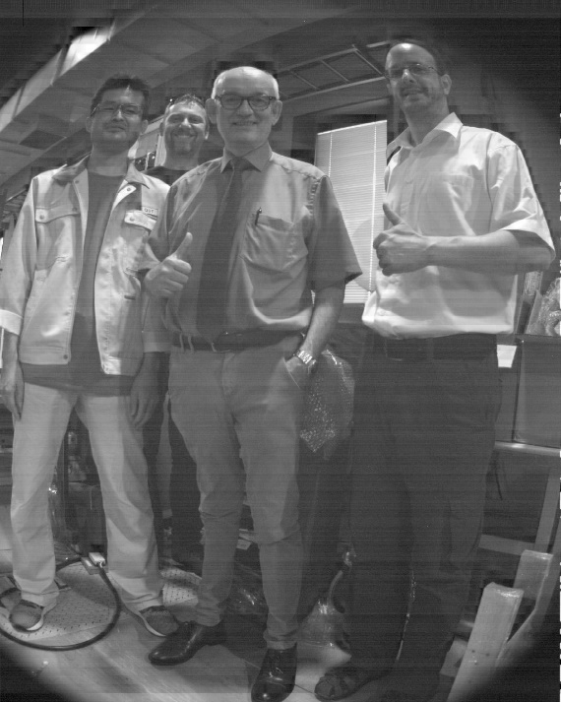
Project start-up in Naka
EDICAM delivered to Naka, immediately after arrival:
transportation to lab / storage place
leak test of port plug flange
testing of optics, camera and PC operation
training of Japanese staff
!!! NONE of these were done by QST, but external company !!!
T. Szepesi EDICAM commissioning | WPSA General Meeting 2022.05.05. 3

Slide 4
Project start-up in Naka
Individual linkage test – 120 days after arrival
Aim: to demonstrate EDICAM can co-operate with discharge control system
receive discharge scheduling commands via: LAN (NSEQ messages), hardware (TTL)
produce and upload data to raw data server
ca. all possible discharge control scenarios were mimicked
QST staff involved: RO of EDICAM + IT expert
Was done locally at the storage place / lab, no need to install device at tokamak
T. Szepesi EDICAM commissioning | WPSA General Meeting 2022.05.05. 4

Slide 5
Project start-up in Naka
Integrated linkage test #1 – 8 months after arrival
Aim: to demonstrate EDICAM can be operated in parallel with other systems
more like a general performance test, not a test for the given device alone
was done by QST staff alone
promising, but operation was stable → need more training
T. Szepesi EDICAM commissioning | WPSA General Meeting 2022.05.05. 5

Slide 6
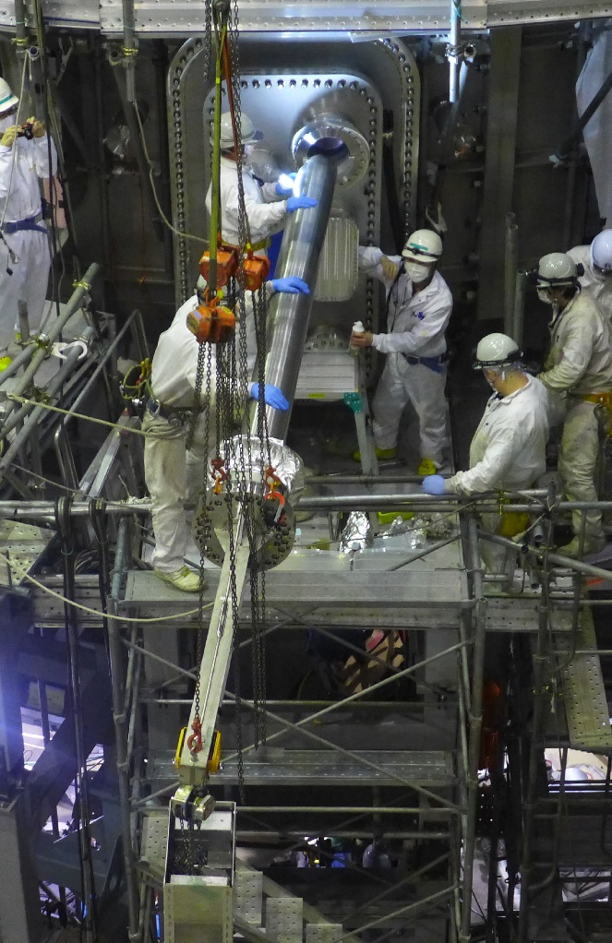
Project start-up in Naka
Port plug installation – 9 months after arrival
machine construction delays, outbreak of COVID pandemic
installation was done by external company + QST & F4E supervision
we could not travel there!
everything worked for first try
no vacuum leak, no hardware conflicts
T. Szepesi EDICAM commissioning | WPSA General Meeting 2022.05.05. 6

Slide 7
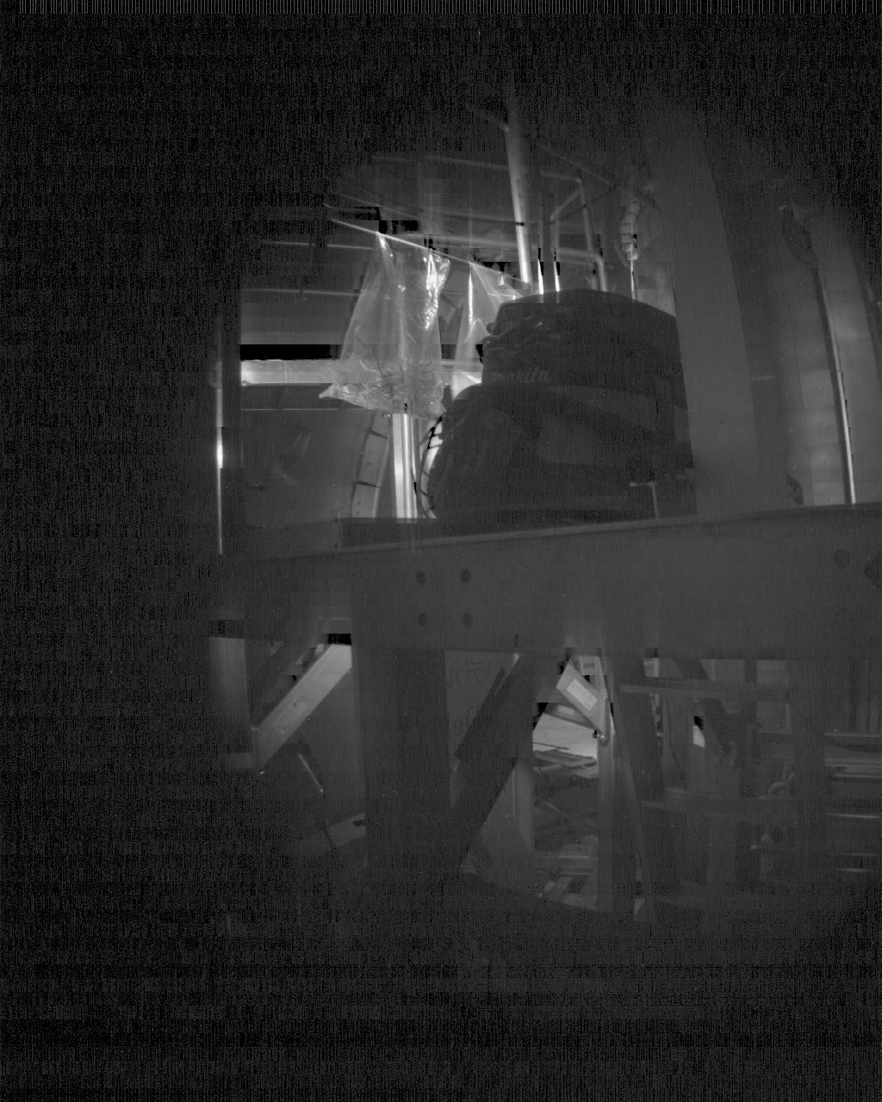
Project overview
First measurements with empty torus
first in-vessel images / 16 April 2020
done by QST → did not realize installation incomplete
I asked to re-dock the camera to proper position
T. Szepesi EDICAM commissioning | WPSA General Meeting 2022.05.05. 7

Slide 8
Project overview
First measurements with empty torus
first in-vessel images / 16 April 2020
done by QST → did not realize installation incomplete
I asked to re-dock the camera to proper position
first high-quality images / 14 May 2020
measurement done EK staff
a special KVM device (hardware-based!) was needed to access EDICAM computers from Europe
T. Szepesi EDICAM commissioning | WPSA General Meeting 2022.05.05. 8

Slide 9
Project overview
Lessons learned
EDICAM delivered to Naka / 22 July 2019
individual linkage test / Nov 2019
integrated linkage test #1 / 13 March 2020
port plug installed / 10 April 2020
first in-vessel images / 16 April 2020
first high-quality images / 14 May 2020
Commissioning can go rather smooth and quickly, if organized carefully.
Testing, even with discharge control system, is possible before actual installation in torus hall.
Working in torus hall basically impossible, due to local regulations (?)
QST staff can arrange many things and take over tasks if really needed ↔ pandemic
Remote access to diagnostic was problematic, but could be solved. Maybe better in the future..?
Many tasks done by external company – staff speaks only Japanese!
T. Szepesi EDICAM commissioning | WPSA General Meeting 2022.05.05. 9

Slide 10
Thank you for your attention!

