Slide 1
WPSA CM – Modelling Session Inroduction
WPSA General Meeting, 4-6 May 2022
WPSA Code Management & Simulation Area Coordinator:
G. Falchetto CEA, IRFM (France)

Slide 2
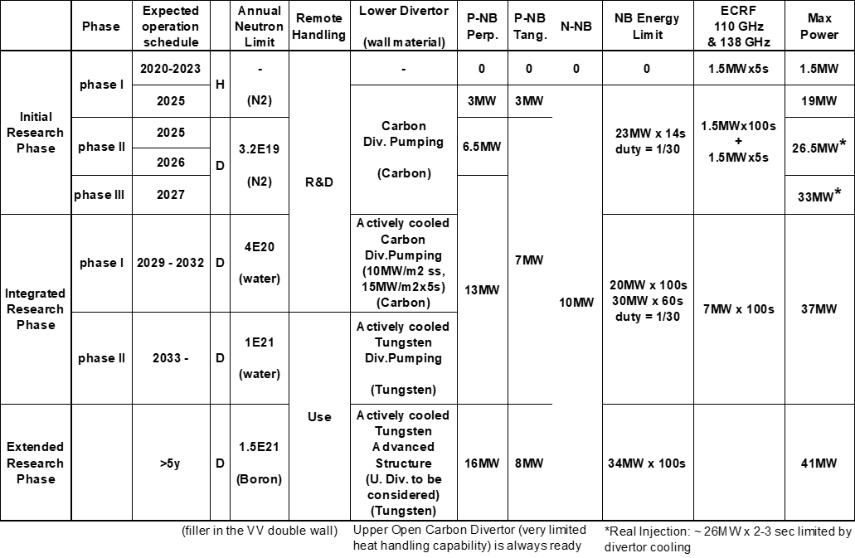
WPSA CM strategy
Establish reliable modelling codes, workflows and operation related tools for routine use in JT-60SA scientific exploitation
Modelling support to the enhancements and diagnostics procured by EU
Specific focus on modelling the Initial Research Phase
+ contribute to Integrated Research Phase wall diagnostics design (F4E/WPDIV)
Updated Project Phases BA SC 29

Slide 3
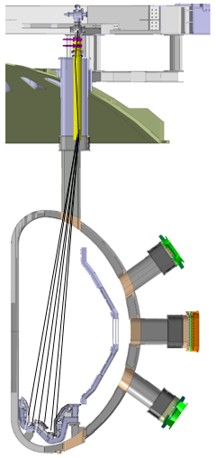
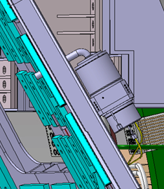
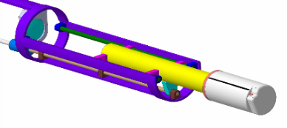
Preparing controllable high-β long-pulse scenarios
Integrated scenario modelling.
Discharge simulator development
New JT-60SA sub-systems
τ_{R}
pumping/fuelling
edge, divertor
turbulence
fast ions
Cryopumps
divertor VUV
EC wall conditioning
breakdown and ramp-up
high-β long-pulse sustainment
& control
FILD
ELM
NTM
RWM
disruptions & VDE
Pellets
EDICAM wide-angle camera
Thomson Scattering
MGI

Slide 4
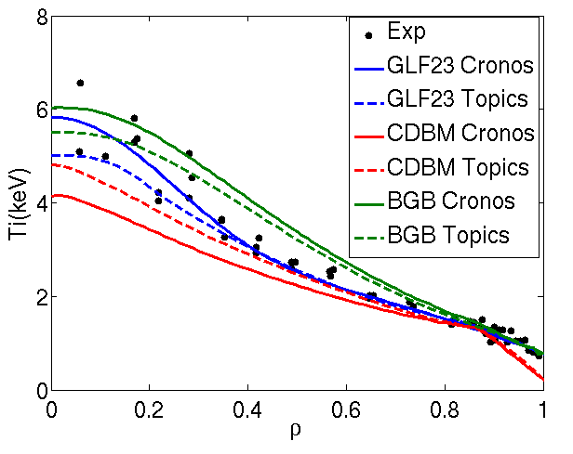
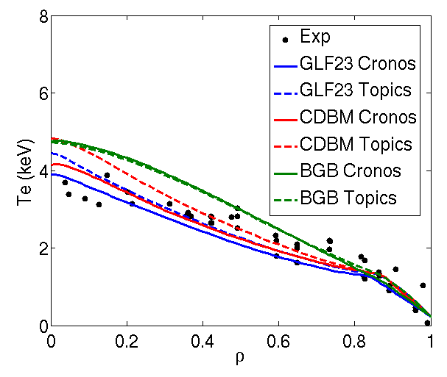
Basis for JT-60SA scenario modelling
Simulations of JT-60SA scenarios should be based on the two machines
that are the most similar, for size and configuration: JT-60U and JET
Validation of a modelling framework:
reference JT-60U and JET shots selected (H-mode, hybrid, advanced)
benchmark of actuator computations (NBI, ECCD)
benchmark of JA (TOPICS) and EU (CRONOS, JINTRAC, ASTRA)
integrated modelling codes
transport, pedestal, fast particle models selected
run predictive simulations for the reference shots and various models
find a unified modelling framework that works for both machines
This should give the maximum confidence for prediction of JT-60SA
JT-60U discharge 33655
TOPICS and CRONOS
comparison for 3 transport models
J. Garcia et al., Nucl. Fusion 54 (2014) 093010
N. Hayashi et al., Nucl. Fusion 57 (2017) 126037
L. Garzotti et al., Nucl. Fusion 58 (2018) 026029

Slide 5
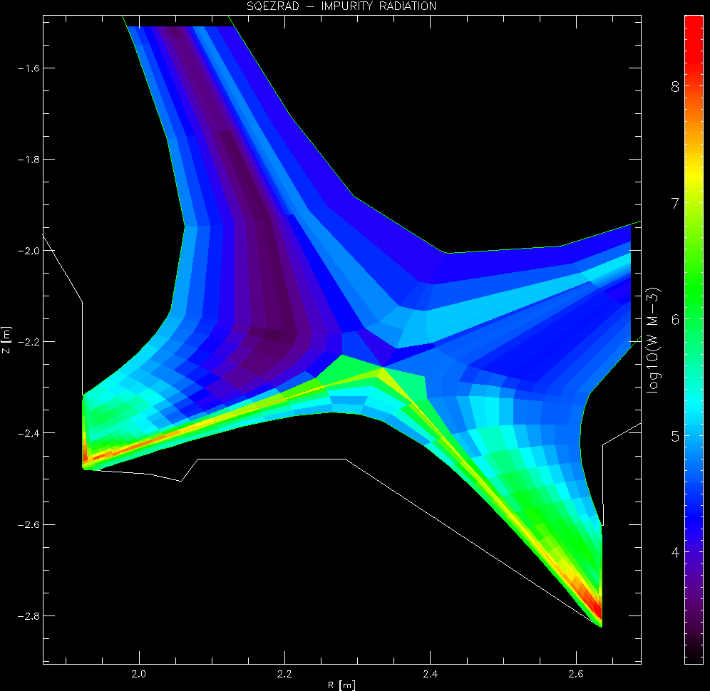
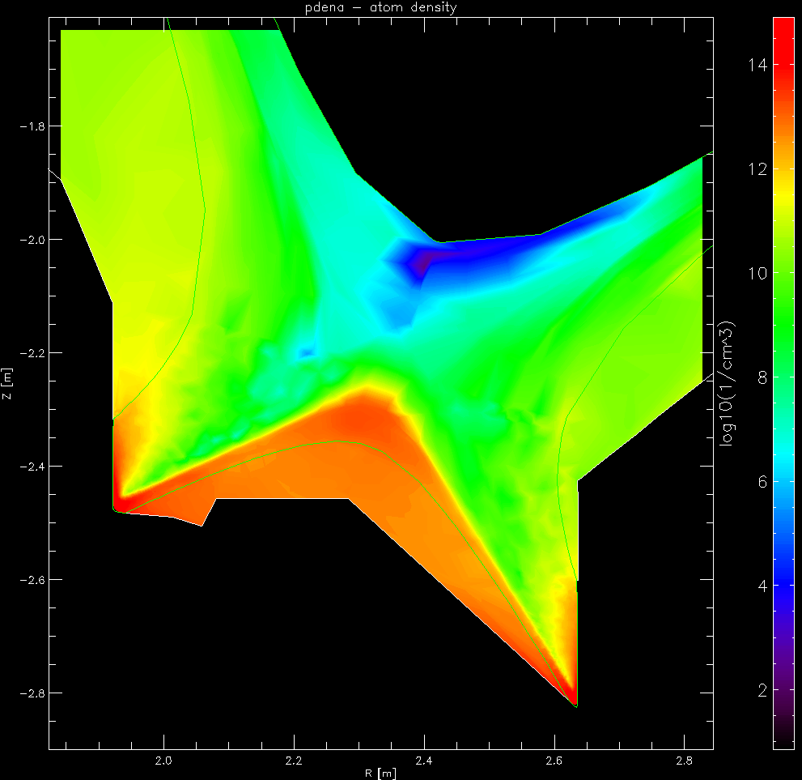
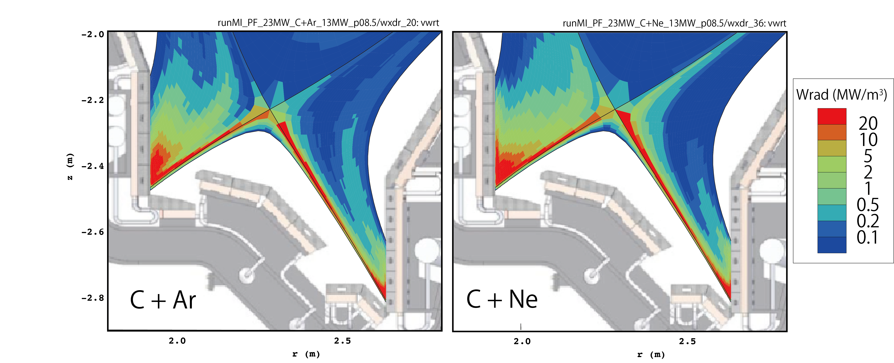
Edge, radiation and detachment control
Carbon radiation Neutrals density
High-density scenario simulated by EDGE2D-EIRENE first and SOLEDGE based on previous systematic analysis by COREDIV
P_{aux}=30 MW, <n_{e}>=9×10¹⁹ m⁻³
n_{e}^{sep} = 3.6×10¹⁹ m⁻³
Greenwald fraction ~0.8
SOLPS-ITER simulations for W divertor:
G. Rubino et al., Nucl. Mater. and Energy 26 (2021) 100895.
K. Gałązka, M. Romanelli et al.
Multiple species radiation simulated by SONIC code. Ar and Ne seeding rates adjusted to obtain divertor heat load < 10 MW/m²
Radiation power distribution is broadened in Ne compared to Ar seeding case
S. Yamoto et al.

Slide 6
WPSA CM modelling activities 2021-2022
https://wiki.euro-fusion.org/wiki/WPSA:_Code_Management_and_Simulation
Operation oriented tools
Discharge simulator development
Modelling for JT-60SA Initial Research Phase scenarios
Scenario modelling with operationally oriented integrated modelling transport codes
Edge and divertor modelling
Energetic Particle stability analysis
MHD stability analysis
RWM control
Non-linear MHD modelling of pellet triggered ELMs
Coordinate with
Experiment Team
Topical Group Leaders
Notes:
The ongoing tasks under the “code management and modelling” area coordinated by Gloria Falchetto within EU project WPSA aiming at supporting JT-60SA scientific exploitation were presented.
On the one side, the development of operation related simulation tools such as the discharge simulator: first METIS CREATE-NL strong coupling has been achieved, although unstable in transient phases, hence an improved coupling method between FBE-transport codes (NICE/METIS) is being implemented.
On the other hand, ongoing modelling focused at addressing initial research phase scenarios: successful Scenario 2 ramp-up modelling with JINTRAC; SOLPS-ITER grid sensitivity study in pure D case assessing suitable reference resolution for benchmarking with SONIC; gyrokinetic Energetic Particle stability analysis (LIGKA) aiming at automated application of the EP workflow to the assessment of EP-stability in ramp-up and steady-state plasmas; non-linear MHD modelling of pellet triggered ELMS (JOREK) in Scenario 4 with reduced pedestal pressure (40kPa); computations preparing for validation of disruption modelling tools (CARMA0NL-CARIDDI) on JT-60SA mechanical data; and, finally, newly started task on simulations of energy deposited by runaway electrons (FLUKA) on PFC.

Slide 7
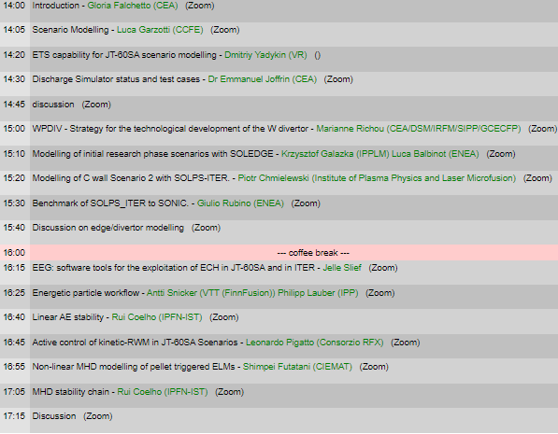
WPSA CM - Modelling session
Today 14h - 17h30 S1-3: Initial research phase modelling
Operation regime development
WPDIV
Edge/divertor
EEG
Fast particles
MHD control
pedestal
stability

Slide 8
THIS MEETING: SCIENTIFIC DISCUSSION
Progress towards the deployment of
validated modelling and analysis tools
for operation and scientific exploitation
Expected contents of the presentations/discussions:
scientific discussion on the status of the tasks
development plan
needs of input data
publication plan
coordination with QST and experiment team
Please upload the slides on indico

Slide 9
WPSA.CM Modelling Tasks deliverables 2022
TOPIC | Deliverable 2022 | Del Owner
 | Plasma operation oriented tools
Plasma discharge simulator | Verified JT-60SA pulse simulator including implementation of current, gaps and vertical stabilization controllers | E. Joffrin JF Artaud G Giruzzi C Boulbe B Faugeras (CEA, Univ Nice) M Mattei D Frattolillo (ENEA CREATE)
 | Provision of discharge simulator select test cases | W Bin G Giruzzi (ENEA CNR Mi, CEA)
Scenario development transport analysis | Report/publication on integrated modelling of ramp up of initial research phase Scenario 2 with first principles transport models | L Garzotti D Taylor et al (UKAEA) P Strand D Yadikin E Fransson (VR) P Huynh J Morales (CEA)
Edge and divertor modeling | Sensitivity study of low n /current drive scenarios with C divertor, with SOLEDGE3X edge transport code, including impurity seeding impact | G Falchetto (CEA) K Galazka
 | Assessment of JT-60SA Initial research phase II scenario 2 via edge/divertor modelling integrated with core conditions | L Balbinot (ENEA)
 | Modelling of C wall Scenario 2 with SOLPS-ITER. | P Chmielewski (IPPLM)
 | Report on the benchmark of SOLPS_ITER to SONIC. | G Rubino D Coster (ENEA, IPP)

Slide 10
WPSA.CM Modelling Tasks deliverables 2022
TOPIC | Deliverable 2022 | Del Owner
Energetic Particle modelling | Demonstration of automated application of the EP workflow to the assessment of EP-stability in ramp-up and steady state plasmas. | Ph Lauber (IPP-Garching)
 | Provide ASCOT distribution function for beam ions | A Snicker (VTT)
 | Analysis of linear AE stability of initial research phase (H,D) scenarios | R Coelho (IST)
MHD and control | MHD stability chain deployed to users | R Coelho (IST)
 | Application of CarMa-D model in state-space representation for developing RWM control time simulation and test controller concepts | L Pigatto et al (ENEA RXF)
Pedestal and edge | Report/publication on (JOREK) modelling of multiple pellet injection in self-consistently evolving pedestal profile | S Futatani (CIEMAT UPC)

Slide 11
WPSA CM - Modelling support to diagnostics
15h30 – 16h30 Modelling in support to diagnostics
Divertor
WPDIV
Transport
Fast particles

Slide 12
WPSA.CM Synthetic Diagnostics Task Deliverables 2022
TOPIC | Deliverable 2022 | Del Owner / Team
 | Synthetic diagnostics development
Turbulent transport | Assessment of the JT-60SA PCI diagnostics measurement, on relevant high-beta gyrokinetic turbulence including fast ions | A Iantchenko (EPFL)
FILD | Optimization of FILD detector head geometry using synthetic diagnostics | M Garcia-Munoz et al (CIEMAT Univ Sevilla)
new

Slide 13
WPSA CM operation related activities 2021-2022
Operation oriented tools and synthetic diagnostics :
Electron Cyclotron Wall Conditioning ECWC simulation tools validation
Breakdown simulator development & optimization of BD scenarios
Camera tomography
Proposal for disruption mitigation/avoidance trigger
Modelling for JT-60SA Initial Research Phase scenarios
Runaway electron heat loads on PFC
Disruption modelling tools ready for validation
Notes:
The ongoing tasks under the “code management and modelling” area coordinated by Gloria Falchetto within EU project WPSA aiming at supporting JT-60SA scientific exploitation were presented.
On the one side, the development of operation related simulation tools such as the discharge simulator: first METIS CREATE-NL strong coupling has been achieved, although unstable in transient phases, hence an improved coupling method between FBE-transport codes (NICE/METIS) is being implemented.
On the other hand, ongoing modelling focused at addressing initial research phase scenarios: successful Scenario 2 ramp-up modelling with JINTRAC; SOLPS-ITER grid sensitivity study in pure D case assessing suitable reference resolution for benchmarking with SONIC; gyrokinetic Energetic Particle stability analysis (LIGKA) aiming at automated application of the EP workflow to the assessment of EP-stability in ramp-up and steady-state plasmas; non-linear MHD modelling of pellet triggered ELMS (JOREK) in Scenario 4 with reduced pedestal pressure (40kPa); computations preparing for validation of disruption modelling tools (CARMA0NL-CARIDDI) on JT-60SA mechanical data; and, finally, newly started task on simulations of energy deposited by runaway electrons (FLUKA) on PFC.

Slide 14
WPSA.CM IC/operation related Tasks Deliverables 2022
TOPIC | Deliverable 2022 | Del Owner / Team
ECWC modelling | Report on the validation of ECWC code (TOMATOR-1D) on the first data from JT-60SA Integrated Commissioning | J Buermans (LPP-ERM-KMS)
Breakdown modelling | Documentation on runs on JT-60SA breakdown using a nonlinear optimization technique. | Daria Ricci L Figini M Mattei (ENEA CNR Mi, CREATE)
Visible imaging | Feasibility study of tomographic inversion for characterizing runaways in plasma conditions relevant for JT-60SA | J Cavalier J Svoboda (IPP.CR)
MHD and control | Estimate of heat load levels and distributions caused by REs via a workflow coupling particle tracing codes to FLUKA. | J Caloud A Casolari E Macusova (IPP.CR)
 | Validation of disruption modelling tools (CarMa0NL-CARIDDI) on first JT-60SA mechanical data | F Villone et al (ENEA CREATE)
Disruption trigger | Proposal for building parsimonious disruption mitigation/avoidance triggers | Jesùs Vega (CIEMAT) M Gelfusa A Murari R Rossi T Cracinescu (ENEA, IAP) F Bairaktaris A Papadopulos (NCSRD)

Slide 15
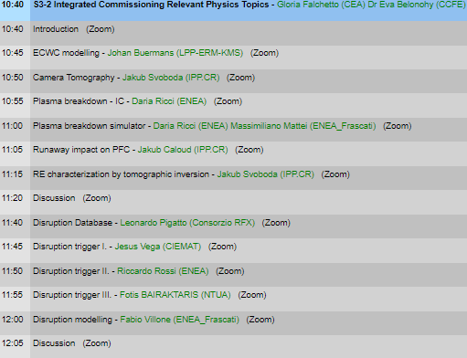
WPSA CM - support to IC and operation
Friday 6th 10h30 – 12h30 S3-2 Integrated Commissioning Relevant Operation related tool development and modelling
IC
MHD:
Runaway
Disruptions

