Slide 1

WPSA – General meeting
WPDIV JT60SA
04/05/22 M. Richou (marianne.richou@cea.fr)

Slide 2
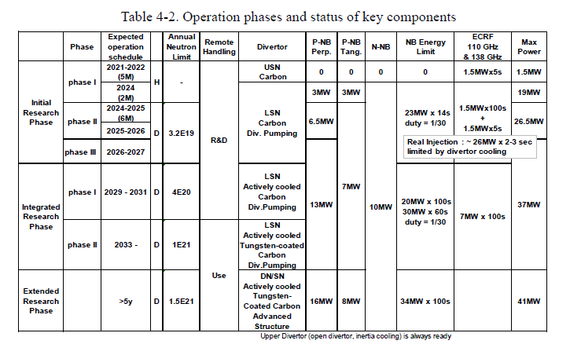
JT60SA - Operation phases
document BA SC 27-7.4 issue 07/21
Carbon
Scope
Tungsten

Slide 3
WPDIV-JT60SA (Main objectives)
F4E has the responsibility to procure C actively cooled divertor target PFCs (C-ACD), to be operated around 2029 (-> Full divertor delivery in 2025)
For the C-ACD, the objective of WPDIVJT-60SA subproject consists in providing support to F4E to run the C-ACD series manufacturing (thermo-mechanical analysis, Electromagnetic loads analysis, mechanical testing, high heat flux tests)
A transition to a full metallic device is foreseen after 2033 for the “Integrated Research Phase II”. With this new phase, actively cooled tungsten (W) divertor target PFCs will have to be installed (W-ACD) (-> Full divertor delivery in 2031)
For the W-ACD, WPDIVJT-60SA subproject has the responsibility to design and develop the W-ACD by full scale prototype manufacturing and high-heat-flux testing.

Slide 4
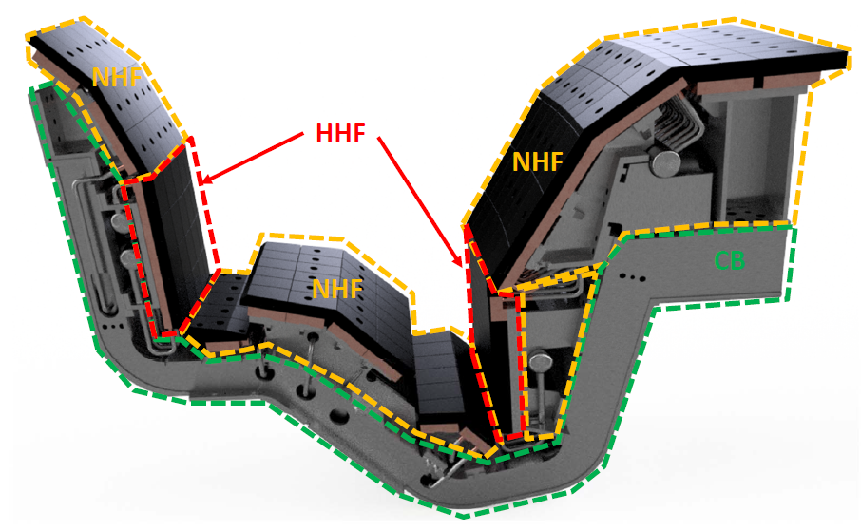
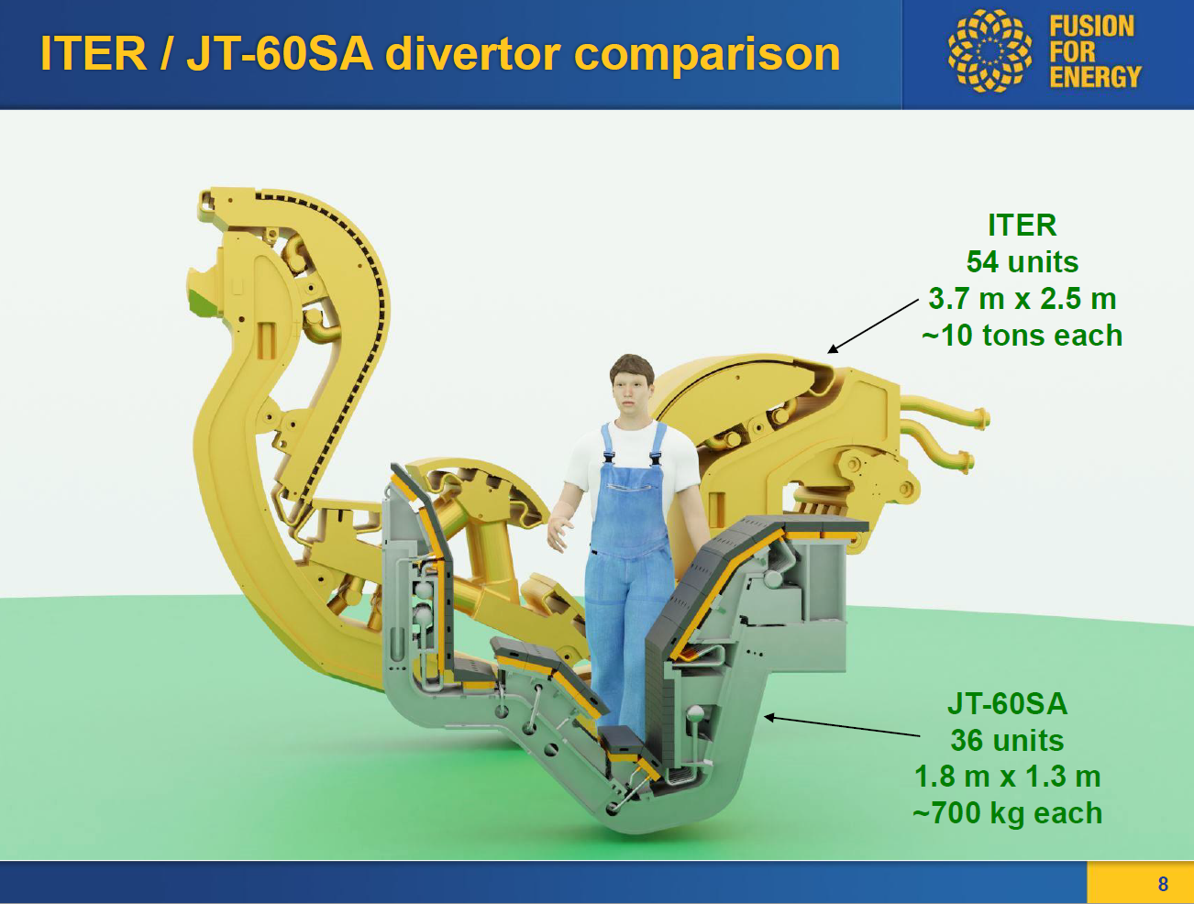
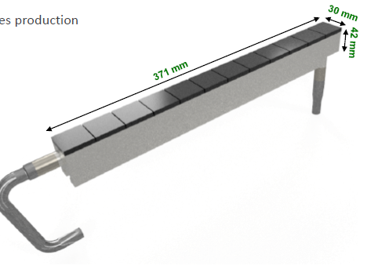
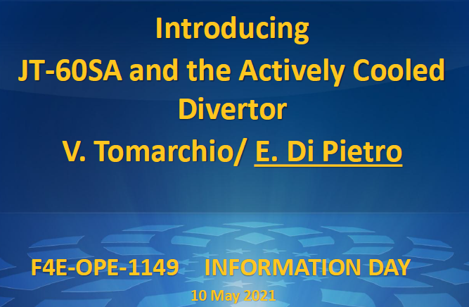
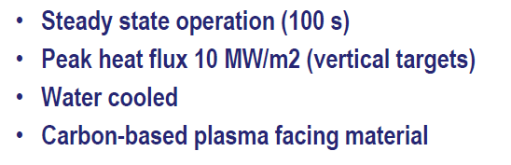
The JT60SA divertor (Integrated Phase 1)
For JT60SA, the divertor is composed of : cassette + plasma facing components
Graphite
TZM
Source
40°C, 20 bar (inlet) 0.8 kg/s

Slide 5
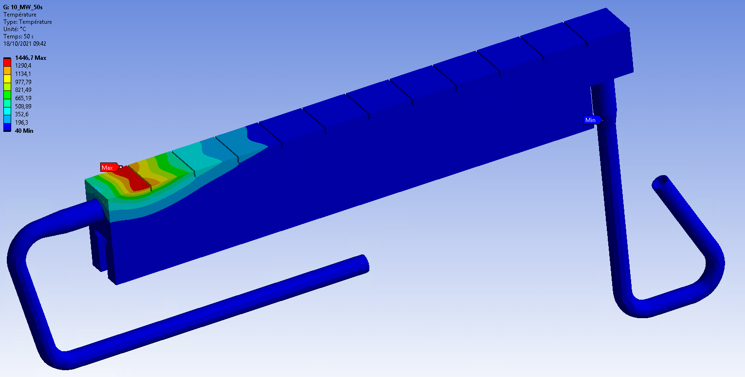
Achievements 2021
Highlights for activities related to C-ACD:
  Under nominal heat flux of 10MW/m² some stress peaks have been identified, but further verification (w.r.t. brazing pre-stress + up to date material properties) shall be carried out
  Electromagnetic loads are not the limiting load cases
Heat FLux
340 mm
10 MW/m²
Graphite
1500°C
TZM
(Tmax=800°C)
Target length / m

Slide 6
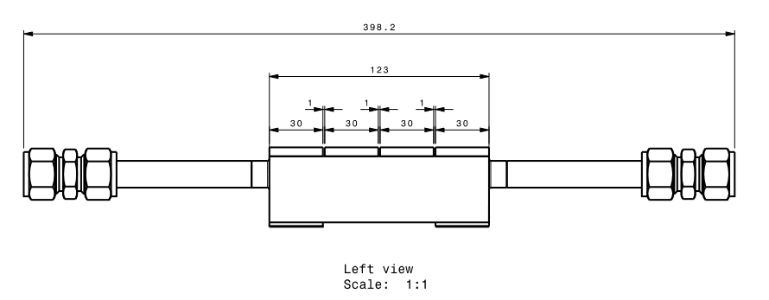
Prospects 2022
With regard to the JT-60SA C-ACD, the objectives are to :
  Provide the data (mechanical, thermo-physical) on raw materials (materials delivered by F4E)
  Finalize the thermal design analysis (updated mechanical properties, thermo-mechanical history induced by the manufacturing process)
  Assess the performance by high heat flux tests of small-scale/prototypes (prototypes provided by F4E)
  Participate to dicussions for the design of C-ACD Langmuir Probes (WPSA collab.)
Graphite
TZM
Small-scale (4 tiles)
Prototype full scale (12 tiles)
~100 mm
Graphite
TZM

Slide 7
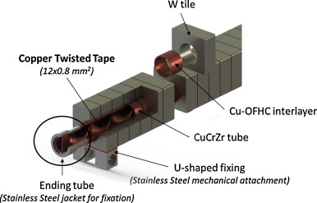
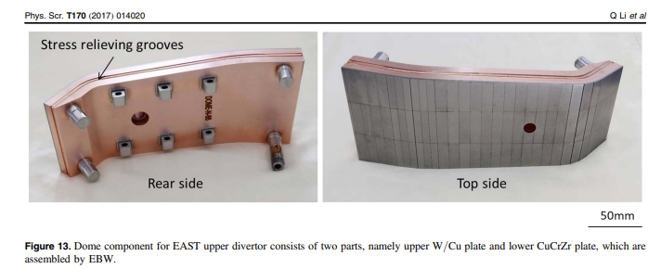
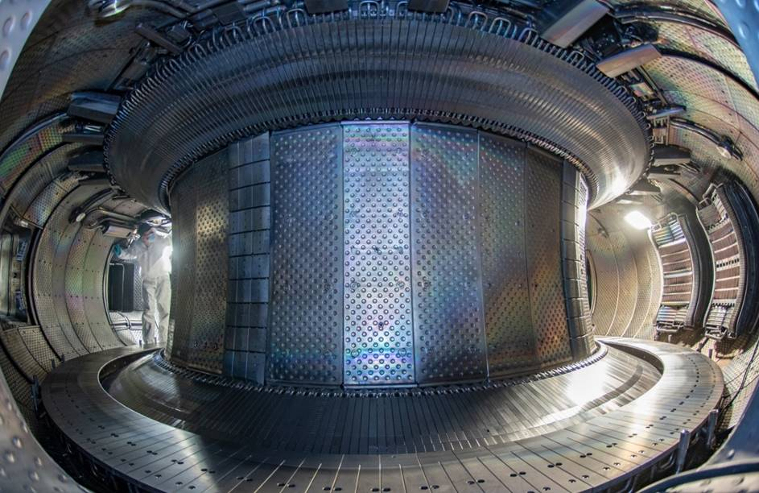
W target ( Integrated Reasearch Phase II) - Technology
W monoblock
W Flat tile
CuCrZr
12 mm
WEST curent configuration

Slide 8
W target - Time line
2023 | 2024 | 2025 | 2026 | 2027 | 2028 | 2029 | 2030 | 2031 | 2032 | 2033
2022 | 2023 | 2024 | 2025 | 2026 | 2027
Start of the manufacturing
End
of manufacturing
Plasma
Operation
FP9 2021-2025
Choice of concept and material
Already proven technology
Thermal performance

Slide 9
W target - Time line and needs
FP9 2021-2025
Start of the manufacturing
Steady state metallic plasma operation (WEST)
Feedback from W monoblock concept and surface shaping dimensions (WEST)
JT60SA:
First feedback from heat flux deposition, pumping (2025)
First feedback from long pulse operation in JT60SA (2026)
Needed data from the modeling (WPSA):
Pumping efficiency (W vs Carbon) (2023) -> Needed for the definition of the target geometry
Assessment of the neutron activation (2023) -> Needed for the definition of the structural material
What is the surface shaping needed (2024) -> Needed for the choice of the armor material (machining tolerances) and for the final drawing

Slide 10
WPDIV and WPDIV-JT60SA
Program manager
WPDIV
R. Neu
Fusion Science
J-H. You
M. Richou
M. Richou
R. Neu
Eu-DEMO
W7X
JT60SA
IDTT
Courtesy G.Federici, 2020

Slide 11
Conclusions
For the C-ACD, the objective of WPDIVJT-60SA subproject consists in providing support to F4E to run the C-ACD series manufacturing (thermo-mechanical analysis, Electromagnetic loads analysis, mechanical testing, high heat flux tests)
For the W-ACD, WPDIVJT-60SA subproject has the responsibility to design and develop the W-ACD by full scale prototype manufacturing and high-heat-flux testing. For this, the first assumption, in order to save cost and R&D time, is to keep the same interfaces and boundary conditions as the ones taken for the design of C-ACD (heat flux, cooling capability, interfaces…), while developing PFC solution(s) compatible with an industrial fabrication
Close collaboration with WPSA to define our inputs

Slide 13
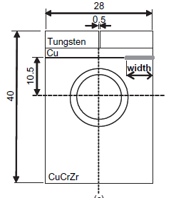
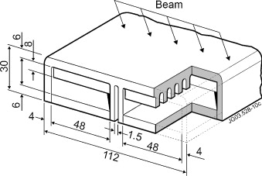
W HHFT - Enhanced technology: W flat tile on CuCrZr heat sink
Standard cooling channel
Hypervapotron
Synergies with W7-X:
  Use of additive manufacturing for CuCrZr heat sink, especially for hypervapotron
  Suitability of W3.5Ni1.5Cu for divertor application (better manufacturability)
13

