Slide 1
Simulations of the Initial Research Phase II scenarios withSOLEDGE2D/SOLEDGE3X-EIRENE
K. Gałązka^{1,2}, L. Balbinot³, G. Ciraolo¹, G. Falchetto¹ and P. Innocente⁴
1) CEA, Cadarache, FRANCE
2) IPPiLM, Warszawa, POLAND
3) Università della Tuscia, Viterbo, ITALY
4) Consorzio RFX, Padova, ITALY

Slide 2
Aims of edge/SOL modelling
Assess the heat loads on the wall and targets (check also the neutrals loads)
Predict the onset of detachment
Propose a seeding strategy to mitigate heat loads
Contribute to the design studies of divertor / wall diagnostics (ENH session tomorrow)
SA-SE.CM.M.03-T003 | D1- Sensitivity study of low n /current drive scenarios with C divertor, with SOLEDGE3X edge transport code, including impurity seeding impact.
 | D2 - Assessment of JT-60SA Initial research phase II scenario 2 via edge modelling integrated with core conditions.
No active cooling in the Initial Research Phase - power exhaust mitigation is crucial
Requirements:
Reliable magnetic equilibrium (including divertor legs) and wall data (chamber + subdivertor)
Machine Data : puffing valve positions and available gases, auxiliary heating power
Power and particle flux through the inner simulation boundary
Reliable prediction of transport based on
Experimental findings and previous simulations from C-wall JET
Estimations from core and pedestal modelling
Existing scalings
Experience from core modelling welcome!

Slide 3
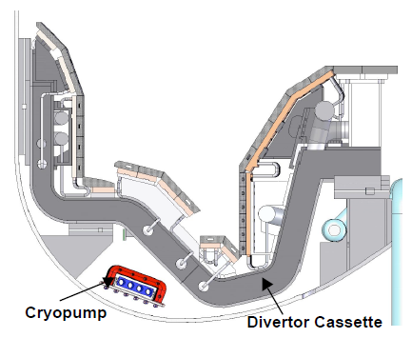
Scenario #2 constraints from the RP / PID
D plasma
Uncooled C wall
Maximum heating power: 19/26.5/33 MW (from PID: 27 MW)
Core density: 5.6×10¹⁹ m⁻³
Estimation of power loads for the reduced power case:
Expected input power to SOL: 20-23 MW
H-mode operation (PSOL > 10 MW)
SOL width < 1.5 mm
D fuelling valve position
(another one in the chamber top)
MAX 5MW
MAX 13MW
Subdivertor currently
not modelled
Pumping surfaces
Maximum particle source at core boundary: S_{n} = 2.5×10²¹ s⁻¹ (NBI)
Deuterium puff range: Γ_{D} = [0, 1.8 × 10²³] s⁻¹
Maximum pumping speed: 100 m³/s
S_{n} = 1.0×10²¹ s⁻¹
Γ_{D} = 1.0×10²² s⁻¹
2 pumping surfaces with albedo 0.95

Slide 4
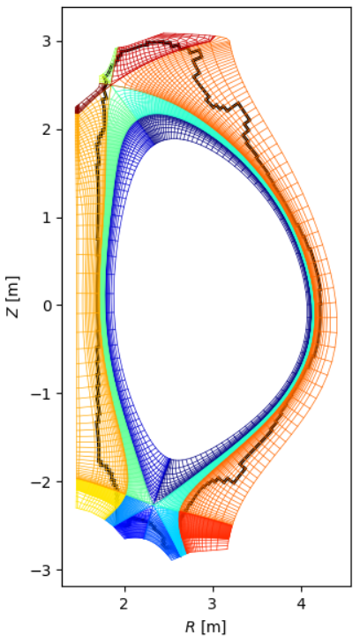
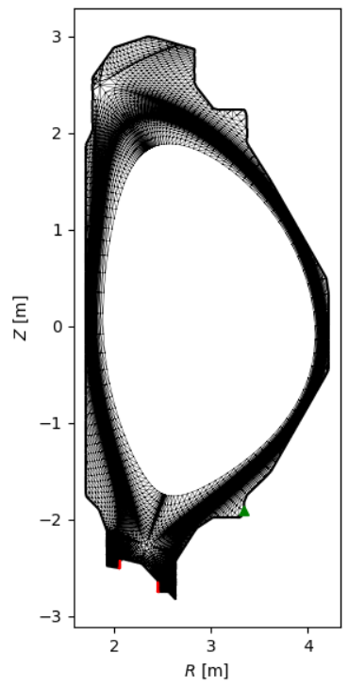
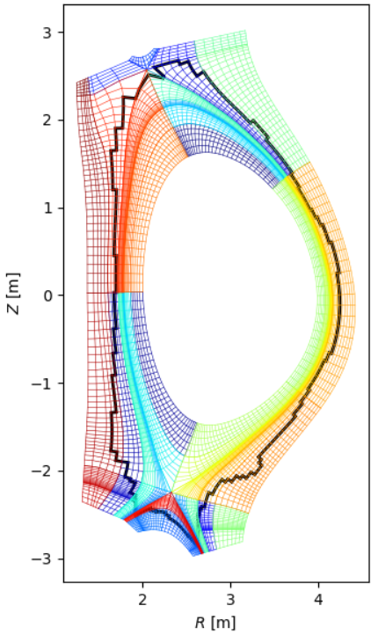
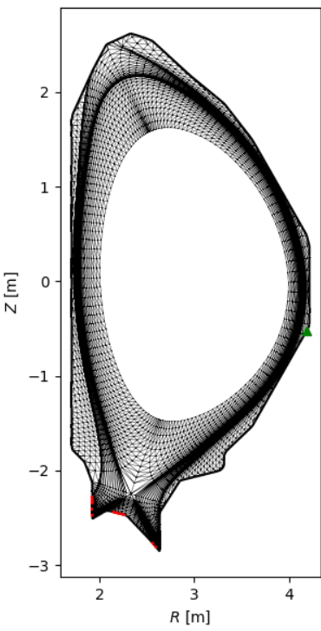
Construction of the grid
SOLEDGE3X-EIRENE grids
SOLEDGE2D-EIRENE grids
used in the past simluations
„New” grid incorporates the secondary X-point amid the volume at the top of the chamber.
Adjusted the details of the wall.
Equilibrium from the IDM repository.

Slide 5
Modeling parameters & status of work
Auxiliary input power scan: [15, 17.5, 20. 22.5, 25] MW (50/50 electrons/ions)
Particle sources: S_{core}= 2.5×10²¹/s, Γ_{D} = 1.0×10²¹ s⁻¹, pump albedo 0.95
Electron density at the seaparatrix should be ~ 2×10¹⁹ m⁻³
Transport coefficient profiles (for the H-mode)
Starting from pure D
Sputtering for C
Gas puff of Ar/Ne impuritues
Power scan completed for pure D, L-mode
Power scan started for pure D, H-mode
Pending:
Power scan with C impurity, H-mode
Power scan with seeded impurity, H-mode
Subdivertor modeling

Slide 6
Publication plan
EPS conference:
K. Galazka et al. "SOL modelling of the JT-60SA tokamak initial operational scenario using SOLEDGE3X-EIRENE code" (contributed poster)
Draft to be sent to Nucl. Mat. and Energy:
L. Balbinot et al. (previous work)
AAPPS-DPP2022 conference:
K. Galazka et al. "Particle transport and heat loads in JT-60SA studied by SOLEDGE3X-EIRENE code." (not decided)

