Slide 1
Tangential phase-contrast imaging diagnostic
for JT-60SA
S. Coda (EPFL-SPC), K. Tanaka (NIFS)

Slide 2
Phase-contrast imaging on JT-60SA
Will provide localized density fluctuation measurements across the minor radius and in all plasma regimes
  δn/n~10⁻⁵, 0.06<kρ_{i}<12 (ITG/TEM/ETG)
  high spatial resolution in the center and at the edge (very favorable configuration on JT-60SA)
First real opportunity to study turbulence and turbulent transport, and validate models, in a reactor-grade device
Gyrokinetic modelling support proposed in parallel, with comparisons mediated by a synthetic diagnostic (cf. A. Iantchenko’s presentation)
Europe/NIFS collaboration, with NIFS funding already secured
S. Coda et al, Nucl. Fusion 61, 106022 (2021), DOI:10.1088/1741-4326/ac2081

Slide 3
Principles of PCI
PCI is an internal-reference interferometer: measures line-integrated density but only by manipulating and recombining beam components
It is more sensitive than an interferometer
(∫δn dl~10¹⁴ m⁻²) but cannot measure absolute phase shift (long wavelength cutoff ≈ size of beam)
An image is created across the beam, and spatial resolution is limited only by the number of detector elements
Localization along the beam can be achieved in a tangential-launch geometry by selecting the direction of the measured wave vector (by optical filtering)

Slide 4
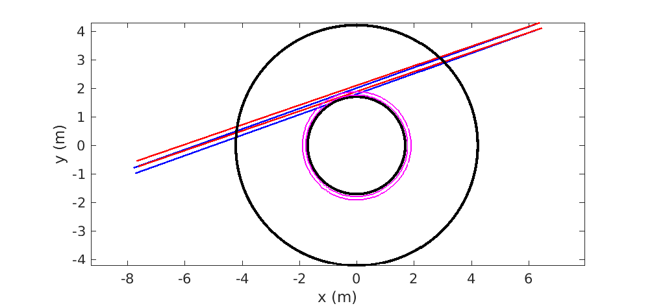
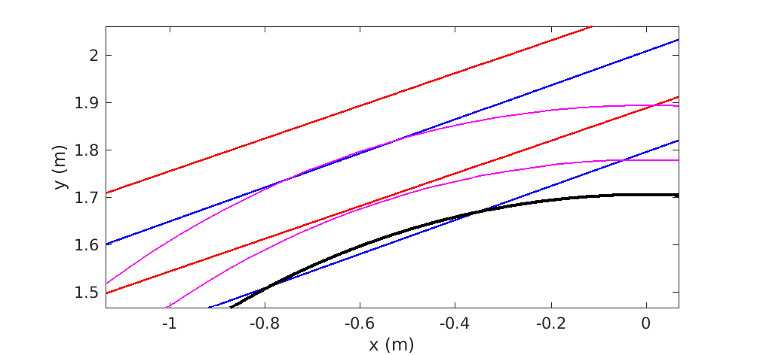
PCI port choice
The inclined option is needed to avoid running into inner wall
Inclined
Straight

Slide 5
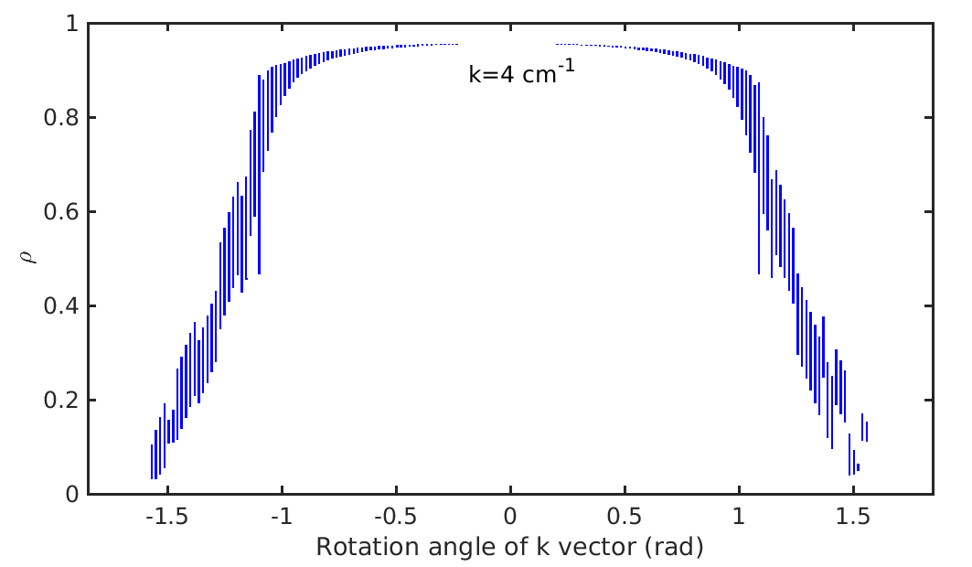
Good localization

Slide 6
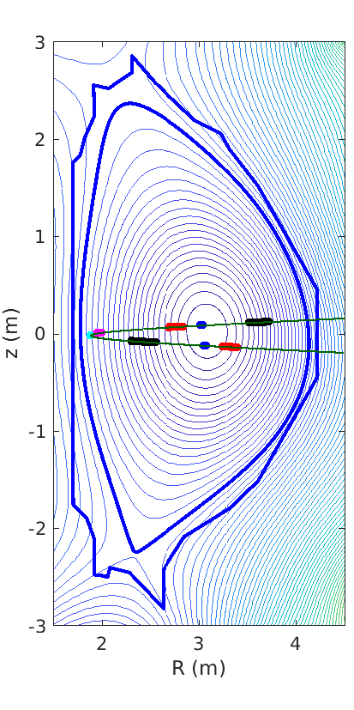
Localization on the flux surface
While well-localized in ρ, at mid-radius the measurement picks up signal from both the HFS and LFS
HFS and LFS can be resolved separately by doubling the detection system (splitting the transmitted beam to create two separate images)

Slide 7
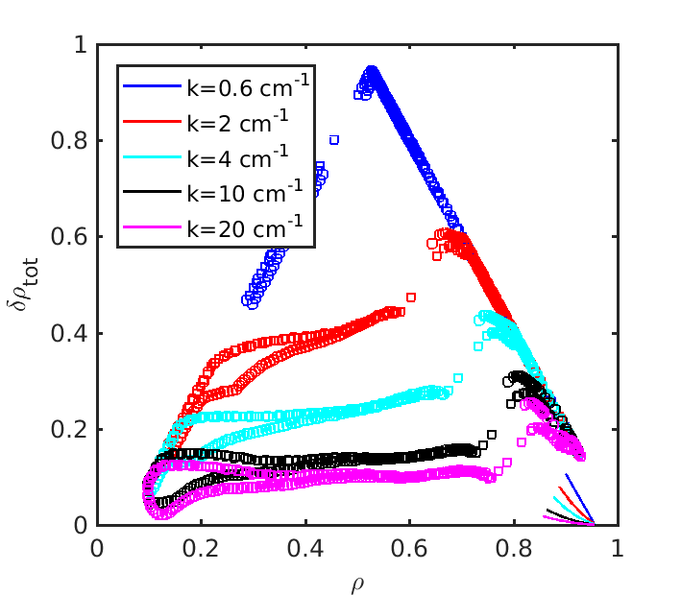
Localization improves with increasing k
k direction:
predominantly k_{ρ}
in center,
k_{ρ} and k_{θ} in two
separate edge
measurements

Slide 8
Hardware layout
Beam generation
  CO₂ laser of ~100 W power
  Beam expansion by telescopic arrangement
  Relay mirrors all off-vessel (max 32-cm diameter)
Vacuum interfaces
  ZnSe windows
Beam collection
  Relay mirrors all off-vessel (max 45-cm diameter)
  Reflective-refractive focusing and imaging system:
  must be close to vessel since scattered components diverge rapidly

Slide 9
Hardware layout
Neutron + gamma shielding, fire-safety beam shielding planned
Automated LN₂ cooling included in design
Mechanical vibrations are not a cause for concern. DIII-D and TCV have optics mounted on vessel and feedback focusing system counteracts vibrations very effectively

Slide 10
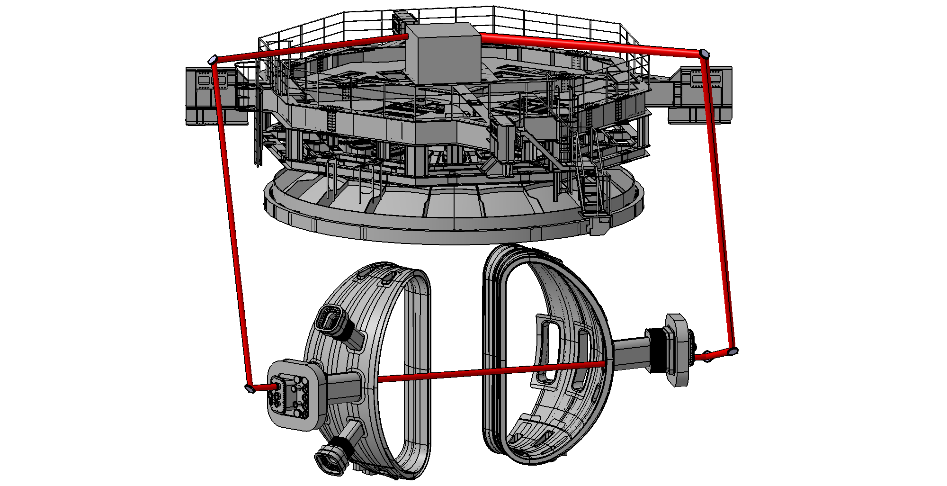
First design
Based on assumption that upper stage could be used
Design essentially completed in early 2021

Slide 11
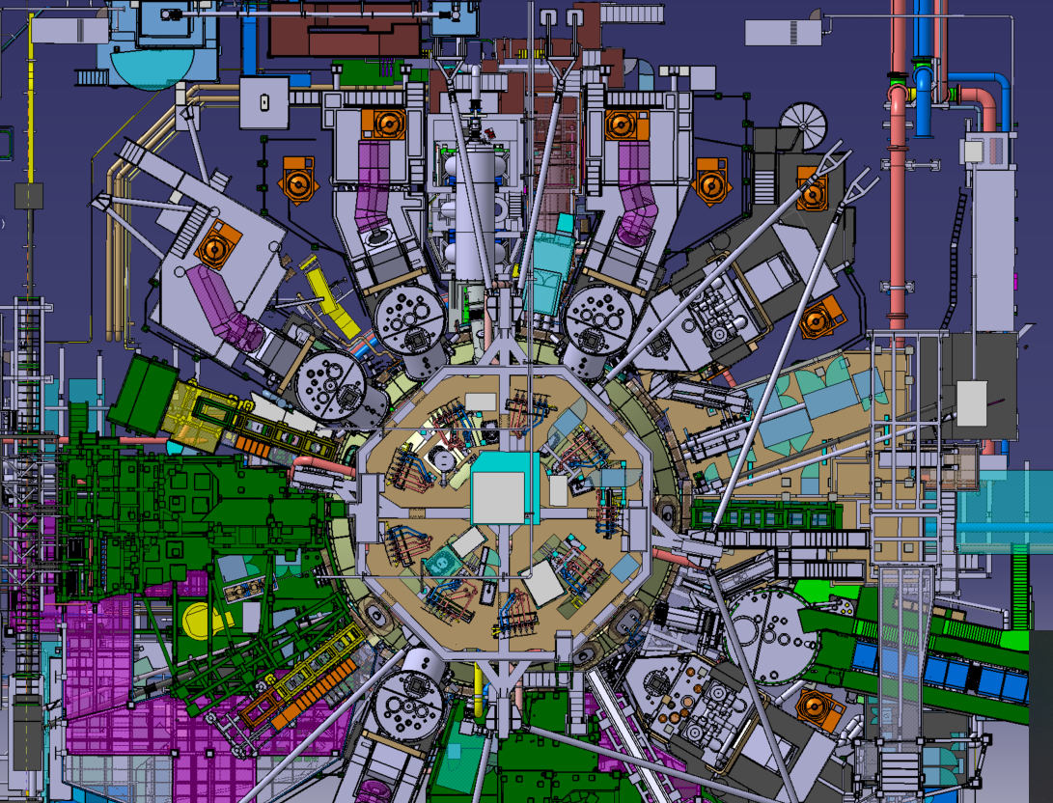
2021: updated layout
New QST preference is to avoid upper stage, and to keep laser system outside torus hall for easier maintenance
Data acquisition in basement: reduced radiation environment
CO2 laser
L1, L2
L5
L6
P1
L7
P8
L8,

Slide 12
Optical-path design underway
Existing mirror supports
Service platform
L3
L2
Existing tubes
L1

Slide 13
Optical-path design underway
Service platform
L3
Pass close to the beams
Pass close to the reserved space
NBI stand
L6

Slide 14
Optical-path design underway
L10

Slide 15
Current status
Awaiting QST feedback on constraints on optical path
Mechanical design to be completed after iteration
Procurements have begun on the NIFS side (LN2 filling station)
Hiring of dedicated staff will be required
  a postdoc and a graduate student are envisioned – with first data possible from 2024
  construction can be accelerated if needed
Budget sharing envisioned between NIFS and Euratom
  Complete hardware costs estimated at 500 k€, to be finalized

Slide 16
ADDITIONAL SLIDES

Slide 17
How is spatial localization achieved?
At every location, measurement selects wave vectors that are perpendicular to the magnetic field (since k_{par}~0) and to the laser beam (else canceled by integration), i.e.
k ∝ Bxk₀
Selecting the direction of k by spatial filtering, we select a spatial location
In JT-60SA, best spatial localization is achieved near the magnetic axis and in the pedestal (on the HFS)

Slide 18
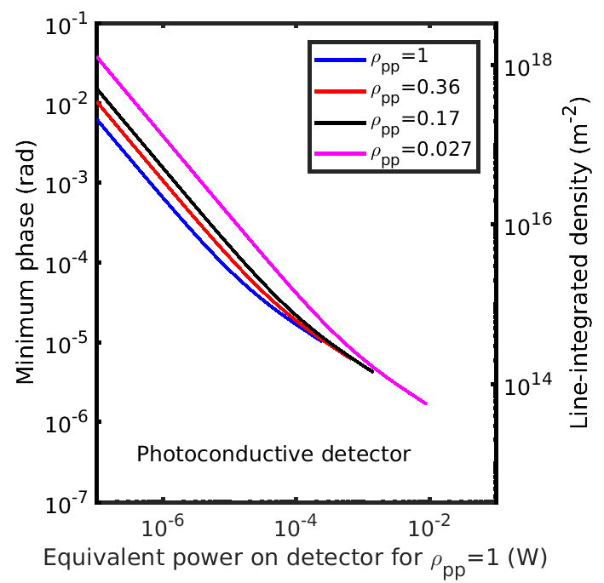
Sensitivity is crucial
Depending on
integration length,
densities as low as
10¹⁵ m⁻³ can
be measured

Slide 19
Gyrokinetic modelling (gene)
Linear analysis shows importance of retaining full physics, including impurities, collisions, e.m. effects
e.m. modes coexist
ETG appear
minor in
this scenario
ITG
TEM
A. Iantchenko et al, paper in preparation

Slide 20
Gyrokinetic modelling (gene)
Synthetic diagnostic for direct comparison with data
LFS
HFS

Slide 21
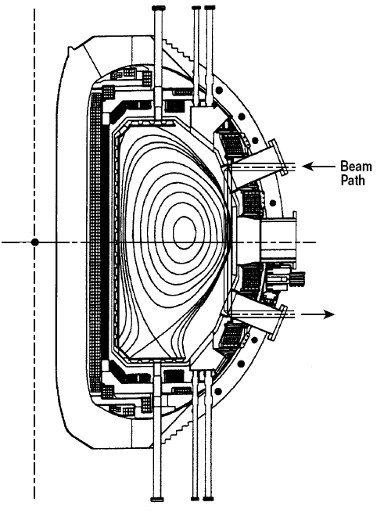
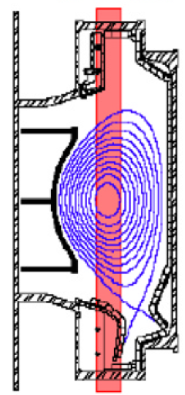
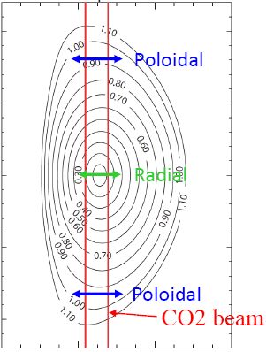
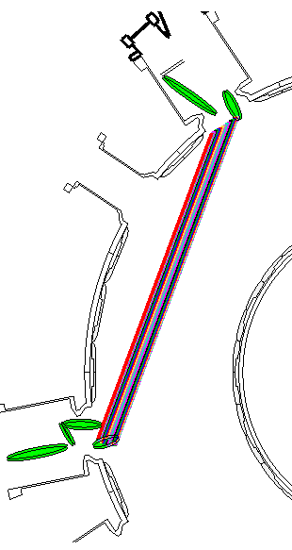
Historical highlights of PCI applications
DIII-D
C-Mod
LHD
TCV
W7-X

Slide 22
Historical highlights of PCI applications
TCA: Alfvén waves, drift waves
DIII-D: first detection of zonal flows; turbulence suppression at L-H transition; ELM dynamics
Alcator C-Mod: EDA quasi-coherent mode, ICRF waves
LHD: 2D imaging of turbulence, correlation with electric-field shear, comparisons with synthetic diagnostics
TCV: first tangential system, effect of shape on turbulence, GAM characterization

Slide 23
Timeline of TPCI for JT-60SA
Collaborative, initially volunteer effort from K. Tanaka (NIFS) and
S. Coda (EPFL-SPC), starting in 2014
Feasibility study funded by EUROfusion (WPSA) delivered in 2019
Near-final design by end of 2020

Slide 24
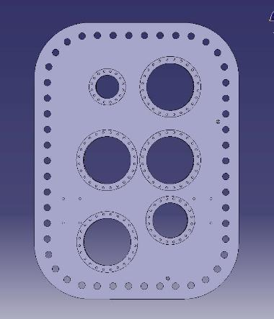
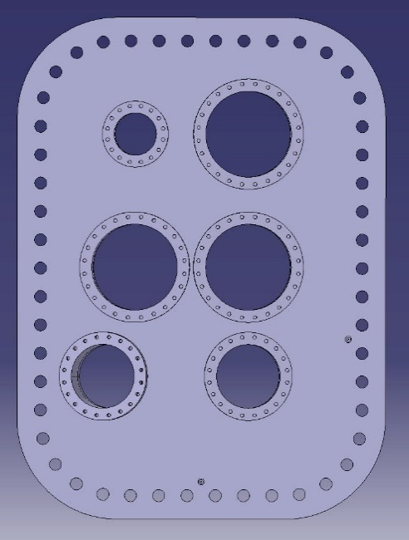
Design criteria: beam geometry
P8 (exit)
P1 (entry)
Diagnostic Flange
Diagnostic Flange
PCI
[PCI alternate]
CO2 Laser
CO2 Laser
PCI (chosen)

