Slide 1
WPSA General Meeting - FP9 Enhancements: EC Stray Detection System
A. Moro, L. Figini, S. Garavaglia (ISTP - CNR) C. Piccinni (IPP - Garching)
with contribution from WPSA (C. Sozzi, J. Ayllon) and IO (A. Sirinelli, G. Vayakis)

Slide 2
Scientific Objectives and Task Description
Design and procurement of EC Stray Detection diagnostic for JT-60SA including the preparation of a proposal to be considered by QST-F4E-EUROFusion.
Adaptation of the ITER bolometer to JT-60SA will be explored.
Madrid
Napoli
Padova
Milano

Slide 3
Tasks activities
EC Beam tracing analysis Analysis considering IC and final antenna configuration - System requirements
In vessel ECH sensor study IO-F4E-EUROfusion-QST Collaboration Agreemeent
Engineering integration study Selection of in-vessel locations for sensor: - strong QST involvement (dedicated meetings, next one May 19th) - proposal for sensor allocation and interfaces (e.g. cabling and support) definition
Prototyping, basic sensor testing, calibration and commissioning plans coatings characterization and measurements tests on (adapted) ITER bolometer (TBC after 2.), diagnostic qualification proposal
Madrid
Napoli
Padova
Milano

Slide 4
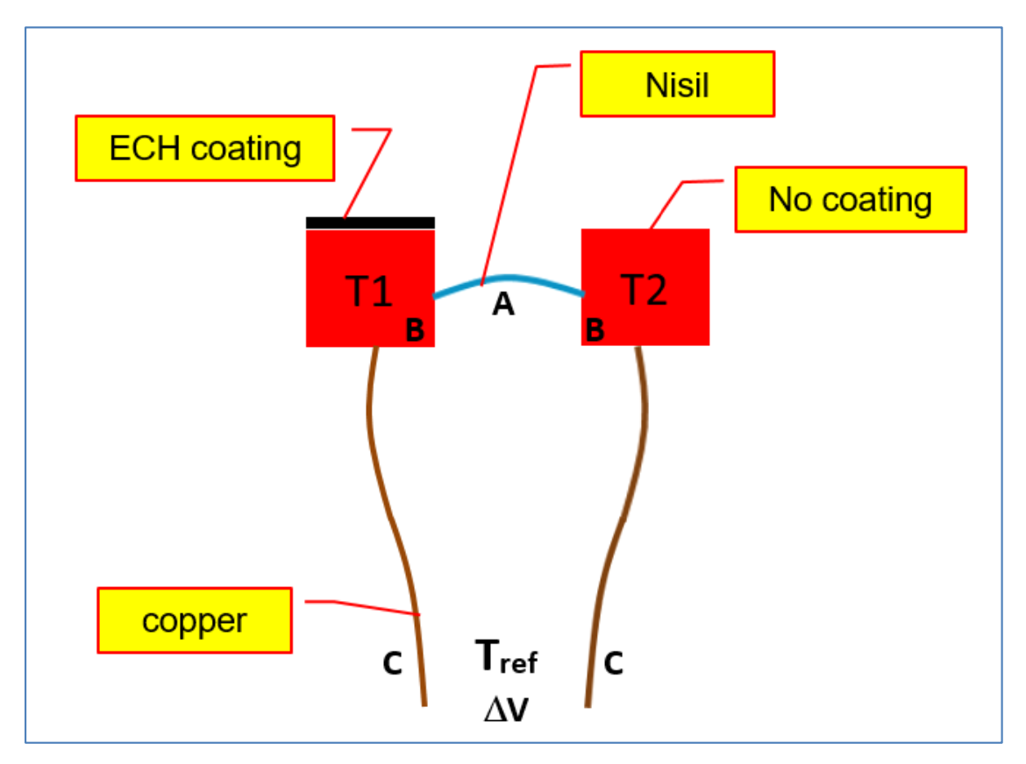
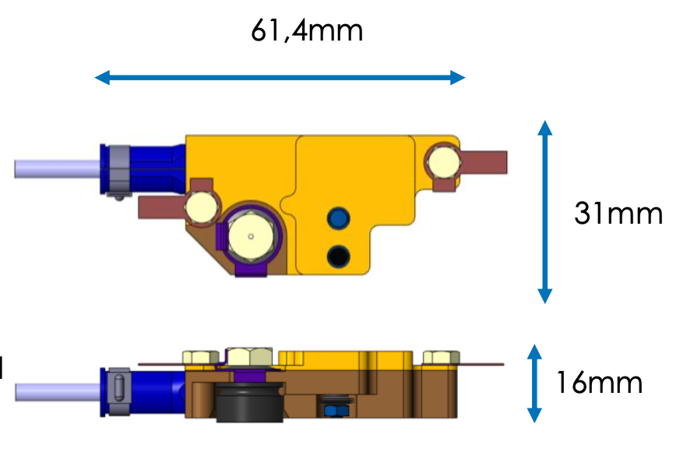
ECH Sensor System for ITER
Extensive design studies, prototyping, FDR stage (IO, Bertin Technologies)
Madrid
Napoli
Δ𝐕 = (𝑺_{𝑨} − 𝑺_{𝑪})(𝑻_{𝟐} − 𝑻_{𝟏})
Padova
Specification | Symbol | Value
Overall Sensor volume | V | 61.4x31x16 mm³
Sensor weight | m | 170 g
Temperature range | ΔT | [100-816 ℃]
Transient sensitivity | dΔT/dt/p | 1.93 10⁻⁵ K m²/J
Steady state sensitivity | dΔT/dt/p | 5.65 10⁻⁴ K m²/J
Power resolution | P_{step} | 100 kW (optimized to 20 kW)
Thermal response |  | 1 K/s
Response time | t | 1.3 s (optimized to 0.3s)
Accuracy | ΔP_{den} | 375 kW/m² (optimized to 120 kW/m²)
Signal amplitude | ΔV | ~ few mV [0-10 mV]
2 cylinders, ∅ 4mm
Milano
ΔV between hot and cold bolometer
ΔV ➠ ΔT ➠ ECH power
Thermal model (i nodes)
Algorithm for T_{i}(t)
N. Masseen et al., “Microwave Detector design for ITER”, ITER_D_JR2KH6
A. Sirinelli, “System Design Description (DDD) 55.GB In-vessel ECH Detectors”, ITER_D_V2GEA7 v1.0
A. Sirinelli, “55.GB - ECH sensor AMESIM model”, ITER_D_5PRGQM
10 prototypes – 2 for JT-60SA

Slide 5
Collaboration under IO-F4E-EUROfusion-QST
Coating R&D at ITER (Development and qualification):
• ECH coating is the most critical parameter for the performance of the sensor
• The absorption efficiency @ 170 GHz required to be compliant with the performances is 80%.
• The development of this electro-magnetic absorbing coating consists in defining the coating composition, the substrate preparation and the deposition process and measure its absorption performances
Madrid
Napoli
Padova
Milano
Courtesy of A. Sirinelli and Bertin Technology

Slide 6
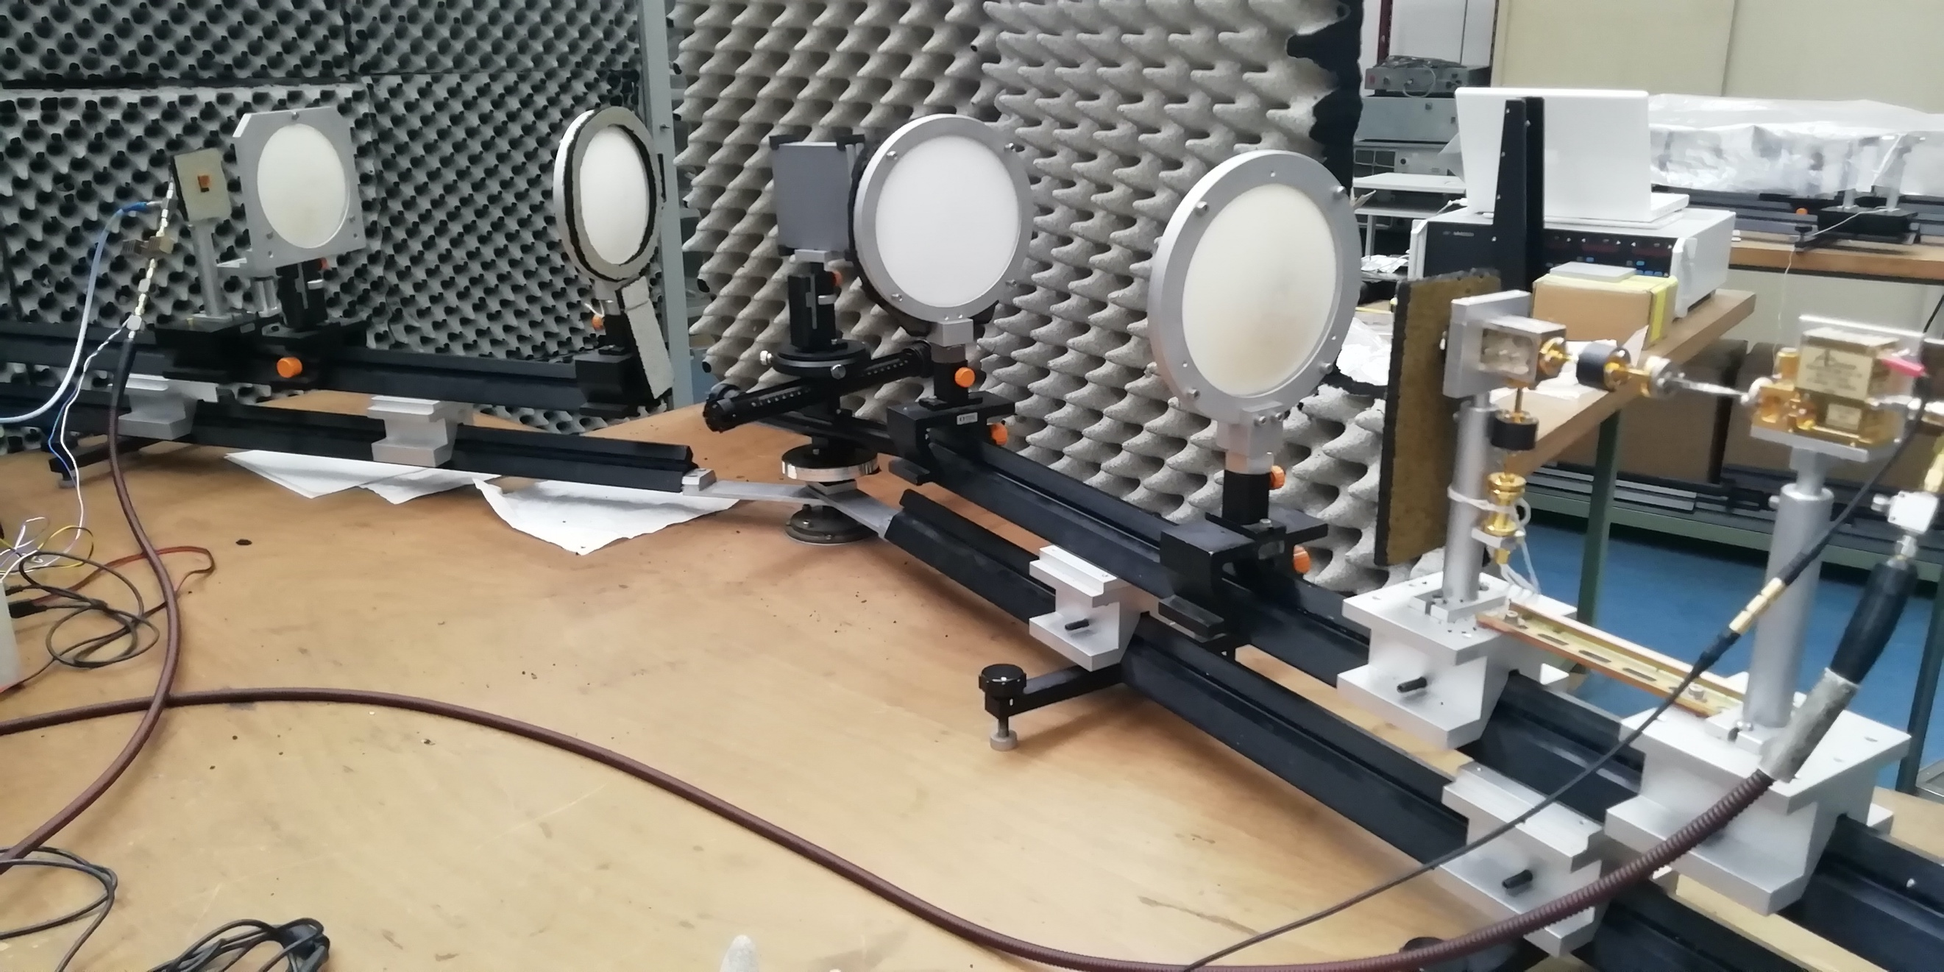
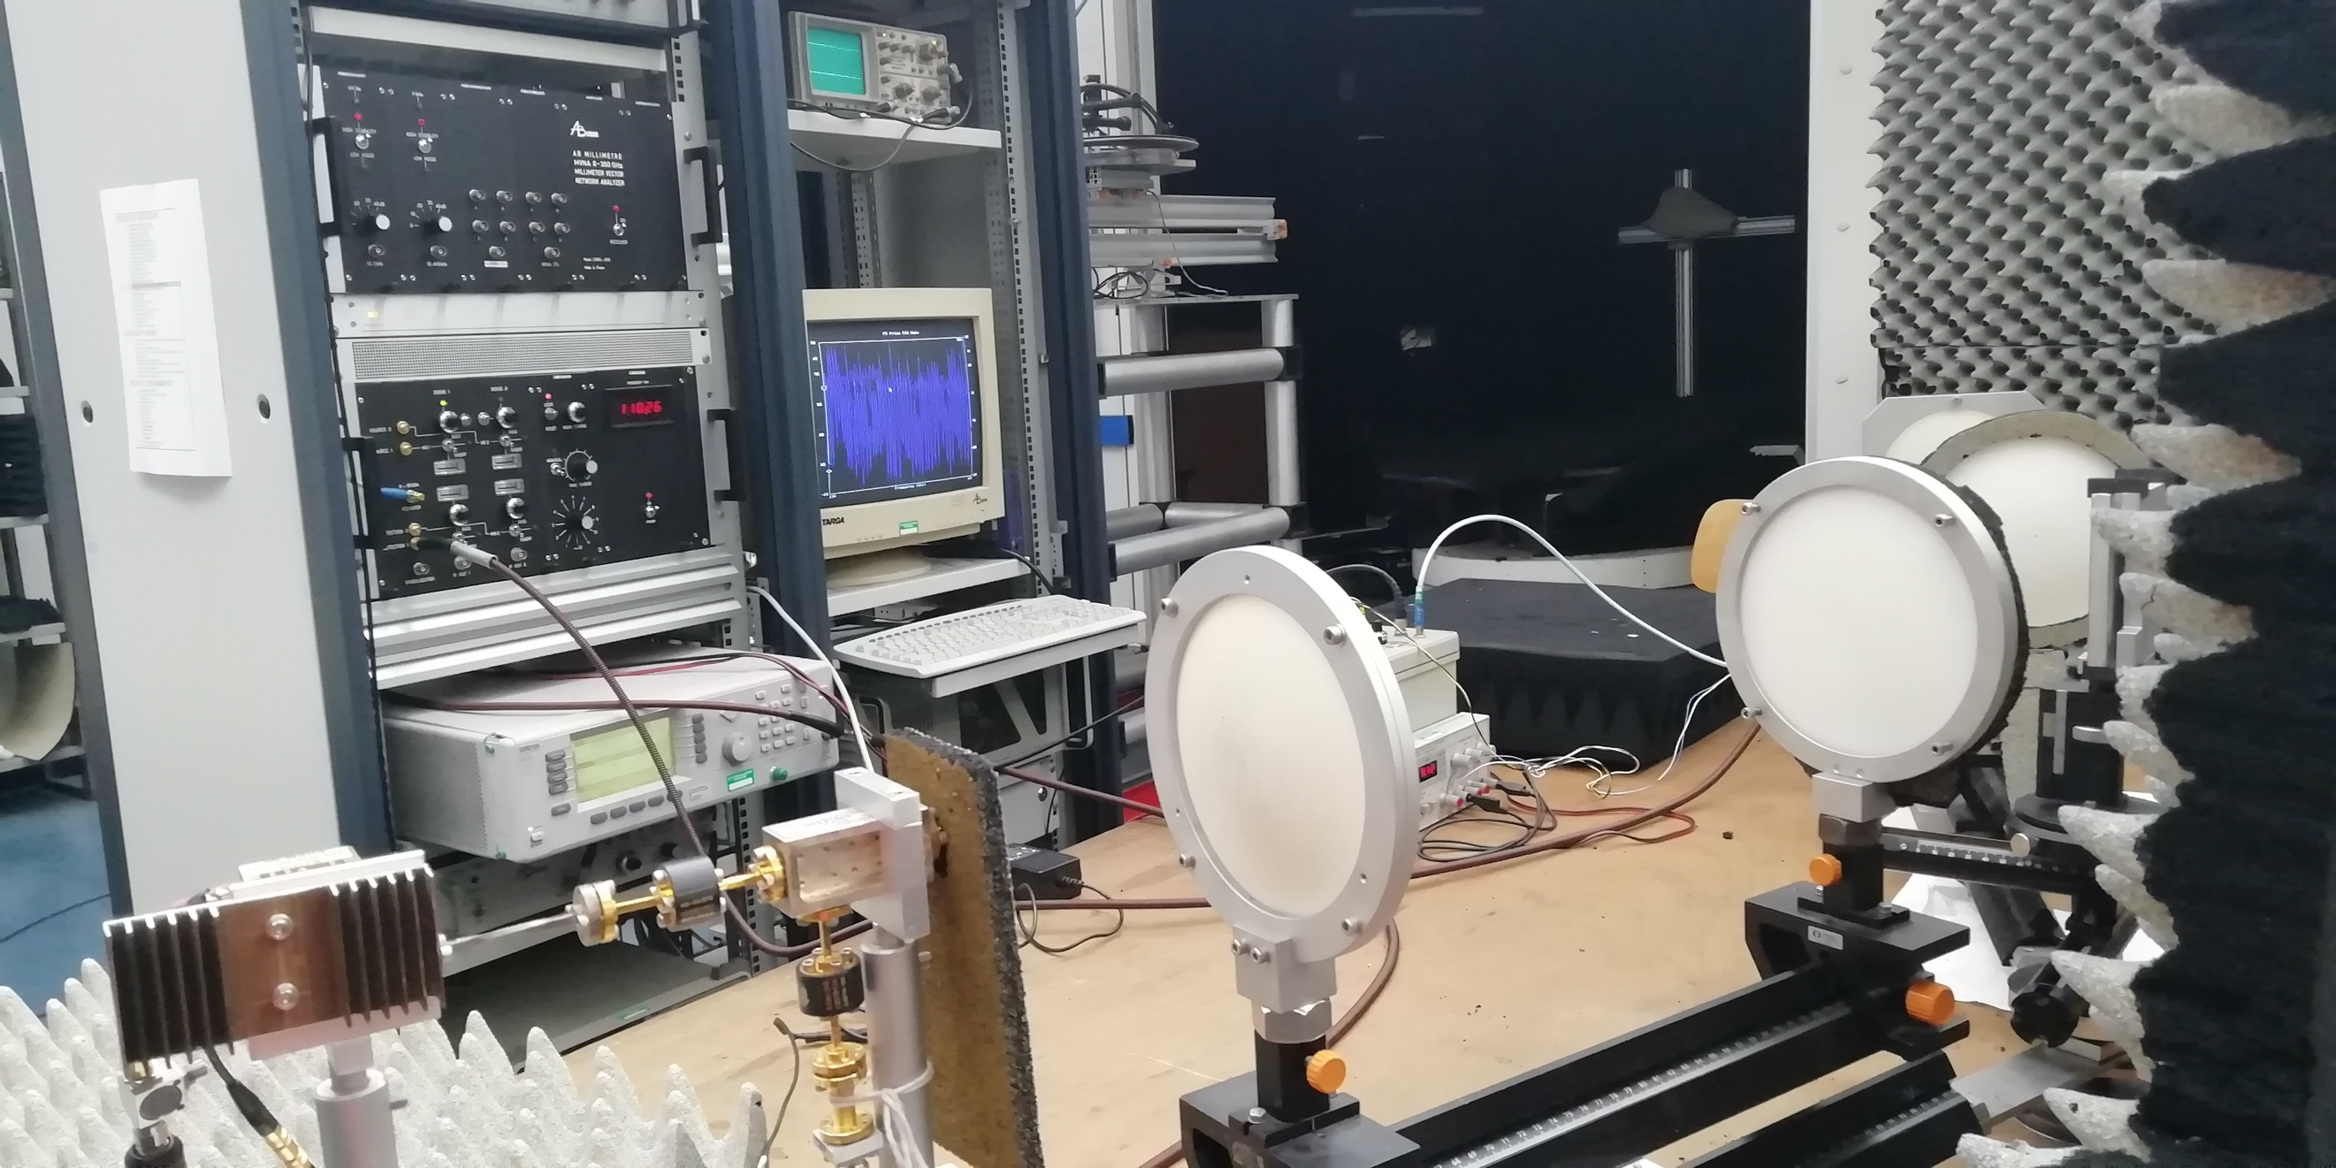
Ceramic coating measurements at ISTP-CNR lab
H-plane
Madrid
Napoli
E-plane
Padova
Ceramic coating samples measurements at ISTP-CNR lab
20 samples: Ti₂O₃ (5), Cr₂O₃ (8), Al₂O₃Ti₂O₃ (7) with different coating thickness
2 frequency bands to cover the 70-220 GHz range
2 launched polarizations (E-plane, H-plane)
13 incidence angles (15-70 deg)
determine material properties (ε, tan δ) and mm-wave fractional power loss
provide adapted coated cylinder (optimal coating & thickness, covering largest freq. range)
Milano

Slide 7
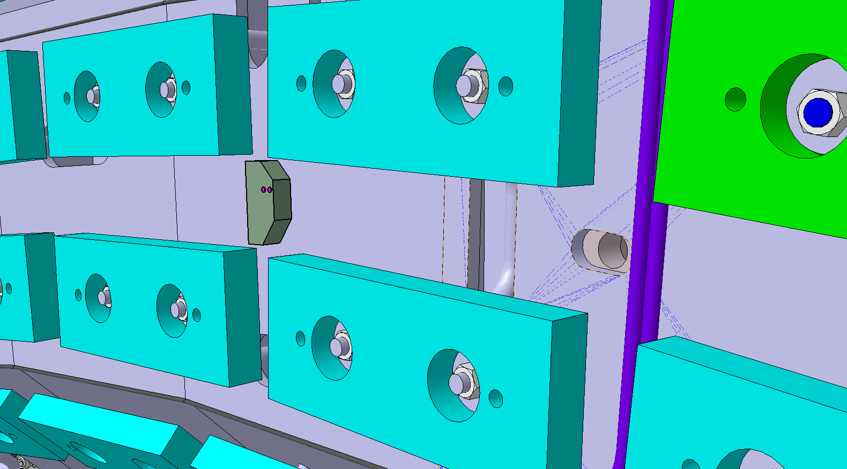
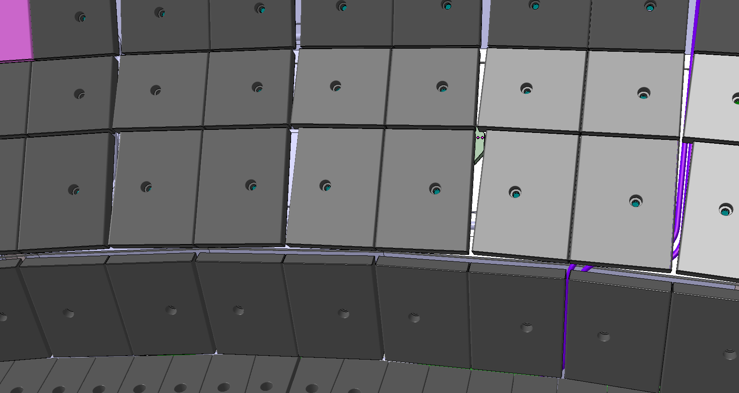
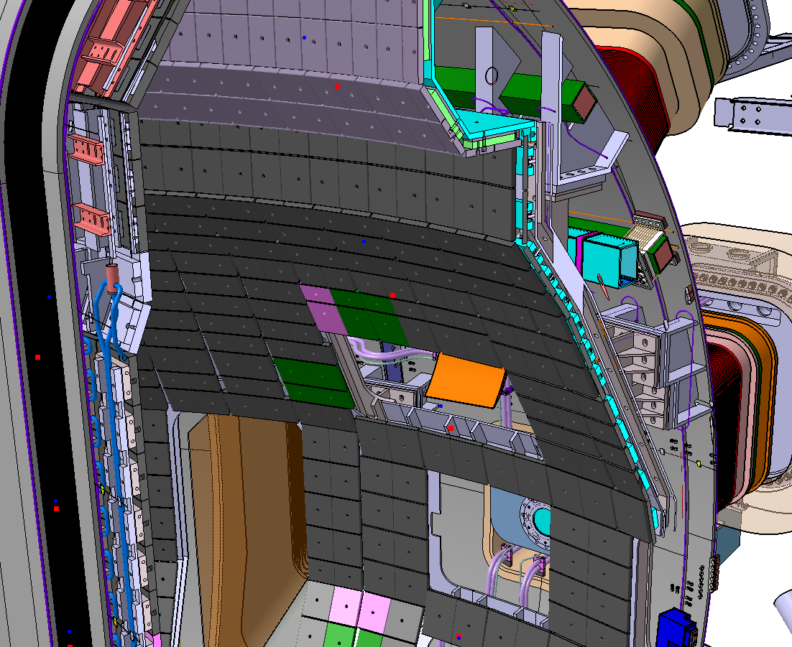
In-vessel sensor integration (in progress)
ECH layout during EP:
Steerable launchers, P8 & P11
Integration considers:
Preferred option: 2 sensors close to ECH (LFS)
no direct illumination
stabilizing plate
in the shadow of the tiles
Madrid
Napoli
Padova
Milano
2nd reflection (with support of beam tracing analysis for expected P_{den})
Alternative option: inside other ports, (P10 equ, P18, still under investigation)

Slide 8
Conclusions
Status of the task
Engineering integration of ‘adapted’ ITER bolometer
Coordination with QST
Schedule proposed requires IO feedback (‘weak’ point):
shipping of prototypes
FDR outcomes (to define dedicated tests)
sensor models (particularly important for CAD integration)
coated bolometer optimized for JT-60SA to be manufactured
Publication plan
Contributions submitted to EC-21 & SOFT 2022 conference (June, Sept.). SOFT proceeding will be published in Fusion Engineering and Design.

